Slide 1
Linear accelerator conference 2024 Welcome to chicago!
erhtjhtyhy
John Byrd
Lia Merminga
Argonne National Laboratory
Fermi National Accelerator Laboratory

Slide 2
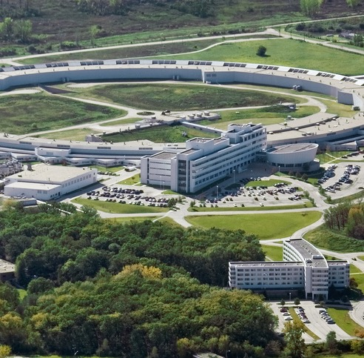
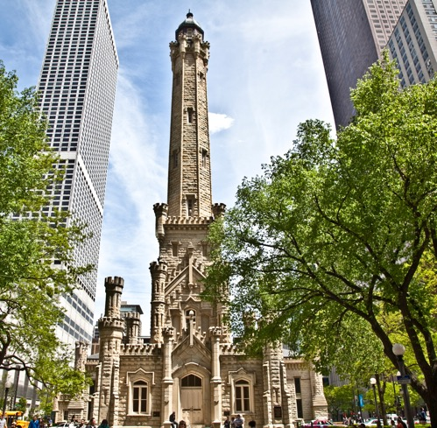
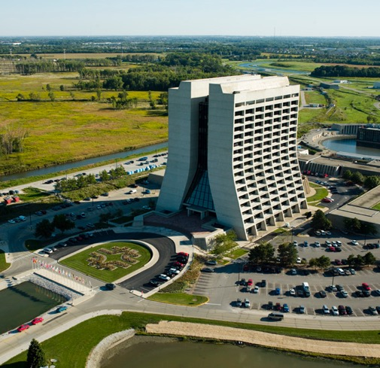
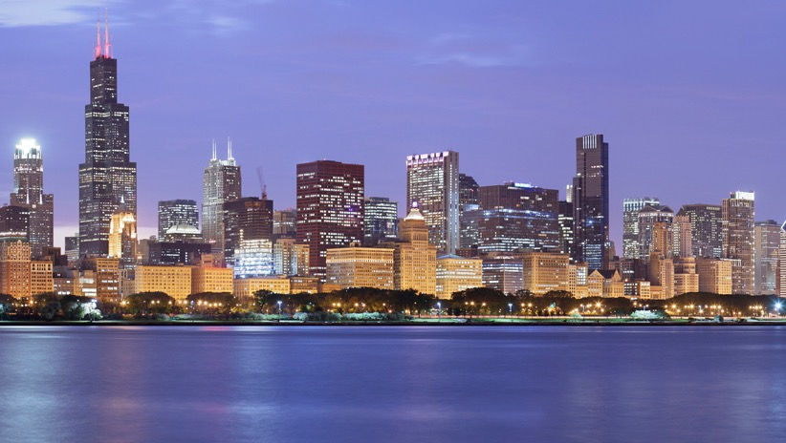
Why Chicago?
Argonne National Laboratory
Fermilab National Accelerator Laboratory
Great North American City

Slide 3
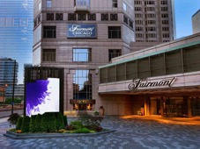
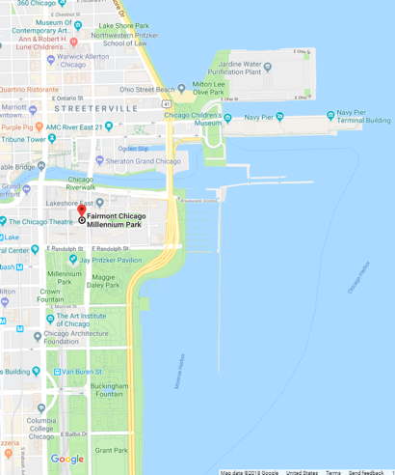
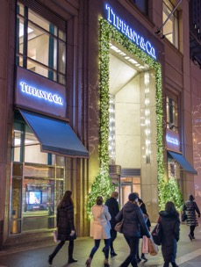
Downtown Chicago
Based on Fall 2024, September/early October
Several hotels interested in hosting meeting. Two primary venues under consideration: Sheraton Riverwalk and The Fairmount.
All within walking distance to all attractions
Conference space and guest rooms under one roof
Notes:
Point of Tiffany slide is to mention shopping.

Slide 4
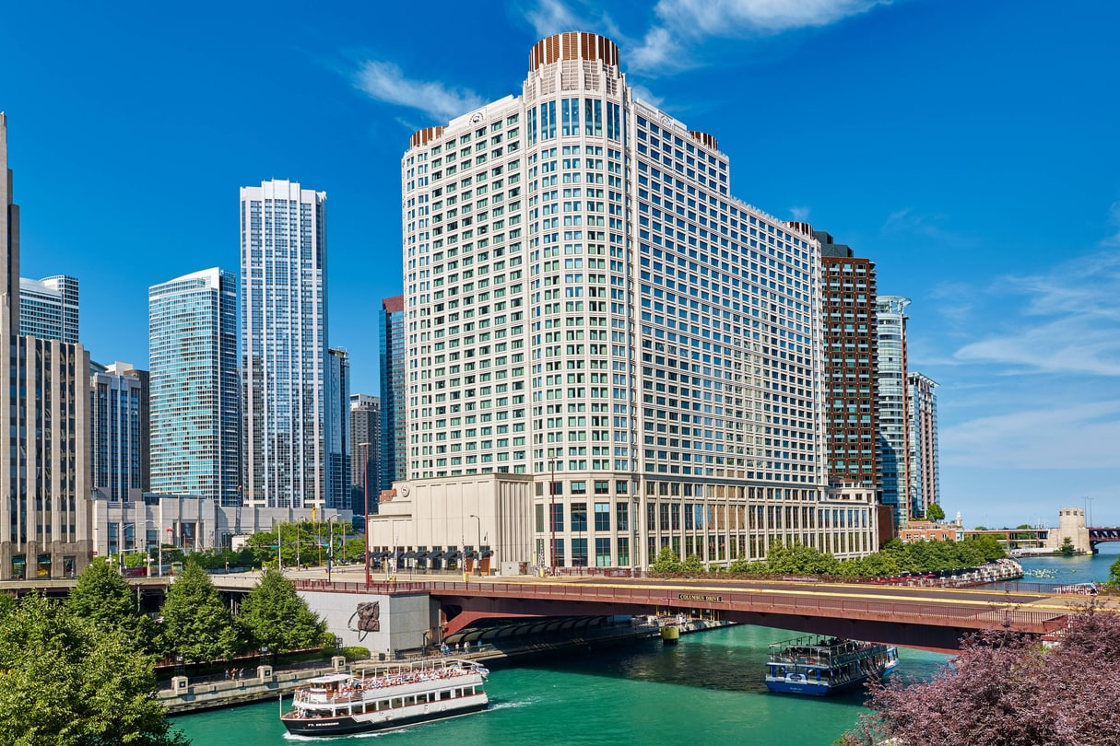
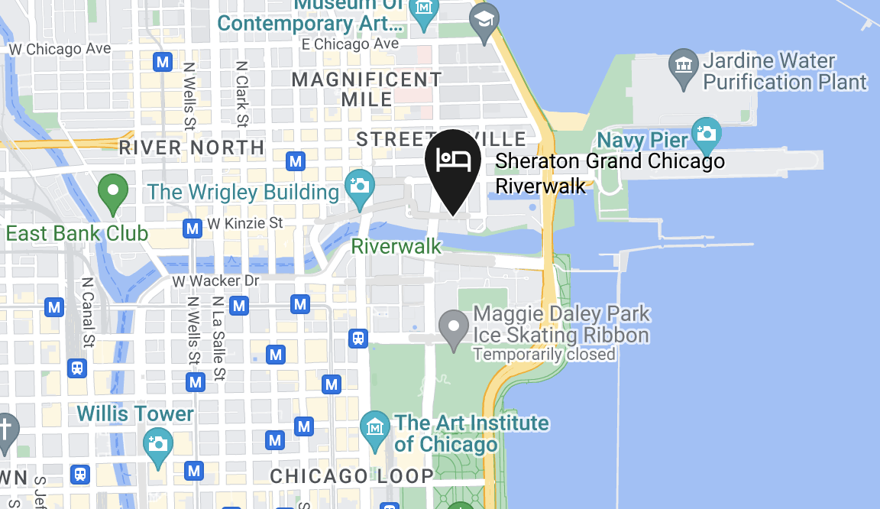
Sheraton Grand Chicago Riverwalk
Large conference venue with multiple meeting spaces
Site of several past accelerator conferences (NAPAC2016, SRF2013)

Slide 5
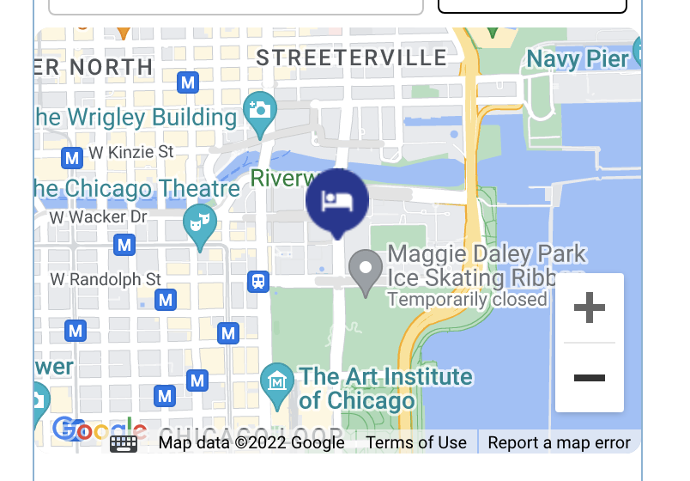
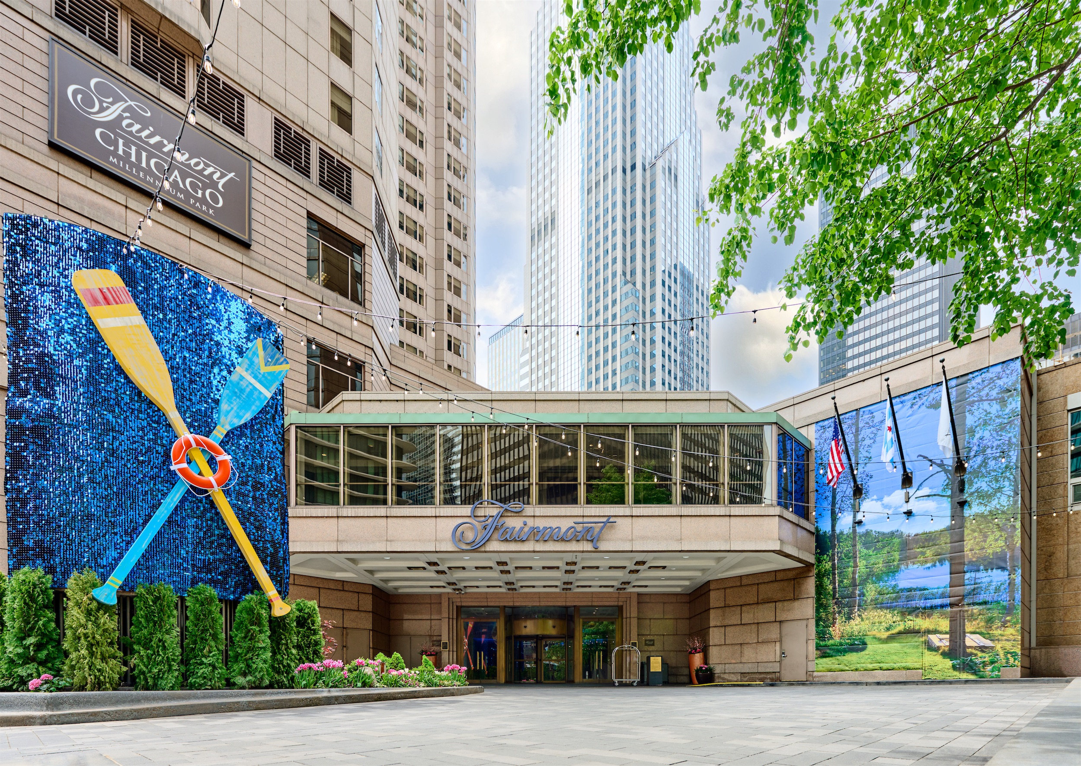
The Fairmont Chicago At Millennium Park
Smaller conference venue but with space for a meeting of 500
Site of several past accelerator conferences (LINAC20xx)

Slide 6
Challenges
Argonne lost money on several cancelled conferences during the pandemic and are very cautious regarding new contracts.
They are delaying on signing contract with venue to have guarantees against cancellation and to try and recoup some losses from previous cancellations.
There has been significant cost inflation since the original LINAC proposal in 2018. We don’t know yet what the registration fee will be or whether we can get financial support from the laboratory.
Potentially limited international participation due to pandemic, geopolitical tensions, travel policies of funding agencies, etc.
We will keep the Linac IOC informed on all these developments.

Slide 7
Chicago organizing committee
Co-CHAIRS
Lia Merminga
Fermilab PIP-II Project Director
John Byrd Argonne Accelerator Division Director
Local Organizing Committee
Mike Kelly, ANL (past Chair of SRF Conf)
John Power, ANL
Anita Garcia, ANL
Paul Derwent, FNAL
Brian Chase, FNAL
Marion White, ANL (past Chair of several major conferences)
Jacque LeBreck
Argonne Conference & Event Planning Lead
Notes:
IS THIS STILL ACCURATE???

Slide 8
Conference budget: assumptions
350
Attendance
$800???
Average Cost
TBD
Notes:
John: This is a placeholder for relevant informatio
(We could add estimated cost for early bird, late and student registrations)
n you need to set up the following slide, which provides due diligence on budgeting for event.

Slide 9
budget
EXPENDITURE
ITEM INCLUDING FIXED & VARIABLE COSTS |  | COST | NUMBER | SERVINGS | TOTAL
Venue | Venue Rental | $150,000 |  |  | Waived with F & B Minimum
 | Audio Visual (Wifi & Media Services) |  |  |  | $40,000.00
 | Equipment, Presentation & Décor |  |  |  | $3,500.00
 | Exhibition Stands |  | 30 |  | $20,000.00
Catering | Lunches | $75 | 350 | 3 | $78,750.00
 | Refreshments | $50 | 350 | 6 | $105,000.00
Conference | PCO
 | Conference bags | $2 | 350 |  | $700.00
 | Conference booklets |  | 350 |  | $5,000.00
 | Conference gifts | $4 | 350 |  | $1,400.00
 | Proceeding staff expenses |  |  |  | $15,000.00
 | Student support | $800 | 15 |  | $12,000.00
 | Student awards |  |  |  | $2,000.00
Events | Conference Reception | $50 | 350 |  | $17,500.00
 | Chairman's Reception | $40 | 70 |  | $2,800.00
 | IOC Dinner | $60 | 30 |  | $1,800.00
 | Conference Banquet | $150 | 350 |  | $52,500.00
 | Banquet Entertainment |  |  |  | $2,000.00
 | Transportation |  |  |  | $—
 |  |  |  |  | $359,950.00
Income | Registration Fees | 350 | 850 |  | $297,500.00
 | Exhibitor Fees |  |  |  | $90,000.00
 |  |  |  |  | $387,500.00
Notes:
John: This slide has an embedded excel sheet that can be manipulated. Please review and let us know what you think about these assumptions. We can then work with creative services to make this look good for the presentation.

Slide 10
Potential Excursion
Chicago Architecture River Cruise
Experience the "top tour in Chicago and one of the top ten tours in the U.S." according to TripAdvisor users. The Chicago Architecture Foundation Center River Cruise is a must for out-of-towners and Chicagoans alike. CAC-certified volunteer tour guides—called docents—interpret more than 50 buildings along the Chicago River. You'll find out how Chicago grew from a small settlement into one of the world’s largest cities in less than 100 years. In 90 minutes, get the real story on Chicago architecture and its history.

Slide 11
Sunset Banquet cruise
Dinner cruise on Lake Michigan to enjoy the Chicago skyline

Slide 12
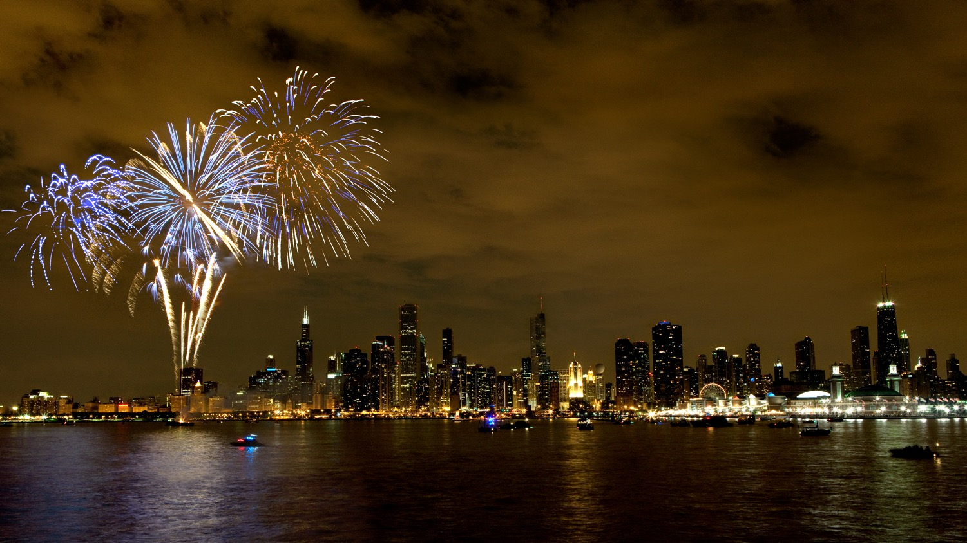
See you in chicago, linac 2024!

