Slide 1
Linac2022 De-Brief
Carsten P Welsch, University of Liverpool
Local Organising Committee Chair

Slide 2
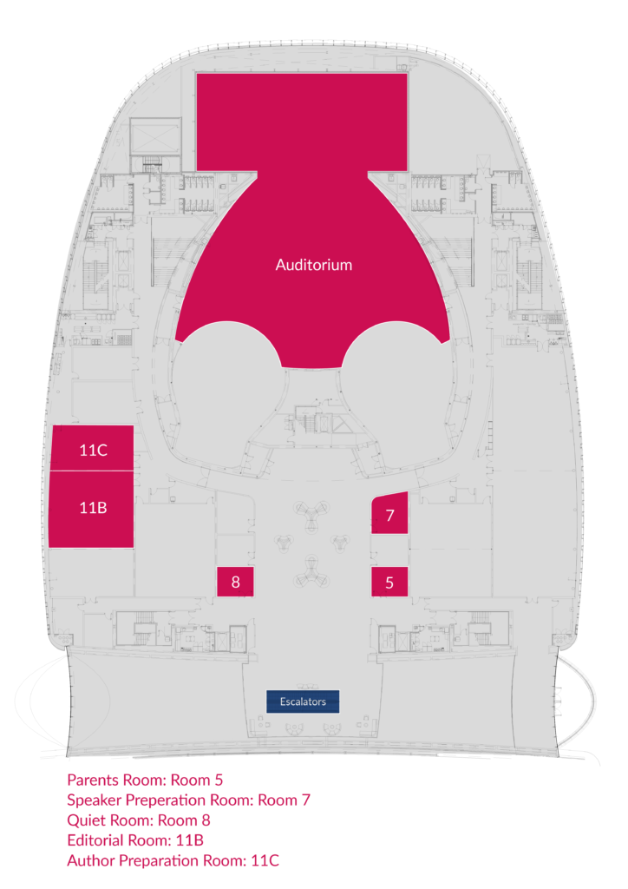
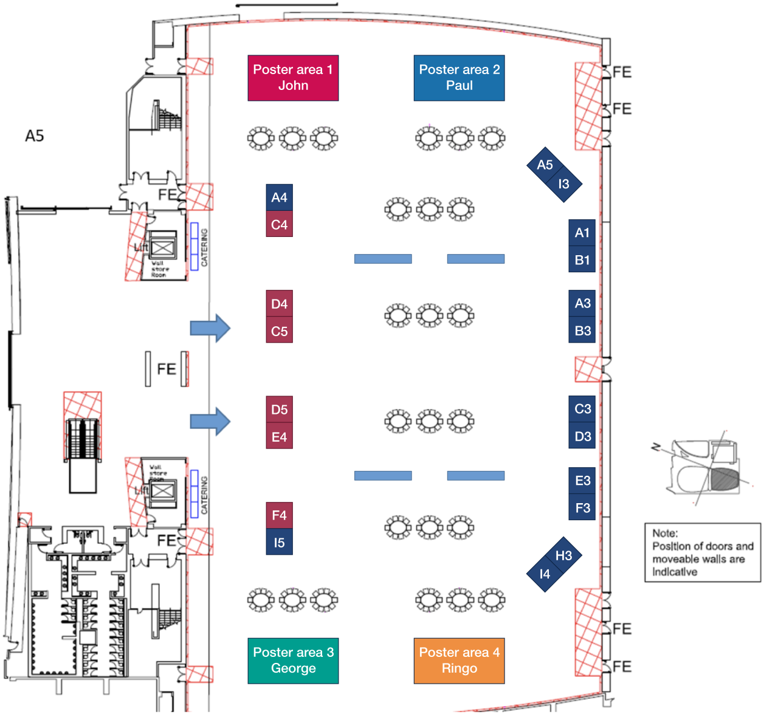
ACC Overview
A whole event centre, exclusive for Linac2022.

Slide 3
Visual Identity
Badge, posters, screen – all following the same approach.
#LINAC2022 for social media
Helps create a clear message from the event to our community and beyond.

Slide 4
Give Aways
Backpack
Stress ball and pen
Printed scientific program
Industry signature sheet

Slide 5
Information
Developed comprehensive material – did our best to move away from paper.
Thanks to STFC media services!

Slide 6
LINAC2022 App
Available for iOS and Android;
Delegates can put together their personal program;
Remote delegates can join live sessions;
Opportunities to connect with other participants;
Info about sponsors and exhibitors.
Q&As handled via the app – paradigm change.

Slide 7
EDI @ LINAC2022
First accelerator conference with free childcare provision;
EDI considerations were integral to all aspects of LINAC2022;
Parents’ room was made available throughout the week – positive feedback from community.
LINAC2022 is proud of its inclusive approach and has clear conference conduct policies in place.

Slide 8
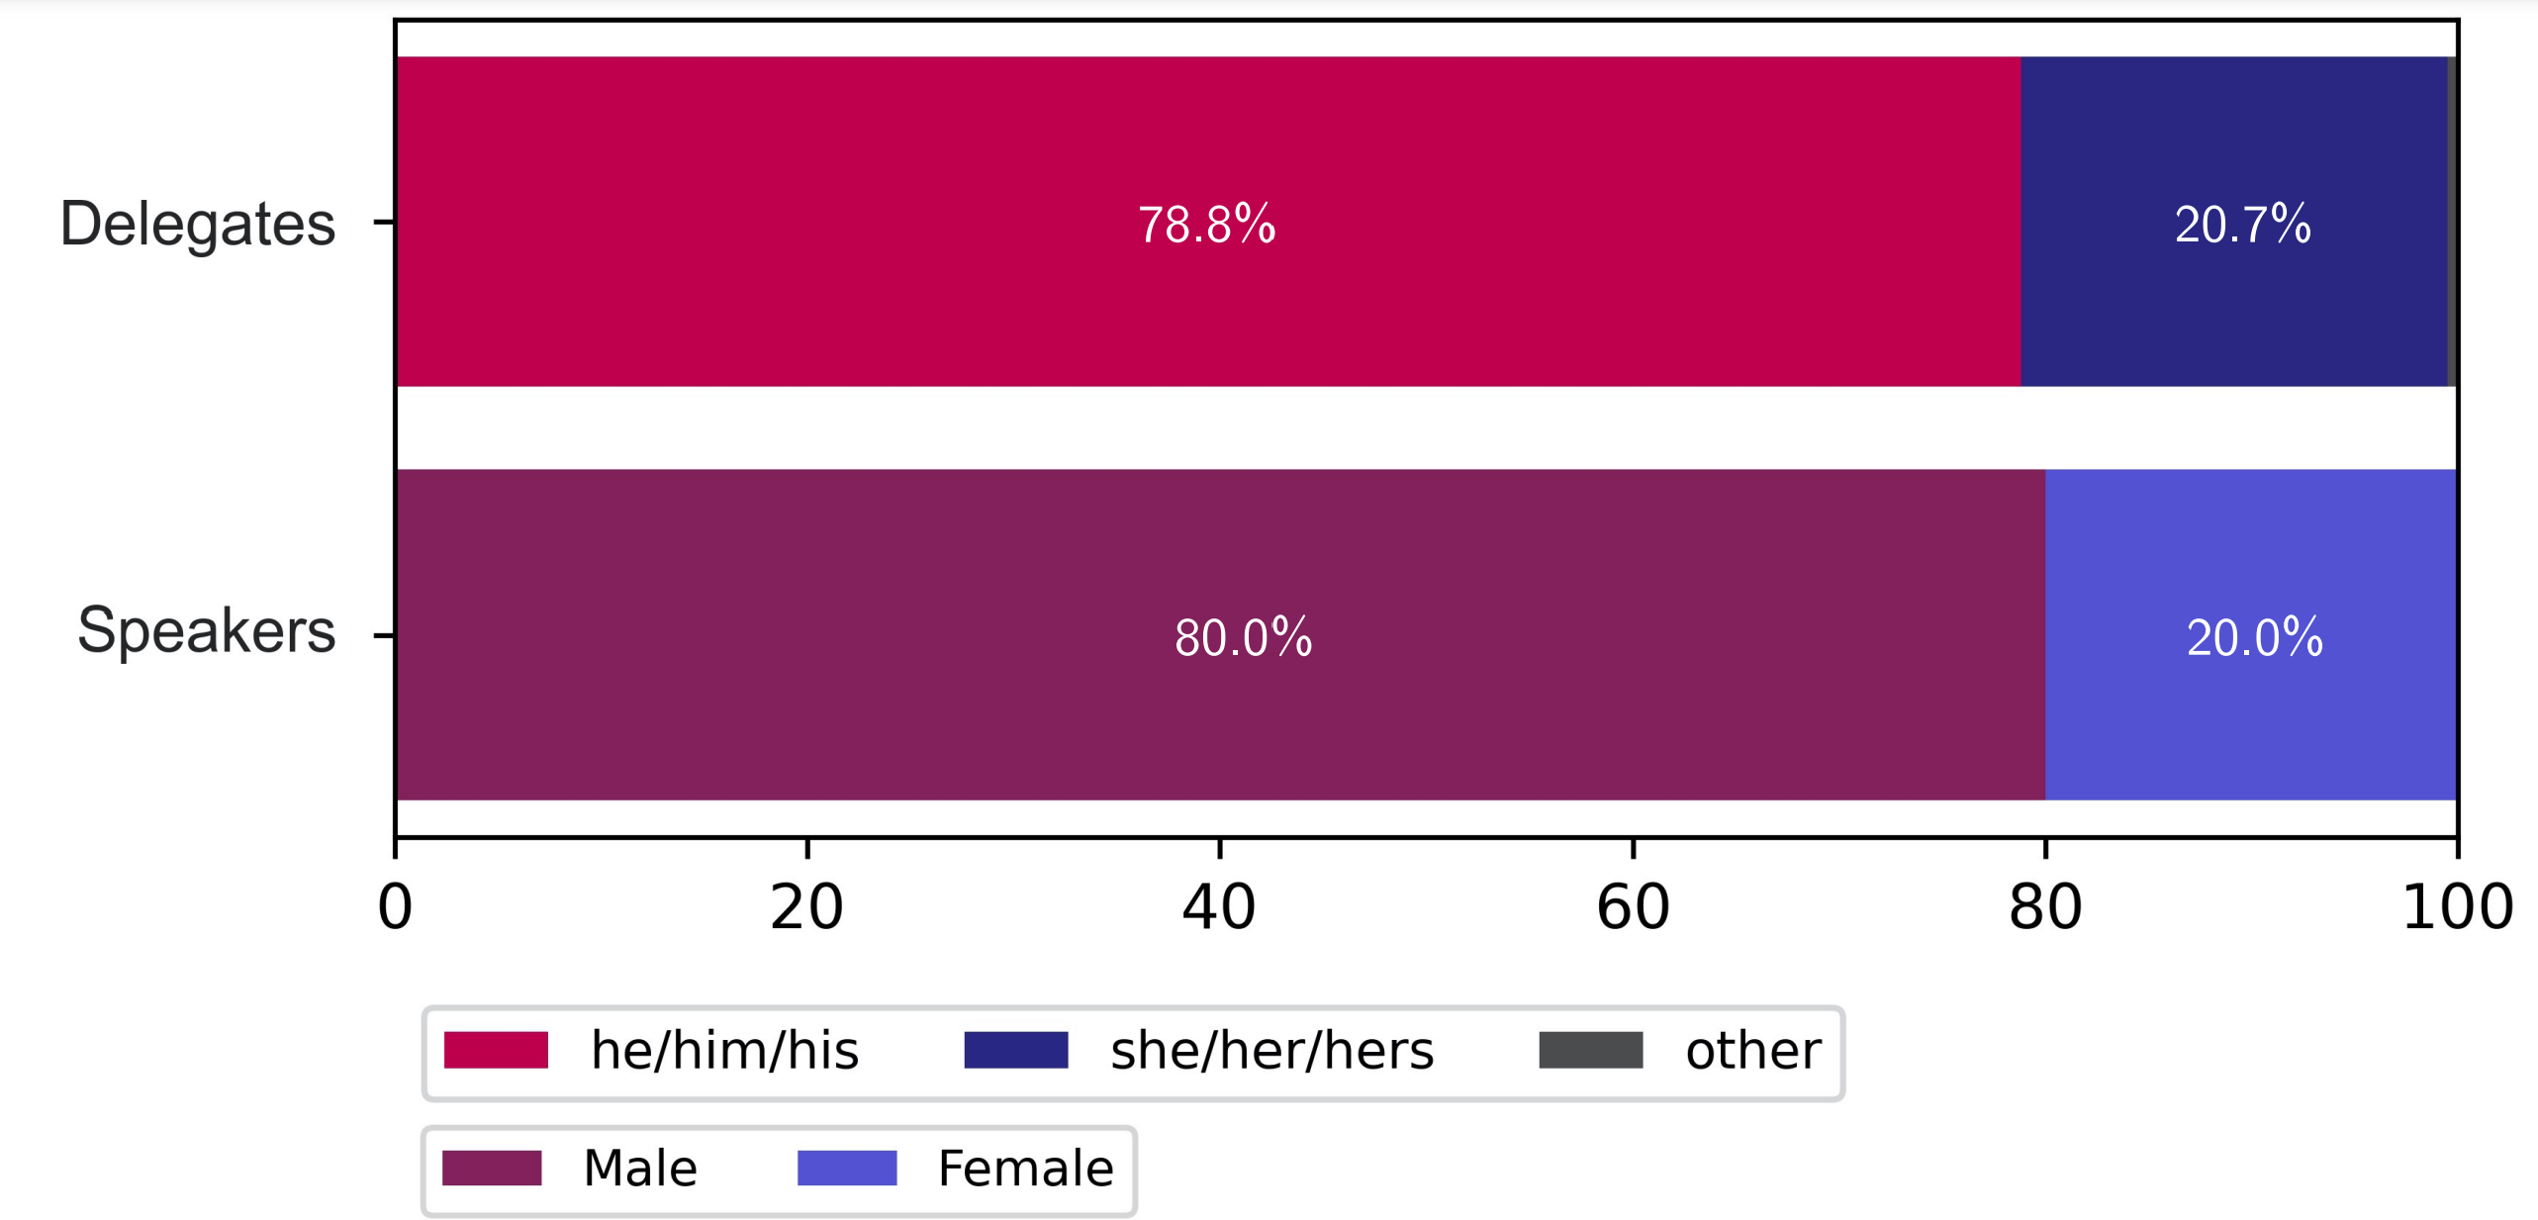
EDI Information
Thanks to Tessa Charles!

Slide 9
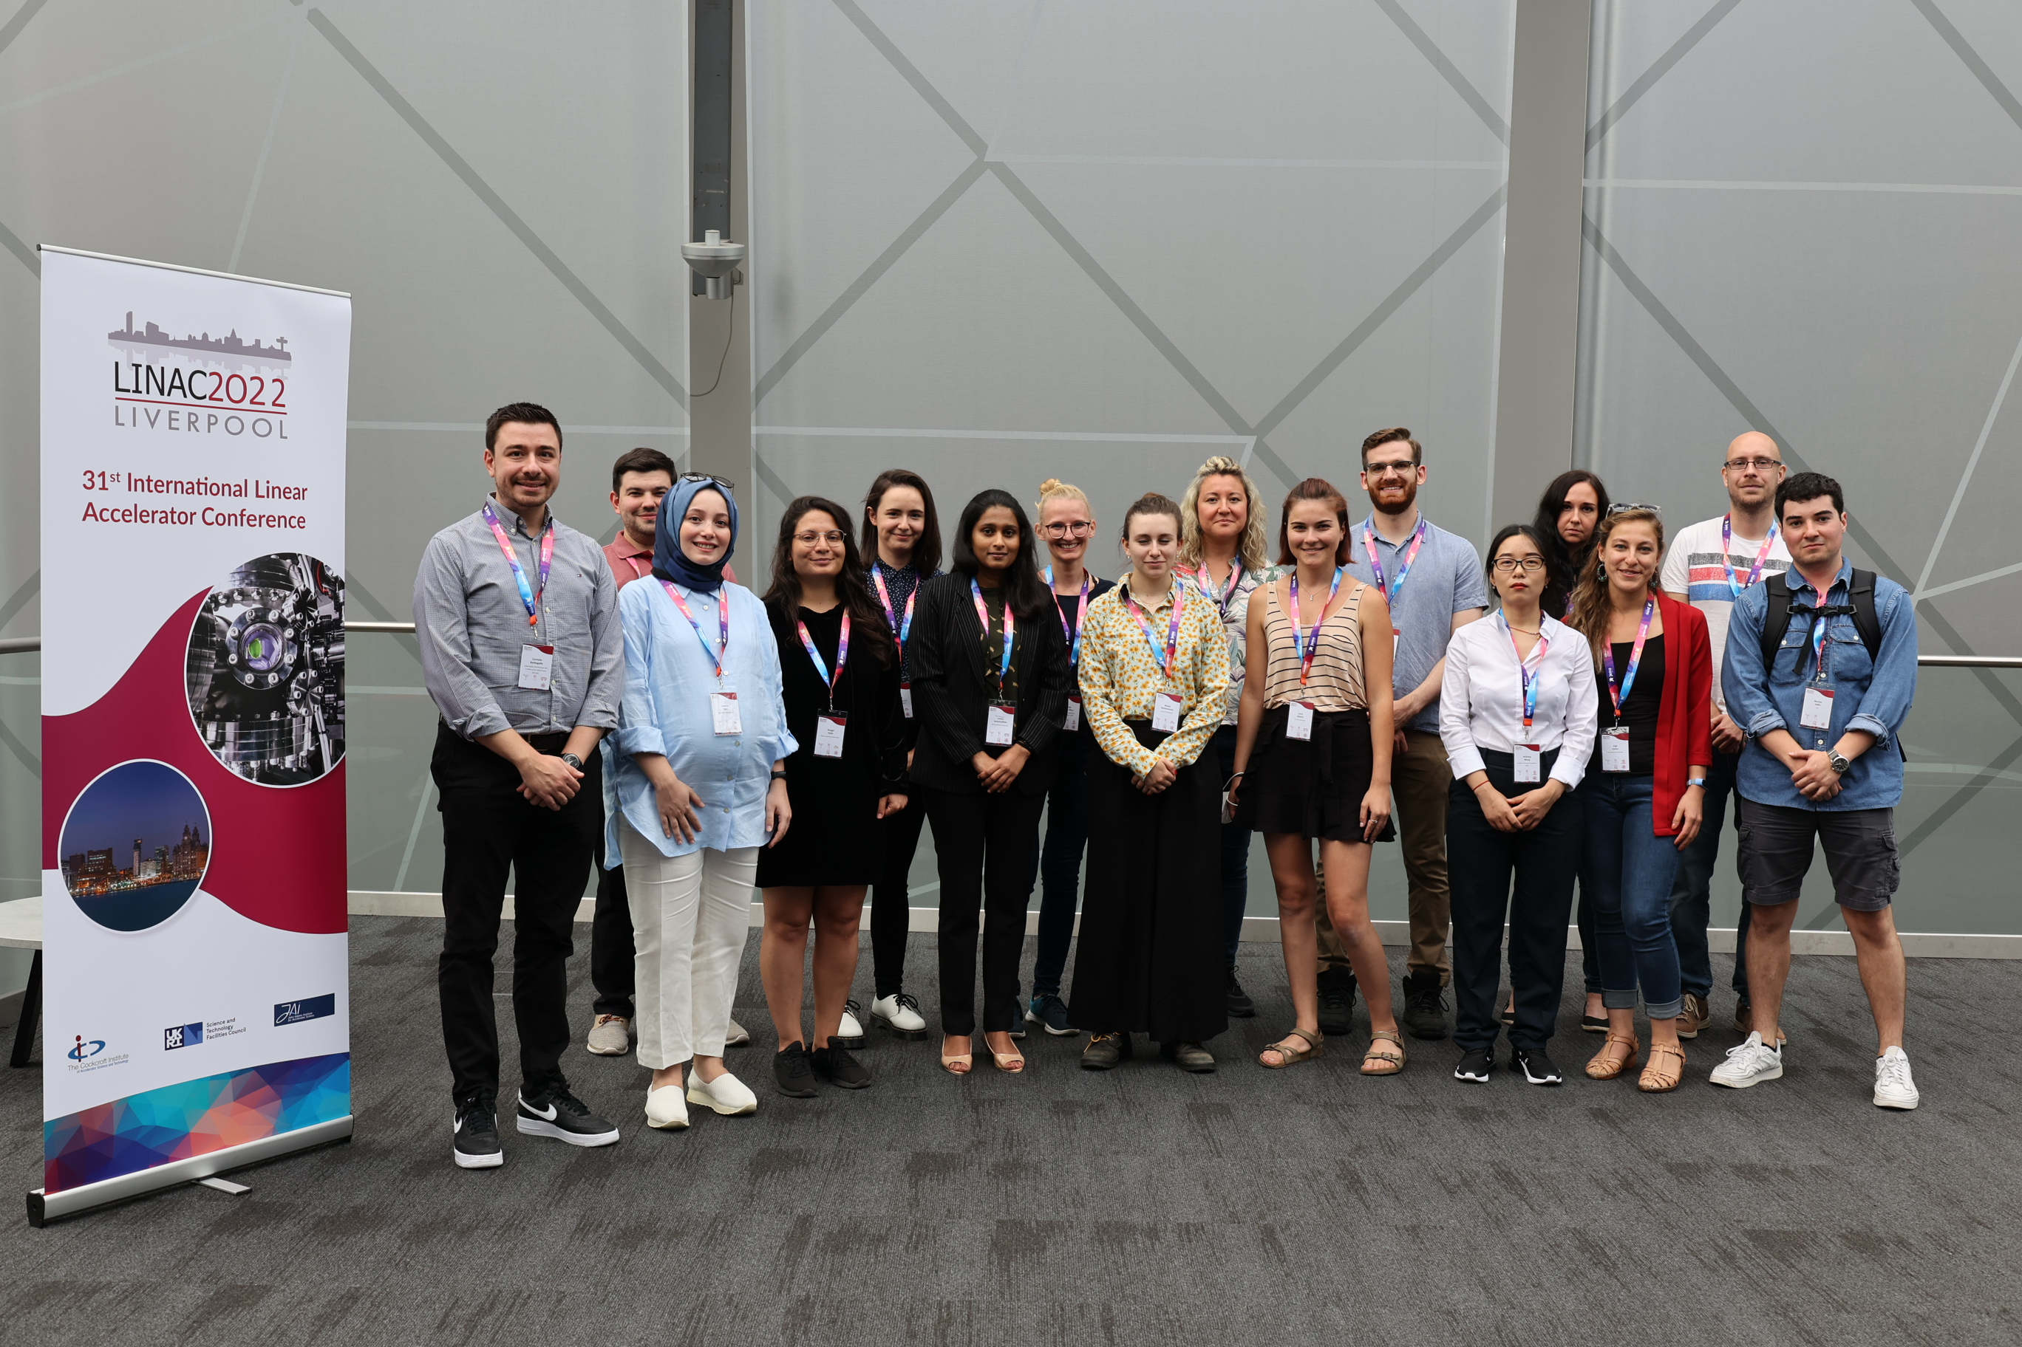
Student Travel Grants

Slide 10
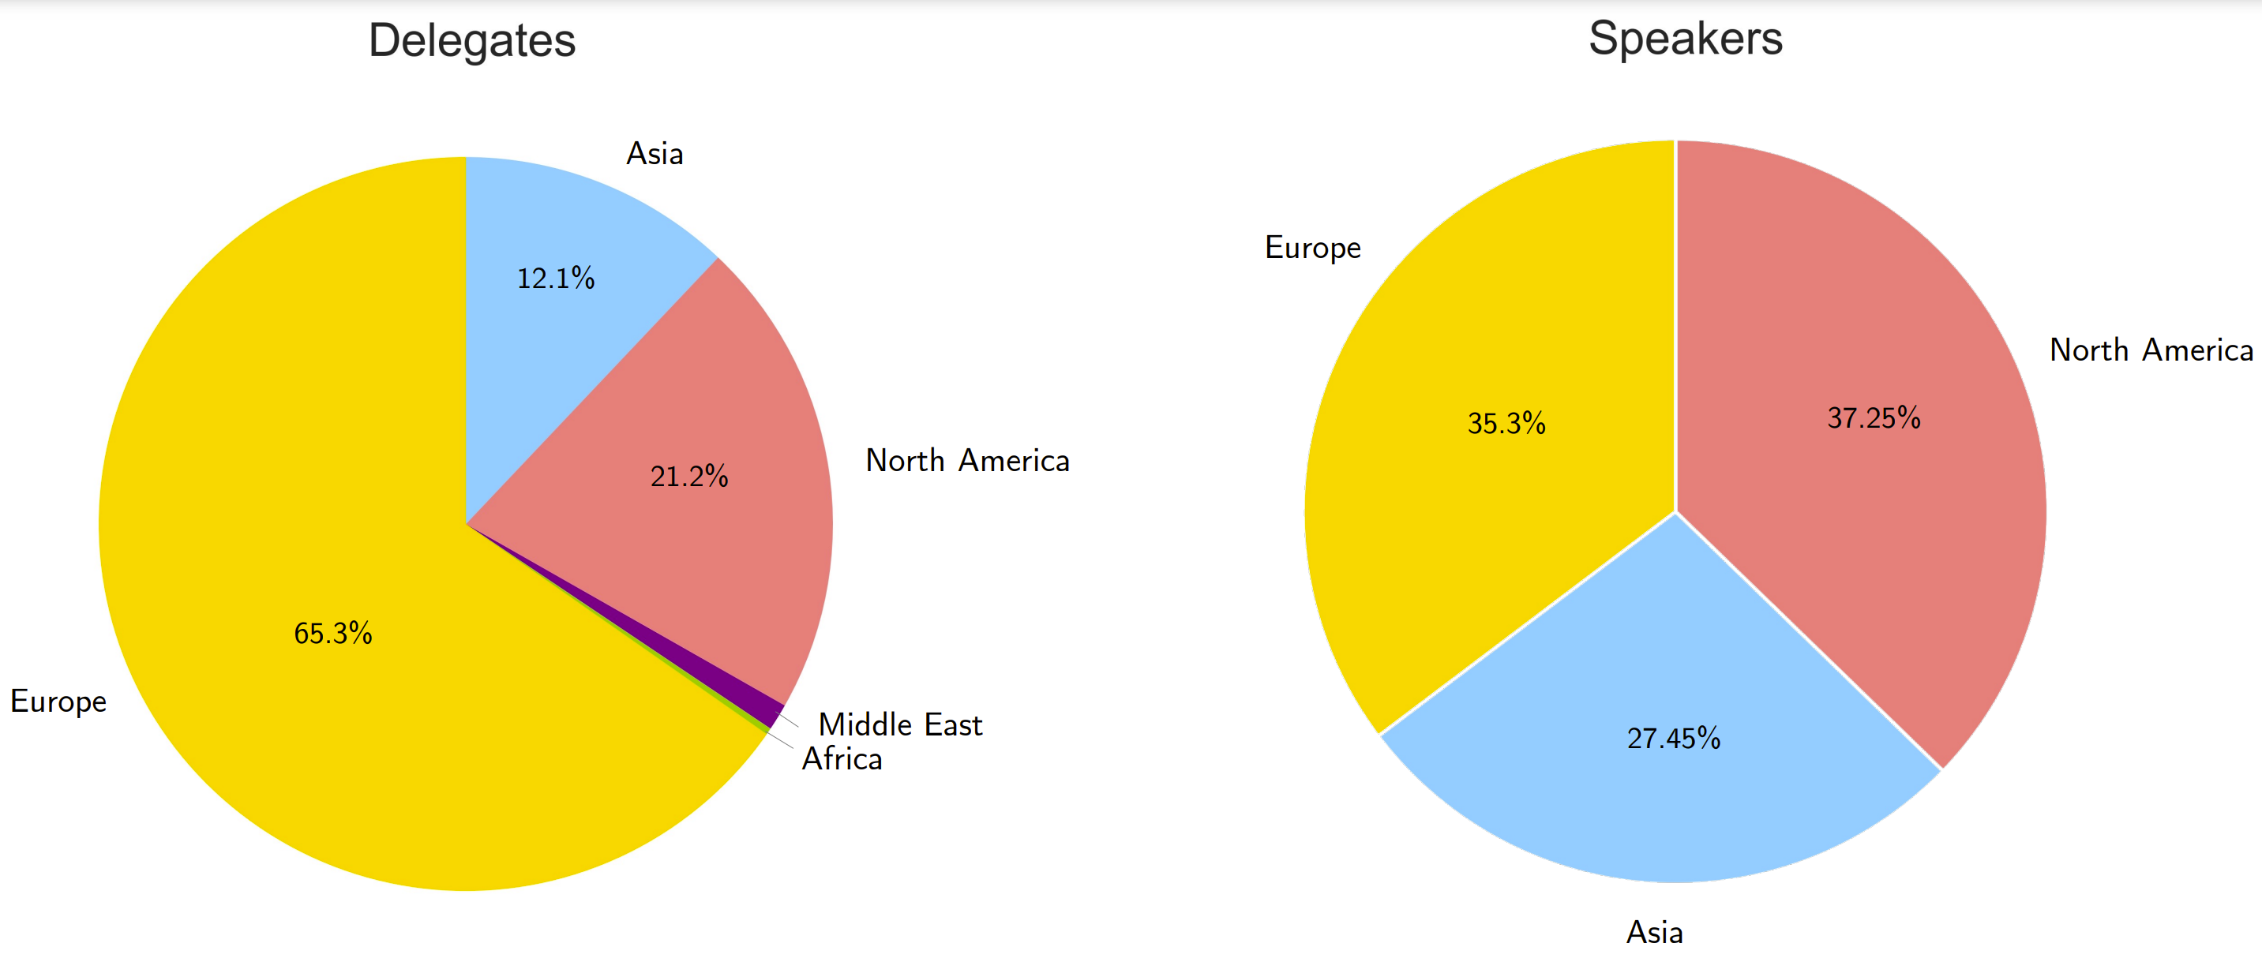
Registrations
 | Total
Delegates (Early) | 151
Delegates (Late) | 142
Students Total | 47
Exhibitors | 20
Jacow/IT/Admin | 14
Total In-Person | 359
Remote | 19
Companions | 11

Slide 11
JACOW - SPMS
Editorial room was set up according to needs, despite usual teething problems on day 1, work has been problem-free
Excellent interaction between Rob Apsimon and editors prior to and during conference was key for well-organised editorial process. Fantastic team!
Registration process has largely run very smoothly.
Minor challenges:
Standard working hours at ACC (security, access)
Worldspan – SPMS interface.

Slide 12
Industry Exhibition / Sponsors
Crucial to make conferences financially viable – major challenge for LINAC2022 to engage businesses;
Businesses struggle after pandemic; still considerable travel restrictions in place around the world;
Aim: best exposure possible, highlighting our sponsors, organised special events for exhibitors (cheese and wine meet’n greet), quiz challenge, etc. – received very positive feedback.

Slide 13
Social Events
Secured iconic locations across Liverpool for events throughout the week:
Reception with open bar and no limit on drinks and tapas;
Chairs’ Reception in Liverpool cathedral - excellent feedback;
IOC Dinner in Liver building – one of our three graces;
Excursions to prime spots – weather should be good :)
Banquet in St George’s Hall, entertainment secured until 00:30
Huge interest in lab tour on Friday.

Slide 14
Financial Summary
Preliminary – subject to change
Expenditure | Cost (£k) | VAT (£k) | Total Cost (£k)
ACC (Venue, IT services, decor, booths, posters, tables) | 154.0 | 30.8 | 184.8
ACC Catering | 45.2 | 9.1 | 54.3
Remote hosting | 10.0 | 2.0 | 12.0
WorldSpan | 19.7 | 2.8 | 22.5
Conference Bags(incl booklets and gifts) | 7.5 | 1.5 | 9.0
Jacow team support | 12.1 | 2.4 | 14.5
Student Grant Support (23 total at £1.3k/person + registration) | 29.9 | 6.0 | 35.9
Student Awards | 4.0 | 0.0 | 4.0
Reception (273) | 7.9 | 1.6 | 9.5
Chair's Reception (75) | 10.6 | 2.1 | 12.7
IOC Dinner (15) | 1.7 | 0.3 | 2.0
Banquet (311) | 37.2 | 7.4 | 44.7
WISE Event (incl catering) (222) | 4.3 | 0.9 | 5.2
Daresbury Tour (incl Lunch) | 4.9 | 1.0 | 5.9
Excursions (247) | 15.5 | 2.1 | 17.6
Total Expenditure (£k) | 364.5 | 70.0 | 434.5
Income | Cost (£k) | VAT (£k) | Total Cost (£k)
Delegate Registration Early (151) | 71.3 | 17.8 | 89.1
Delegate Registration Late (142) | 78.4 | 19.6 | 98.0
Student Registration (Reduced Fee) (24) | 7.1 | 1.8 | 8.9
Student Registration (Free) (23) | 0.0 | 0.0 | 0.0
Remote Registration (19) | 3.3 | 0.8 | 4.2
Exhibitors (Gold) (6) | 24.0 | 4.8 | 28.8
Exhibitors (Standard) (14) | 49.0 | 9.8 | 58.8
Additional Sponsorship | 15.5 | 3.1 | 18.6
Linac18 Transfer ($100k) | 76.3 | 0.0 | 76.3
Total Income (£k) | 324.9 | 57.7 | 382.6
Differential (£k) | -39.6 | -12.3 | -51.9

Slide 15
Conclusion
So far – extremely successful after challenging COVID period – great to see our community get back together and discuss again!!
Whatsapp groups used as efficient tool for live communication
Years in the planning – fantastic to finally have everyone here!
Some challenges:
Visa problems (delegates, students, speakers)
Partnership with industry and attracting sponsors
Useful integration of remote delegates – community needs to embrace opportunities and cannot expect freebie
(too) frequent program changes
Lack of planning in satellite event (WISE)
(more) centralised communication for all aspects of the conference.

Slide 16
Thank you!

