Slide 1
Making a brighter future through advanced accelerators
Introduction & Goals of the Day
Deepa Angal-Kalinin

Slide 2
CLARA Schematic & Project Phases
FEBE Hutch
FEBE Arc
PHASE 2: 250 MeV, ASSEMBLED OFFLINE,
Partly installed in the accelerator hall.
Includes dedicated 250 MeV beamline (FEBE) for novel experiments.
PHASE 1: 50 MeV, 250 pC at 10 Hz ACHIEVED
Phase 1 + VELA line used in exploitation experiments presented at today’s meeting.

Slide 3
CLARA Schematic & Project Phases
FEBE Hutch
FEBE Arc
PHASE 1: 50 MeV, 250 pC at 10 Hz ACHIEVED
PHASE 2: 250 MeV, ASSEMBLED OFFLINE,
Partly installed in the accelerator hall.
Includes dedicated 250 MeV beamline (FEBE) for novel experiments.
PHASE 3: 100 nm FEL
NOT YET FUNDED
Decision tied to UK XFEL
Total length = 90 m

Slide 4
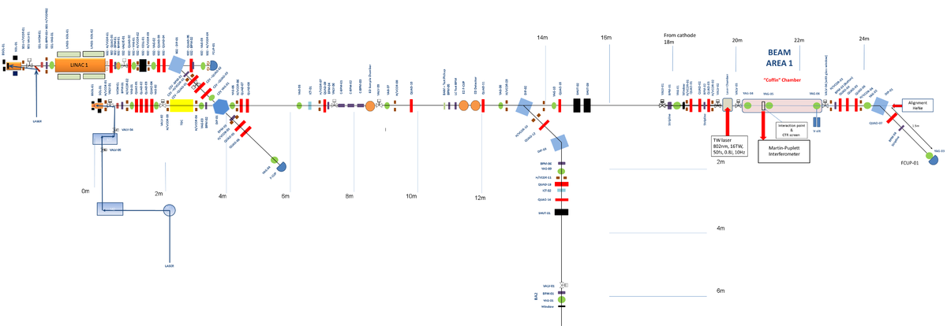
CLARA Phase 1 Exploitation Experiments (2021/22)
Suspended exploitation programme due to COVID-19 resumed in October 2021 and completed by April 2022.
Eight experiments were completed.
5 out of 6 experiments in Beam Area 1 used TW laser.
VHEE cell/plasmid
Pixel detector
Beam Area 1
10Hz gun
400Hz gun
DWA
LWFA external injection
Plasma-after-glow
THz acceleration
CDR
Pulsed radiolysis
wall
Beam Area 2
Details of the beam line available at:
Angal-Kalinin et al, Phys. Rev. Accel. Beams 23, 044801, 2020
4

Slide 5
Goals of the Day
After completion of the exploitation run, feedback was solicited from the PI’s and staff (different forms).
Internal wash-up meeting was organised on 20th of June to discuss both feedbacks to take on board where we need to change/address points raised for future exploitation.
Tim Noakes will summarise the feedback next. An action plan will be drawn to ensure where possible changes can be made for future exploitation runs.
We will hear scientific results from all 8 experimental teams.
We will share information regarding status of CLARA Phase 2 including FEBE and our near future plans.
At the end of the meeting CLARA tour will be organised for those interested.

Slide 6
Housekeeping
No fire alarm tests planned today, so if the fire alarm goes off, we will need to leave the room immediately.
Rest rooms are located on the right hand side when you exit this room.
We are expecting ~20 people to connect remotely, so please ask questions at the end of the presentation using a microphone.
Those remotely connected, please “Mute your microphone” when you are not presenting or asking question and use “Raise your hand” feature on Zoom.
Those interested in tour of CLARA Phase 2, please sign up for tours by end of lunch time.
Venue for lunch and group photo will be Electron Hall.

