Slide 1


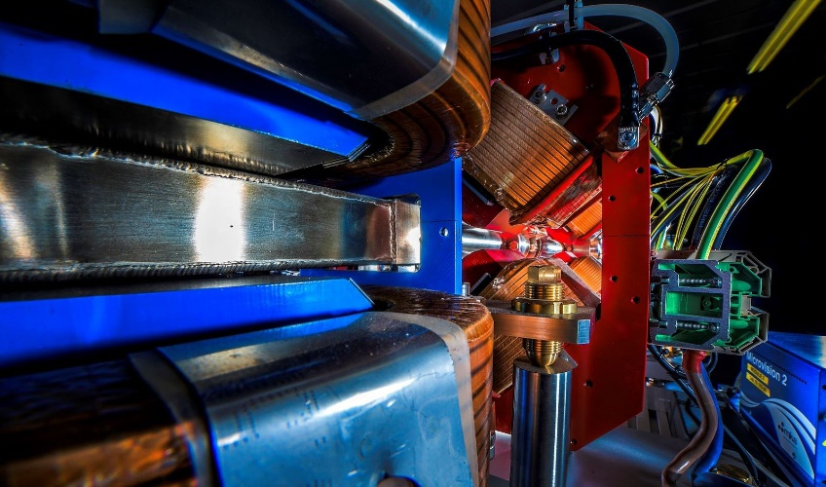
Making a brighter future through advanced accelerators
FEBE Laser Plans
Edward Snedden, ASTeC-FLT
3rd CLARA User Meeting
05.07.22

Slide 2
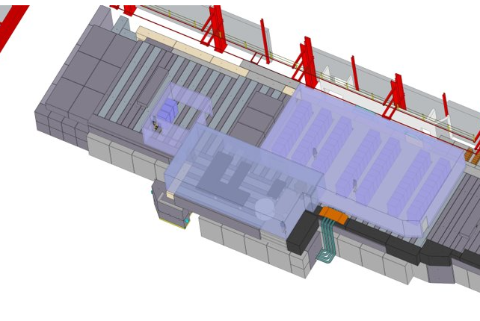
Overview
FEBE Laser: Introduction
Integration into FEBE beamline
  Laser system
  Laser room
  Synchronization
  Laser transport
  Project plan
Experiment planning
E Snedden - 3rd CLARA User Community Meeting
2

Slide 3
Introduction
FEBE will combine ‘FEL-ready’ electron beam with a 100 TW laser.
This will be unique infrastructure for research in novel acceleration.
Users can benefit from:
High quality and configurable electron beam (e.g., suited for injection into plasma)
Advanced technology developed for the CLARA FEL (e.g., synchronization, beam diagnostics)
Flexibility in experiment design through the FEC1/2 chambers
Update: we have received £4.2 M funding (beginning 23/24) to provide the laser to the FEBE hutch. This will be delivered as part of CLARA: Phase 2.
This will make FEBE a valuable facility in support of long-term R&D goals, including those outlined in the ESPP Accelerator R&D Roadmap.

Slide 4
Integration
Laser system
Commercial 100 TW (~2.5 J at ~25 fs, fully compressed) Ti:Sapphire.
The laser will be provided ‘upgrade-ready’ to higher power (e.g. →250 TW), including the vacuum compressor.
ASTeC aims to appoint a dedicated ‘laser operations’ crew, responsible for operating and maintaining the laser during exploitation periods.
Laser alignment will be supported by a CW reference laser and low pulse energy modes (similar to BA1).

Slide 5
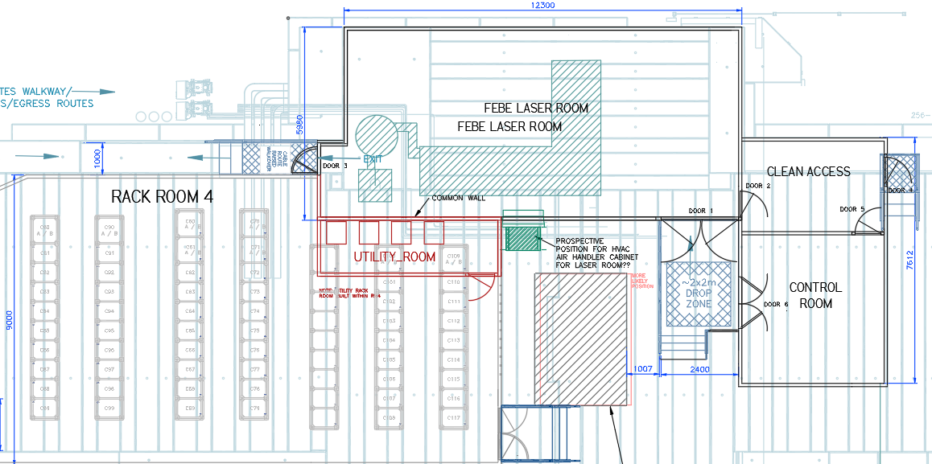
Laser room shell complete, can be visited today by those interested in touring CLARA.
Integration
Laser room
Immediately on top of the FEBE hutch to minimise path length to target.
Class 10,000 (ISO 7) clean room with environment control.
Operated from immediately adjacent laser control room.
Power suppliers will be housed in nearby Rack Room 4.

Slide 6
Integration
Synchronization
The laser oscillator will be optically synchronized to the CLARA optical clock. ASTeC and CI are progressing ‘FEL-ready’ synchronization systems, including:
Ultralow noise optical clock (complete)
Stabilized (<10 fs over 24 hr), in-fibre optical clock distribution (design and testing complete)
Two-colour laser-laser locking (free-space design complete, testing underway, all-fibre upgrade design in progress)
Goal: provide <10 fs start-to-end locking of the FEBE laser
to the optical reference (on track!).

Slide 7
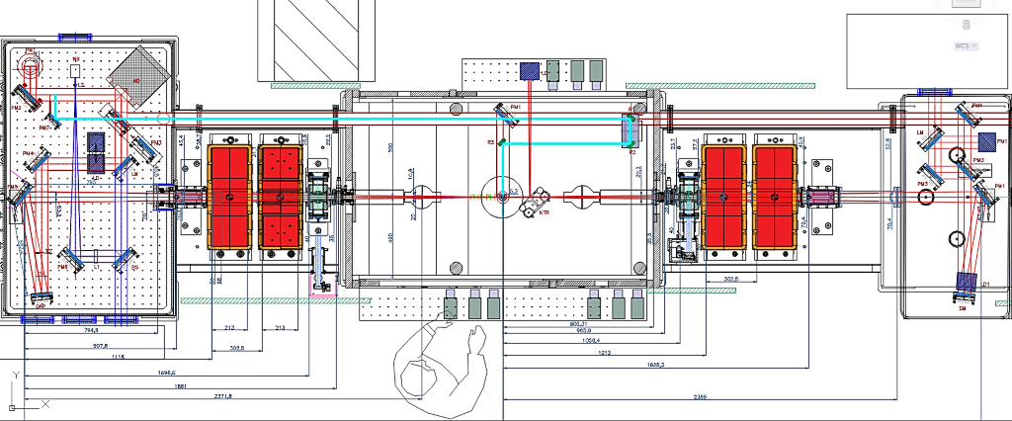
Integration
Transport
Deformable mirror
Pass through to chamber
Down-periscope from laser room
CLARA Beam
CLARA Beam
CLARA Beam
OAP
~7’’ Diameter
~3.5m Focal Length
Primary Laser IP (could move focus upstream)

Slide 8
Integration
Project plan
Laser funding begins 23/24, split over two years. Laser supply and integration managed through CLARA Project work package.
Goals: laser contract begins April 2023, exploitation begins 2025.
2022
2023
2024
2025
2026
2027
2028
2029
2030
2031
CLARA
SD1
HRRG
SD2
Technical Beam FEBE
Commissioning
Machine Development and CLARA Exploitation
UK XFEL
CDR: Options analysis
TDR
Construction
FEBE Laser contract begins
FEBE Exploitation kick off meeting
FEBE Laser ready for exploitation

Slide 9
Experiment planning
The FEBE beam line and laser is an exciting opportunity but a big challenge!
Combining CLARA with 100 TW pulses is complex problem requiring specialist knowledge and systems. We need to think beyond the BA1 model.
Work against the novel acceleration challenges requires laser/plasma physics, accelerator physics and diagnostics to come together in a working experiment.
All of the above is possible through close cooperation and collaboration between ASTeC and the user community!
Please contact edward.snedden@stfc.ac.uk if you are interested and would like more details concerning FEBE laser exploitation.

Slide 10

Thank you
astec.stfc.ac.uk
@ASTeCSTFC

