Slide 1



FEBE Experimental Capabilities
Thomas Pacey,
On behalf of CLARA & FEBE teams
ASTeC,
Daresbury Laboratory
3rd CLARA User Meeting, 5th July 2022
Notes:
Welcome

Slide 2
Outline
Overview CLARA Front-End & BA1
Overview FEBE beam delivery
FEBE infrastructure
FEBE Beam Parameters
Conclusions

Slide 3
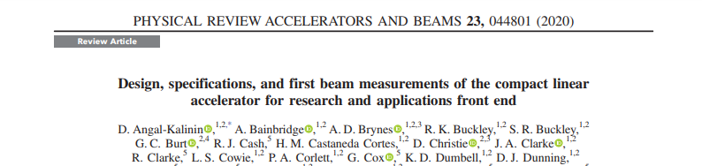
CLARA Front End Overview
Nominal beam at BA1 IP:
35 MeV
100 pC (space charge limitation)
300 fs RMS length
100 um RMS radius
Plus other charge and bunch length setups!
PI Laser:
Fixed longitudinal pulse shape
TW Class Laser
Linac 1
BA1
CLARA
Front -End
VELA
RF Gun:
10 Hz
100 pC
C2V:
Fixed R56
Large T566
Chamber
Notes:
Where we are now

Slide 4
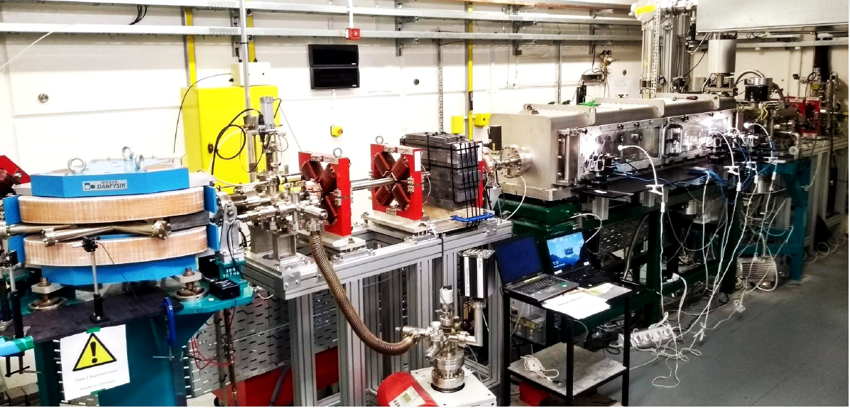
BA1 Infrastructure
BA1 comprises of components from CLARA,ALICE,EMMA & SRS facilities
Equipment not designed to support user exploitation
Program of continuous improvement involving staff effort and capital investment
BA1 laser is > 15 years old.
Intrinsic difficulties controlling some of the hardware.
Challenge to sustain high performance during user run
Reflect on the sum being greater than the parts
Notes:
Sum greater than the parts

Slide 5
FEBE Overview
Shielded hutch specifically designed for user exploitation
Designed to support experiments from themes that have we have had in Run 1 (’18/19) and 2 (‘21/22) and more
Bespoke infrastructure, building on lots of lesson’s learned in Run 1&2
Take advantage of the full capabilities of CLARA with FEL quality beam
  synchronisation, modelling, controls, machine learning optimisation, etc
Notes:
Run 1 and Run 2 – evidenced by new experiments in 2
Started to see benefits of CLARA with stability and feedbacks in Run 2

Slide 6
CLARA & FEBE Overview
CLARA
Phase 1
PI Laser:
Variable longitudinal pulse shape
Linac 1
RF Gun:
100 Hz
250 pC
Notes:
400Hz Technological proof of concept

Slide 7
CLARA & FEBE Overview
CLARA
Phase 1
CLARA
Phase 2
PI Laser:
Variable longitudinal pulse shape
Variable Bunch Compressor
Variable R56
Low T566
Linac 1
Linac 2
Linac 3
Linac 4
RF Gun:
100 Hz
250 pC
4th Harmonic
Cavity
Dechirper
Notes:
400Hz Technological proof of concept

Slide 8
CLARA & FEBE Overview
CLARA
Phase 1
CLARA
Phase 2
CLARA
FEBE
100 TW Class Laser
PI Laser:
Variable longitudinal pulse shape
Variable Bunch Compressor
Variable R56
Low T566
FEBE Mask
Flexible design
Linac 1
Linac 2
Linac 3
Linac 4
FEC1
FEC2
FEBE Arc
Variable R56
FEBE Hutch
RF Gun:
100 Hz
250 pC
4th Harmonic
Cavity
Dechirper
FEBE experiments will benefit from:
Improved beam quality
Highly flexible beam delivery
Improved beam diagnostics & characterisation
Notes:
400Hz Technological proof of concept

Slide 9
FEBE Design Principles
Sliding shield door
Matching Section + diagnostics
Laser
2 Interaction Points
Flexible compression pre arc & Mask
Post-IP spectrometer line
~250MeV
Radiation shutters
FEBE arc is designed to mitigate CSR
100 TW Class Laser is delivered from roof & coupled to beamline
Potential for PM dipole in the second chamber for broadband energy spectrum measurements.

Slide 10
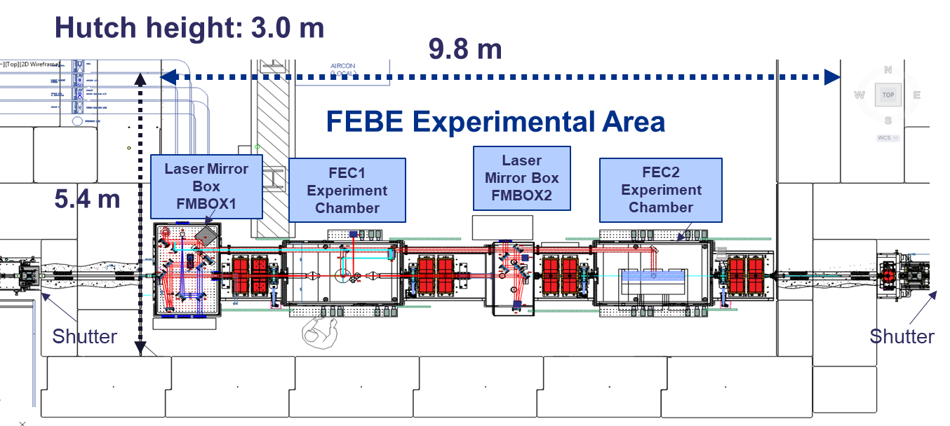
FEBE Hutch
Large hutch, 2 large chambers, Double IP, lots of diagnostics space!
Beamline loaded with diagnostics!

Slide 11
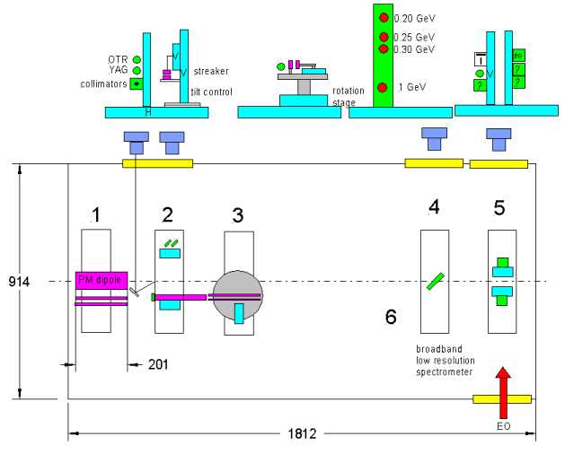
Illustrative only
Suite to be finalised
Diagnostics
Arc, matching:
  Beam position monitors and YAG stations
  Beam arrival monitor
  CTR/CDR bunch compression monitor
Hutch:
  BPMs, YAG/OTR, ICT
  FEC2 diagnostics suite to be offered, shown right
Dump:
  OTR imaging station
  Faraday cup in energy spectrometer
Short permanent dipole magnets (drive/witness separation, low-res spectrometer)
OTR/YAG/collimator, dielectric streaker
Dielectric streaker cont.
Vertical screen (low-res spectrometer)
Placeholder for multiple additional diagnostics (to be defined)
Empty space, possible use for additional diagnostics

Slide 12
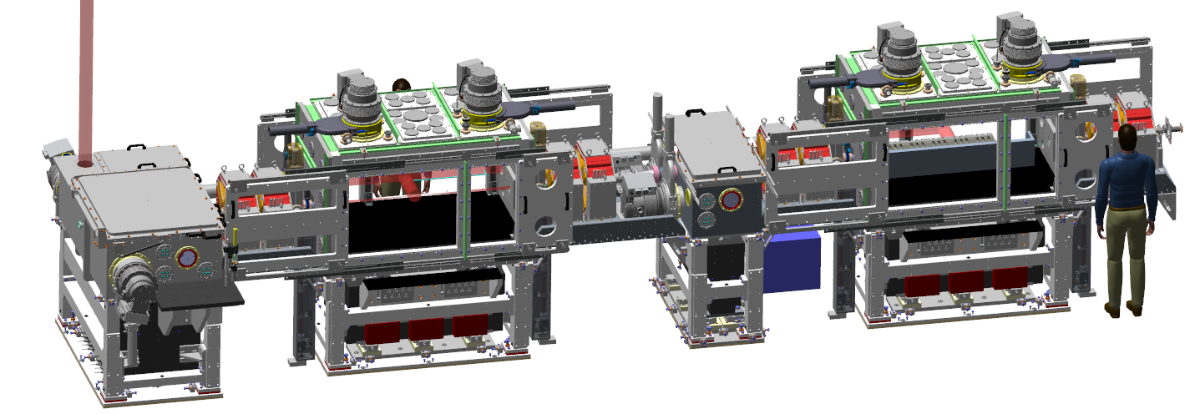
FEBE Hutch
LASER In Periscope
LASER Out & Dump
FEC#2
Can support PM Dipole
FEC #1
Laser focus
Primary IP
Up to
600 MeV
CLARA
250 MeV
Chamber doors and feeds to be finalised
Notes:
Chamber designs still to be finalised

Slide 13
FEBE acceleration energies
Accelerated beam charge and rep. rate subject to meeting radiation shielding power limits
Up to 250 MeV
250 MeV from CLARA linacs
Up to 600 MeV can be transported to FEBE Dump
>600 MeV can be generated,
provided safely dumped in FEBE Chamber 2
250 – 600 MeV
>600 MeV
Notes:
ONE of the things is novel acceleration

Slide 14
Examples of built-in infrastructure
Gas delivery lines and differential pumping designed in from ground up
Large stable chambers, big doors, can be used at atmosphere
Space outside chambers for in-vacuum antechambers or breadboards
Electron beam diagnostics suite in FEC2
Laser delivered to focus in FEC1
Notes:
Non-exhaustive

Slide 15
Beam parameters
Planned
Subject to change

Slide 16
Beam parameters
  Offered parameters to evolve, based on development time
  ‘Day 1’ → Nominal
Parameter | High charge | Low charge
Energy [MeV] | 250 | 250
Charge [pC] | 250 | 5
RMS t [fs] | 100 | 50
σ_{E}/E [%] | <5 | <1
RMS x [µm] | 100 | 20
RMS y [µm] | 100 | 20
ε_{N} x @ 250 MeV [µm] | 5 | 2
ε_{N} y @ 250 MeV [µm] | 5 | 2
Important: all parameters to be confirmed through measurement using appropriate diagnostics.

Slide 17
Beam parameters
  Offered parameters to evolve, based on development time
  ‘Day 1’ → Nominal → R&D
Parameter | High charge | Low charge
Energy [MeV] | 250 | 250
Charge [pC] | 250 | <5
RMS t [fs] | 50 | ≤50
σ_{E}/E [%] | 1 | <1
RMS x [µm] | 50 | 1
RMS y [µm] | 50 | 1
ε_{N} x @ 250 MeV [µm] | <5 | 1
ε_{N} y @ 250 MeV [µm] | <1 | <1
  R&D: dedicated effort required beyond standard operations, and/or new diagnostic technology required
Notes:
PEAK current ~4kA simulated Max
Bad longitudinal profile and transverse profiles
~2kA seems workable in simulation

Slide 18
Beam parameters
R&D beam parameters: users interested in these beam options are encouraged to approach ASTeC with a view to research collaboration
Require level of ASTeC effort beyond standard CLARA operations
Flexibility in CLARA means we could potentially achieve exotic setups e.g.
  Longitudinal electron beam profile tailoring, including multi-bunch:
  Photo-injector laser pulse shaping
  FEBE mask

Slide 19
Beam parameters – take homes
Going to be better than in BA1
Subject to continuous improvement
Diagnostics will improve over time with R&D
Keep community informed of commissioning progress before “Day 1”
Want to hear from community about experiment ideas before proposal phase
Notes:
Want to hear so we are confident our commissioning plans and priorities are aligned with community needs
No commitments to study or test ideas

Slide 20
Conclusions
FEBE represents a step change in our infrastructure and potential to perform high impact experiments
Flexibility is at the heart of the design to support & futureproof for our community
FEBE will leverage the full CLARA R&D project
  FEL quality beam, synchronisation, modelling, controls, machine learning optimisation, etc.
Looking forward to commissioning and hearing new and exciting ideas from the community

Slide 21
Backup slides

Slide 22
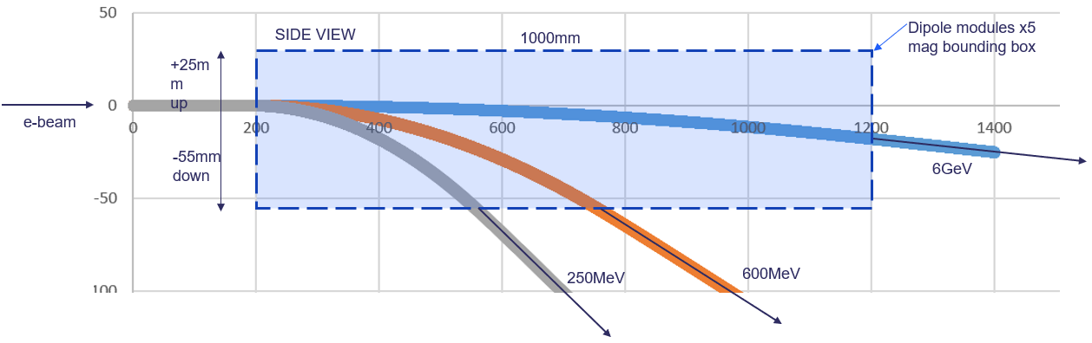
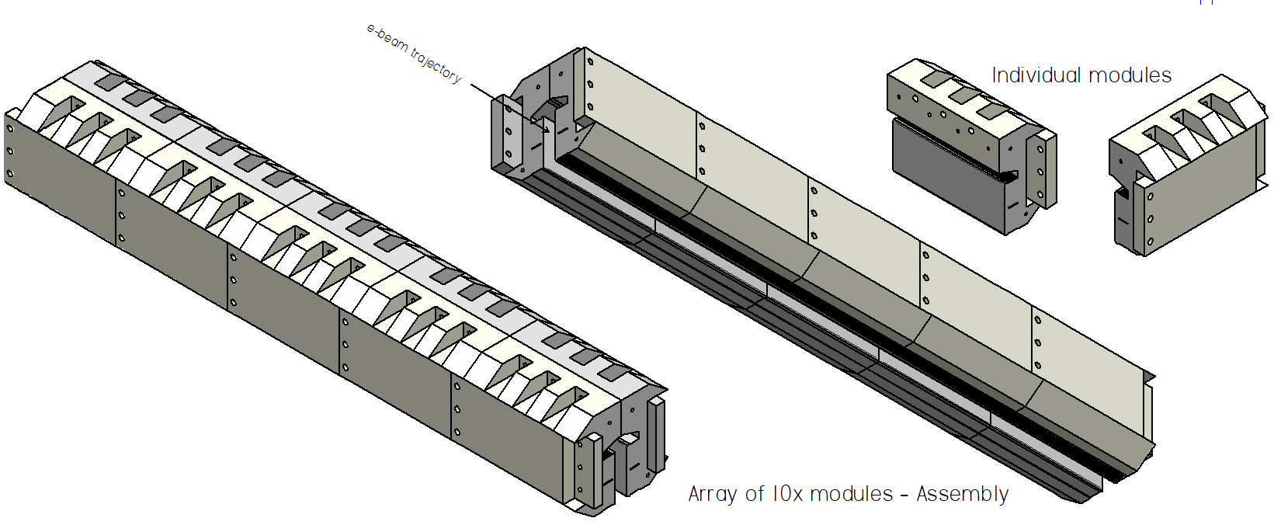
Diagnostics
FEC2 includes removable PM dipole spectrometer. Features include:
  Broad bandwidth: 250 MeV – 600 MeV – >1 GeV
  Modular design: sections can be replaced if damaged, length reduced as function of energy
  Deflection of ebeam down, matched door panel for viewports/cameras
Simulated trajectories as a function of energy
Vertical (down) beam deflection
200 mm per module, up to 1000 mm total length

Slide 23
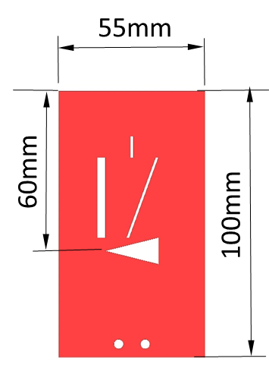
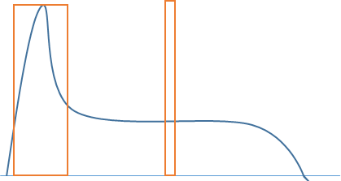
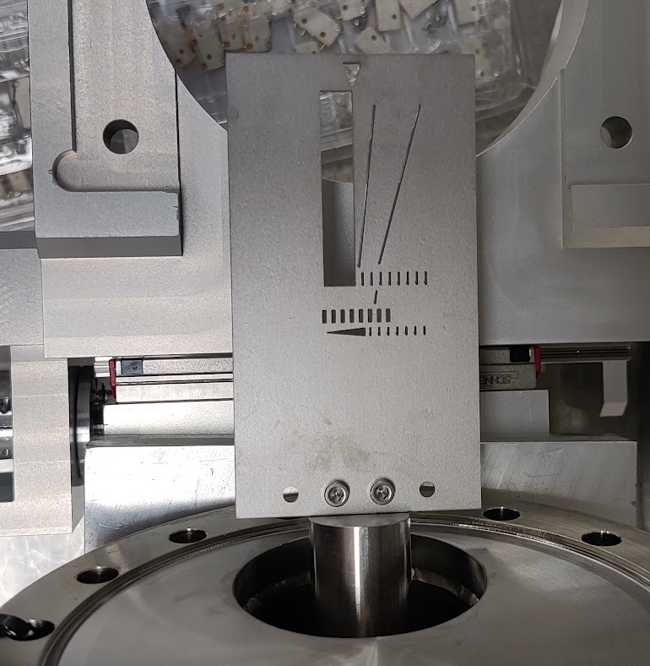
FEBE arc mask
Vital component for beam driven acceleration (drive/witness)
5mm thick tungsten plate, x/y translation. YAG screen included at station.
Works with PI laser shaping & CLARA beam transport
Test mask to be installed on ‘Day 1’, design to be iterated based on commissioning.
Designed with ease of access in mind,
flexibility to change tungsten plate
100 mm vert. travel
Holes are
sketched
only
ρ
+/- 10mm horiz. travel
x

Slide 24




Diagnostics in Arc
YAG+BCM
BAM
ICT
YAG+MASK
YAG
BPM
x2 BPM, x1 screen per cell
  CSR ports on all dipoles
Mask at high dispersion point
Beam Arrival Monitor (BAM)
Coherent Transition Radiation Bunch Compression Monitor (CTR-BCM)
ICT
Before beam enters hutch we have timing, bunch length and charge

Slide 25
Diagnostics in hutch
X4 screens, up and downstream of chambers
X4 BPMS – entrance and exit, either side of FMBOX2 (centre of hutch)
Beamline ICT between FEC1 and FEC2
Beam axis, optics, losses all accounted for in hutch
YAG
Quad + Corr.
Quad + Corr.
BPM
ICT
FMBOX1
FEC1
FMBOX2
FEC2

Slide 26
Diagnostics in dump line
Large Dia YAG
F-Cup
YAG + OTR
YAG +OTR YAG screen for emittance measurement post experiment
  Low emittance/high brightness beams
Up to 600 MeV variable dispersion spectrometer + Faraday Cup
  Large Dia. YAG (98mm)
BPMs pre & post dipole
CSR extraction line on dipole
  Potential non invasive longitudinal diagnostic
Post hutch we have emittance, energy, energy spread, charge

