Slide 1
Making a brighter future through advanced accelerators
Status of CLARA Phase 2 and Near Future Plans
Deepa Angal-Kalinin
On behalf of CLARA Team

Slide 2
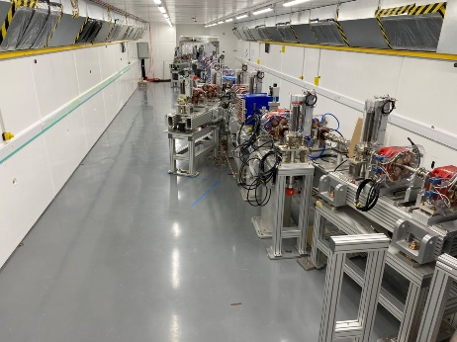
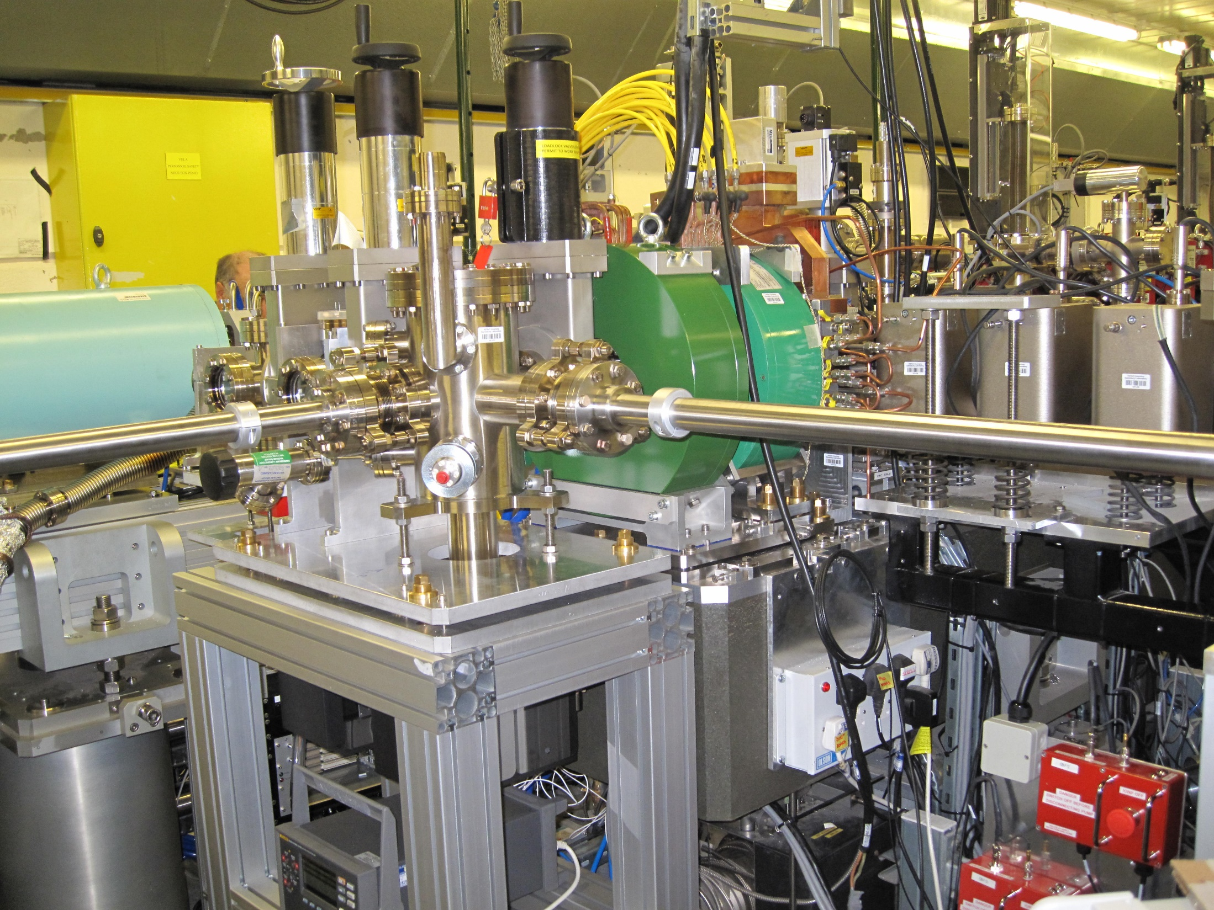
Overview
CLARA Phase 2
Schematic
Accelerator Hall
FEBE Overview
Installation and Infrastructure progress
CLARA and UK XFEL timeline
Summary

Slide 3
CLARA Phase 2 - Schematic
250 MeV, 250 pC FEL ready bunches at 100 Hz
FEBE Hutch
FEBE Arc
Three 4 m long S-band Linacs, Variable Bunch Compressor, X-band lineariser, diagnostics sections.
FEBE design is conceived and developed in collaboration with stakeholders and is building upon the existing community interest and demonstrations on CLARA FE.
The design incorporates the means to combine electron bunches with high energy laser light and facilitate user research in novel acceleration.
Dedicated diagnostics pre- and post interaction point to fully characterise beams.

Slide 4
CLARA 250 MeV - Accelerator Hall
Tested & ready for install 2023
Tested & installed 2021-22
BA1
Status 2022

Slide 5
CLARA 250 MeV - Accelerator Hall Roof

Slide 6
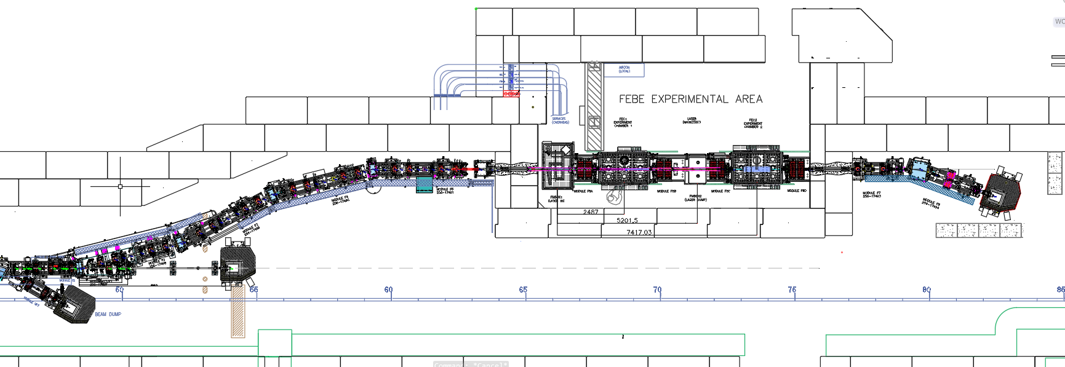
FEBE Design Overview
Laser insertion
Two interaction points
Matching section
Post-interaction spectrometer line
Flexible compression arc + mask
~250 MeV
Radiation shutters
Up to
600 MeV
Hutch footprint: 10×5.4×3 m³, Shielding: total beam power 6 W Flexibility with bunch charge (maximum 250 pC), bunch repetition rate (maximum 100 Hz), beam energy (250 MeV – 2 GeV)

Slide 7
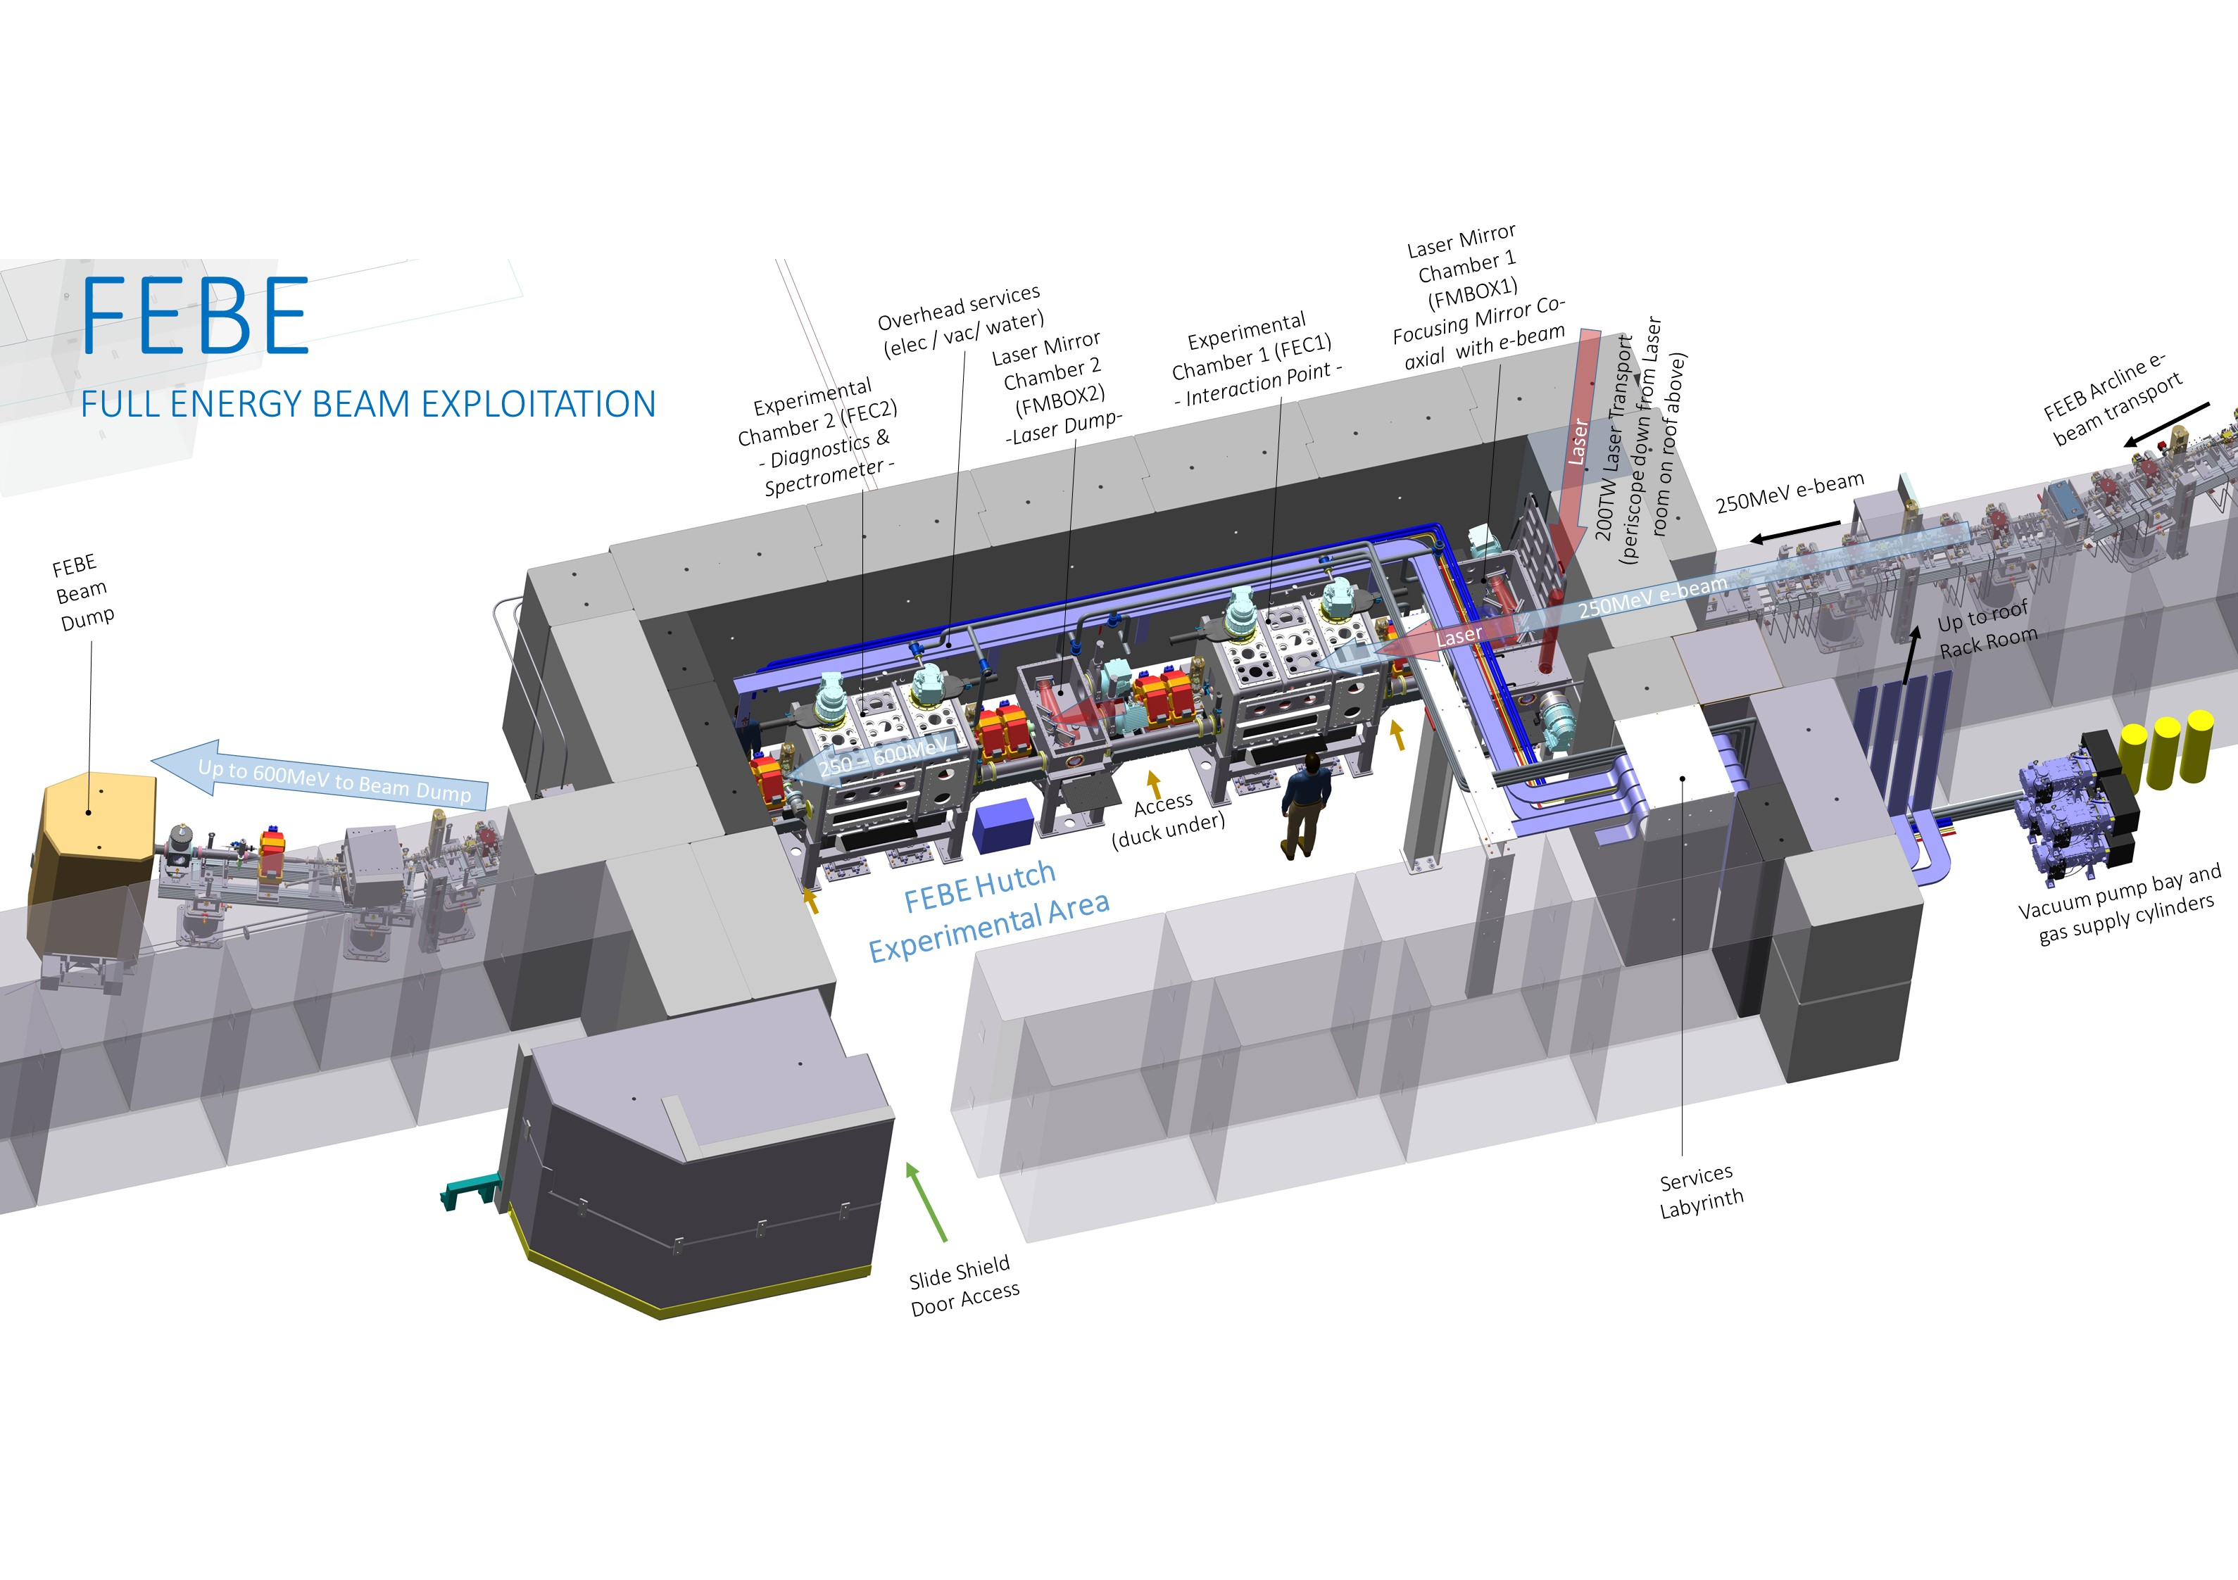
FEBE Hutch Overview
Two identical chambers: more flexible, provides diagnostic support, and a route towards ambitious interaction/transport/application

Slide 8
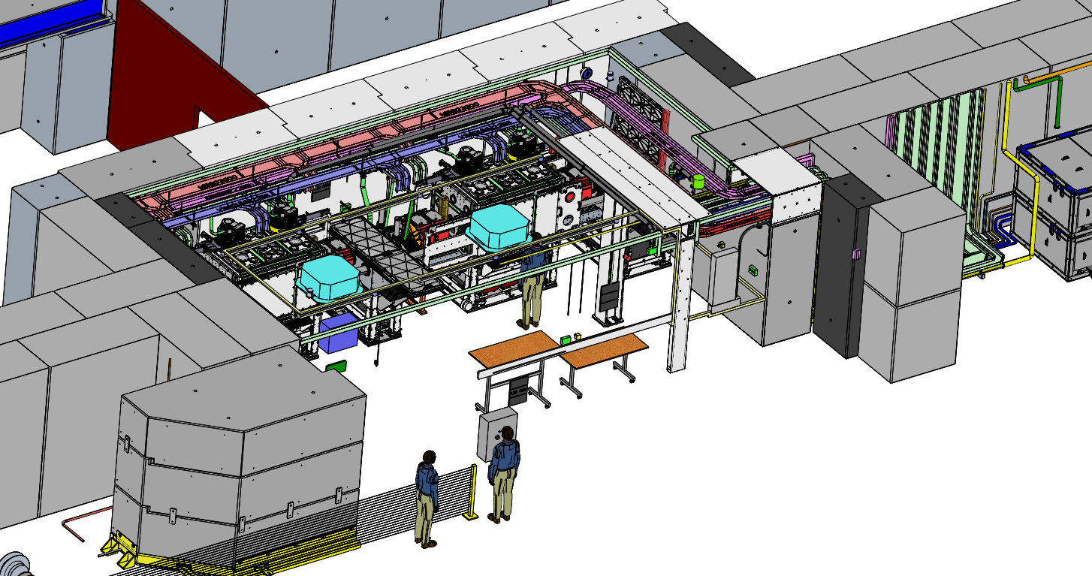
FEBE Hutch – Services Planning
Services in FEBE hutch are being finalised.
North Shield Wall Blocks Removed

Slide 9
FEBE Hutch – Services Planning
View from South

Slide 10
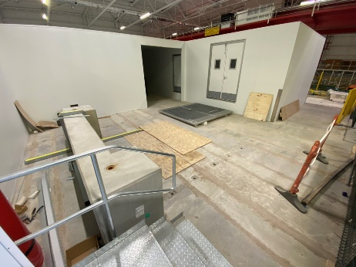
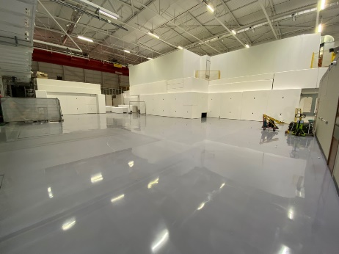
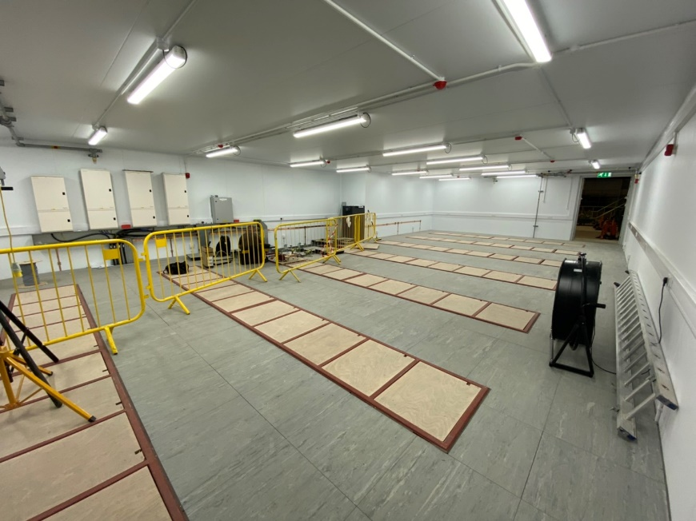
Phase 2 Preparation Progress (1)
Accelerator module construction & installation
Completion of 100TW Laser room complex
Electrical/mechanical services installation
Painting floors and bunker surfaces to allow clean installation
FEBE Laser Room on Roof
Phase 2 Installation
FEBE Laser Room and Rack Room 4 on Roof
Rack Room 4 on Roof

Slide 11
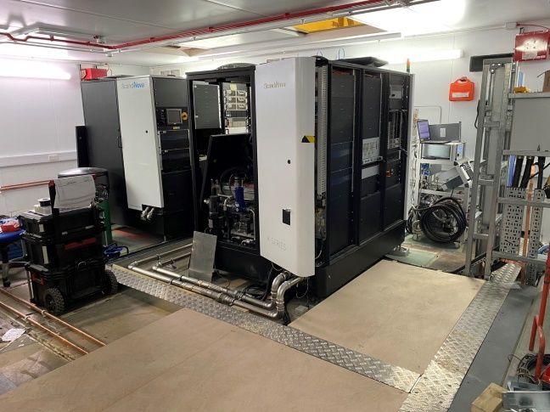
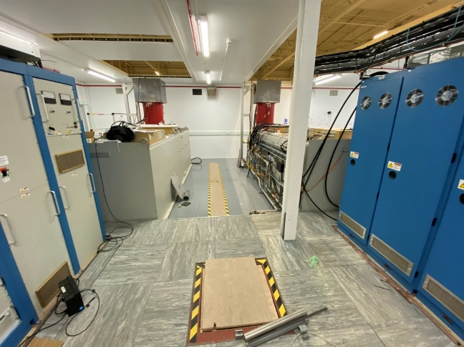
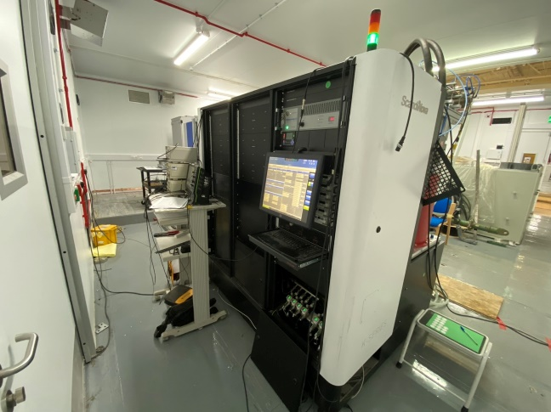
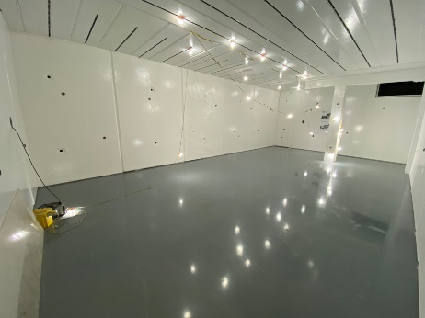
Phase 2 Preparation Progress (2)
Gun Modulator replacement progressing well. HRRG commissioning to begin in August 2022.
Linac 2 & 3 modulators tested to low RF power, testing to continue once Linac 4 is complete.
Deflecting cavity modulator currently undergoing RF test.
FEBE hutch ready for equipment and service installation
RF Room 1
Gun modulator replaced
RF Room 2
Linac 2 & 3 modulators
RF Room 3
TDC and Linac 4 modulator
FEBE Hutch

Slide 12
CLARA 250 MeV - Accelerator Hall
Status 2023
Deepa Angal-Kalinin, Third CLARA User Meeting, 5th July 2022

Slide 13
CLARA & UK XFEL Planning
2022
2023
2024
2025
2026
2027
2028
2029
2030
2031
CLARA
SD1
HRRG
SD2
Technical Beam FEBE
Commissioning
Machine Development and CLARA Exploitation
UK XFEL
CDR: Options analysis
TDR
Construction
FEBE Laser contract begins
FEBE Exploitation kick off meeting
FEBE Laser ready for exploitation
SD1
Shutdown - Gun Modulator/klystron change
SD2
Shutdown - Phase 2 installation

Slide 14
Summary
CLARA is providing unique platform for developing skills & expertise in addressing several technical and scientific challenges for future UK XFEL & for novel user experiments.
Straight-on space is retained for accelerator technology R&D in support of UK XFEL.
Phase 2 will provide 250 MeV FEL ready beam – To reach design parameters sufficient time needs to be allocated for commissioning and machine development in first few years.
Provisions for spare components are being made to ensure increased beam availability. Plans are also underway to recruit dedicated operators.
FEBE user kick-off meeting will be arranged in 2024 before exploitation call will be issued but early engagement with CLARA team is encouraged.
FEBE experimental capabilities will be covered in Tom Pacey’s talk and FEBE laser plans will be covered in Ed Snedden’s talk.

