Slide 1
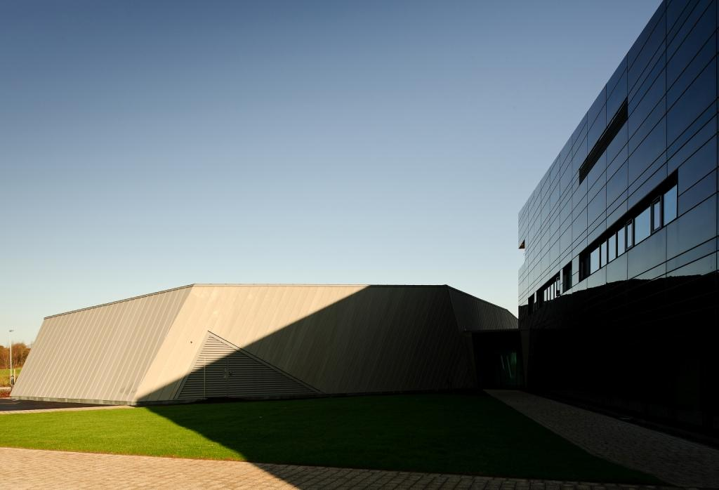




Towards Pulsed Radiolysis Capabilities for the UK Science Community
Alex Baidak, Research Fellow
CLARA User Meeting, 05 July 2022

Slide 2
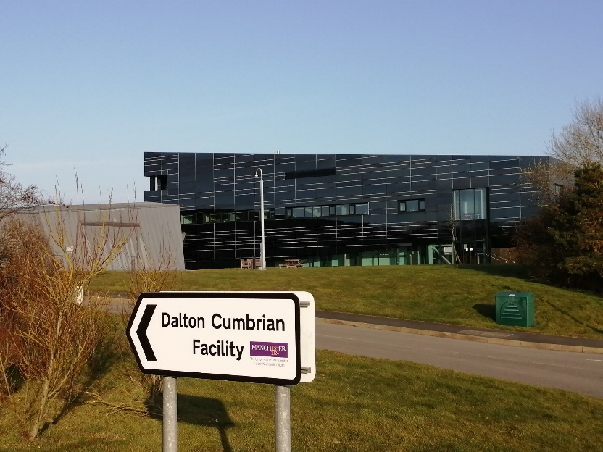
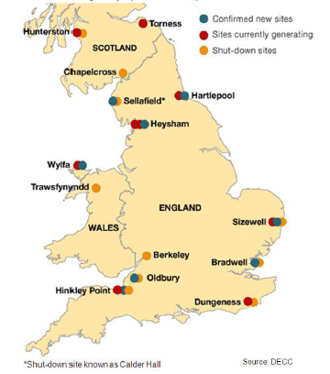
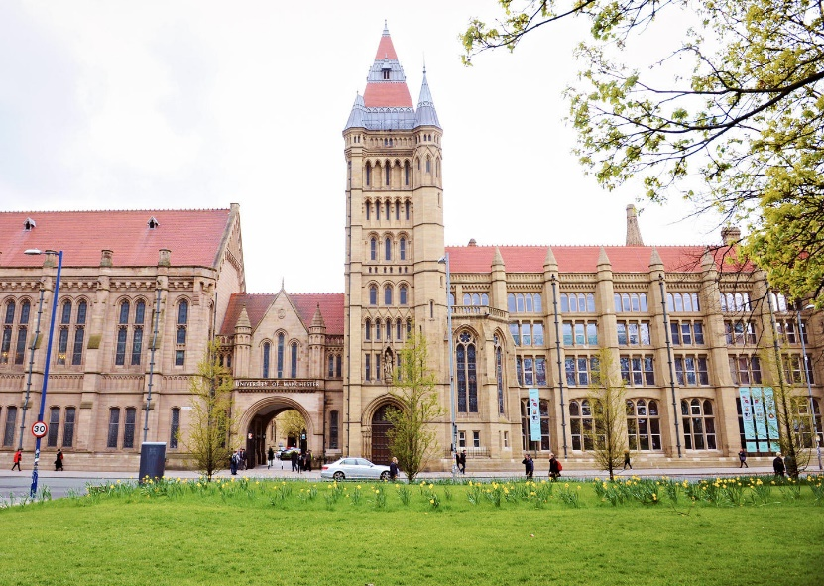
Dalton Cumbrian Facility (DCF)

Slide 3
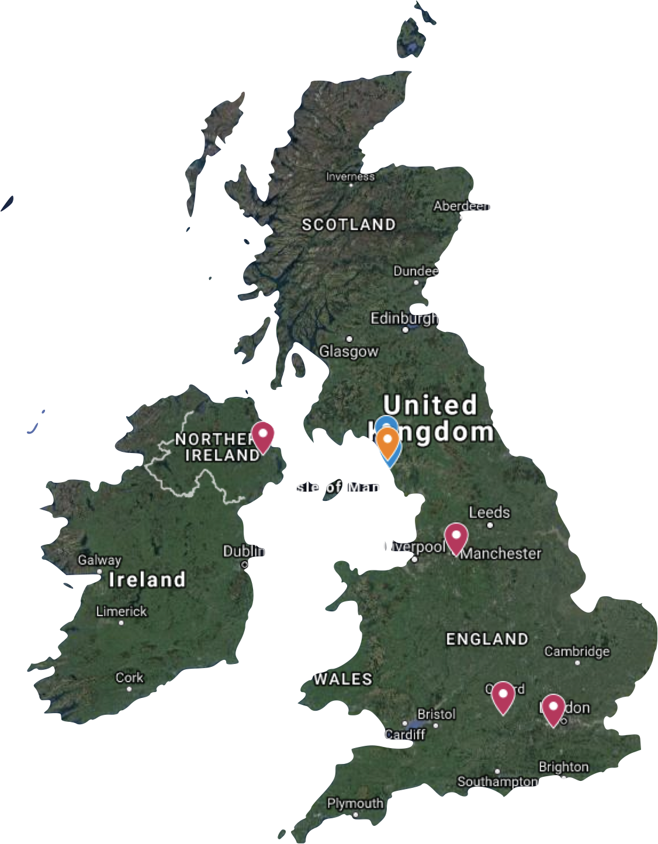
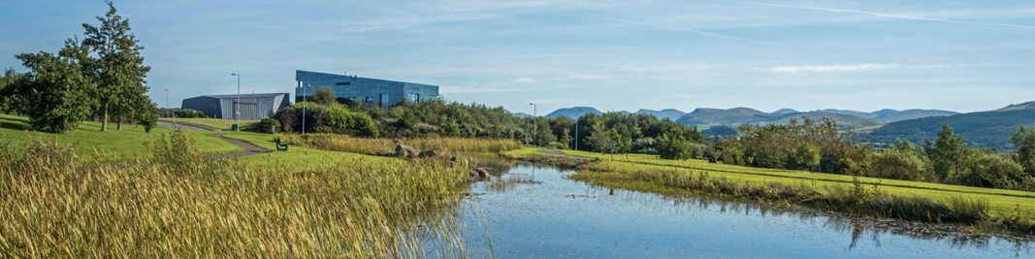
Dalton Cumbrian Facility (DCF)
Delivers >10,000 hours radiation access per year
  inc. national programs for UK academics
  multiple access routes, many free at point of delivery
4 distinct sources of ionising radiation
  gammas, X-rays, ion sources
In-situ preparation, characterisation and analytical equipment
Highly competent professional support team

Slide 4
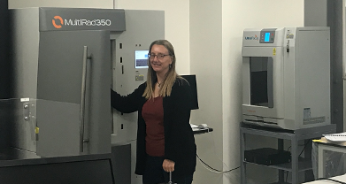
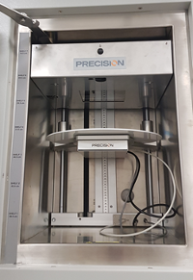
X-ray cabinet source
Precision MultiRad350
Henry Royce Institute funded
30 – 350 kVp
up to 140 Gy/min
turntable,
hypoxic chamber,
collimators,…
like sources in many labs

Slide 5
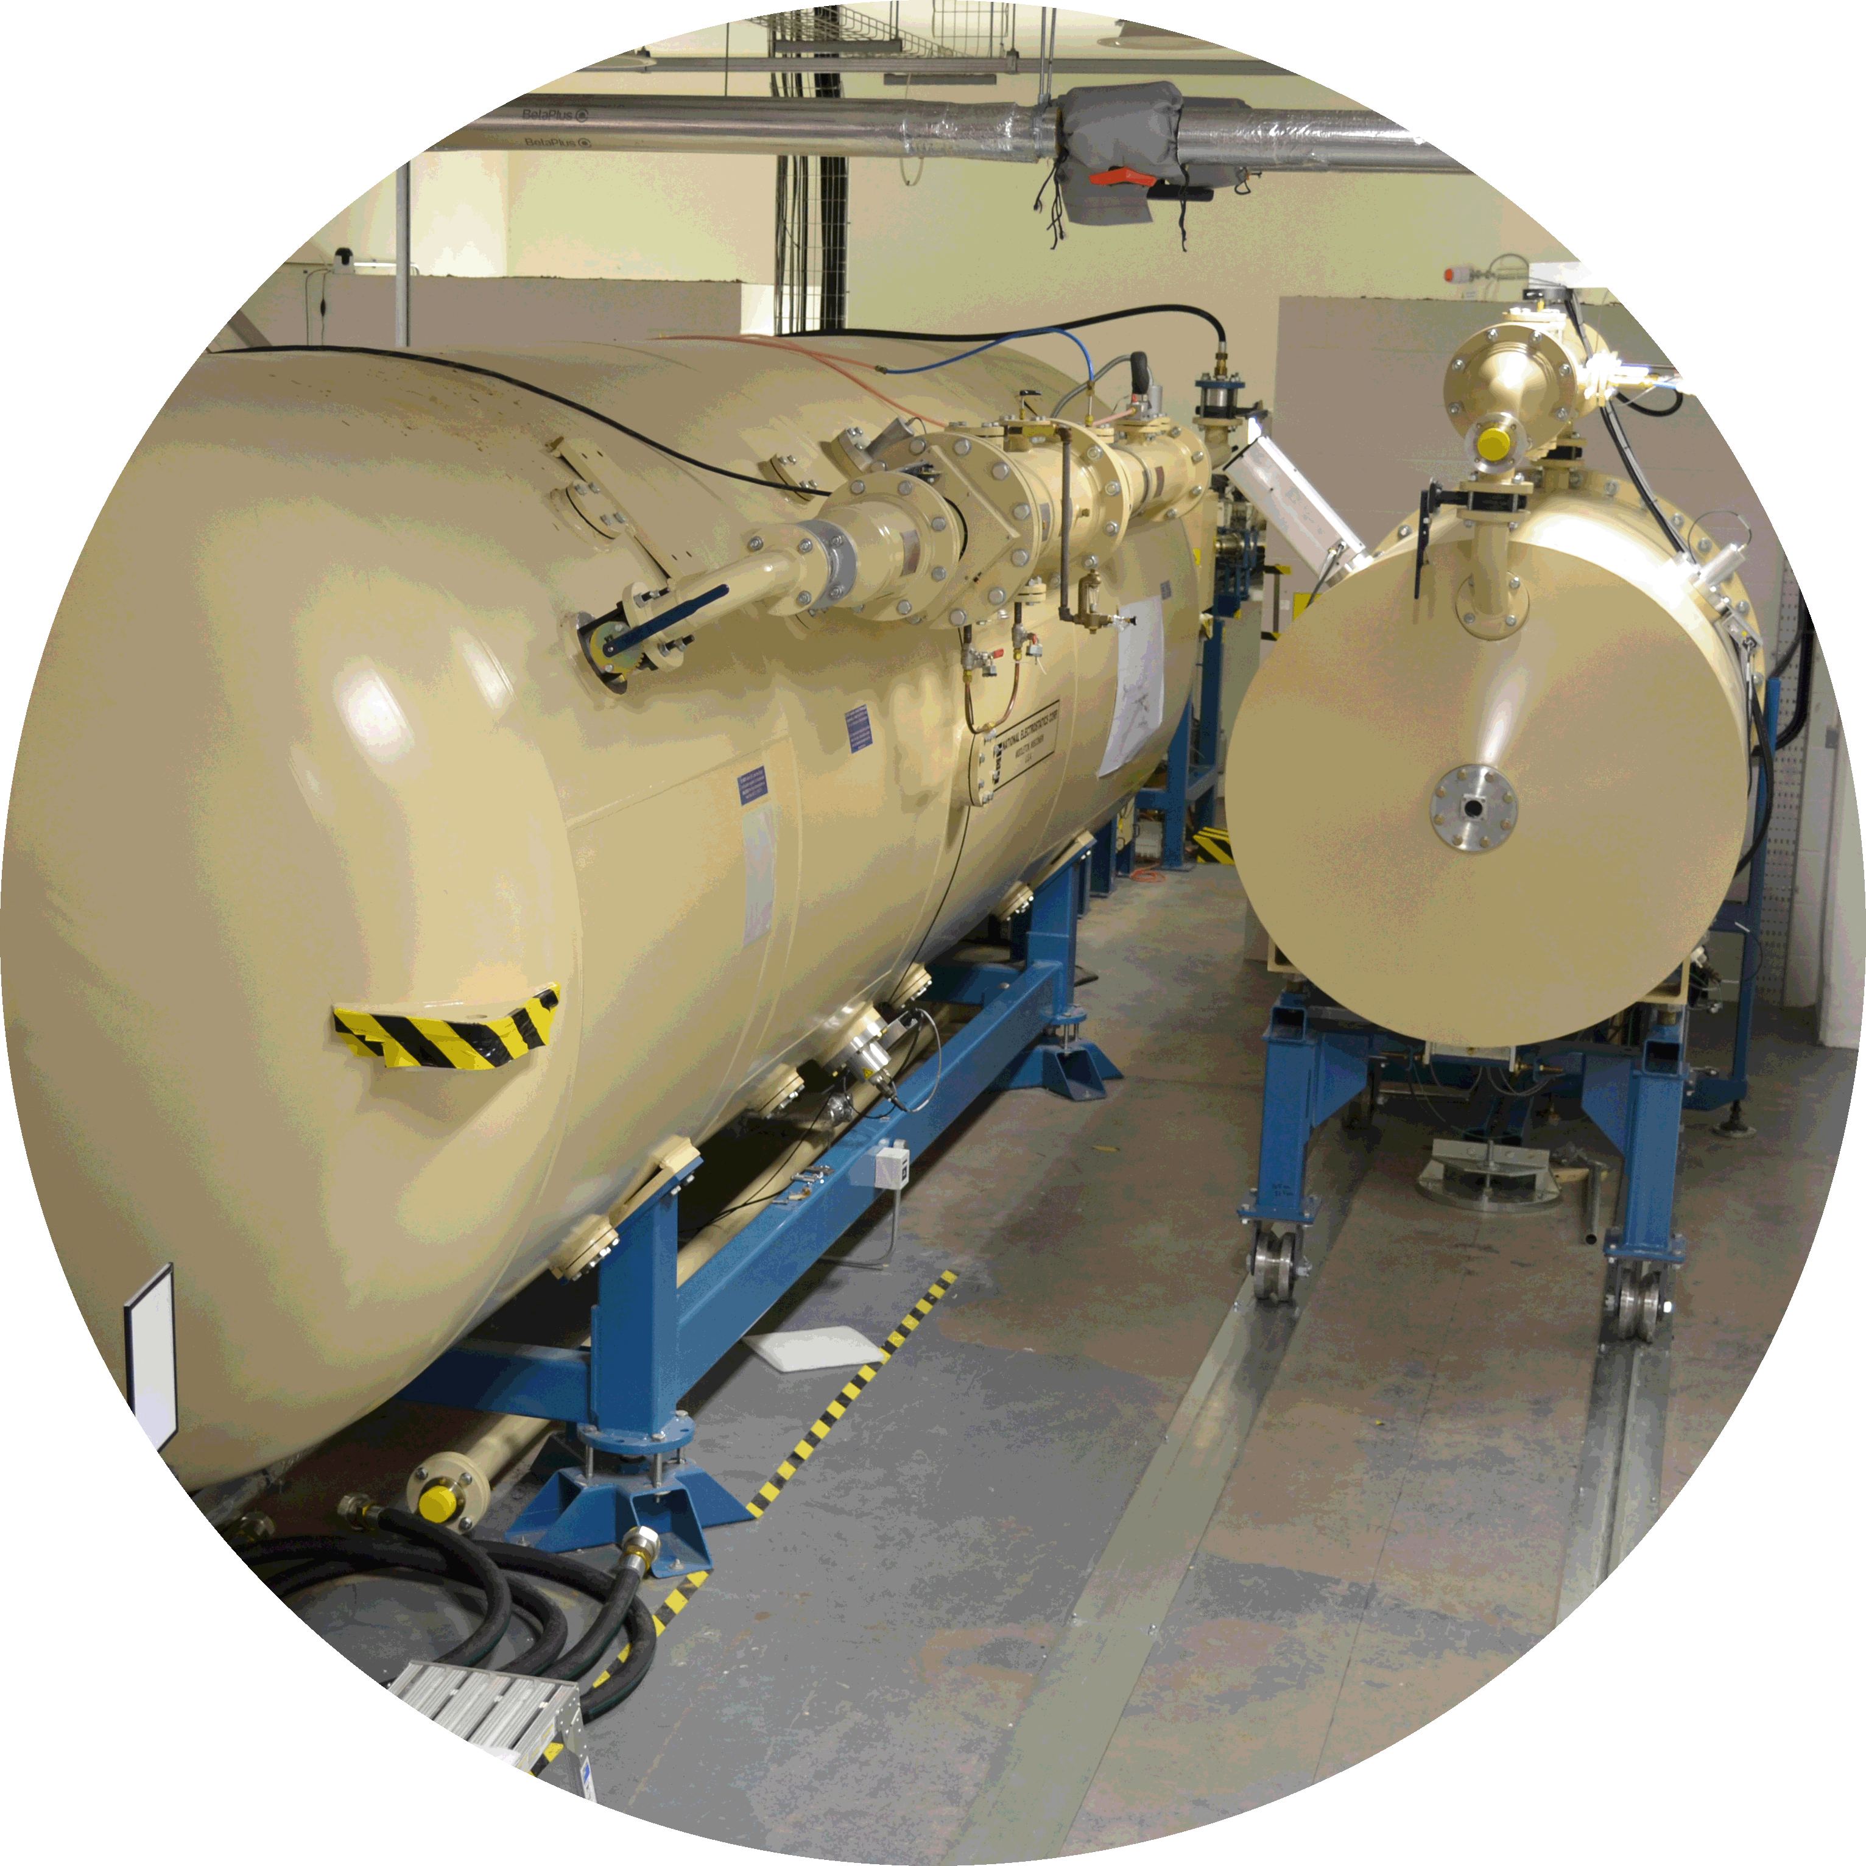
DCF Facilities
2 NEC Pelletrons
  5MV Tandem (15SDH-4)
  2.5MV Single (7.5SH-2)
3 Ion sources
  TORVIS – high current proton & alpha
  SNICS – heavy ion source
  RF – gas plasma source (p, He, Ar, Kr, Xe)
6 Beamlines

Slide 6
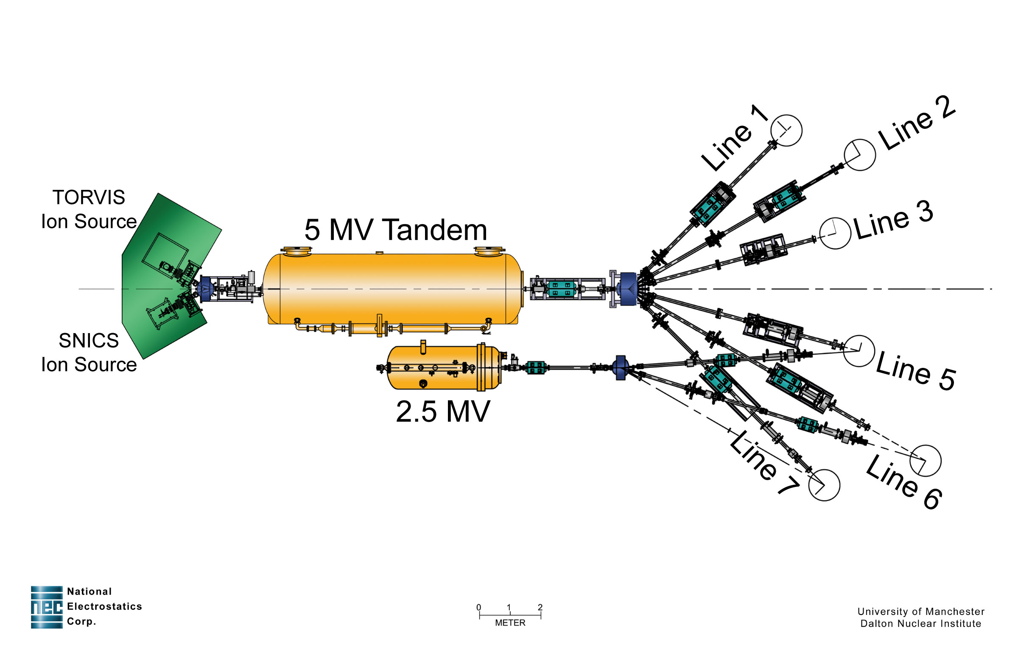
‘6’ Beamlines
Line 1 – Hotcell for high proton dose radiation damage
Line 2 – Radiation chemistry with autoclaves
Line 3 – Flexible Radiation chemistry
Line 5 – Radiation Damage
Line 6 – Radiation Damage
Line 7 – IBA (PIXE, RBS, ERD, NRA)

Slide 7
Need for Time-Resolved Technique
Problem: Characterisation of all irradiated systems at DCF is done “post-mortem” => early stage events remain obscure => a lot of mechanistic information is lost.
Solution: to do pulse radiolysis!

Slide 8
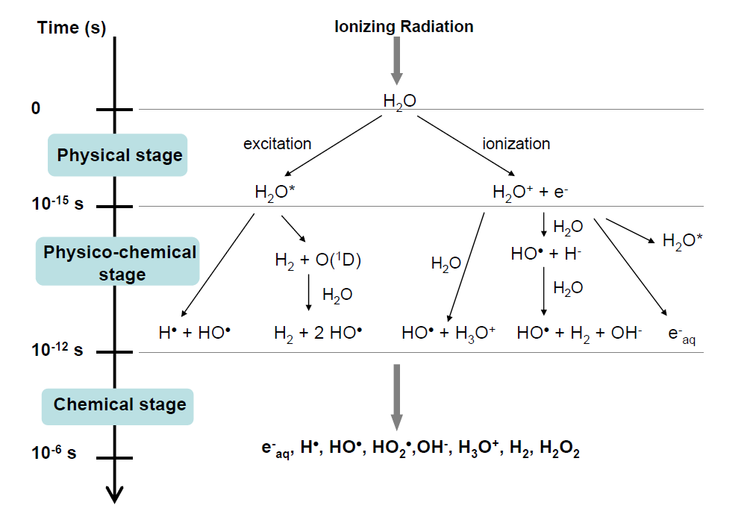

Existing Challenges in Radiation Chemistry
???
Well studied.

Slide 9

Pulse Radiolysis and Radiation Science
Primary species: identification and reactivity
Figure 1: Short-lived species in pulse radiolysis of water.
(e-)_{aq}: strong absorption band with l_{max} ~ 720 nm
Notes:
XPS X-ray photoelectron spectroscopy

Slide 10
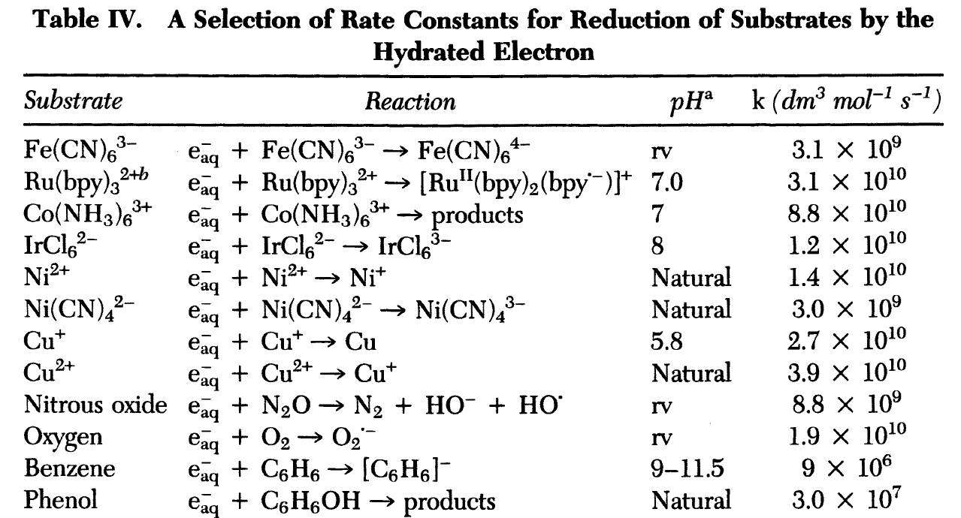
Pulse Radiolysis and Radiation Science
Kinetics and mechanisms of reactions
Diffusion-controlled reactions (or slower) – ns time resolution is sufficient.
Notes:
XPS X-ray photoelectron spectroscopy

Slide 11
Pulse Radiolysis and Radiation Science
Secondary intermediates & reaction mechanisms
H₂O → (e-)_{aq} + (H+)_{aq} + .OH + H. + H₂ + H₂O₂
Scavenging to produce secondary radicals:
e_{aq}⁻ + N₂O → N₂ + O^{·-} (a1)
O^{·-} + H₂O → ·OH + OH⁻ (a2)
e_{aq}⁻ + S₂O₈²⁻ → SO₄^{·-} + SO₄²⁻ (b)
·H/·OH + HCO₂⁻ → H₂/ H₂O + CO₂^{·-} (c)
Notes:
XPS X-ray photoelectron spectroscopy

Slide 12
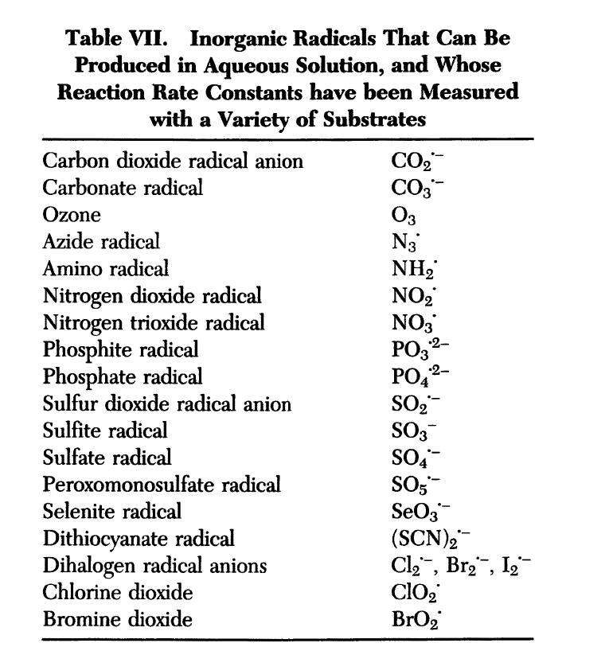
Pulse Radiolysis and Radiation Science:
Secondary intermediates & reaction mechanisms
Notes:
XPS X-ray photoelectron spectroscopy

Slide 13
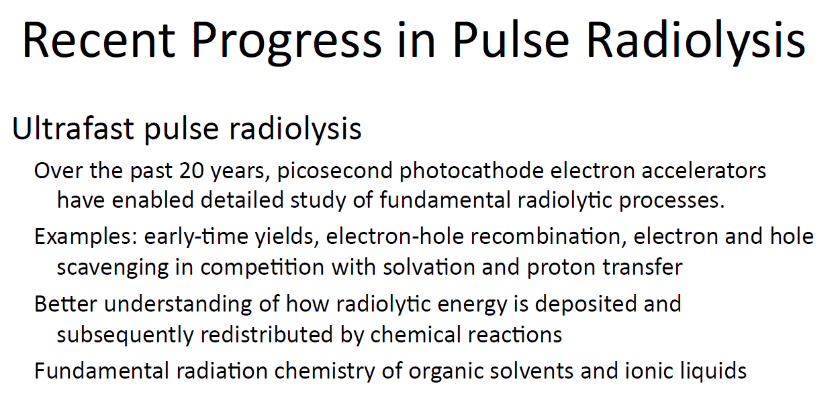
CREDIT: J. Wishart’s ICARST 2017 talk

Slide 14
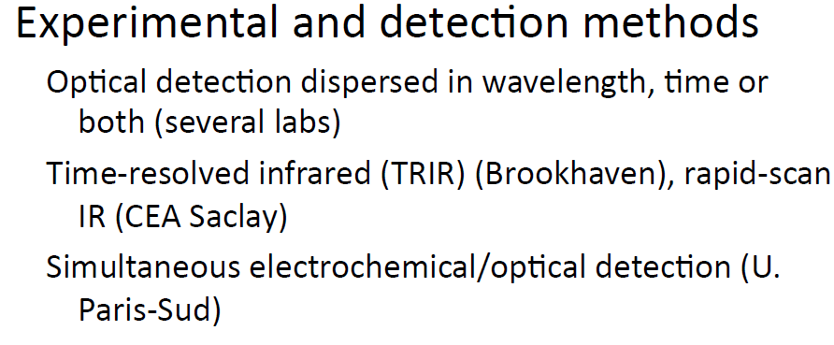
CREDIT: J. Wishart’s ICARST 2017 talk

Slide 15
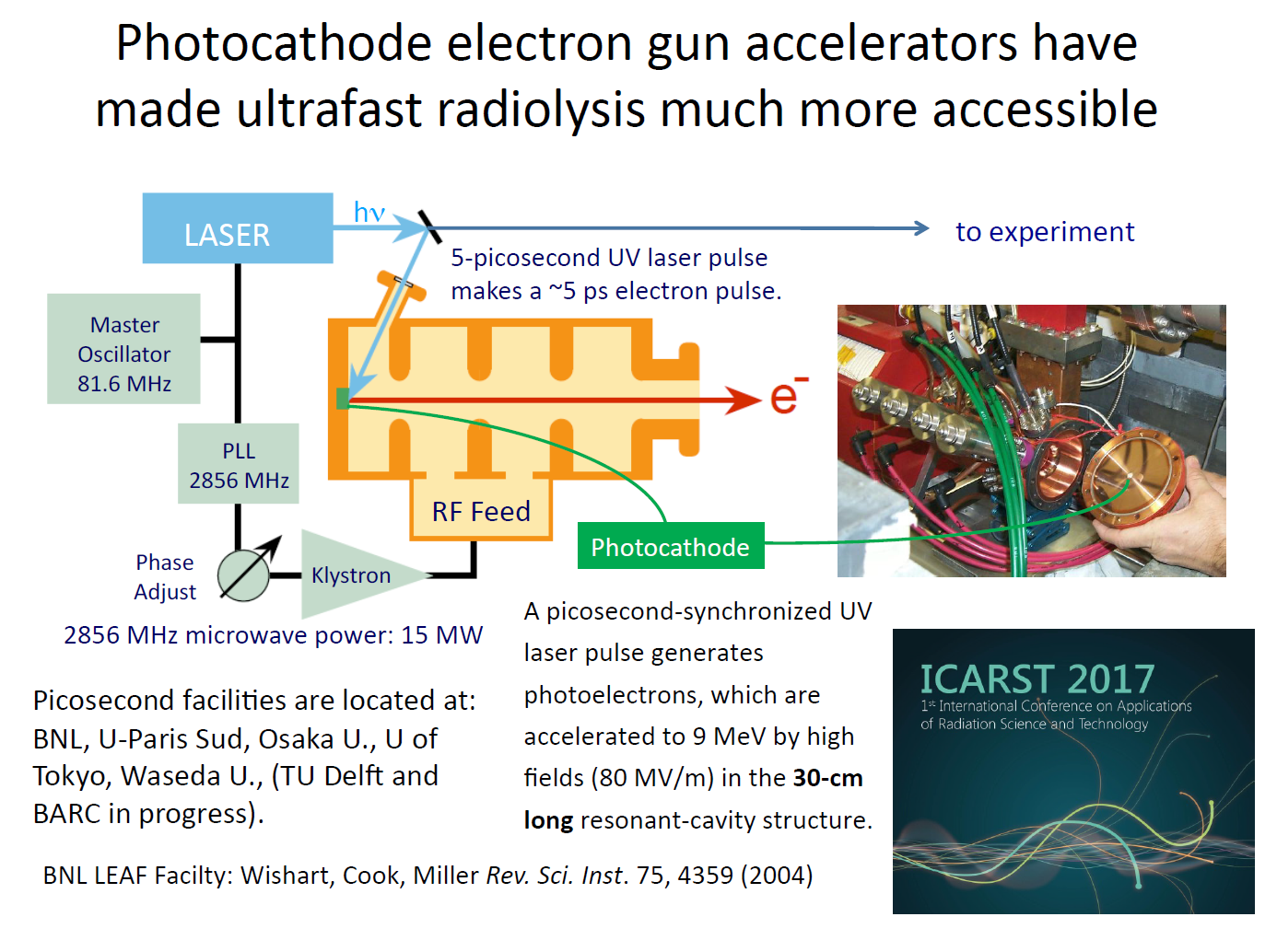
CREDIT: J. Wishart’s ICARST 2017 talk

Slide 16
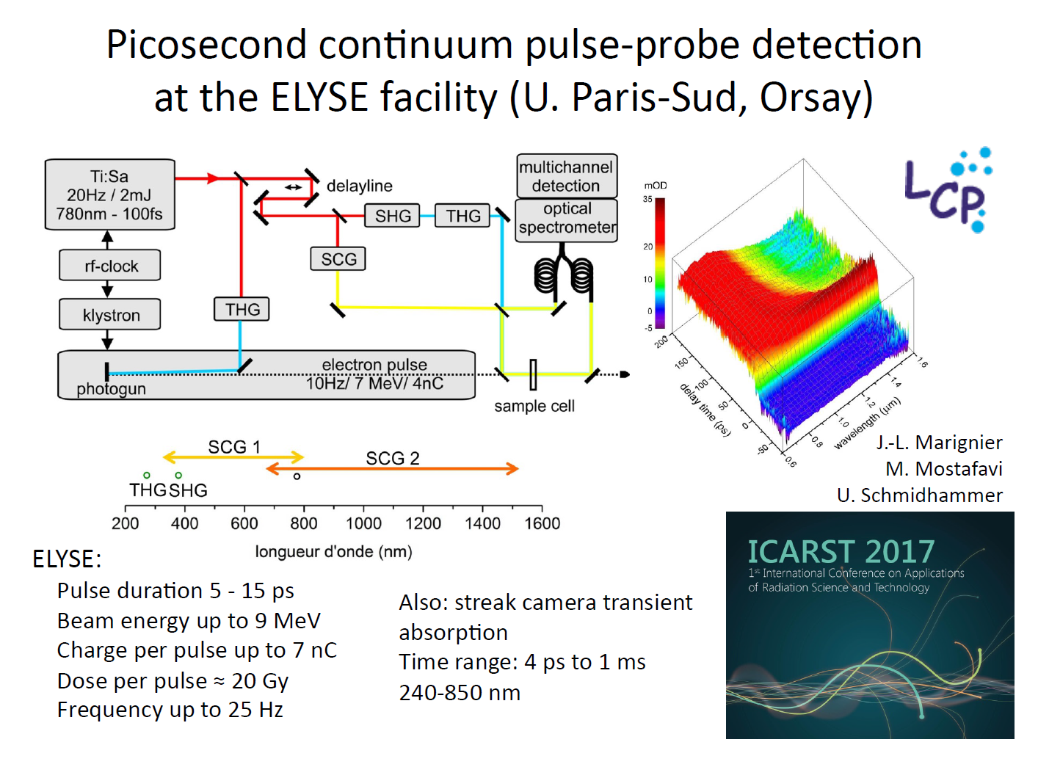
CREDIT: J. Wishart’s ICARST 2017 talk

Slide 17
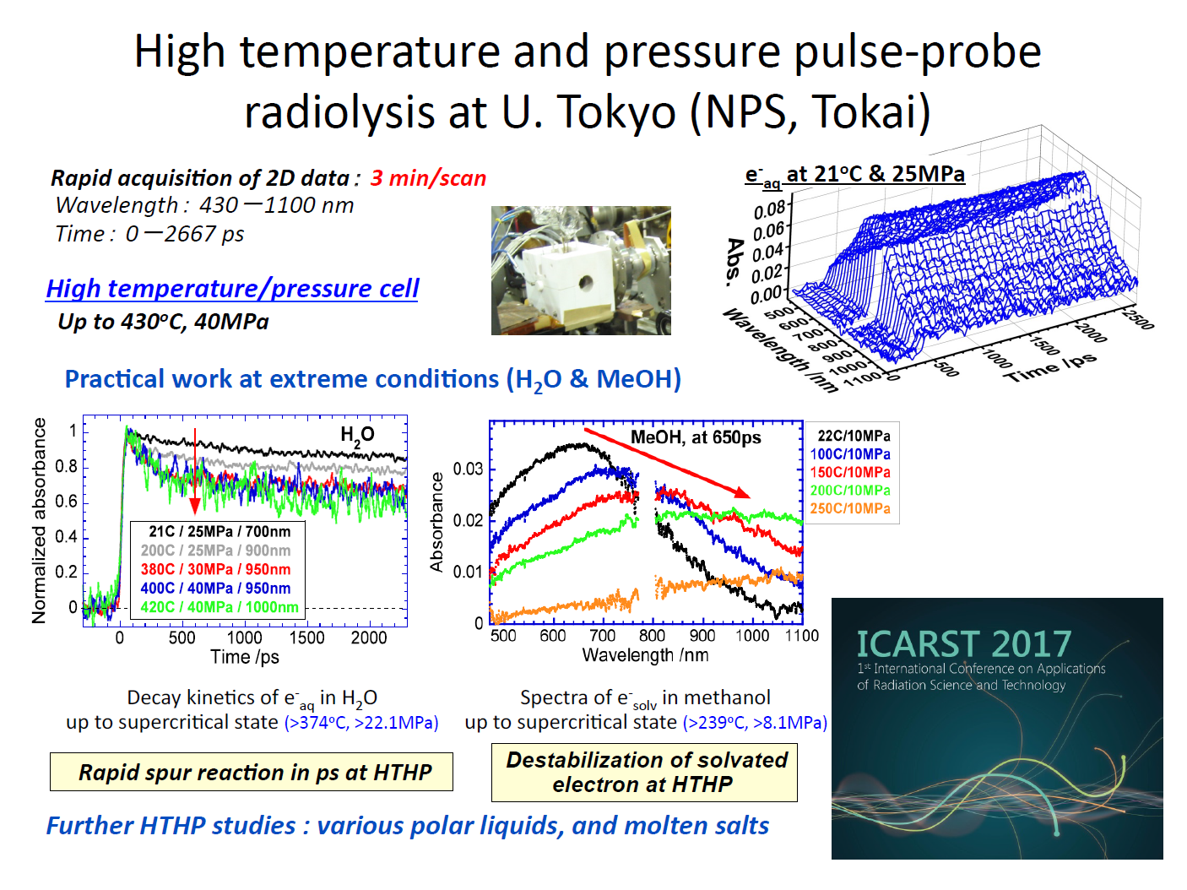
CREDIT: J. Wishart’s ICARST 2017 talk

Slide 18
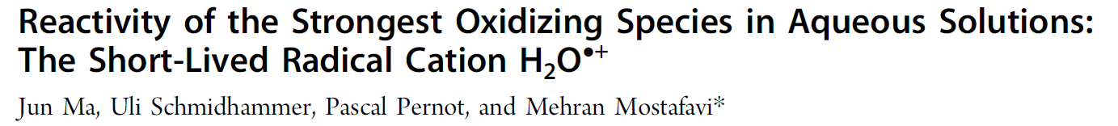
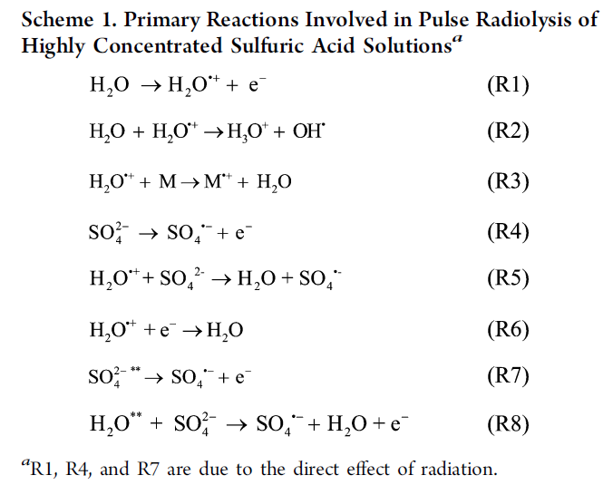
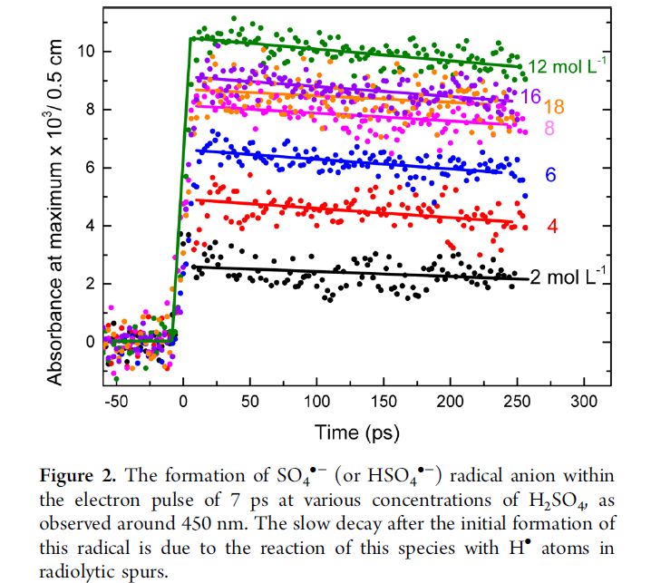


Slide 19
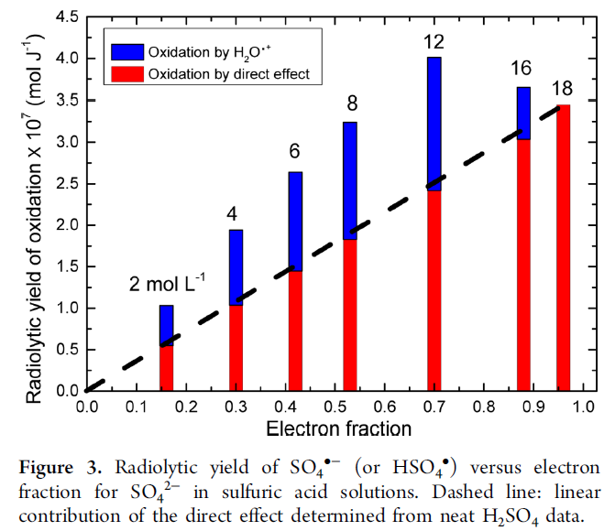
Conclusion: Direct oxidation by H₂O^{•+}
might of importance to:
Radiotherapy and radiobiology
PUREX process
Interfaces in waste forms
Radiation-induced corrosion

Slide 20
Ultra-fast electron-driven radiation chemistry in aqueous environments

Slide 21
Ultra-fast electron-driven radiation chemistry in aqueous environments
A pump-probe experiment aiming at observing the time-dependence of creation of electrons (ionisation) and their subsequent solvation in a range of water-based samples. Calculations suggested the signal should be clearly visible with the available beam parameters. However, despite trying a wide range of samples, alignments and technique variations, no such signal was observed.

Slide 22

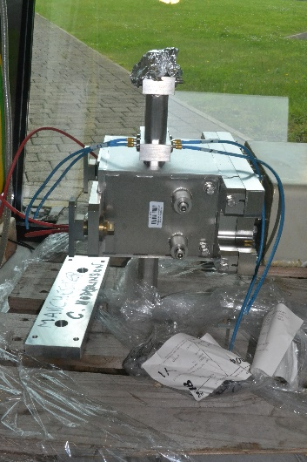
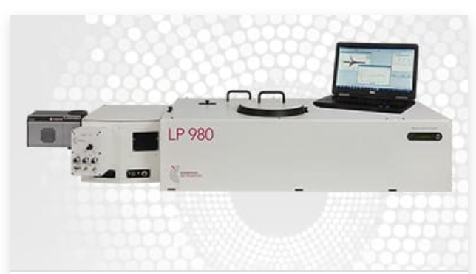
Beamline upgrades
70 ns pulses – light ions + neutrons
Donation, beam kicker Daresbury
Transient absorbance spectrometer
Henry Royce Institute funded

Slide 23
Conclusion
Radiation scientists in the UK need domestic ultra-fast (and even ns!) pulse radiolysis capability;
Scientific quality of existing research projects in radiation chemistry would benefit from direct studies of non-homogenous and ultra-fast chemistry:
Radiation synthesis of metal nanoparticles (NP) in solutions;
Metal NP in radiotherapy;
Radiation chemistry of nuclear fuel recycle (high concentrations of solvents);
Radiation chemistry of nuclear waste (extensive interfaces);
Biological systems (damage to DNA).
Pulsed proton source at DCF: to be developed.
Ultra-fast experiments with electron beams at CLARA.

Slide 24
Acknowledgements
Staff at CLARA:
David Dunning and other members of the team.
Team DCF:
  Fred Currell, Andrew Smith, Ruth Edge, Mel O’Leary

Slide 25
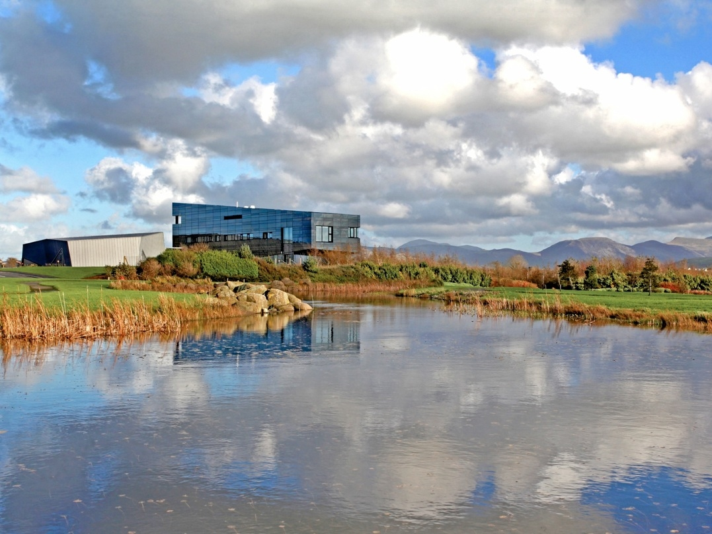
Thank You!
Aliaksandr.baidak@manchester.ac.uk
www.dalton.manchester.ac.uk

