Slide 1
Investigation of fundamental properties of Cherenkov Diffraction Radiation at CLARA facility
Can Davut, Kirill Fedorov, Pavel Karataev, Thomas Pacey, David Walsh

Slide 2
Content
Cherenkov Diffraction Radiation
Previous experiment at CLARA
Plan for experiment in March 2022
Results and discussion
  Impact parameter dependence
  Emittance measurements
Further analysis, simulations, and publications

Slide 3
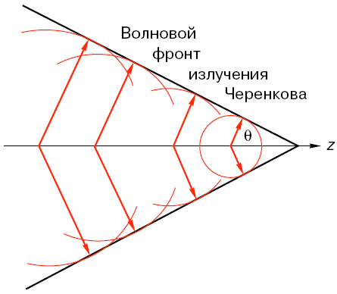
Cherenkov Radiation
Cherenkov Radiation is generated whenever the charged particle velocity is larger than the phase velocity of light
R(t)
O
z(t)

Slide 4
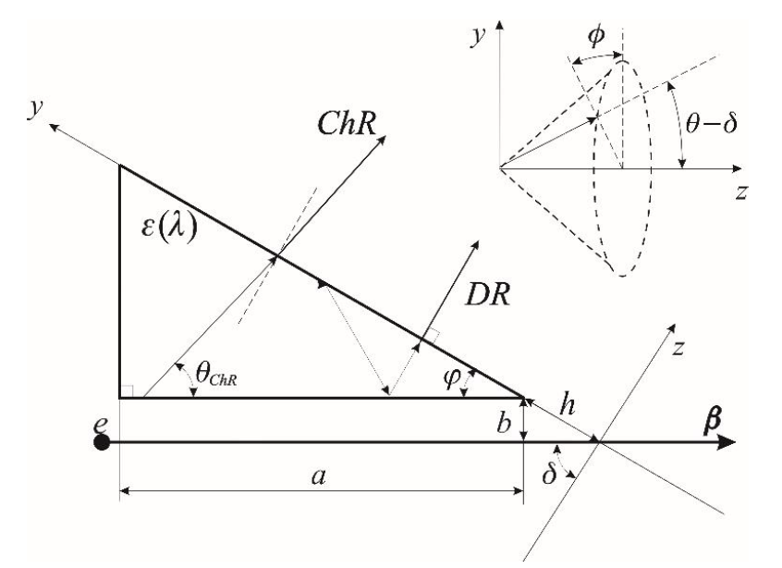
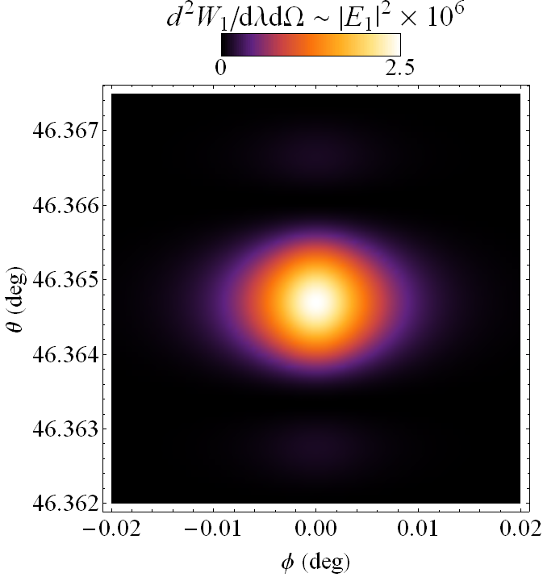
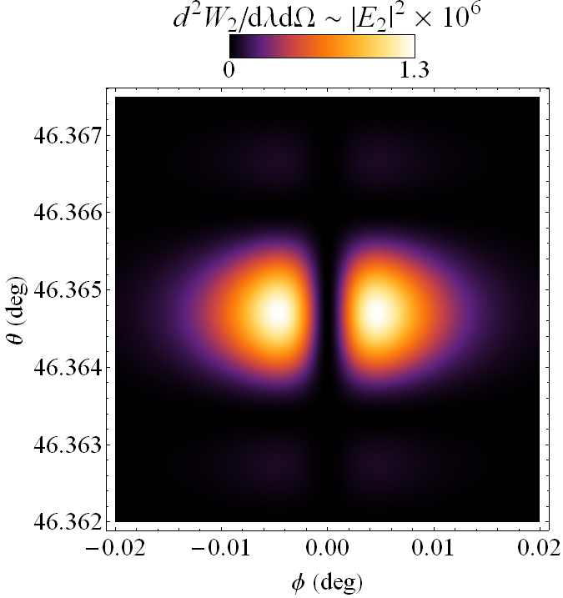
Cherenkov Diffraction Radiaiton
ChDR geometry
Vertical polarization
Horizontal polarization
Angular distribution

Slide 5
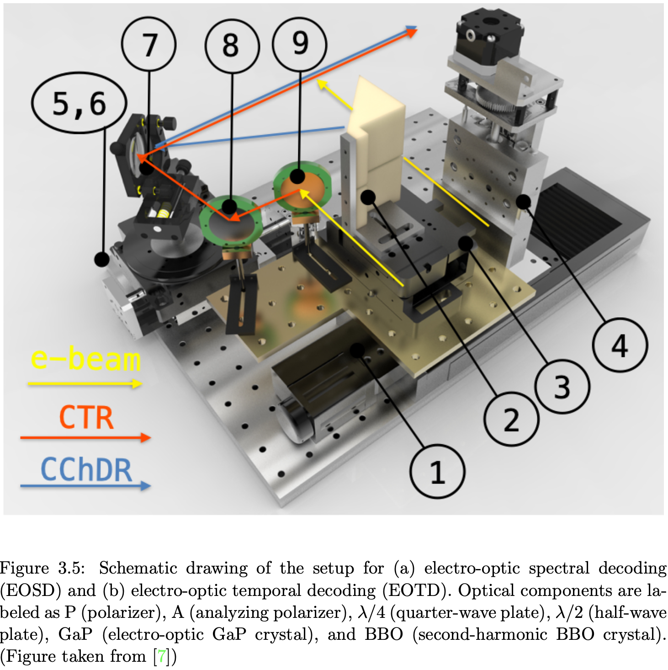
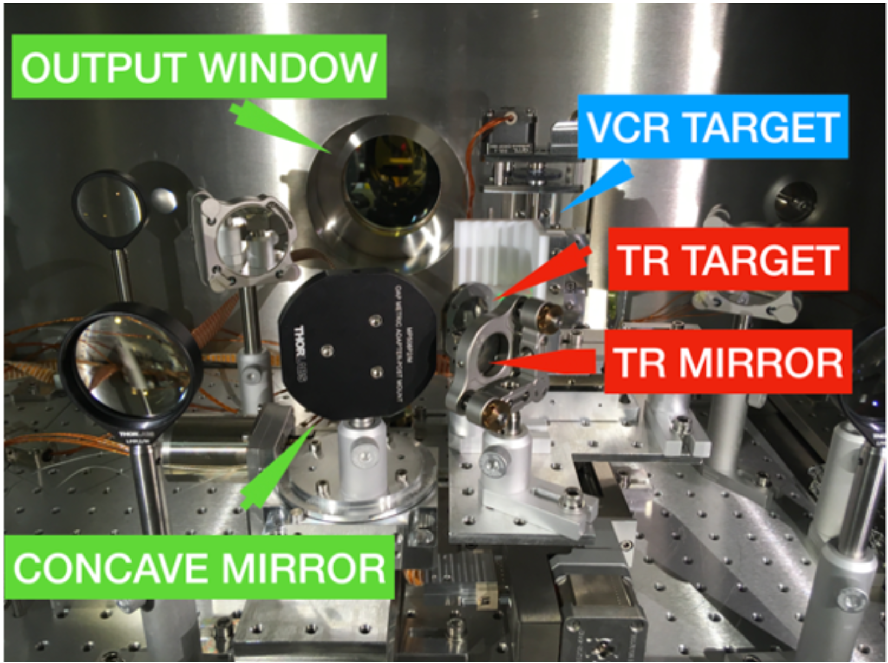
Experimental setup – in-vacuum part
1 — Horizontal positioning stage
2 — Teflon (VCR) target
3 — Tip-Tilt stage
4 — Vertical positioning stage
5 — Concave mirror
6 — Rotational stage
7 — Rotational stage 2
8 — TR mirror
7 — TR target

Slide 6
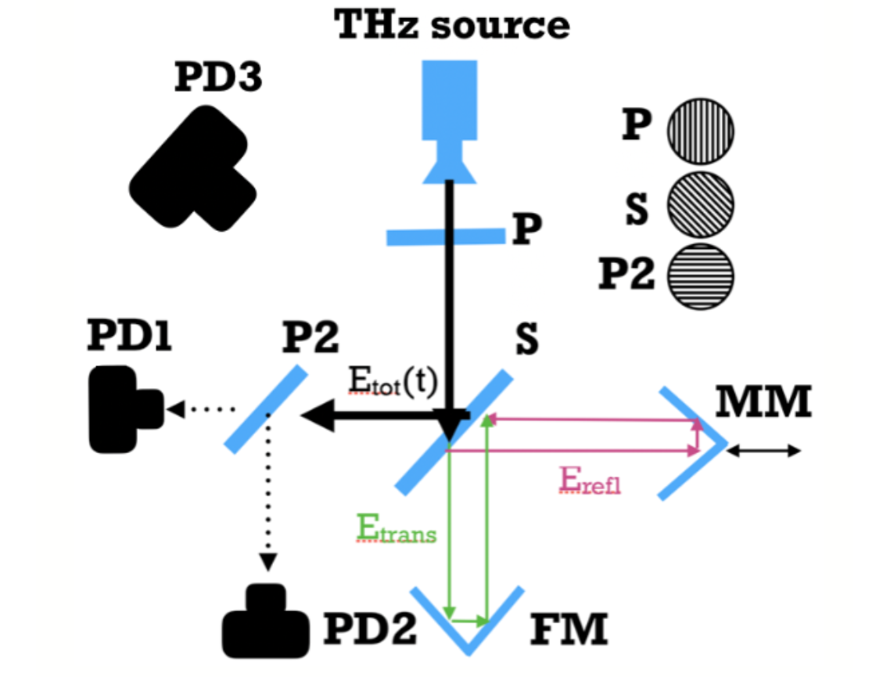
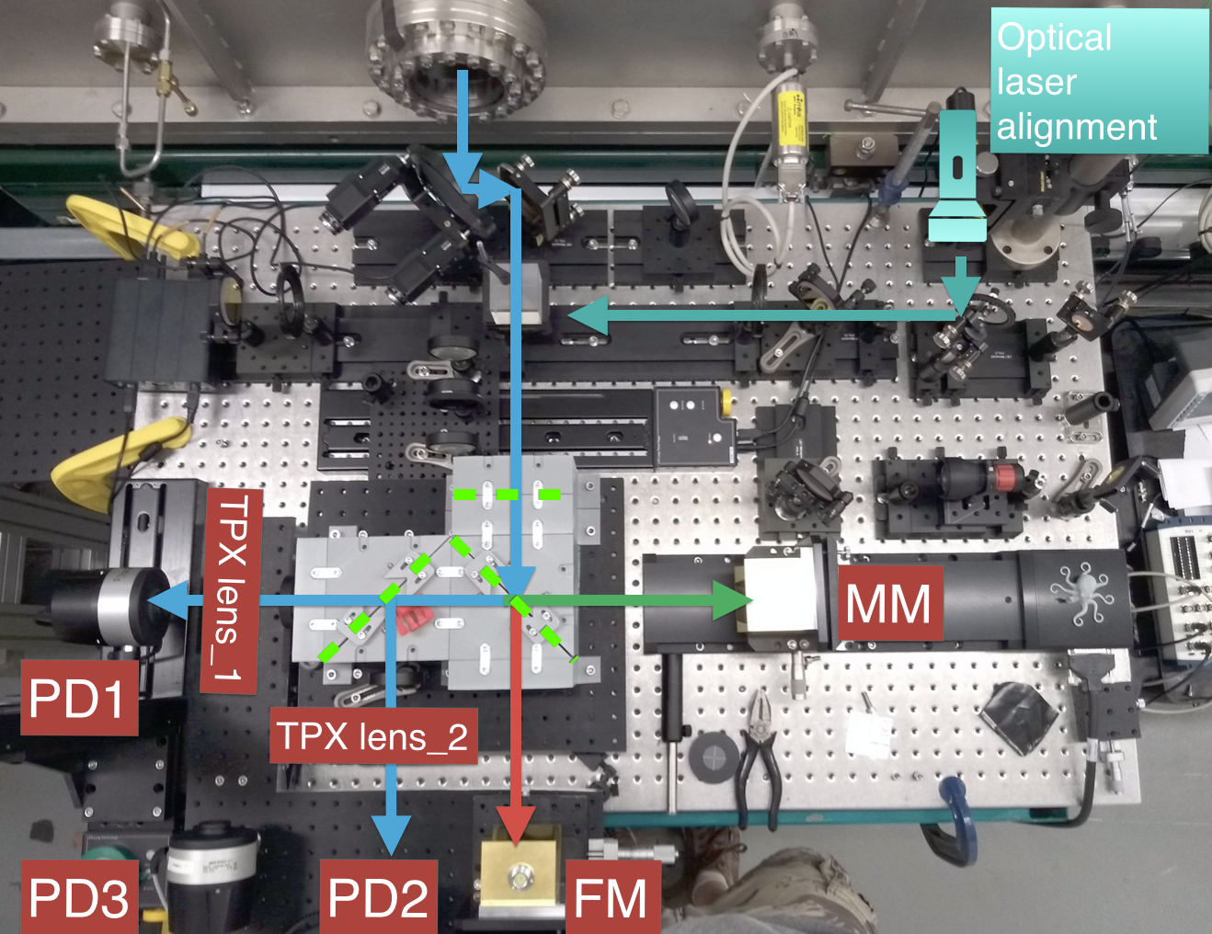
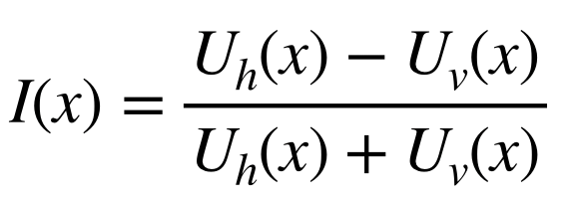
Experimental setup – Spectrometer
Martin-pupplet interferometer

Slide 7
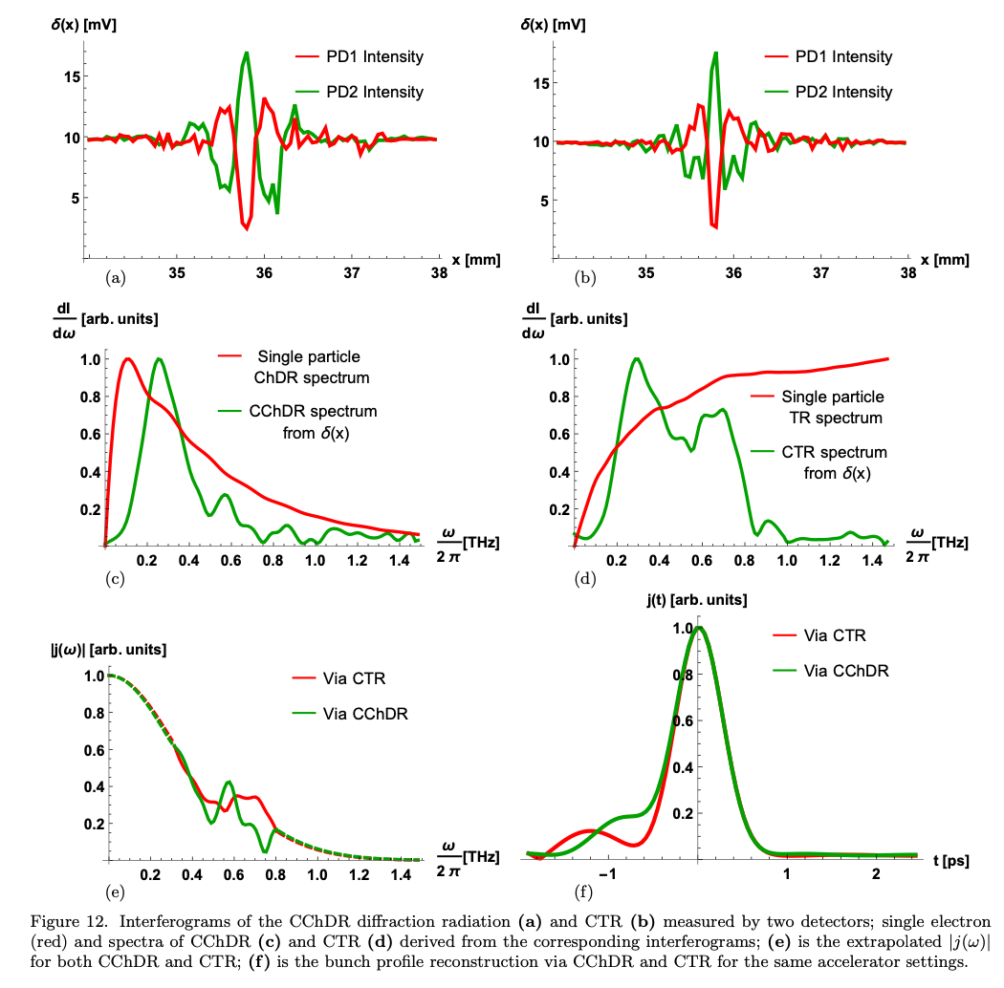
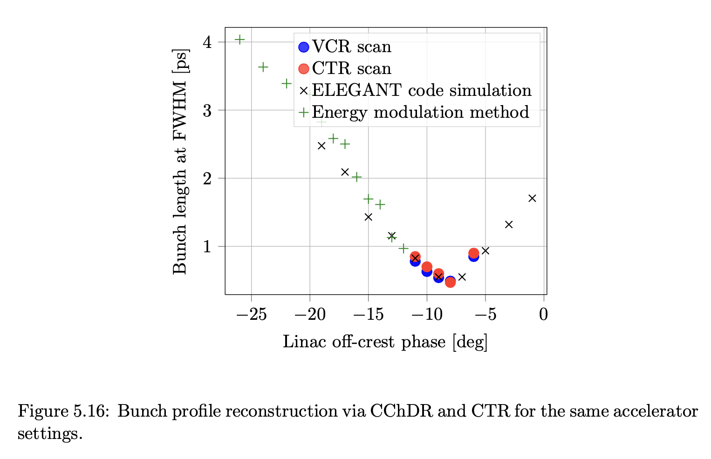
Experimental results

Slide 8
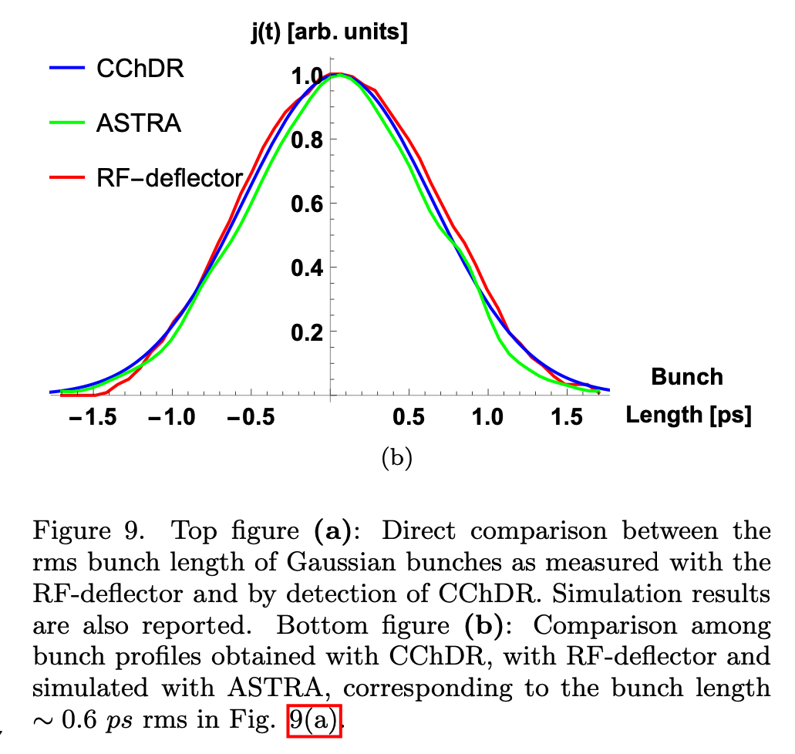
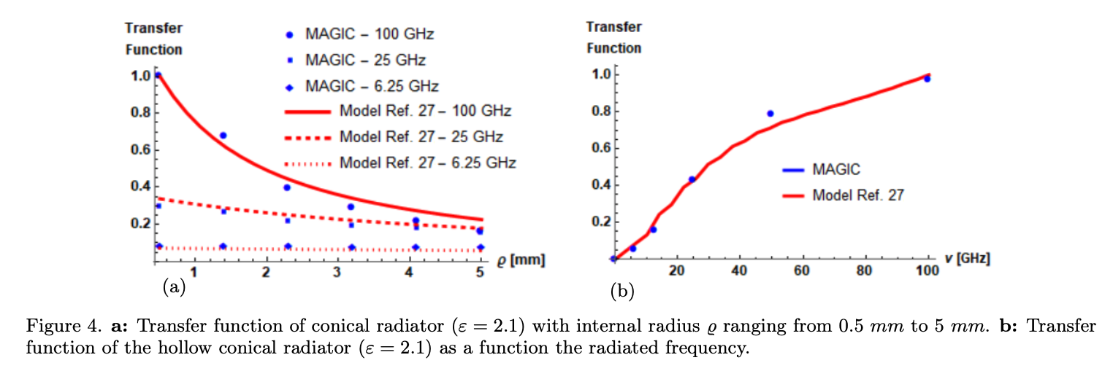
Publications and comparison with CLEAR experiment
Non-invasive beam instrumentation exploiting Coherent Cherenkov Diffraction Radiation
A. Curcio, M. Bergamaschi, R. Corsini, W. Farabolini, D. Gamba, L. Garolfi, R. Kieffer, T. Lefevre, S. Mazzoni, K. Fedorov, J. Gardelle, A. Gilardi, P. Karataev, K. Lekomtsev, T. Pacey, Y. Saveliev, A. Potylitsyn, and E. Senes, Noninvasive bunch length measurements exploiting Cherenkov diffraction radiation, Phys. Rev. Accel. Beams 23 (2020) 022802.
K. Fedorov, P. Karataev, Y. Saveliev, T. Pacey, A. Oleinik, M. Kuimova, and A.Potylitsyn, Development of longitudinal beam profile monitor based on Coherent Transition Radiation effect for CLARA accelerator, Journal of instrumentation, JINST 15 C06008 (2020)

Slide 9
Experimental plan for this run
Measurement of fundamental properties
  Dependence on impact parameter
  2D angular distribution
    Essential for alignment of the target and mirror wrt to the particle beam
    Direct the radiation precisely out of the vacuum chamber to deliver on the EO crystal
EO spectral measurements of CChDR
Investigation of the beam emittance dilution in the presence of ChDR target
Resonant CChDR

Slide 10
Experimental plan for CLARA

Slide 11
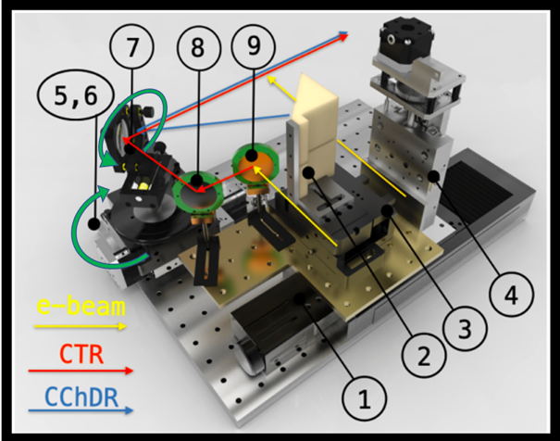
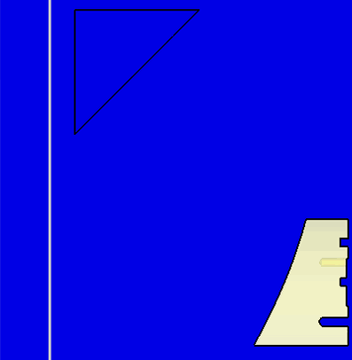
Modified experimental setup
1 — Horizontal target positioning stage
2 — Teflon ChDR target
3 — Target platform
4 — Vertical vertical positioning stage
5 — Off axis (45⁰) parabolic mirror
6 — Rotational stage (𝛉-angle)
7 — Rotational stage (𝛗-angle)
8 — steering mirror
9 — scintillator screen for beam measurement
To
detector

Slide 12
Charge dependence
c = 2.38 ± 0.54

Slide 13
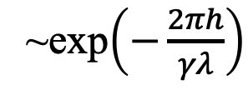
Impact parameter dependence
~exp$\left(−\frac{2πh}{γλ}\right)$

Slide 14
2D Angular distribution measurement

Slide 15
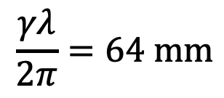
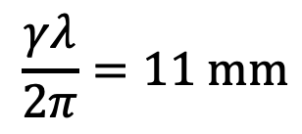

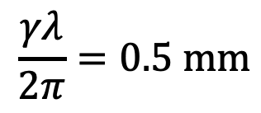
Comparison of target parameters for different facilities
We have observed a fast reduction of intensity at:
CLARA: W = 40 mm (±20 mm)
CLEAR: W = 100 mm (±50 mm) diameter?
Diamond LS: W = 2 mm (±1 mm)
For 𝝀 = 1 mm, 𝜸 = 70;
$$\frac{γλ}{2π}=11 \text{mm}$$
For 𝝀 = 1 mm, 𝜸 = 400;
$$\frac{γλ}{2π}=64 \text{mm}$$
For 𝝀 = 0.5 𝝁m, 𝜸 = 6000;
$$\frac{γλ}{2π}=0.5 \text{mm}$$
But, we have not observed it at Cornell: W = 10 mm (±5 mm)
For 𝝀 = 0.5 𝝁m, 𝜸 = 4200;
$$\frac{γλ}{2π}=0.33 \text{mm}$$

Slide 16
Radiation suppression hypothesis

Slide 17
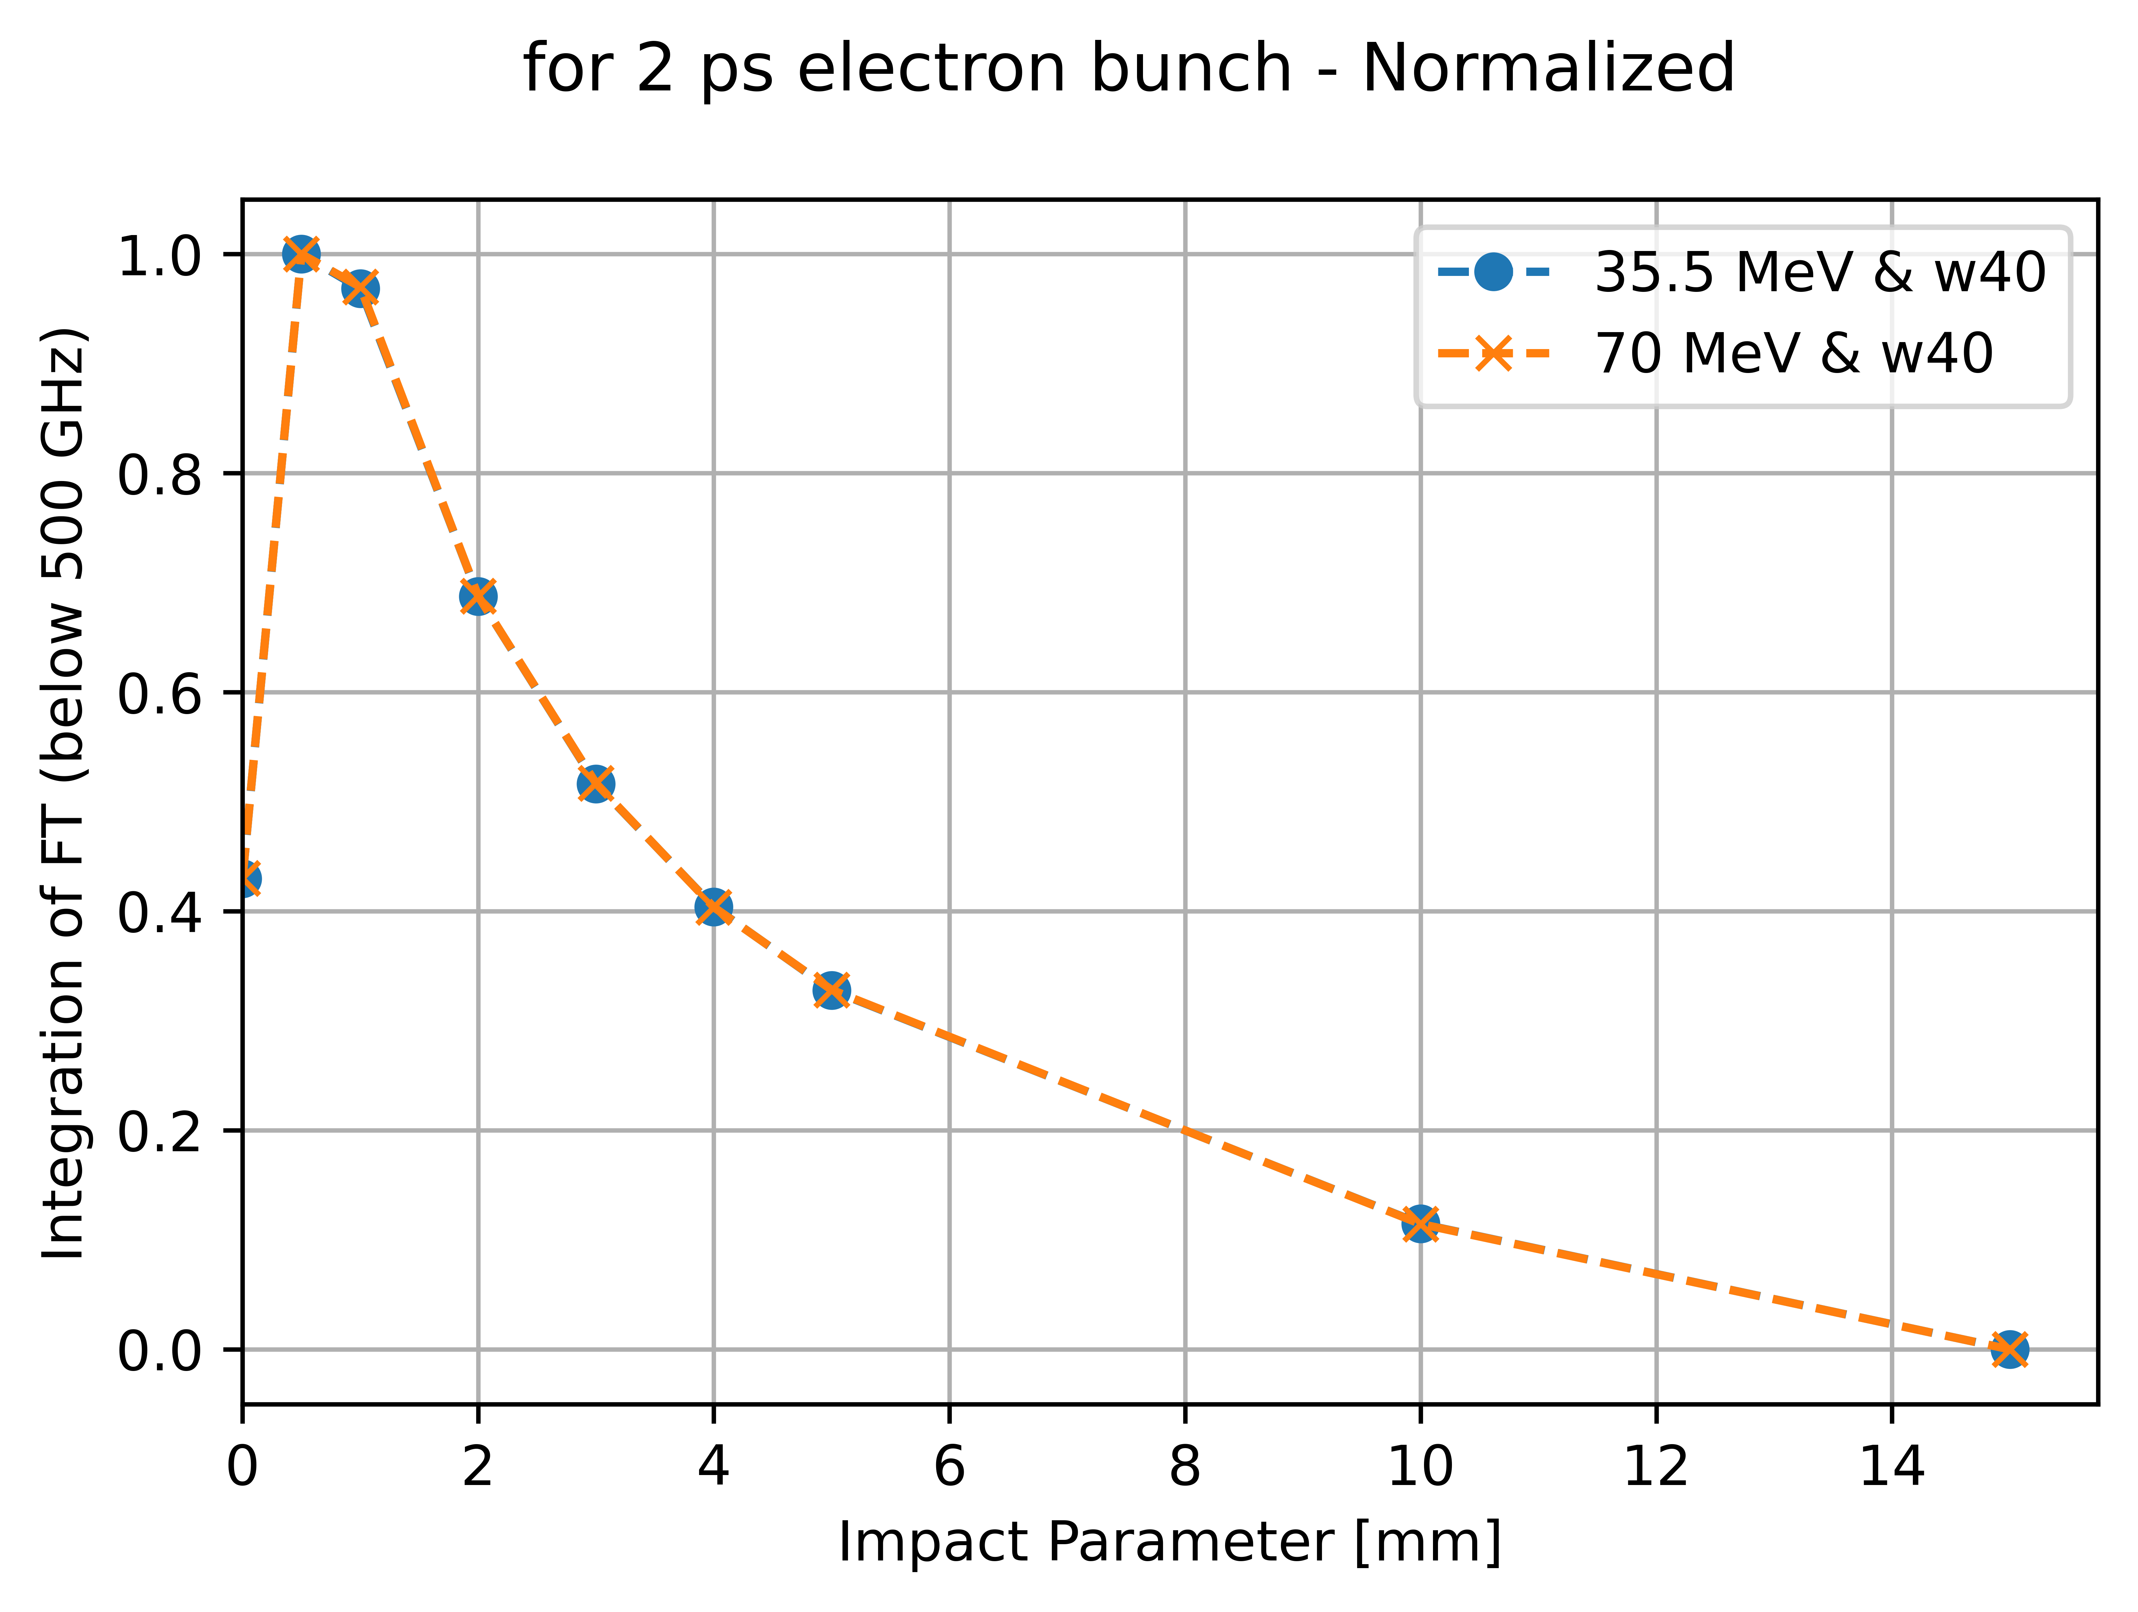
CST (PIC) Simulations
Aim : Simulations performed to double check energy dependence of ChDR intensity

Slide 18
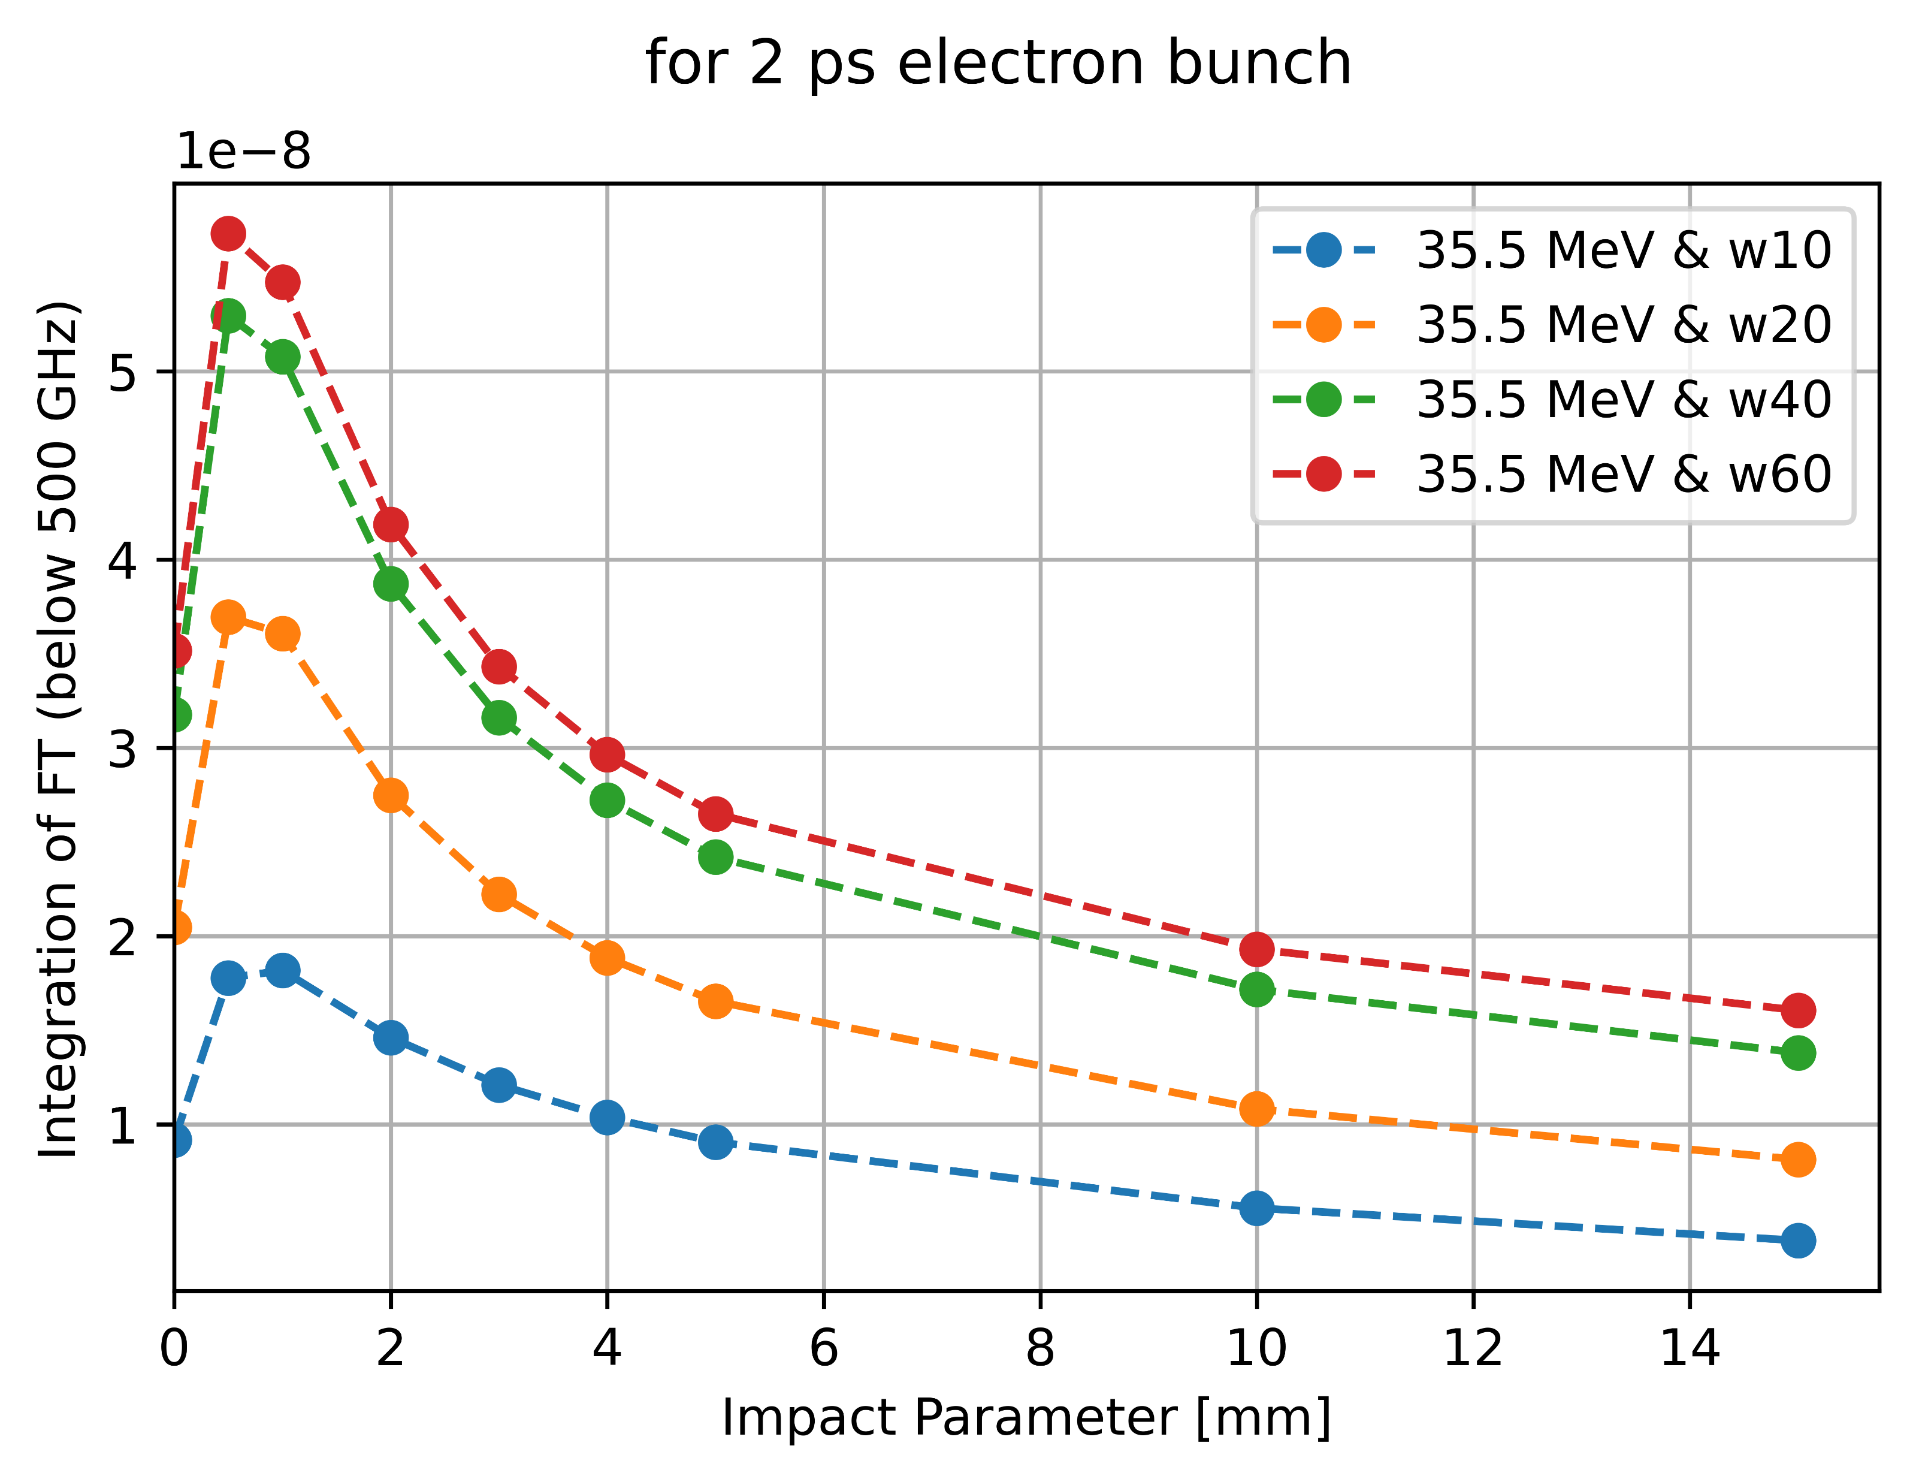
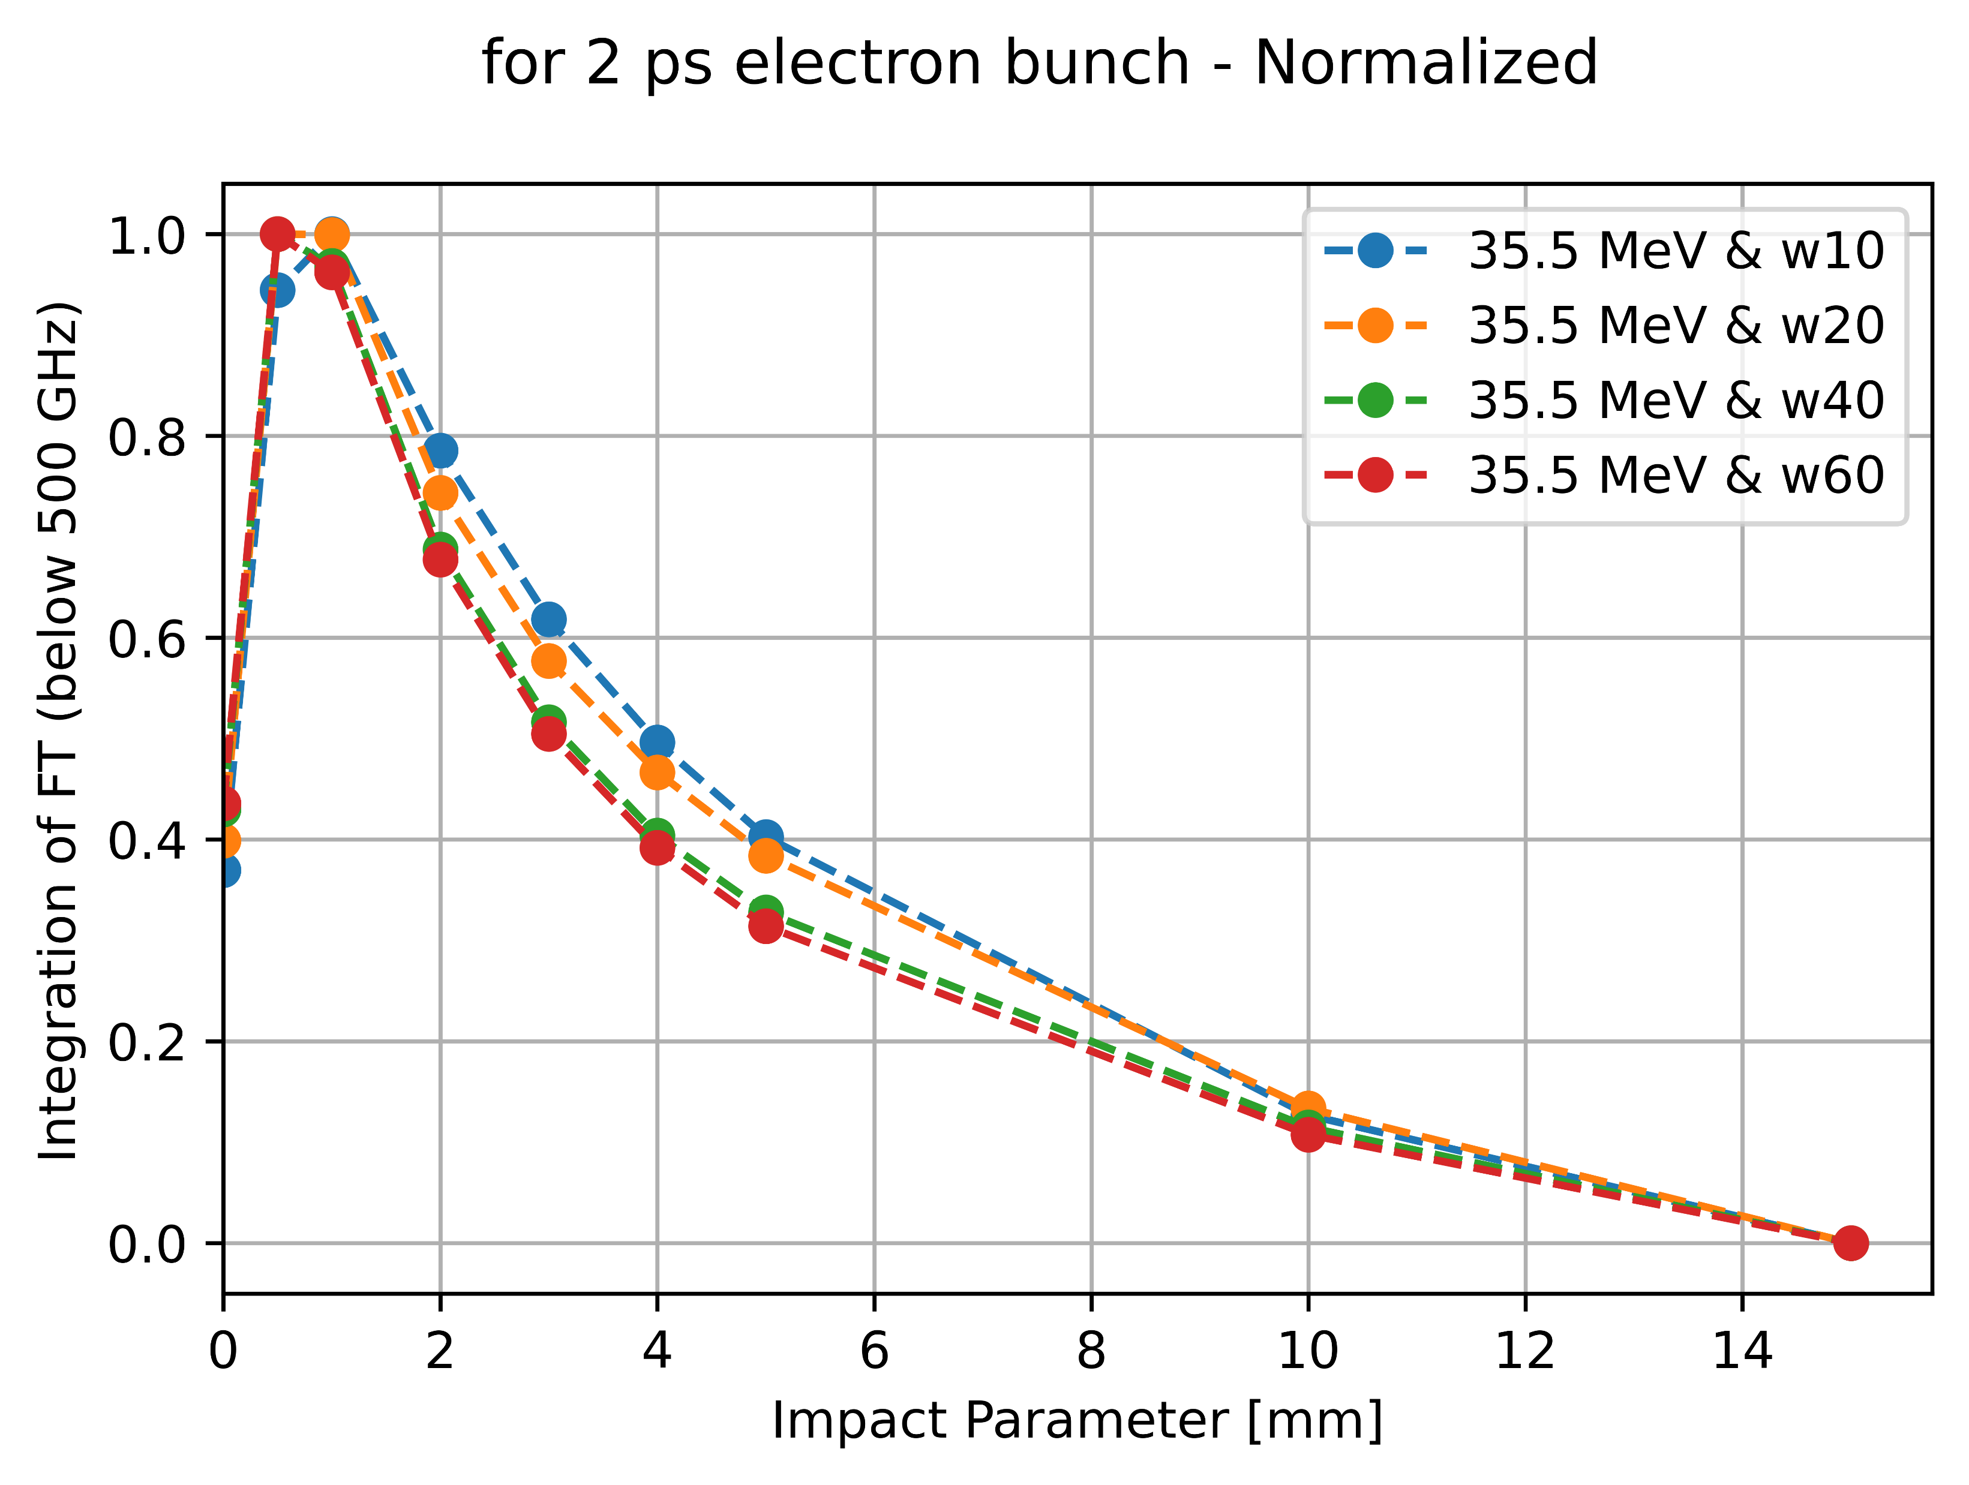
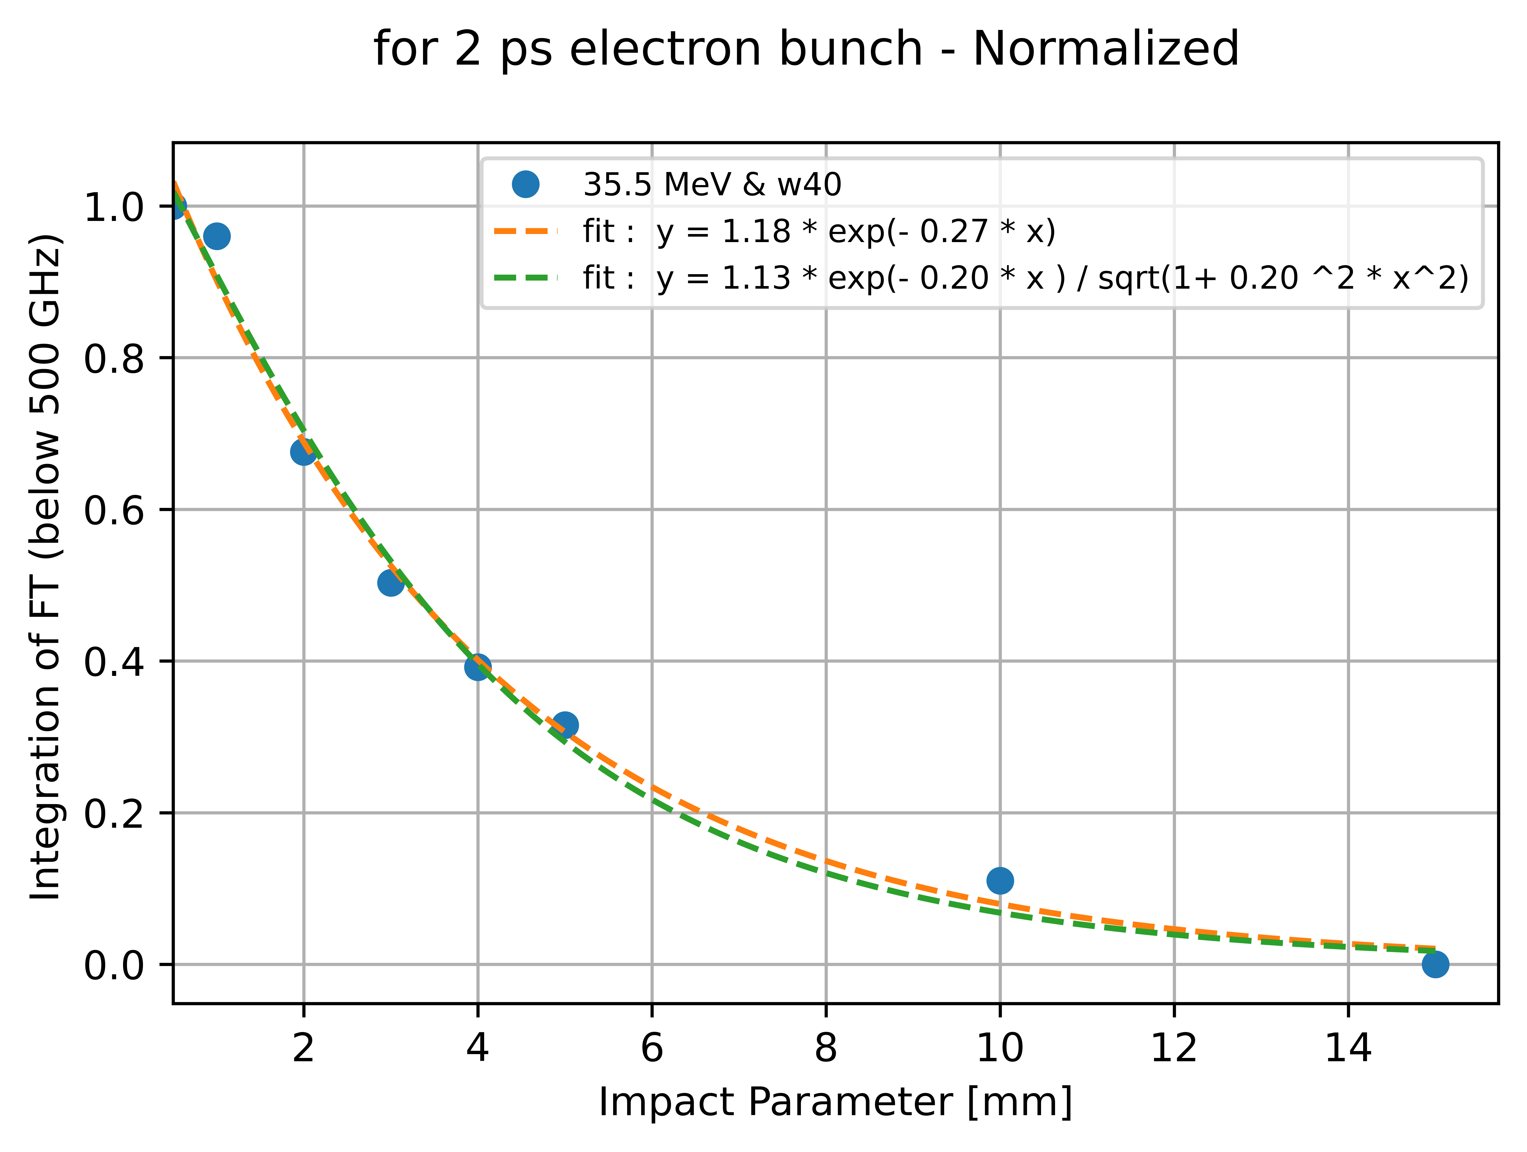
CST (PIC) Simulations
Aim : Simulations performed to double check experimental results (Experimental data shows a decay in the ChDR intensity faster than an exponential decay)
E-field signal through the face defined measured and Fourier transform of each signal calculated and integrated up to 500 GHz
Impact parameter scan for different radiator widths
Impact parameter scan for different radiator widths - Normalized
Fit for 40 mm radiator width – the one used in experiment

Slide 19
Particle deflection due to ChDR target

Slide 20
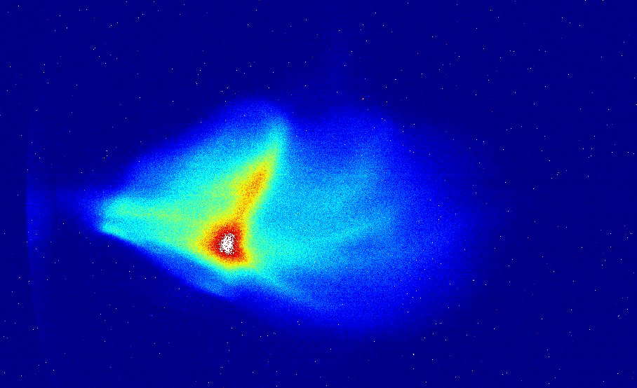
Particle deflection due to ChDR target

Slide 21
Emittance and angular deflection
Emittance measured using slit method
Angular deflection

Slide 22
Summary
The height of the target
  Has to be taken into account for radiator optimization;
  For BPMs this might be an advantage due to better sensitivity to the beam position;
  Intensity can be increased by increasing the length of the radiator.
Wakefield attraction
  Has to be investigated in details;
  A possible solution is a thin radiator to minimize coherent effects.

Slide 23
Future Work
Emittance dilution
  Simulations have begun;
  Wakefield attraction needs to be understood for practical applications;
  A publication is planned.
Impact parameter dependence
  Experiment, simulations, and theory return different result;
  Fast decay might be useful for beam position measurement;
  EO data analysis will provide additional details for understanding;
  High impact publication is planned.
Synergy with other experiments
  AWAKE bunch length monitor and BPM;
  Diamond LS ChDR in-dipole BPM;
  Generation of intense THz radiation beams using stimulated coherent ChDR mechanism at Candle, DAFNE, LUCX, etc.

Slide 24
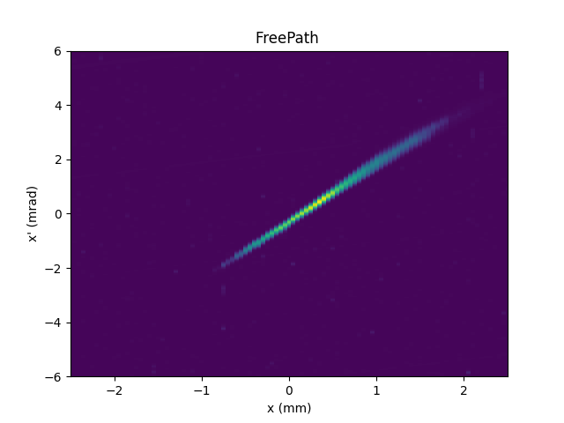
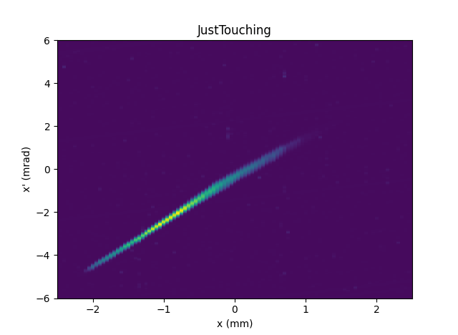
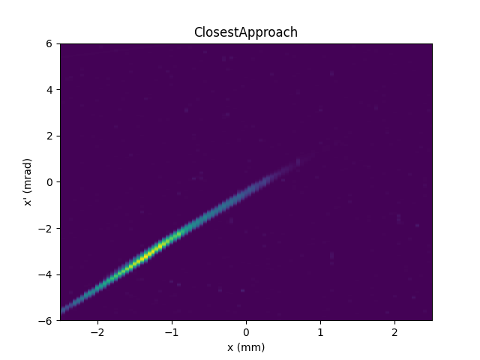
Phase-space measurements using slit method

Slide 25
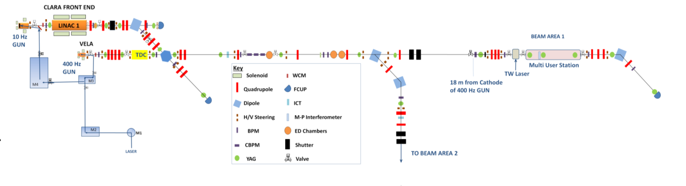
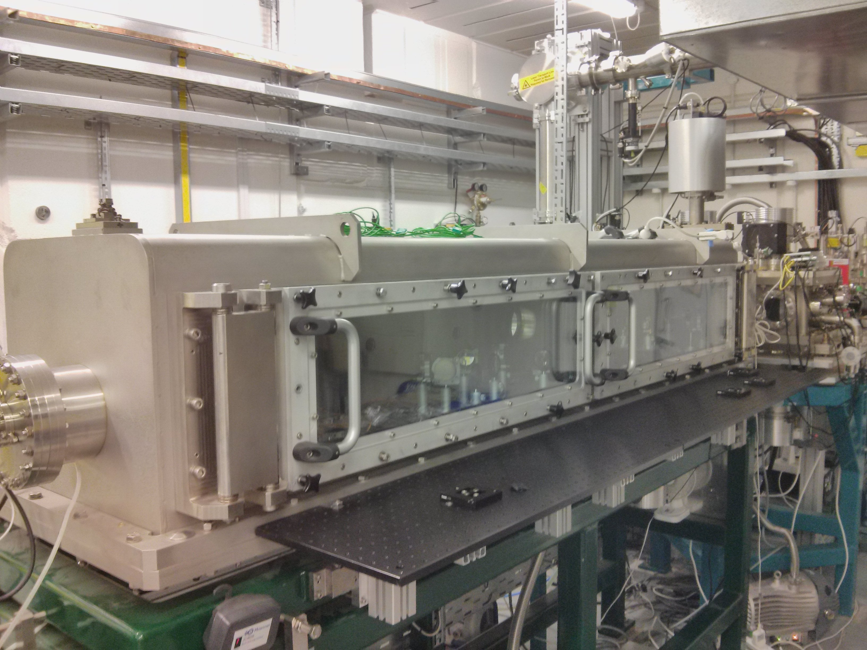
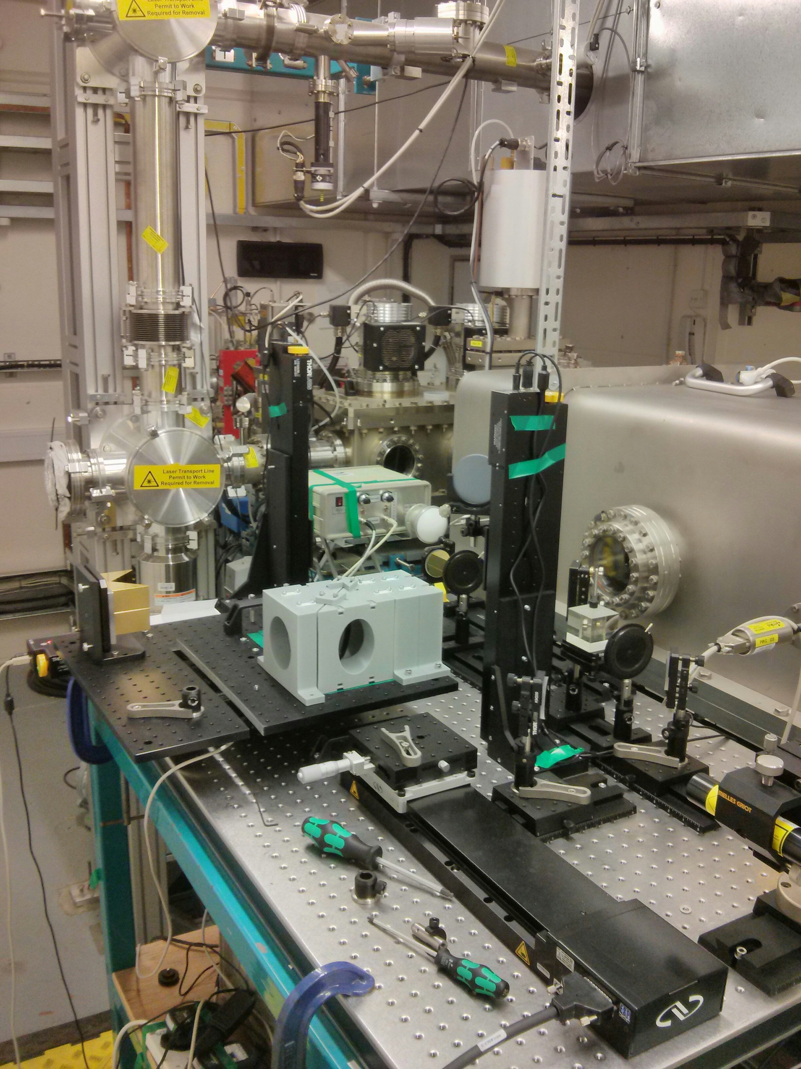
Experimental work at CLARA facility
Parameters:
Rep. rate ≈ 10 Hz
Bunch lengths ≈ 500 fs
Energy ≈ 35 MeV
Charge ≈ 50 pC
Transverse size ≈ 200 um

Slide 26
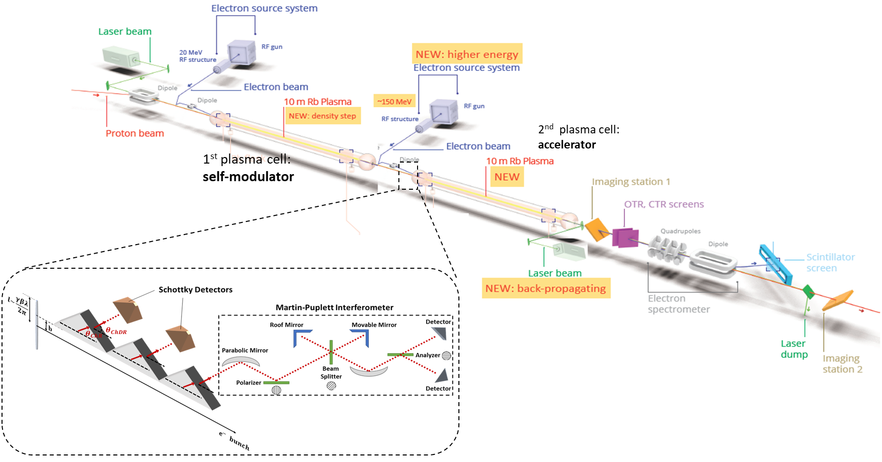
Synergy with AWAKE

Slide 27
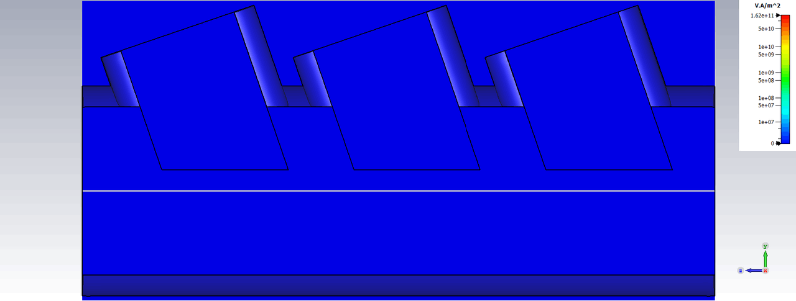
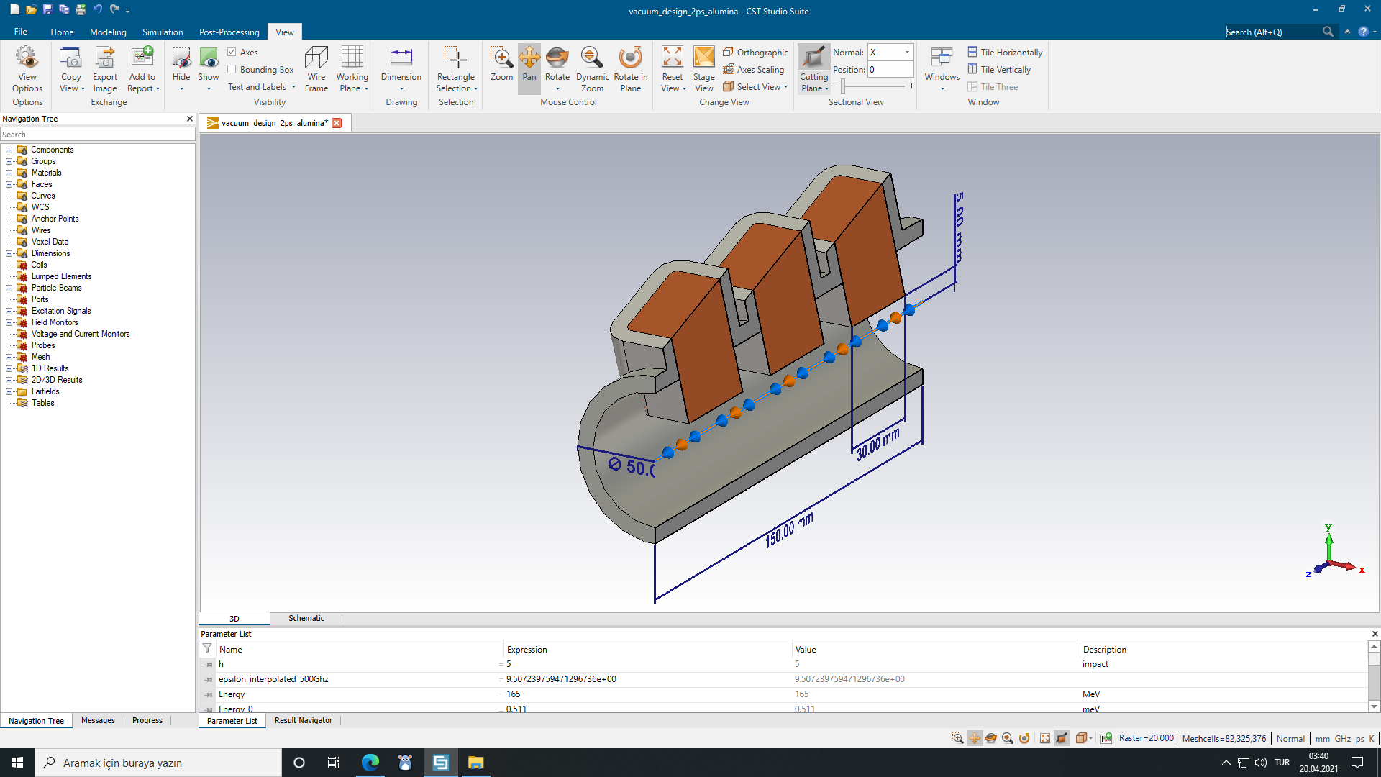
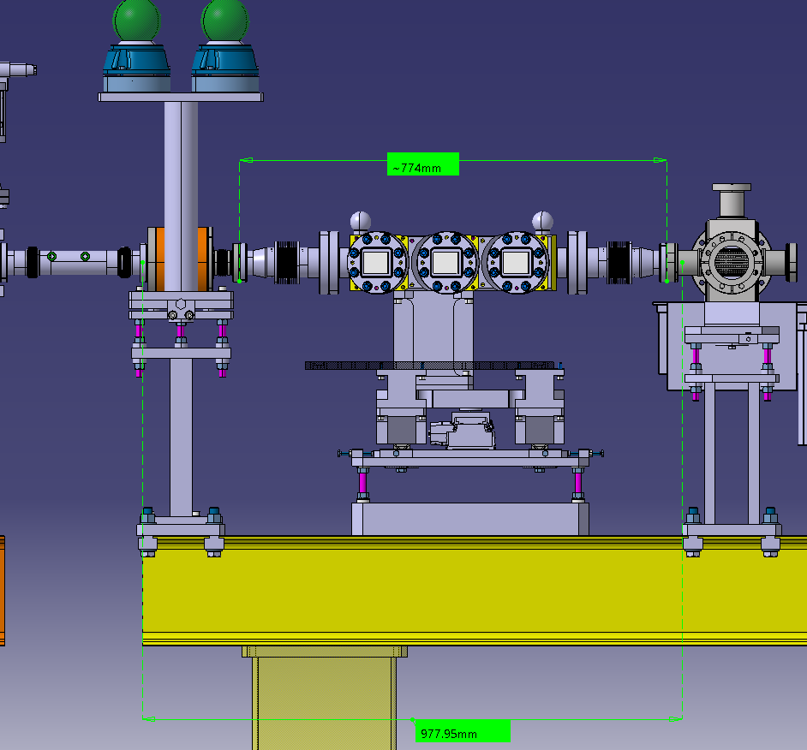
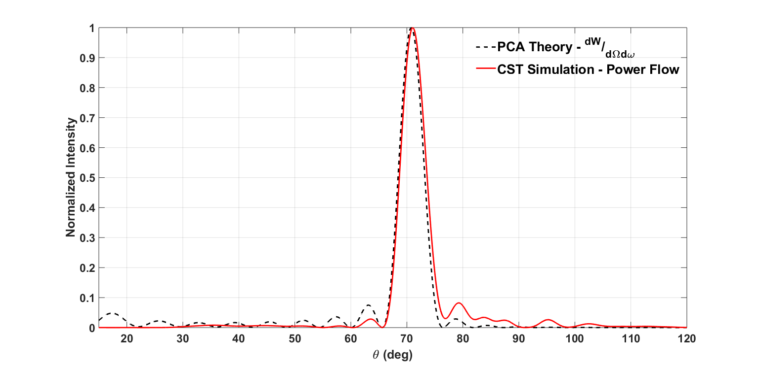
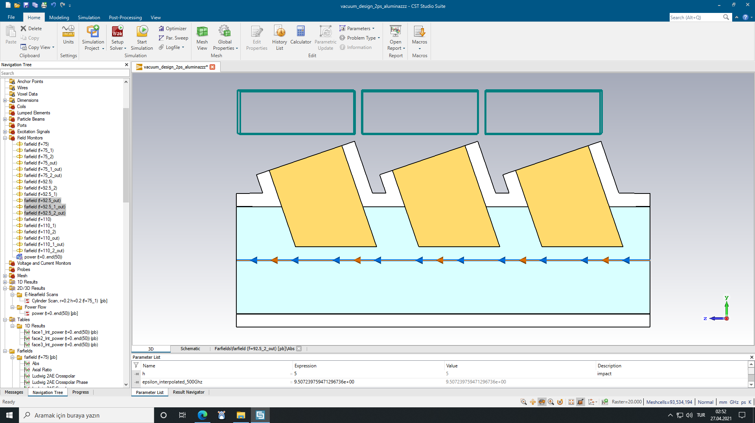
Bunch length monitor for AWAKE Run 2
1st
Demonstration of vacuum chamber installed at CLEAR.
Plan is to conduct the experiment at the end of April.

Slide 28



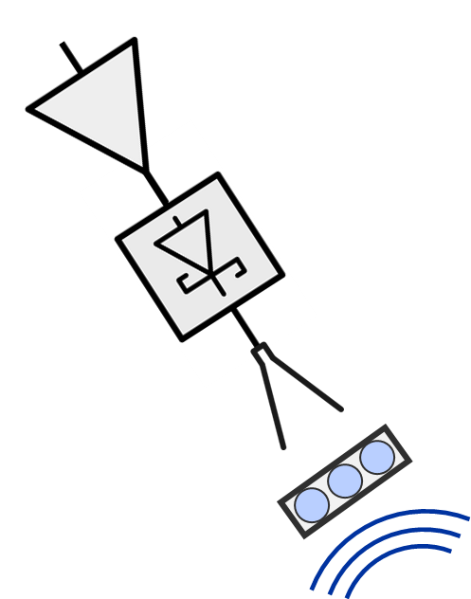
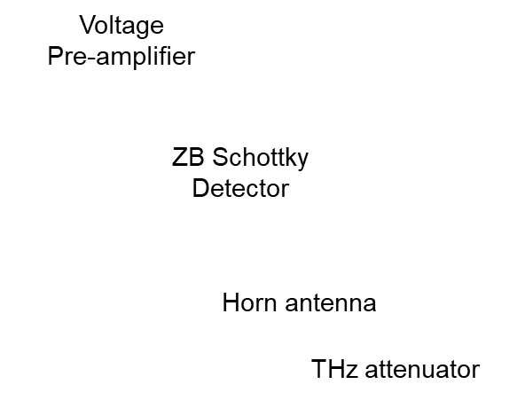
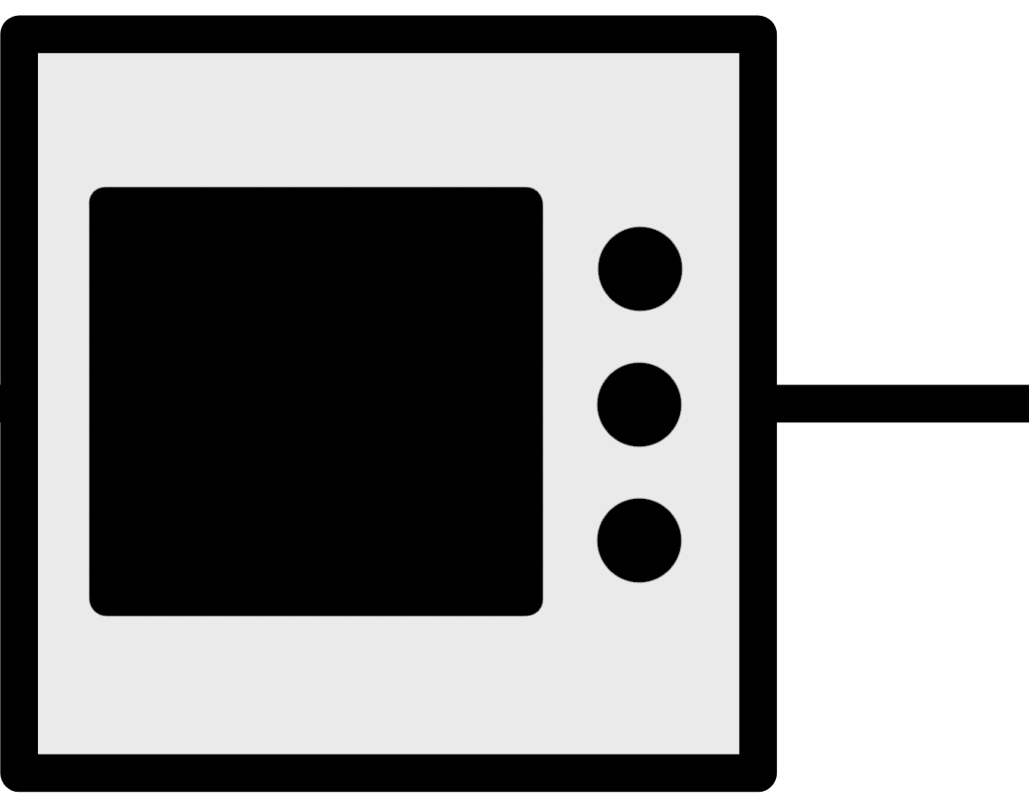

Experiment Layout (Plan)
Pre-amplifier
control
M-P
Interferometer
Data Acquasition
e⁻ beam
Laboratory
Tunnel

Slide 29
Resonant CChDR
Geometry Simulations Experiment
Wavelength range = 20 – 30 mm; Beam energy - 6.2 MeV; grating with 5 elements

