Slide 1



The Effect of High Energy Electrons on DNA Damage
1
Hannah Wanstall, Dr. Nicholas Henthorn, Dr. Elham Santina, Dr. Michael Merchant, Dr. Amy Chadwick, Dr. James Jones, Dr. Deepa Angal-Kalinin, Prof. Roger Jones

Slide 2
Overview
2
Introduction to VHEE Radiotherapy
Motivation for the Experiment at CLARA
Overview of our Experimental Setup
DNA Damage Experiments
  Plasmid Irradiations (35 MeV)
  Human Cancer Cell Irradiations (25 – 35 MeV)
Summary and Conclusions

Slide 3
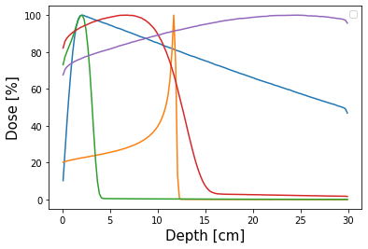
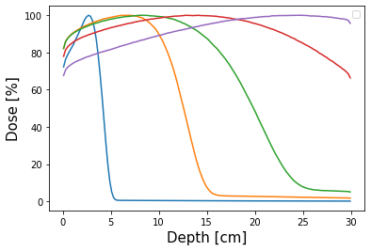
3
Essentials of VHEE Radiotherapy
VHEE Radiotherapy = 50 – 250 MeV Electrons
Simulation work has shown that VHEE is capable of reaching deep-seated tumour sites in patients (DesRosiers, 2000¹; Whitmore, 2021²; Lagzda, 2020³)
200 MeV e-
200 MeV e-
100 MeV e-
10 MeV e-
6 MV Photon
10 MeV e-
30 MeV e-
50 MeV e-
150 MeV Proton
30 MeV e-
¹DesRosiers C, Moskvin V, Bielajew AF, Papiez L. 150-250 meV electron beams in radiation therapy. Phys Med Biol. 2000 Jul;45(7):1781-805.
²Whitmore L, Mackay RI, van Herk M, Jones JK, Jones RM. Focused VHEE (very high energy electron) beams and dose delivery for radiotherapy applications. Sci Rep. 2021 Jul 7;11(1):14013. doi: 10.1038/s41598-021-93276-8. PMID: 34234203; PMCID: PMC8263594.
³Lagzda A, Angal-Kalinin D, Jones J, Aitkenhead A, Kirkby K.J., MacKay R, Van Herk M, Farabolini W, Zeeshan S, Jones R.M. Influence of heterogeneous media on Very High Energy Electron (VHEE) dose penetration and a Monte Carlo-based comparison with existing radiotherapy modalities. Nuclear Instruments and Methods in Physics Research Section B: Beam Interactions with Materials and Atoms. 2020 Nov.: 482, pg’s 70-81
Notes:
PDD graph is on axis dose distribution. 5mm beam sigma. Simulated with 10^5 – 10^7 particles depending on modality.

Slide 4
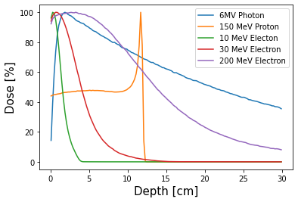
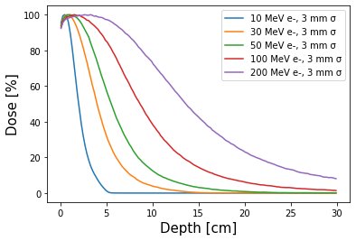
3
Essentials of VHEE Radiotherapy
VHEE Radiotherapy = 50 – 250 MeV Electrons
Simulation work has shown that VHEE is capable of reaching deep-seated tumour sites in patients (DesRosiers, 2000¹; Whitmore, 2021²; Lagzda, 2020³)
6 MV Photon
30 MeV e-
200
10 MeV e-
150 MeV Proton
100
200 MeV e-
10
30
50
¹DesRosiers C, Moskvin V, Bielajew AF, Papiez L. 150-250 meV electron beams in radiation therapy. Phys Med Biol. 2000 Jul;45(7):1781-805.
²Whitmore L, Mackay RI, van Herk M, Jones JK, Jones RM. Focused VHEE (very high energy electron) beams and dose delivery for radiotherapy applications. Sci Rep. 2021 Jul 7;11(1):14013. doi: 10.1038/s41598-021-93276-8. PMID: 34234203; PMCID: PMC8263594.
³Lagzda A, Angal-Kalinin D, Jones J, Aitkenhead A, Kirkby K.J., MacKay R, Van Herk M, Farabolini W, Zeeshan S, Jones R.M. Influence of heterogeneous media on Very High Energy Electron (VHEE) dose penetration and a Monte Carlo-based comparison with existing radiotherapy modalities. Nuclear Instruments and Methods in Physics Research Section B: Beam Interactions with Materials and Atoms. 2020 Nov.: 482, pg’s 70-81
Notes:
ON AXIS SLIDE

Slide 5
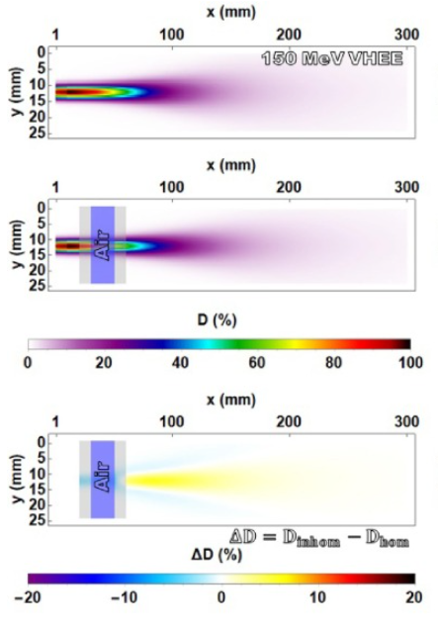
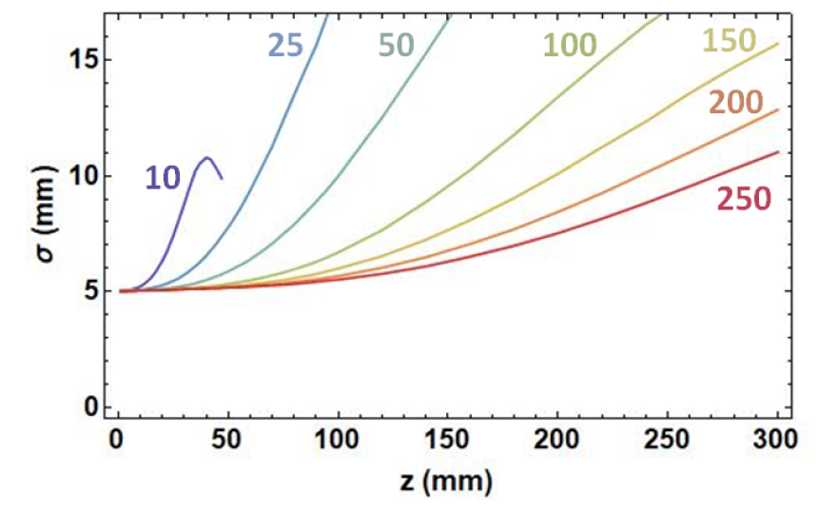
3
Simulation of VHEE through a water phantom with and without air pockets:
Essentials of VHEE Radiotherapy
VHEE has potential to treat various cancer types, particularly those located in inhomogeneous regions (i.e. lung, prostate) (Lagzda, 2020)
Increasing electron energy significantly reduces scattering/penumbra
Transverse penumbra reducing as electron energy is increased:
Lagzda A, Angal-Kalinin D, Jones J, Aitkenhead A, Kirkby K.J., MacKay R, Van Herk M, Farabolini W, Zeeshan S, Jones R.M. Influence of heterogeneous media on Very High Energy Electron (VHEE) dose penetration and a Monte Carlo-based comparison with existing radiotherapy modalities. Nuclear Instruments and Methods in Physics Research Section B: Beam Interactions with Materials and Atoms. 2020 Nov.: 482, pg’s 70-81
Notes:
PDD graph is on axis dose distribution. 5mm beam sigma. Simulated with 10^5 – 10^7 particles depending on modality.

Slide 6
3
Essentials of VHEE Radiotherapy
VHEE has potential to treat various cancer types, particularly those located in inhomogeneous regions (i.e. lung, prostate) (Lagzda, 2020)
Increasing electron energy reduces scattering/penumbra
A VHEE radiotherapy machine would potentially be more compact based on CLIC-like technology used in linear colliders
VHEE shows potential for FLASH radiotherapy – a developing field that is based on delivering a high dose in a short time interval (> 40 Gy/s) vs conventional dose rates (~ 0.05 Gy/s)
Lagzda A, Angal-Kalinin D, Jones J, Aitkenhead A, Kirkby K.J., MacKay R, Van Herk M, Farabolini W, Zeeshan S, Jones R.M. Influence of heterogeneous media on Very High Energy Electron (VHEE) dose penetration and a Monte Carlo-based comparison with existing radiotherapy modalities. Nuclear Instruments and Methods in Physics Research Section B: Beam Interactions with Materials and Atoms. 2020 Nov.: 482, pg’s 70-81
Notes:
PDD graph is on axis dose distribution. 5mm beam sigma. Simulated with 10^5 – 10^7 particles depending on modality.

Slide 7
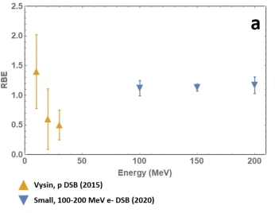
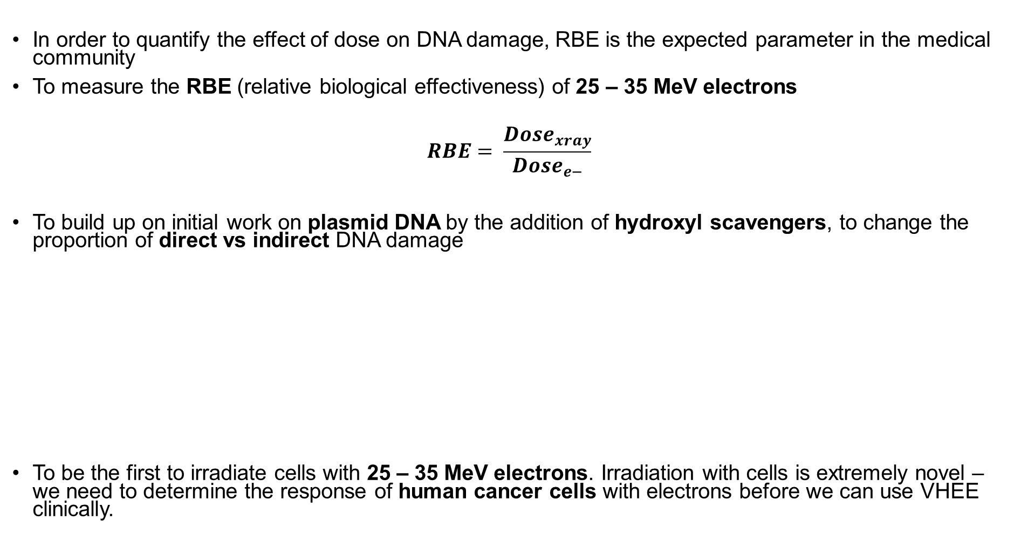
Motivation for Experiment
4
In order to quantify the effect of dose on DNA damage, RBE is the expected parameter in the medical community
To measure the RBE (relative biological effectiveness) of 25 – 35 MeV electrons
$$RBE= \frac{{Dose}_{xray}}{{Dose}_{e−}}$$
To build up on initial work on plasmid DNA by the addition of hydroxyl scavengers, to change the proportion of direct vs indirect DNA damage
To be the first to irradiate cells with 25 – 35 MeV electrons. Irradiation with cells is extremely novel – we need to determine the response of human cancer cells with electrons before we can use VHEE clinically.
Small et al (2021)* measured an RBE value of between 1.09 – 1.19 for 100 – 200 MeV electrons via plasmid irradiations at the CLEAR facility at CERN (following experiments at Daresbury Lab)
Blue Line where RBE = 1
*Small, K.L., Henthorn, N.T., Angal-Kalinin, D. et al. Evaluating very high energy electron RBE from nanodosimetric pBR322 plasmid DNA damage. Sci Rep 11, 3341 (2021)

Slide 8
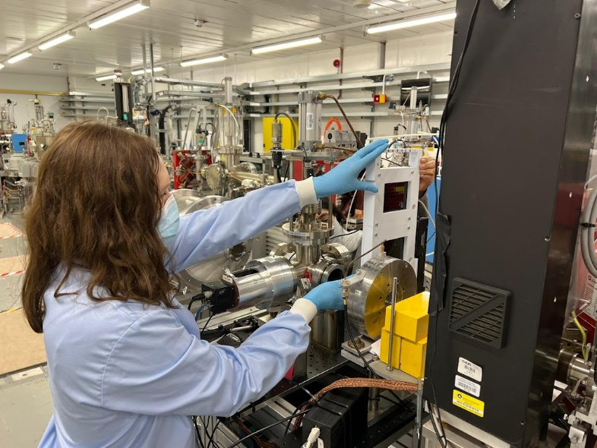

Overview of Experimental Setup
Irradiation of 96 well plates at CLARA beamline, Daresbury, UK
5
Human Cancer Cells
Plasmid DNA
From dipole
Beryllium window
Faraday Cup beam dump
Collimator – drilled lead block
Wall Current Monitor
YAG screen
Sample Holder
Typical Bunch Charge = 45 – 70 pC
Irradiations performed between ~400 – 14,000 pC
(Equivalent to ~ 2 – 75 Gy)
Dark current was calculated to be ~0.3% of total dose
Beam Energy = 25 – 35 MeV
Beam σ = 2.5 ± 0.07 mm

Slide 9
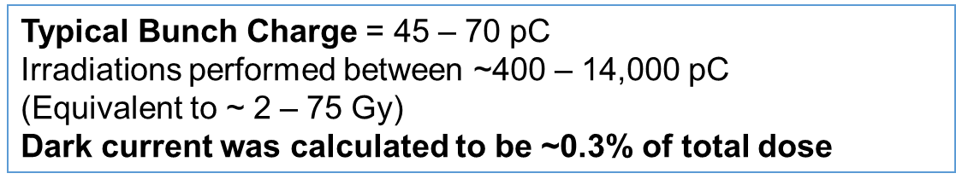
3.5 MW RF Power
1 min
Time (min) | Dose (Gy)
1 | 0.505
2 | 0.800
3 | 1.245
4 | 1.637
5 | 1.947
2 min
3 min
4 min
5 min
Average dose in central 3 mm x 3mm square within Gaussian beam

Slide 10
Plasmid Experiments

Slide 11
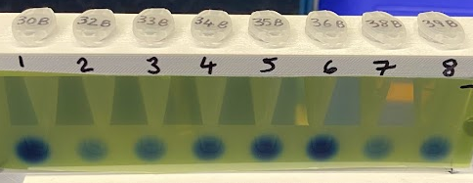
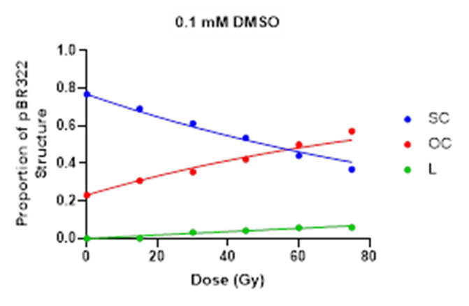
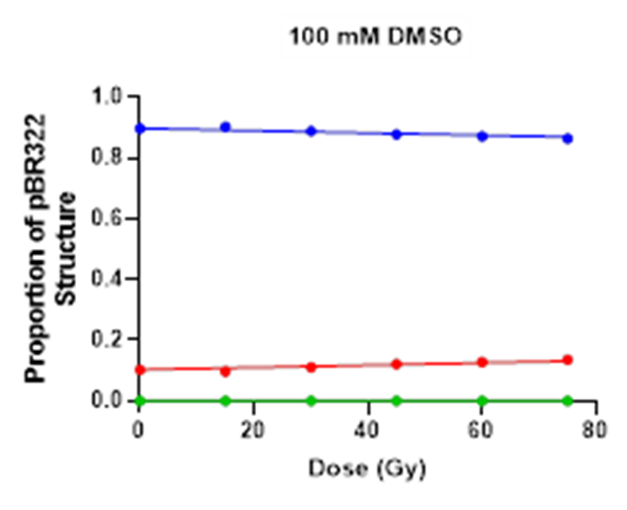
Methods for Quantifying DNA Damage to pBR322 Plasmid DNA
6
3.
Samples were then separated via gel electrophoresis and proportions of supercoiled (SC), open circular (OC) and linear (L) DNA were measured
4.
McMahon model was applied to determine values for SSB and DSB frequency for both 35 MeV electrons and x-rays
1.
Samples of 100 ng/μl pBR322 DNA were prepared in environments with varying concentrations of hydroxyl scavenging chemicals (Tris & DMSO)
e.g. 0.1 mM DMSO
e.g. 100 mM DMSO
0 Gy
15 Gy
30 Gy
45 Gy
60 Gy
75 Gy
0 Gy
15 Gy
30 Gy
45 Gy
60 Gy
75 Gy
OC (Single DNA Break)
OC
L (Double DNA Break)
L
Increasing Dose
SC (Undamaged DNA)
SC
Increasing Dose
2.
Samples were irradiated at 5 dose points – 15, 30, 45, 60 and 75 Gy. This was completed with both 35 MeV electrons and 300 kV x-rays
SC (Undamaged DNA)
OC (Single DNA Break)
L (Double DNA Break)

Slide 12
The Effect of Increasing Hydroxyl Scavenger Concentration on DNA Damage
7
As we reduce direct DNA damage via increasing scavenger concentration, we see a decrease in SSB and DSB number
There are small changes between DNA damage induced by x-ray and 35 MeV electrons
Error increases in both SSB and DSB number as scavenger concentration increases and DNA damage becomes a rare event
[Increasing Scavenging Capacity]
[Increasing Scavenging Capacity]

Slide 13
Calculating a Value for High Energy Electron RBE
8
Mean = 1.155
RBE value for 35 MeV electrons is calculated to be ~1.16
Therefore, 35 MeV electrons result in ~16% more DNA damage then conventional x-rays
This effect is fairly consistent with increasing scavenger concentration, indicating that amount of direct damage does not effect outcome
Mean = 1.161

Slide 14
Human Cell Experiments

Slide 15
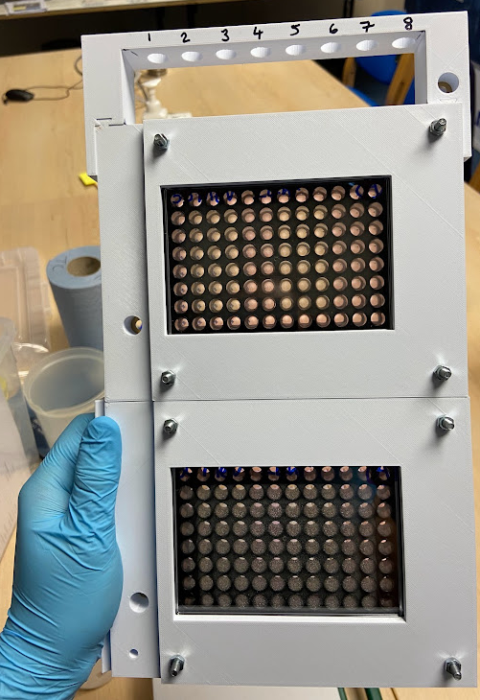
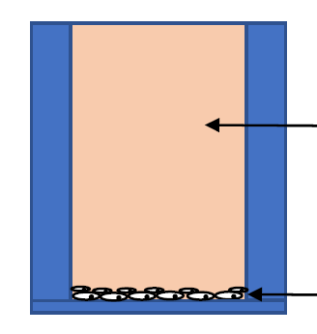
Methods for Quantifying the Induction of DNA Damage and Repair Foci in Human Cancer Cells
9
Day 1.
Day 2.
Day 3.
Following weeks.
Human lung and prostate cancer cell lines (A549, DU145 and PC3) were seeded into 96 well plates
Samples were irradiated at 2 dose points: 2.17 and 5.37 Gy. This was performed at three beam energies (25, 30 and 35 MeV electrons)
Cells were fixed 1hr after irradiation.
Cells were stained via immunofluorescence for DNA damage and repair foci. Foci were visualised using x63 high throughput microscopy and quantified using a foci counting software.
Cells were fixed 24 hr after irradiation
85 mm
12.1 mm
Well filled with cell media
128 mm
Cells adhered to bottom of well
6.3 mm
Irradiation of 96 well plates at CLARA beamline, Daresbury, UK

Slide 16
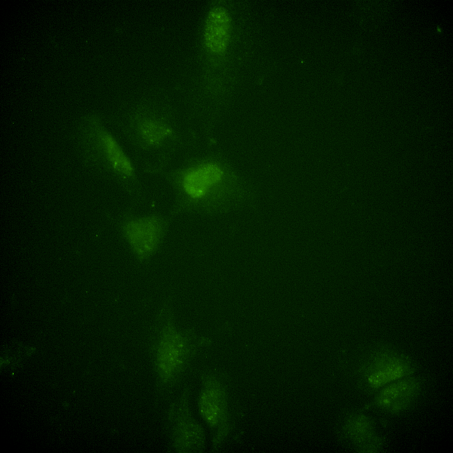
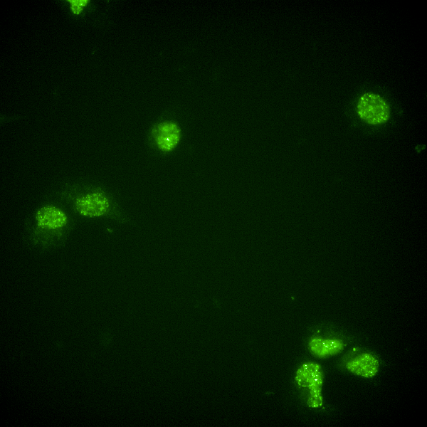
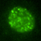
Measuring DNA Damage in Response to 25 – 35 MeV Electrons
10
(prostate cancer cell line)
(lung cancer cell line)
(prostate cancer cell line)
Graphs indicate increase in number of DNA damage foci (γH2AX) vs unirradiated control
e.g. DNA damage foci displayed in DU145 prostate cancer cells pre- and post- irradiation with 35 MeV electrons
0 Gy
2.17 Gy, 1 hr post-irradiation

Slide 17
DNA Repair Foci - Conclusions
11
There are no significant differences between the number of DNA damage foci induced between 25, 30 and 35 MeV electrons
Number of DNA damage foci changes back to baseline levels 24 hrs post-irradiation with both high and low doses

Slide 18
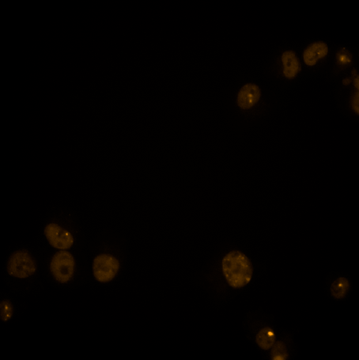
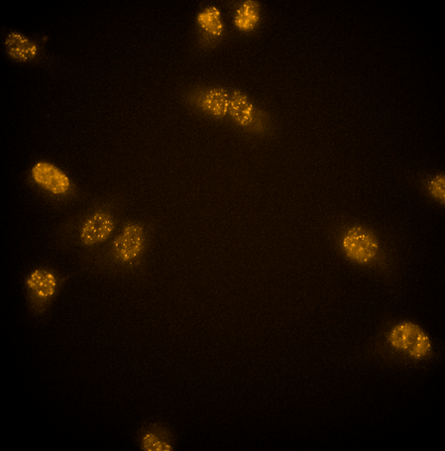
Measuring DNA Repair in Response to 25 – 35 MeV Electrons
12
(lung cancer cell line)
(prostate cancer cell line)
(prostate cancer cell line)
*Error bars are SEM
Graphs indicate increase in number of DNA repair foci (53BP1) vs unirradiated control
e.g. DNA repair foci displayed in DU145 prostate cancer cells pre- and post- irradiation with 35 MeV electrons
0 Gy
2.17 Gy, 1 hr post-irradiation

Slide 19
DNA Damage Foci - Conclusions
13
There are no significant differences between the number of DNA repair foci induced between 25, 30 and 35 MeV electrons
Number of DNA damage foci changes back to baseline levels 24 hrs post-irradiation with both high and low doses

Slide 20
14
Summary and Conclusions
Plasmid irradiation studies indicate an RBE value of 1.16 for 35 MeV electrons
There are no significant differences between 25, 30 and 35 MeV electrons in the induction of DNA damage or repair foci, suggesting that quantity of DNA damage is insensitive to electron energy in this range
We will repeat these measurements with conventional radiotherapy to determine an RBE for induction of DNA damage and repair foci
We are planning on two further experimental runs:
CONV and FLASH rate 22 MeV electrons at DESY, Hamburg.
CONV and FLASH rate 100 – 250 MeV electrons at CLEAR, CERN.

Slide 21


12
Thank you for listening!
Many thanks to all in the CLARA team, especially James Jones, Rob Smith, Storm Mathisen, Frank Jackson & Deepa Angal-Kalinin for arranging beam time and providing a very successful series of experiments!

