Slide 1
Misusing CLARA: Detection of individual MeV electrons using a charge integrating hybrid pixel detector
Erik Fröjdh :: Scientist :: Paul Scherrer Institute
2022-07-05 CLARA User meeting
Notes:
Experince with programming?
Software engineering
Our detector software

Slide 2
Outline
Motivation
The JUNGFRAU detector
Overview of our experiment
Single electron response
Dynamic range scan
Spatial resolution (MTF)

Slide 3
Why did we apply for beamtime?
Electrons are emerging as a strong complement to X-rays for diffraction-based studies
Collaborators already started to use the JUNGFRAU for electron experiments
→ How well does a JUNGFRAU detector work at a pulsed MeV electron source?
Impact/desired outcome
Confidence that the detector works as expected
Verify simulations to guide future design
Publication in a detector related journal (most likely JINST)

Slide 4
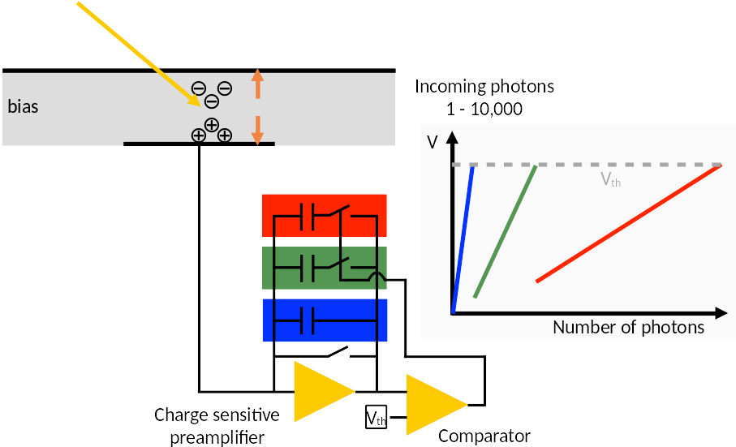
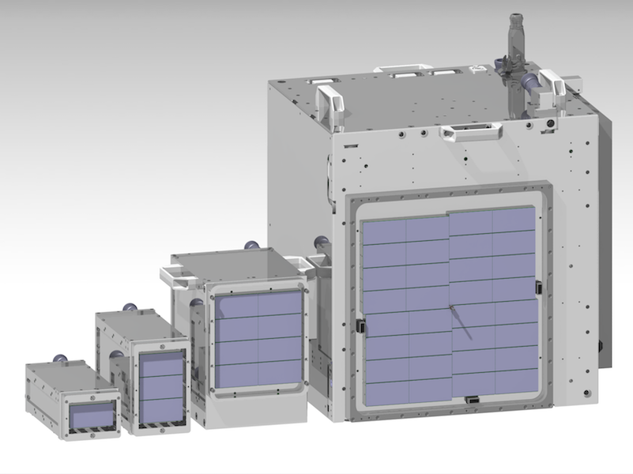
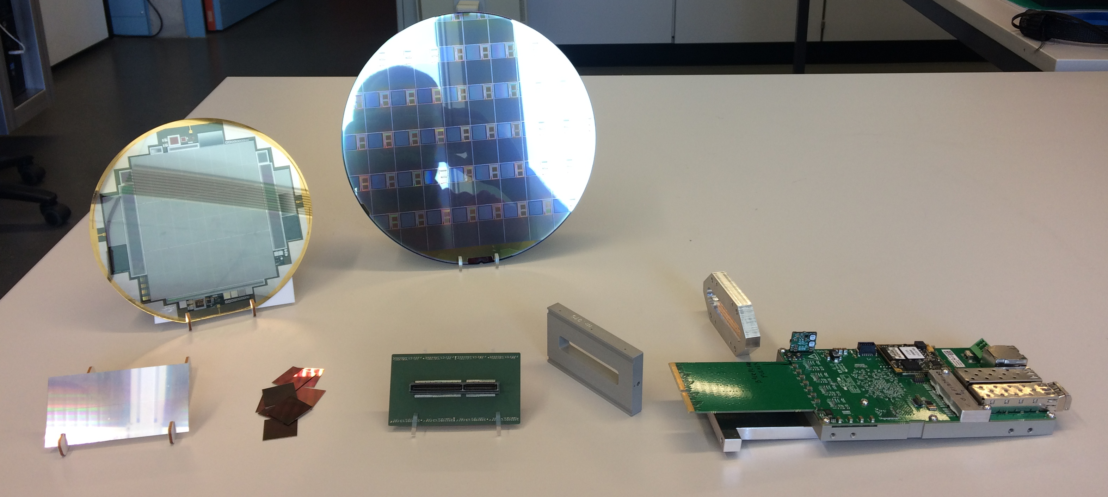
The JUNGFRAU detector
Charge integrating hybrid pixel detector (75 × 75 µm²)
3 dynamic switching linear gains per pixel
Low noise (< 52 e⁻ ENC in high gain)
Dynamic range of 10⁴ 12 keV photons
Maximum frame rate 2.2 kHz
Modular hardware → scalability for large-area detectors
G2
G1
G0
0.5M 1.5M 4M 16M
ASIC wafer
sensor wafer
vacuum barrier
Viktoria Hinger
high-density interconnect
readout board
sensor
module holder
8 × ASICs

Slide 5
The JUNGFRAU detector
Charge integrating hybrid pixel detector (75 × 75 µm²)
3 dynamic switching linear gains per pixel
Low noise (Single electron with SNR ~500)
Dynamic range of 1000 primary electrons
Maximum frame rate 2.2 kHz
Modular hardware → scalability for large-area detectors
G2
G1
G0
0.5M 1.5M 4M 16M
ASIC wafer
sensor wafer
vacuum barrier
Viktoria Hinger
high-density interconnect
readout board
sensor
module holder
8 × ASICs

Slide 6
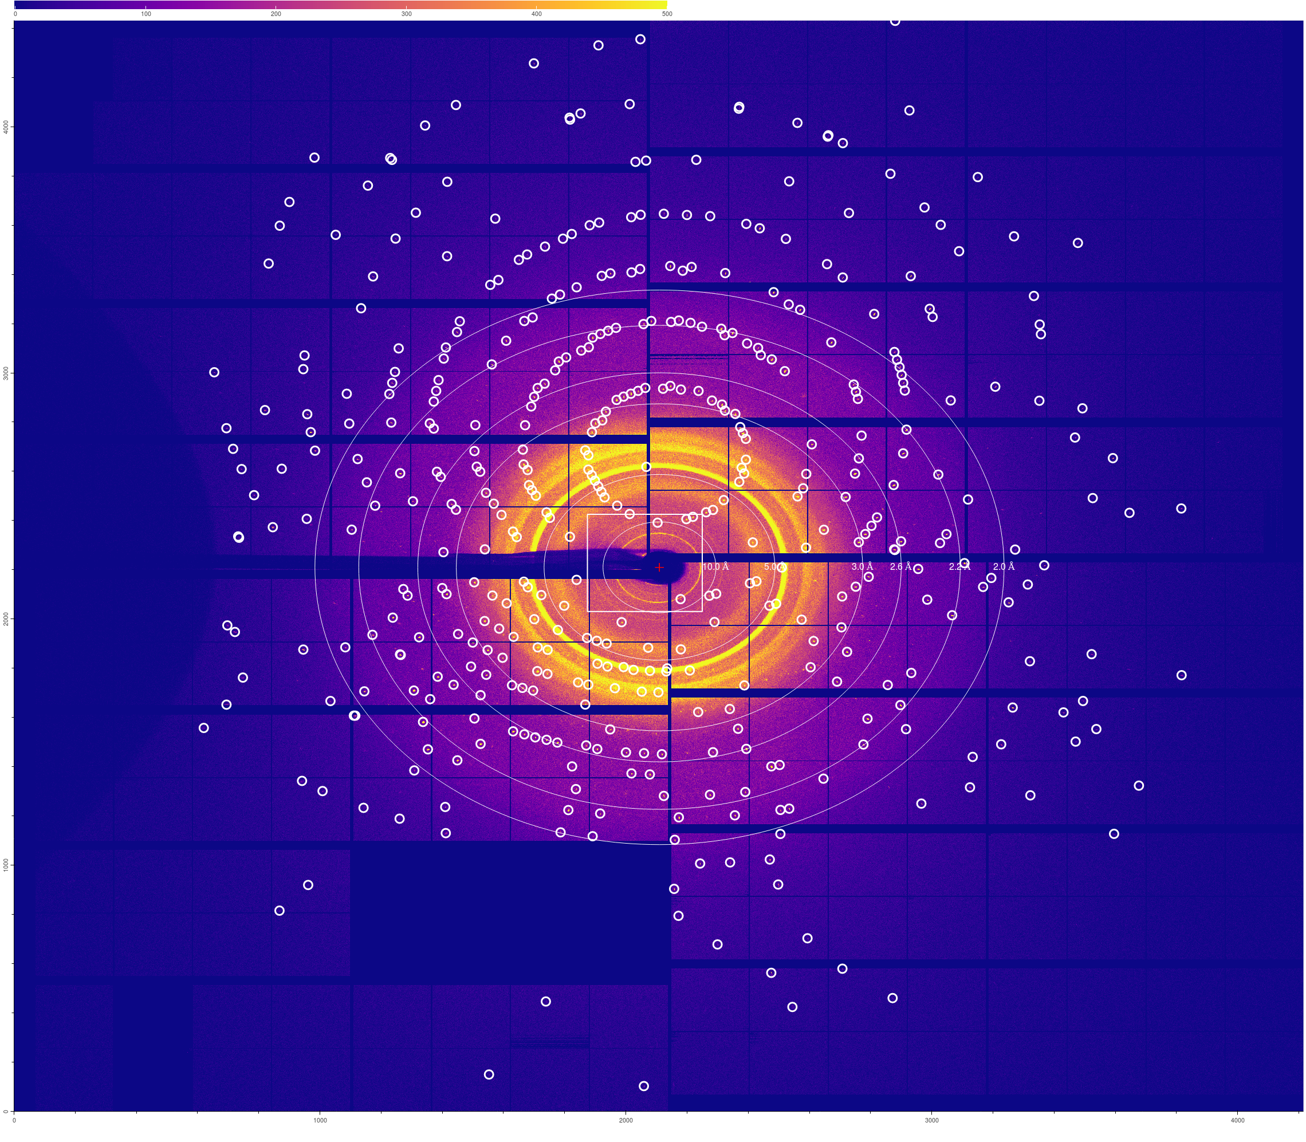
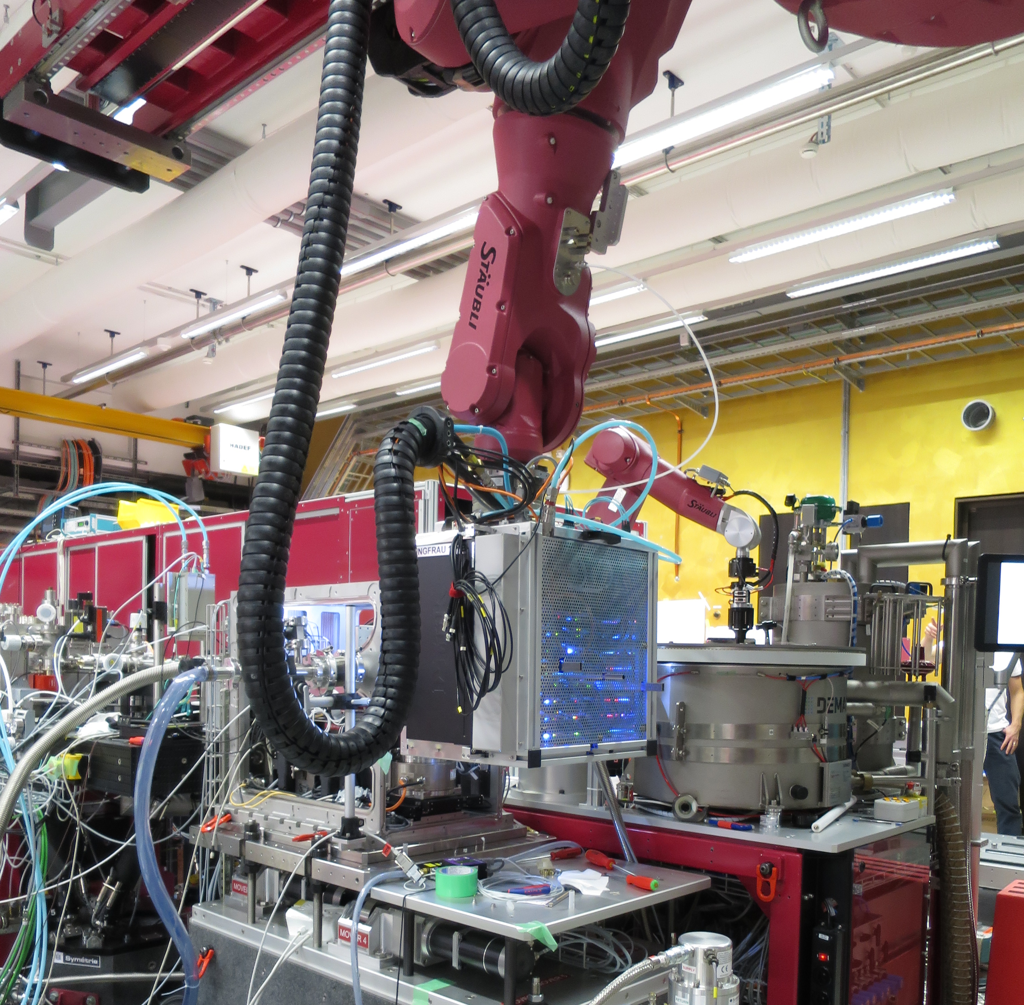
JUNGFRAU at SwissFEL
Covers all needs of SwissFEL
Hard X-rays (2 keV—16 keV): 15 systems in operation
(serial) femtosecond crystallography
X-ray emission spectroscopy
X-ray diffraction
beam diagnostics
…
Soft X-rays (250 eV—2 keV): 1 system in operation (Maloja), more in planning
coherent diffractive imaging (CDI)
resonant inelastic X-ray scattering
plasmonic dynamics
transient resonance scattering
…
JUNGFRAU at SwissFEL Bernina
Viktoria Hinger
Notes:
JUNGFRAU at Bernina: Macromolecular crystallography (MX) diffraction with peak finder, fixed target with precise 100 Hz movement, crystals in LCP (liquid crystal phase) cells on chips
15 systems:
smaller systems: 4.5M, 1.5M, and single modules
16 Mpixel systems at Alvra, Bernina end stations
in construction for Cristallina end station

Slide 7
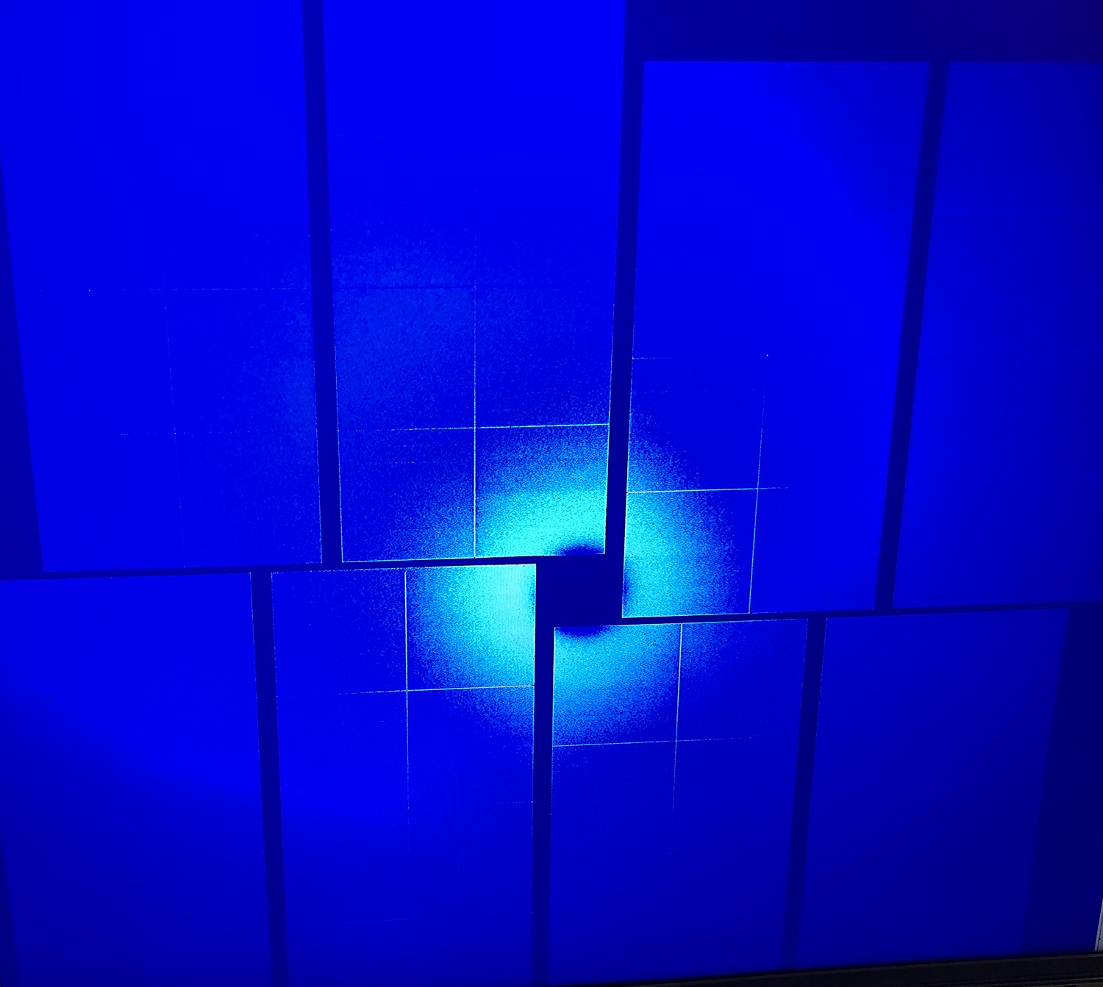
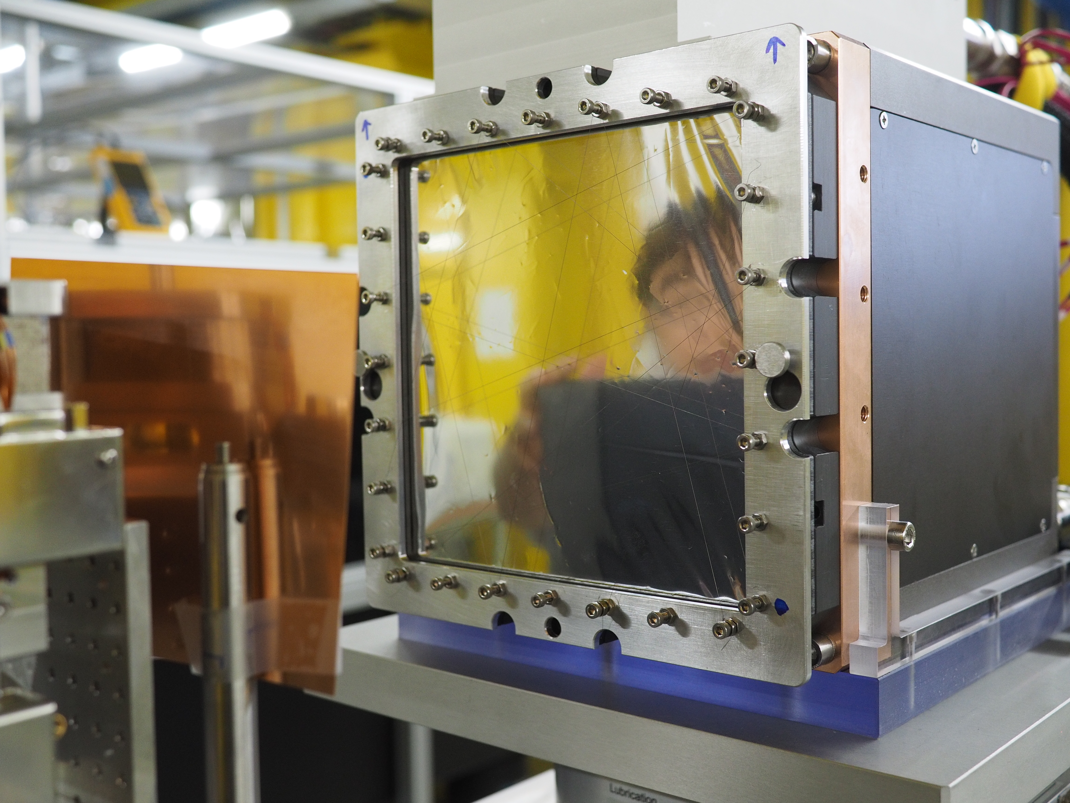
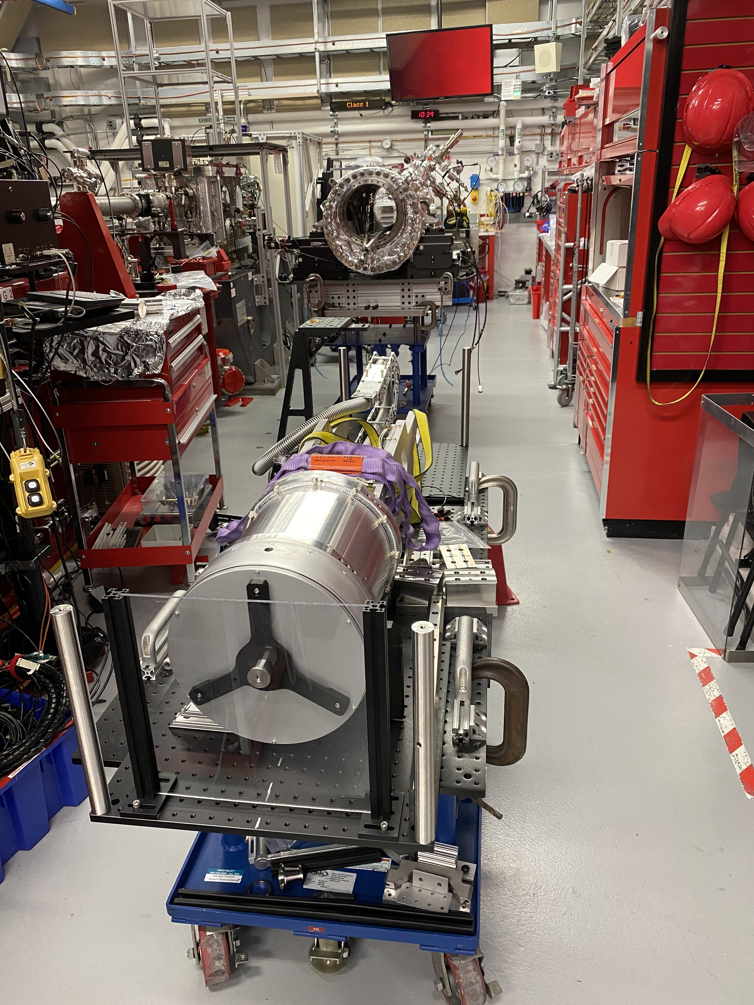
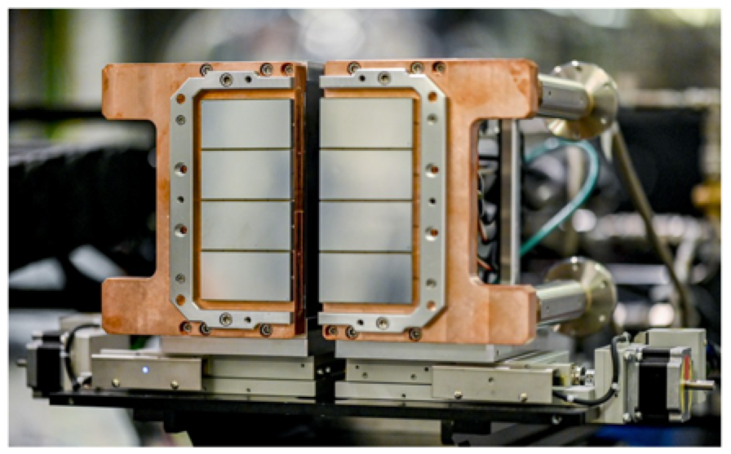
JUNGFRAU at other FEL facilities
JUNGFRAU 4M at PAL (South Korea)
Viktoria Hinger
JUNGFRAU 4M in vacuum at LCLS CXI beamline (US)
JUNGFRAU 4M at EUXFEL SFX beamline (Germany)
Page 7
Notes:
Scatter in air @ LCLS for calibration tests
Vacuum chamber

Slide 8
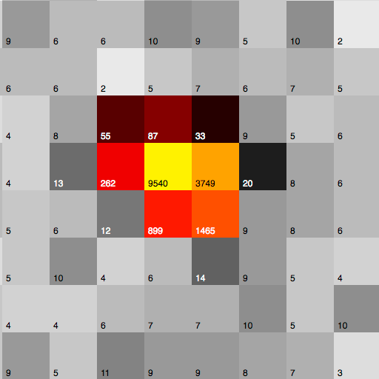
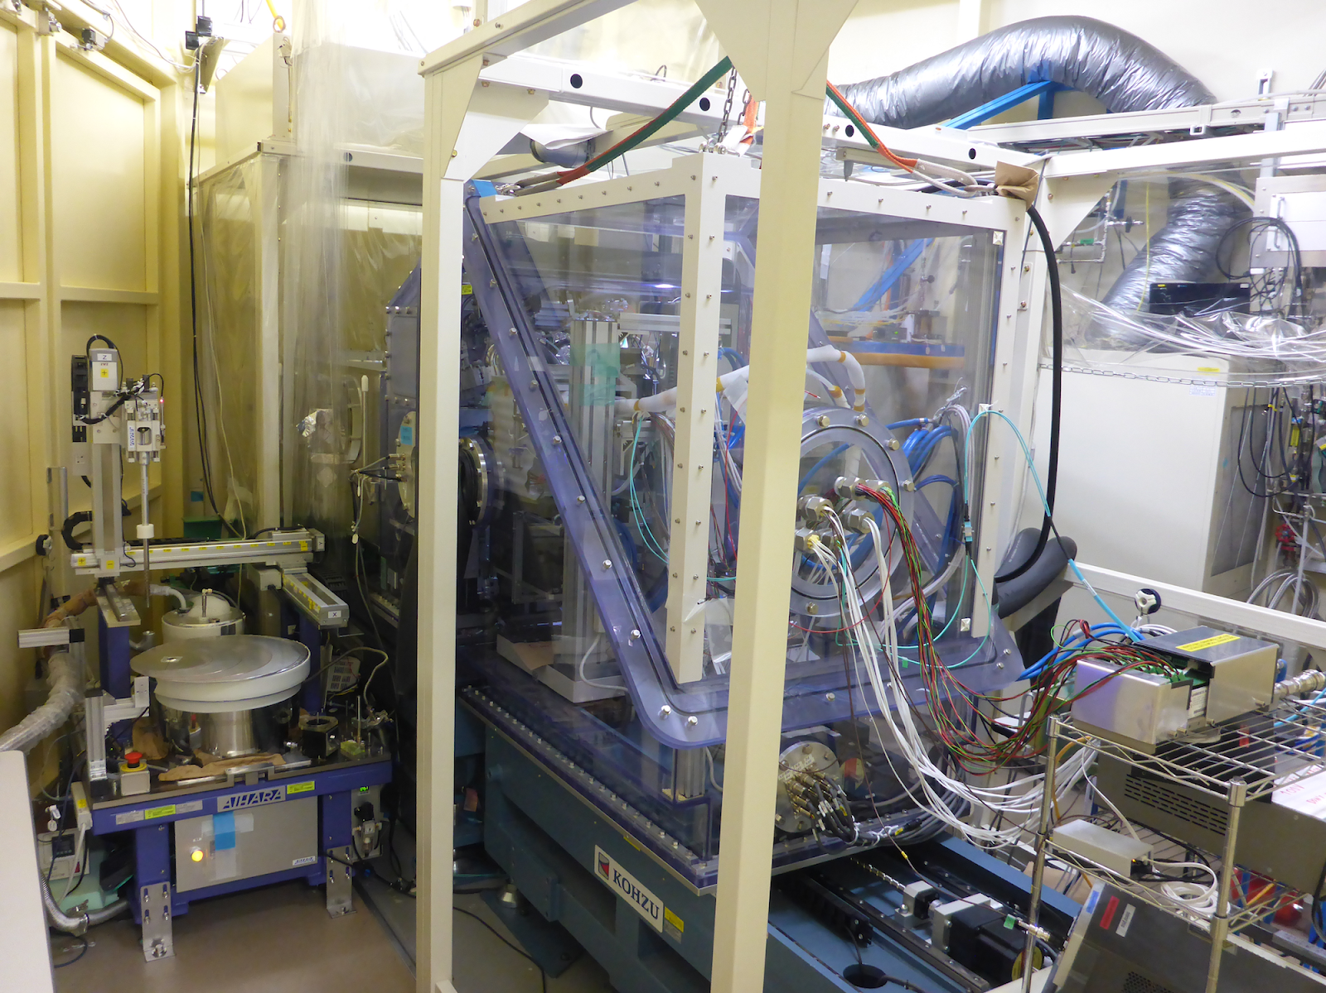
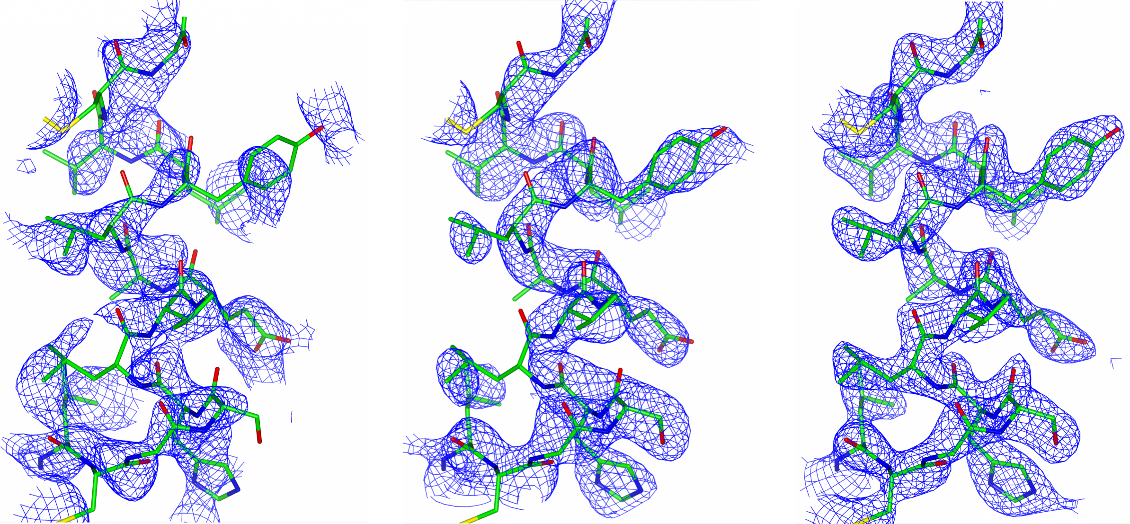
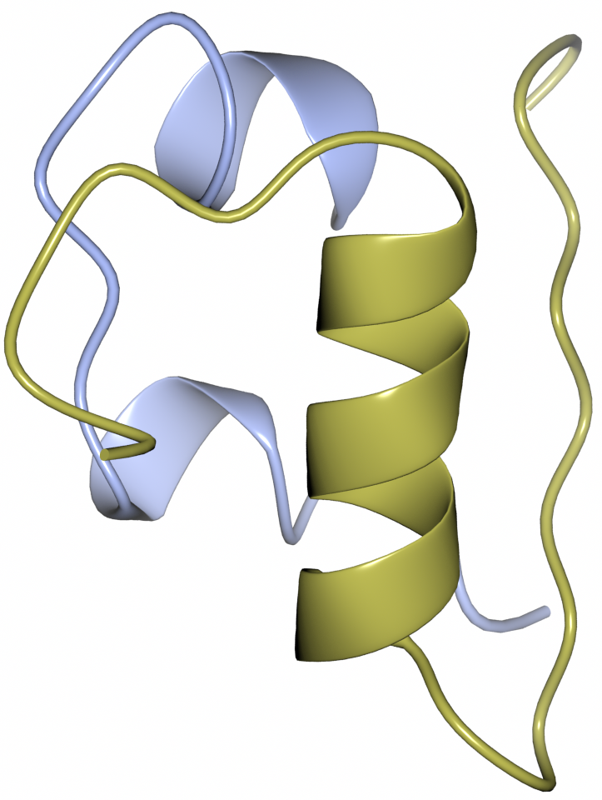
JUNGFRAU at synchrotrons
Swiss Light Source (SLS)
“Fast and accurate data collection for macromolecular crystallography using the JUNGFRAU detector”, Nature Methods volume 15, pages 799–804 (2018)
KEK Photon Factory (Japan)
JUNGFRAU 1M at SLS: thaumatin crystal diffraction
First structure solved by JUNGFRAU: Insulin October 2016 – credits K. Nass, S. Redford
Viktoria Hinger
JUNGFRAU 4M in helium tank environment at KEK Photon Factory
Page 8
Notes:
Charge integrating detector has advantages for synchrotrons
High photon flux (very high equivalent count rate)
Precision (spatial response is more uniform at pixel scale)

Slide 9
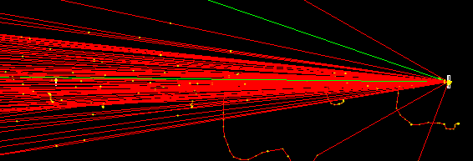
Simulating a hybrid detector
GEANT4 based pixel detector framework
Pixel size
Sensor material and thickness
Charge transport using drift-diffusion
Optional signal induction and pixel front-end
Can simulate the full experimental setup
Important since we rely on scattering to reduce the intensity
Focused beam crossing 0.5mm Be window + 1.2m air before hitting the detector
A. Schübel, et.al. “A Geant4 based framework for pixel detector simulation”. JINST 9.12 (2014), p. C12018.
D. Krapohl, et.al.. “Validation of Geant4 pixel detector simulation framework by measurements with the Medipix family detectors”. TNS 63.3 (2016), pp. 1874–1881..

Slide 10
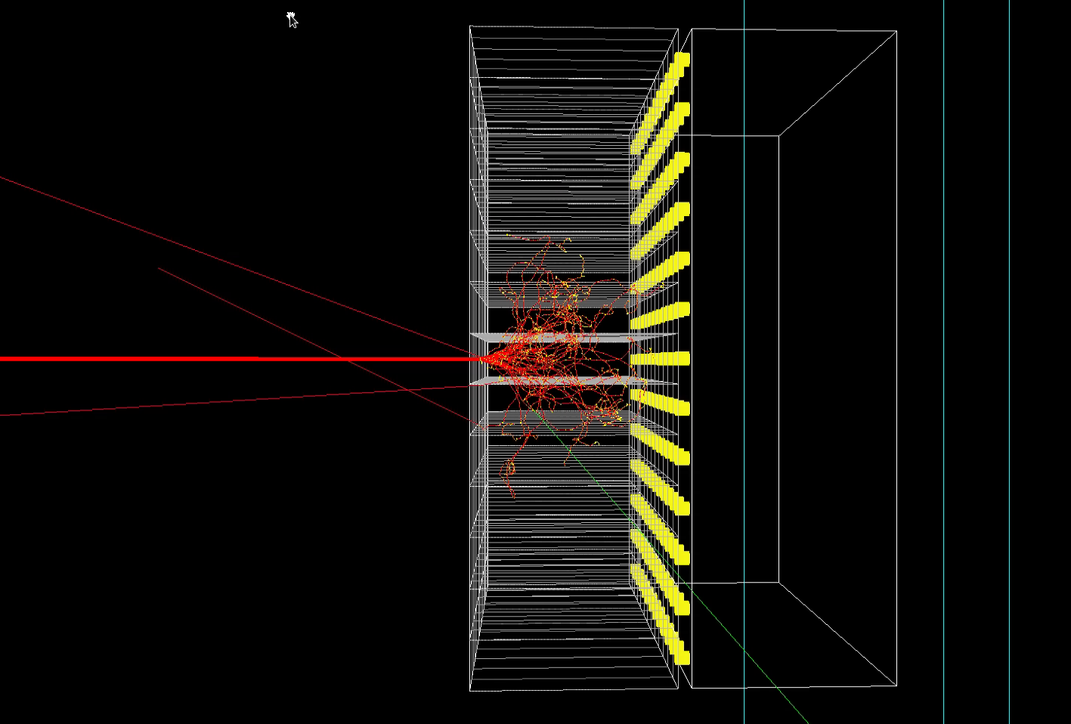
75um pixels 300 keV e-

Slide 11
Measurement setup
Detector + Faraday cup on linear stage
Measurement computer inside the hutch directly connected to the detector
Data on 10 Gbit/s fiber
Control over normal network
3 mm W edge for MTF

Slide 12
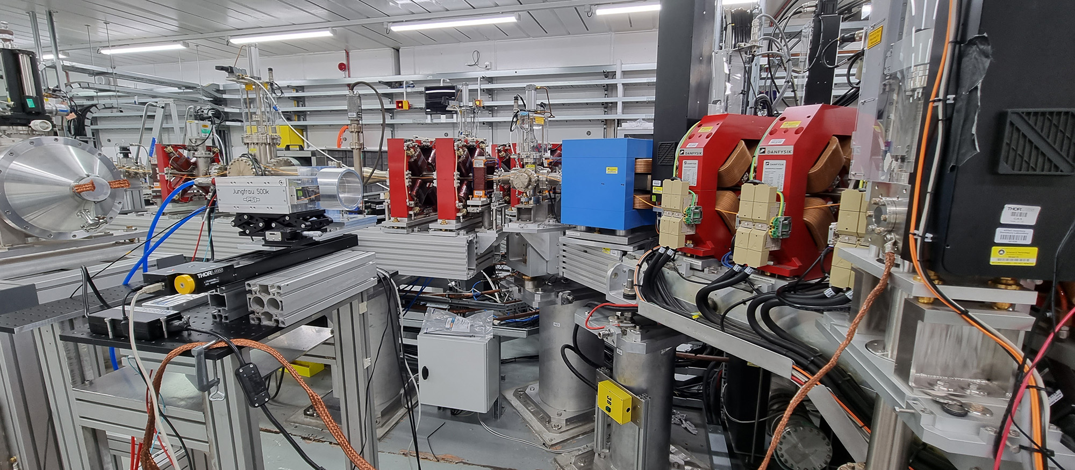
Measurement setup

Slide 13
Looking at single electrons
Ideally <1 primary e- per mm²
As low pulse charge as possible
Ask Julian for details
Major contribution from dark current
Using scattering in the Be window + air

Slide 14
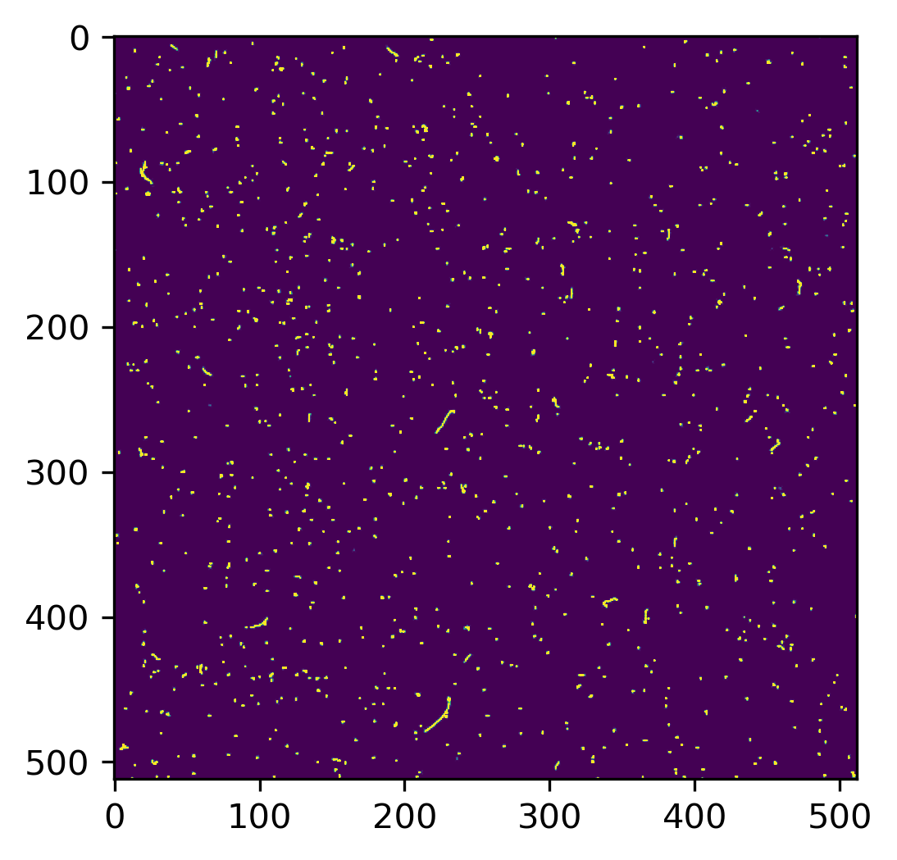
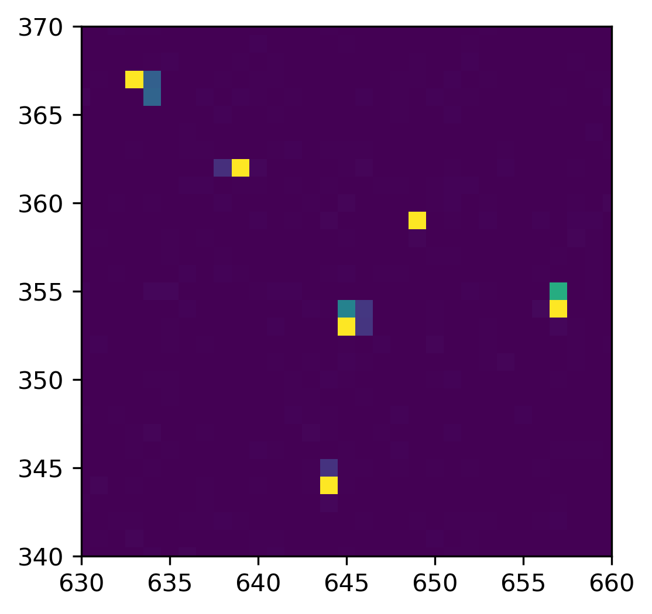
How does single electrons look in JUNGFRAU?

Slide 15
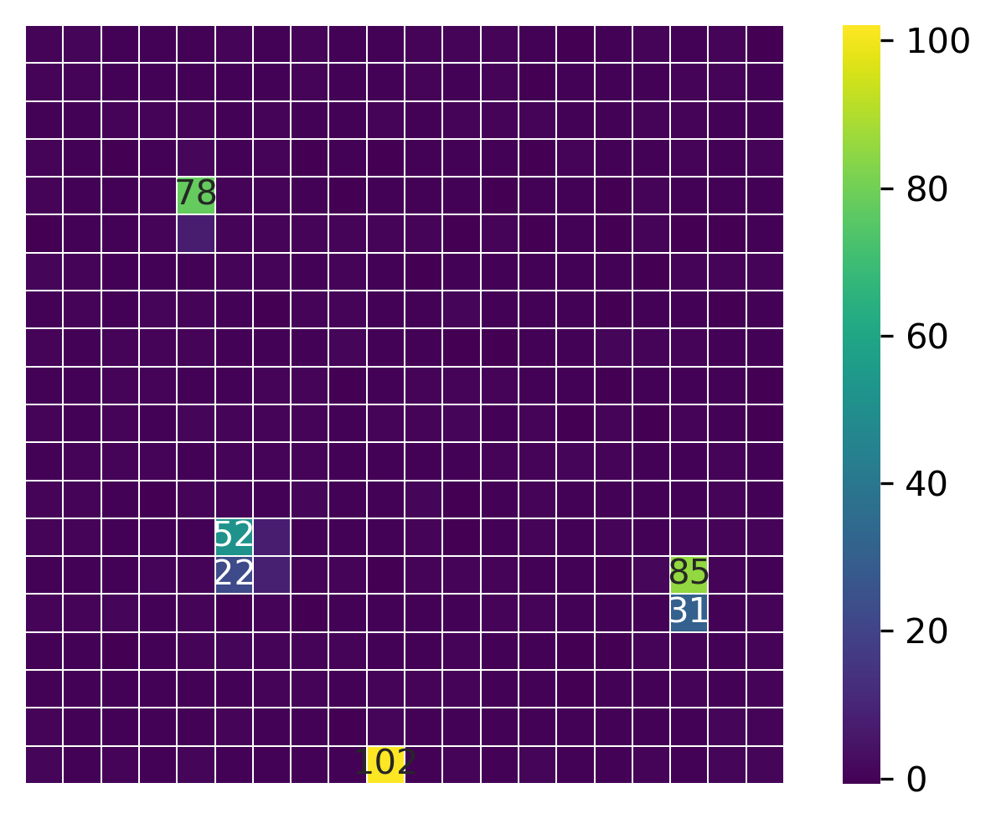

Slide 17
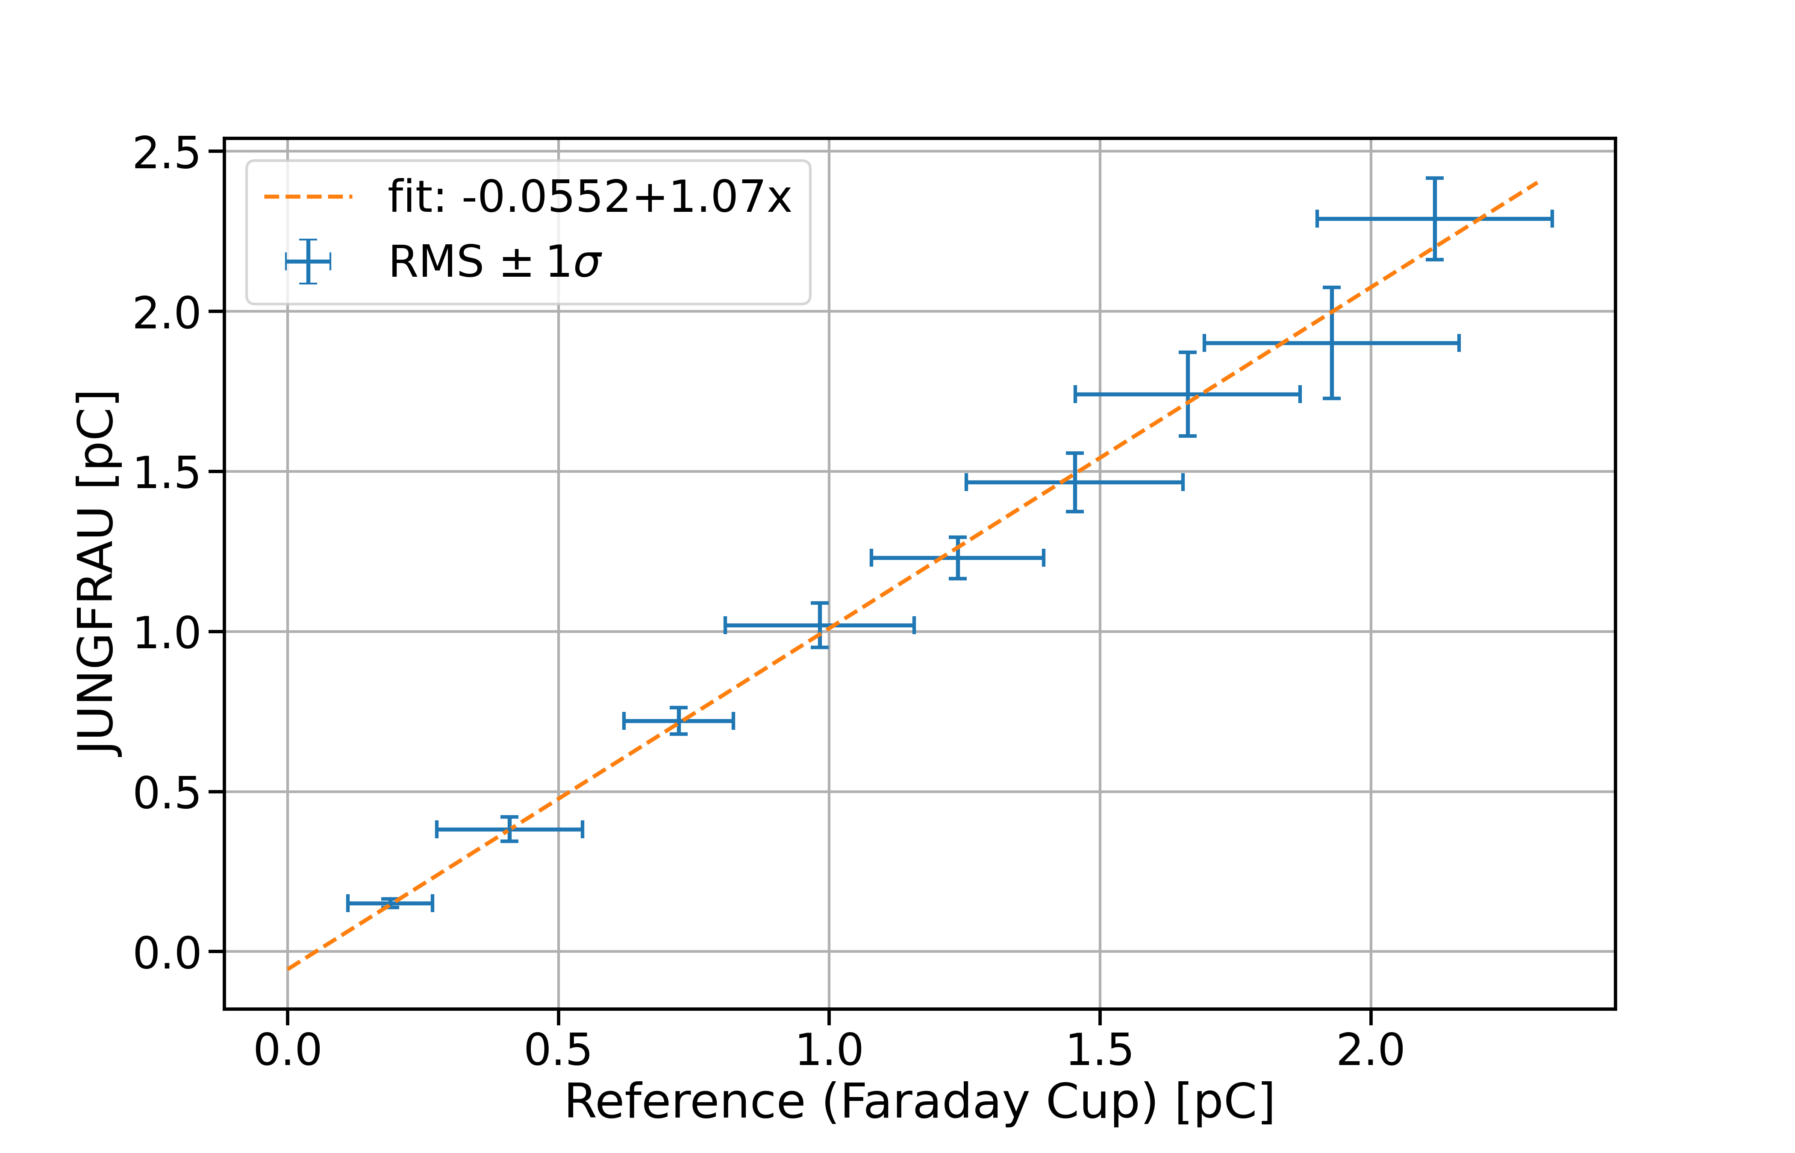
Charge scan
Custom designed Faraday Cup (Storm)
Confirm that JUNGFRAU is linear over the full dynamic range
Verify the measure charge

Slide 18
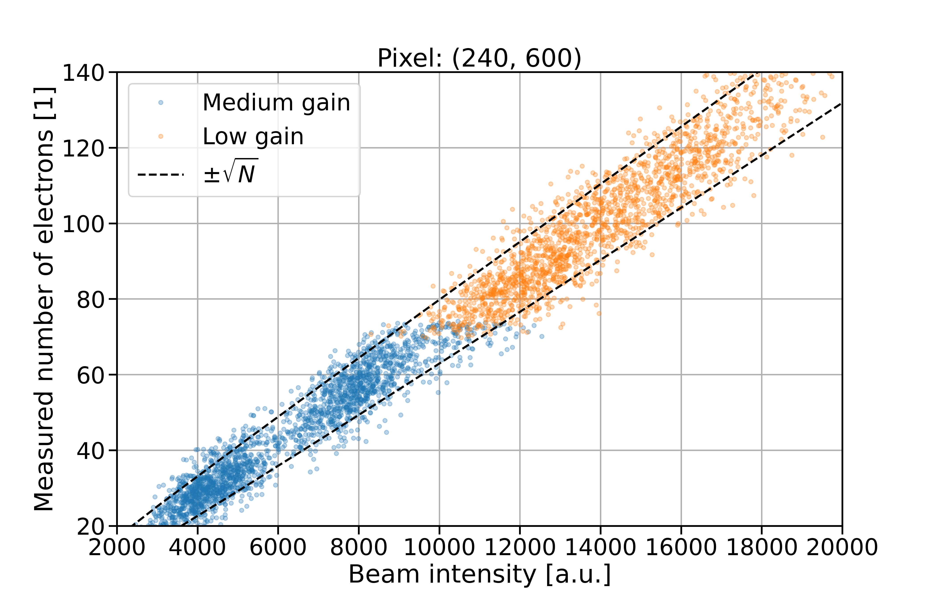
Gain switching in single pixel

Slide 19
Slanted edge MTF
Standard technique to measure spatial resolution
How to stop MeV electrons?
3mm tungsten ok for 5-10MeV…
Mount edge as close to the sensor as possible
Flatfield correction (non uniform beam)
Tungsten edge mounted on detector
Note: Not final configuration

Slide 20
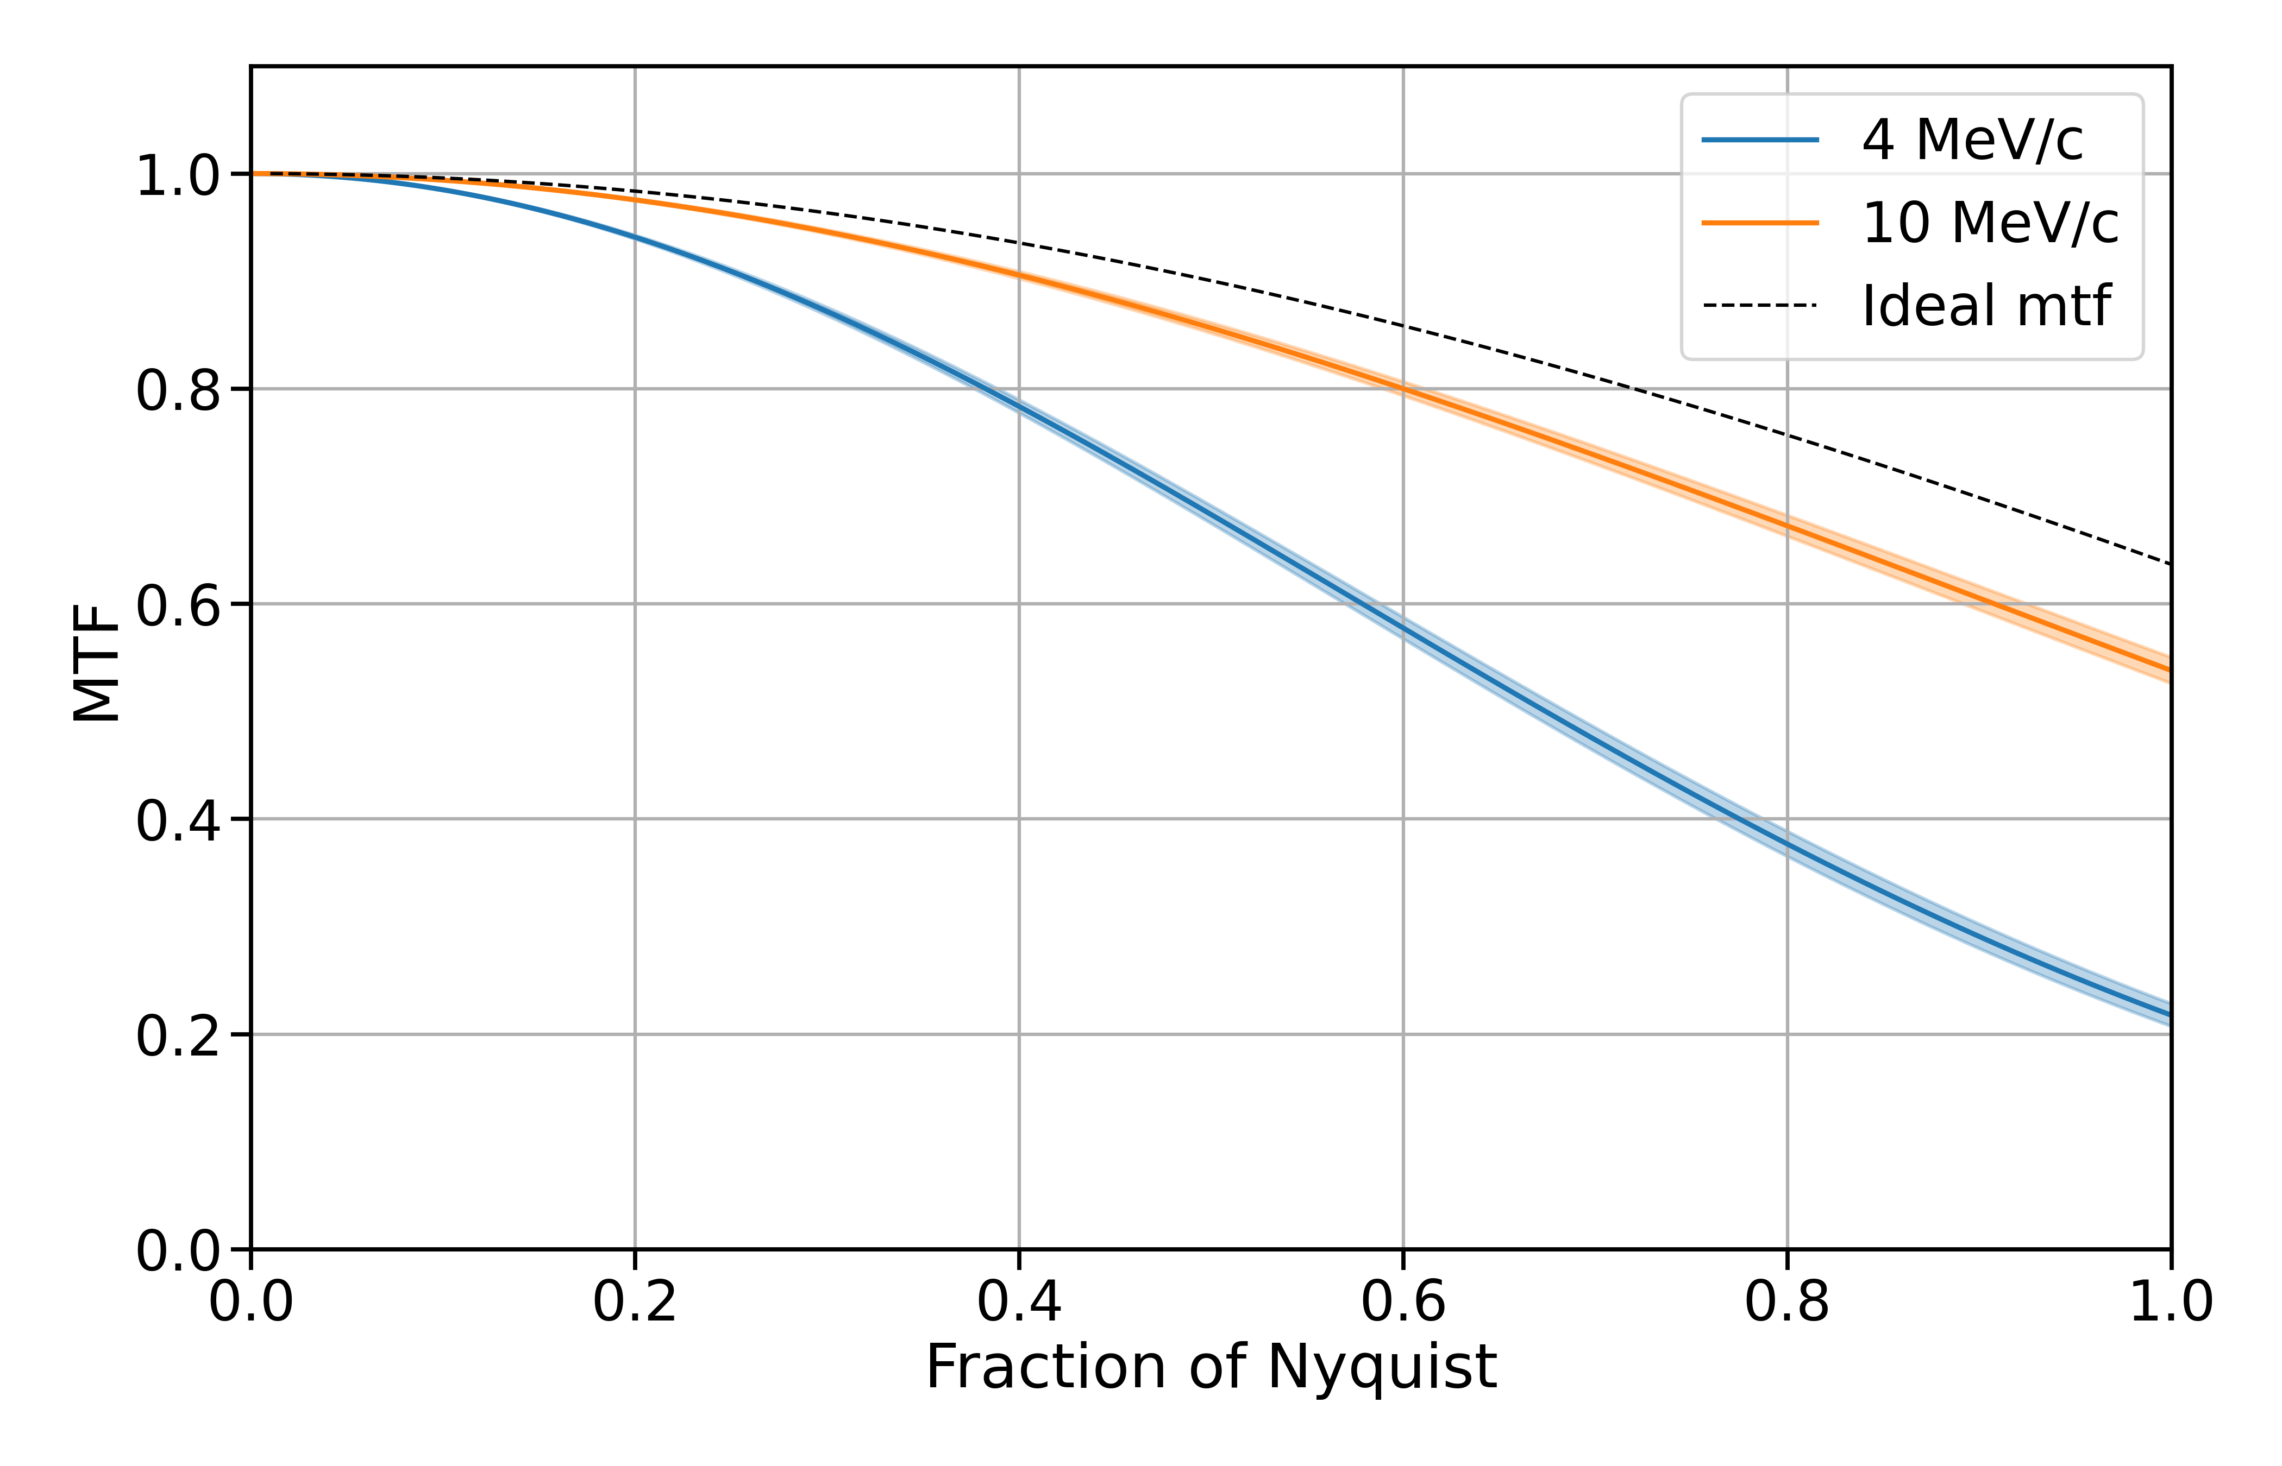
Measured MTF at 4 and 10 MeV/c
Close to ideal response at 10 MeV
Still suffering from scattering in the sensor layer at 4 MeV
Thinner sensors?
Simulation study

Slide 21
Conclusions
Linerar response over full dynamic range
Sensitivity close to Poisson distribution of incoming particles
X-ray calibration holds for electrons (as expected)
“Good” spatial resolution which could be improved with a thinner sensor?
JUNGFRAU is a suitable detector for not only for X-ray, but also electron diffraction experiments

Slide 22
Future experiments…
Simulation study to optimize sensor layer
Radiation hardness measurements
Make use of the higher repetition rate and bunch charge
Diffraction experiment
Together with another group (internal or external)

Slide 23
Thank you for the great support!

