Slide 1
Challenges of data acquisition and analysis
Lewis R. Reid 5th July 2022

Slide 2
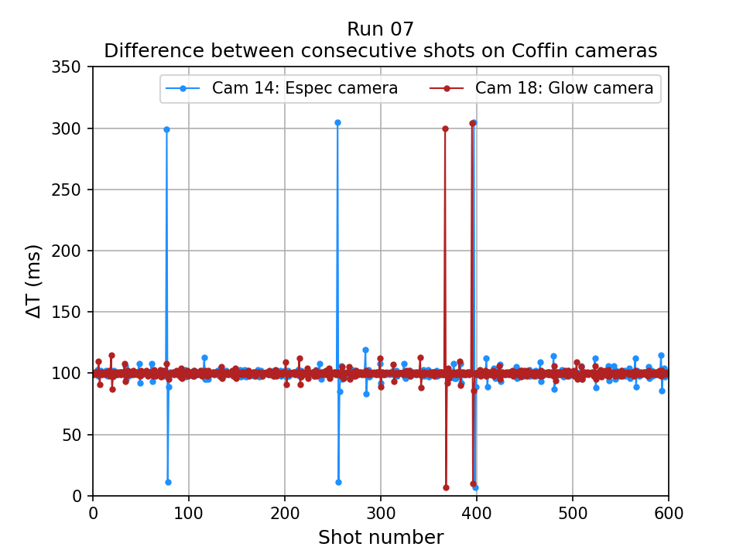
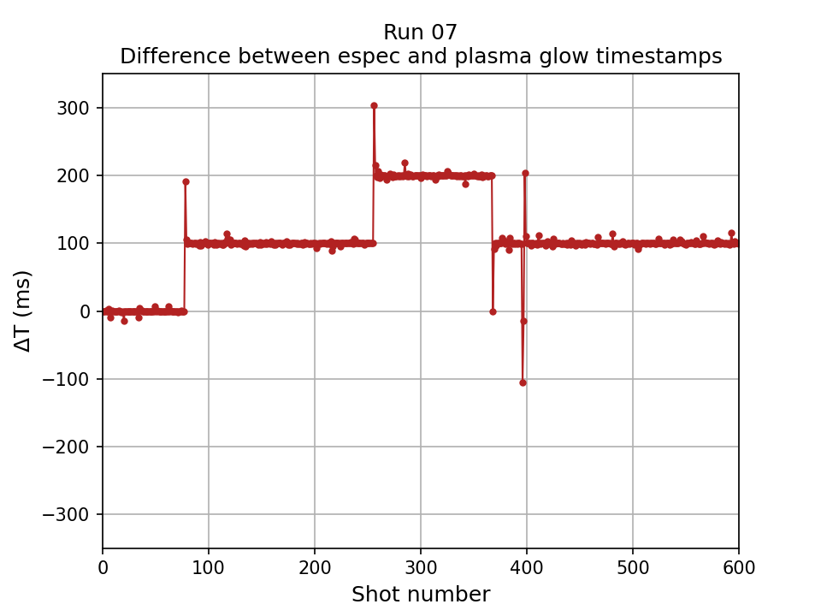
Re-alignment of Coffin camera images
Initial analysis showed that we can’t assume that the image numbers on the plasma glow and electron spectrometer cameras can be trusted. i.e. for a given run, the i^{th} spectrum image doesn’t always correspond to the i^{th} glow image.
Images should be spaced by 100 ms but a range of 10-300 ms has been observed.
This is important as the plasma glow camera is how we determine whether the gas jet fired or not.
Top image: Plot of difference in camera timestamps for 600 consecutive images for each of the two cameras individually. Majority of shots have close to image every 100 ms but some outliers cause problems.
Bottom image: Plot of difference between time stamps on corresponding plasma glow and espec camera images.
Images for aligned for ~80 shots then are no longer in synchronisation. “gas on” and “gas off” images are mislabelled from this point onwards.

Slide 3
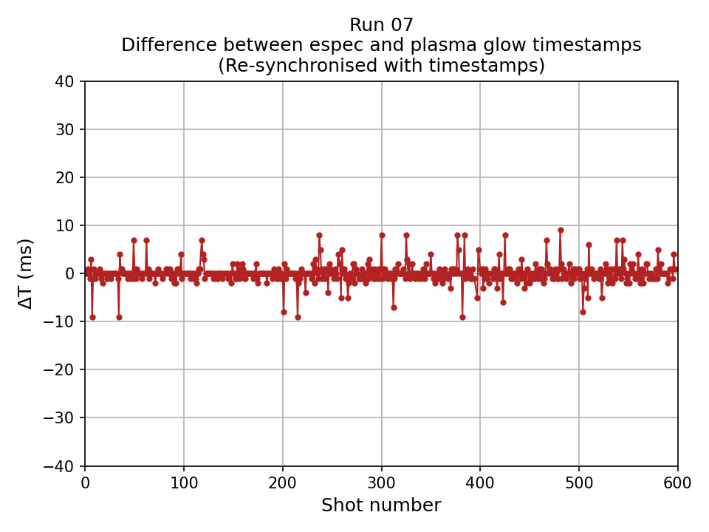
Re-alignment of Coffin camera images
The shots are realigned using the timestamps on the camera images themselves but very strict limits have to be placed on this. I call shots aligned when the timestamps are within 10 ms – much shorter than the 100 ms spacing between shots. This process works however it is not perfect:
Around 3% of shots are discarded.
There is occasional instances of two images being captured within a few ms – one electron spectra image will have two suitable candidates for the glow image.
The number of images discarded is acceptable with two diagnostics but more complex, future, experiments could result in a large proportion of the data to be castaway when this issue starts to compound.
After image realignment

Slide 4
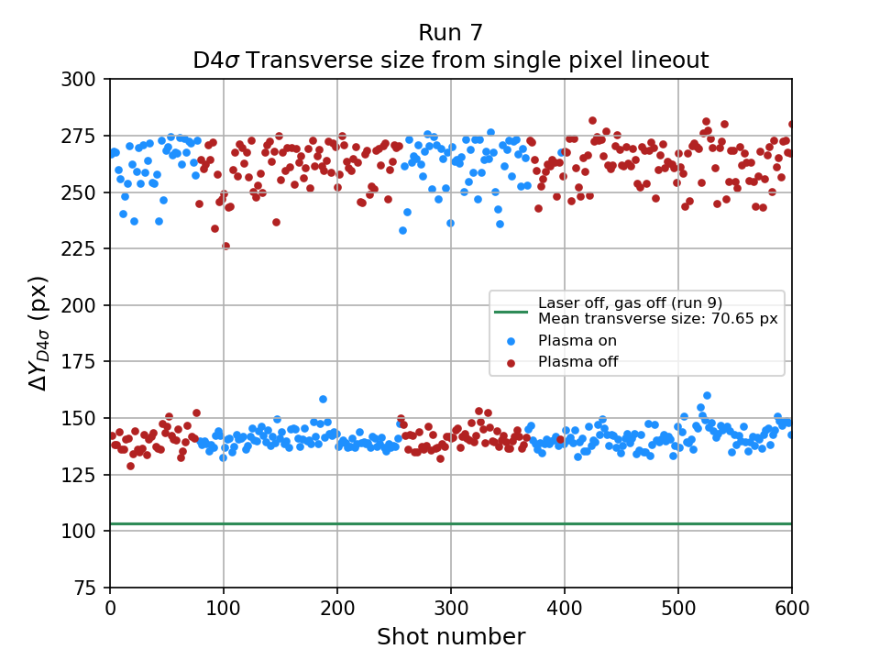
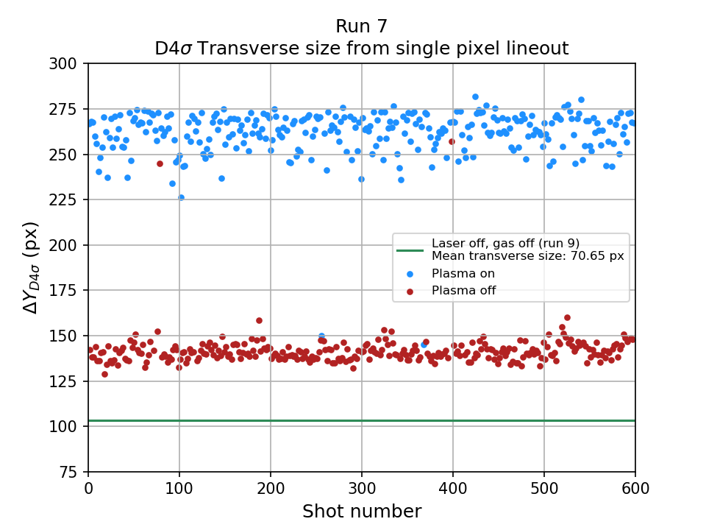
Re-alignment of Coffin camera images
After image realignment
After image realignment

Slide 5
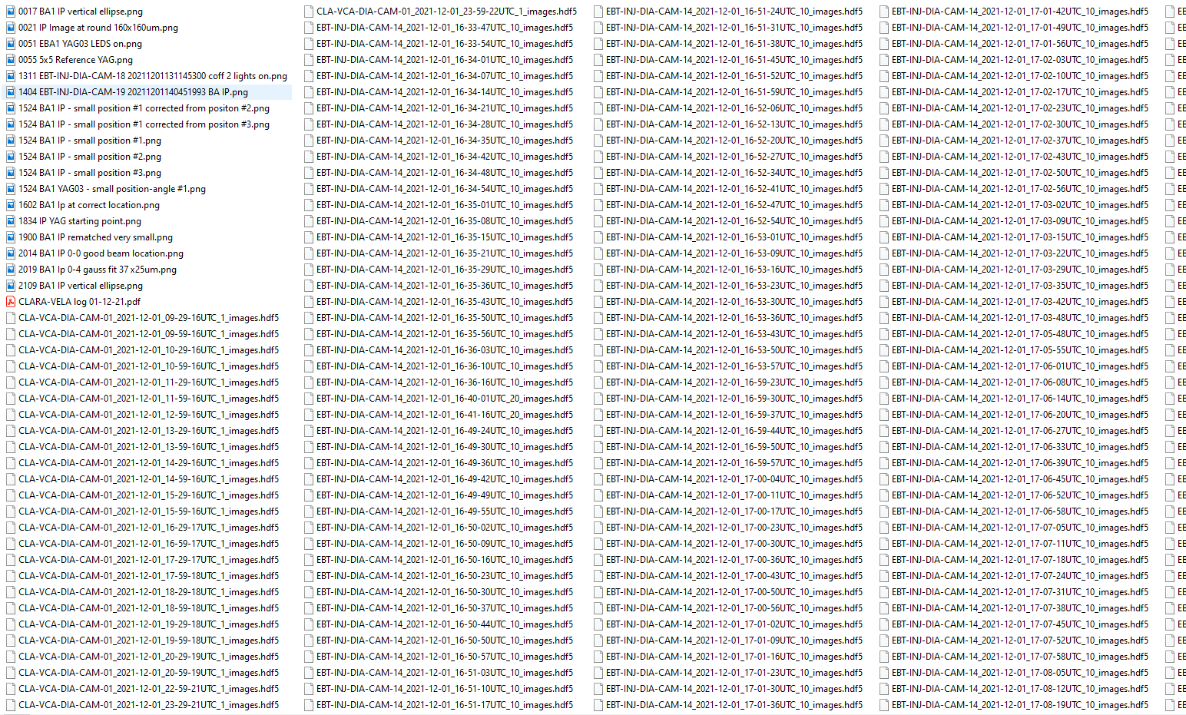
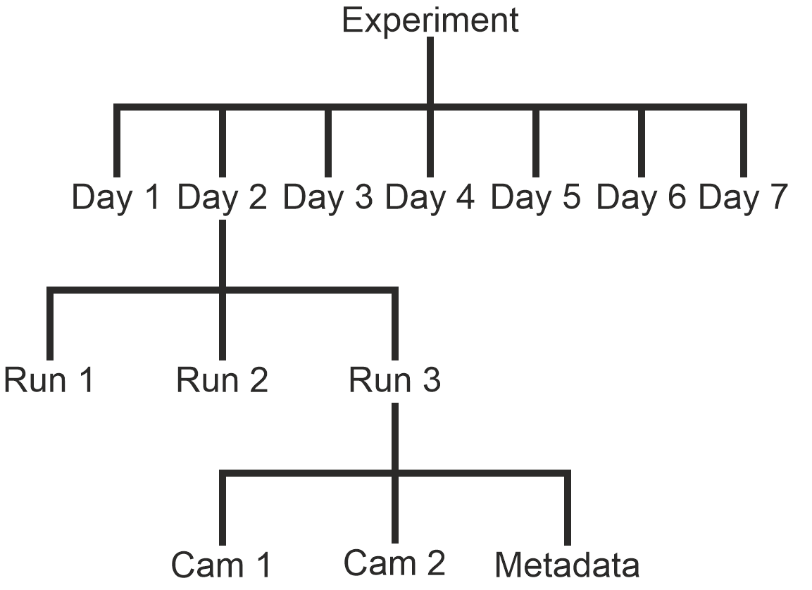
Structure of data acquisition
Lack of experience and time in the control room pre-experiment meant that no code was prepared ahead of the exploitation time
All data was saved by date with files for a given day in a single directory
Detailed notes had to be taken throughout the experiment to keep track of the files and the file names.
For future campaigns, we would aim to work on data acquisition sooner in the planning process and would want to test acquisition
We would want to build the directory structure into the acquisition for easier tracking of files and simplifying analysis.
This is inline with the open research framework and may be necessary as open data sets become more fashionable - The structure of how the data is saved will be important for this to be understandable for others.

Slide 6
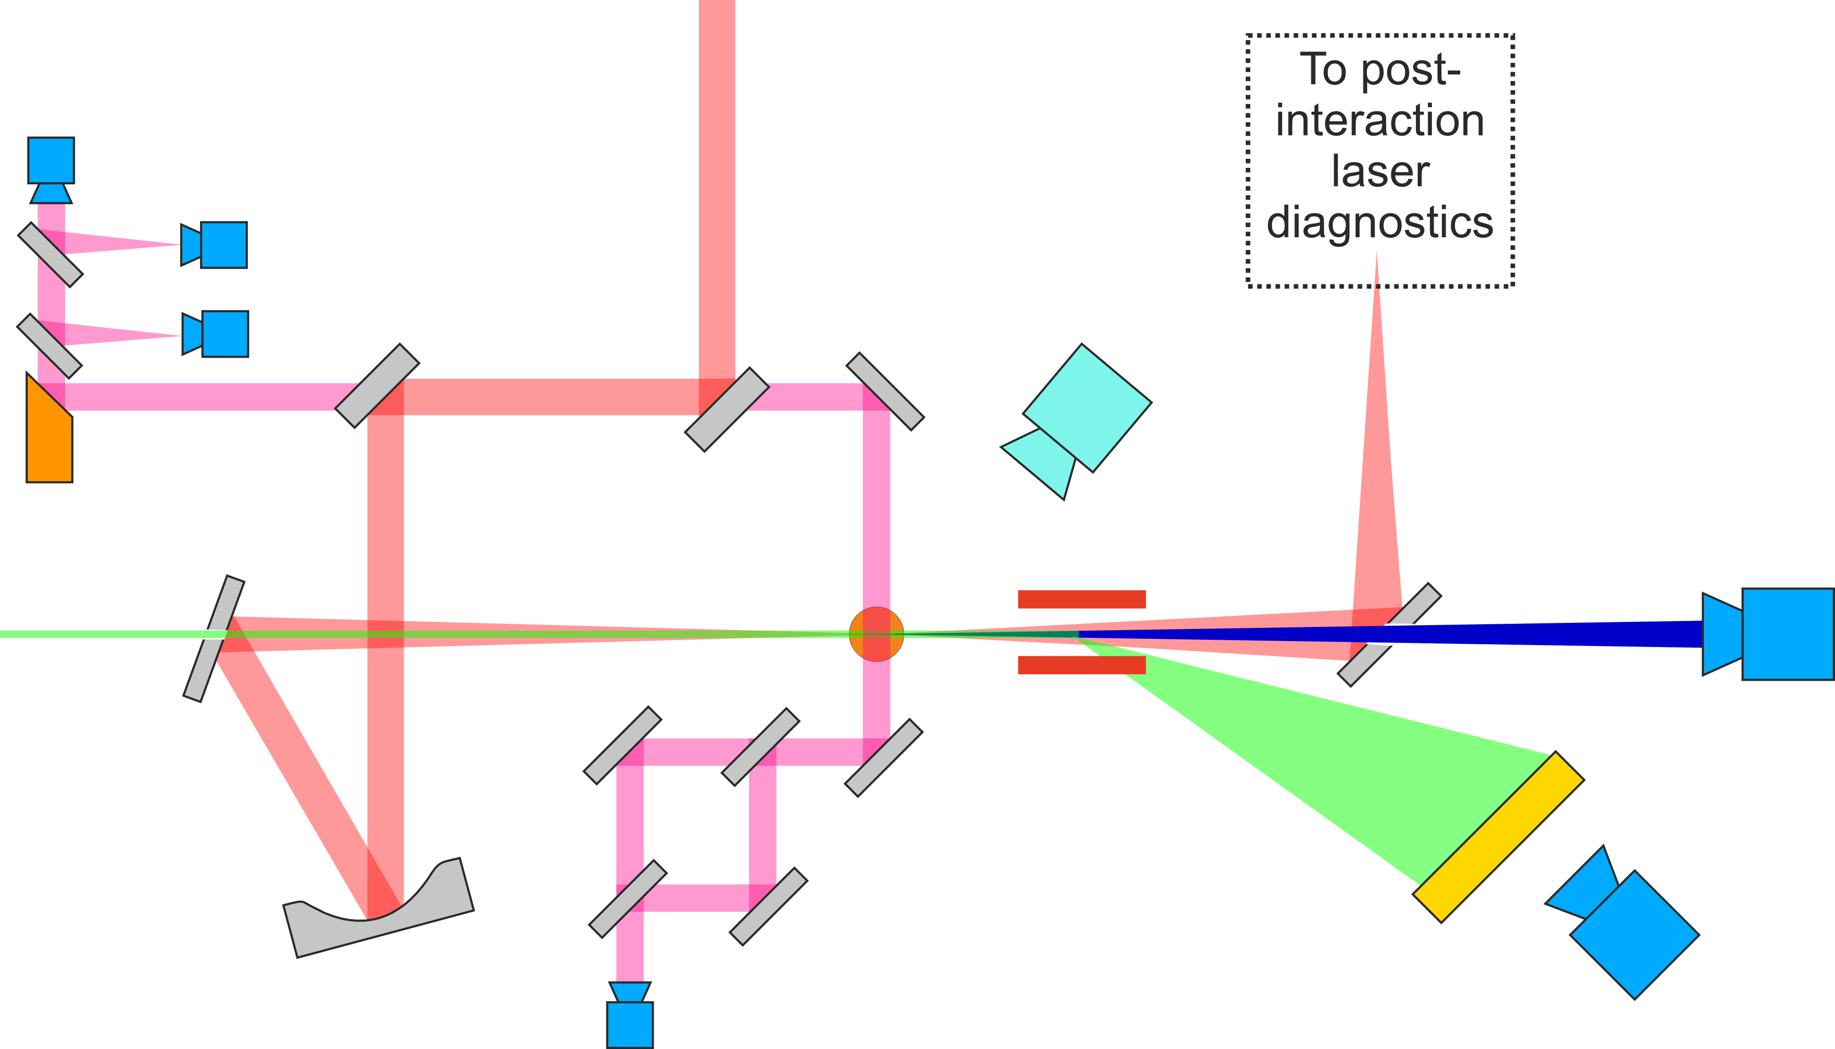
Diagnostics for future campaign
As an example what we may want to do in the future, we have considered the on-shot diagnostics that we would like to install for a follow up experiment:
Electron beam spectrum
Electron beam charge
Laser beam energy
Laser beam spectrum
Laser beam pointing / jitter
Laser time of arrival
Electron beam time of arrival
Plasma density (transverse laser probe)
Plasma glow
Betatron x-ray spectrum
In an ideal world, the data acquisition system should be able to would be able to save these with confidence in the synchronisation between all the files. Organising this volume of data would require a great deal of thought.

Slide 7
Conclusions
Data synchronisation and timestamping will be critical in the future especially as number of diagnostics and complexity increases.
The network infrastructure may be something we need to look at to support this.
Designing the DAQ system to be ready for future experimental campaigns is something that can only be achieved if facility scientists and users work collaboratively.
Planning for data acquisition and structure of how it is saved is critical for experiments. In future, we would place equal emphasis on this as the physics we are investigating.
Open data and open datasets are coming, planning and preparing now may save a lot of problems in the future.

Slide 8
Notes:
If you need any help using this presentation, contact the Marketing Communications team on 0151 794 3214 or email: mcteam@liv.ac.uk.

