Slide 1

Transverse beam dynamics in dielectric wakefield structures
Y. Saveliev, T. Overton, T. Pacey, G. Xia
Beam delivery team: N. Joshi, S. Mathisen, B. Muratori, N. Thompson, M. King
CLARA User Meeting
5 July 2022

Slide 2
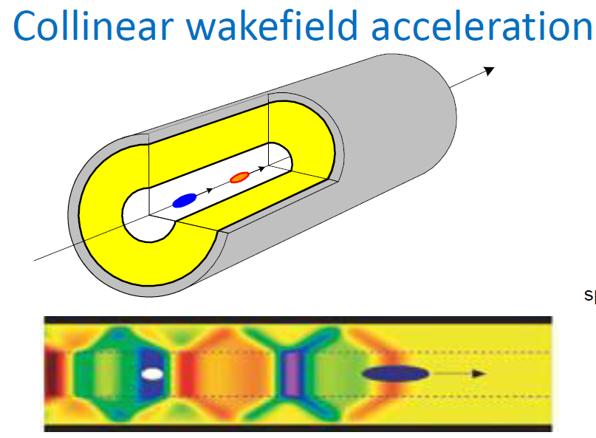
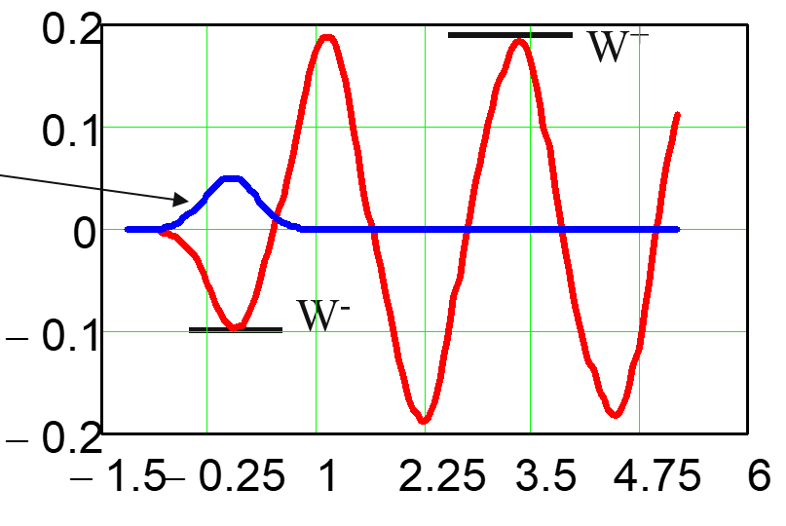
Dielectric Wakefield Acceleration (DWA) : novel concept
Main (accelerated) bunch
Drive bunch
>300MeV/m accelerating gradients demonstrated experimentally
~ GeV/m gradients feasible

Slide 3
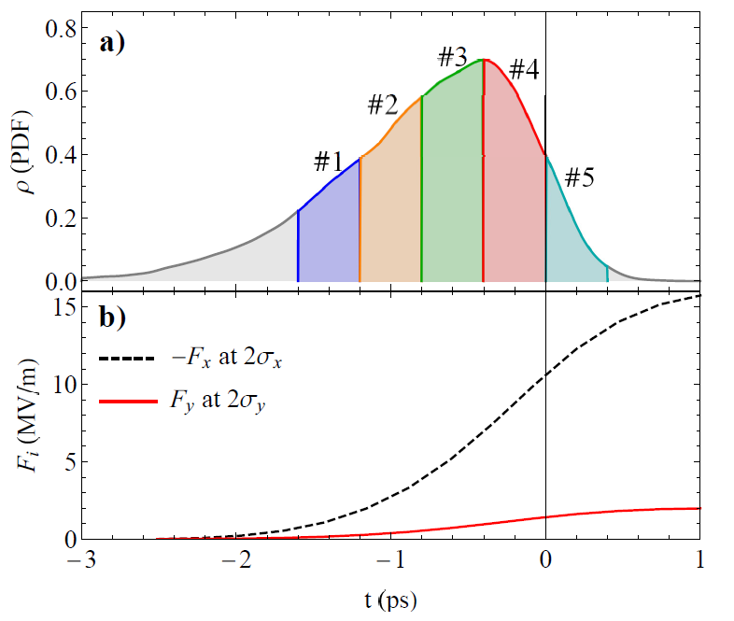
Transverse wakefields
Quadrupole wakefields. Beam on axis.
Transverse (and longitudinal !) wakefields increase towards the tail of the bunch
Dipole wakefields. Beam off-axis.
Beam Breakup (BBU) instability

Slide 4
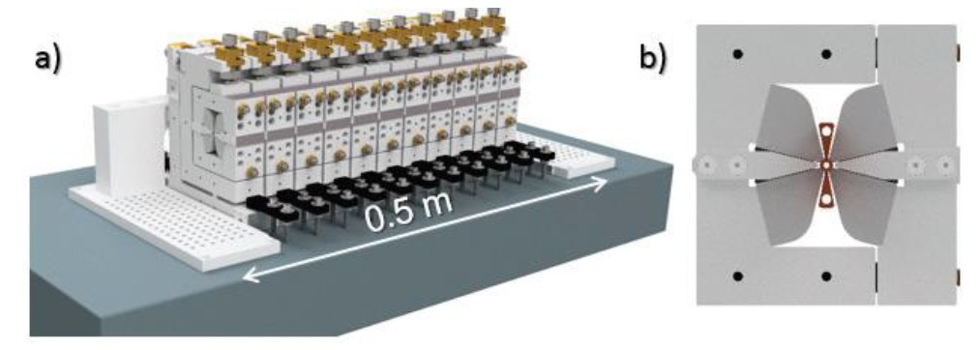
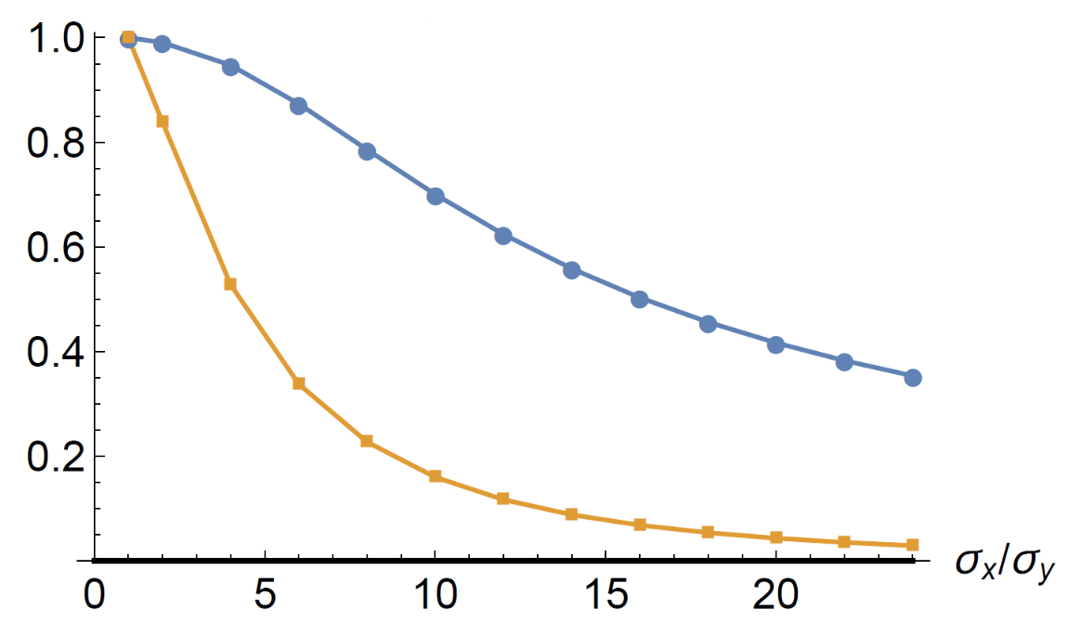
BBU suppression concepts
BNS damping
Circular structures
Quadrupole “wiggler”
High aspect ratio (flat) beams
Planar structures
Ez
Fy

Slide 5
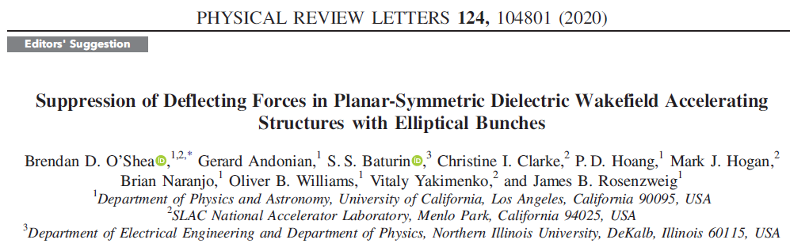
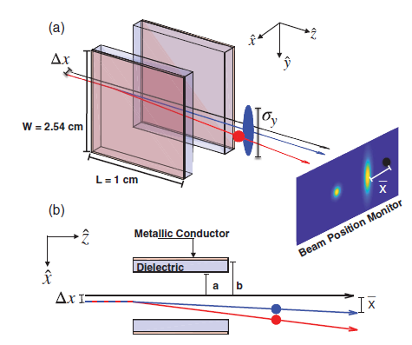
Transverse beam dynamics studies
Many publications on theory and computer simulations
Very little on experimental studies
Only one experimental work on high aspect ratio elliptical beams
Very short structure (10mm)
BPMs are used (not screens)
Very small structure gap (<1mm)
Very high beam energy (20GeV)
Cannot measure quadrupole wakefields
Cannot measure longitudinal wakefields

Slide 6
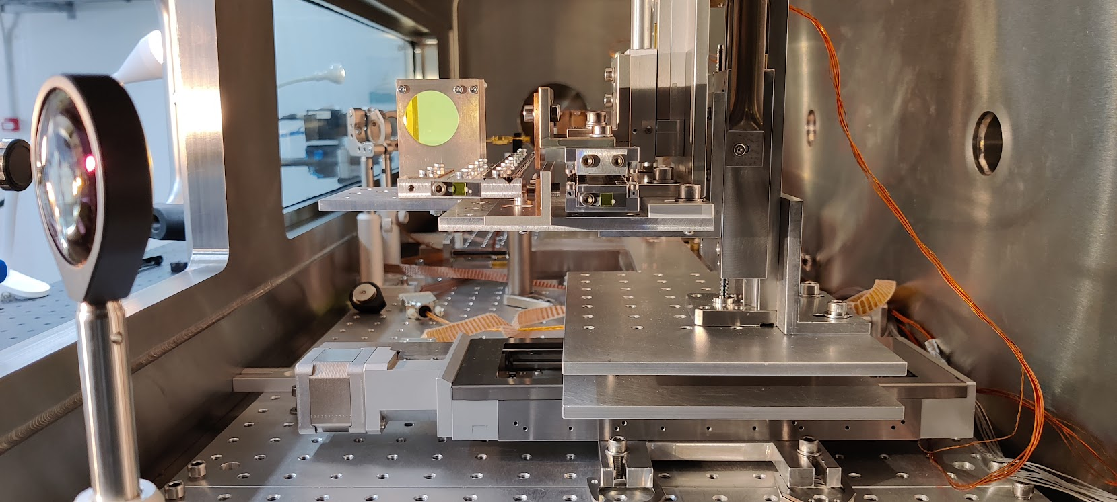
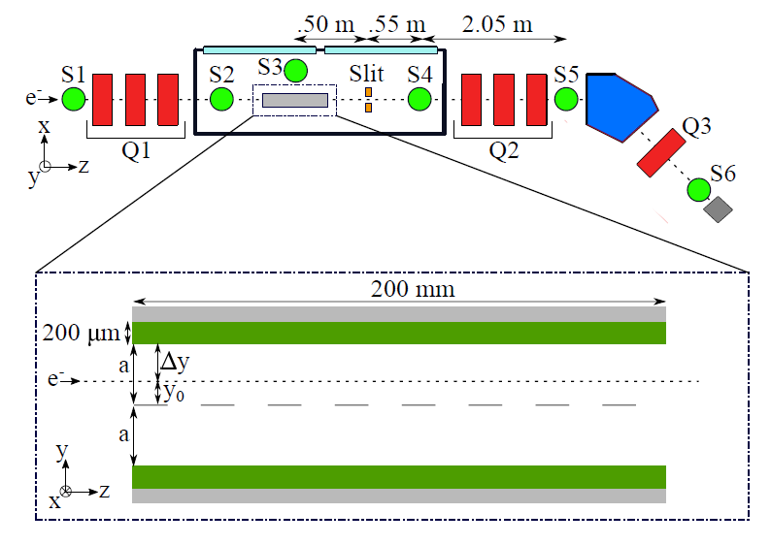
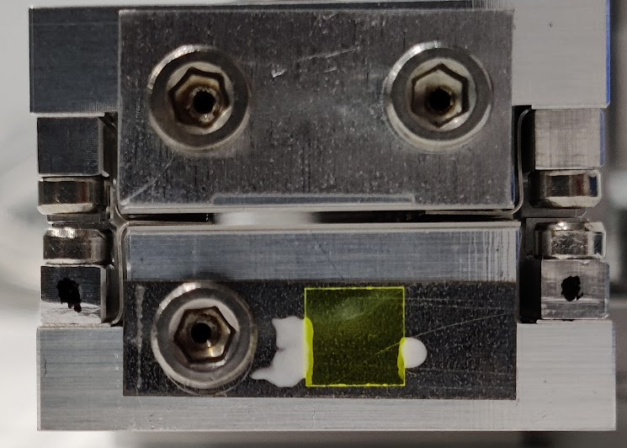
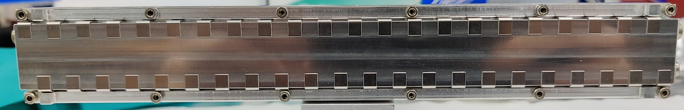
CLARA BA1 experiments
DWA structure: ½ of the CLARA wakefield energy dechirper

Slide 7
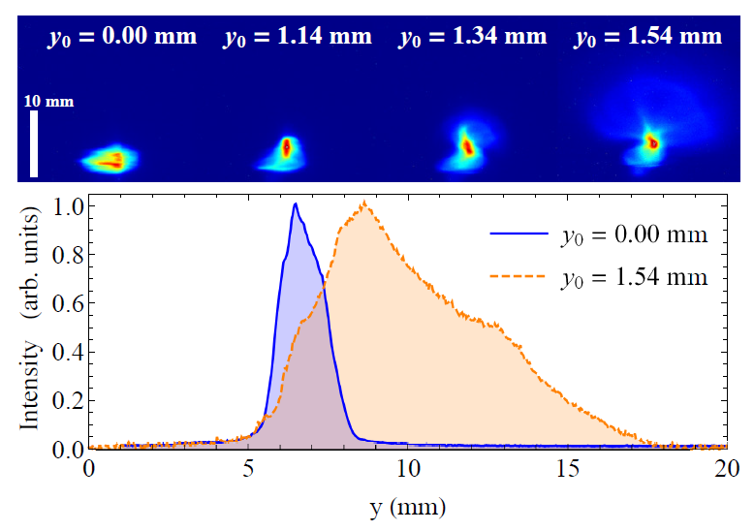
Elliptical beams study (1)
Beam energy 35 MeV
Bunch charge 85-100 pC
RMS bunch length 300 & 800fs
RMS beam size (H) 150-1500 μm
RMS beam size (V) 150 μm
Combined effect of quadrupole and dipole wakefields
Dipole wakefield streaks the beam vertically
Strong Fx: overfocussing takes place close to the bunch head
Streak profiles can be used for the bunch length and longitudinal profile reconstruction
Beam images with vertical offset from axis
&
Vertical image profiles

Slide 8
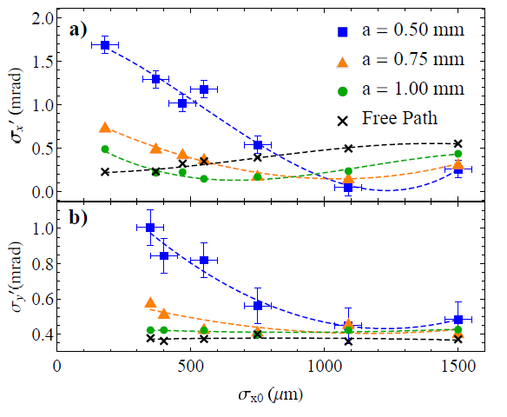
Elliptical beams study (2)
Beam divergence in H and V planes vs horizontal beam width
Complex behaviour in H-plane
More straightforward behaviour in V-plane
Reduction of divergence in V-plane (Fy) with σx but …
… smaller effect at larger gaps
Horizontal (focussing) force cannot be discounted in practical DWA implementations

Slide 9
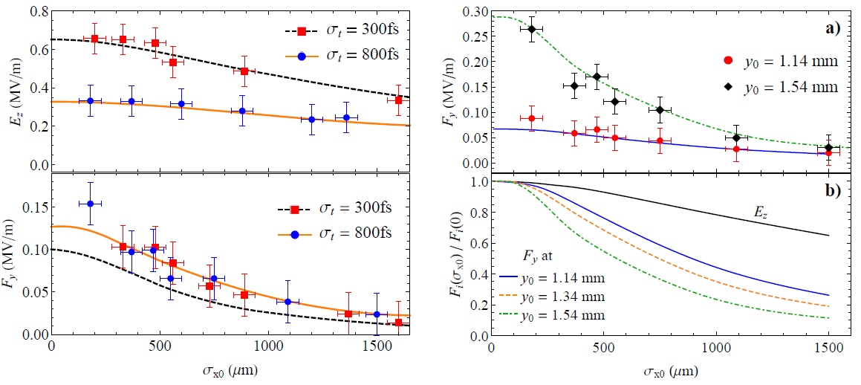
Elliptical beams study (3)
Average Ez and Fy vs horizontal beam width
Average Ez and Fy calculated from centre-of-mass change
Excellent agreement with computer simulations
Faster drop in Fy compared to Ez
The above more pronounced when beam is closer to dielectric plate (helps with BBU)

Slide 10
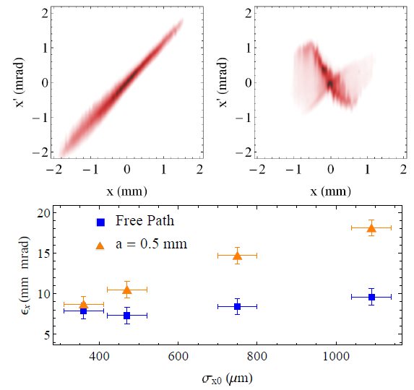
Elliptical beams study (4)
Transverse phase space and projected emittance with and without DWA
Measured by slit scans
Phase spaces provide insight into transverse beam behaviour
Expected rise of horizontal emittance with beam size

Slide 11
Elliptical beams study:
Conclusions and outcome
Excellent agreement of experimental data with simulations by in-house developed computer code
Demonstrated all trends predicted by theoretical studies
BBU suppression with elliptical beams seems to be working …
… but quadrupole wakefields may present a significant complication
… including focussing wakefields (due to reduction in beam size thus negating the effect of ellipticity)
Paper was submitted to PRL but was not accepted
One of the recommendations: scaling the results to practical DWA bunch parameters
Will resubmit to PRAB with added section on scaling
Other measurements have been made (gap and offset variation, comparison between planar and circular DWA structures etc.)
Emphasis on benchmarking of our in-house developed code
Work in progress
Submission to PRAB expected

Slide 12
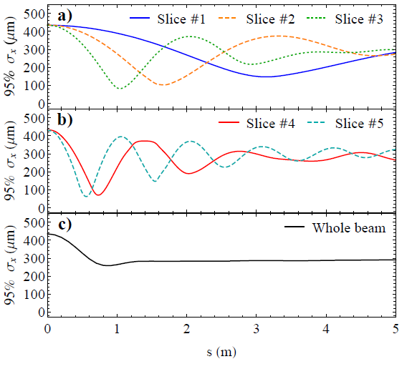
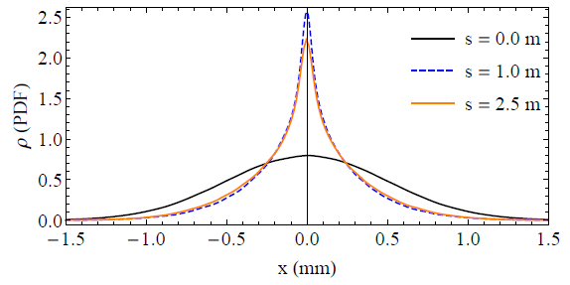
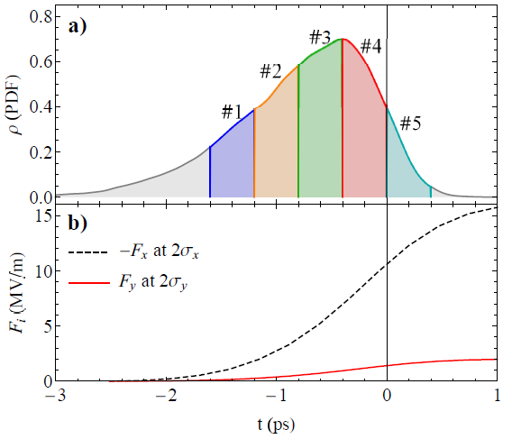
Scaling to practical DWA bunch parameters (1)
Bunch charge 10nC
Beam energy 1GeV
H-beam size 500μm
Bunch length (full) 3ps
Skew Gaussian
Structure gap 2mm
Horizontal profiles of the full beam
at s=0, 1.0 and 1.5m
Horizontal width of 5 longitudinal slices along the 5m structure

Slide 13
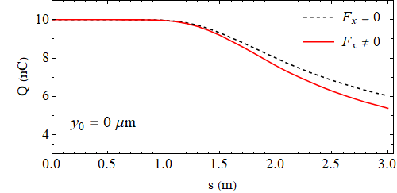
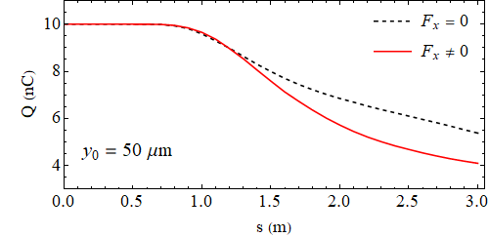
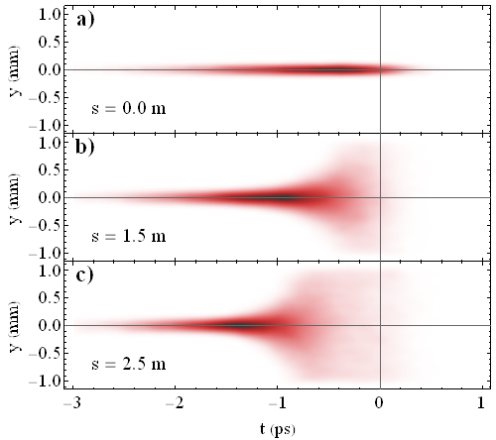
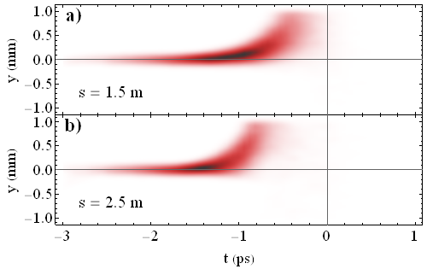
Scaling to practical DWA bunch parameters (2)
Lesser than expected effect from Fx but not negligible
Vertical (defocussing) wakefield leads to beam losses already after ~ 1m
500μm wide beam is still not enough to reduce BBU instability
Beam on axis
Offset = 50μm
Something need to be done with both quadrupole and dipole fields

Slide 14
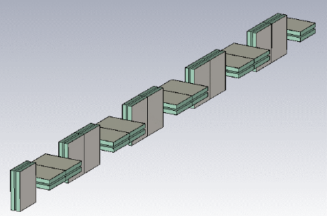
Scaling to practical DWA bunch parameters (3)
Quadrupole fields
Dipole fields
Use a sequence of short orthogonally oriented sections (similar to FODO)
Works well with small size circular beams (confirmed by simulations [Lynn et al. 2021 IPAC]
Unlikely to work for wide elliptical beams even with modest 500μm width (still insufficient wrt BBU)
Use even wider > 1000μm beams
Even less likely to be realisable
Are these results “killing” the concept of wide elliptical beams for suppression of BBU instability?
High impact publication
(not journal, - physics!)

Slide 15
Thank you
Facebook: Science and Technology Facilities Council
Twitter:@STFC_matters
YouTube: Science and Technology Facilities Council

