Slide 1
Overview of the call process, planning and scheduling, highlights from exploitation user feedback
Tim Noakes
CLARA Technical Co-ordinator
5th July 2022

Slide 2
Overview
Application process
Call for proposals
Technical assessments
Beam time allocation panel
Scheduling
Highlights from user feedback
Specific issues raised

Slide 3
Application process
Before the call for proposals issued documentation prepared
VELA_CLARA_Access policy – describing mechanism for access to the VELA/CLARA accelerator
VELA_CLARA_Evaluation_Criteria – describing the evaluation criteria for beam time Applications
VELA_CLARA_Useful information – describing VELA/CLARA accelerators and what users can expect during experimental runs
VELA_CLARA_ExploitationProposalForm – Beam time request application form
First two documents were unchanged from the previous call whereas the ‘Useful Information’ and ‘Proposal Form’ were modified
These documents distributed with the call for proposals

Slide 4
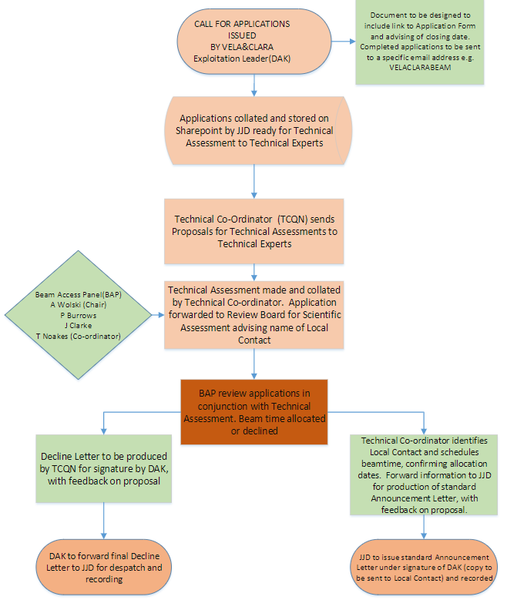
Overview of the process
Additional ‘flow diagram’ of the process also developed for internal use
All documentation and processes developed to be ‘compatible’ with existing STFC/EPSRC guidelines
Documentation and process to be reviewed again prior to next (CLARA/FEBE) exploitation period

Slide 5
Call for proposals
Call issued by Deepa Angal-Kalinin (CLARA exploitation leader) on 2nd July 2019
Deadline for submissions 15th August 2019
Applicants encouraged to contact ASTeC staff members to discuss individual requirements before submitting applications – many applicants did this!
22 applications received by the deadline
141 shifts requested out of available 70 – factor of 2 oversubscribed!
13 were for experiments in Beam Area 1 (BA1), most of which required significant set-up time in addition to experimental time

Slide 6
Technical assessments
Technical assessments carried out on all the proposals
Feasibility of experiment
Additional capabilities that might be required
Technical support and other resource that might be required and how this would be funded
Potential health and safety issues
Number of days requested/needed for experiment and set-up
Technical assessments carried out by Technical Co-ordinator (me!) and at least one other staff member
Some proposals were technically quite difficult which may have influenced the panel awarding beam time
The procedure is likely to change for future exploitation using CLARA/FEBE

Slide 7
Beam time allocation panel (BAP)
Beam time allocation panel met on 2nd October 2019
Prof Andy Wolski, Liverpool and Cockcroft Institute (Chair)
Prof Phil Burrows, Oxford and John Adams Institute
Prof Jim Clarke, ASTeC, STFC
Dr Tim Noakes, ASTeC, STFC (technical capacity only)
Three ‘voting’ members scored each proposal using the criteria outlined in the relevant document
Scores collated to form an initial ranking order
Pairwise comparison of proposals to form final ranking list
Sanity check of ‘diversity’ across the top ranking proposals
The vast majority of proposals met minimum criteria for allocation!

Slide 8
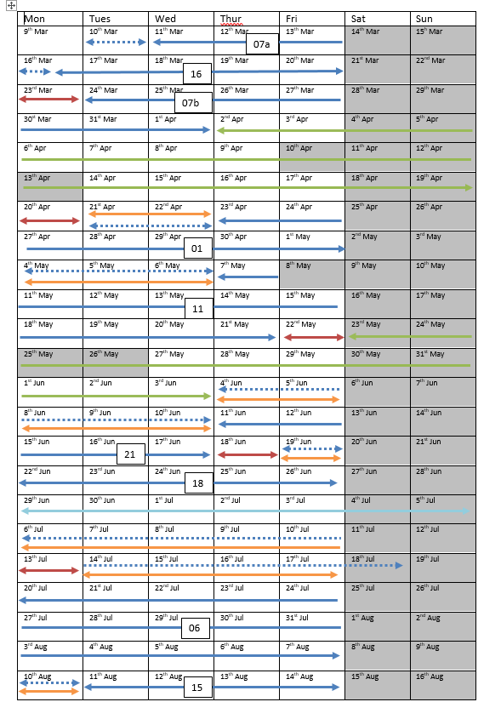
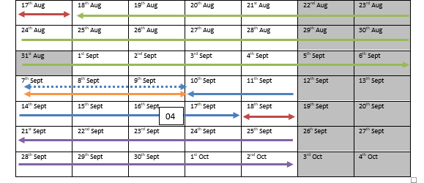
Scheduling
10 Experiments approved (including 3 ARIES trans-national access) but one dropped out before scheduling - decision not to reallocate time!
6 experiments required BA1 with 3 in the accelerator hall
8 hour shift/day with some flexibility to run on into the evening at the discretion of the local contact/beam delivery
Unlike the previous period time for routine maintenance contingency and machine characterization days also included.
Exploitation inter-dispersed with longer periods of High Repetition Rate Gun (HRRG) commissioning on the VELA line

Slide 9
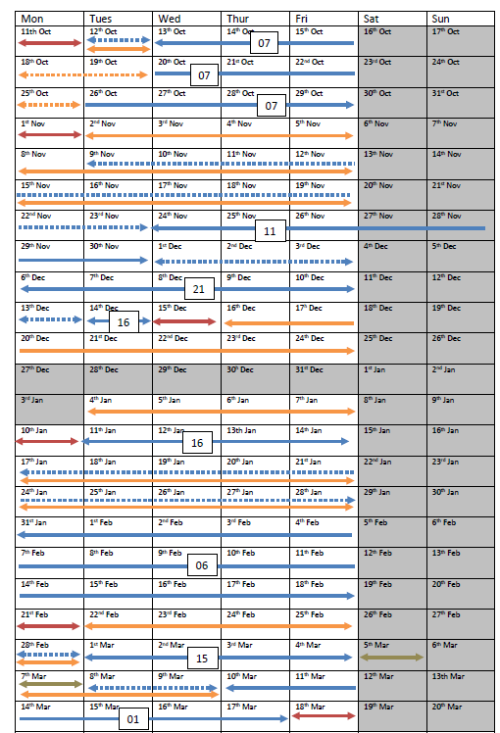
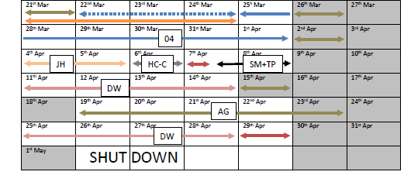
Final version of programme
Multiple attempts to re-schedule beam time (over 15 different schedules drawn up) due to Covid (and RF waveguide problems)
A second experiment was withdrawn before the run commenced
Decision to run exploitation as a single block (no HRRG conditioning until later) but with additional ‘maintenance’ time (effectively contingency)
Finally commenced 12th Oct 2021
We delivered the whole programme (despite Covid measures still being in place)
With some exceptions the programme ran relatively smoothly

Slide 10
Local contacts and teams
Each experiment allocated a different local contact from ASTeC staff
Contact point for experimental team
Should establish/more clearly define user requirements
Assist in the preparation of Risk Assessment and Methods Statements (ultimately users responsibility)
Try to ensure everything is ready at start of run
Support the users throughout the run
Also adopted a new ‘Teams’ way of working where beam delivery and key technical staff were identified in advance.
Better engagement of lab staff with the experiments
Improved planning through earlier involvement
Smaller number of dedicated beam delivery staff provide greater continuity

Slide 11
User Feedback
All users were requested to provide feedback on their experiences
Essentially we used the same form (with a few new questions) as previously to allow comparison of performance
In-house form - not professional!
Responses received from all 8 experiments run effectively covered the whole exploitation period!

Slide 12
Feedback form contents
Divided into sections looking at
Before the experiment
Set-up time
Experiment time
The future
General
Covered areas such as
Technical support
Beam delivery
Results have been collated and (hopefully) anonymised

Slide 13
Before the experiment (1)
Was sufficient technical information provided?
Agree/Strongly Agree (range Disagree to Strongly Agree)
Users would have preferred better knowledge of TW laser parameters, measured rather than simulated
Did they receive sufficient information about local procedures such as Health and Safety?
Agree/Strongly Agree (range Disagree to Strongly Agree)
Users commented that the risk assessment process was onerous and difficult to complete. They felt more help was required. Another commented on the uncertainty on which online training courses they needed to complete beforehand
Did they feel they had sufficient support in writing and Risk Assessment and Method Statement?
Agree (range Disagree to Strongly Agree)

Slide 14
Before the experiment (2)
Did their local contact adequately assist them in preparation?
Agree/Strongly Agree (range Disagree to Strongly Agree)
Some users wanted more and more inclusive preparation meetings and insufficient access due to over commitment of staff was also mentioned
Were sufficient details of TW laser performance provided where applicable?
Neutral/Agree (range Disagree to Strongly Agree)
Users stated that some key parameters were not known or at least not measured before the beam time commenced, However, others commented on the professionalism and expertise of the ‘laser delivery’ team.

Slide 15
Set-up time
Proportion of set-up time delivered?
88% delivered (range 66% to 100%)
BA1 vacuum issues (mostly mitigated by weekend working) given as reason for shortfall. Also need for additional equipment commissioning
Did they receive adequate access to areas and equipment during set-up?
Agree/Strongly Agree (range Disagree to Strongly Agree)
Personnel carrying out vacuum work and 'unreasonable limitations on out of hours laser modes' given. Guidance on how much time to ask for was also requested. Comments on the usefulness of being scheduled near to other similar experiments sharing the same set-up also made. Also compliments on how quick and easy set-up was.

Slide 16
Experiment time (1)
Proportion of beam time delivered?
100% (unanimous)
Were the beam properties as outlined?
Yes (unanimous)
One user mentioned poor transverse beam properties and another wanted more Gaussian beams. However, half the users commented on exceptional beam stability.
Were TW laser parameters as agreed beforehand?
Yes/No, and it impacted the experiment (80:20 split between answers)
Users commented on the professionalism of the laser support staff and impressive stability and repeatability of the TW laser but wanted more power.

Slide 17
Experiment time (2)
Where other facilities/capabilities (e.g. diagnostics) sufficient
Partially/Yes (range Partially to Yes)
More spatial and temporal diagnostics requested, issues with image data collection and lack of time stamping raised. Request for a trigger to indicate 'beam on'
Ability to interact with the machine for data acquisition?
Issues with image data collection and time stamping raised again. Comments such as ‘no problems at all’ and ‘the interaction was great’

Slide 18
Experiment time (technical support)
Mechanical support
Very Satisfied (unanimous)
Vacuum support
Very Satisfied (range Satisfied to Very Satisfied)
IT support
Very Satisfied (range Satisfied to Very Satisfied)
Other technical support
Very Satisfied (range Satisfied to Very Satisfied)
Comment that many staff had gone above and beyond what could be expected to make the experiment work.

Slide 19
Experiment time (scientific support)
Beam delivery/optimisation support
Very Satisfied (range Satisfied to Very Satisfied)
Laser support
Very Satisfied (unanimous)
Other scientific support
Very Satisfied (range Satisfied to Very Satisfied)
Comment from one user that they had accumulated more useful data than on any similar run on other facilities in the last 25 years

Slide 20
‘Teams’ mode of working
Benefits of working in new ‘Teams’ mode
Laboratory staff more engaged with experiment?
Agree (range Neutral to Strongly Agree)
There were noticeable benefits of working in this mode?
Agree (range Neutral to Strongly Agree)
Some users who response was Neutral were effectively already working in this mode. Users were generally in favour of the ‘Teams’ working mode

Slide 21
Experiment time (results)
Proportion of experimental programme completed?
Average of 79% (range 0% to 100%)
Likely impact
88% thought that they were likely to produce Journal (and conference) publications, some in high impact journals.
25% felt the work had contributed to the development of new accelerator technical systems
25% cited other impact such as material for Ph.D. theses and data to support future grant applications

Slide 22
The future and overall performance
Likely to want to access CLARA again in the next period?
75% Yes, 13% Maybe, 13% No.
Overall Experience of using CLARA
Satisfied/Very Satisfied (range Satisfied to Very Satisfied)
General comments
Beam and laser stability were good and spectrometer spatial resolution better than expected
Desire to run another experimental campaign as the capability is important for UK science
Staff were incredibly helpful but a concern that some were working at unsustainable levels
‘The facilities … more than met our requirements’

Slide 23
Issues arising from user feedback
Five areas identified
Planning – Some users recognised the need to be better prepared for their experiments
Risk assessments – Do users need more help with this?
Data acquisition and diagnostics – Requirement to save multiple image streams simultaneously and shot numbering
TW laser parameters – Not relevant when FEBE laser is online
Support – Need to develop a model that puts less burden on key individuals and removes ‘single points of failure’

Slide 24
Wash-up meeting
Internal meeting convened to consider both user and staff feedback
Round table discussions on three topics
User support (including role of local contact, ‘teams’ model)
Planning (including the preparation of risk assessments)
Data acquisition (including multiple image stream recording and shot numbering/time stamping)
Many suggestions that will feed into preparations for CLARA/FEBE exploitation in the future

Slide 25
Summary
Outline of the beam time allocation process given
Process to be reviewed prior to CLARA/FEBE exploitation
Results of the user feedback survey presented
User satisfaction with the CLARA exploitation period very high – lots of high quality science done!
High level of support and attitude of staff was a key reason for this success
A few issues raised which should be fed into plans for future CLARA/FEBE exploitation

Slide 26
Thank you
astec.stfc.ac.uk
@ASTeCSTFC

