Slide 1
Bayesian Data Analysis for Interpreting QENS Experiments
Sanghamitra Mukhopadhyay
ISIS Facility, Rutherford Appleton Laboratory, Chilton, Didcot, Oxfordshire OX11 0QX

Slide 2
Motivation
Using Bayesian data analysis for neutron spectroscopy
  Analysis of Quasi elastic neutron spectroscopy (QENS) involves fitting of number of peaks where their characteristic parameters predict physical processes underlining of any dynamical event.
  Bayesian Data Analysis used to analyse complicated data consists of complicated spectrum
Development of the tool for the purpose of analysis of QENS data on neutron instruments
  Convolution with instrument resolutions
  Quantitative understanding of the quality of peak fitting
  Sequential fitting and multidimensional data fitting
Implementation of robust and efficient algorithm for high throughput QENS data analysis

Slide 3
Outline
What is QENS spectra?
What is Bayesian data analysis ?
Fitting Algorithm for Bayesian Analysis of Data (FABADA)
Implementation of FABADA in Mantid
Examples of QENS data fitting
Summary
Outlook

Slide 4
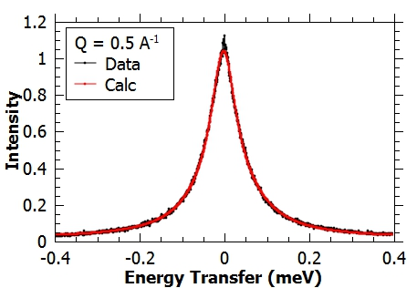
What is Quasi Elastic Neutron Scattering (QENS) ?
QENS is used to study the rotational and diffusive motions of atoms and molecules in materials.
The four dimensional data is often analysed by fitting with number of Lorentzians
The width of Lorentzian (Γ) depends on Q and temperatures

Slide 5
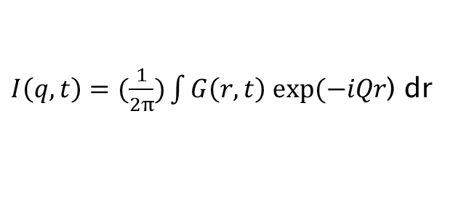
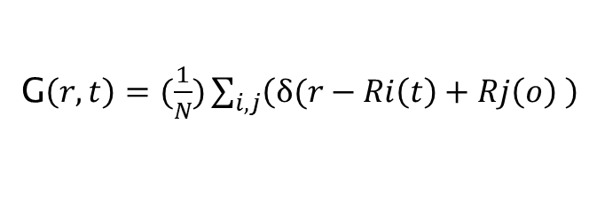
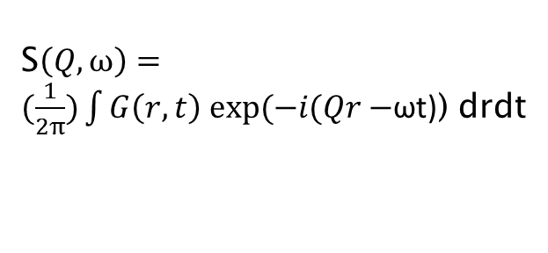
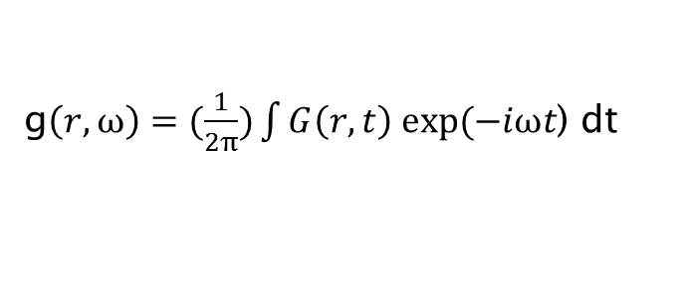
Molecular Dynamics for INS and QENS
t
Molecular dynamics space
Intermediate scattering function
van Hove correlation function
Q
r
Dynamic structure factor
Frequency dependent radial distribution function
Neutron scattering space
ω

Slide 6
QENS Experiment on molten NaF ionic liquid
The Γ(Q) determines the mechanism of diffusion
Each Lorentzian is associated with particular type of molecular motion so it is important to know how many Lorentzian are there in a single peak
F. Demmel and S. Mukhopadhyay, J. Chem. Phys. 144 14503 (2016).

Slide 7
Diffusion Models for QENS
The model determines different types of mechanisms of diffusions

Slide 8


QENS Experiment to design solid acid catalyst
Diffusion modes of cyclohexanone oxime passing through a pore with active sites (red), Top: Smooth Fickian diffusion means the oxime diffuses straight down the pore. Bottom: Jump diffusion sees the oxime move between active sites with a specific residence time.
The Q dependence of the HWHM of the Lorentzian for Zeolite-Y (left) and SAPO-37 (right) obtained from QENS experiment on OSIRIS
M. E. Potter et al., ACS Catal., 7 2926 (2017).

Slide 9
Bayesian Data Analysis
Statistical methods are used to analyse complicated data consists of several overlapping peaks, backgrounds and spurions.
Bayes Theorem
H : Hypothesis
D: Experimental data
I: Implicit information
Model selection (How Many Lines are there?)
Where M is the number of peaks, χ is the cost function
PDF P(χ²) is calculated by the FABADA code

Slide 10
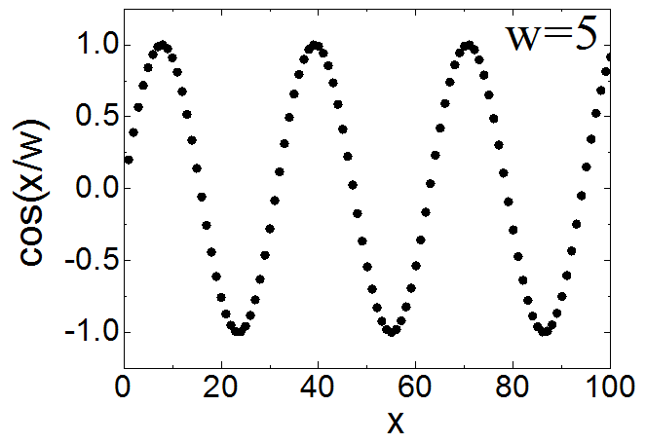
Classical fitting schemes: two main problems
... a simple function

Slide 11
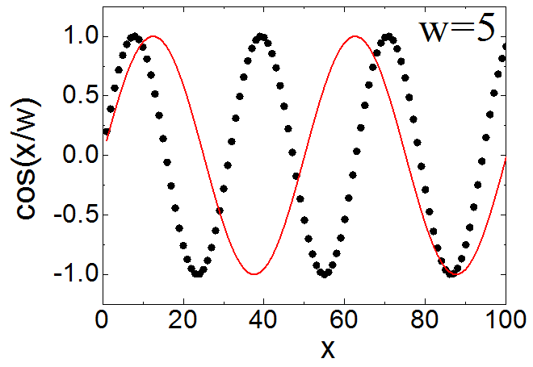
Classical fitting schemes: two main problems
... a simple function
WHY IS IT NOT FITTING?????

Slide 12
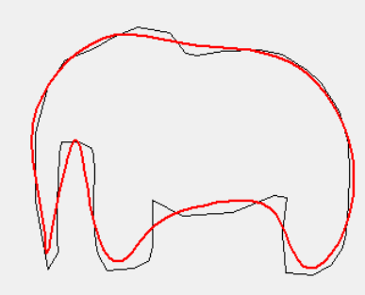
Classical fitting schemes: two main problems
... model selection is often dangerous:
With four parameters I can fit an elephant,
and with five I can make him wiggle his trunk.
Von Neumann

Slide 13
Classical fitting schemes: two main problems
... model selection is often dangerous:
With four parameters I can fit an elephant,
and with five I can make him wiggle his trunk.
Von Neumann
Goodness of fit quantified by a single number
... having into account the number of parameters m

Slide 14
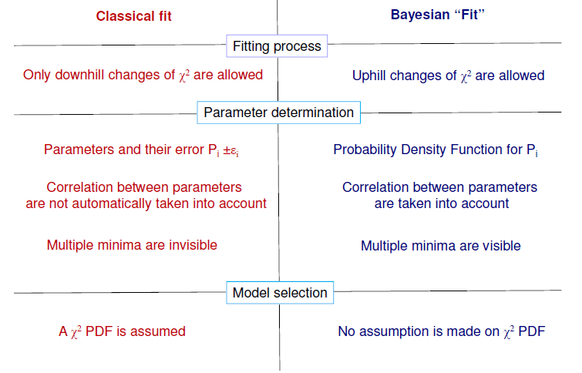
Bayesian Data Analysis

Slide 15

Fitting get’s stuck
Model selection
χ² landscape minimum
χ² landscape exploration

Slide 16
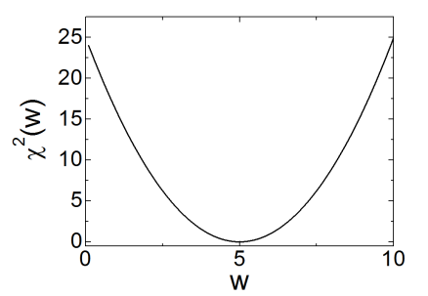
Fitting get’s stuck
Model selection
χ² landscape minimum
χ² landscape exploration
How it is supposed to be
How it is supposed to be
Single global minimum
Squared well

Slide 17
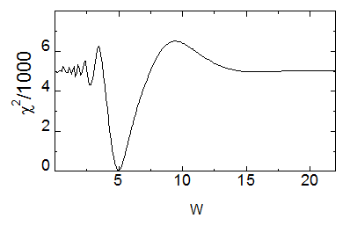
Fitting get’s stuck
Model selection
χ² landscape minimum
χ² landscape exploration
How it is supposed to be
How it is supposed to be
Single global minimum
Squared well
How it really is
How it really is
Multiple minima (unable to jump)
It is not squared

Slide 18
FABADA
Fitting Algorithm for Bayesian Analysis of Data
FABADA algorithm uses Markov Chain Monte Carlo method and Gibbs sampling to find out the local minimum of χ² and calculates probability distribution function.
It is a general purpose algorithm can be used anywhere where Bayesian analysis is required
To perform the best fit, a model selection algorithm also runs within FABADA which selects the preferred number of peaks and their parameters by minimising the cost function.
We have adapted this algorithm to analyse QENS
https://gcm.upc.edu/en/members/luis-carlos/bayesiano

Slide 19
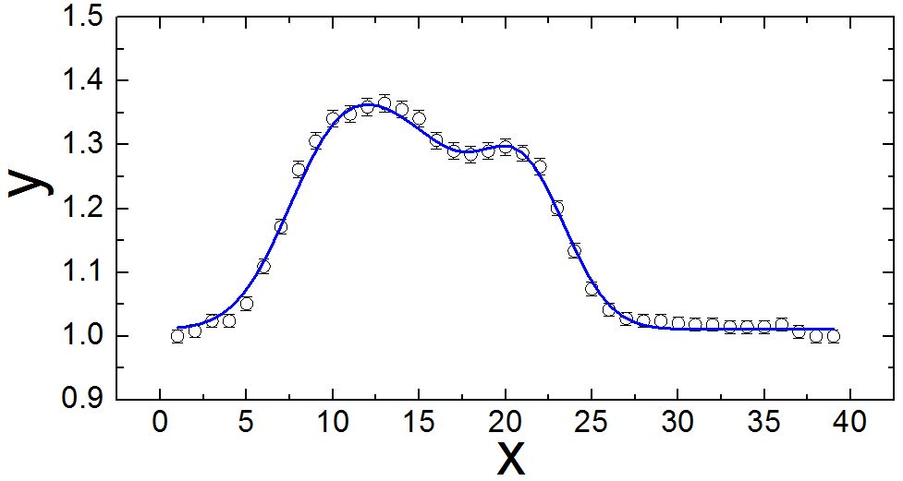
Bayesian tool to explore χ² landscape
Step | χ² | P₁ | P₂ | P₃
1 | 1.368·10⁴ | 1.341 | 0.0023 | 10.223
2 | 1.360·10⁴ | 1.342 | 0.0023 | 10.223
3 | 1.362·10⁴ | 1.342 | 0.0023 | 10.223
4 | 1.348·10⁴ | 1.342 | 0.0022 | 10.170
... | ... | ... | ... | ...
χ²_{old}

Slide 20
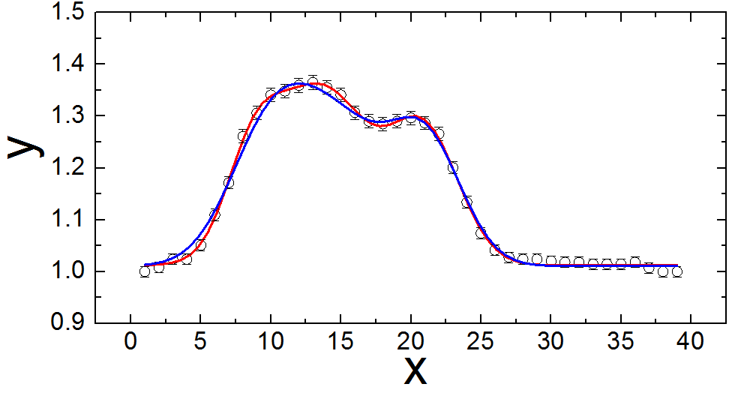
Bayesian tool to explore χ² landscape
Step | χ² | P₁ | P₂ | P₃
1 | 1.368·10⁴ | 1.341 | 0.0023 | 10.223
2 | 1.360·10⁴ | 1.342 | 0.0023 | 10.223
3 | 1.362·10⁴ | 1.342 | 0.0023 | 10.223
4 | 1.348·10⁴ | 1.342 | 0.0022 | 10.170
... | ... | ... | ... | ...
Acceptance rules:
If better always
If not, with probability
χ²_{new}
χ²_{old}
χ²_{old}

Slide 21
Bayesian tool to explore χ² landscape
Step | χ² | P₁ | P₂ | P₃
1 | 1.368·10⁴ | 1.341 | 0.0023 | 10.223
2 | 1.360·10⁴ | 1.342 | 0.0023 | 10.223
3 | 1.362·10⁴ | 1.342 | 0.0023 | 10.223
4 | 1.348·10⁴ | 1.342 | 0.0022 | 10.170
... | ... | ... | ... | ...
Acceptance rules:
If better always
If not, with probability
χ²_{new}
χ²_{new}
χ²_{old}
χ²_{old}
(Adaptive Gibbs Sampling Algorithm)

Slide 22
Bayesian tool to explore χ² landscape
fit
analyze

Slide 23
Bayesian tool to explore χ² landscape
fit
analyze
It does not get stuck

Slide 24
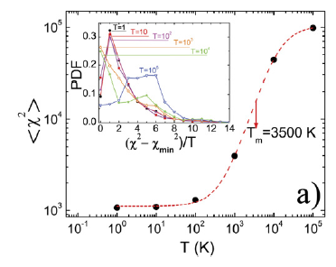
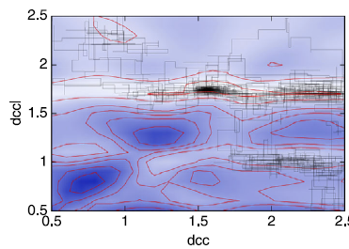
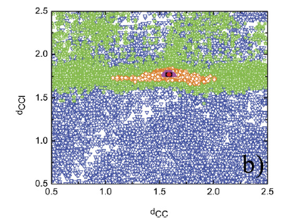
Bayesian tool to explore χ² landscape
fit
analyze
It does not get stuck
... and if it does
we increase the errors
Simulated annealing
A 2D χ² landscape
Warming up the fitting

Slide 25
Bayesian tool to explore χ² landscape
fit
analyze
It does not get stuck
Robust parameter
estimation
δP=σ
Parameter estimation:
Parameters are obtained as PDF's not as P±δP

Slide 26
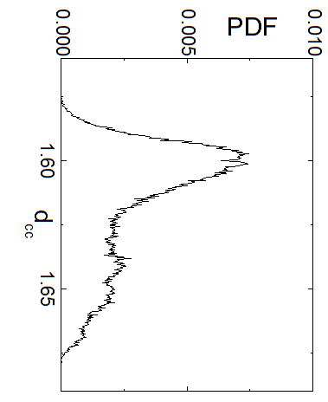
Bayesian tool to explore χ² landscape
fit
analyze
It does not get stuck
Robust parameter
estimation
Parameter estimation:
Parameters are obtained as PDF's not as P±δP

Slide 27
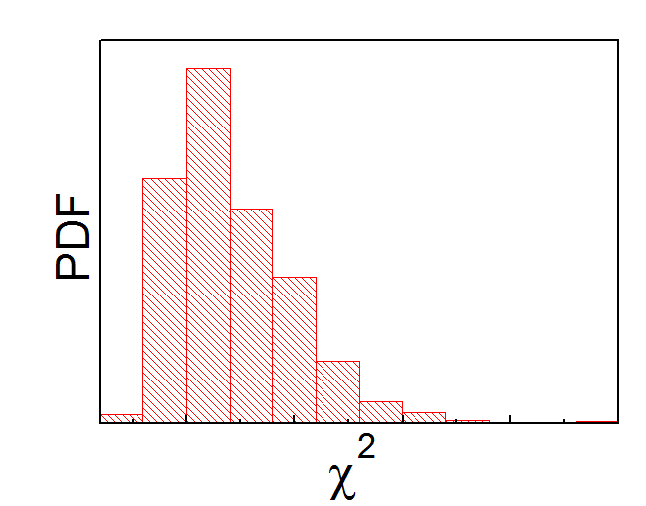
Bayesian tool to explore χ² landscape
fit
analyze
It does not get stuck
Robust parameter
estimation
Robust model selection
Model selection:
all possible combinations of parameters are investigated
and their χ² calculated

Slide 28
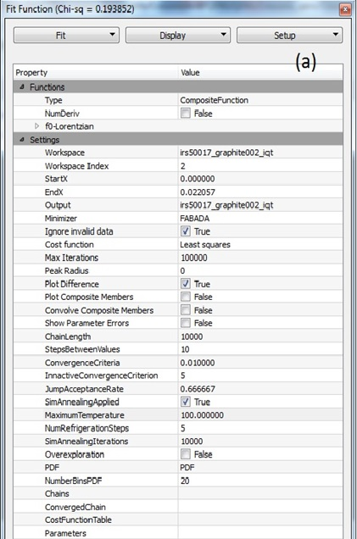
FABADA in Mantid (FIM)
FABADA has been implemented as a general purpose minimiser in fit wizard in Mantid
Choose FABADA as minimiser
Use high value for maximum number of iterations
Use of simulated annealing is optional
Define temperature if simulated annealing is chosen
https://www.mantidproject.org/MantidPlot:_Simple_Peak_Fitting_with_the_Fit_Wizard

Slide 29
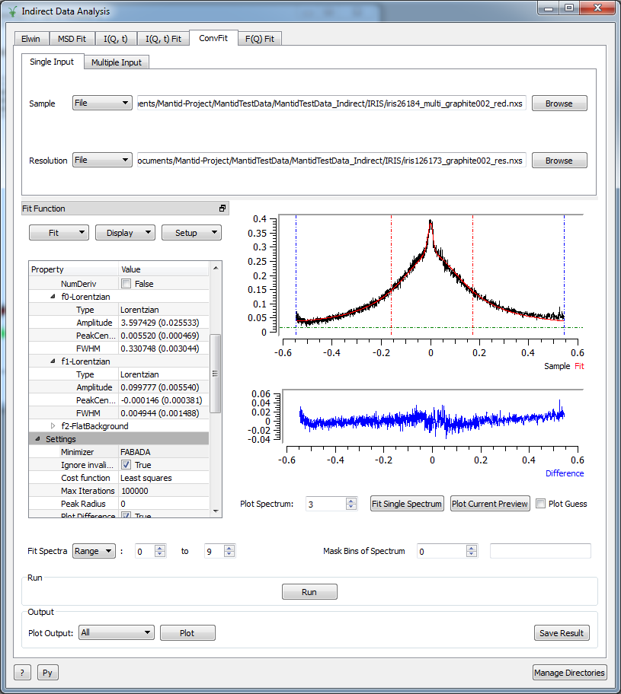
FIM as an Interface
D Monserrat, A Vispa, LC Pardo, R Tolchenov, S Mukhopadhyay, F Fernandez-Alonso, J Phys Conf. Ser 663 (2015).

Slide 30
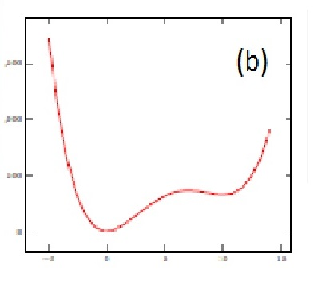
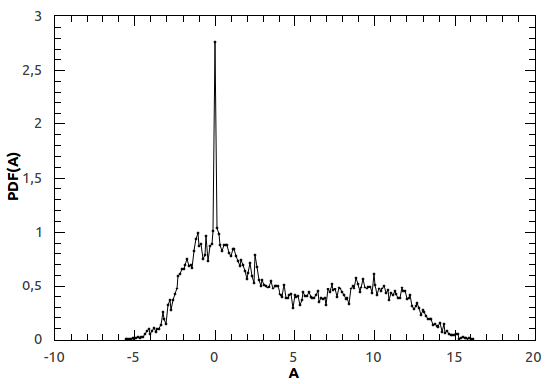
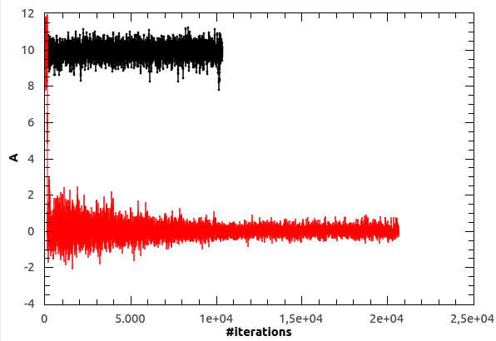
Recent Updates : Simulated Annealing
Simulated annealing can be used to find out global minimum
BL Vidal, E Oram, RA Banos, LC Pardo, S Mukhopadhyay, and F Fernandez-Alonso, J. Phys. Conf. Ser 1021, 12012 (2018).

Slide 31
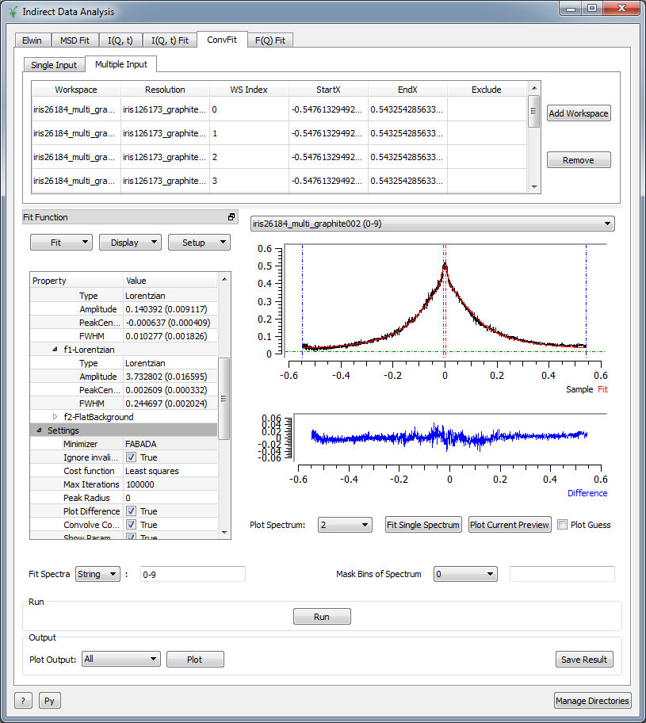
Multi dimensional Data Fitting
In multi dimensional data fitting option one can get option to fit several parameters simultaneously, such as amplitude and energy transfer
or
fix FWHM of certain peaks

Slide 32
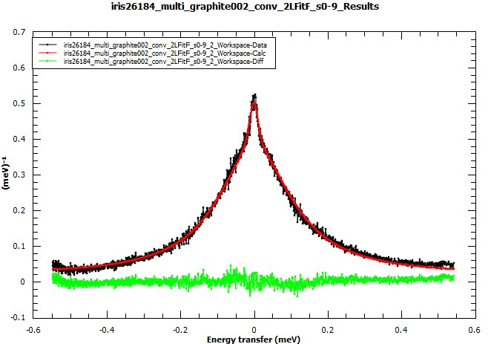
Fitting QENS Data
A typical plot and results after fitting a QENS spectrum using FIM

Slide 33
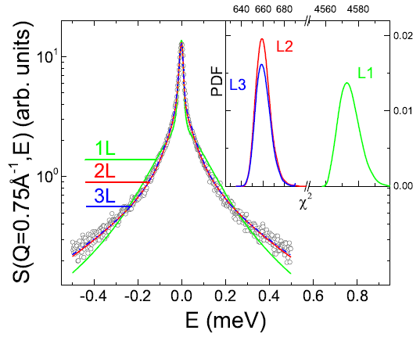
Fitting QENS Data
FABADA is used to fit QENS data obtained from IRIS instrument at ISIS.
There is no gain by using L=3 over L=2 for this QENS fitting
A. Vispa, D. Monserrat, G. J. Cuello, F. Fernandez-Alonso,S. Mukhopadhyay, F. Demmel, J.Ll. Tamarit, and L. C. Pardo, Phys Chem Chem Phys 19 20259 (2017)

Slide 34
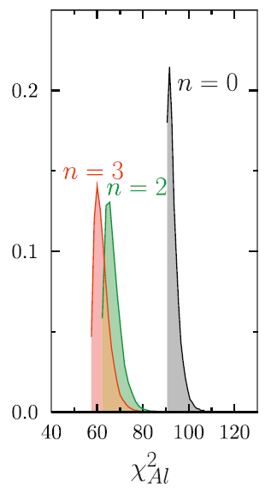
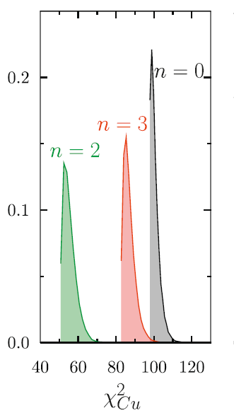
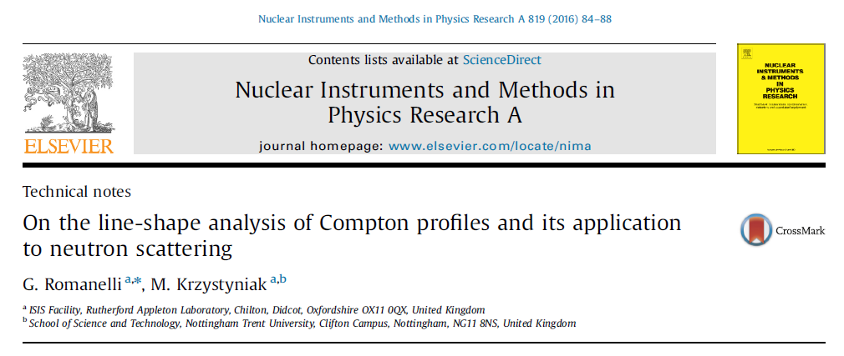
Fitting Neutron Compton Profile
Gaussian peaks are fitted using FIM for analysing data obtained from VESUVIO instrument at ISIS
N=3 is the better fitting for Al but not for Cu

Slide 35

How Machine Learning can Help for High Throughput QENS
With sample changer our capacity has improved by three times
Required high throughput data analysis
20 Q points
X 3 Lorentzian
X 10 temperatures
X 3 samples
= 1800 peak fitting
Supervised learning ?

Slide 36
Summary
Bayesian analysis is useful to analyse complicated data consists of several overlapping peaks, backgrounds and spurions.
FABADA algorithm has been implemented in Mantid to facilitate Bayesian analysis
The next step is to introduce machine learning using Bayesian methodology for high throughput QENS

Slide 37
Outlook
Dealing with sparse, low-count-rate data in a statistically rigorous fashion
The definition of quantitative criteria for a systematic analysis of the information content (and associated correlation) of the underlying PDFs
The development of a library of models starting with those typically used for the analysis of QENS and Compton data
The use of genetic algorithms and machine learning to increase overall efficiency for high throughput data analysis

Slide 38
Acknowledgements
Universitat Polit`ecnica de Catalunya and the UK Science & Technology Facilities Council for their continued support of this collaborative work
Mantid team at ISIS for helping the implementation
Friendly Users group of Molecular Spectroscopy for testing the implementation patiently
Thank you for your attention !

