Slide 1
Atlassian & DAFNI
James Hannah - Systems Team Meeting, June 2022

Slide 2
DAFNI uses Atlassian for…
Software development (“Agile”)
Internal Documentation
…NOT System Support, Asset Catalogue, Service Mgmt (yet)

Slide 3
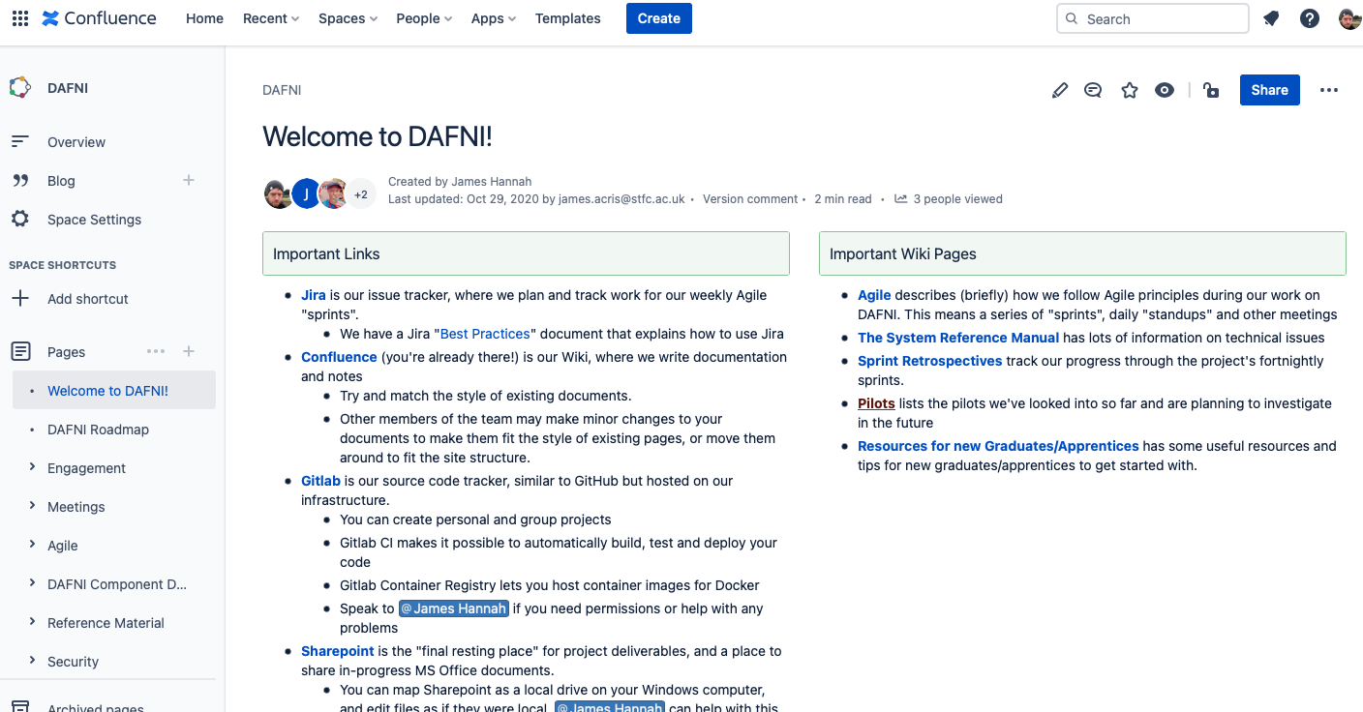
Project documentation (Wiki)
We’ve used this as our wiki since the start of the project
Management of the hierarchy is required

Slide 4
Confluence Thoughts
It’s a pretty good wiki
Looks fairly good, editor isn’t bad, search is good
The markup is a bit weird
Markdown-ish
Pandoc can convert to/from the special markdown it uses
Permissions/access control system is good (per space, page…)
Centralising in a few common department spaces will be good
Like any wiki - who sets the rules?

Slide 5
Agile (Scrum) Software Development
Semi-formal project management
Tasks organised into sprints
Move from left-to-right as they change status (to do, in progress, blocked, peer review, done)
Cleared during a periodic sprint review meeting
Definitely more focused to ongoing project work than service delivery

Slide 6
Jira Thoughts
It’s way better than Trello
Lots of view options other than “scrum” (simple task lists, kanban, etc)
A million options for everything imaginable
Fields, status, forms, workflows, rules, …
Can bi-directionally link to Gitlab, Confluence, Slack

Slide 7
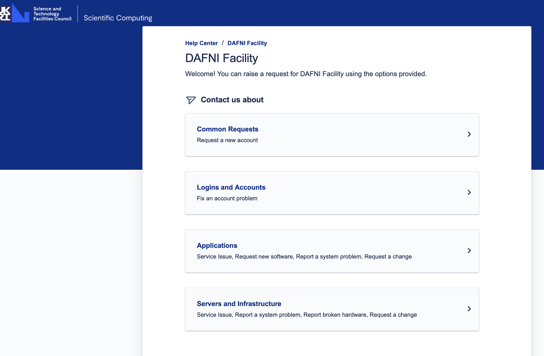
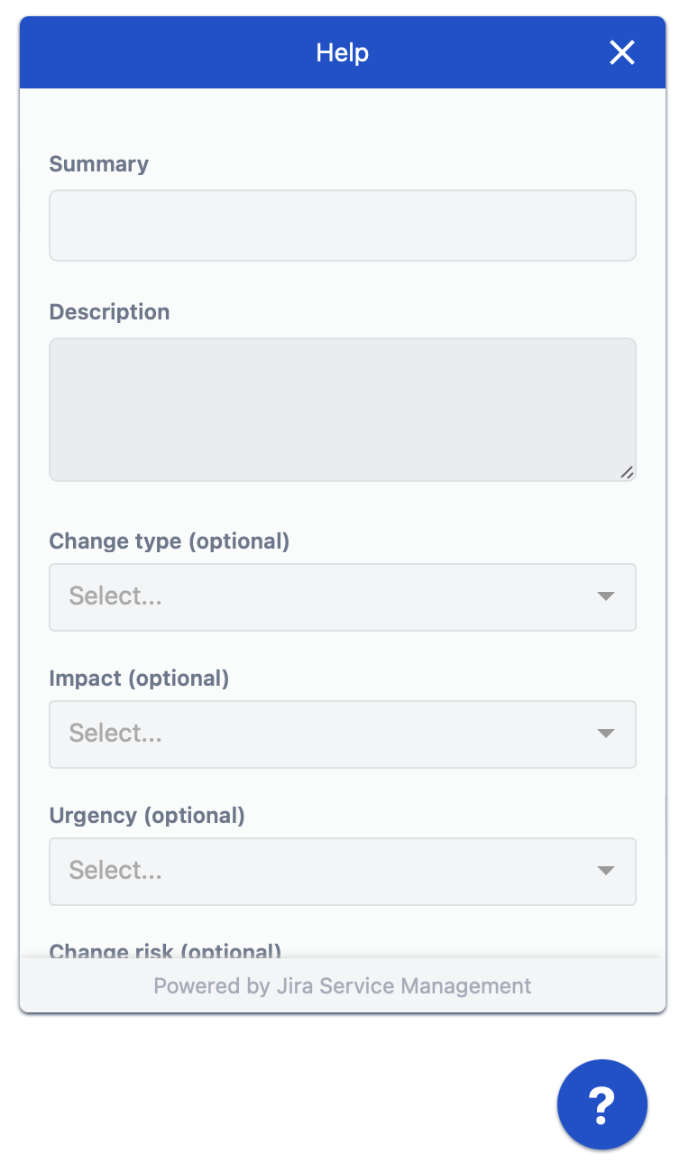
Future: Service Management?
Yet to explore…
Public Knowledgebase + Incident Reporting / Support Form
Queues, Incidents, Alerting, Change Management, Post Mortems
Slack Support
Already “working”
Replies + Assignment
Web page chat form?

