Slide 1
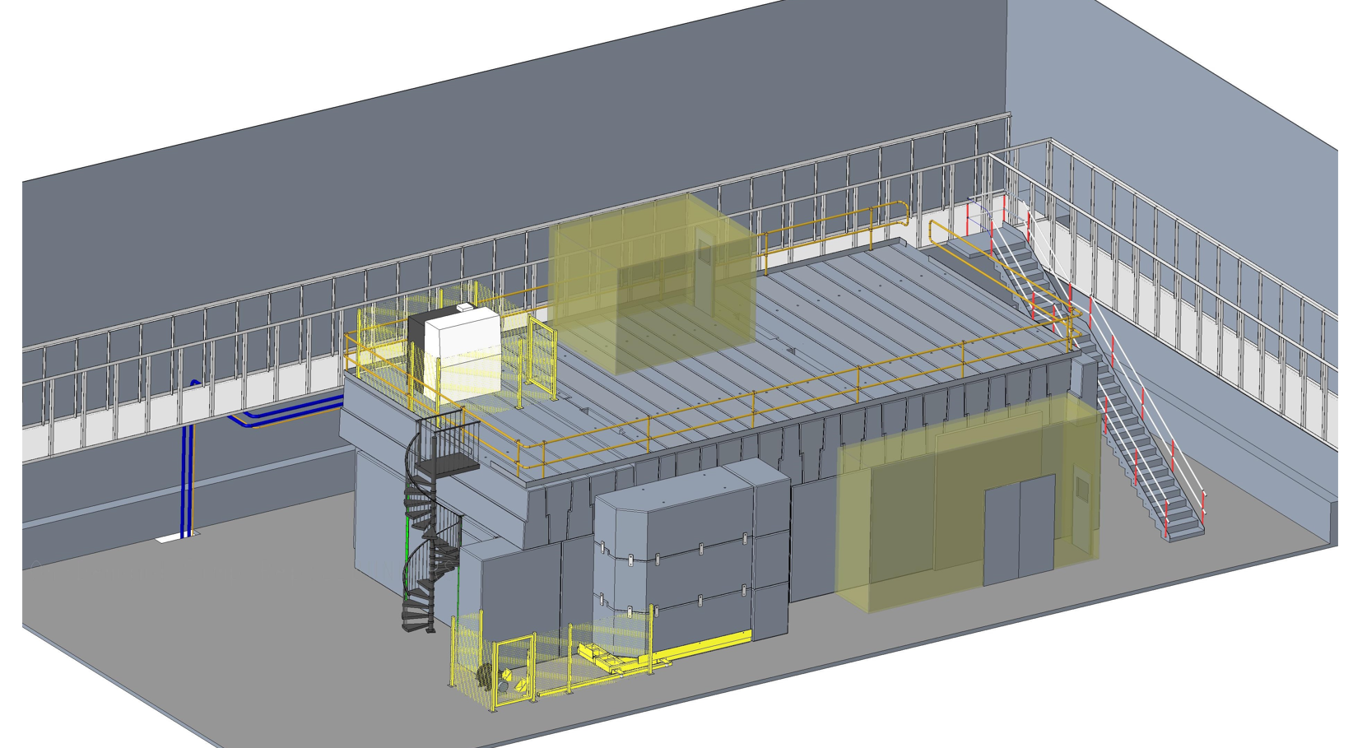
Muon RF activities at the Cockcroft Institute
Prof Graeme Burt, Lancaster University on behalf of CI RF team

Slide 2
Cockcroft RF Team
Lancaster: RF testing, Klystron design
Strathclyde: Physics of breakdown, RF testing
STFC: lower B field testing on CLARA gun (if INFRA funded in 2024 Mechanical design, controls)

Slide 3
Discharges in Magnetic Fields
In RF cavities magnetic fields (B-fields) have been noted to
  Increase dark current
    diamond machining of surfaces and surface preparation crucial for reducing dark current
    magnetic field can focus dark current into a beamlet causing more damage
  Require re-conditioning of cavities
  May inhibit conditioning and limit peak E field
  Increase risk of arcing which can happen extremely rapidly (ns scale)
In DC vacuum breakdown, B – fields have been noted to improve diode insulation BUT also:
  Increase number of active emission sites
    suppression of the screening effect
  Enhance optical emissions from the cathode flare plasma
  Suppress material polishing in short pulse driven systems

Slide 4
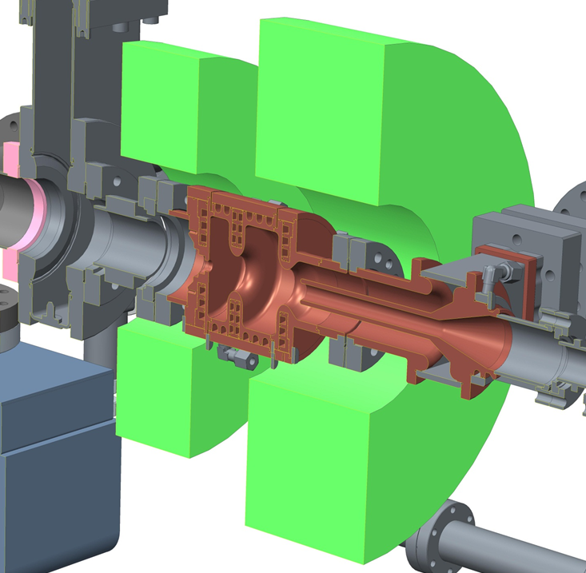
High Repetition Rate RF Gun
ASTeC in collaboration with Lancaster University has developed a High Repetition Rate Gun for CLARA.
The gun has a solenoid on it allowing some testing with lower magnetic fields (0.2 - 0.3 T)
May be partially relevant for muons in the short term to validate models.
Testing gradients of 80/100/120 MV/m

Slide 5
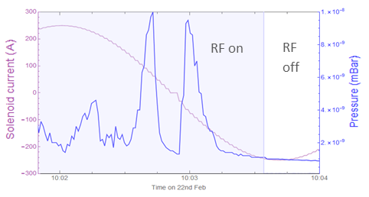
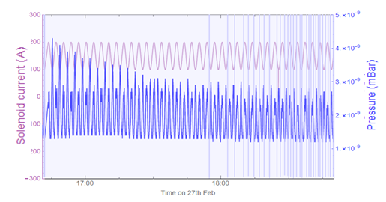
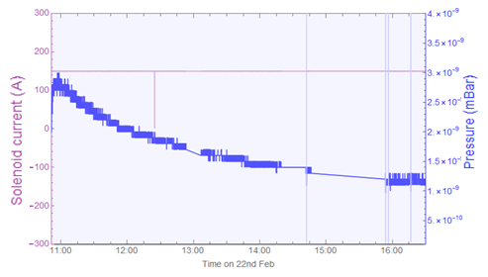
VELA gun Solenoid effects
Oscillation from -250 A to + 250 A caused vacuum spikes up to 1 x 10⁻⁸ mBar.
Solenoid switch on to 150 A caused pressure increase to 2.7 x 10⁻⁹ mBar. Which recovered slowly.
Solenoid oscillation from 100 to 200 A caused decaying oscillation of the pressure.

Slide 6
Links to DC Vacuum Spark Dynamics (Spark et al)
Spark, Cross, Phelps and Ronald [4] investigated high PRF cathode erosion in vacuum arcs
  Showed sensitivity of ‘critical field’ and ‘cathode polishing’ of knife edge emitters to B-field
B_{cav}=1.6T, V_{beam}=140kV
B_{cav}=3.6T
B_{cav}=4.5T
B_{cav}=4.9T
B_{cav}=1.6T
B_{cav}=4.5T, V_{beam}=140kV
  [4] S.N. Spark, A.W. Cross, A.D.R. Phelps A.D.R. and Ronald K. ‘Megawatt, 330Hz PRF tunable gyrotron experiments’, Int. J. of Infrared and Millimeter Waves. 15, No12, pp2003-2017, 1994.

Slide 7
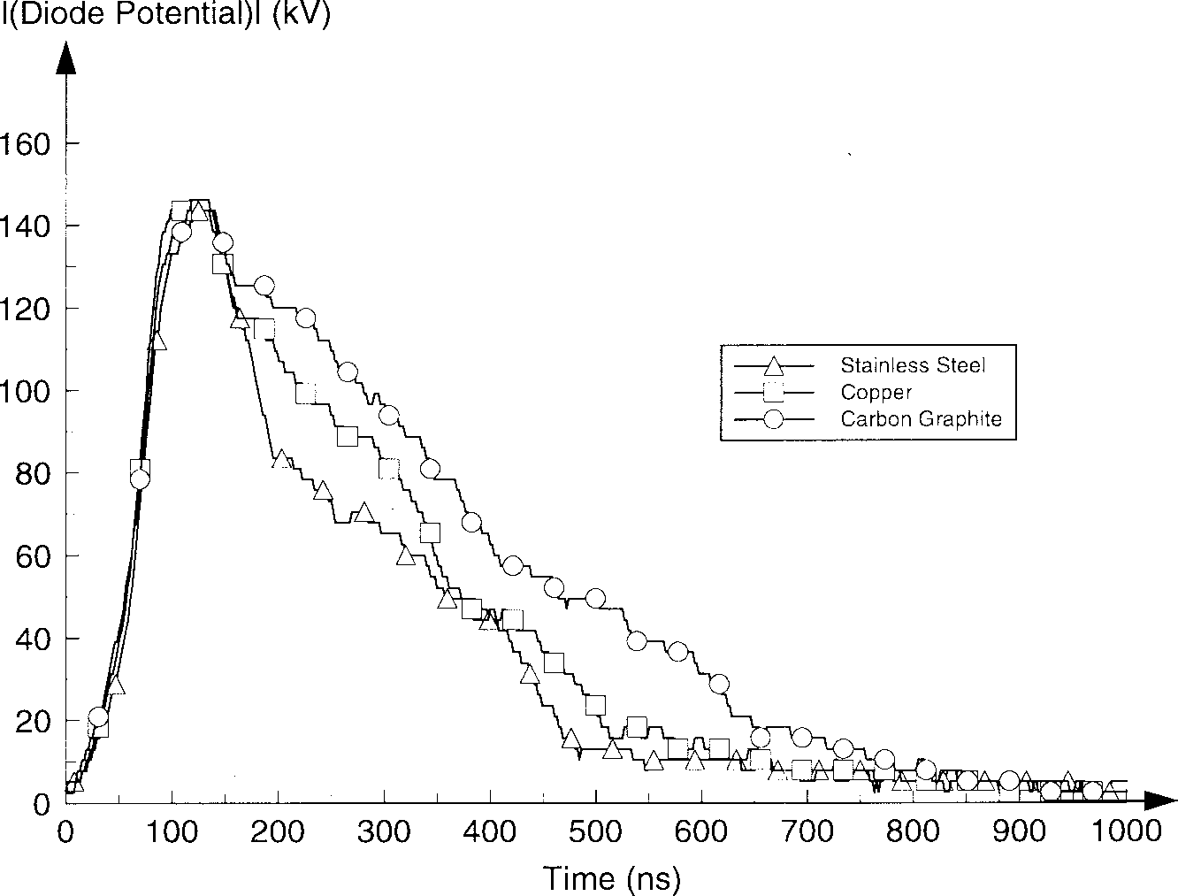
Links to DC Vacuum Arc Dynamics (Ronald et al)
  Influence of the diode gap spacing & the B-field on the collapse of the diode potential
    Material stainless steel
  Influence of material on rate of collapse of diode potential
    Anode-cathode gap 27mm
    B-field 0 Tesla
  [5] K. Ronald, A.W. Cross, Alan D. R. Phelps et al “Explosive Cathode Experiments”, IEEE Trans. on Plasma Science, 26, No 3, June 1998

Slide 8
Links to DC Vacuum Arc Dynamics (Ronald et al)
Ronald et al [5] investigated pulsed vacuum arcs
  Showed sensitivity of cathode flare plasma (distribution and intensity) to B-field in knife edge emitters
  [5] K. Ronald, A.W. Cross, Alan D. R. Phelps et al “Explosive Cathode Experiments”, IEEE Trans. on Plasma Science, 26, No 3, June 1998

Slide 9
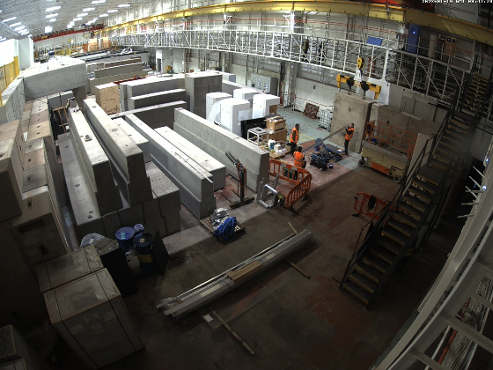
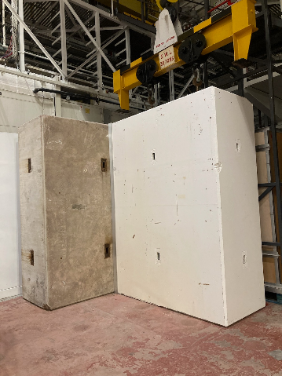
CI RF Bunker: Longer term plans (funding dependant)
Have started putting the concrete in place with handover expected mid 2022
S-band 7 MW klystron and LLRF control being shipped/procured

Slide 11
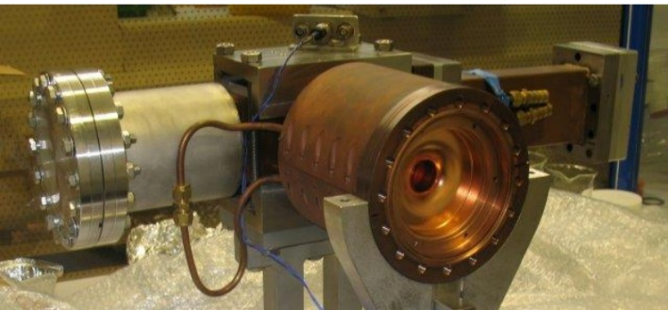
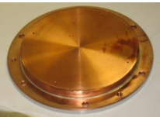
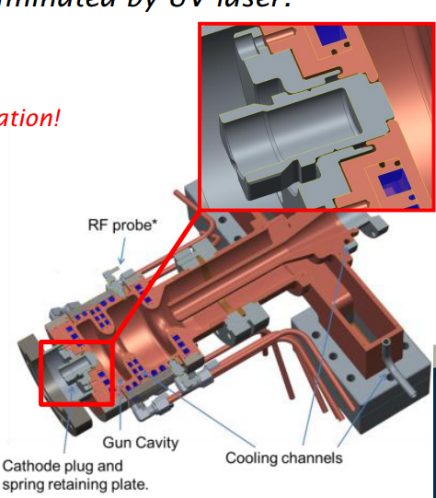
RF sample testing
Plan to replicate something like our RF guns where we have removable back plates or plugs
Can design to maximise peak fields on the removable part while keeping most of the cavity the same
Can test different materials
Possibility to test same sample with DC
Southampton could design a solenoid to go around this cavity
As its only 3 GHz we can use a smaller bore (~10-15 cm)
Can couple via an axial coax line similar to our RF gun to avoid having large waveguide feed go through the coil

Slide 12
Progress on klystron
Masters student has started and will work over the summer but as yet hasn’t installed the code yet.
If funded the Horizon grant would fund a PhD student to create a more detailed design
One issue is variability in the requirements (frequency, power, pulse structure)
Aim to utilize “two-stage” technology developed for CLIC and scaled to ILC
Need to look a long term stability with the longer pulse length
High duty cycle/high power will be a challenge for the collector so will need Multiphysics design

Slide 13
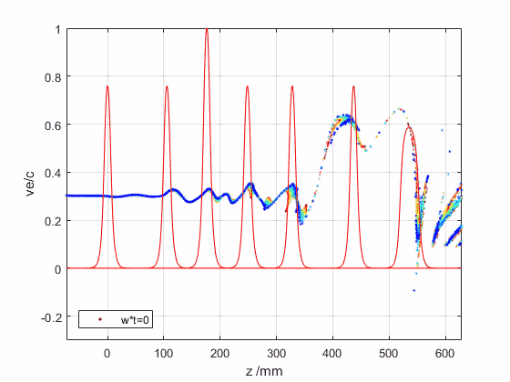
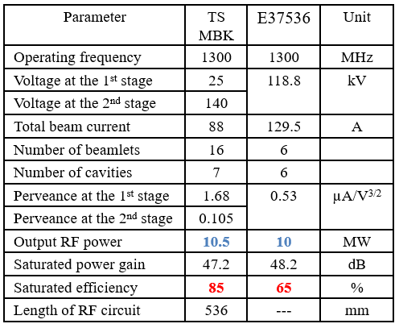
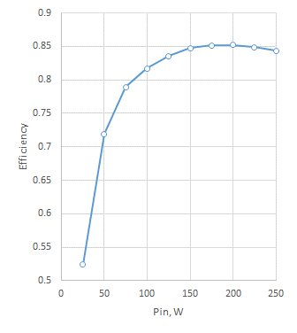
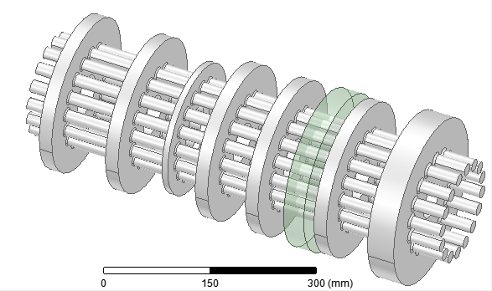
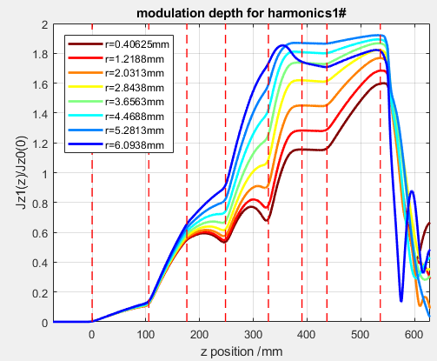
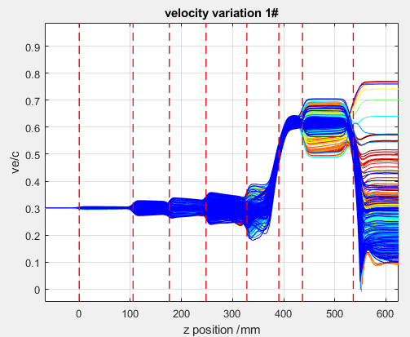
Example High Efficiency Klystron (from Igor Syrathchev CERN)
High Efficiency 10 MW, 1.3 GHz, ILC TS MBK (scaled from TS CLIC MBK+2nd harmonic)
RF circuit length 53.6 cm
DC gap
2nd harmonic
cavity

Slide 14
Plans
Without further funding:
  CLARA HRRG commissioning will happen but more emphasis on getting it operating and less on physics
  MSc student will do a study of klystron scaling
With Horizon grant
  PhD student to analysis CLARA HRRG data to study effect of B-field and prepare for future tests, study DC arcs, and simulations.
  PhD student to do a more complete klystron design study focusing on stability and collector
With experimental studies funds
  Can do testing in CI RF bunker at higher B fields with a dedicated solenoid, still at 3 GHz

