Slide 1
HTS Magnets for Muon Collider
Commercial HTS conductors have come a long way:
Utilisable Jc and piece length beyond the field limit of Nb3Sn
Performance are still improving
A heathy mix of suppliers/developers
But cost still very high
High field LTS solenoids are ahead of LTS high field accelerator magnets
Solenoids: structurally simpler, long established base in laboratory settings
1GHz NMR at 23.5T has been available for more than 10 years
ReBCO 2G performance capabilities demonstrated in pancake coils
26T a standalone stack of pancakes in 2016 (Yoon)
“Little Big Coil” LBC produced 14.4T inside 31.1T resistive magnet in 2019 (Hanh)
1260A/mm² at 45T
ReBCO 2G pancake coils still far from technology proven or maturity
LBC pancakes suffered extensive deterioration after field/thermal cycling
Non-insulated and non-impregnated ReBCO windings yet to be proven beyond demo coils
Intrinsic vulnerability of extensive joints in stack of double pancakes: possible due to direct contact to the winding and integral to the mechanical support
ReBCO delamination more susceptible to micromovement in non-impregnated coils
Impregnation likely unavoidable for mechanical robustness of larger coils
Muon cooling magnets offers a promising case for high field HTS solenoid

Slide 2
Courtesy of Lionel Quettier Feb 2022

Slide 3
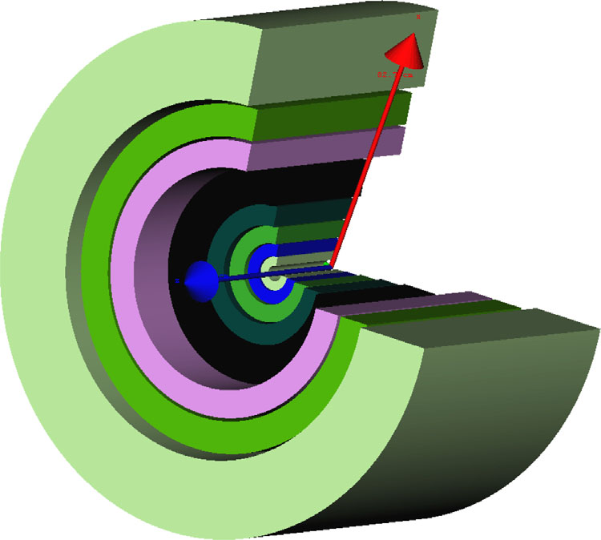
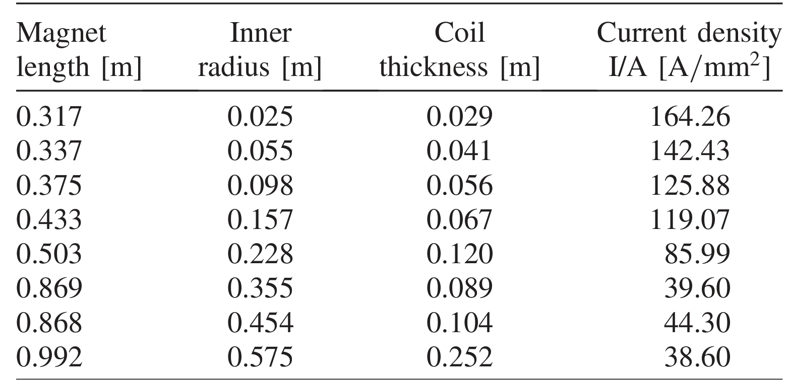
Existing Magnet Concept for Final Cooling
17 stages/magnets of 4 designs with scaled down peak fields ~ 30T
A generic cooling magnet (Sayed et al 2015)
(Sayed et al 2015)

Slide 4
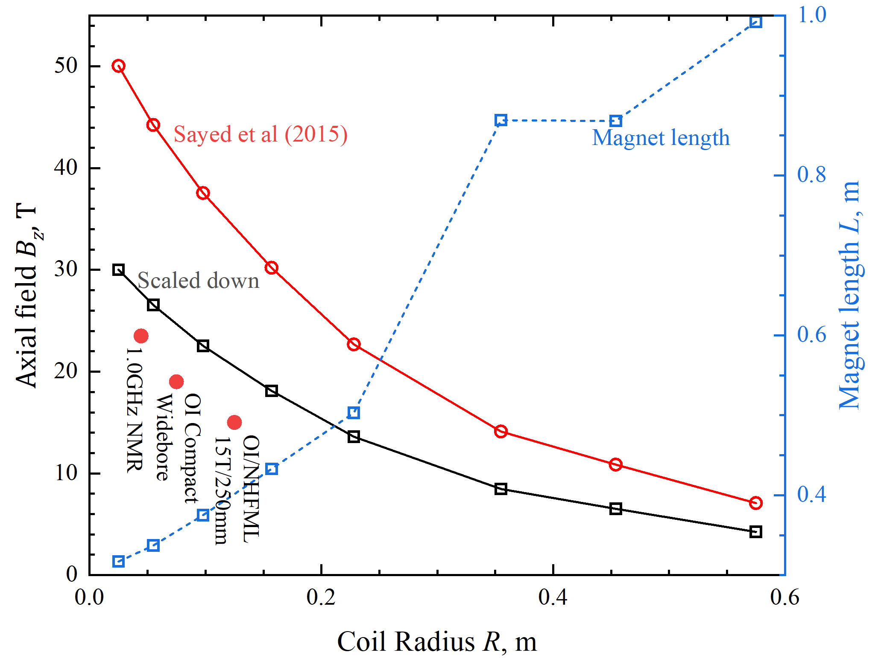
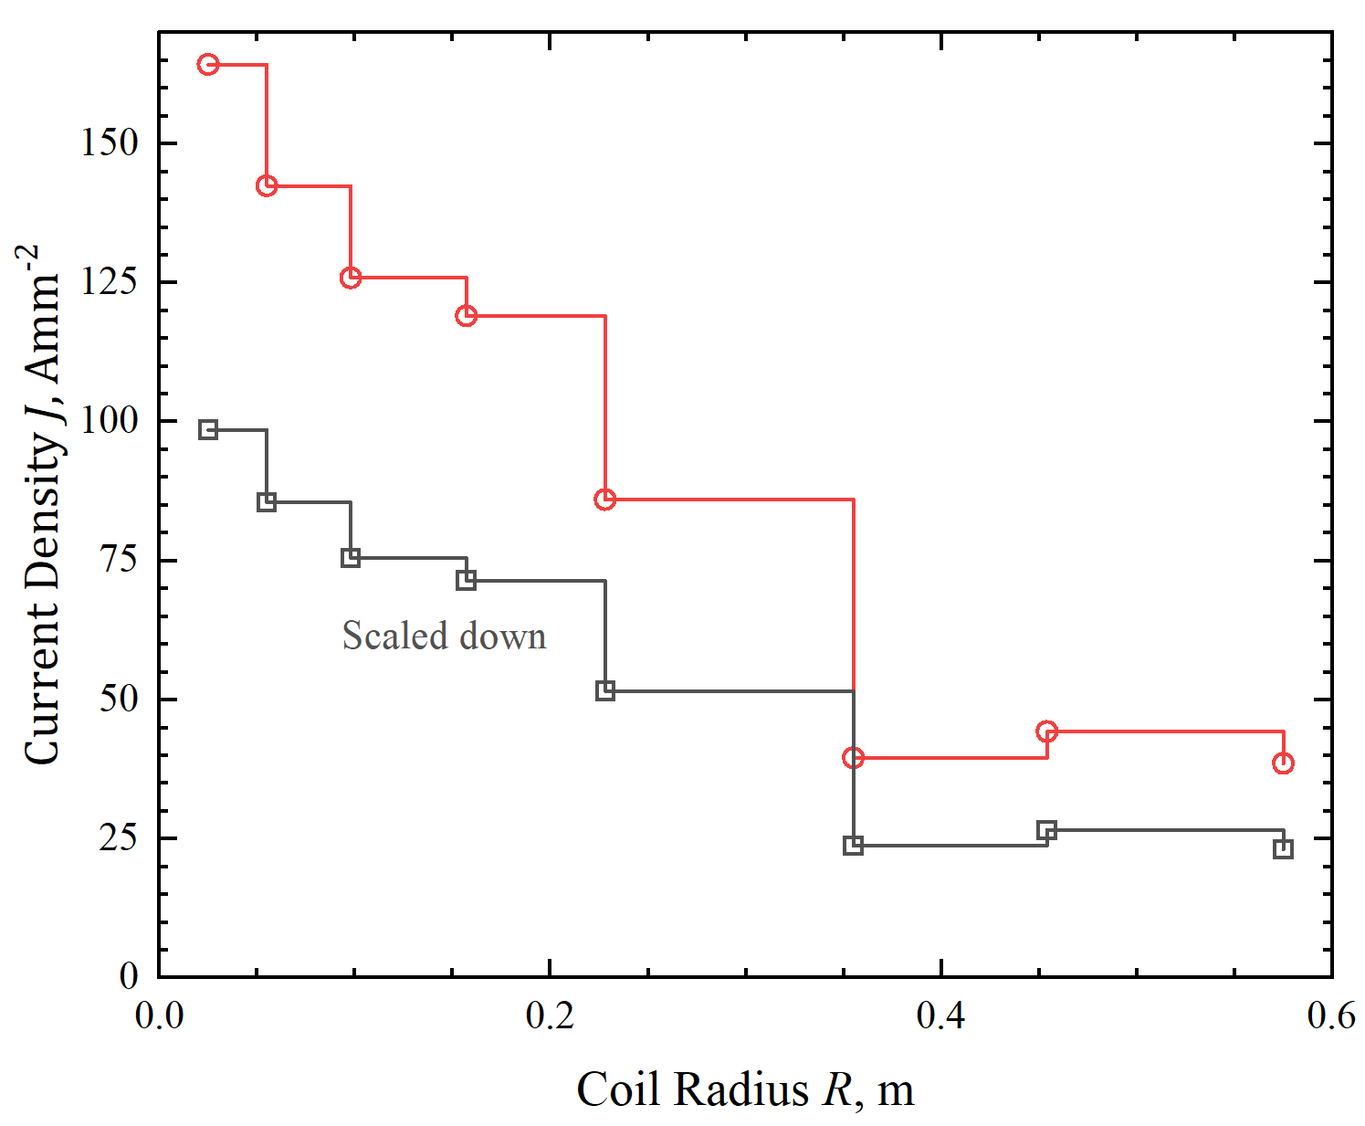
A Closer look at the Generic Concept
Outer LTS solenoids: up to 24T with 0.5m-1.5m ID-OD, at the limit of the present technology of Nb3Sn/NbTi hybrid
LTS can be significantly more compact
Scaled down version needs HTS to provide 6.5-15T within 88mm-250mm OD
Increasing HTS current density at higher field of HTS seems opposite to prevailing practices: plenty of scope for design and optimisation
NHMFL 32T HTS/LTS hybrid

Slide 5
NHMFL All Superconducting 32T Magnet
Almost slot in for the scaled down version
More compact than the generic concept
Room for improvements and innovation in HTS technology
Magnet adaptation and cryomodule design for horizontal configuration
0.8m
0.75m

Slide 6
UK/SOTON Interests/Plan within and beyond EU/CERN Project
Innovation and design for the generic concept
Baseline design using pancake stack
Also examine compact assemblies of single layer solenoid of cables/tape-stacks
Possibility for impregnation and cryogenic/mechanical stabilisation
Optimisation of J grading for mechanical stress (300MPa?)
Demonstration of technology: synergy with CERN HFM
Built on SOTON’s insulation/impregnation technology demonstrated in a Roebel cable pancake: no deterioration upon 100s thermal and field/quench cycles at J up to 600A/mm² and hoop stress up to 150MPa
Single tape pancake with impregnation and insulation in 10T/150mm exert
Single layer solenoid of single tape and tape-stack cable 10T/150mm exert
Development of HTS prototype/demo for the scaled-down/generic cooling magnet concept
Incremental effort for 5-30T at 250-1000A/mm² with focus on mechanical robustness
Possible combination with solenoid of 2212 round-wire for lower cost (UK IMPDAHMA project)
UK needs a LTS facility for high field magnet development: a ready made candidate in OI 150m bore 19T+ compact magnet
Brucker has just announce a compact 1GHz NMR: likely a significantly reduced magnet radius for 23.5T https://www.bruker.com/ko/news-and-events/news/2022/bruker-demonstrates-novel-and-unique-compact-1-0-ghz-nmr-magnet.html
Explore LTS/HTS opportunities for target and rectilinear magnet for work beyond design

