Slide 1
Cooling

Slide 2
Cooling & Muon Collider

Slide 3
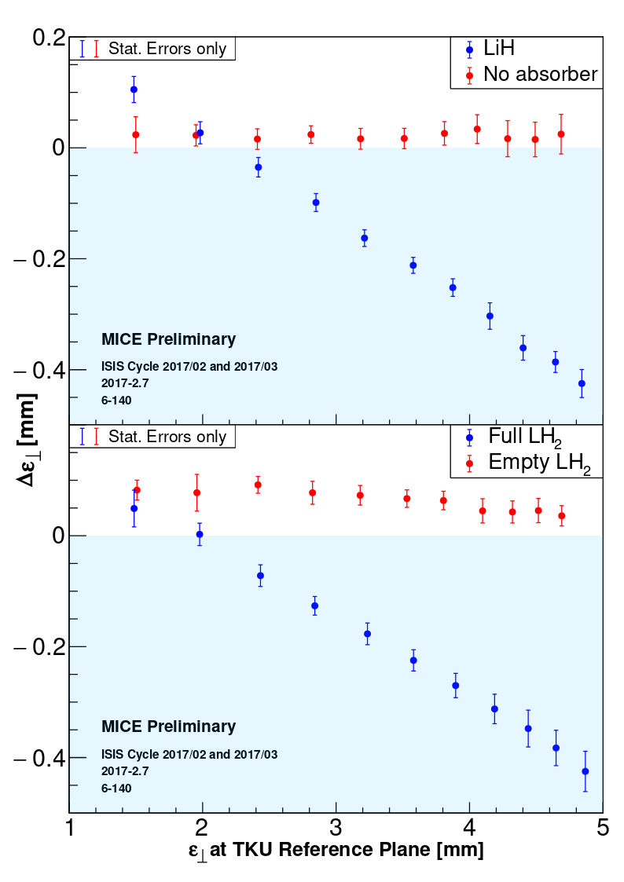

Slide 4
M. Palmer, Sep 2013

Slide 5
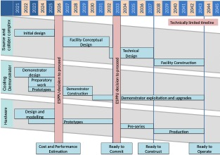

Slide 6
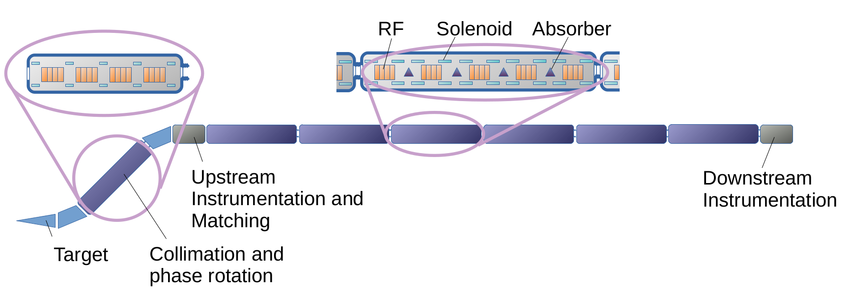
Cooling demonstrator

Slide 7
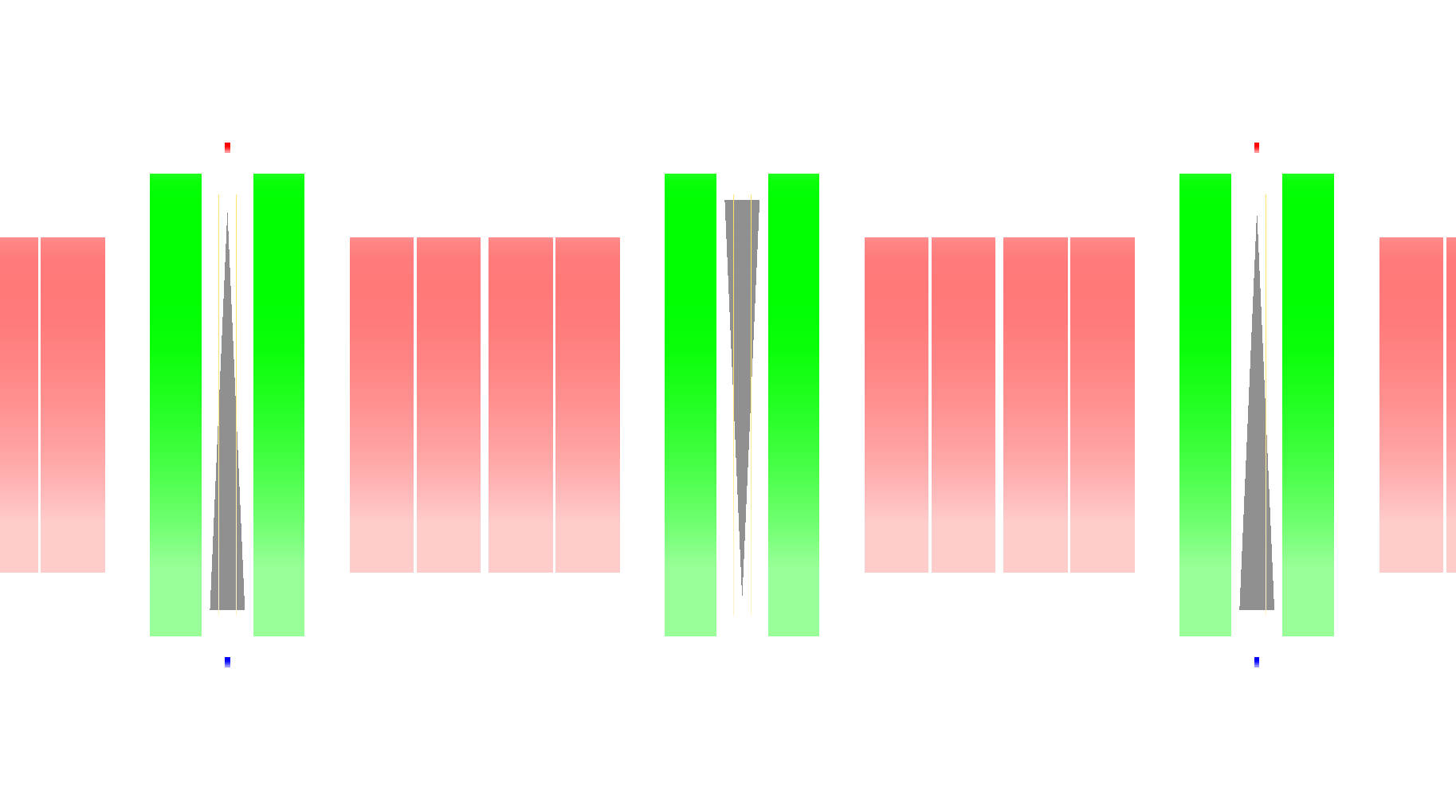
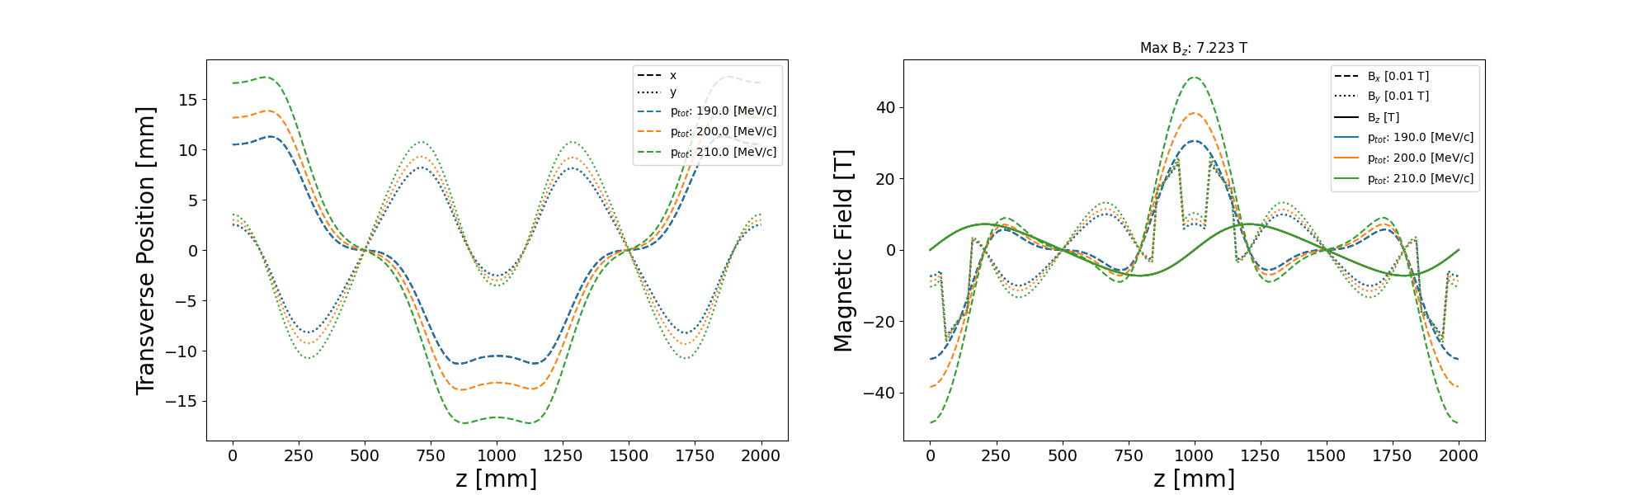
Demonstrator baseline
2 m
Tracking
Tracking

Slide 8
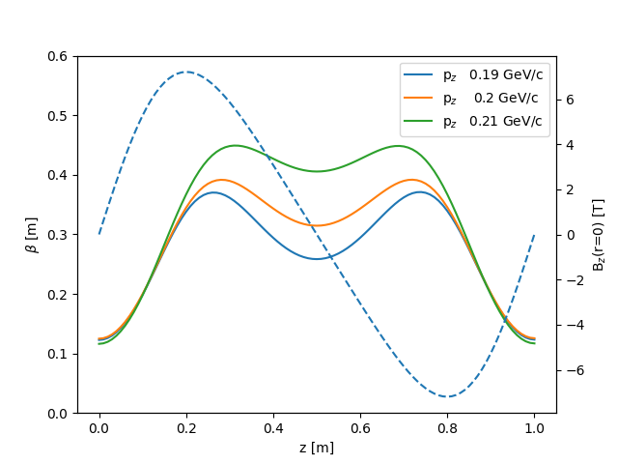
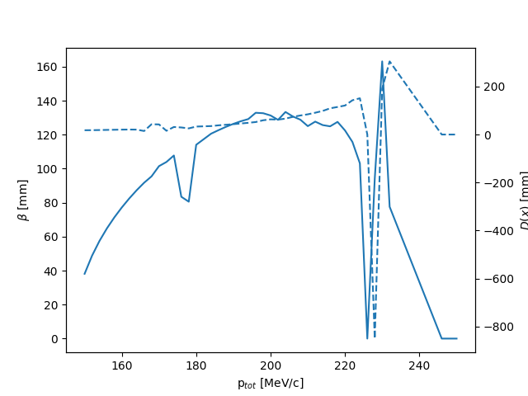
Demonstrator Baseline (2)
Optics
Tracking
Phi = 2 pi
Phi = pi

Slide 9
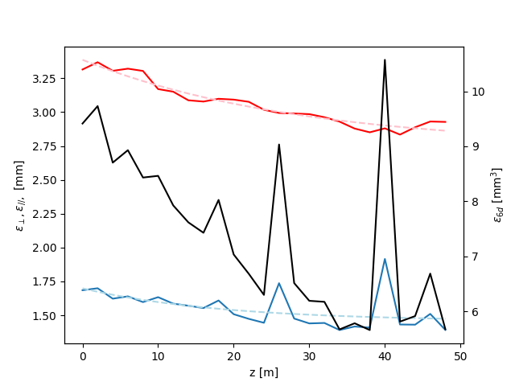
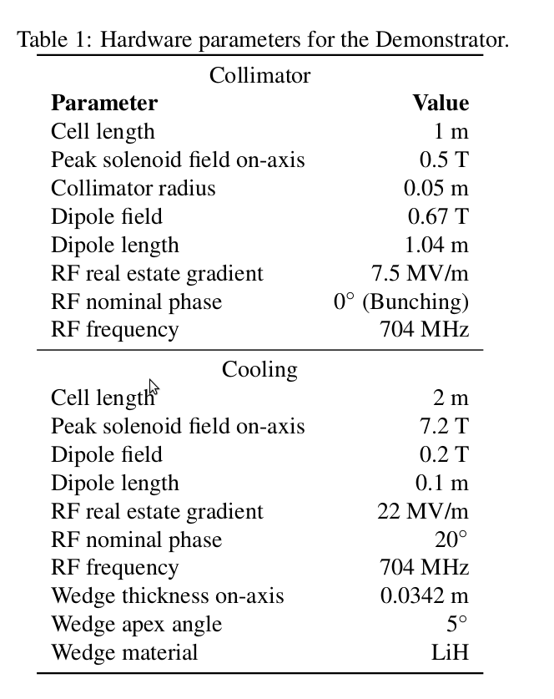
Demonstrator Baseline (3)
Transmission ~ 99 %
Decays ~ 4 %

Slide 10
Rectilinear optimisation (1)
More work on tuning optics
  Tidied up optics calculation
  Integrate decoupled transfer matrix through one cell (RK4)
    One can show that focusing strength = -qB₀²/(4p)
    Use dM/dz = M(z→z+dz) M(0→z)
  Calculate periodic beta direct from the transfer matrix
Looking at relationship of harmonic content to focusing
  Cf: Wang and Kim, Phys. Rev. E Vol. 63 “Recursive Solution for Beam Dynamics of Periodic Focusing Channels”
Nb: linear optics code used for some plots is at:
  https://github.com/chrisrogers1234/solenoid_optics/tree/master
(Linearised dispersion in solenoids – not used but relevant):
  Wang, NIMA, Vol. 503, “Dispersion in a bent-solenoid channel” (2003)

Slide 11
Rectilinear – Optimisation (2)
Optimisation of rectilinear can improve performance
  Determines final longitudinal emittance
  Will likely be Demonstrator lattice
Magnetic lattice has two main performance indicators
  Dynamic aperture – how big is the beam that we can fit?
  Minimum beta function – how tightly can we focus (i.e. how well does it cool)
  Looks like they are quite strongly related (TBD)
  Optics is all determined by harmonic content of on-axis Bz
Note dispersion is also important
  Determines ratio of transverse cooling to longitudinal cooling
  Driven by dipole field
  Likely not technologically limit – so not dealt with here

Slide 12
Observations (Rogers, updated by me)
At start of cooling channel, maintain high acceptance
  Long cells, relatively low fields
  Seek solenoid lattice that gives good focusing and high acceptance
At end of cooling channel, maintain low beta function
  Gives best cooling
  Short cells, high fields
Require to find optimum
Demonstrator likely to be rectilinear lattice

Slide 13
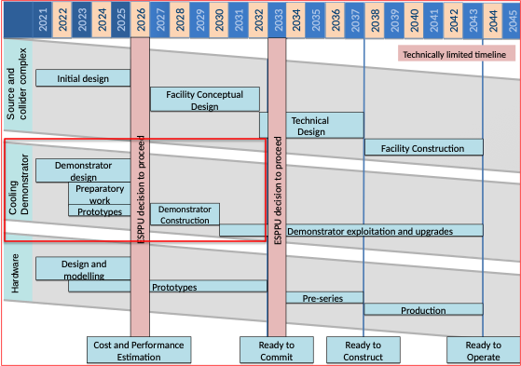
Opportunity

Slide 14
Conclusion
Build on position established by Rogers et al to:
  Integrate UK activity with iMC to deliver:
    Conceptual design for demonstrator that includes:
      Feasible 6D cooling demonstration experiment
      Evaluation of integration with nuSTORM/ENUBET neutrino facility

