Slide 1
Materials
MRF Introduction
Dr E Eardley
Dr S Kuksenko
Dr P Earp

Slide 2
MRF Capability
Sample Receipt
Sample Prep
Sample Transfer
Testing
Data Analysis
Data Export
The MRF is an irradiated material characterisation user facility capable of preparing, storing, analysing and disposing of β/γ active samples of 3.75GBq* activity with a total facility inventory of 3.75TBq*.
The MRF houses a suite of characterisation instrumentation including FIB capability for the machining of micro scale liftouts for external TEM and APT use.
The MRF collaborates with both reactor and ion beam operators globally to facilitate the integrated irradiation, shipping and characterisation of materials.
MRF is outside of a licensed nuclear site.
*⁶⁰Co equivalent

Slide 3
Sample handling
Sample storage, cutting, mounting, grinding and polishing of active materials
Hotcells with 3.75TBq ⁶⁰Co equivalent total inventory capacity.
Low activity glovebox, use based on dose rate and safety case.
Non active sample prep.
Instrumentation housed in dedicated research rooms with 3.75GBq ⁶⁰Co equivalent activity limit
Remote instrument loading.
Shielded transport from hot cell to research room
Low activity glovebox
Available for low dose rate samples based on an individual assessment
Mechanical cutting, grinding and polishing
Precision ion polisher and sputter coater
Hotcell EDM/laser micro machining capability under developement

Slide 4
Instrumentation
Microstructure:
FIB
SEM with EDS, WDS and EBSD
AFM
CSLM Raman
XRD
pFIB
TEM
Thermo Physical
Physical properties measurement system
14T 1.8-1000K
Thermal desorption spectrometry
Laser flash analysis
-150 – 2000°C
Dilatometer
-150- 2000°C
Simultaneous thermal analysis
-150-2000°C
Gas Pycnometry
Ion exposure and impregnation system
Flash differential scanning calorimeter
Mechanical testing
Nano and instrumented indentation
Micromechnanic testing
5kN, 10kN static load frames
15kN dynamic load frame
Ultrasonic fatigue rig (20kHz)
Impulse excitation test (RT-900°C)
Small punch test (3-8mm diameter)
High activity hot cell located static load frame.
Piezo driven in situ micromechanic stage
High activity ready
Low activity ready
Available March 2023

Slide 5
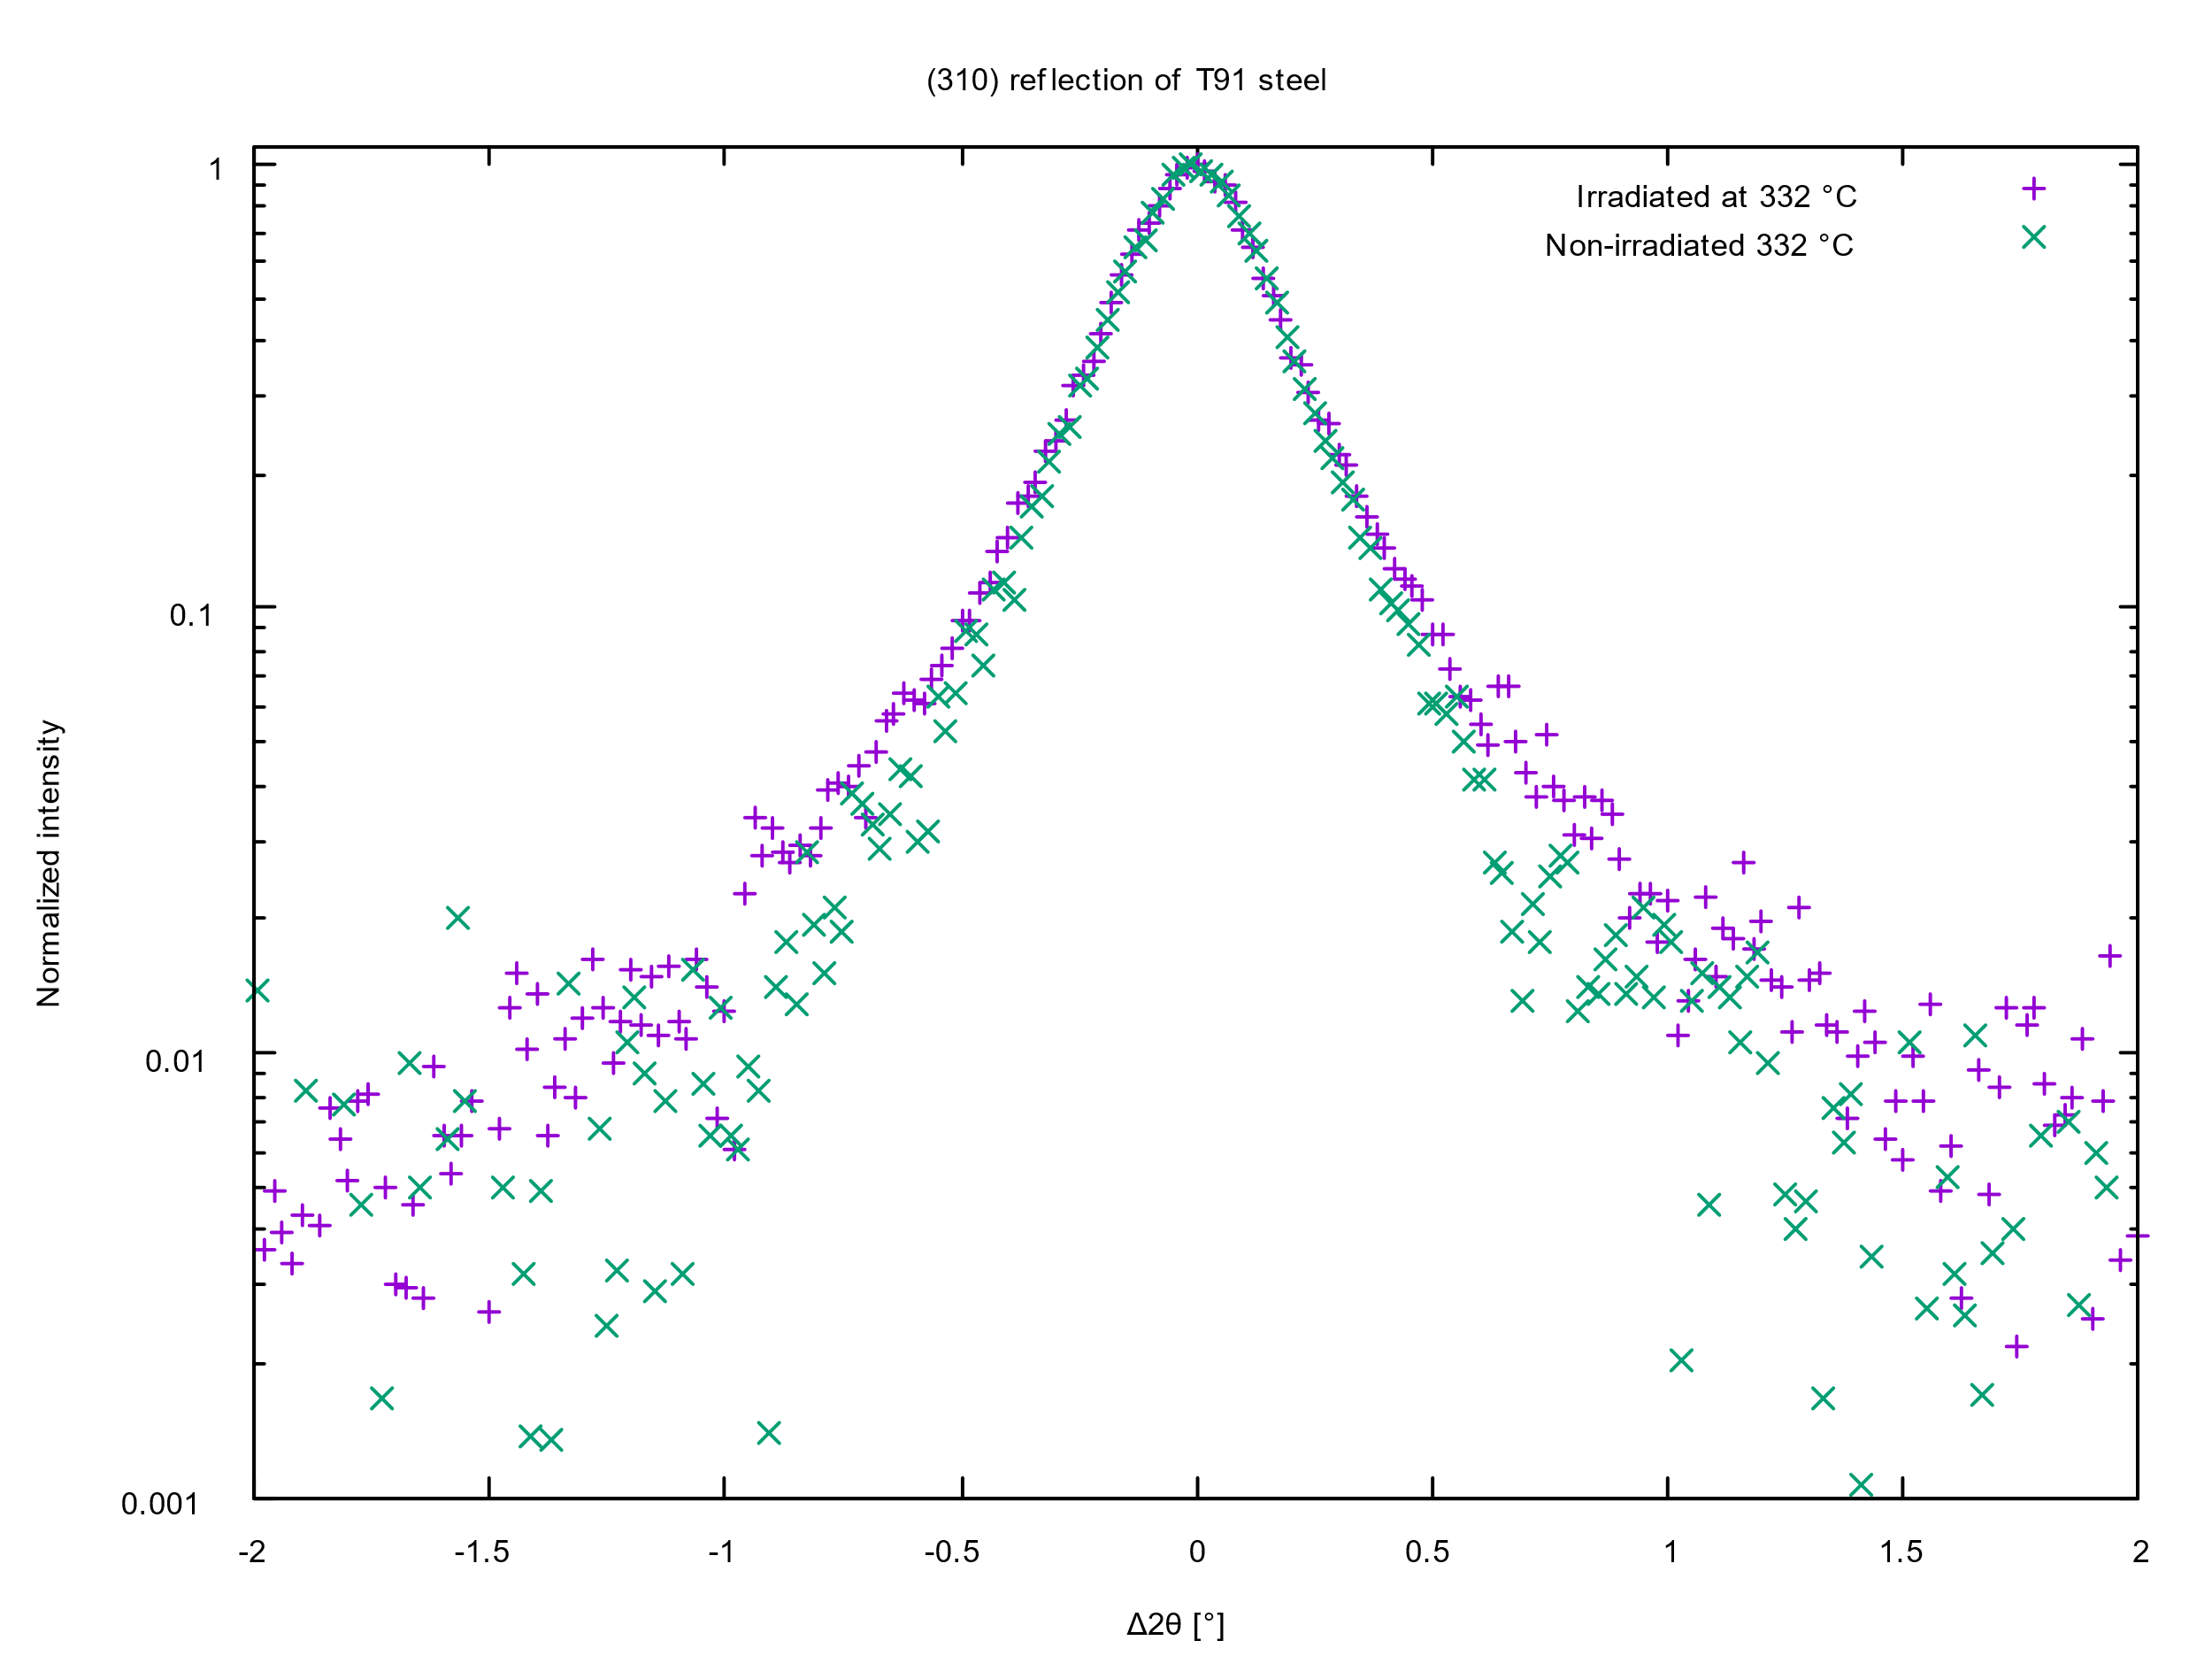
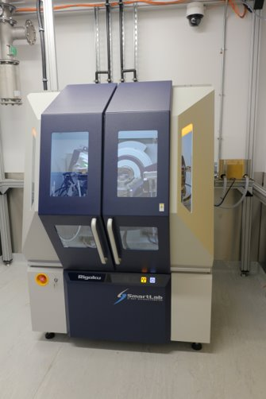
XRD
Xray Diffractometer
High brightness
Rotating anode source diffractometer optimised for the analysis of diffraction line broadening and defect characterisation.
Image shows broadening of the (310) reflection in a T91 steel.

Slide 6
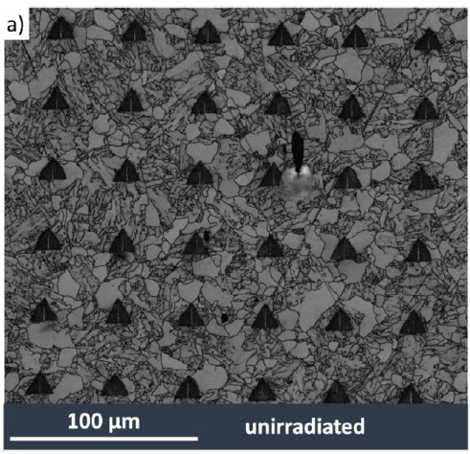
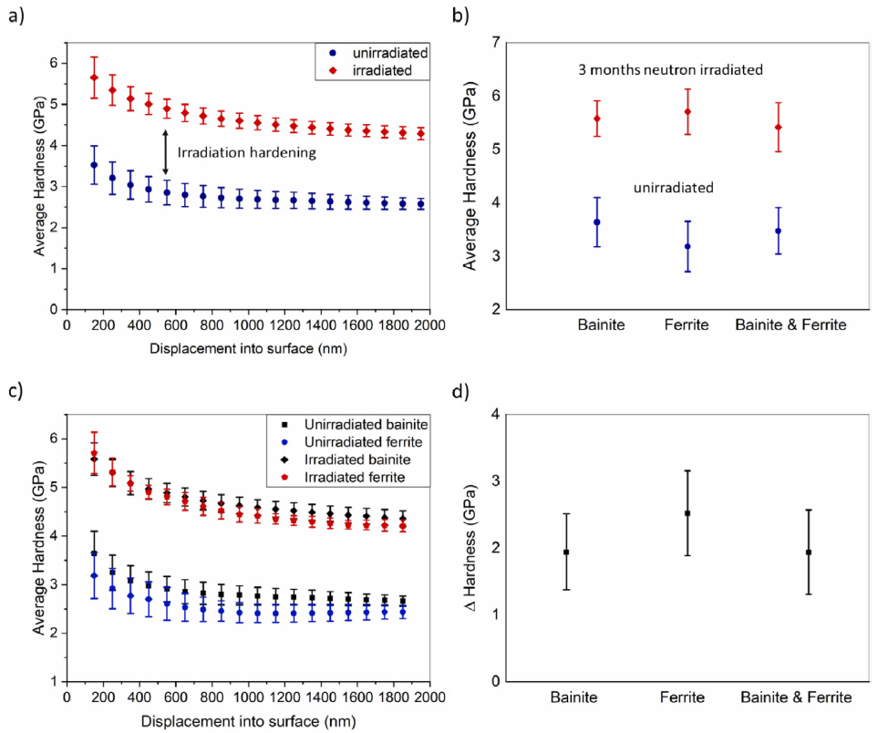
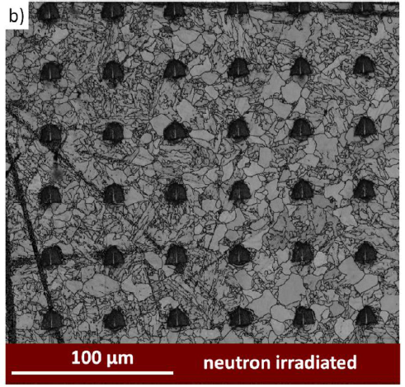
Microscopy & Nanoindentation
On the influence of microstructure on the irradiation response of HIPed SA508 steel for Nuclear applications. Carter et al. Journal of Nuclear Materials 559 (2022)153435

Slide 7
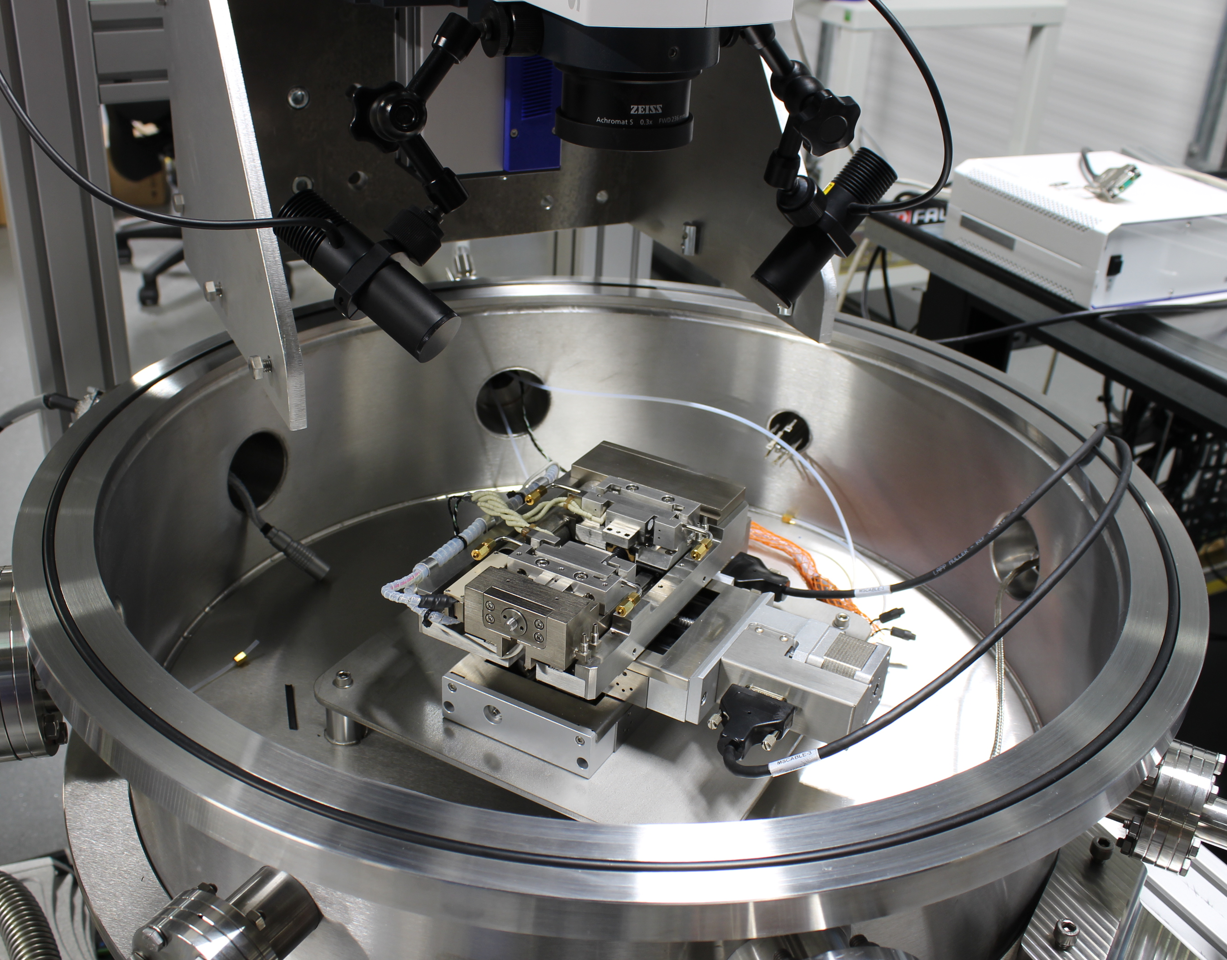
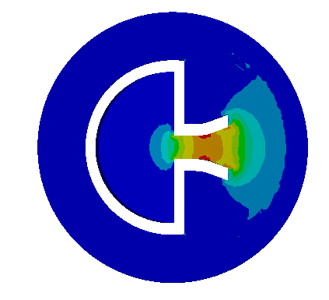
UFR and SSMT
Small Scale
Mechanical Test
A 5kN test frame
housed within a high vacuum chamber to allow testing between 150 and 600°C without oxidation.
Ultrasonic Fatigue Rig
The Ultrasonic Fatigue Rig (UFR) rapidly measures high-cycle fatigue life. Specimens are small discs with a mushroom-shaped cantilever.
DIC derived strain maps showing the non uniform nature of the induced strain leading to localised yield and failure in a mini tensile specimen

