Slide 1
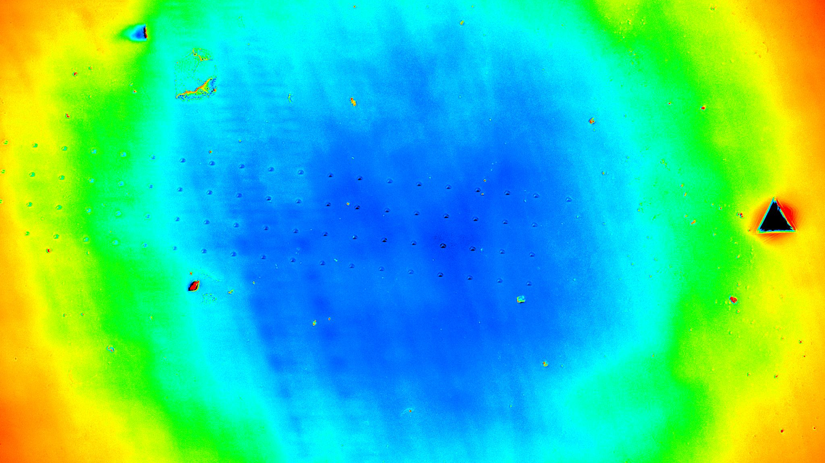








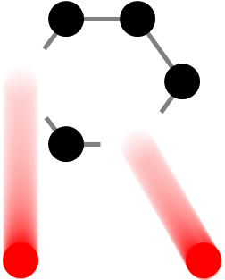
U.S.-Japan Science and Technology Cooperation Program in High Energy Physics
Advanced Material Studies for
High Intensity Proton Production
Targets and Windows
T.Ishida*, S.Makimura, N.Kawamura, H.Takahashi (J-PARC/KEK)
E.Wakai, Y.Iwamoto , S.Meigo, M.Teshigawara (J-PARC/JAEA)
S.Kano (Univ. of Tokyo)
H.Matsuda, M.Hagiwara (QST)
N.Nakazato (Muroran Inst. Tech.)
K.Ammigan*, S.Bidhar, F.Pellemoine, K.Yonehara (FNAL)
D.J.Senor, A.M.Casella, A.Roy, R.Devanathan (PNNL)
M.Palmer, D.Kim (BNL)
R a D I A T E C o l l a b o r a t i o n
R a d i a t i o n D a m a g e I n A c c e l e r a t o r T a r g e t E n v i r o n m e n t s

Slide 2
U.S.-Japan Science and Technology Cooperation Program in High Energy Physics
Started in 1979 to strengthen cooperative relations between the U.S. and Japan in research and development in the fields of high energy physics.
  Today, this program is implemented under "the Agreement between the Government of Japan and the Government of the U.S.A. on Cooperation in Research and Development in Science and Technology" signed on June 20, 1988
  Being managed under KEK and the US Department Of Energy (DOE)
KEK's budget has been transferred to the U.S. to carry out international joint research in high-energy physics, mainly in the United States
  The review committee is organized at KEK every year and the budget was allocated on every JFY basis.
  Since 2013, the RaDIATE activity was started as one of the topics of the accelerator neutrino program
Since 2016, the RaDIATE has been recognized as an independent program
From 2017, DOE started to allocate a budget for the US-Japan program
  DOE also organizes a review process and chooses programs by a joint committee at KEK and DOE
From 2021, the execution period is extended to 3 years as a maximum
Currently, the RaDIATE program is approved for FY2021-2022 (two years) and encouraged by the committee to renew the application in FY2023

Slide 3
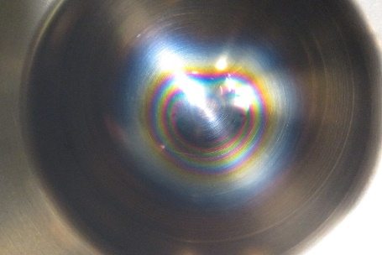
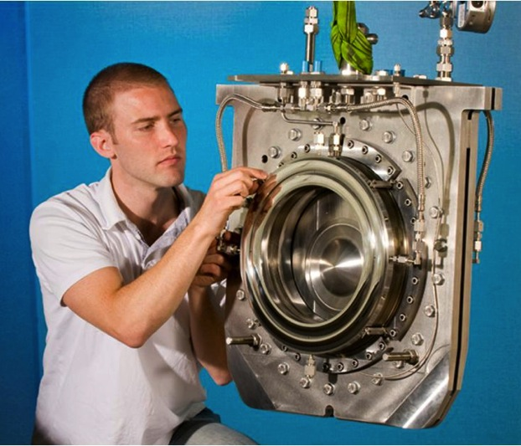



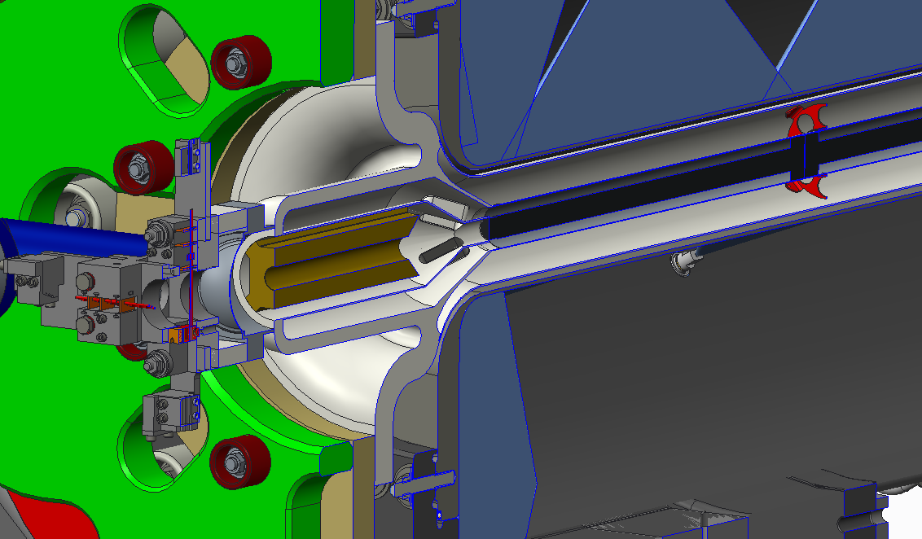
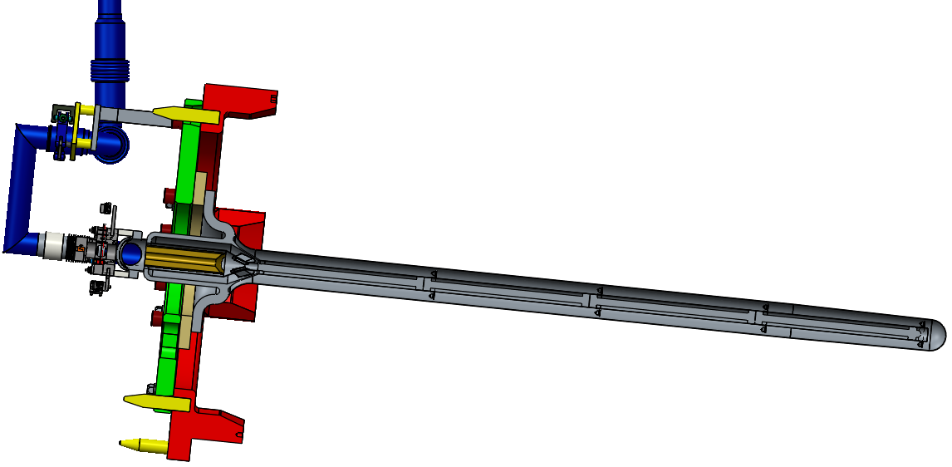

Research Scope
Radiation damage effect of Ti-6Al-4V ?
Alternative Alloys ?
Study radiation damage effects in beam-intercepting accelerator materials, which limits major accelerator facilities in beam power
  To enable accurate lifetime prediction of target/window and to design robust components
  Develop new materials to extend component lifetimes in future multi-MW accelerator facilities
Focus upon critical materials at J-PARC/FNAL neutrino projects to realize high-power (+1.2MW ~ 2.4MW) operation for CPV observation
  Titanium alloys (Ti): primary beam window (T2HK) / target containment window (T2HK/LBNF)
  Beryllium (Be): primary window/decay pipe window (LBNF)
Novel materials under development for neutrino, μ-e conversion, SNS… experiments
  SiC-SiC composite: ν, μ target
  Ductile tungsten TFGR-W: μ-e, SNS, anti-proton target
After 1.6 x 10²¹ pot
P⁺
D.Wilcox, NBI2019

Slide 4

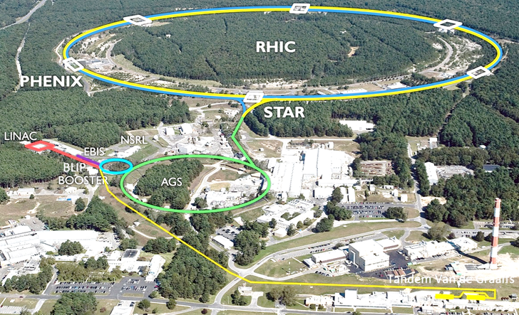
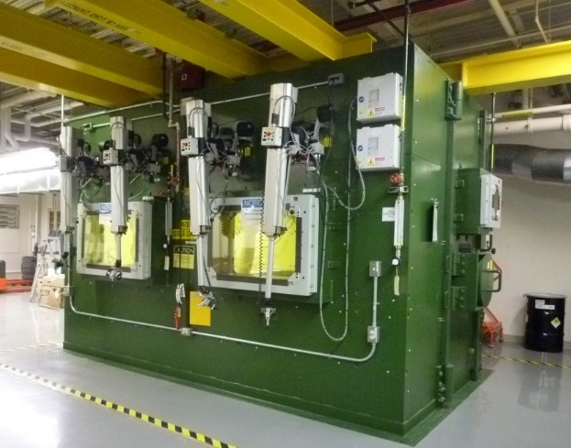
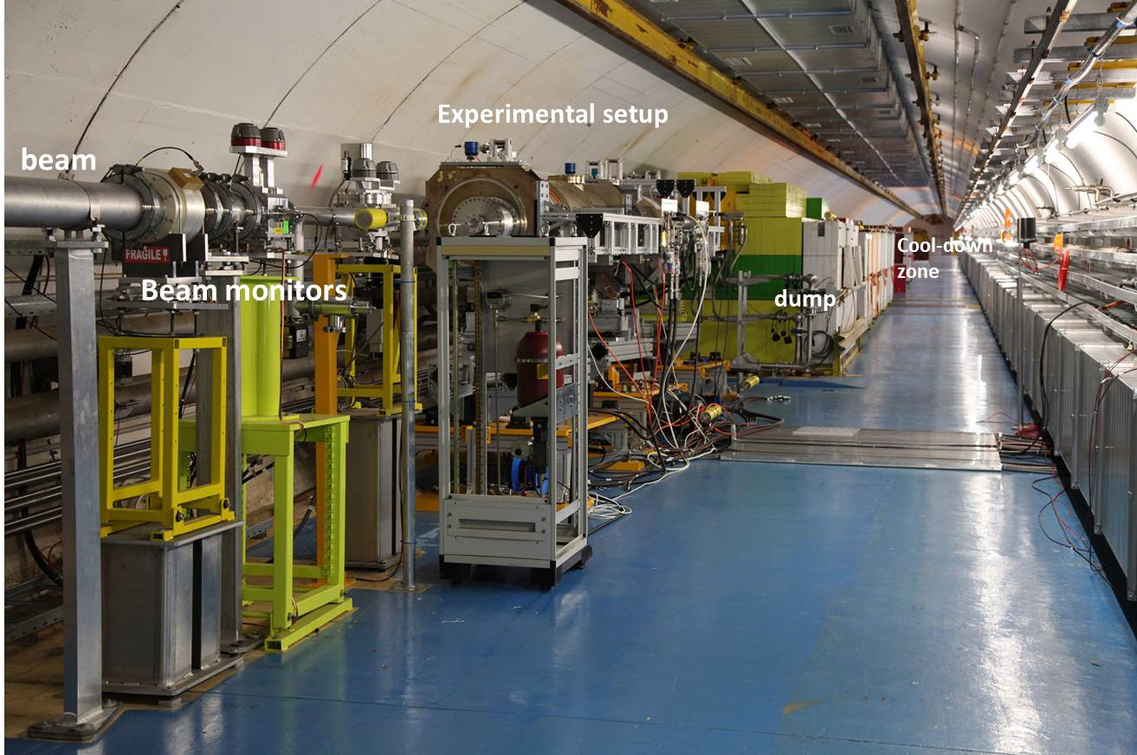
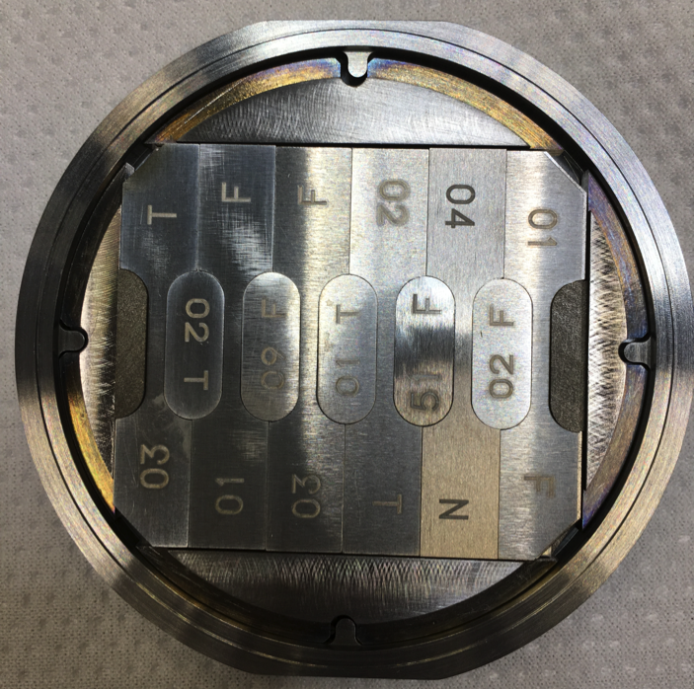

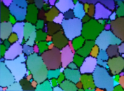

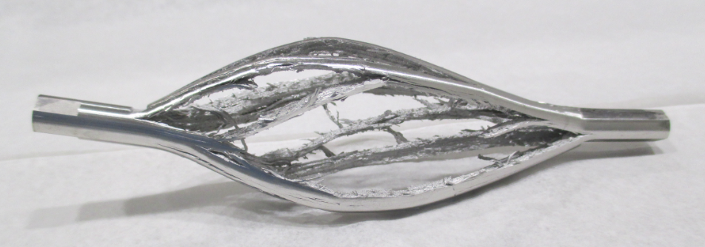
Research Method
Brookhaven Linac
Isotope Producer
440GeV
Proton
RaDIATE
Medical Isotope
181MeV
Proton
High-intensity proton irradiation experiment at BNL-BLIP facility
  Test specimens including candidate materials for various beam intercepting devices were provided by participating accelerator labs
  Post-Irradiation Examination (PIE) being conducted at participating reactor/fusion energy research institutions with “hot-cell” facilities：Pacific Northwest National Laboratory (PNNL)
In-beam thermal shock destructive inspection at CERN-HiRadMat facility
  Including irradiated/damaged specimens at BLIP
  Gauge the effect of radiation damage on thermal shock behavior
1st irradiation round completed in 2017-18, 2nd round scheduled in 2022-24

Slide 5
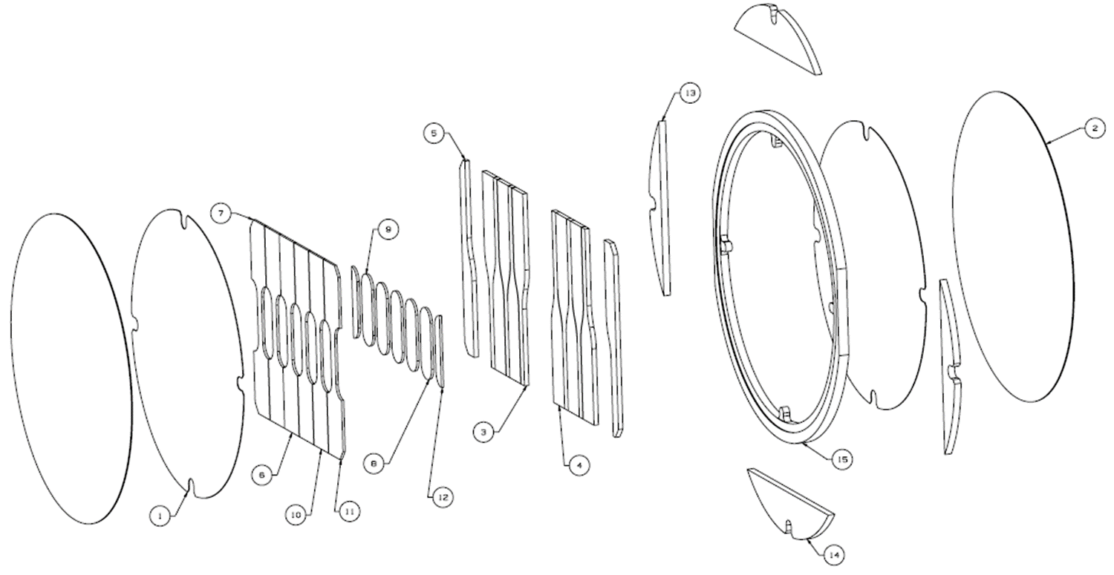
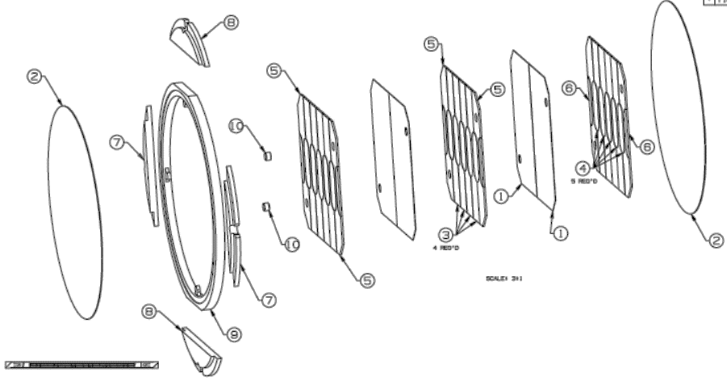
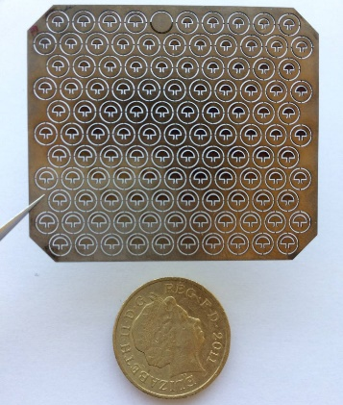
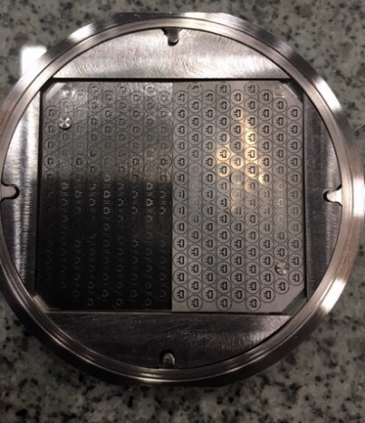
Ti-alloy Specimens irradiated at BNL-BLIP facility
DS-Ti1
DS-Ti2
Tensile/micro/meso-foil/bend-fatigue
Tensile/micro/meso-foil
Mesoscale foil
Mesoscale foil
Ti-6Al-4V Grade 23 MA
Ti-6Al-4V Grade 23 Solution-Treatment and Aged
Ti-15-3 Solution Treatment w/o Aged
CP-Ti Grade 1 (JIS-1)
Ti-5Al-2.5Sn (Grade 6)
CP-Ti Grade-2
Ti-6Al-4V Grade-5 Ultra-Finegrain
Ti-6Al-4V Grade 5
Ti-6Al-4V Grade-23 ELI
Ti-3Al-2.5V Grade-9
181MeV rastered beam
(3 cm dia. footprint) with
154uA avg. current
9.4days, 7.3x10²⁰ pot
0.25 DPA(NRT) at maximum
Half foil
2grades x 2 layers
32.9 days, 2.8x10²¹ pot
0.95DPA(NRT) at maximum
https://doi.org/10.7566/JPSCP.28.041001

Slide 6
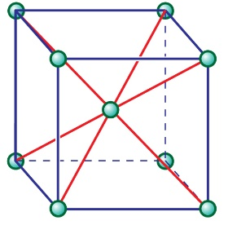
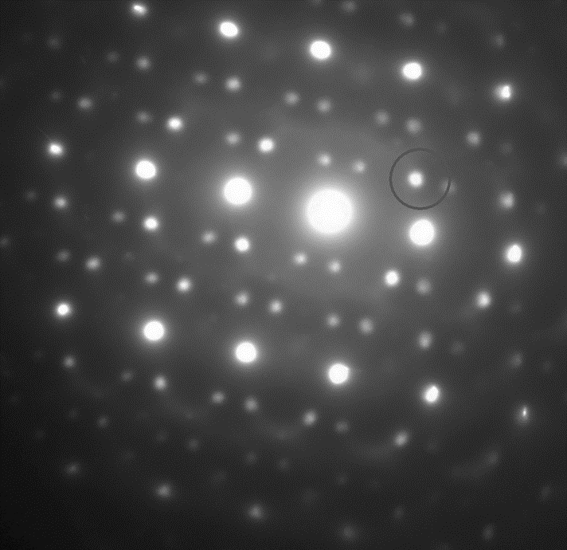

Radiation Damage Studies on Titanium Alloys
Requirements for Ti alloys as next-generation beam window materials:
  Maintain enough strength & ductility even when irradiated at a few displacement-per-atom (dpa) under an operational temperature of 300ºC
The conventional two α+β phase Ti-64 alloy loses its ductility after only about 0.1 dpa
  Due to embrittlement caused by the radiation-induced ω phase in the β matrices, in addition to the hardening caused by dislocation loops in the α matrices
β
Electron Microscopy
of Ti-6Al-4V alloy
α-phase
β-phase
（Hexagonal）
β-phase
（Body Center Cubic）
α-phase
1 μm
（Hexagonal Close Packed）
Radiation-Induced
ω-phase
https://doi.org/10.1016/j.jnucmat.2020.152413

Slide 7
Omega Phase in Gr 23 Ti-64 ELI, Irradiated, DS-Ti2
Precursor?
Atomic column imaging shows only a diffuse zone that may be a precursor to omega phase
Confirmed by diffuse spots in the <113> ZA
Atomic column imaging shows several omega phase zones
Confirmed by discrete spots in the <113> ZA
Omega phase 1-3 nm in size, ρ = ~1 x 10²⁴ m⁻³
Matt Olszta / Dan Edwards

Slide 8
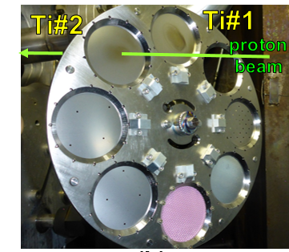
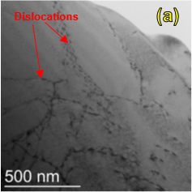
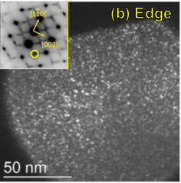
Metastable β-phase alloy Ti-15-3
PIE on irradiated J-PARC OTR foil: 50μm-thick, single metastable-β (BCC) phase alloy Ti-15V-3Cr-3Al-3Sn (Ti-153) at PNNL
β-phase
Very low density of defect clusters were formed by irradiation
No significant changes on micro-Vickers hardness
A high density of nano-clusters of athermal ω and martensitic α’’ phases
These were stable after irradiation.
Ti-1: 1.4×10²⁰pot
0.12 peak DPA
15-3 Ti alloy may have a high resistance for radiation damage due to
nanoscale precipitates working as point defect sink sites
https://doi.org/10.1016/j.nme.2018.04.006

Slide 9
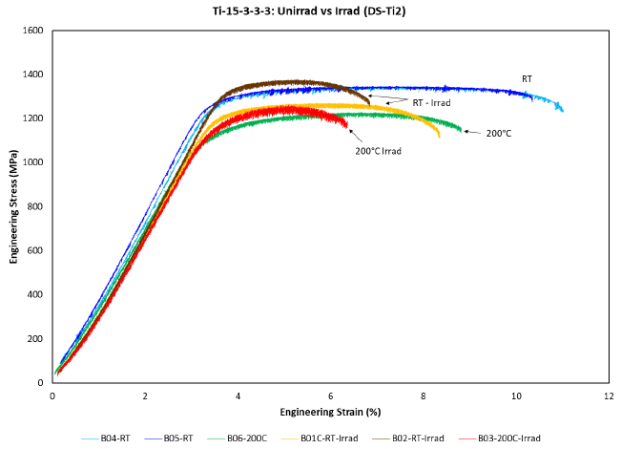
DS-Ti2 PIE： Ti-15-3 Tensile Tests
0.95DPA
The metastable β-phase Ti-15-3 with Solution-Treatment and Ageing (STA) heat treatment
  Ageing heat treatment is typical to the alloy, to make α-phase precipitation in the mother β-phase: “precipitation strengthening”
  Phase composition/microstructure (53% primary β + 47% coarse α precipitate) are different from OTR foil w/o ageing (100% metastable β-phase)
Unirr.
0.25DPA
uniform elongation = 1.5%
Ti-15V-3Cr-3Sn-3Al
Solution-Treatment and Aged (STA)
RT | DPA | YS | UTS | YS/UTS | UE | TE | ΔYS | ΔUTS | ΔUE | ΔTE
Unirr. | 0.00 | 1261 | 1350 | 93% | 4.00 | 7.38
B01C | 0.25 | 1198 | 1271 | 94% | 2.10 | 5.20 | -5% | -6% | -48% | -29%
B02 | 0.95 | 1320 | 1379 | 96% | 1.45 | 3.40 | 5% | 2% | -64% | -54%
α
β
Almost no radiation hardening, and a few % of uniform elongation remains

Slide 10
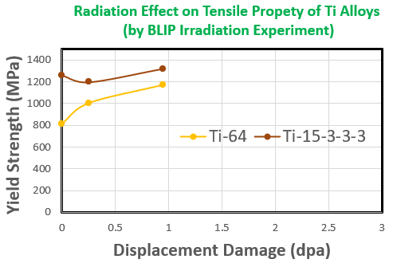
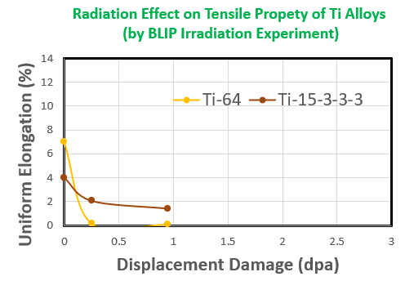
Comparison of Ductility between Ti-6Al-4V & Ti-15-3
Ti-15-3 in STA condition: Higher Strength, Larger Total Elongation (3.4% after irradiation), retain Uniform Elongation
Ti-6Al-4V: Smaller Total Elongation (2.4%), NO Uniform Elongation = deformation only occurs within local region (necking)

Slide 11
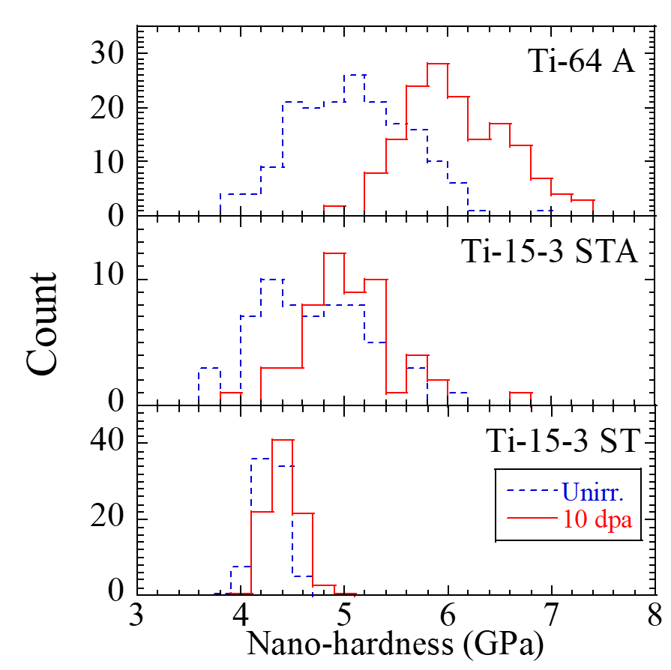
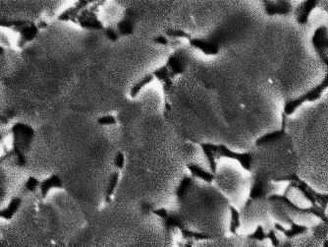
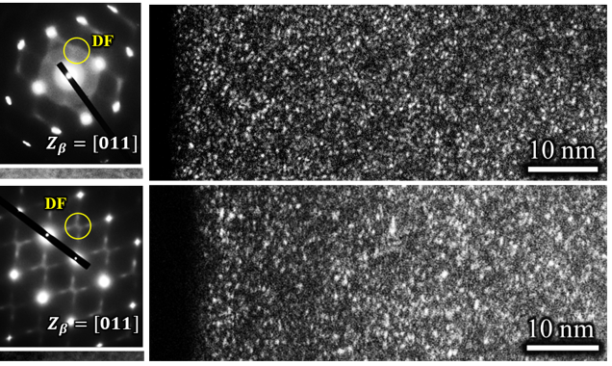
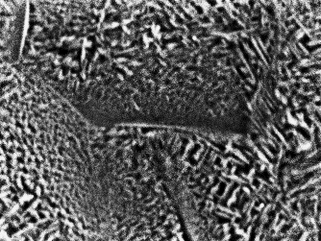
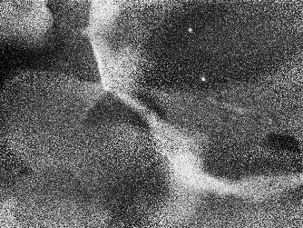
Ion Beam Irradiation at Higher DPA Region
Ti-64
78% α
nano-scale precipitation >10²⁴/m³
Unirr.
Ti-15-3STA
53% β / 47% α
10 dpa
Ti-15-3ST
100% β
10 μm
The single metastable β phase Ti-15-3 alloy exhibits high radiation damage tolerance, that does not undergo irradiation hardening up to 10 dpa at room temperature
  Dense nano-scale precipitates (precursors of the athermal ω phase) that act as effective “sink sites” to absorb irradiation defects
Ti-15-3 is typically aged at ~500ºC to precipitate α phase that enables serviceability at a higher temp.
  α-phase precipitates are too coarse, which can weaken the sink strength and degrade the radiation damage tolerance
  Clear irradiation hardening (not as severe as that of Ti-64)

Slide 12
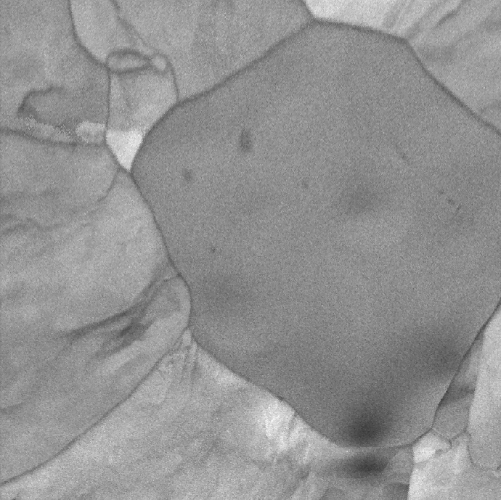
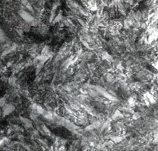
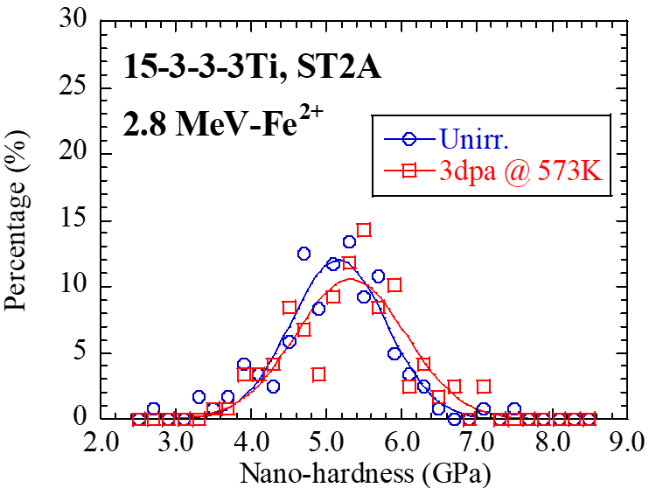
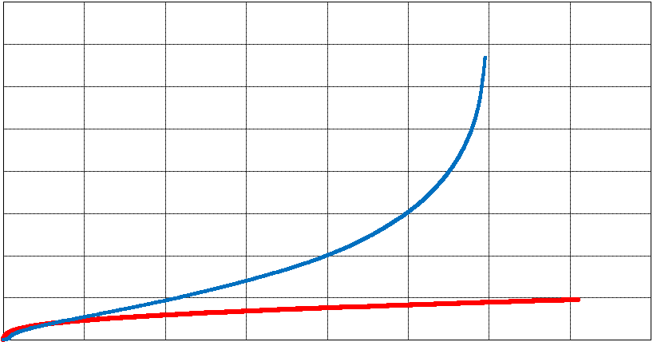
Irradiation Resistance of Ti-15-3 at Higher Temp.
Ti-15V-3Cr-3Sn-3Al
47% precipitate α
53% primary β
Two-step aging treatment from low temperature to high temperature (ST2A)
  α-phase precipitation to become very fine
  Preserving irradiation resistance at 300ºC
  Need to verify ductility by proton irradiation
Creep tests showed Ti-15-3 ST2A can be used at higher temperatures than Ti-64
  Conventional Ti alloys in aircraft engines are near-α phase. The fact that Ti-15-3 ST2A, a metastable β alloy under proper aging, can be used at high temperatures is a new finding
100% metastable β
Typical Aging
510℃x24H
β
β
α
10μm
1μm
STA
2-Step Aging 300℃ x 8H → 540℃ x 24H
40
400℃ / 448MPa
Unirradiated
30
Creep Strain (%)
Ti-6Al-4V
20
10
Ti-15-3 ST2A
1μm
ST2A
0
0
2,000
4,000
6,000
Time (hour)

Slide 13
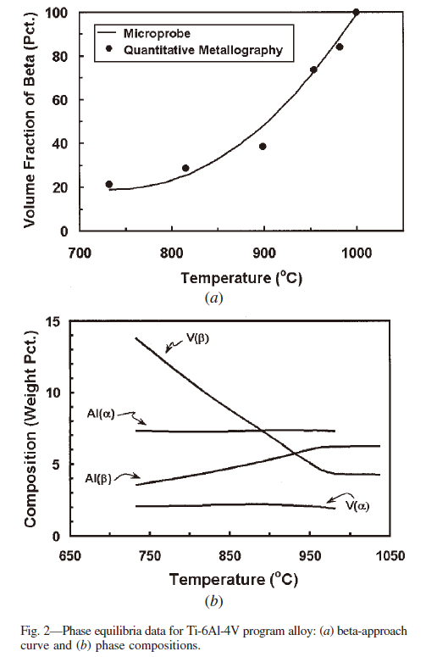
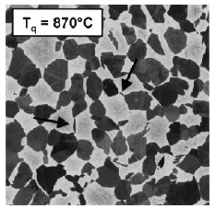
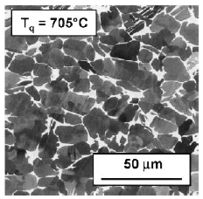
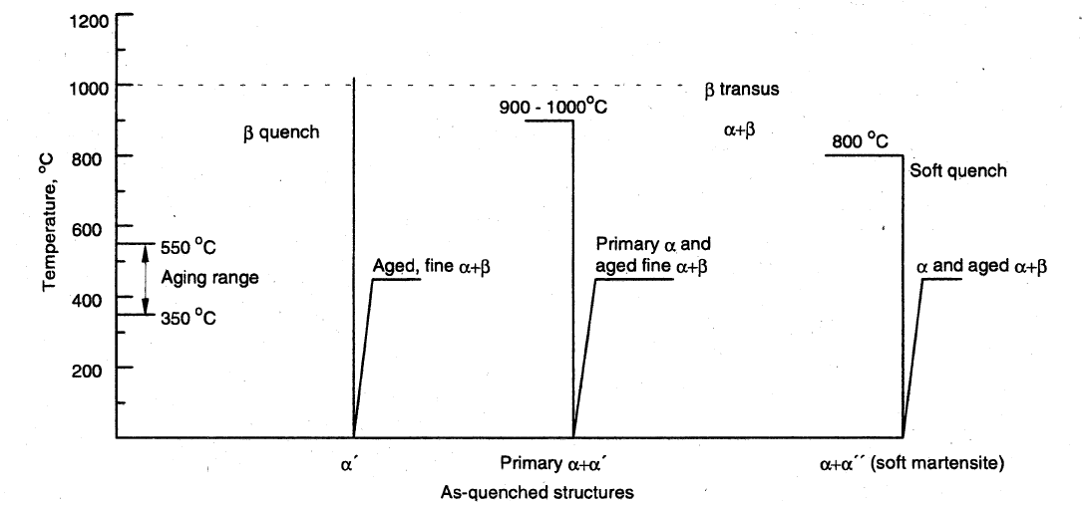
Ti-6Al-4V Quenched and Aged Microstructure
α
β
Solution Treatment
→ Water Quench
Soft Quench
Lower solution temperature allow higher amounts of solute, which generally favors the formation of orthombic (α”) martensite upon quenching
S.L. SEMIATIN et al Microstructure Evolution during Alpha-Beta Heat
Treatment of Ti-6Al-4V
ASM International: Material Properties Handbook Titanium Alloys p. 618

Slide 14
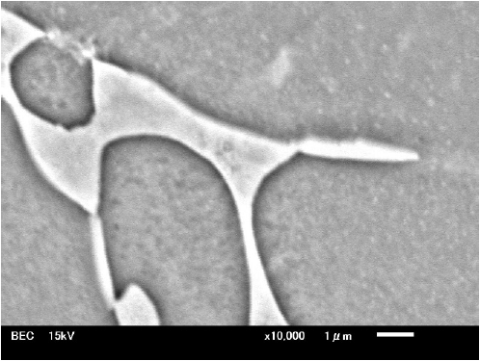
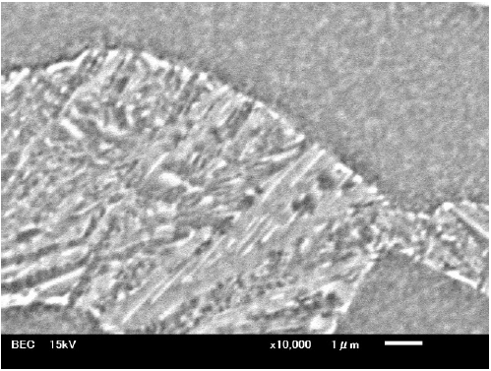
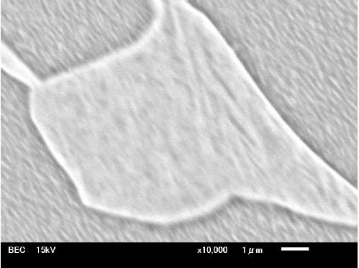
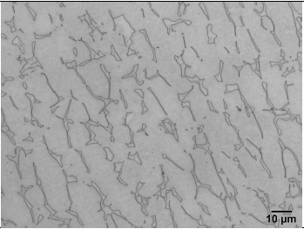
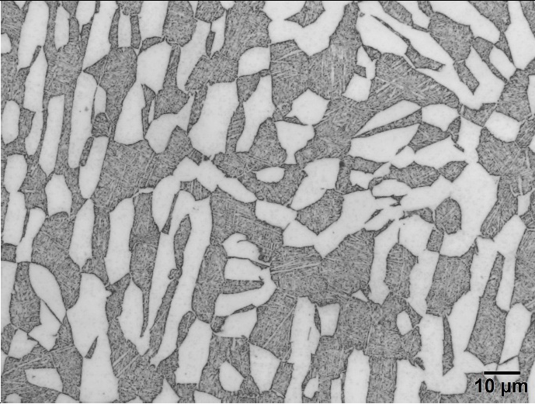
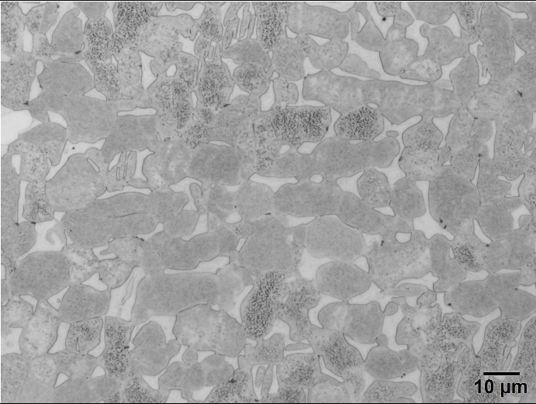
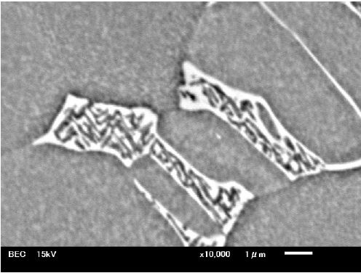
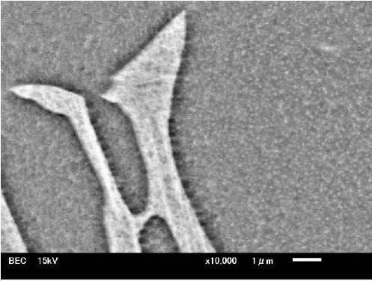
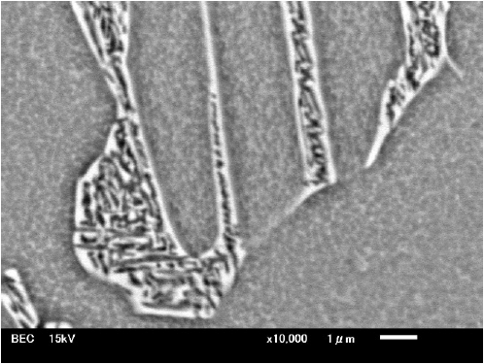
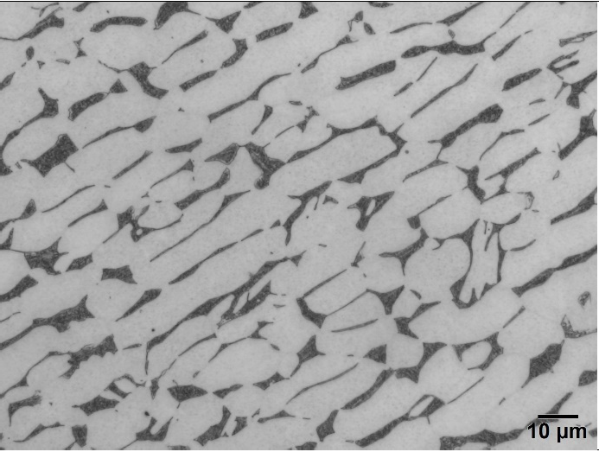
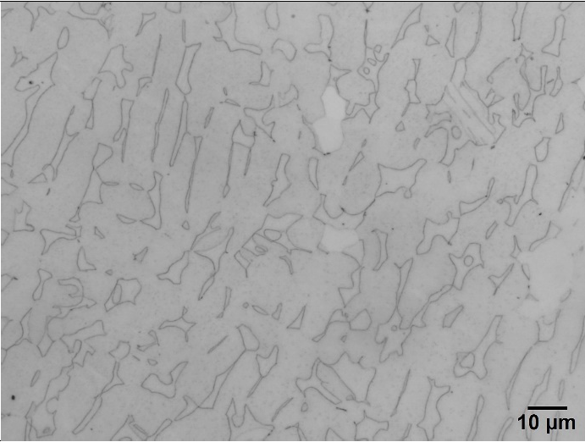
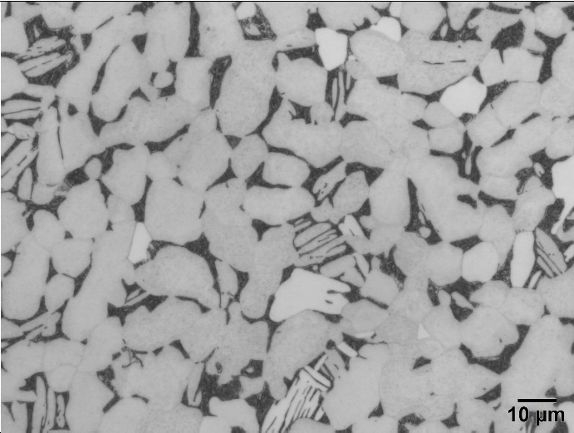
Full Anneal (FA)
Solution-Treated and Aged (STA)
Soft-Quenched(SQ)
Soft-Quenched and
Aged at Low Temperature (SQLA)
Soft-Quenched and
2-Step Aged (SQ2A)
Soft-Quenched and Aged (SQA)
How do these different microstructures of Ti-6Al-4V affect the radiation damage tolerance?

Slide 15
Summary
Under the US-Japan program, various Titanium Alloys were irradiated up to 0.95dpa at the BNL-BLIP facility from 2017-to 2018
  Mesoscale fatigue foils of 5 different grades have been provided to CCFE
  The Ti-15-3 solution treatment without aging is only available as the meso-foil. It may show high-radiation damage tolerance due to the sink effect of the rich athermal ω / martenstic α” precipitates. Evolution or stability of ω phase is worth to be examined by TEM.
  Bend tests on the mesoscale foil will provide ductility information, which is critical for HEP beam window application
Ion irradiation at the HIT facility revealed that the metastable β phase Ti-15-3 alloy exhibits high radiation damage tolerance, that does not undergo irradiation hardening up to 10 DPA at RT.
  Two-step aging treatment from low temperature to high temperature (ST2A) enables the α-phase precipitation to become very fine and maintains the irradiation resistance at 300ºC (no irradiation hardening observed), being satisfactory for beam window application.
So far Ti-6Al-4V purchased from stock market was used for beam window, after applying simple stress relief annealing only. However the alloy has wide range of tunability on its microstructure: Ratio of α/β phase, and precipitation in the β-phase under quenching and aging.
  Worth examining heat treatment procedure which gives best radiation damage tolerance
We have also purchased alloys for high-temperature applications: TIMET β21s, 6246, 828, 834, 1100, and Daido DAT grades
  DAT54, an advanced α-type alloy developed for aircraft engine applications up to 600ºC, also does not show irradiation hardening from ion irradiation
  Procured as small batches: Need to investigate proper Thermo-Mechanical Processing for each grade

Slide 16
Backup

Slide 17
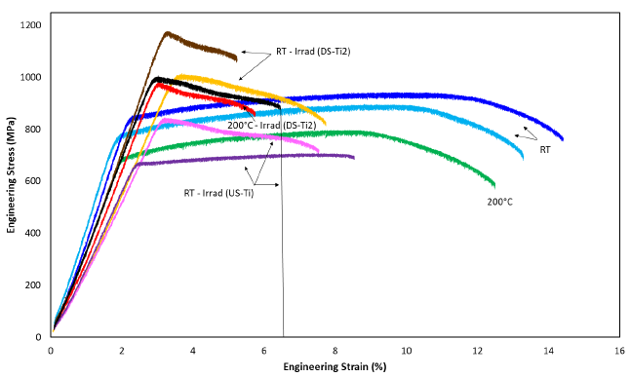
DS-Ti2 PIE： Ti-6Al-4V Tensile Test
0.95DPA
Maximum stress point
If stress increases beyond Yield Stress (YS), the material elongates uniformly
The elongation up to the maximum stress point (Ultimate Tensile Strength, UTS) is referred to as “Uniform Elongation (UE)”
  It is important to retain UE in a structural material, because it allows graceful failure without rapid growth of cracks
Materials are typically hardened after irradiation due to the accumulation of radiation defects, which increases the yield stress of the material
At the same time, uniform elongation is reduced
Yield Point
0.25DPA
Unirr.
fracture
Uniform Elongation
Necking
Total Elongation
α+β Ti-6Al-4V Gr.23 A
RT | DPA | YS | UTS | YS/UTS | UE | TE | ΔYS | ΔUTS | ΔUE | ΔTE
Unirr. | 0.00 | 814 | 921 | 88% | 7.05 | 12.10
T13C | 0.25 | 1002 | 1016 | 99% | 0.20 | 4.85 | 23% | 10% | -97% | -60%
T15 | 0.95 | 1169 | 1178 | 99% | 0.10 | 2.37 | 44% | 28% | -99% | -80%
“radiation hardening”
“loss of ductility / embrittlement”
After irradiation, Ti-6Al-4V loses almost all UE, stress decreases immediately after yielding

Slide 18


DS-Ti2 PIE： Ti-6Al-4V Micro-Structural Studies
Diffraction patterns indicate omega is fully formed, discrete diffraction spots instead of diffuse streaks, can image small particles of omega phase
*: for all 4 variants
DPA | Mean Size (nm) | Numebr density (m⁻³)* | Inter-prt. spacing (nm) | Vol fraction (%)
0.0 | 1.4±0.3 | 5.7x10²⁴ | 7.6 | 0.8
0.95 | ↑3.2±1.0 | ↓2.2x10²⁴ | ↑8.5 | ↑3.7
Confirmation of radiation-induced ω phase formation, coarsened at higher irradiation range

Slide 19





Fatigue Performance of Proton Irradiated Ti Alloy
Laser sensors
DS-Ti1: Ti-6Al-4V Gr23 ELI
Lever arm
Control
>10M cycles:~750MPa
Eccentric connecting rod
Irradiated
Motorized z-stage
~635MPa
Proton-irradiated fatigue life data crucial in evaluating accelerator beam window lifetime
  Preliminary data exhibit that fatigue strength at 10 million cycles reduced from 750MPa to 635 MPa at RT for 0.24 DPA ⇔ ~8M pulses/year for 1.16 sec repetition cycle (Need verification)
The design for the third-generation Fatigue Testing Machine (FTM) has been completed
  Testing with stress ratios between -1 and +1
  Variably adjustable eccentricity to provide a stress range of up to 1,200 MPa
  Testing of Ti alloy samples (un-irradiated) will be carried out to validate results against the ASTM standard test
Can be a reference to what obtained from meso-fatigue ultrasonic tests.

Slide 20



The Coating on Titanium Alloy to Prevent Corrosion
Severe corrosion was observed on the target station side of the J-PARC window.
  caused by the synergistic effect of the humidity in the helium atmosphere and the beam current.
The surface treatment of titanium alloys with a coating of titanium nitride (TiN) or aluminum nitride (TiAlN) by Physical Vapor Deposition (PVD) is effective in preventing corrosion.
To apply the coatings to beam windows, it is necessary to evaluate their irradiation resistance and thermal shock resistance.
HiRadMat specimen
Belcoat-V (Ti-AlN, ρ4.5, LXC 4.5e-6)
Belcoat-G (Ti-N, ρ4.8, LXC 9.0e-6)
https://kobelco-coating.com/en/
Test radiation damage tolerance of the coating

Slide 21

- ta-C : diamond
- Ti-N (rho=4.8) : LXC 9.0e-6
- TiAlN (rho=4.5):LXC 4.5 e-6
Thickness : 5um +- 0.2um

