Slide 1





LBNF-UK Target Materials kick-off meeting
Chris Densham (LBNF-UK target PI)
for project team at STFC Rutherford Appleton Laboratory

Slide 2
Approx Agenda
14:00 Intro & status of LBNF UK target project and materials requirements – and project reporting requirements [Chris]
14:30 Status & plans of US/Japan RaDIATE programme on titanium and graphite [Frederique & Ishida-san]
15:00 PIE facilities available for this project at Culham [Slava]
15:30 Current status of irradiated titanium research in UK/Oxford/Culham and future plans [Jicheng]
16:00 Birmingham/MC40 cyclotron materials irradiation plans [Biao]
16:30 MC40 sample environment design status [Mike & Eric]
17:00 Graphite: status of relevant work and future plans [Dong]

Slide 3














RaDIATE
Collaboration
Led by Patrick Hurh (2012 – 2020)
Frederique Pellemoine (2020 – present)
Radiation Damage In Accelerator Target Environments
radiate.fnal.gov
Broad aims are threefold:
to generate new and useful materials data for application within the accelerator and fission/fusion communities
to recruit and develop new scientific and engineering experts who can cross the boundaries between these communities
to initiate and coordinate a continuing synergy between research in these communities, benefitting both proton accelerator applications in science and industry and carbon-free energy technologies

Slide 4
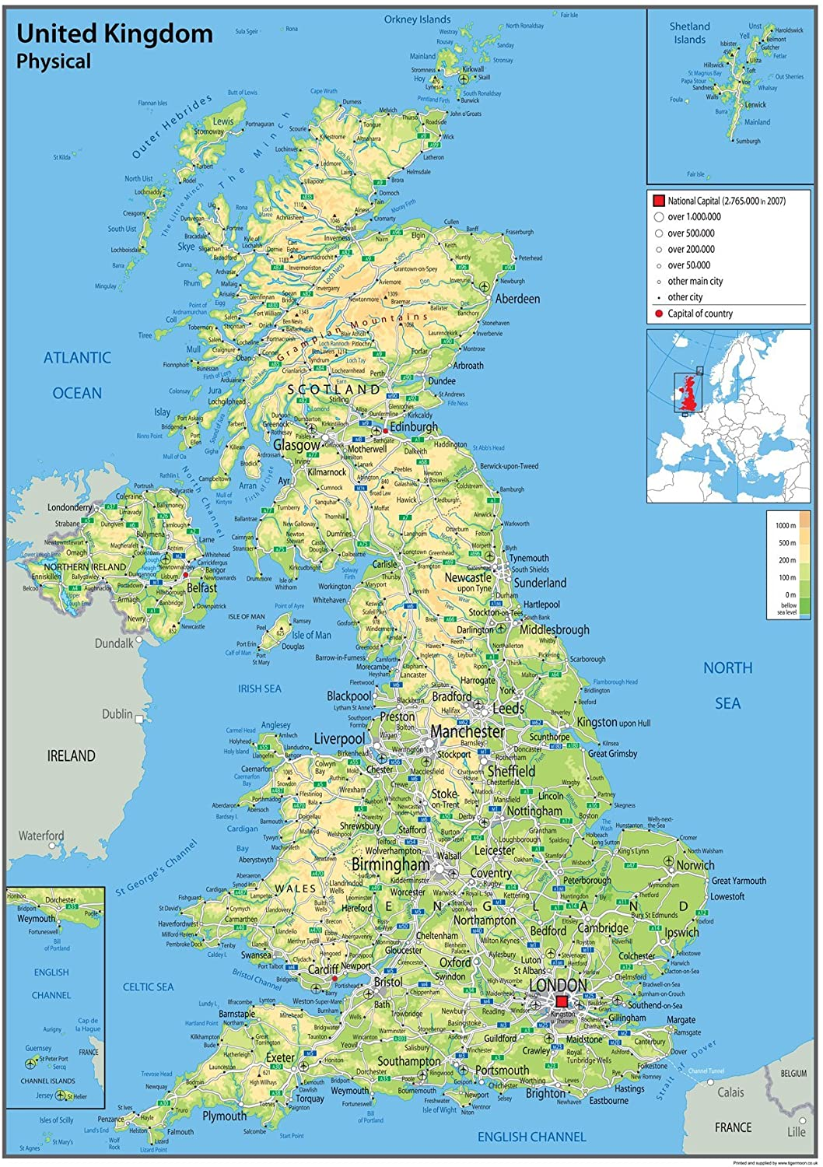
Materials Science – UK contributions to target & window materials research
Contributions to RaDIATE materials science program
Initial funding via HyperK-UK project
  Kick-started academic materials science projects
Project now supported by LBNF-UK
  Supports all outstanding HK-UK activities (ie BLIP irradiated samples)
Coordinate activities with US-JP collaboration
Birmingham University, PDRA (MC40 cyclotron for sample irradiation, c.30 MeV protons)
Oxford University
PDRA (micromechanics) PhD (titanium - our irradiated samples)
RAL (UK coordination)
ISIS (Bristol study of NuMI graphite on ISIS/ENGIN-X instrument approved)
Culham Laboratory
(Materials Research Facility for all Post-Irradiation Examination)
Bristol University (graphite research)

Slide 5
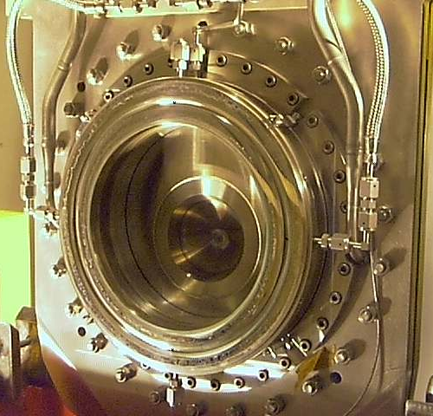
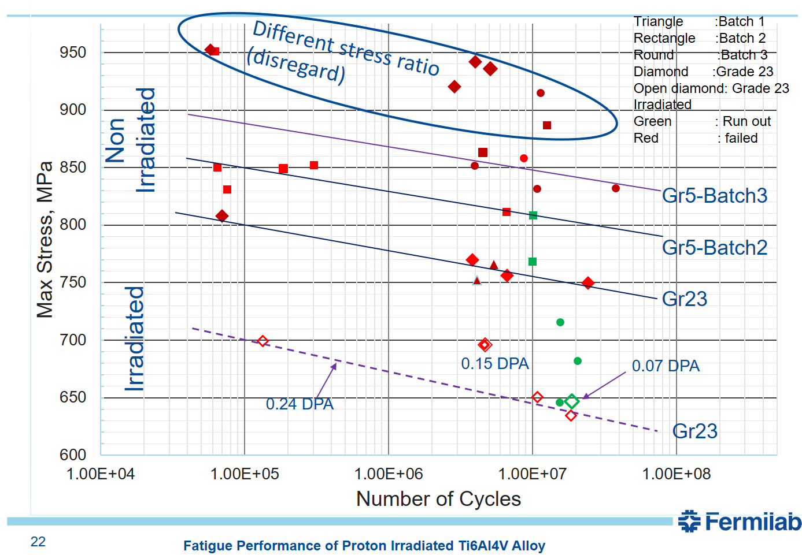
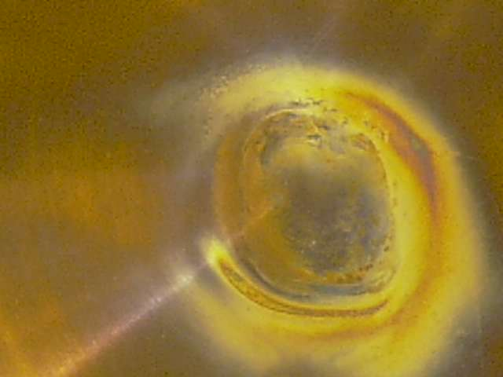
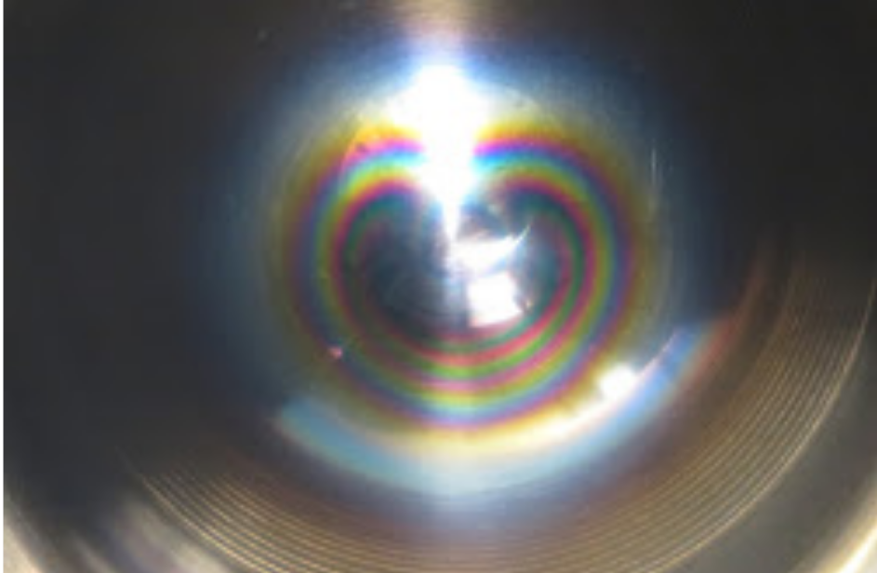
Lifetime limits: Radiation Damage of T2K Titanium Windows
Sparse data on prototypic radiation damage of titanium to date
Grade 23 shows a ≈15% reduction in fatigue strength at 10^8 cycles after proton irradiation to 0.24 DPA
T2K beam window #1 (DS) after c.2e21 POT
Grade 5 Ti-6Al-4V
T2K beam window #2 (US) after c.1.6e21 POT
“Fatigue Performance of Proton Irradiated Ti6Al4V Alloy”, Sujit Bidhar, 6th RaDIATE Collaboration Meeting, Dec 10, 2019

Slide 6
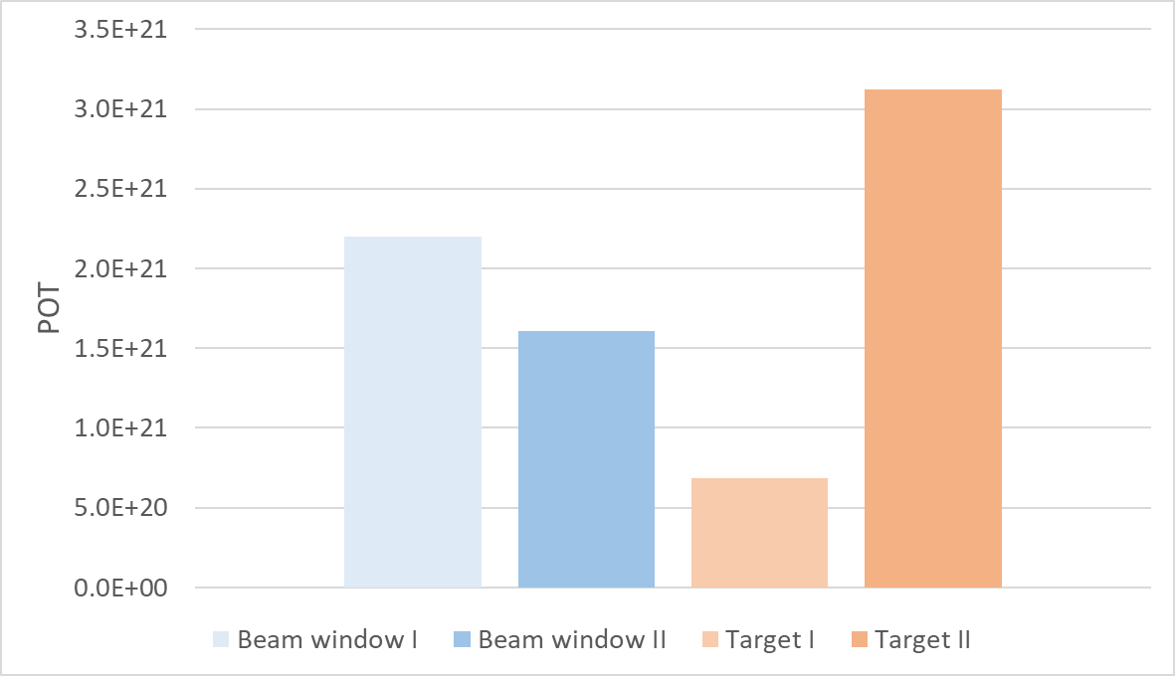
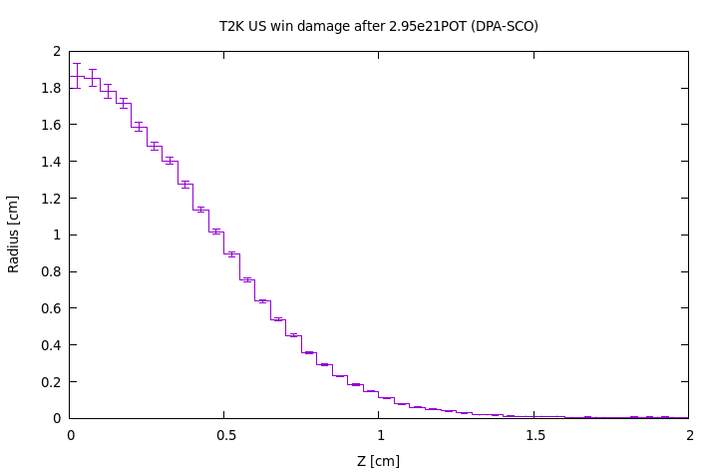
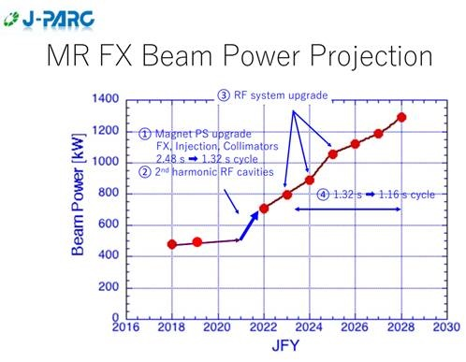
Good experience so far on T2K at 500 kW
How long will a Ti-6Al-4V window/target last?
Target currently has highest POT ~3 x 10²¹ POT
C.2 DPA higher than BLIP sample data so far(c.0.24 DPA)
3.1x10²¹
1.6x10²¹
In service
FLUKA estimate current target window @ 1.9DPA
Damage threshold = 40eV
Replaced before failure
Replaced before failure
In service
Similar DPA/year for LBNF at 1.2 MW

Slide 7
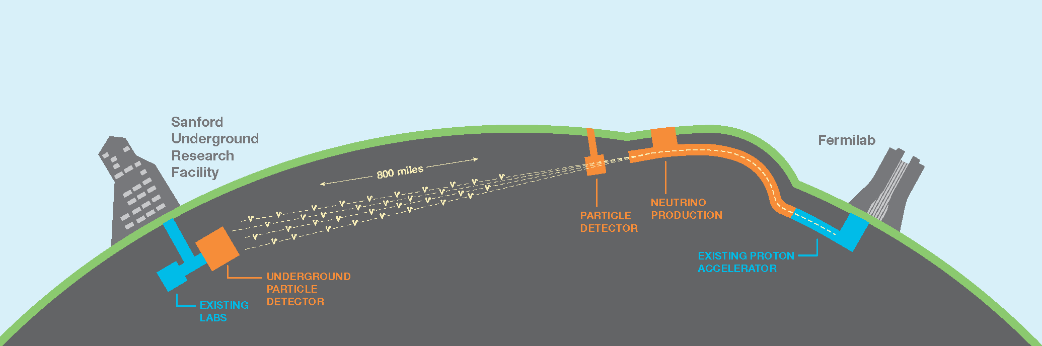
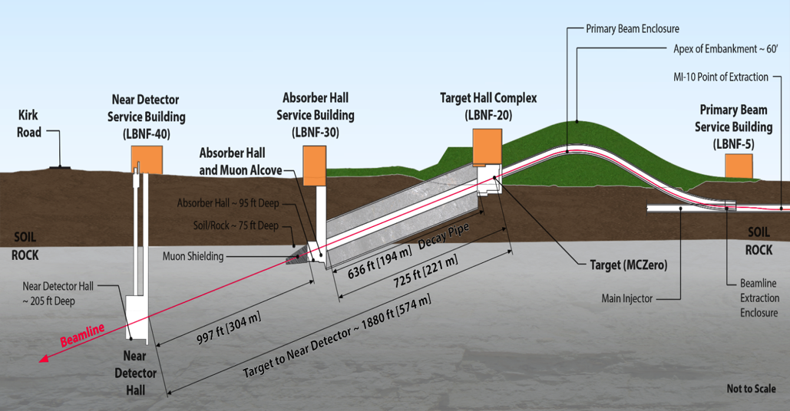
The LBNF/DUNE Beamline
Primary 120 GeV proton beam interacts with graphite target
Generates wide-band neutrino beam (~ few GeV)
Initial proton beam power 1.2 MW
Upgradeable to 2.4 MW

Slide 8
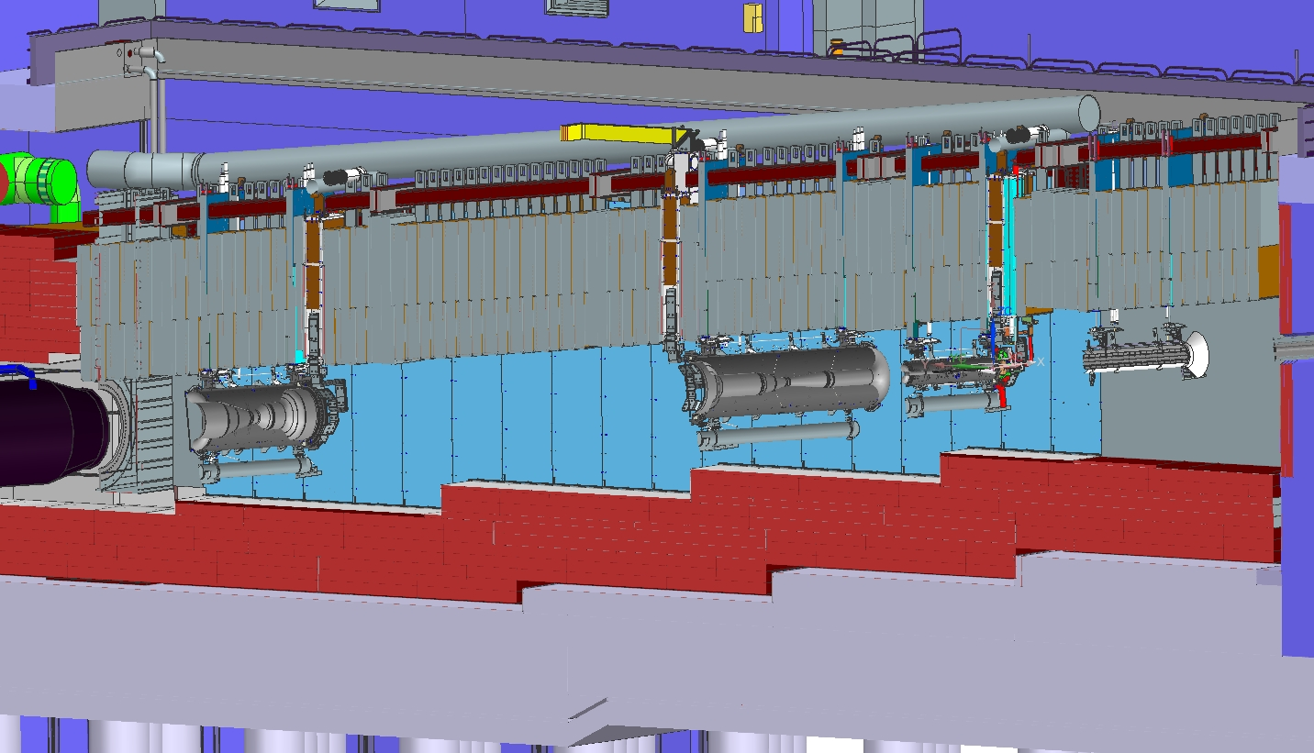
LBNF Target Station
P⁺
Target within 1st magnetic horn

Slide 9
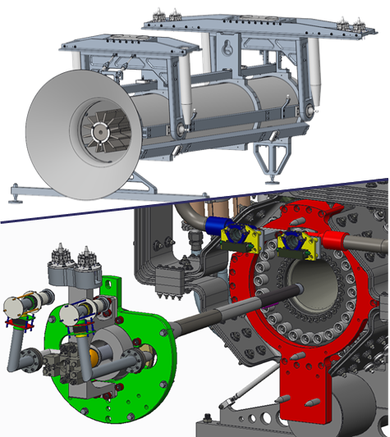
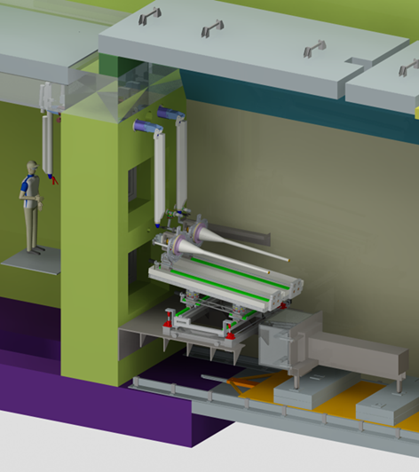
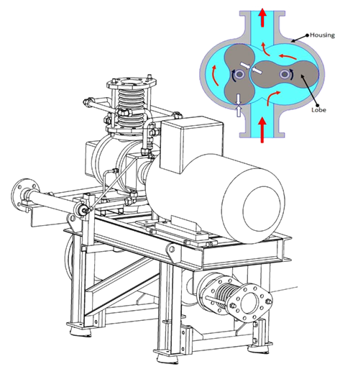

LBNF-UK Target and Associated Equipment
RAL / High Power Targets Group
Project management
Engineering design and construction
Procurement
Commissioning
WP0: Project Management
PI: Densham / PM: Loveridge
WP1
“Target and Beamline Apparatus”
(Loveridge)
WP2
“Remote Handling”
(Harvey-Fishenden)
WP3
“Helium and
Ancillary Plant”
(Davenne)
University of Warwick
Target: physics performance simulations
PDR Dec 2020
PDR Dec 2021
Baffle PDR tomorrow
Birmingham / Bristol / Oxford / Culham
Target: materials research
Target PDR
Dec 2020

Slide 10
LBNF-UK Target and Associated Equipment:
Project Phases and Status
2018
2019
2020
2021
2022
2023
2024
2025
2026
2027
2028
DESIGN
FEATURE PROTOTYPING
FINALIZE UK SCOPE
PHASE-2 PROPOSAL SUBMISSION
Phase 1
(Design Phase)
Funded at 100% of budget request
PRODUCTION DRAWINGS
MATERIALS RESEARCH
PROCURE/MANUFACTURE/SUPPLY
TARGET/HORN INTEGRATION
Phase 2
(Construction Phase)
M&O
(Operations Support)
TARGET STATION COMMISSIONING
FIRST BEAM
PRODUCTION OF REPLACEMENT COMPONENTS

Slide 11
Funding letter for LBNF/DUNE Target Phase 2
(STFC Projects Peer Review Panel / Science Board)
‘Science Board were informed of the technical challenge of the different lengths of the target. A 1.5m target length is technically feasible, but the team would like to increase this to 1.8m and are one of the few groups globally that have the knowledge and skills to achieve this. Science Board were very supportive of the proposal and endorsed the recommendation of PPRP to fund in full the LBNF DUNE Target Phase 2 project. Science Board also agreed that the team should introduce a robust reporting schedule for each phase of the project […].

Slide 12
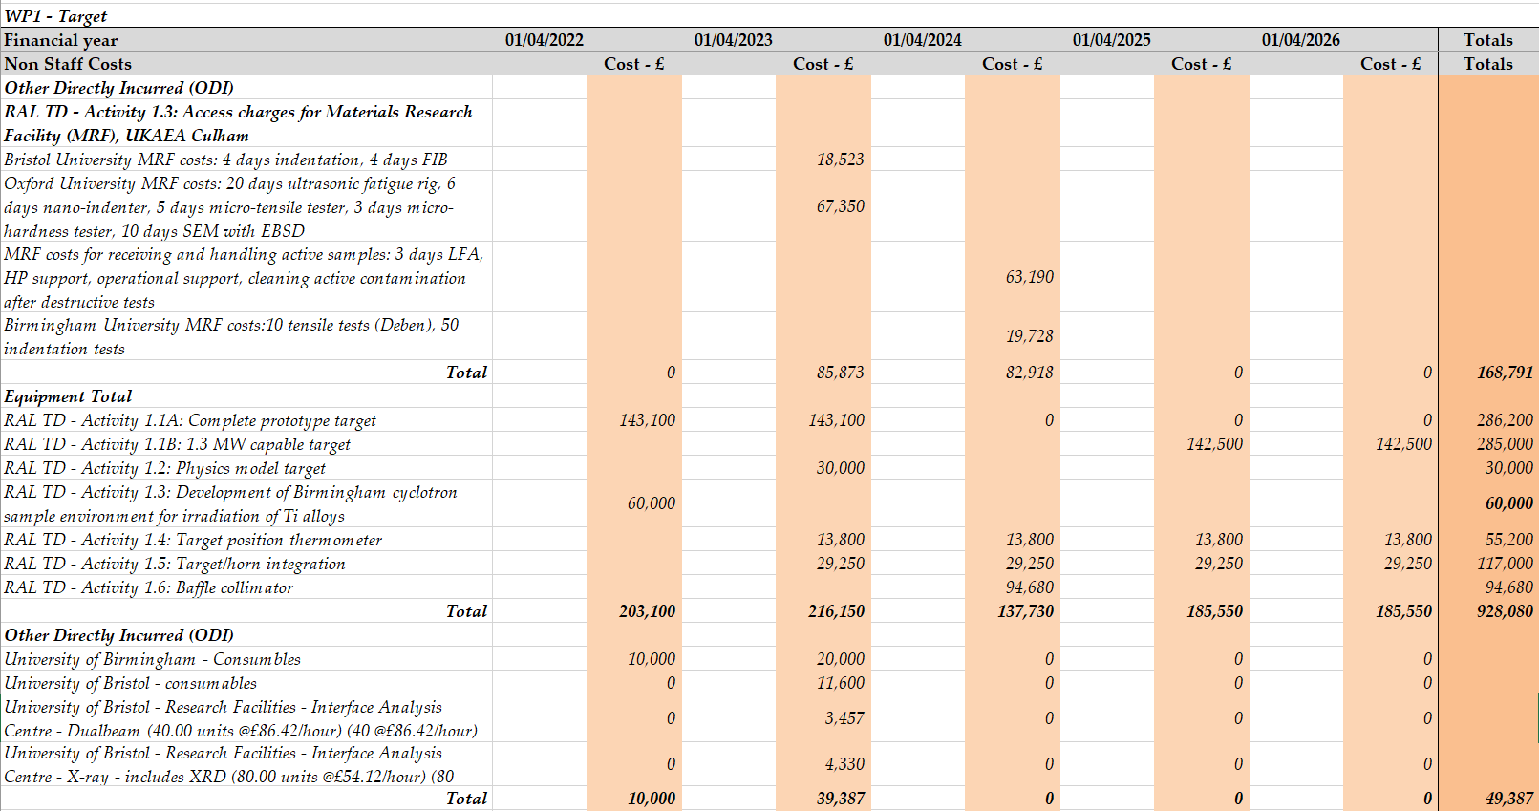
Target & materials budget (non-staff)

Slide 13
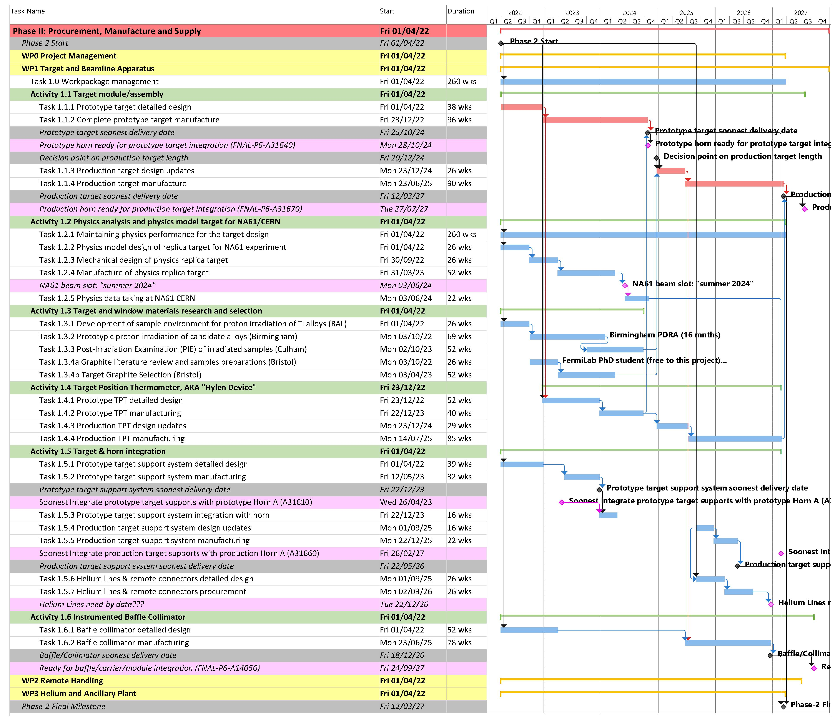
UK WP1: Target and Beamline Apparatus
Project Schedule
– resource loaded to enable ‘earned value’ assessment (c/o Peter Loveridge)

Slide 14
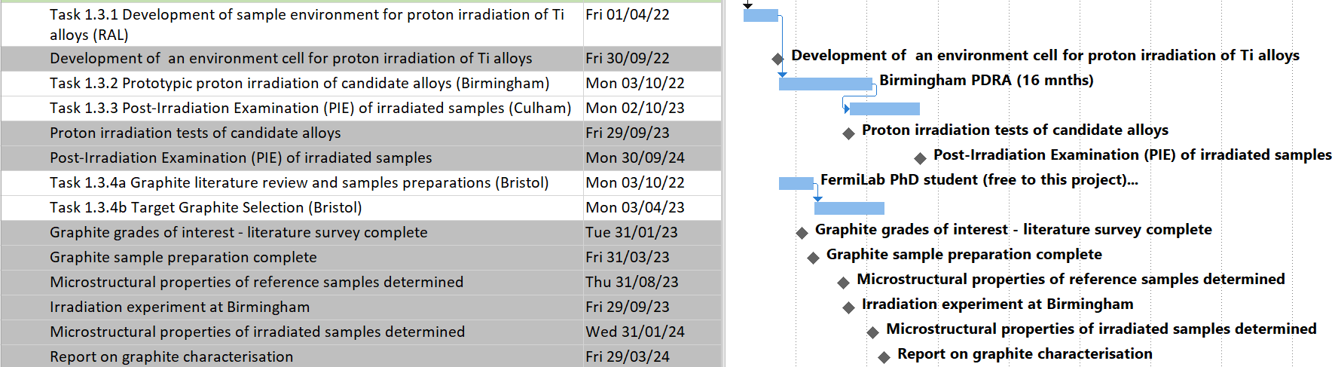
Project milestones – need to formalize soon
Need to submit Milestones, Deliverables table to STFC Oversight Committee meeting
Document submission 24th May for meeting on 7th June

Slide 15
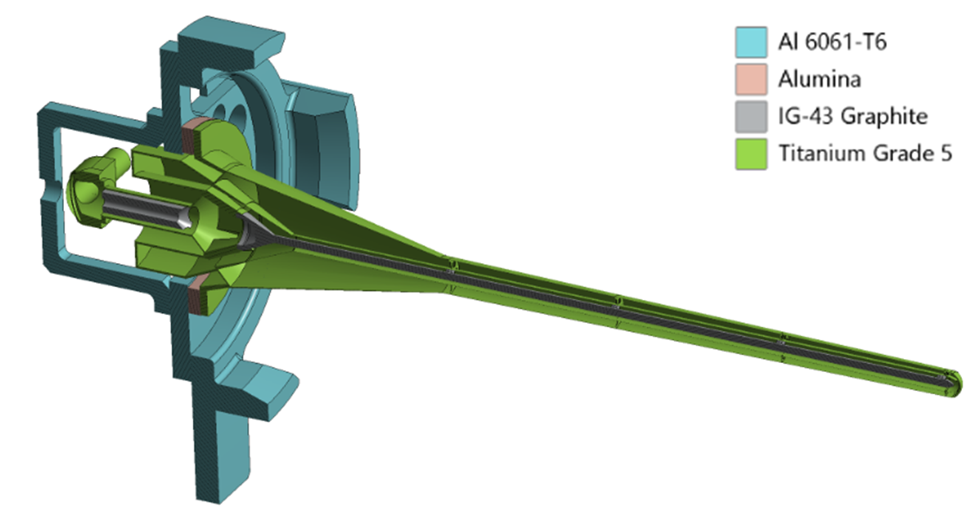
LBNF Target Components
Target core: segmented graphite rod 16 mm diameter, 1.5 – 1.8 m long
Titanium target containment vessel with up-stream and down-stream beam windows
P⁺
Upstream titanium beam window:
Target:
Segmented graphite rod
‘Bafflette’:
Protects downstream elements
enables ‘beam based alignment’
Downstream titanium beam window

Slide 16
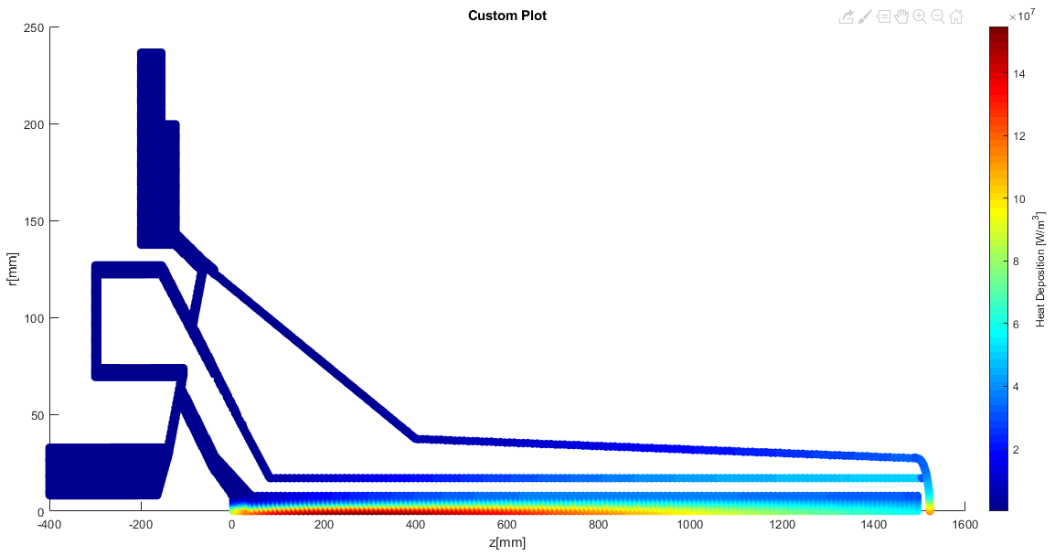
FLUKA Heat Load
1.2 MW proton beam on a 1.5m long target

Slide 17
FLUKA Results – John Back, July 2021
Includes biasing at the beam windows
  “These use samples of 1 million proton events as before, but it forces more DPA interactions in the beam windows and then reweights them”
2x larger radial bins in windows (for DPA only)
Case | Beam Power (MW) | Peak Heat (MW/m^3) |  | Total Heat (kW) | Peak DPA per year ()
 |  | Graphite | Titanium |  | Target | US Win | DS Win
Overfocussed | 1.2 | 256 | 391 | 25.0 | 1.0 | 5.0 | 0.8
Nominal | 1.2 | 157 | 191 | 24.1 | 0.5 | 2.5 | 0.7
Underfocussed | 1.2 | 138 | 166 | 23.7 | 0.5 | 2.1 | 0.6

Slide 18
Peak Temperature by Location
Increasing length from 1.5 to 1.8m adds about 25% extra heat
  The local heat deposition in the outer container increases rapidly with target length
Increasing the flowrate from 40 to 46g/s keeps the helium outlet temperature below 160°C
  The only components which see an increased peak temperature are the outer container and the downstream bam window
Peak temperature by location (°C) – Flowrate is 40g/s at L=1.5m, 46g/s at L=1.8m
1.2MW | Target Core | Flow Guide | Outer Can | US Window | DS Window | Bafflette | Manifold | Helium Peak | Helium Outlet
L=1.5m | 506 | 213 | 133 | 107 | 128 | 37 | 197 | 282 | 152
L=1.8m | 477 | 196 | 151 | 100 | 132 | 36 | 197 | 269 | 158

Slide 19
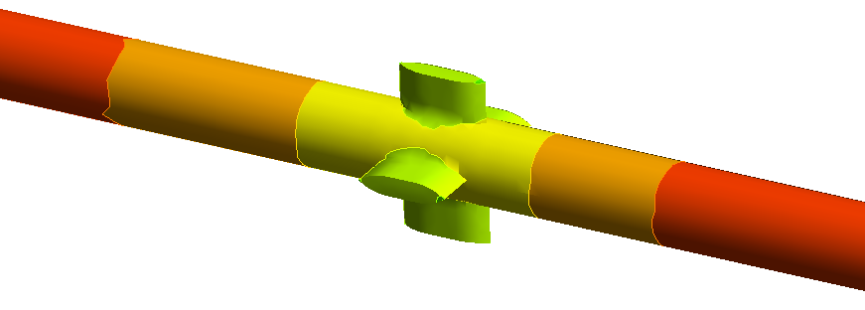
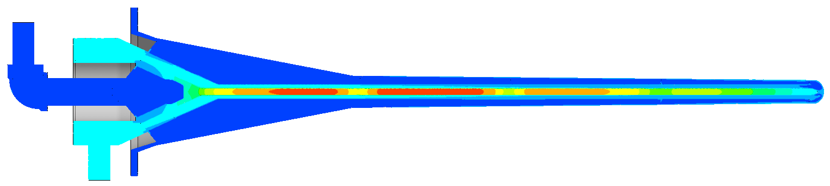
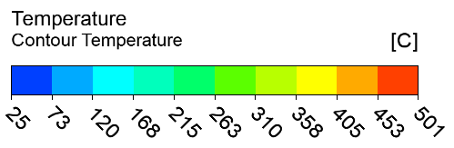
Thermal Results (Graphite)
Target length = 1.5m
Beam power = 1.2MW
Inlet temperature = 35°C
Helium mass flowrate = 40g/s
Back-pressure at outlet = 4.5barA

Slide 20
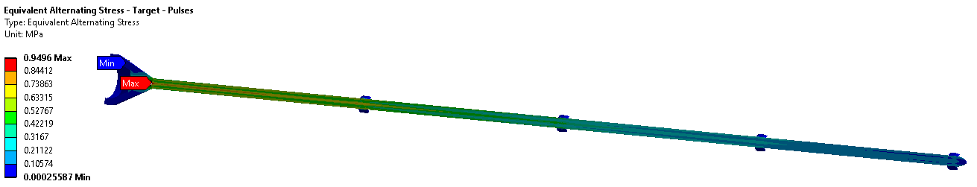
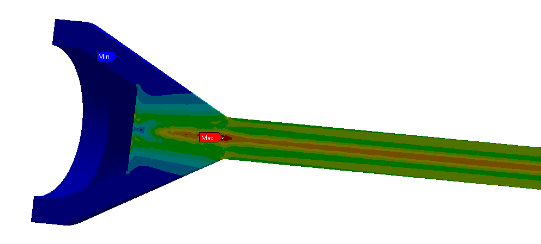
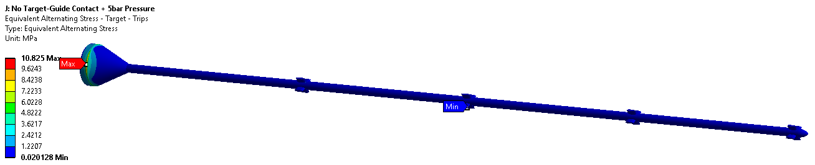
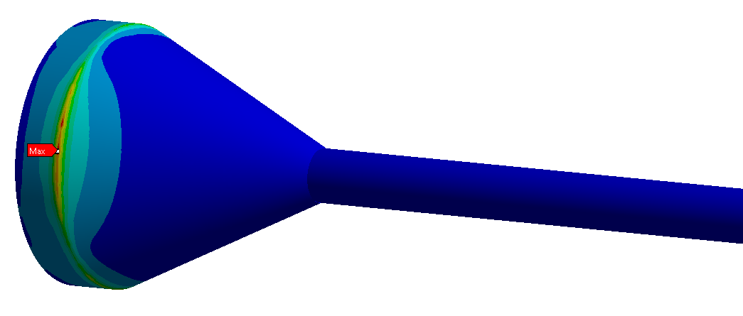
Fatigue Results – Graphite
Goodman equivalent alternating stress results
 | SE (MPa)
Target Pulses | 0.9
Target Trips | 10.8
Target Trips, No Stress Conc. | 1.0

Slide 21
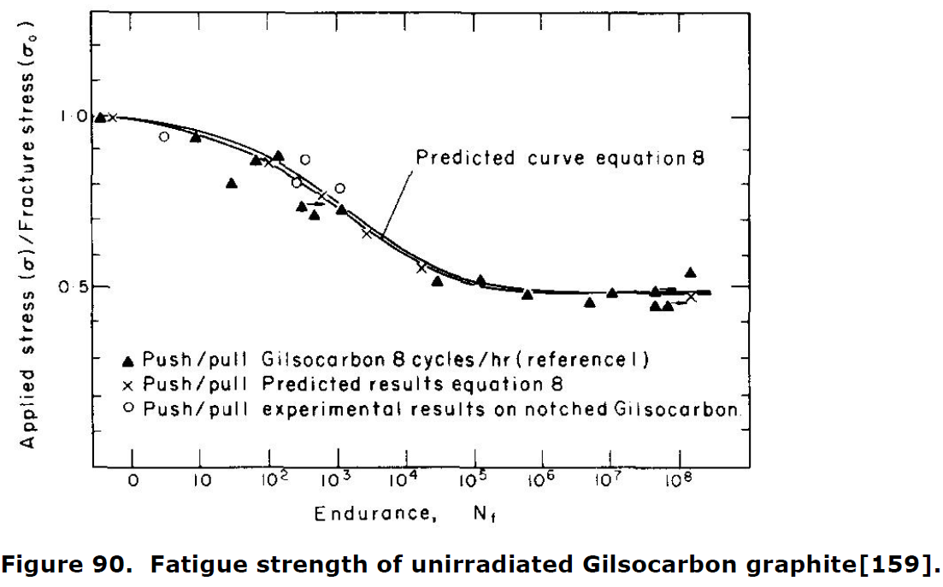
Graphite Fatigue Data
“Literature Review On The Irradiation Response Of Be, W And Graphite for Proton Accelerator Applications”, NNL (13) 12703, Issue 1, 2013:
  Endurance limit of nuclear grade graphite is approximately half of the tensile strength
  This remains true if the tensile strength increases due to radiation, or reduces due to oxidation
  Fatigue strength reduces with cycles up to ≈10^5, then stays constant up to 10^8 cycles
“Failure investigation of nuclear grade POCO graphite target in high energy neutrino physics through numerical simulation”, S. Bidhar et al., Nuclear Materials and Energy, 2020.
  “Although nuclear grade graphite has good tensile strength, it has poor fatigue strength. Typically, the endurance limit is found to be 14 MPa at a million cycles for such graphite”
 | IG-43 Graphite
UTS at room temp (MPa) | 37
Estimated endurance limit (MPa) | 18.5
Beam pulse stress amp. (MPa) | 1.3
Pulse cycles per year () | 1.50E+07
Beam trip stress amp. (MPa) | 0.3
Trip cycles per year () | 4.99E+03

Slide 22
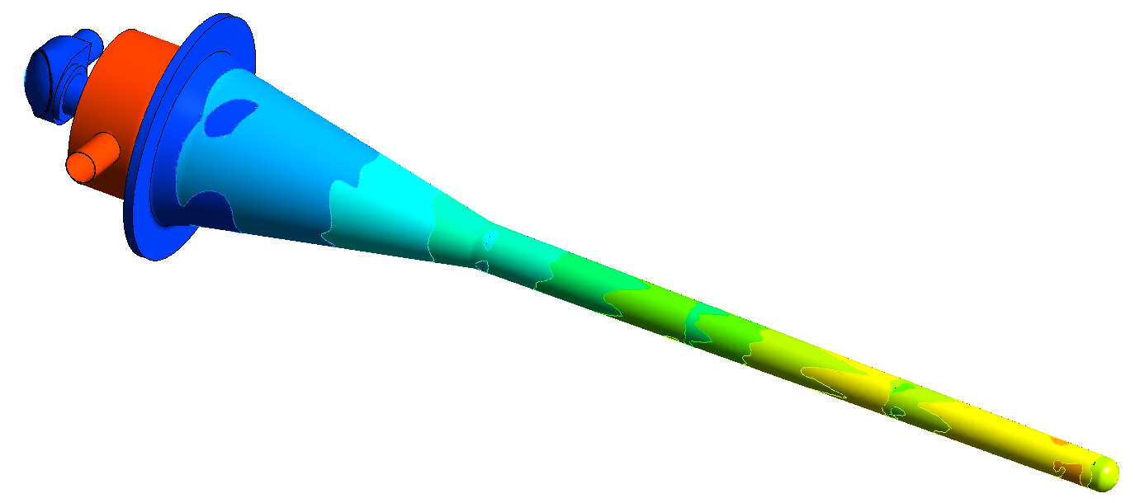
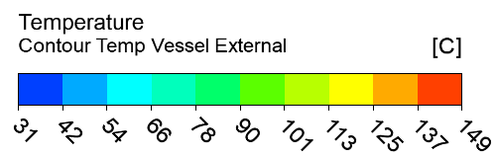
Thermal Results (titanium)
Target length = 1.5m
Beam power = 1.2MW
Inlet temperature = 35°C
Helium mass flowrate = 40g/s
Back-pressure at outlet = 4.5barA

Slide 23
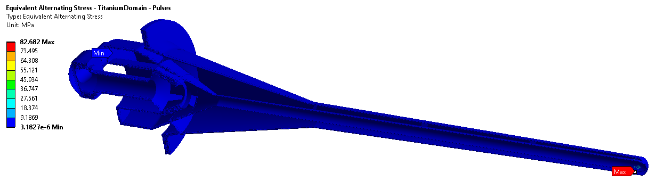
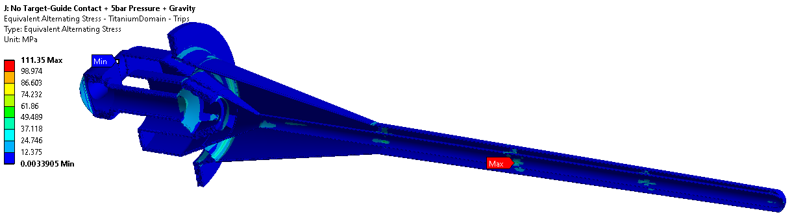
Fatigue Results – Titanium
Goodman equivalent alternating stress results
 | SE (MPa)
Titanium Pulses | 82.7
Titanium Trips | 111.3
Ignoring stress concentrations, peak stresses in titanium occur at the upstream window

Slide 24
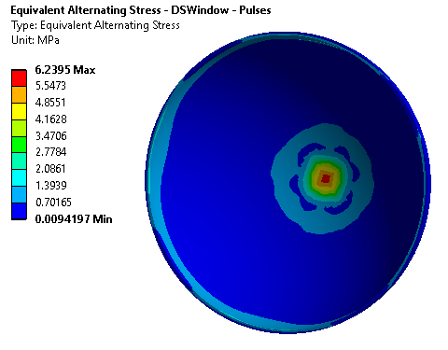
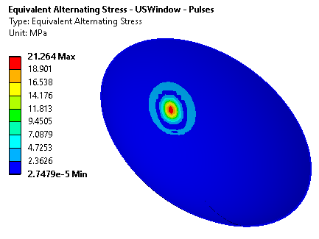
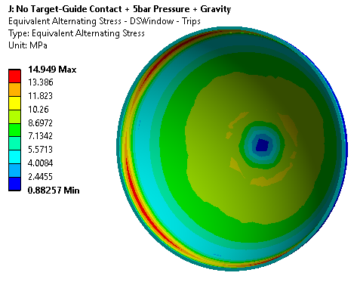
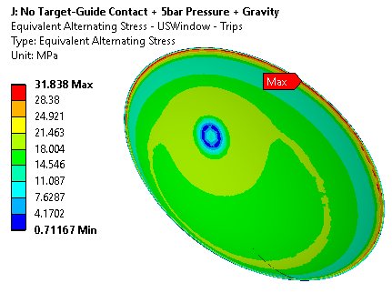
Fatigue Results – Beam Windows
Goodman equivalent alternating stress results
 | SE (MPa)
USWin Pulses | 21.3
USWin Trips | 31.8
USWin Trips, No Stress Conc. | 28.0
 | SE (MPa)
DSWin Pulses | 6.2
DSWin Trips | 14.9
DSWin Trips, No Stress Conc. | 10.8

Slide 25
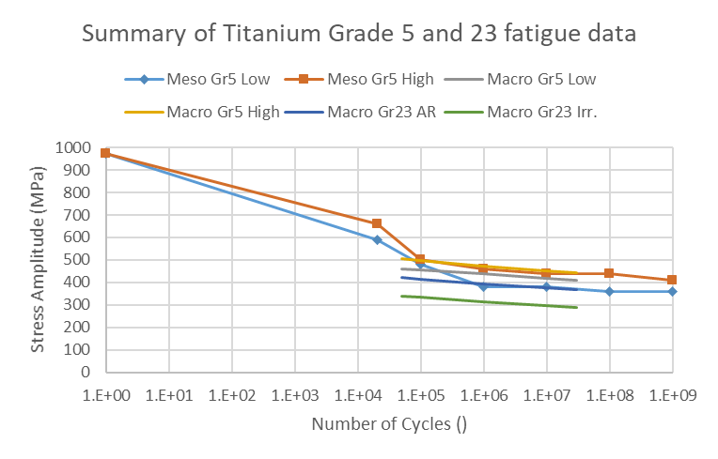
Titanium Fatigue Data – Grades 5 and 23
Use Gerber relation to convert all-tensile (R>0) test results to equivalent fully reversed (R=-1) stress amplitudes

Slide 26
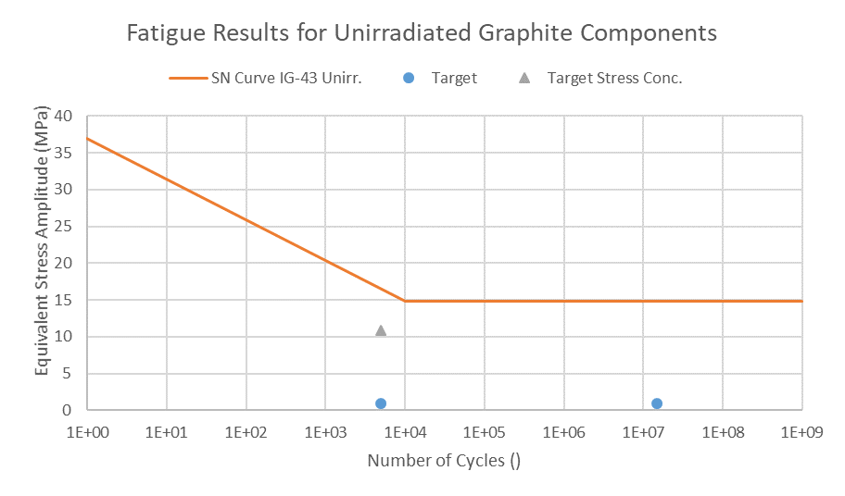
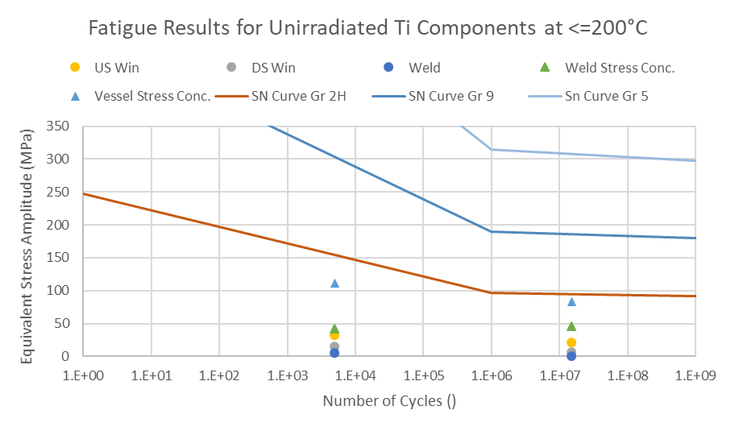
Fatigue Results Summary
Results including stress concentrations and conservative temperature
  Important to reduce stress concentrations at graphite-titanium join and titanium fin connection points (particularly near welds)
  Bulk material has good safety margins against SN curves for unirradiated materials

Slide 27
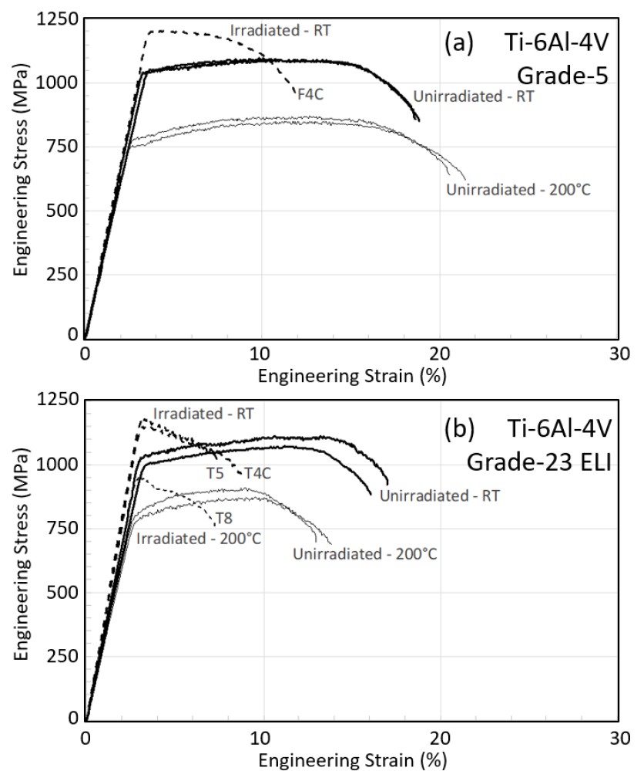
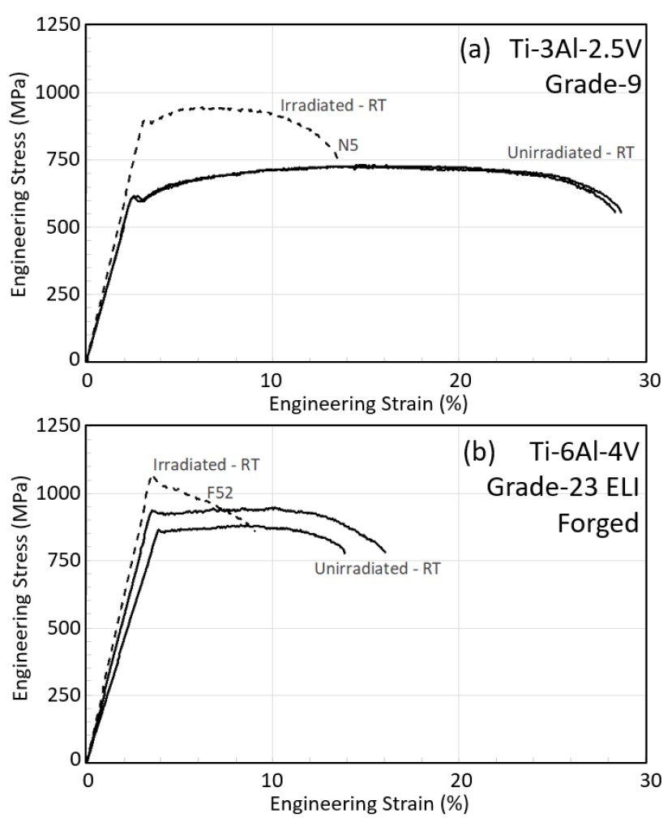
Case | Peak DPA/yr ()
 | US Win | DS Win
VOF | 17.1 | 1.3
OF | 5.0 | 0.8
Nominal | 2.5 | 0.7
UF | 2.1 | 0.6
VUF | 1.7 | 0.6
F4C=0.06 dpa at Tirr=47°C
N5=0.22 dpa @112°C
T4C=0.06 dpa @ 47°C,
T5/T8=0.23 dpa @ 125°C
F52=0.22 dpa @112°C
“Tensile behavior of dual-phase titanium alloys under high-intensity proton beam exposure: radiation-induced omega phase transformation in Ti-6Al-4V”, T. Ishida et al., Journal of Nuclear Materials, 2020

Slide 28
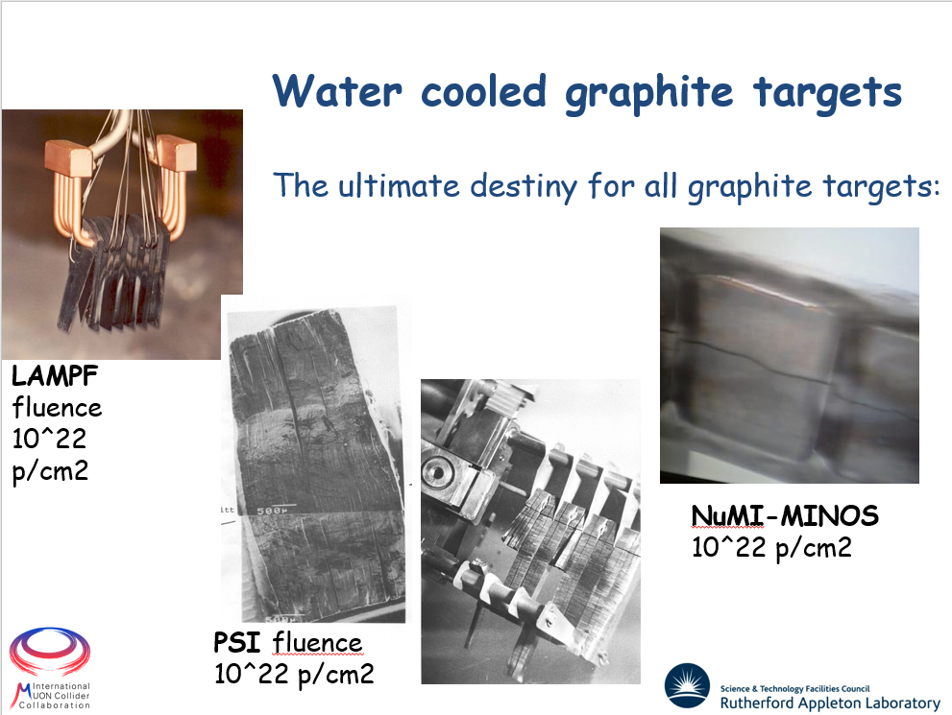
Effects of Radiation Damage – Graphite
Increasing the current or reducing the spot size increases proton flux
  Does changing the beam energy also affect dpa rate?
Target failures at around 10^22 protons/cm^2 have been recorded at LAMPF, PSI and NuMI-MINOS
Case | Beam Energy (GeV) | Beam Sigma (mm) | Current (uA) | Peak Flux (p/cm^2/yr)
Very Overfocussed | 120 | 1 | 10 | 1.79E+22
Overfocussed | 120 | 1.867 | 10 | 5.13E+21
Nominal | 120 | 2.667 | 10 | 2.51E+21
Underfocussed | 120 | 2.933 | 10 | 2.08E+21
Very Underfocussed | 120 | 3.2 | 10 | 1.75E+21
C. Densham, “Muon Collider target: Visions and Opportunities”, Muon Collider Community Meeting, 2021

Slide 29
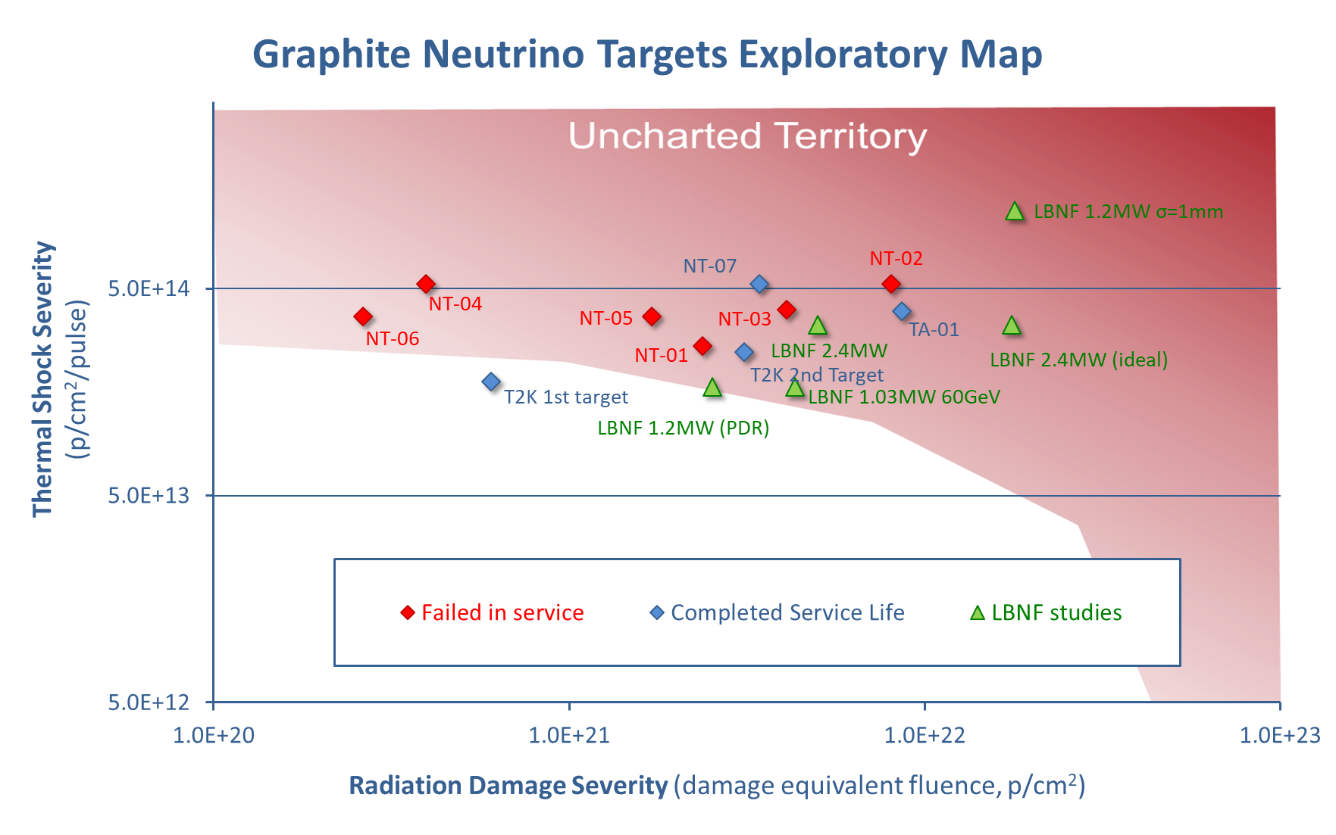
1.2MW, 30% Overfocused case almost exactly overlaps 2.4MW case (1/0.7^2 = 2.04)

Slide 30
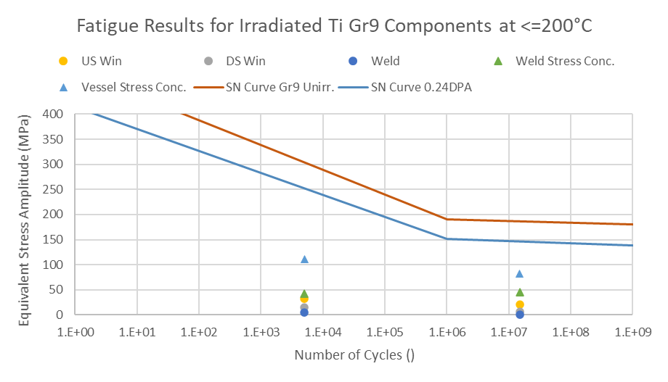
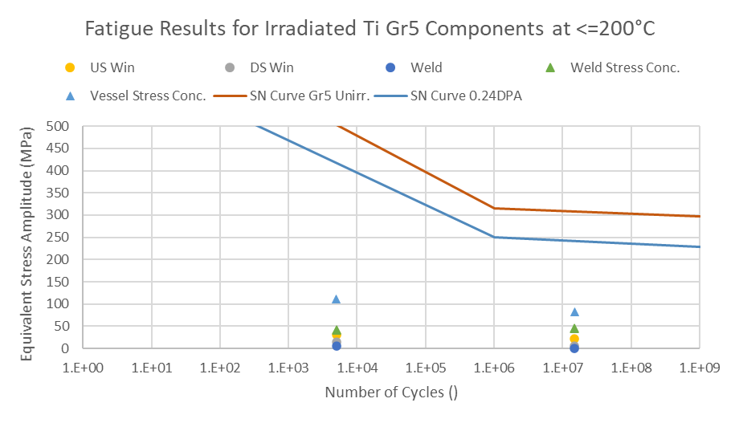
Irradiation Results Summary
Titanium SN curve derated based on operating temperature and DPA
  Large margin on Grade 5 Ti at 0.24 DPA – but peak dose in US window is 2.5 DPA/yr
  Less margin for Grade 9 – but radiation damage effects may be less severe?
Irradiation effect on graphite fatigue is unknown – currently estimated life based on previous experience at T2K and NuMI/NOvA

Slide 31
Summary of Target Survivability
Some results may need to be updated – check carefully
Survivability parameters for LBNF target at 1.2MW, 1yr lifetime, nominal beam sigma.
Parameter | Value | Limit | Limit Basis | Notes
Pulse cycles per year | 1.5E+07 | N/A | N/A | Based on 57% uptime, 1.2s beam cycle time.
Beam trip cycles per year | 5.0E+03 | N/A | N/A | Assuming 57% uptime and 1 trip per hour - Approximately typical value from ISIS and T2K operating history.
Graphite pulse stress amplitude (MPa) | 0.9 | 14.8 | Lower bound from fatigue tests on unirradiated Gilsocarbon [1], scaled down by UTS ratio of IG-43/Gilsocarbon. | Assumes Toyo Tanso IG-43 graphite.
Graphite trip stress amplitude (MPa) | 1.0 | 14.8 | Lower bound from fatigue tests on unirradiated Gilsocarbon [1], scaled down by UTS ratio of IG-43/Gilsocarbon. | Assumes Toyo Tanso IG-43 graphite.
Titanium pulse stress amplitude (MPa) | 22.0 | 280 | Lower bound from fatigue tests on unirradiated macroscale Gr5 [2], scaled down by UTS ratio of Gr2/Gr5. | Assumes Ti grade 2 windows - in practice a stronger alloy (e.g. Gr5 or Gr9) is likely to be used.
Titanium trip stress amplitude (MPa) | 30.5 | 308 | Lower bound from fatigue tests on unirradiated macroscale Gr5 [2], scaled down by UTS ratio of Gr2/Gr5. | Assumes Ti grade 2 windows - in practice a stronger alloy (e.g. Gr5 or Gr9) is likely to be used.
Peak proton fluence per year (p/cm^2) | 2.5E+21 | 3.1E+21 | T2K 2nd target has survived beyond this value - still in operation, limit will continue to be updated. | Conservative fluence limit.
Peak proton fluence per year (p/cm^2) | 2.5E+21 | 1.0E+22 | Target failures at around 10^22 protons/cm^2 have been recorded at LAMPF, PSI and NuMI-MINOS. | Non-conservative fluence limit.
Thermal shock severity (p/cm^2/pulse) | 1.7E+14 | 2.5E+14 | T2K 2nd target has survived beyond this value - still in operation, limit will continue to be updated. | Conservative thermal shock limit. LBNF target geometry is more similar to T2K than to NT-07.
Thermal shock severity (p/cm^2/pulse) | 1.7E+14 | 5.3E+14 | NT-07 target survived to this value. Other NT targets failed at lower values, mainly due to water leaks. | Non-conservative thermal shock limit. Water leaks will not be an issue for the helium cooled LBNF target.
[1] “Literature Review On The Irradiation Response Of Be, W And Graphite for Proton Accelerator Applications”, NNL (13) 12703, Issue 1, 2013
[2] “Fatigue Performance of Proton Irradiated Ti6Al4V Alloy”, Sujit Bidhar, 6th RaDIATE Collaboration Meeting, Dec 10, 2019

Slide 32
Material Selection
The majority of the titanium components are expected to be Grade 2
  However, during prototyping some manufacturers expressed a preference for Grade 5
  Grade 5 has higher strength but lower ductility, and is not listed in ASME pressure codes
Grade 9 (Ti-3Al-2.5V) is under consideration for the beam windows as it has higher strength than Grade 2 and better radiation resistance than Grade 5
This analysis assumes grade 2 everywhere, which is conservative
This analysis uses graphite properties for Toyo Tanso IG-43, however POCO ZXF-5Q may be used for the final target
  The disadvantageous higher thermal-expansion coefficient of the POCO graphite is compensated for by its proportionally higher strength

Slide 33
Failure modes and load cases
Gross plastic deformation
  Gravity, heating by 1.2MW beam, internal pressure up to 5bar
    The target will be protected by a pressure relief valve set to 5bar
Buckling
  1bar internal vacuum
Fatigue
  Pulsed beam heating
  Beam trips
Vibration/Resonance
  Off-axis beam pulses
  Horn-induced vibrations

Slide 34
Failure Modes not in ASME
Damage to graphite core
Vibration/resonance
Off-normal proton beam
  Off axis
  Over focussed
Radiation Damage
  Working with RaDIATE collaboration and T2K, who are continuing to produce data on irradiated titanium
  Some excess margin on structural requirements
  The highest irradiation is not in the same place as the highest stresses (except the US window)
Creep
  Relatively sparse data, but currently does not look to be an issue below about 150°C
  The helium flow pattern keeps the base of the cantilever well cooled
Covered on upcoming slides

Slide 35
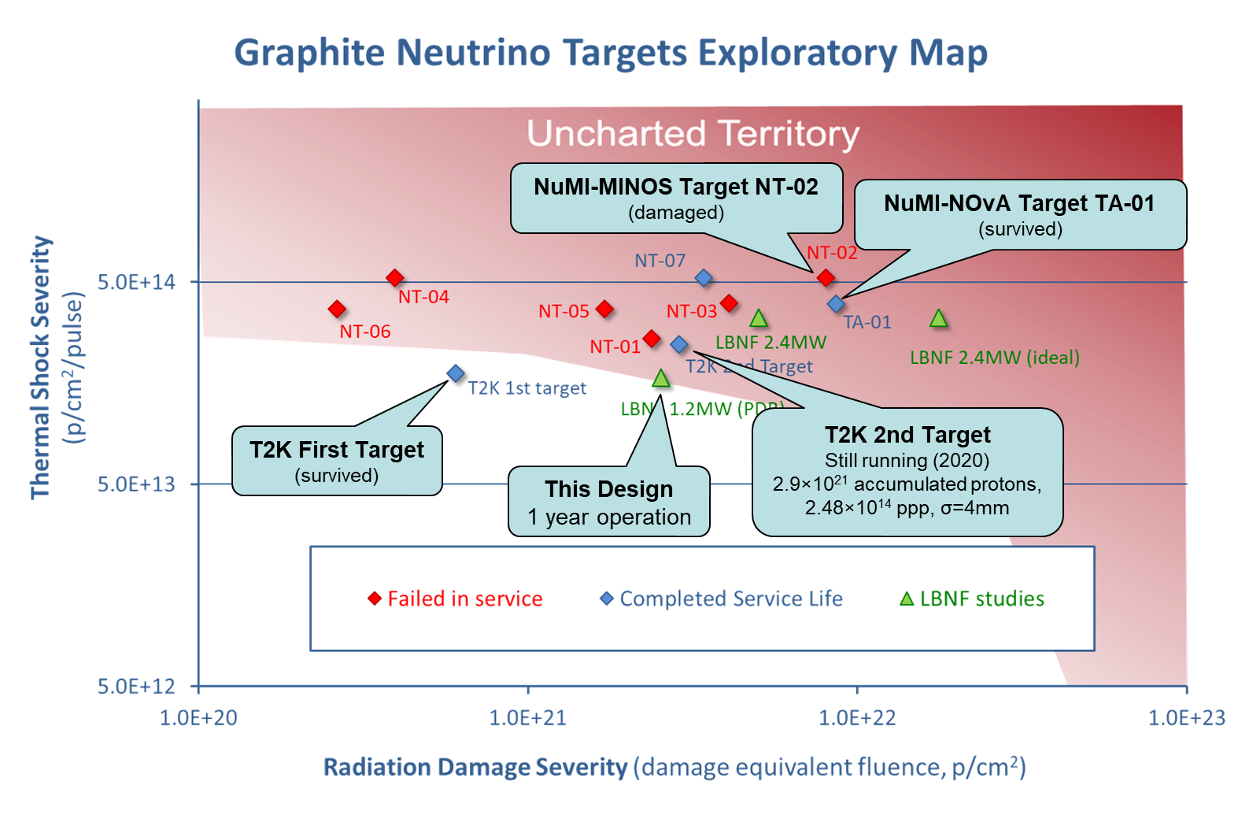
Graphite Structural Integrity
The graphite core does not serve a safety function, but if it is damaged the neutrino output will be compromised
The likely graphite failure modes are:
  Cracking due to thermal fatigue
  Swelling due to irradiation
    Large Beam spot means that beam intensity will be less severe than T2K or NuMI/NOvA
 | Target excl. feet
Steady state stress* (MPa) | 0.6
Single pulse stress (MPa) | 2.5
Pulse stress amp.** (MPa) | 1.3
Trip stress amp.** (MPa) | 0.3
* Due to Temperature + 5bar Pressure + Gravity
** Goodman equivalent fully reversed stress amplitude

Slide 36

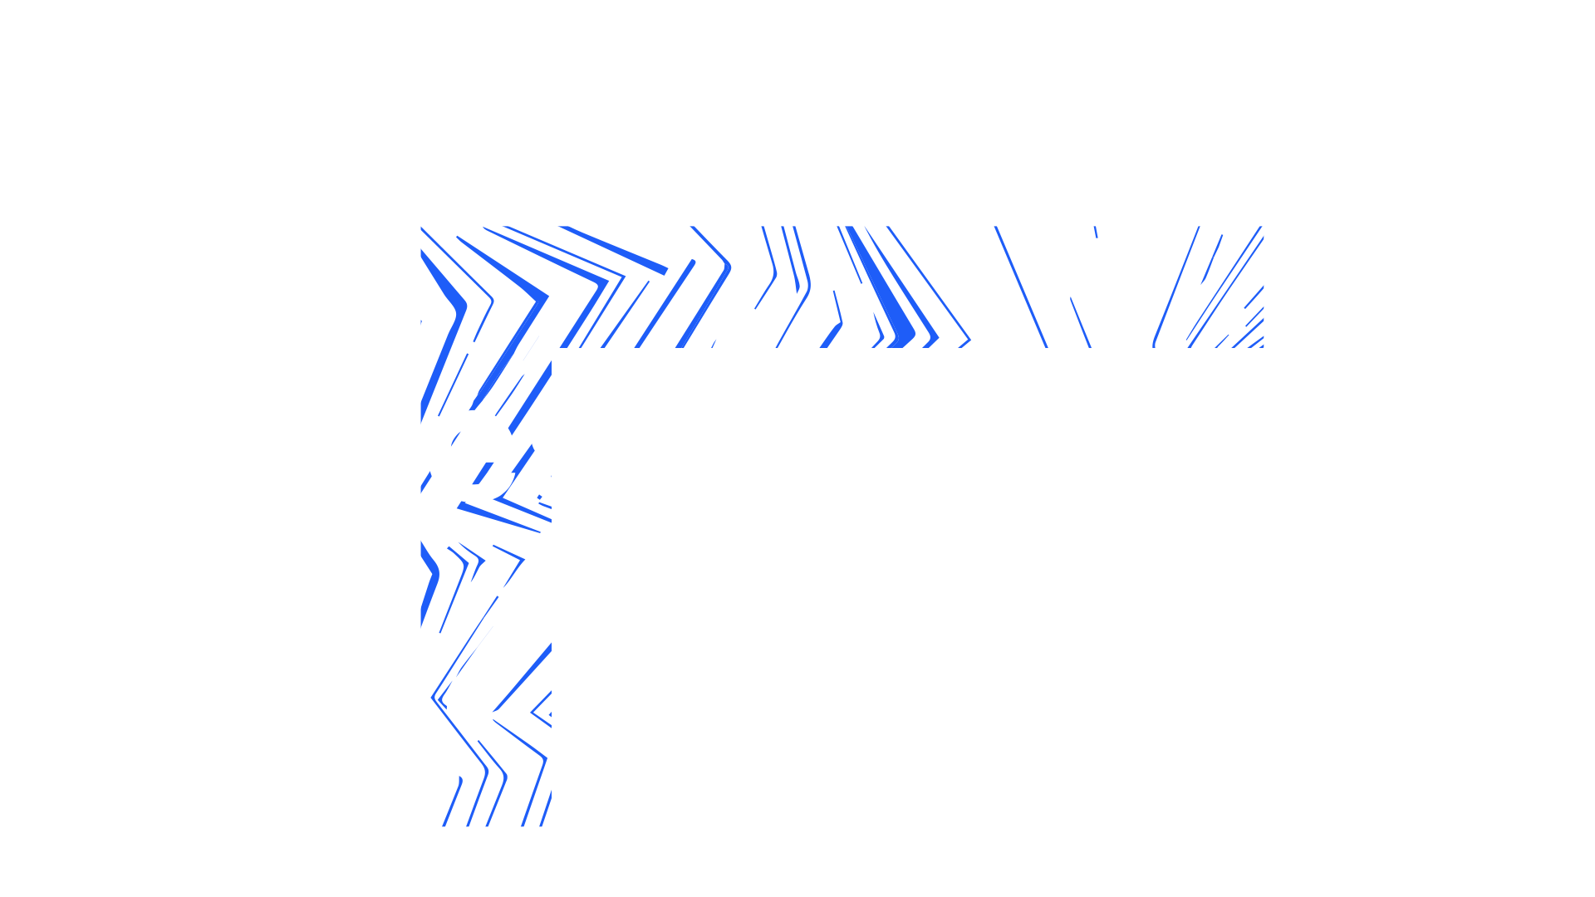


Slide 37
Fatigue
Stress analysis in ANSYS Mechanical, using transient temperature profiles from ANSYS CFX
The Goodman relation is used to account for the effects of mean stress and stress amplitude
Count cycles assuming 57% duty factor, 1.2s cycle time
  Pulsed beam heating – 1.5E7 pulses per year
  Beam trips – 5.0E3 trips per year
    Assuming 1 trip per hour, based on ISIS and T2K operating experience
  Pressure cycles (assumed to be infrequent compared to other cycle types)
Stress amplitudes are compared to S-N curves
  ASME codes do not include S-N curves for titanium, but RaDIATE have been collecting relevant data

