Slide 1



Proton irradiation
of Titanium + Sample Environment
(FLUKA study)
Mike Fitton
5th April 2022
RAL High Power Targets Group
Notes:
The abstract pattern can be removed or repositioned if required. Be careful to ‘Send to Back’ so that it does not obscure any important information.

Slide 2
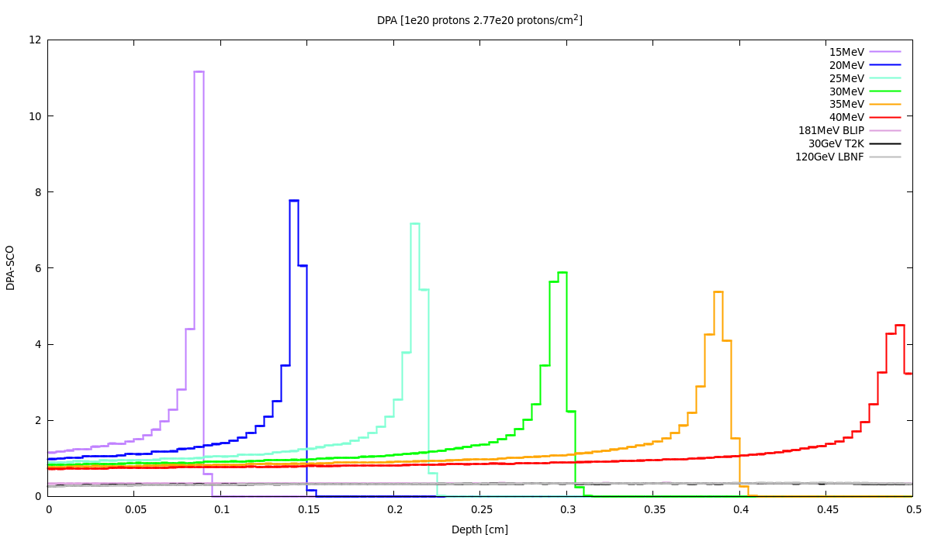
Titanium damage studies – Irradiation at Birmingham cyclotron – Sample environment design
Birmingham cyclotron can deliver protons at energies in 15-40MeV range.
T2K -> 30GeV
LBNF -> 120GeV
Optimum performance is around 28-30MeV where the beam current is 30uA
Most beam time will be available at 28MeV as the same as medical isotope production (a regular commitment for MC40)
Ti Damage threshold used = 30eV
With 30 days irradiation ~1DPA in the titanium is achieved.
Damage is higher at Bragg peak but gas production is unrealistic (next slide)
At 30MeV the range in titanium is approximately 3mm
T2K and LBNF

Slide 3
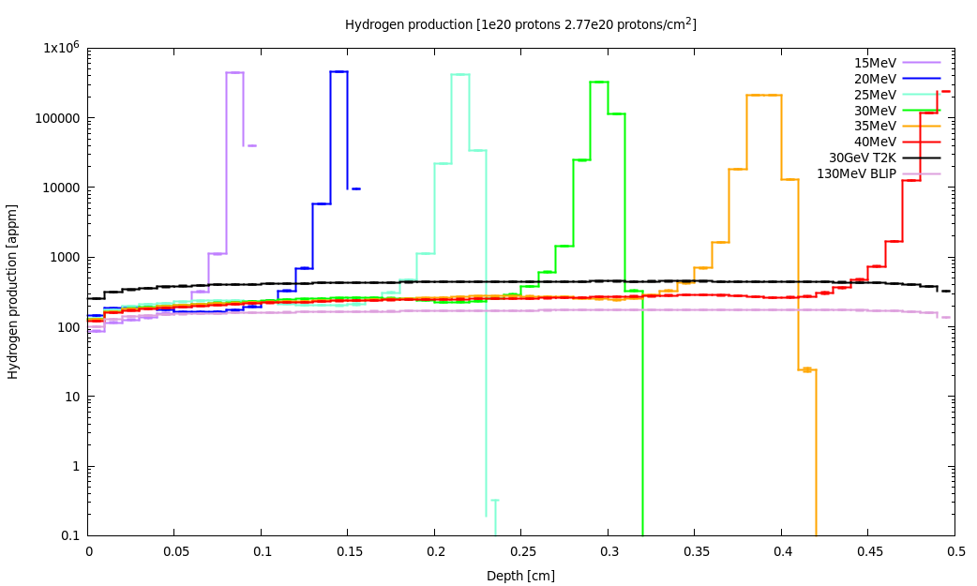
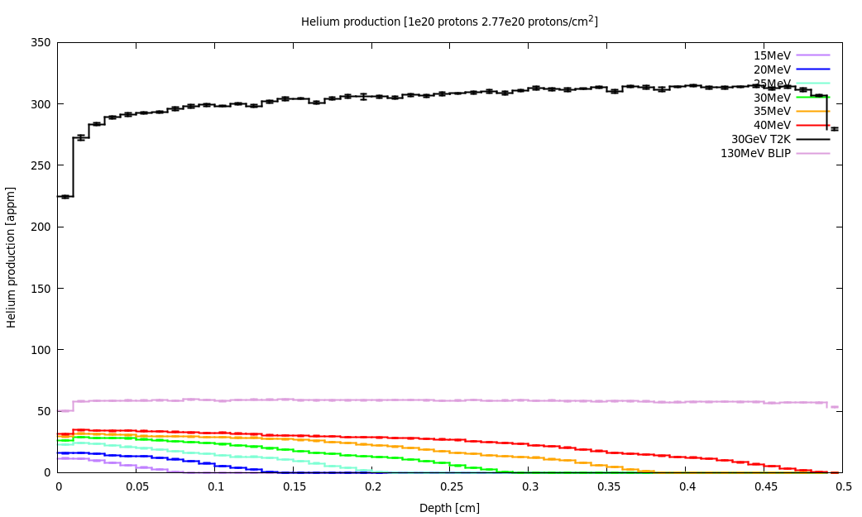
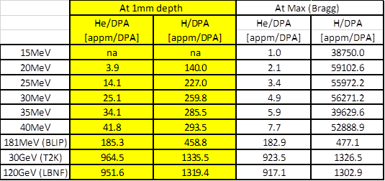
Titanium damage studies – Irradiation at Birmingham cyclotron – H / He production
Hydrogen production is slightly lower (~1/5th) at 10’s MeV compared to T2K (30GeV) except at the Bragg peak where it is much higher (x45+!)
Avoid the Bragg peak as H production is unrealistic. This could cause swelling, cracking, etc
Helium production is much lower (~1/30th) with lower energy irradiation
Could implant He-ions but range is very limited
30 GeV
30 MeV
Helium production
Hydrogen production
30 GeV (T2K)
130 MeV (BLIP)
30 MeV (MC40 at B’ham)

Slide 4
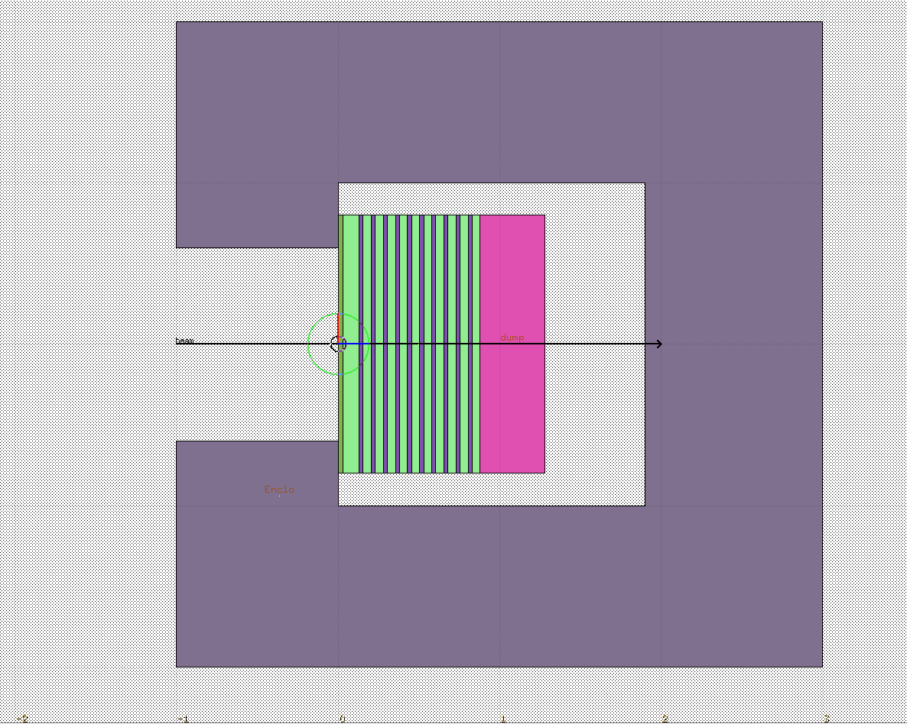
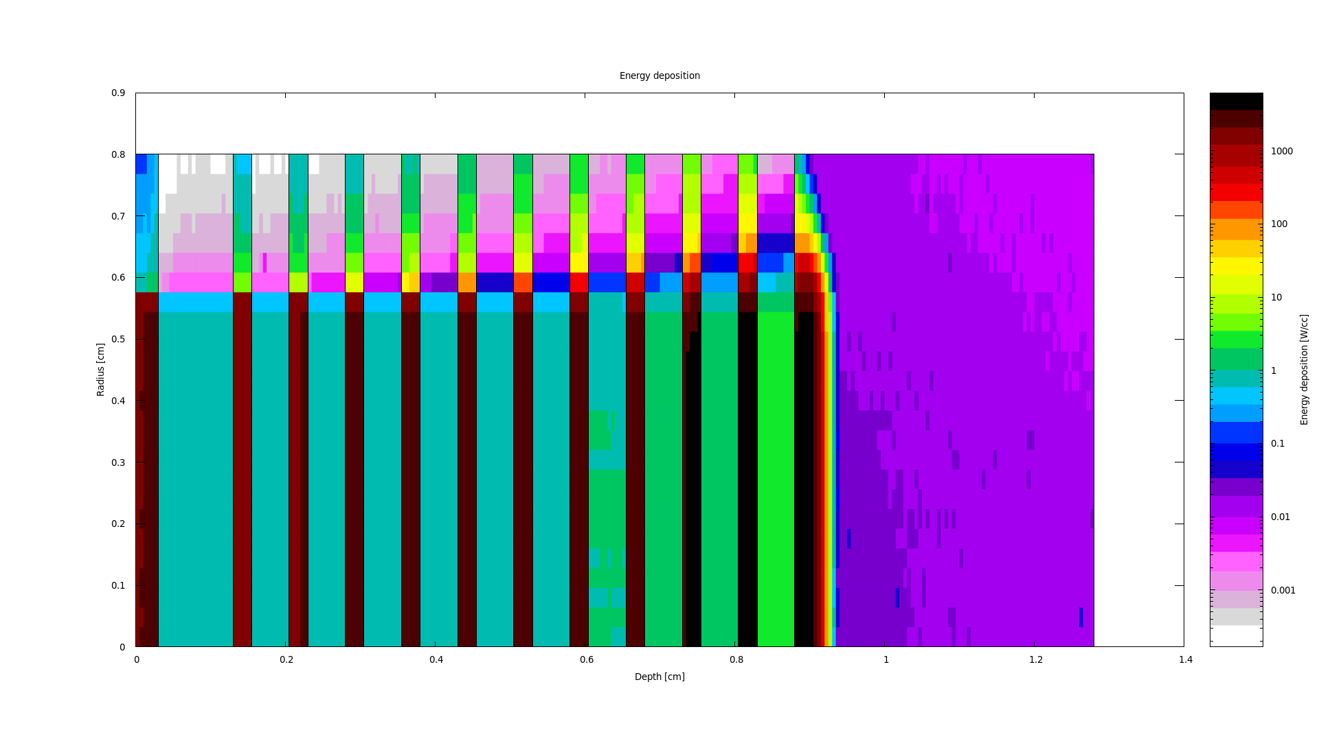
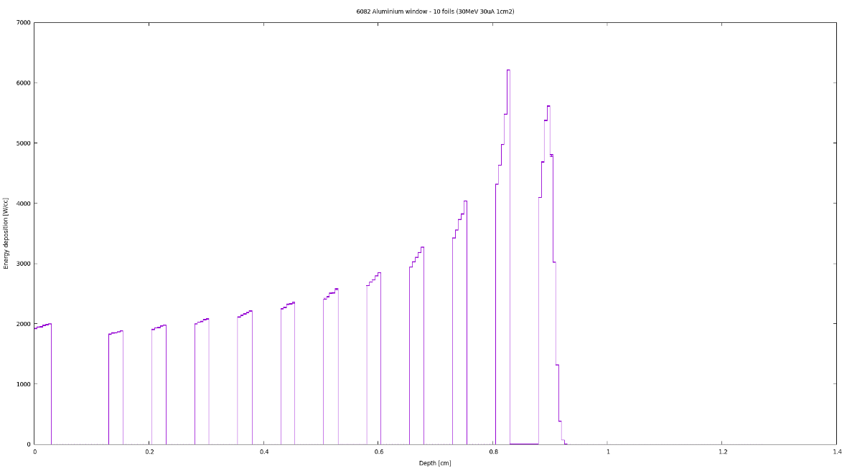
Titanium damage studies – Irradiation at Birmingham cyclotron – Sample environment outline design
Example of FLUKA model
Stainless steel enclosure
Graphite beam dump
30MeV proton beam
0.564cm radius
6082 Aluminium window
Titanium foils
~9-10 x 0.25mm
Nitrogen gas
Example energy deposition used for engineering design

Slide 5
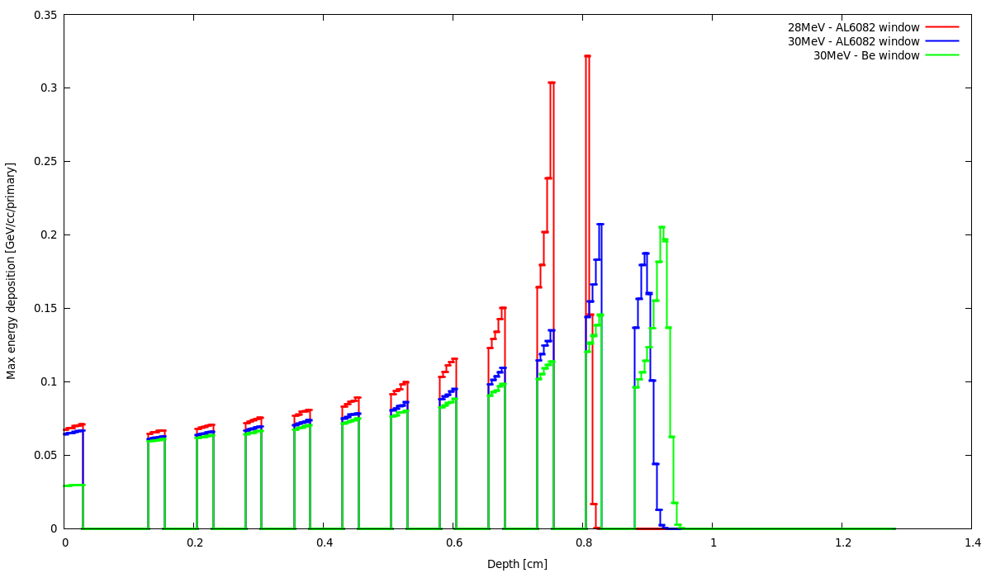
28MeV is preferable to 30MeV as used for medical isotope production → More beamtime !
Aluminium or Beryllium window? -> For cost and simplifying H&S Aluminium is preferred
Downside to these minor changes is that we loose foil 10 and put Bragg peak in foil 9
At 28MeV and with aluminium window Bragg peak in foils 9+10
-> 10 x 0.2mm foils??
Graphite beam dump
Window
Be window allows more beam to samples
Foil 10
Foil 9
Foil 1
Foil 5

Slide 6
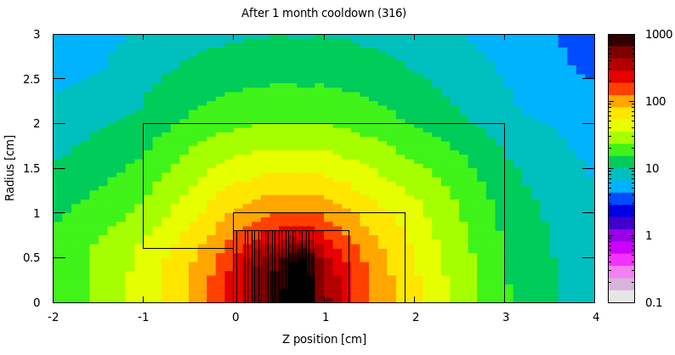
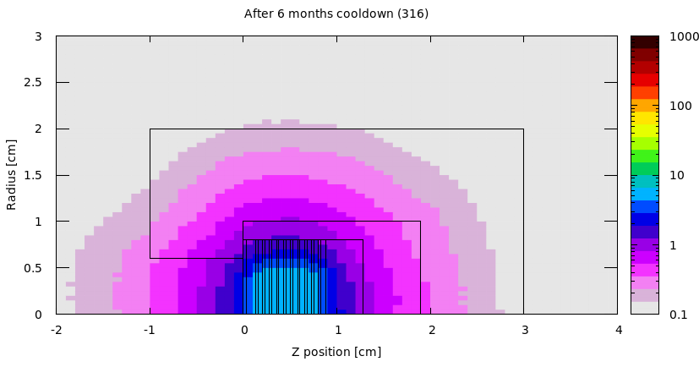
Shielding enclosure and dose rate (after 30 days continuous running)
30uA proton beam
1cm2 cylindrical beam
30 days running
20mSv/hr
mSv/hr
0.1mSv/hr
mSv/hr
1mSv/hr

Slide 7
Activation of samples and samples environment hardware
Samples are grade 5, but include the maximum allowable 0.25% Fe
Table shows results after 30 days continuous running at 30mA, 1cm² cylindrical beam
Total inventory around 300+GBq (Higher than the 100GBq facility limit)
Irradiating samples only at night (e.g. 6hrs per day) should keep inventory near to limit
No significant difference in the activation between grade 2 and grade 5
Vanadium-48 responsible for most short term activation
Vanadium-49 & Scandium-46 responsible for long lived activation

Slide 8
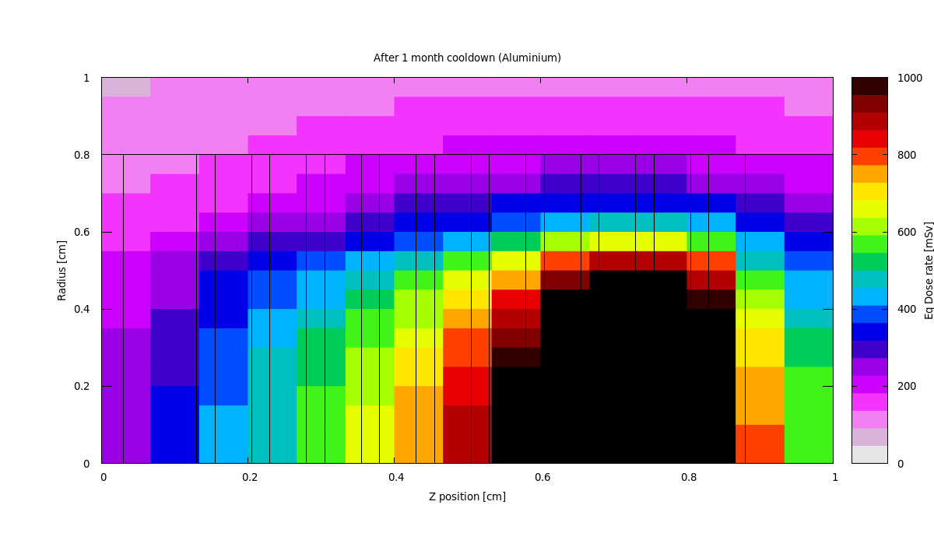
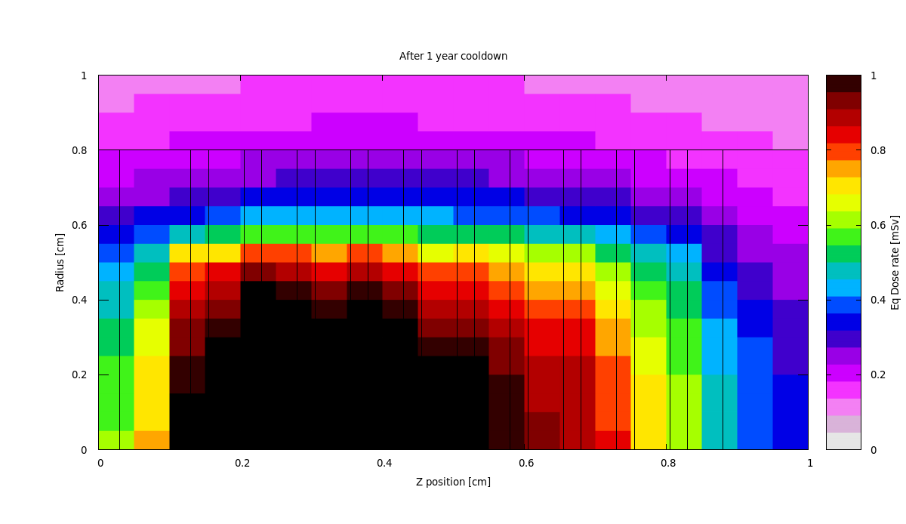
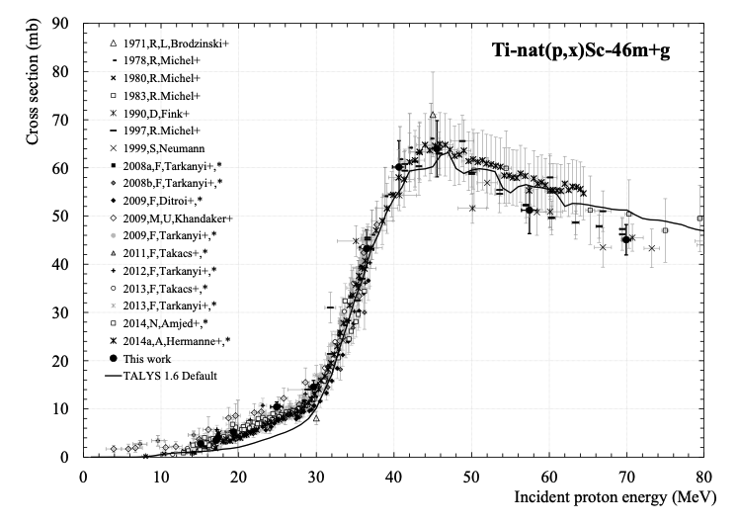
Initially the downstream foils are the hottest
After long cooling period the upstream foils are hottest
Reason is more long lives isotopes (e.g Sc-46)
produced where energy is highest

Slide 9
Activation of Nitrogen cooling gas
Table below shows the activation of the Nitrogen gas in the gap between the window and first sample.
30days running – 1minute and 1 day cool
Main isotope production is Nitrogen-13 and Carbon-11. Both have a short half life
Although small amounts, Beryllium-7 is the only significant isotope with longer half-life
If Helium was used as cooling gas the activation would be lower.
Actual environmental conditions of windows and targets
 | Inside | Outside
T2K | Dry pure Helium / Vacuum | Low purity Helium + H2O
LBNF | Dry pure Helium | Nitrogen + H2O

