Slide 1
Project Management for Accelerators
CI-TS-402 Lecture 1
Jon Lewis – Project Manager, Proton Improvement Plan Phase 2 – [PIP-II]
Monday 13 Jun 2022
Notes:
The abstract pattern can be removed or repositioned if required. Be careful to ‘Send to Back’ so that it does not obscure any important information.

Slide 2
Talk no. 1
1 What is a project?
Projects vs. business as usual
2 Project governance
What are the key ingredients of project delivery?
3 Requirements
…and how to demonstrate you can meet them
4 Summary
Talk no. 2:
Starting from scratch – how to plan a project;
Financial; risk and change management;
International programmes.
Image © STFC Alan Ford
Notes:
To replace photo with one of your own. 1) Send the geometric shape overlay to the back – Right-Click > Send to Back > Send to Back. 2) Replace image – use the guides provided to correctly position it. 3) Send your image to the back so that the geometric overlay re-appears over the image. Remember to delete the image credit if using your own image.

Slide 3
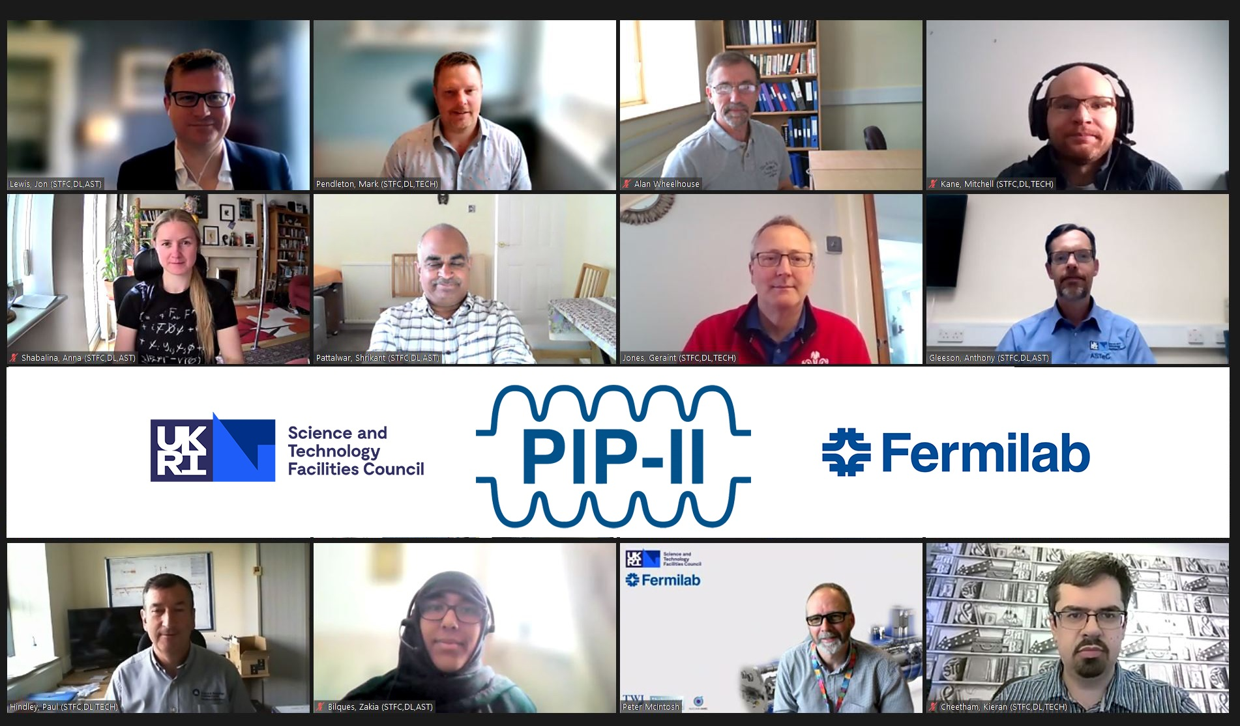
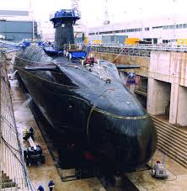
Who am I?
Design of the β=0.92 SRF cryomodule
3

Slide 4
What is a project?
“A project is a unique, transient endeavour, undertaken to achieve planned objectives”
-Association for Project Management
Unique – no one has quite done anything like this before
Transient – projects are transformative. They move you from an undesired state (“where we are”) to a desired state (“where we need to be”).
Endeavour – they require effort!
…undertaken to achieve planned objectives
Planning is critical to delivering a project. We focus a lot on it in this lecture

Slide 5
How to spot a project
Some key characteristics:
Projects…
Non-repetitive
Carry risk and uncertainty
Deliver specified (minimum) quantified results within predetermined quality and safety/health parameters
Have agreed start and end dates within clearly specified cost and resource constraints
Are temporary
Are affected by their environment and adaptive to it.

Slide 6
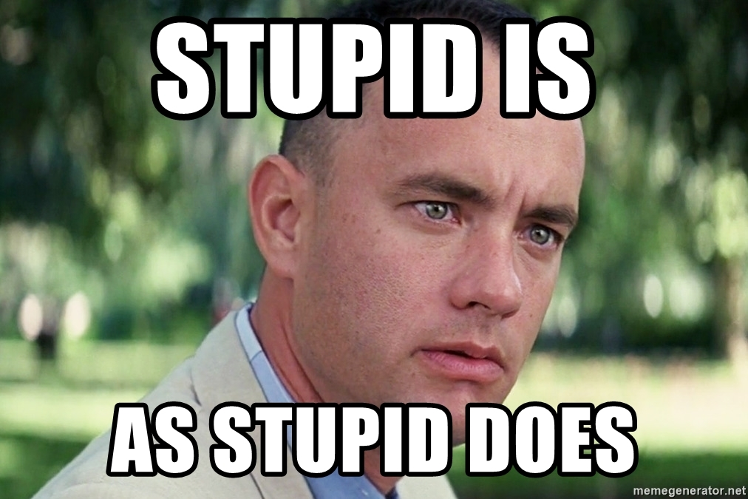
Projects versus Business as Usual (BAU)
Still not sure?
Projects:
Manage change
Manage time
Manage costs
Manage scope
Manage quality
Manage risk
Create the conditions in which benefits can be realised
BAU:
Manages process
Optimises time
Contains/reduces costs
Contains/maintains scope
Maintains/improves quality
Reduces risk
Uses project outputs to create outcomes and realise benefits

Slide 7
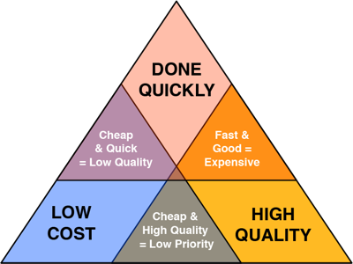
The project triangle
Projects are a constant balancing act.
Project Managers tension…
Performance (quality)
Cost
Time
Time
Before we can deliver a project, we have to…
Make a case for it.
Set the rules for it
Let’s look at these steps next….
This requires active management and good governance.
Cost
Performance

Slide 8
Project Governance
PG 1 Business Cases
PG 2 Some key people
PG 3 Sources of help
PG 4 How will you govern your project?
Notes:
The abstract pattern can be removed or repositioned if required. Be careful to ‘Send to Back’ so that it does not obscure any important information.

Slide 9
Project Governance
PG 1 Business Cases
PG 2 Some key people
PG 3 Sources of help
PG 4 How will you govern your project?
Image © STFC Alan Ford
Notes:
To replace photo with one of your own. 1) Send the geometric shape overlay to the back – Right-Click > Send to Back > Send to Back. 2) Replace image – use the guides provided to correctly position it. 3) Send your image to the back so that the geometric overlay re-appears over the image. Remember to delete the image credit if using your own image.

Slide 10
PG 1 A Business Case
Definition
A business case provides justification for undertaking a project, programme or portfolio.
It evaluates the benefit, cost and risk of alternative options and provides a rationale for the preferred solution.
-APM
The business cases is crucial. It tells us why the work is needed and why our plan is the best way to tackle the work. It is a reasoned, costed argument. It is usually written by the Project Manager and presented to the Project Sponsor. When approved, the BC is ‘owned’ by the Sponsor
In STFC-funded projects, the sponsor is not necessarily an individual. I can be a panel of people such as a Project Board.
10

Slide 11
Business Case vs. Case for Support
STFC & academic institutes favour a Case for Support over a BC
A Business Case presents….
Different options for doing the work (usually inc a ‘do nothing’ option)
A reasoned argument for best option (using PESTLE* or similar)
Risks
Costs
Timescale
Return on investment (£)
Benefits
A Case for Support presents….
The work plan to be funded
Options for de-scope (sometimes)
Detailed list of team members
Risks
Cost
Schedule
Benefits
Staff breakdown by type (esp. nos of PDRAs & PhDs)
For the option championed
A personal appeal…. If you are writing a CfS, please, please start with a summary along the lines of “This CfS requests £x over y years to do z”. It is amazing how few CfSs present their case in this way.
*PESTLE: Political, Economic, Sociological, Technological, Legal and Environmental factors that could affect the project.
11

Slide 12
Business Case & CfS – take-away
A Business Case justifies the why and the what of a project.
In addition, a CfS details who will be involved in project delivery.
We’ll look next at some of the key people involved – the who – of project governance.
We’ll then talk about project governance frameworks – the how.
12

Slide 13
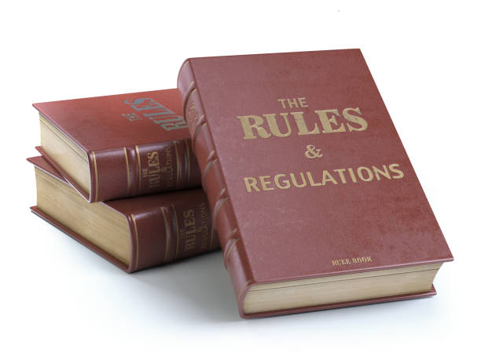
PG 2 Some key people
Exec. Authority
Holds the budget
Sees that work is done.
Directs the work (at high level)
Manages the budget, controls the work.
The Project Sponsor
This person (or board) is the decider. They decide…
Whether to fund the project
Whether to allow significant deviations from plan (i.e. whether or not to accept requests for change)
They receive the benefits from the project
The Principal Investigator
A post not seen outside academia / STFC. This person is the controlling mind. They direct the Project Manager in maximising the benefits that the project is delivering. They approve the governance arrangements (i.e. they sign off the rule book).
The Project Manger
This person is responsible to the PI for the efficient and effective delivery of the plan. They lead the team in generating outputs and they ensure governance is in place (i.e. they write the rule book).
Next let’s look at how we shape governance arrangements.
13

Slide 14
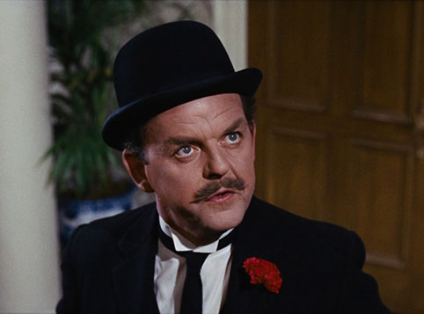
PG 3 – Sources of help (governance)
Context
We need to understand the rules of the game, before we get onto the pitch.
“A British bank is run with precision
A British home requires nothing less!
Tradition, discipline, and rules must be the tools
Without them - disorder! Chaos!
Moral disintegration!
In short, you have a ghastly mess!”
We must set up a clear governance framework and communicate our arrangements clearly.
“I know you think you understand what you thought I said but I'm not sure you realize that what you heard is not what I meant!”
Alan Greenspan
(Chair, US Federal Reserve 1987 – 2006)
14

Slide 15
PG 3 Sources of help
Government guidance
The law of the land
Guidance from professional
bodies
Parent organisation’s rules
(written processes, procedures, guidelines, etc.)
Programme’s management arrangements
Your project’s management arrangements
The purpose of a project management plan is to clearly show how your project will deliver within the rules set by the organisation, and to state clearly any deviations from these rules that are necessary for your project.
Project Management Plan
(PMP)
15

Slide 16
PG 4 Governing your project
The PMP describes how the project will be managed.
The term is often used at Daresbury with a heavy focus on its role in justifying resource commitment.
A PMP is not a just resource plan!!!
Constraints
Time, cost, quality
Legal & Social
Technical
Acceptance Criteria
Inputs
Business Needs
Requirements
Management
of the
Project
Outputs
Project Deliverables
Products/Services
Mechanisms
Tools & techniques
People
Facilities
Knowledge & Skills
16

Slide 17
Governing your project – Your PMP
Your PMP is a cornerstone of your project’s governance arrangements. It:
demonstrates how your project complies with the law of the land, the working practices expected by the organisation sponsoring the project, and management arrangements set by programme(s) of which the project is a constituent part;
shows how executive authority is discharged (i.e. how the project scope, once approved, is delivered);
contributes to the smooth running of you project by detailing or signposting identified, auditable processes that team members are to use;
enables new starters and key stakeholders to familiarise themselves with the method of project delivery and the mechanisms & processes used to govern your project
identifies the people, processes and tools required to deliver agreed project outcomes;
provides context where necessary, explaining why a certain approach has been adopted;
shows where management information generated or used by the project is held; and
describes the arrangements for update and review of management information
Your PMP tells your stakeholders how you will manage risk, cost, change, quality, and… yes… resources across the lifecycle of the project.
17

Slide 18
Project Lifecycles
Definition
A project management life cycle is a framework comprising a set of distinct high­-level stages required to transform an idea of concept into reality in an orderly and efficient manner.
Life cycles offer a systematic and organised way to undertake project­-based work and can be viewed as the structure underpinning deployment.
APM Body of Knowledge (BoK) v. 7
WOTT? No picture???
18

Slide 19
Project Lifecycles (II)
Initiate
Plan
Execute
Monitor & report
Close
The BC and / or CfS are used in this phase.
In the 2nd lecture we’ll look in more detail at planning and some of the tools that make project execution easier.
This is the domain of the PMP
19

Slide 20
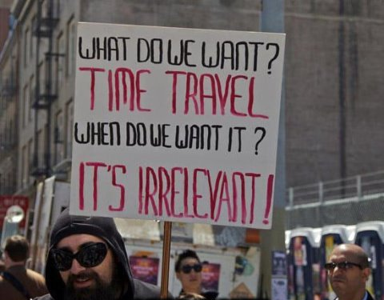
Requirements
Notes:
The abstract pattern can be removed or repositioned if required. Be careful to ‘Send to Back’ so that it does not obscure any important information.

Slide 21
Systems Engineering
Used by Bell Telephone Labs in 1940s.
Adopted by US military and NASA to manage complex engineering designs.
Historically focused on physical systems.
Evolved to encompass the organisation (people & processes) required to deliver the physical ‘thing’.
“In simple terms, the approach consists of identification and quantification of system goals, creation of alternative system design concepts, performance of design trades, selection and implementation of the best design”
– NASA Systems Engineering Handbook
“System engineering is a robust approach to the design, creation, and operation of systems”
– NASA Systems Engineering Handbook
21

Slide 22
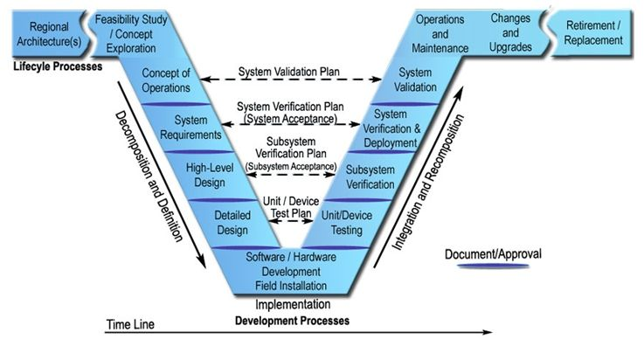
Systems Engineering In 1 Diagram
The v diagram of systems engineering shows the planning effort on the left hand side and the testing effort on the right hand side. Note that there is only one section (at the bottom of the V) where construction actually takes place. Every other step is either planning what to construct or testing the built system.
In my experience, these three stages are the most commonly missed. We like to throw ourselves into the detailed design without taking the time to work out what it is we need and, most importantly, WRITING IT DOWN.
22

Slide 23
The alternative….
Without a plan that has clear goals, the alternative is trial and error – or the ‘shed’ approach. We potter in the shed until we come up with something that vaguely resembles what we wanted…. Often at huge cost…. So why do we do it??
“Planning is an unnatural process; it is much more fun to do something. The nicest thing about not planning is that failure comes as a complete surprise, rather than being preceded by a period of worry and depression.” – Sir John Harvey-Jones
Obligatory Dilbert Cartoon to help make the point
23

Slide 24
Systems Engineering Approach to Projects (1)
The decision to invest in a project is the function of the BC / CfS The ‘regional architecture’ is therefore set and the feasibility study accepted.
The Concept of Operations (ConOps) is vital. It describes what the system should do (and, broadly, how). Every piece of more detailed planning should be driven from the ConOps.
Note that, on the other side of the V diagram, the whole system is validated by referring back to the ConOps and effectively asking the question “Does this thing do what we want it to?” Without a ConOps, there is no identifiable purpose for the system and no way to tell if what you’ve designed is right.
24

Slide 25
Systems Engineering Approach to Projects (2)
System requirements set the goals that the design should achieve. They may include the overall design codes to which the system should be built, maximum weight (if applicable), operating voltage, etc.
The design of the system is the response to the requirements. It is a statement of how the designer sees the ‘thing’ meeting the requirements set,
25

Slide 26
What makes a good requirement?
The International Council on Systems Engineering defines a requirement as:
“A statement that identifies a system, product or process characteristic or constraint, which is unambiguous, clear, unique, consistent, stand‐alone (not grouped), and verifiable, and is deemed necessary for stakeholder acceptability.”
Unambiguous : everyone who reads it should interpret it the same way;
Clear: easy to understand
Unique: not repeated in other requirements
Consistent: aligns with other requirements
Stand-alone: can be understood and verified without reliance on other sources of information (other requirements)
Brevity is good! “The system shall operate at UK mains voltage”
26

Slide 27
Example requirements – good & bad
“The system shall operate at UK mains voltage”
“The system shall draw no more than 30 amps”
“The system shall use single phase power”
These requirements are brief, clear and consistent and, most importantly, verifiable…. In this case, a design review could verify that the system would meet all of these requirements without having to build it.
“The system shall have good usability”
“The system shall work just like the previous one, but on a new platform”
Let’s look at the first bad requirement. Even if ‘usability’ was something we all understood to be the same thing (which we don’t) It is subjective. What does ‘good’ mean? How could we set a test for it?
On first reading, perhaps the second bad requirement doesn’t sound too bad. Most design work is evolutionary, not revolutionary, after all. The customer simply wants a system that does what their current one does, just on a more up-to-date operating platform. However, this is a ‘lazy’ requirement… Doubtless the current system requires workarounds or has capabilities that no-one actually uses. The requirement for the new system also can’t be understood without detailed interrogation of the system currently in use.
27

Slide 28
Managing Requirements
There are a number of ways to manage requirements, including (for technically very complex systems) bespoke IT packaged such as IBM’s DOORS (Dynamic Object Oriented Requirements System).
For most projects, our requirements may not be too complex nor require software but if they are assumed, undocumented, vague or unverifiable, time and money will be lost in making the required upgrades.
Systems engineering gives us a methodical, light-touch method of documenting what we need from our projects, including training for our people and development of new processes. It’s important to write down what we want from the non-tangible things.
28

Slide 29
Tools & Documents
Statements of the desired end state are a good place to start.
From these, we work out and write / draw our Concept of Operations.
System requirements should be agreed with stakeholders and recorded.
For every requirement we should identify a method of demonstrating its achievement.
Mini design reviews will act as our formal of the proposed solutions to our requirements
System 1 design
Integrated Design Review
System 1 build & test
Operations
Write system 1 requirements
Requirements Review
System 2 design
System 2 build & test
Write ConOps
Co-Ops Review
Write system 2 requirements
System x design
System x build & test
Write system x requirements
29

Slide 30
Summary
Notes:
The abstract pattern can be removed or repositioned if required. Be careful to ‘Send to Back’ so that it does not obscure any important information.

Slide 31
We have hurtled through….
The distinguishing marks of a project,
The PCT envelope,
What a Business Case and Case for Support do,
Why governance is important and some basic tools for delivering projects,
PMPs and why your PMP is the key governance document for your project,
Project lifecycles
Requirements and their link to a well-planned project
If you’re a glutton for punishment, hang around for lecture 2 on….
Starting from scratch – how to plan a project;
Financial; risk and change management;
International programmes.
31

