Slide 1
WP5 Proposal Update
Dr Tony Price, Dr Ruth McLaughlan, Prof. Carsten Welsch
27/04/2022
LhARA Collaboration Meeting

Slide 2
Tasks and Deliverables

Slide 3
Tasks and Deliverables

Slide 4
Beamline instrumentation
SciWire (John M)
Gas profiler (Carsten et al)
Emerging technologies (pot for access)
Silicon 2D profiles
BLM
BPM
Magnets

Slide 5
Dosimetry and Verification
We need to develop a 2D real time beam monitoring system.
However, it also needs to be verified with techniques that are dose rate, particle, and time independent
A combination of the below will need to be used to achieve these goals
GaFChromic Films
Alanine Pellets
Standard Calorimeters

Slide 6
End-station Developments
Consultation and design (2 years)
Construction and testing (3-5 years)
Must include the following
Automated cell handling
Controlled atmospheres
Machine Integration
Acoustic Imaging Integration (WP4)
Thinned entrance windows
Energy degraders and collimation
Cellular Imaging capabilities during the irradiation

Slide 7
Gannt Chart
TBC

Slide 8
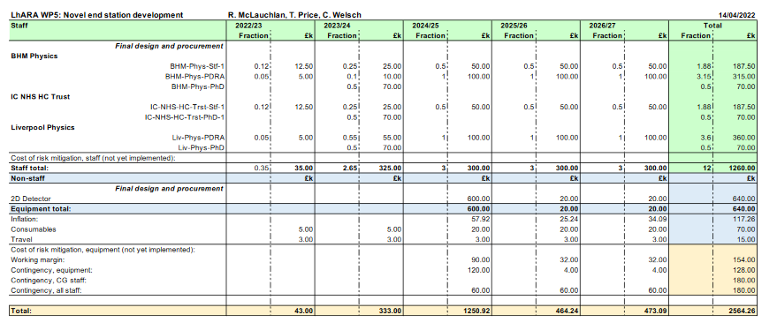
Under development

Slide 9
Any Questions?
Getting there slowly now term has finished.

