Slide 1
SmartPhantom for Beam Tests
John Matheson
Rutherford Appleton laboratory
The Goal: verify simulations with experimental data
Design of an instrumented water phantom for test beam work
Based on scintillating fibre
Calibration against dosimetric standards
Transducers for proton acoustic measurements to be added later

Slide 2
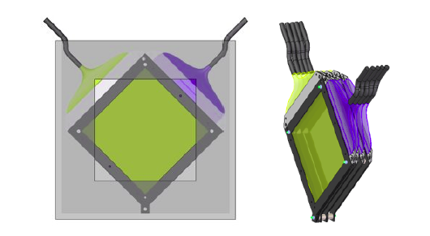
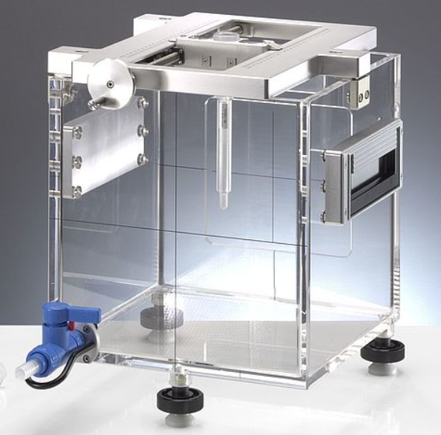
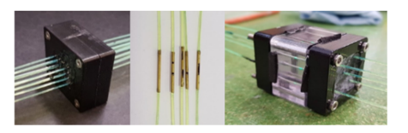
SmartPhantom Layout
Aim is to compare measurements:
proton acoustic
scintillating fibre
dosimetry
Compare measurements & simulations:
protons in water (GEANT4)
protons in detectors (GEANT4)
acoustic signals (k-Wave)
Beam is measured using scintillating fibre planes
Scintillating fibre -> clear fibre -> detector
Aiming to use the edge of the plane as a connector
Clear fibres bundled and sent to CMOS camera
For faster readout, could use photodiodes
Water-filled phantom useful for protons, few 10s of MeV up
From: Medical Applications for Particle Physics (PhD Thesis), H.T.Lau, Imperial College (2021)
www.ptwdosimetry.com
Methods of joining fibres – Jeff Sykora, ISIS

Slide 3
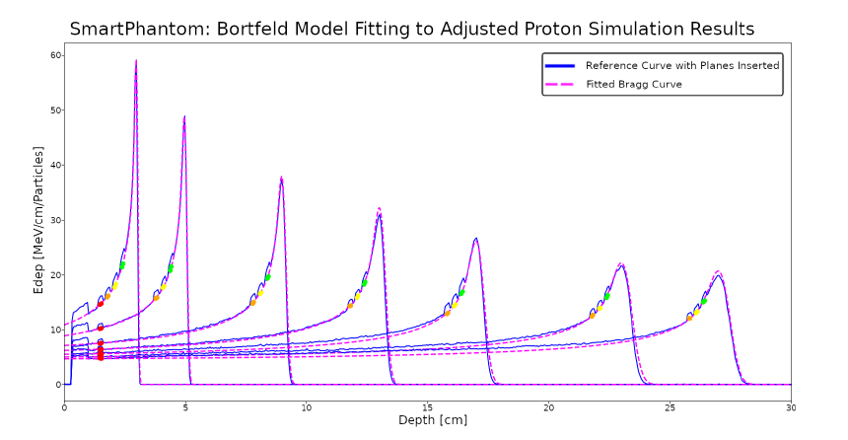
SmartPhantom Simulations (GEANT4)
Solid curves – GEANT4 simulated Bragg Peaks at various energies
Coloured points – energy deposited in the scintillating fibres
Dashed curves – Bortfield model used to reconstruct the B.P. from the fibre data
H.T.Lau

Slide 4
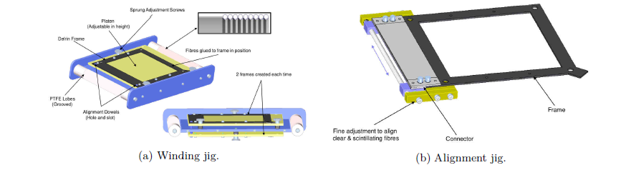
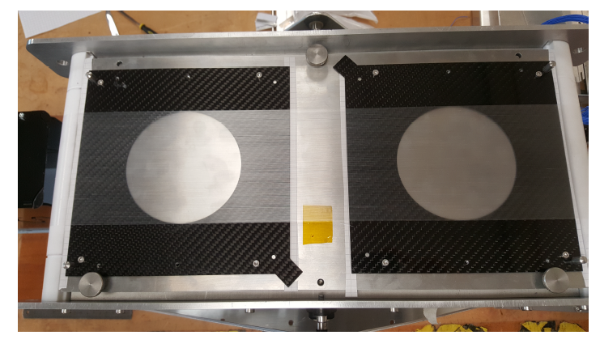
SmartPhantom construction trials
Prototype planes, wound with fishing line on the winding jig

Slide 5
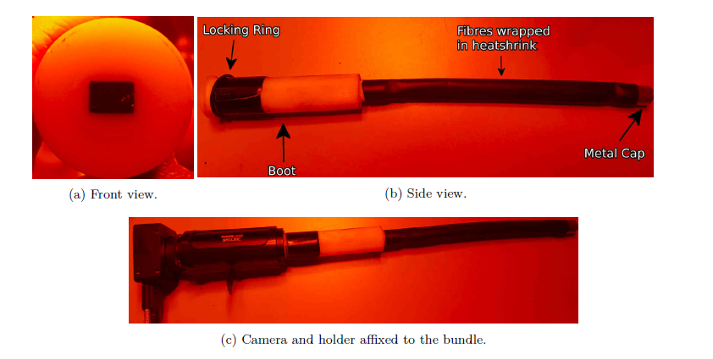
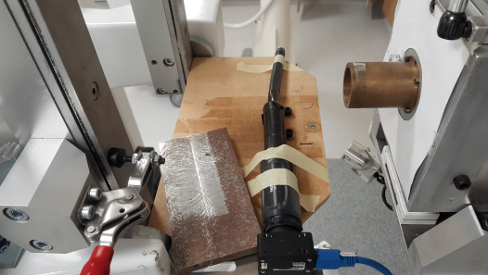
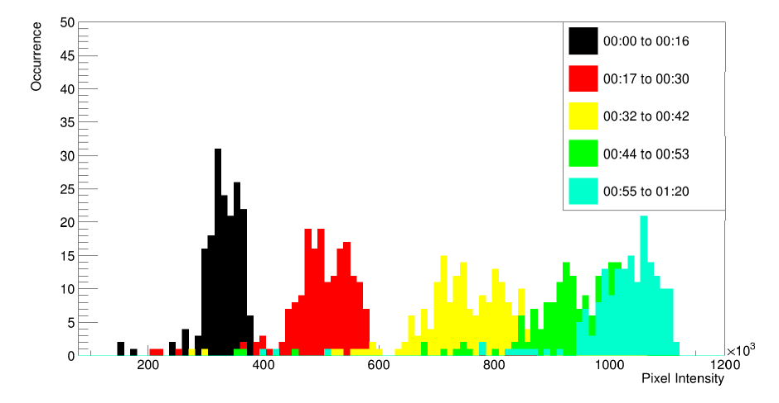
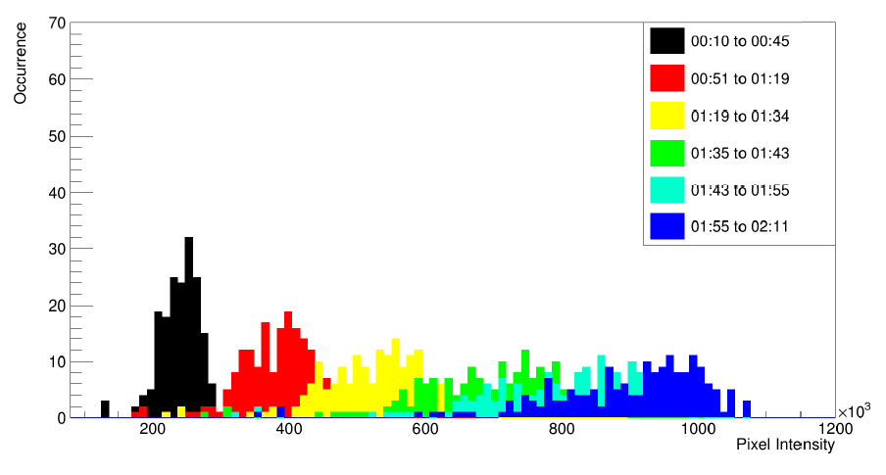
SmartPhantom Scintillating Fibre Tests
Preliminary tests of scintillating fibre bundle at Clatterbridge
Beam intensity increasing with time: 59 MeV beam
Beam intensity increasing with time: 11 MeV beam
H.T.Lau

Slide 6
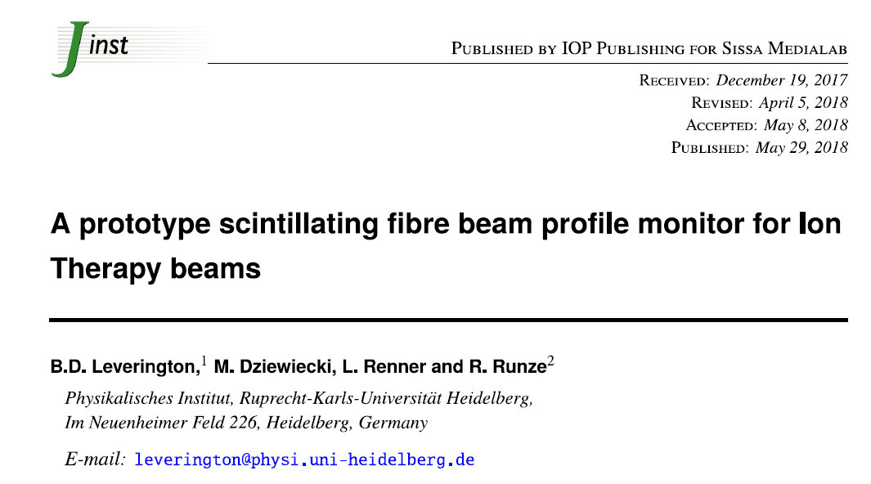
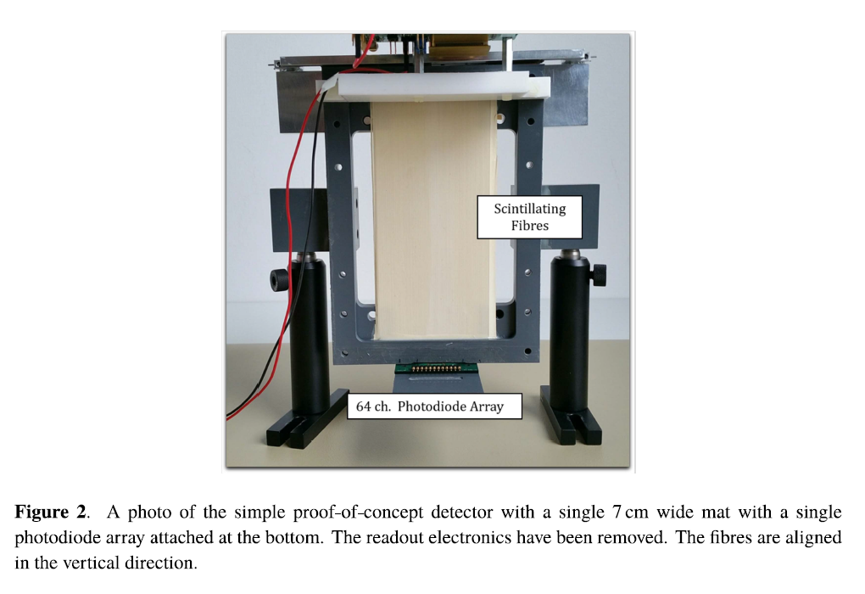

Slide 7
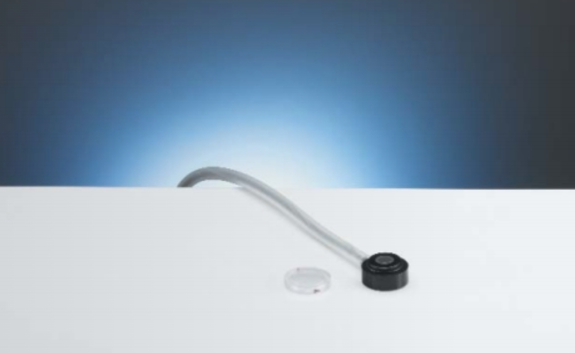
Calibration of SmartPhantom for dosimetry
PTW Markus chamber www.ptwdosimetry.com
Plane parallel ion chamber
Calibrated against primary standard at NPL
Waterproof - can be used in water phantoms
Available at Birmingham Univ. cyclotron
Use to calibrate a transmission ion chamber
Transmission chamber used in routine monitoring
Can be coupled with RCF or alanine dosimetry (relative measurement of dose distribution)

Slide 8
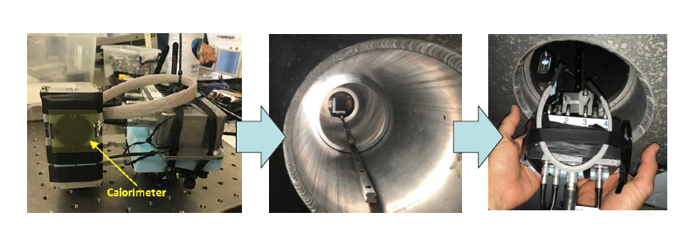
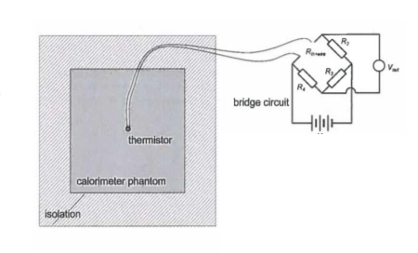
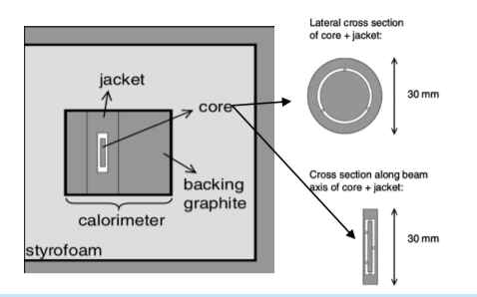
NPL – small portable graphite calorimeter
NPL is developing SPGC
Portable primary standard
Prototype tested at RAL CLF
Can be brought to test beams
francesco.romano@ct.infn.it

Slide 9
Next steps
Near Future
Finalise assembly methods for fibre planes
Complete SmartPhantom first fibre plane and readout assembly
Beam test SmartPhantom, comparing with dosimetric standards
Comparison of SmartPhantom beam test results with GEANT4 simulations
More Distant Future
Integrate proton acoustic measurements into SmartPhantom
Next round of beam tests to check GEANT4 and k-Wave simulations against beam test data

Slide 10
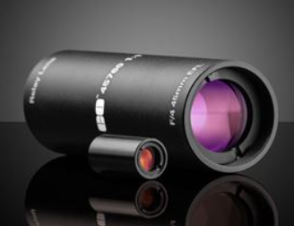
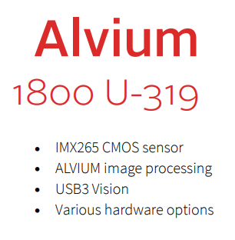
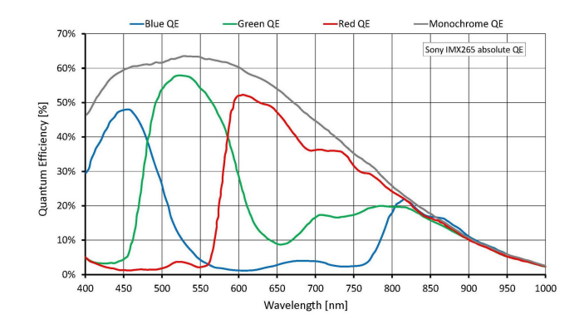
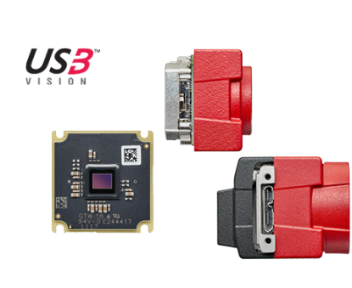
Preparations for testing the first SmartPhantom planes
Currently assembling a kit of parts for a single plane with 2 orthogonal layers of fibres. Includes:
Edmund 45760 Relay lens x 2
Alvium 1800 cameras x 2
Carbon fibre sheets
Optomechanics

Slide 11
Spare Slides

Slide 12
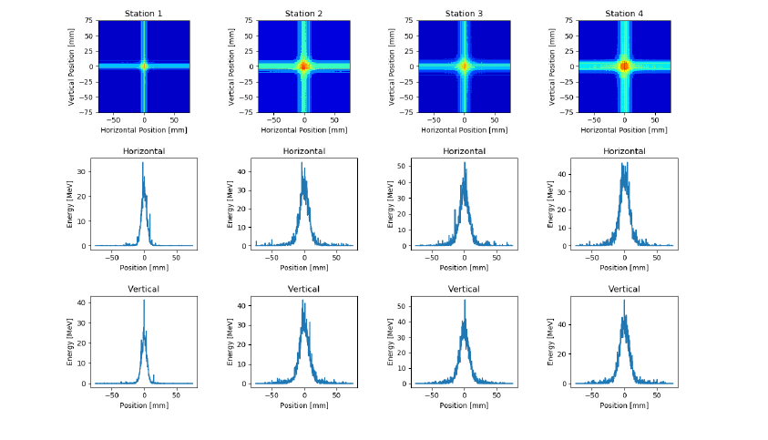
SmartPhantom Simulations (GEANT4)
Sample output from GEANT4 Simulations showing the energy deposited in each fibre at each plane
H.T.Lau

Slide 13
SciWire - Scintillating Fibre Detector
STFC Impact Acceleration Account grant to develop scintillating fibre detector for low-energy ion beams.
Energy measurement.
Intensity profile.
Plane made of fibres arranged in two layers perpendicular to each other.
250$μ$m
5cm
Detector consists of multiple planes.
Scintillation light from all planes is read out from one side for each orientation.
5cm
Step a Sr⁹⁰ source across face of the detector, positioning the source at the centre of a pair of x and y fibres.
Measure position resolution and cross-talk.
Further tests with the laser driven ion beam.
Possibility of dose profiling.
Sr⁹⁰

Slide 14
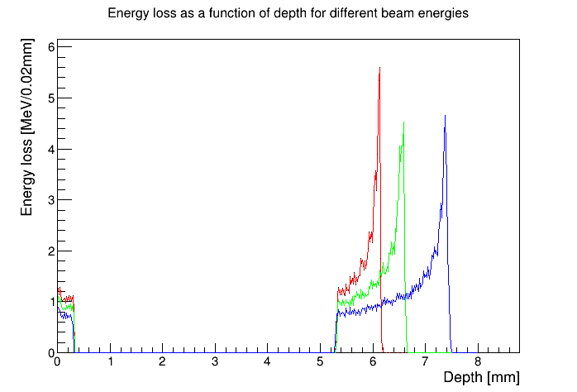
Stage 1 end station
Energy loss in the end station using the beam tracked from after the capture section.
10 MeV
12 MeV
10 MeV
12 MeV
15 MeV
15 MeV
beam
0.075 mm vacuum window
0.25 mm scintillating fibre layer
5mm air gap
1.15 mm sample
container base
0.03 mm cell layer
15 mm cell nutrient
solution

Slide 15
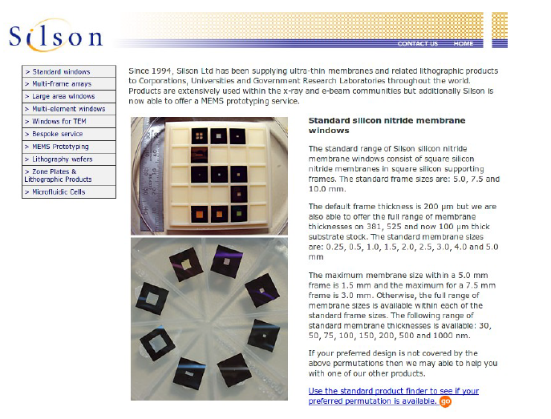
Thin ceramic monitors
AlN or SiN membrane 50-150 micron
Chemically etched and metal electrodes deposited
Beam induces currents on the electrodes
Needs some work to define diameter, thickness, mechanics, electrode geometry, readout
Available from industry (Silson, Ametek/HSFoils)
Thanks to Alex Howard

Slide 16
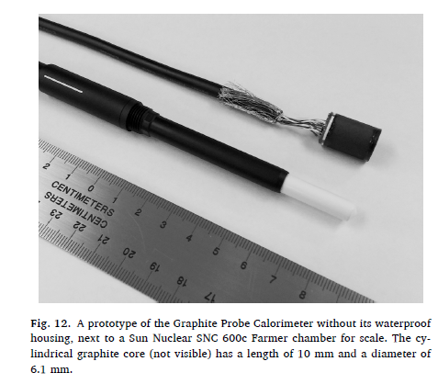
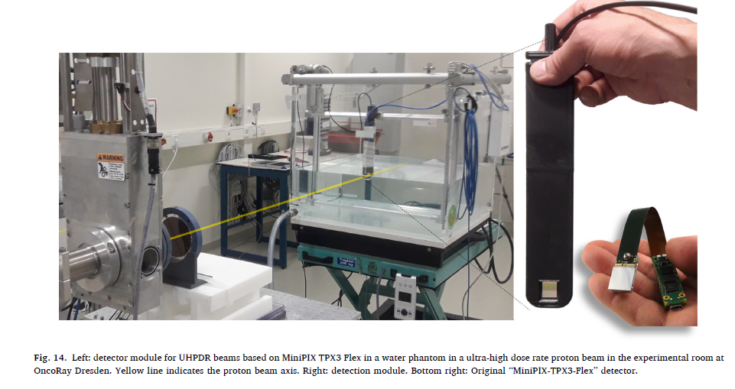

Slide 17
Thorlabs sm1pl x 4
Thorlabs sm1a9 x 2
Thorlabs sm05l20c x 2
Edmund 45760 Relay lens x 2

