Slide 1
Collaboration meeting #3
Welcome and introduction

Slide 2
Our proposal
Getting there!
Still some work to do to
Finalise costings etc.
Ensure consistence

Slide 3
LhARA at the ITRF
Received before Easter from STFC:
  Provides framework
  Defines financial envelope
LhARA EB:
  Discussed … KL will draft response asap

Slide 4
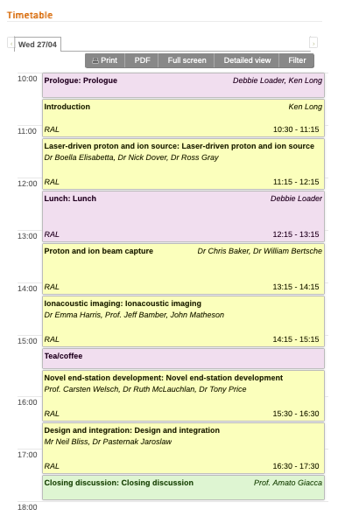
Today!
LhARA collaboration meeting:
https://indico.stfc.ac.uk/event/517

Slide 5
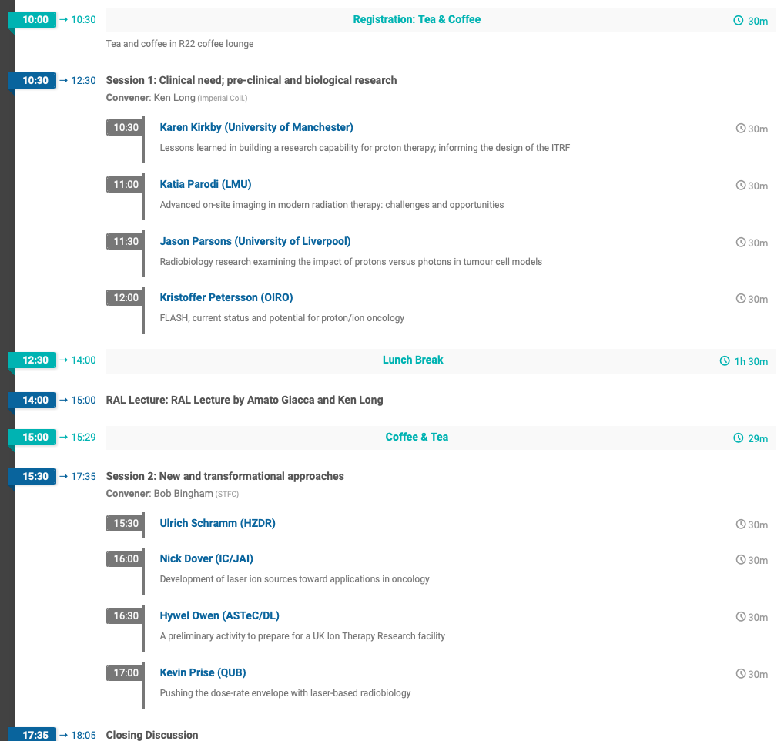
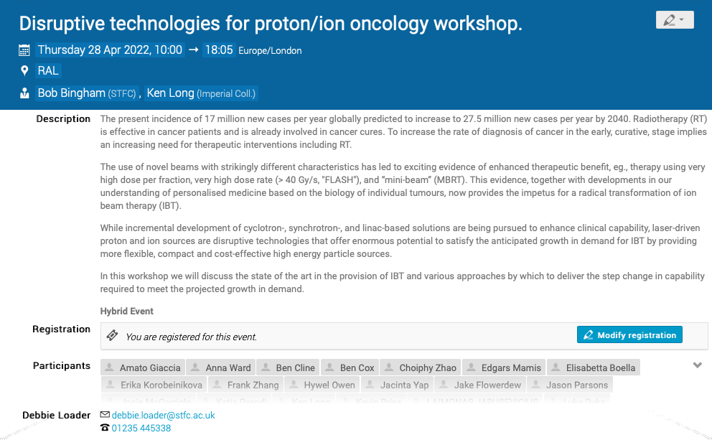
Tomorrow:
https://indico.stfc.ac.uk/event/536

