Slide 1
Grid Tools 6 Month Project
IRIS Accounting Dashboard and Storage Accounting
Jounaid Ruhomaun
DCIG
09/08/2021 - 07/03/2022

Slide 2
IRIS Accounting Dashboard
Moving the service to Aquilon managed VMs involved…
Two new VMware hosts for the previous instance as a ‘prod’ service, and a new ‘pre-prod’ service
Post quattor manual setup steps, involving secrets and registering with IRIS IAM
Grafana V7 and V8 compatibility issues
Creating sandboxes for loadbalancer changes
Setting up a quattor service, ‘apel-accounting-dashboard’ in order to populate config with prod/pre-prod specific properties
Setting up letsencrypt automatic certificate renewal with certbot…

Slide 3
IRIS Accounting Dashboard
Getting certbot working
Certbot runs a HTTP service temporarily whilst doing AMCE checks
Requires port 80 open and free
However, the domain is bound to 3000 on the host, which required running certbot on port 3000
Once this was done, a script to run the renewal command was created and setup to run a cron job in quattor

Slide 4
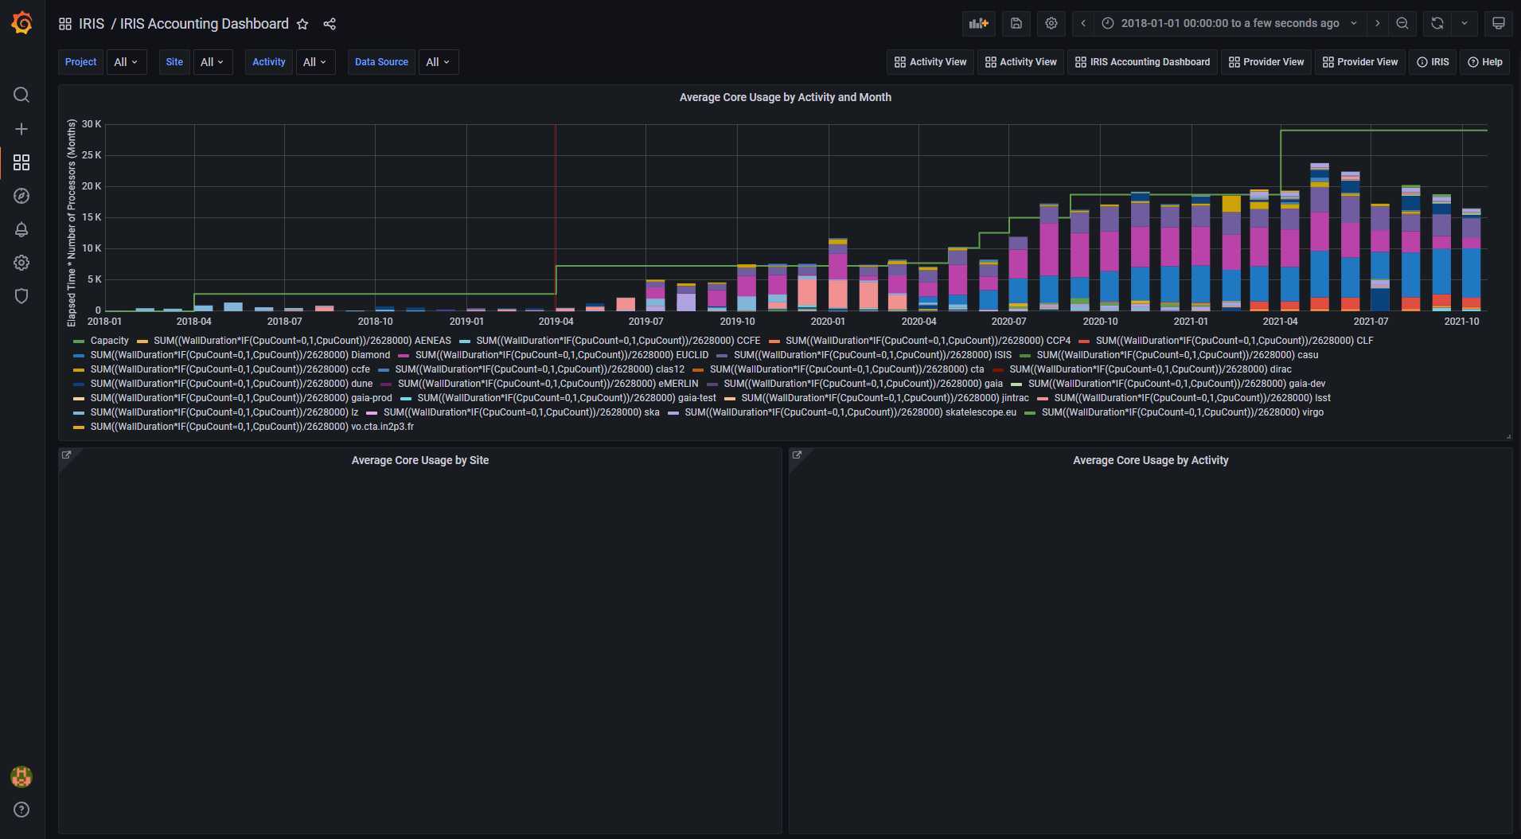
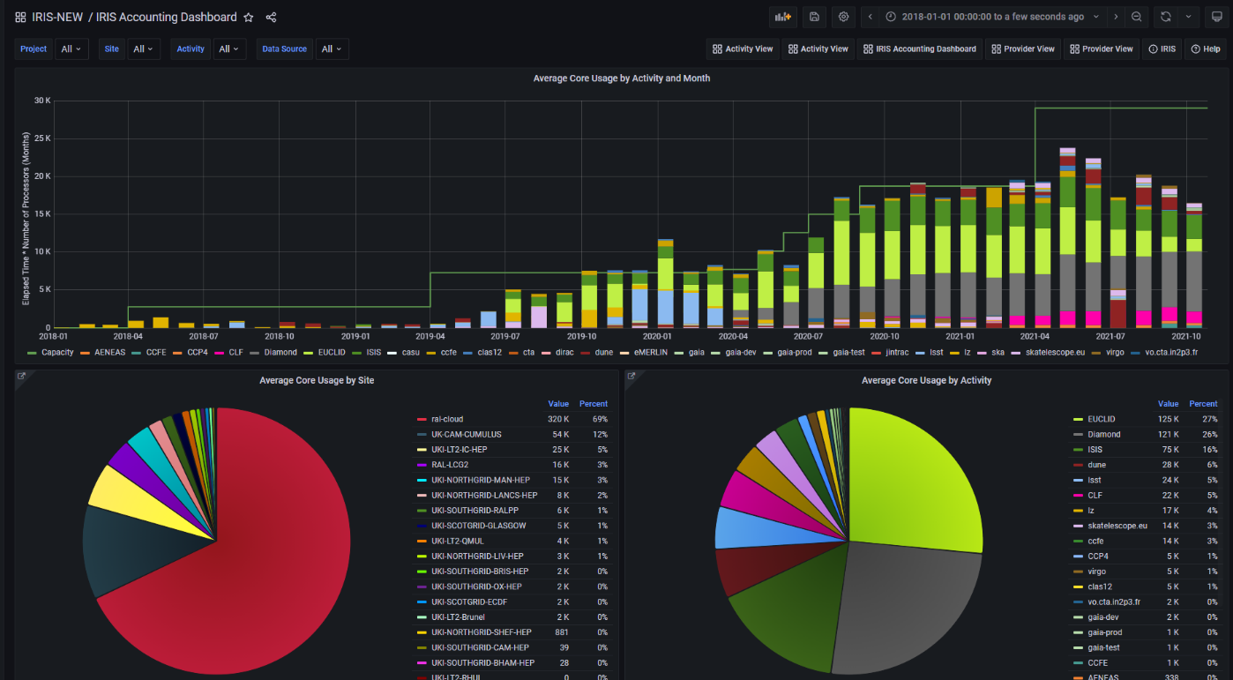
IRIS Accounting Dashboard
Grafana compatibility fixes
Legend labels broken
Pie charts not displaying

Slide 5
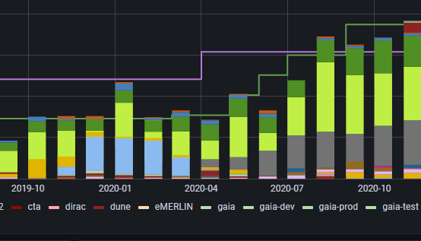
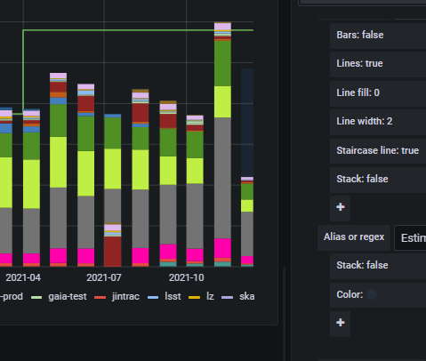
IRIS Accounting Dashboard
Other side issues
Added allocation line and projection bar to latest month

Slide 6
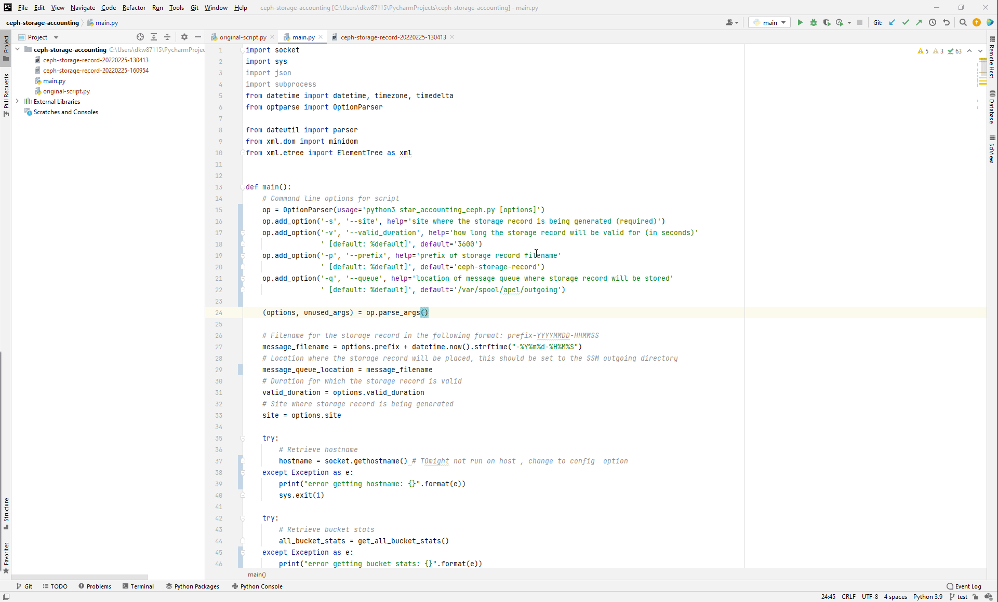
Storage Accounting
Ceph storage accounting script
Converts output from Ceph bucket stats command to StAR format, and places generated record in SSM outgoing queue

Slide 7
Storage Accounting
Problems faced…
Issues finding (and initially following wrong) StAR record format documentation
Deciding how to handle time properties, ‘start time’ and ‘end time’ given only once measure time
Testing required setting up an APEL dbloader, which had many python compatibility issues

Slide 8
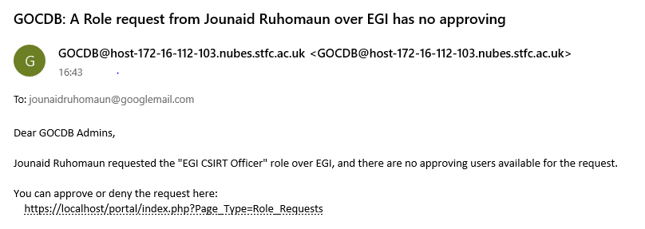
Other Issues worked on
SSM Log the topic - involved adding some extra logging to SSM in order for the AMS version, message queue and connection address to be displayed
SSM Handle large messages - issue involved adding some exception/message handling to SSM when a message larger than 1mb was attempted to be sent
GOCDB If no other user can approve a role request, email the GOCDB admins

Slide 9
Next Project
SciML Benchmarking
Looking at benchmarking Cerebras using the SciML-Bench software
Possibly integrating some new benchmarks into the software

