Slide 1
STFC Security Operations Centre

Slide 2
Agenda
Why/what is a SOC ?
STFC SOC Implementation
Current Status
Future steps

Slide 3
Why do we need a SOC and what is it ?
We have determined and well-funded adversaries with access to latest industry software and tech
We have access to threat intelligence through MISP – must make use of this
Combining Zeek and MISP would give us a very robust security monitoring tool
All this with storage, visualisation, alerting and incident response = SOC
Notes:
Explain what MISP is (Malware Information Sharing Platform)
Explain what zeek is: security monitoring tool and how we can use it in conjunction with MISP

Slide 4
STFC SOC implementation
Monitoring all STFC-RAL traffic: 4 x Janet and 1 x LHCOPN
Threat intelligence: MISP instance from CERN
4 Capture nodes, 4 Search nodes, 2 Head nodes, 2 switches
Workflow: Fibre Taps → Zeek → Kafka → OpenSearch → MISP comparison → Alerts (opsgenie)
Notes:
Only 2 x Janet links active at any one time
Zeek: Dell PowerEdge R6525, dual AMD 7H12 CPUs, dual ConnectX-6 100Gig cards, quad port intel 25Gig NICs, 1TB RAM, 4TB SSD
Elasticsearch: Dell PowerEdge R7525, dual 24 core CPUs, 1TB memory, 96TB storage, 2 Dual ConnectX-6 100 Gig cards, quad port intel 25Gig NIC
Kafka: Dell PowerEdge R650xs servers
Switches: Dell s3048, Mellanox SN2700

Slide 5
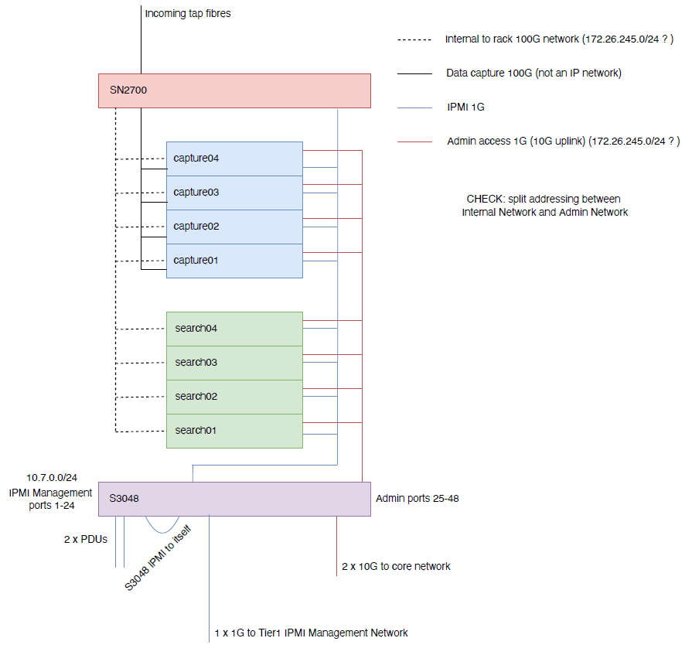
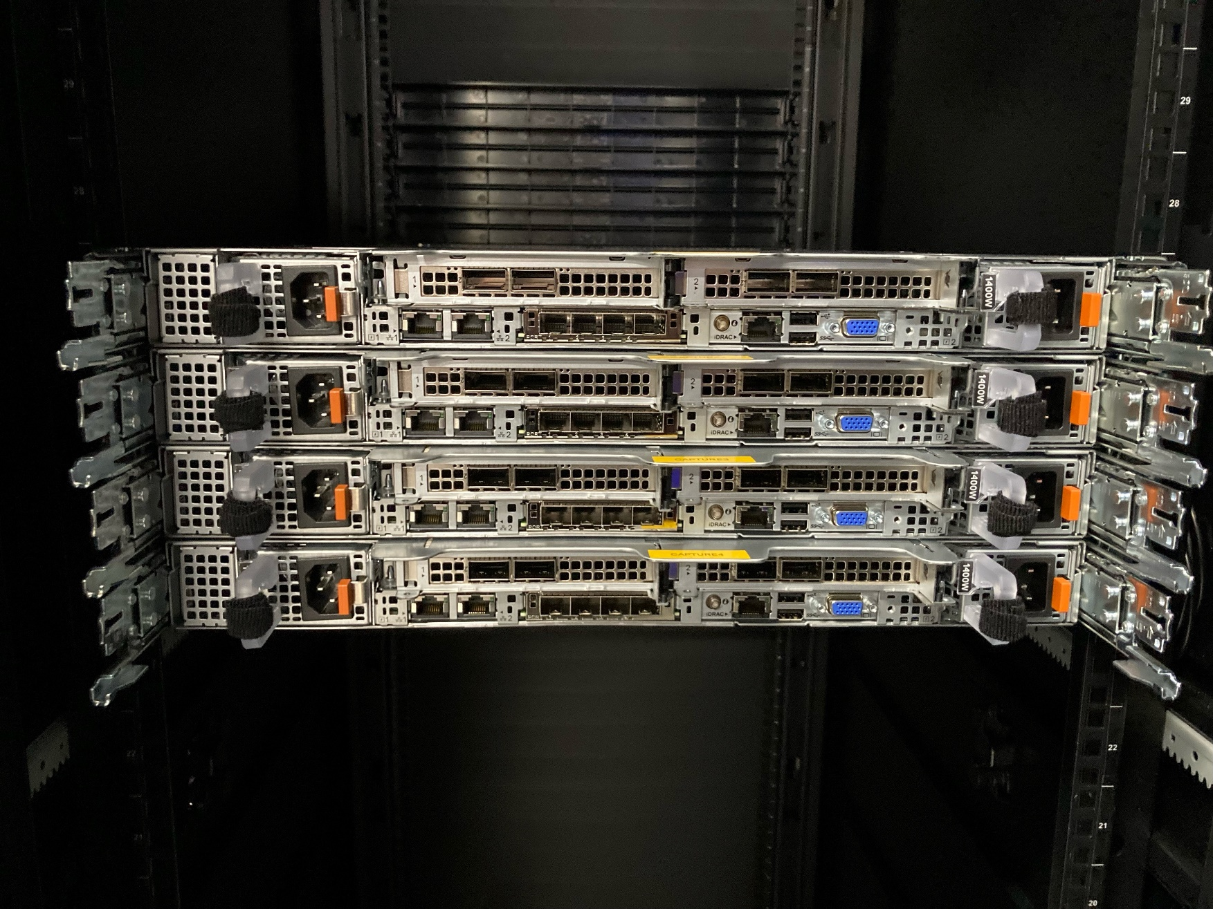
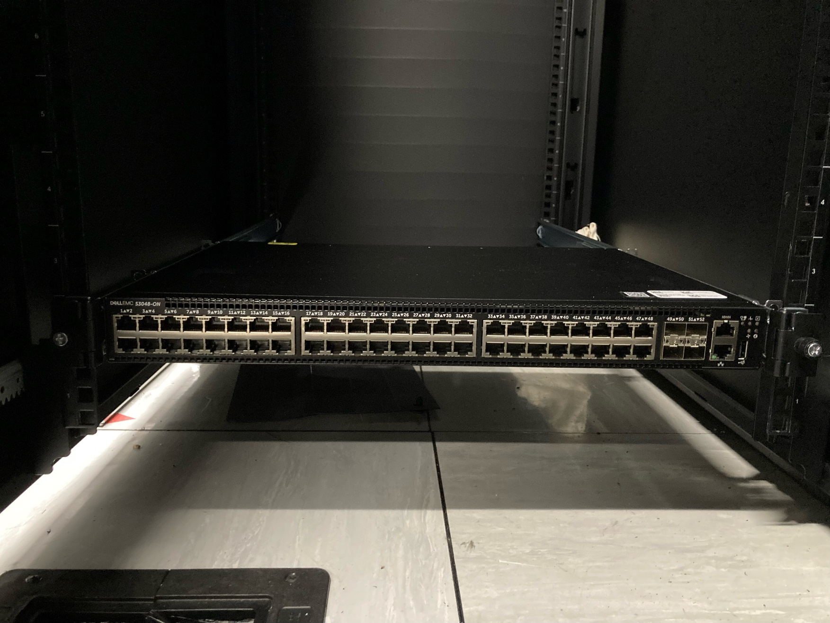
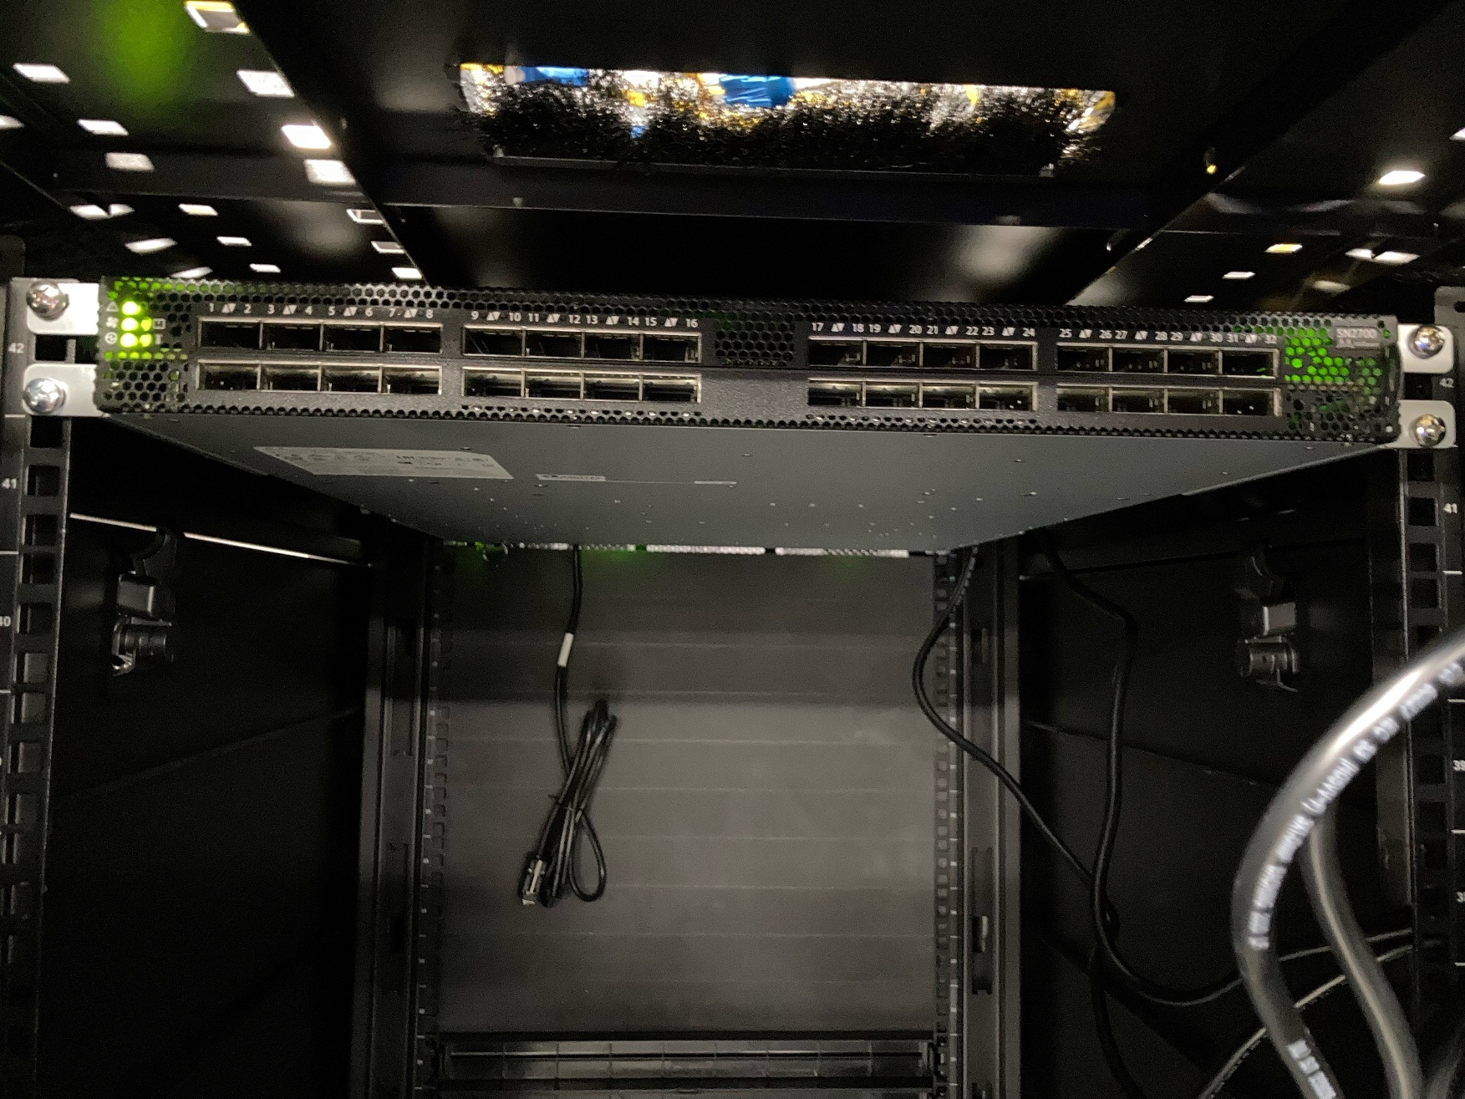
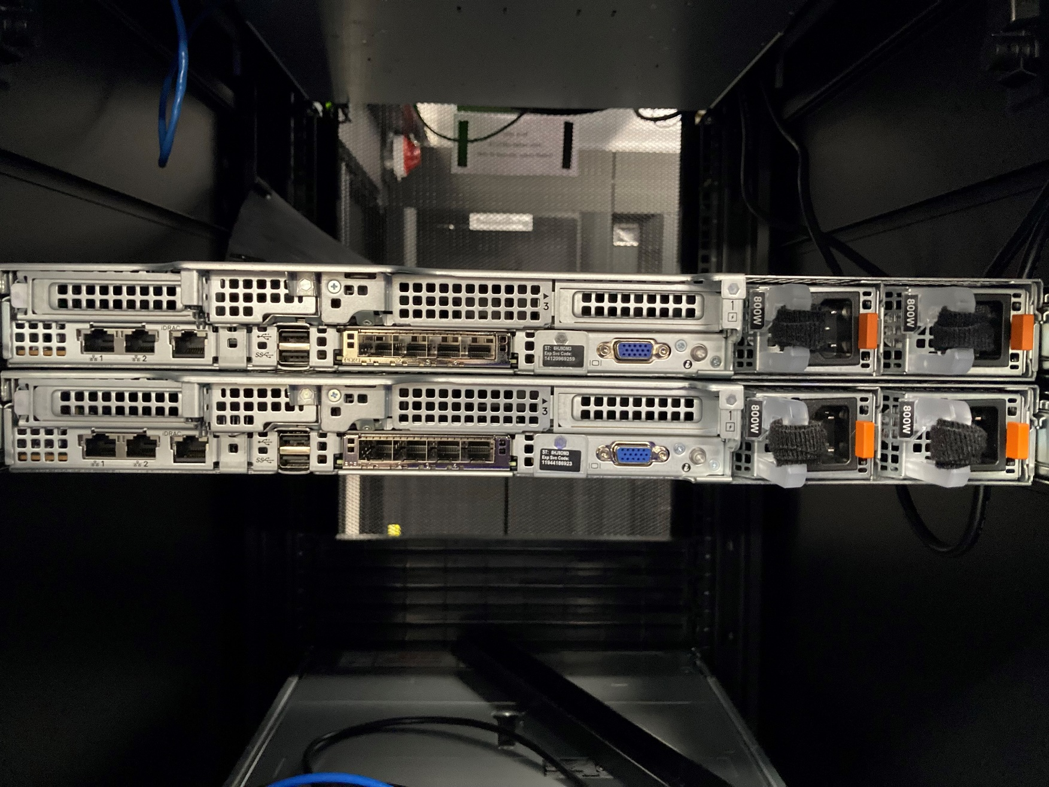
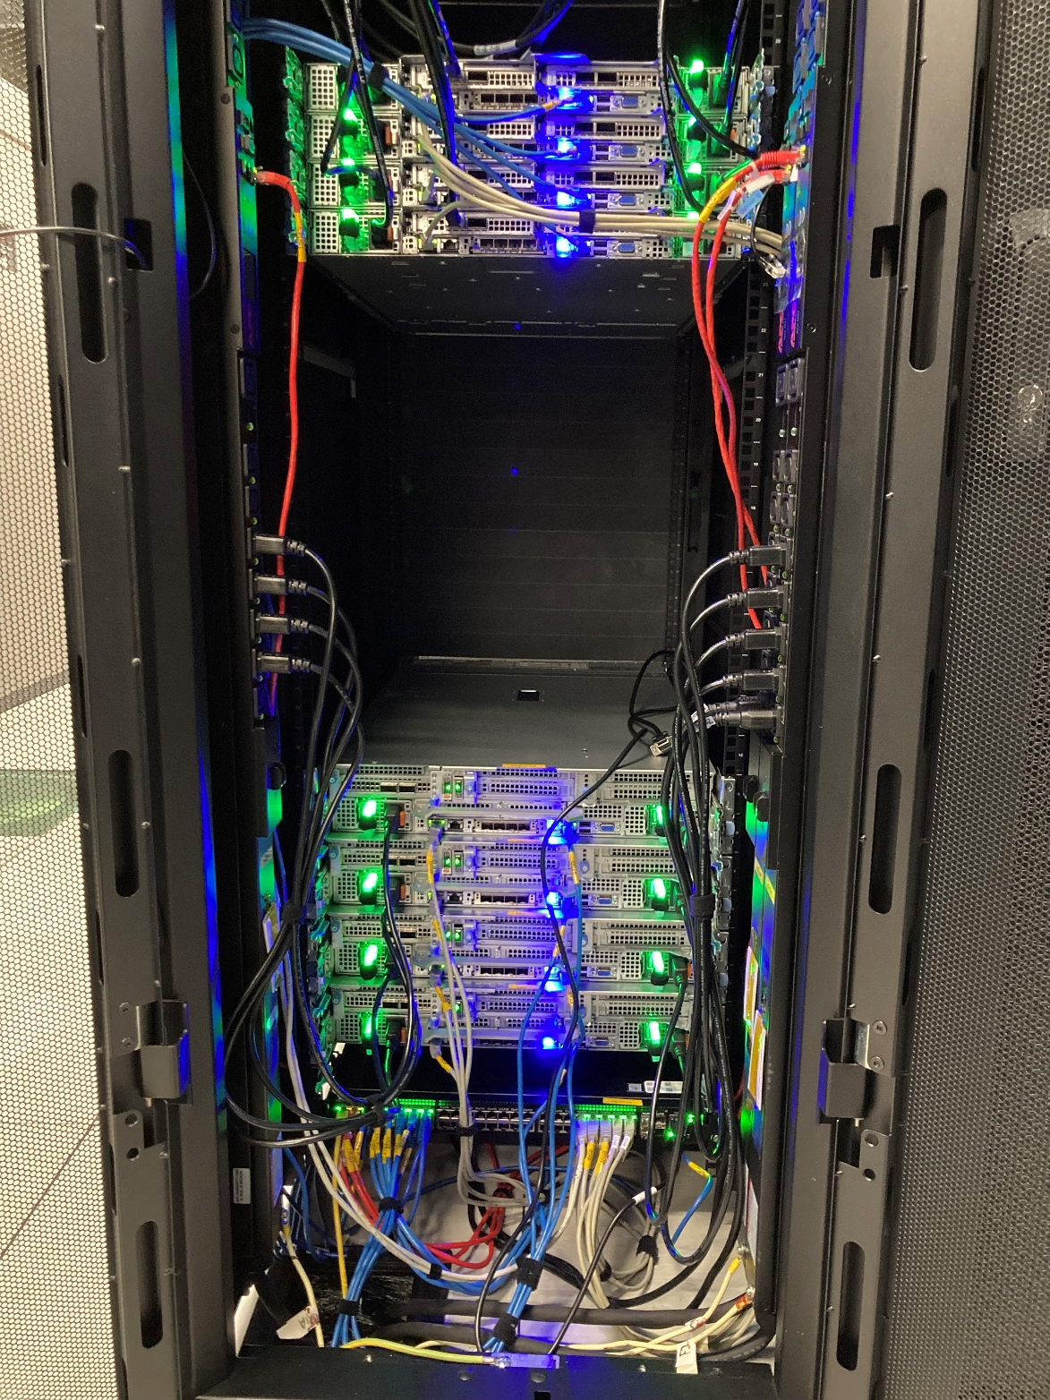
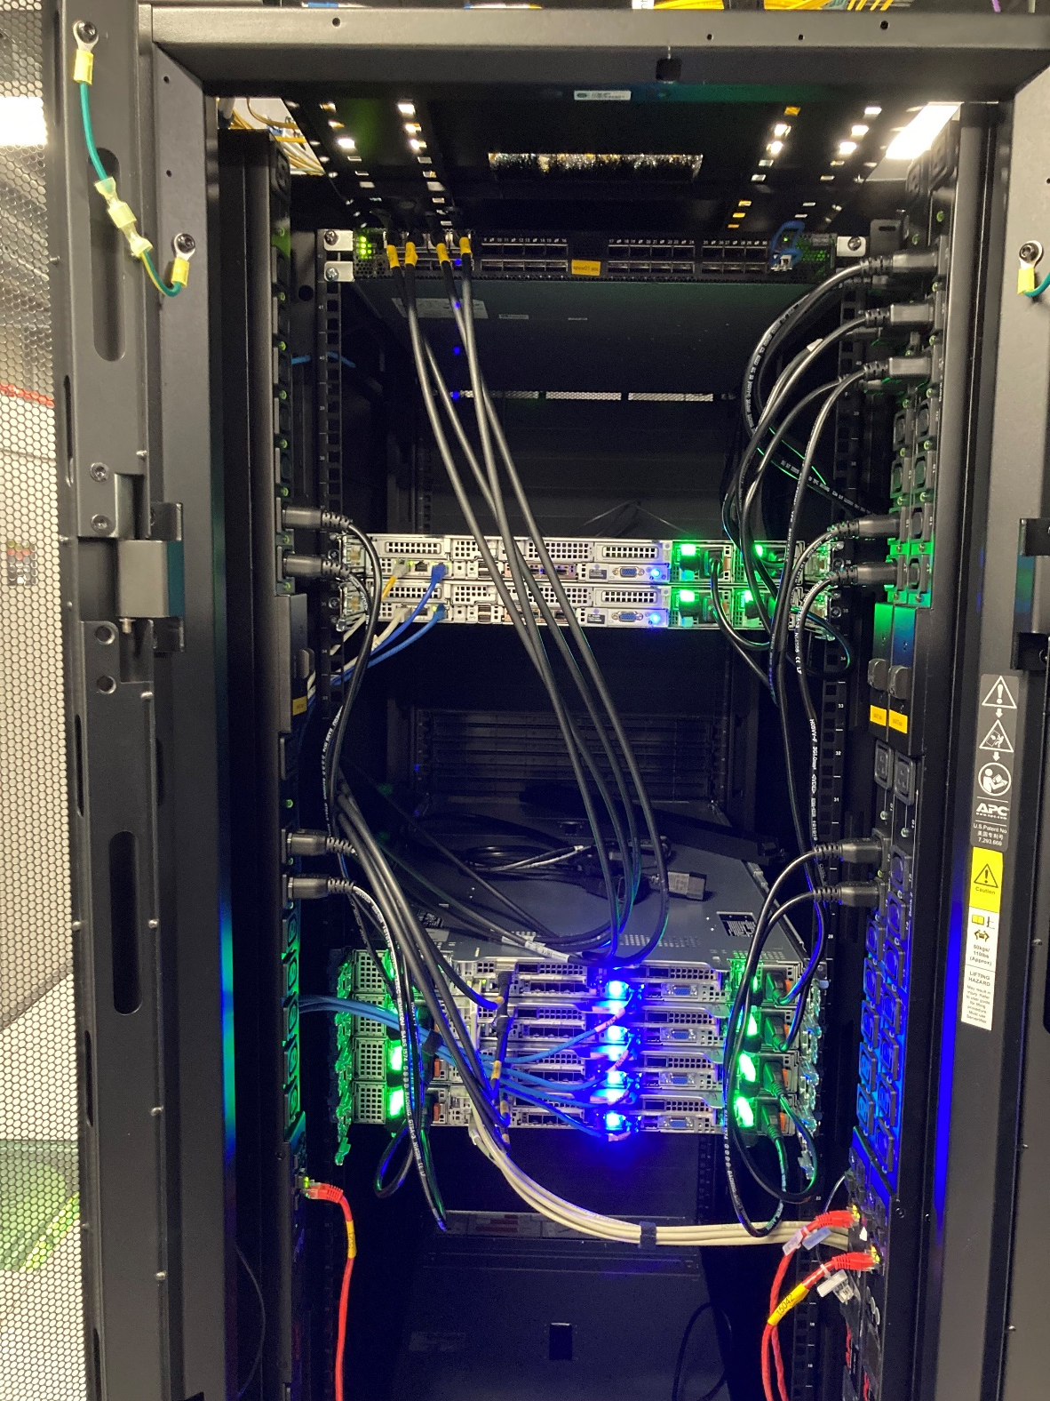
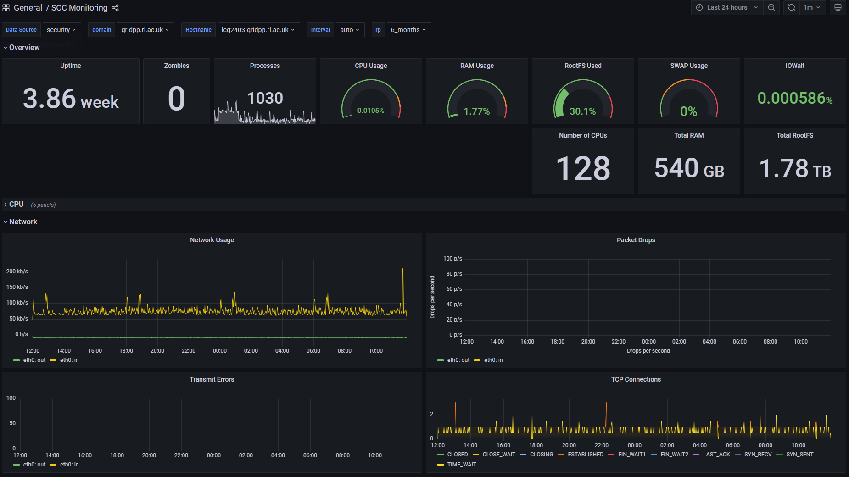
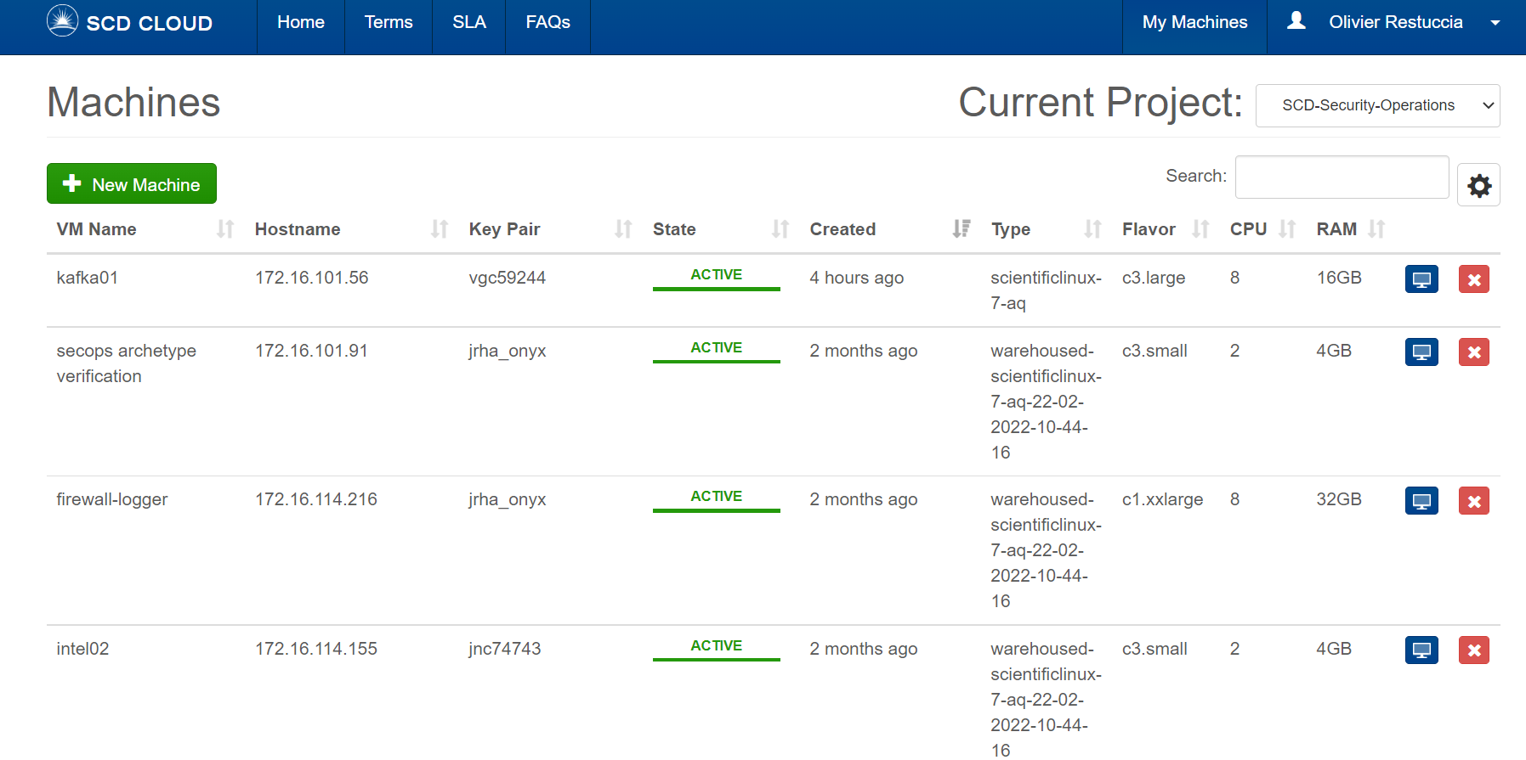
Current status
Hardware installation
Network diagram and switch management
Performance monitoring
Virtual cluster for test deployment

Slide 6
Future Steps
Iron out deployment on virtual cluster using the SecOps archetype
Finish configuration of switches and hosts
Start data flow through the zeek nodes and tune them
Eventually drive deployment of the SOC across STFC sites and other organisations: many interested parties outside of STFC such as Jisc: a project with very large scope and applications

Slide 7
Thank you, questions?
scd.stfc.ac.uk
@SciComp_STFC

