Slide 1
An ultra-low-mass silicon pixel tracker for ILC or C³
[C-cubed, a ‘Cool Copper Collider’ – SLAC, LANL, UCLA, INFN-Frascati, FNAL]
Chris Damerell
RAL
16 Feb 2022
ILC and C³ status, two options for a TeV-scale e+e- linear collider now under discussion at Snowmass
SPT: A Silicon Pixel Tracker of minimal material, matched to both these accelerator concepts

Slide 2
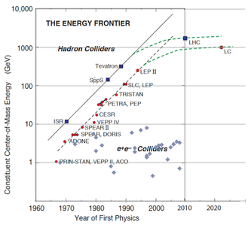
Synopsis of the mammoth ILC saga:
~1990, SLC/SLD working at last. Stimulus for the next step to become real, in form of NLC, TESLA, JLC and CLIC. At Saariselka, the first international workshop, Bjorn Wiik suggested first physics ~2000, hosted by DESY
2003, TESLA was dropped; DESY to focus on EUXFEL
ITRP formed (Barry Barish) and recommended SCRF option in 2004. Most labs cooperated to make it work, with FNAL as the natural host.
2008 DOE/FNAL dropped it; Japan provisionally offered to host, and most labs cooperated on this.
After 14 long years, there’s opposition from KEK, and scepticism from MEXT, who see ILC as a 3-legged stool with one weak one. ‘Europe seems not to be interested’. They could be right - many in Europe are happy to focus on FCC-ee, a wonderful Higgs Factory, but which risks creating a cul de sac in terms of the energy frontier.
A recent twist: is SCRF still the preferred technology, given the exciting developments in ‘cool copper’: C-cubed? There’s always room for a good idea.
Remember, discovery in e+e- of the charm quark (1974) and then the gluon (1979)

Slide 3
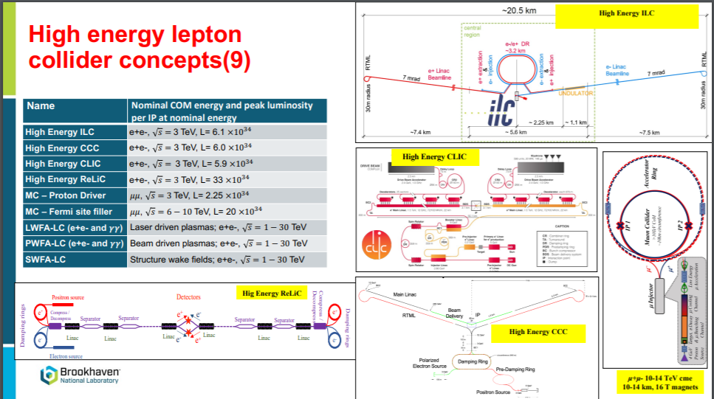
Footprint 31 km for 500 GeV
?
?
?
*
*
* Detector ‘an aspiration’ KL
No change since Bob Palmer ~2000
Thomas Roser, 18 Jan 2022
Snowmass
Footprint 8 km for 550 GeV

Slide 4
In 2004, NLCTA was ‘melting a lot of copper’. ITRP decision in favour of SCRF was reasonable at the time
Ongoing progress with room-temperature high-gradient accelerators has been driven by many commercial applications, including need for compact X-ray sources for baggage checking.
Emilio Nanni and colleagues at SLAC devised a new approach for the e+e- energy frontier – the Cool Copper Collider
The key features are:
  Modified accelerating structures – ‘separated function’ for every cell: large aperture for power delivery, plus small beam apertures, leading to reduced peak fields
  Operation at low temperature (liquid nitrogen, which is cheaper than milk) for greatly reduced surface resistance
Can then raise the accelerating gradient to ~150 MV/m, compared with 31.5 MV/m for ILC (superconducting niobium)

Slide 5
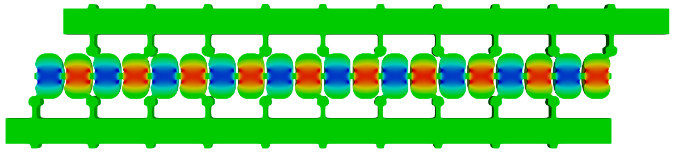
Breakthrough of Distributed RF Coupling Changes the Paradigm for RF Accelerator Performance
RF power coupled to each cell – no on-axis coupling
Full system design requires modern virtual prototyping
Beam aperture only 2.62 mm radius
Control peak surface electric and magnetic fields by optimal cell design
Key to high accelerating gradient
RF Power
Beam
Feed waveguide
π phase at splitter
Electric field magnitude produced when RF manifold feeds alternating cells equally
Emilio Nanni, SLAC. ArXiv 2110.15800 (2021)

Slide 6
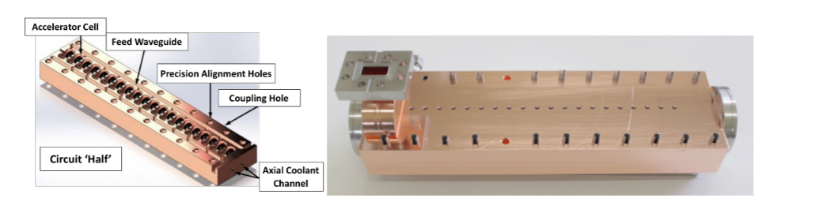
Prototype accelerating structure (half-length - 50 cm long, 20 cells):
Split-block fabrication: 2 copper slabs (no current crosses the mid-plane)
State-of-art CNC machining – inexpensive mass production, no post-CNC finishing required
Tested up to 160 MV/m, including with beam
Robust compared with SC cavities, where the risk of operational accidents (such as the fire in SLC DR and the splice joint failure at LHC), plus earthquake damage, are ongoing concerns. [Even if exposed to smoke, copper cavities can be cleaned by ‘beam scrubbing’. Not so for superconducting cavities.]

Slide 7
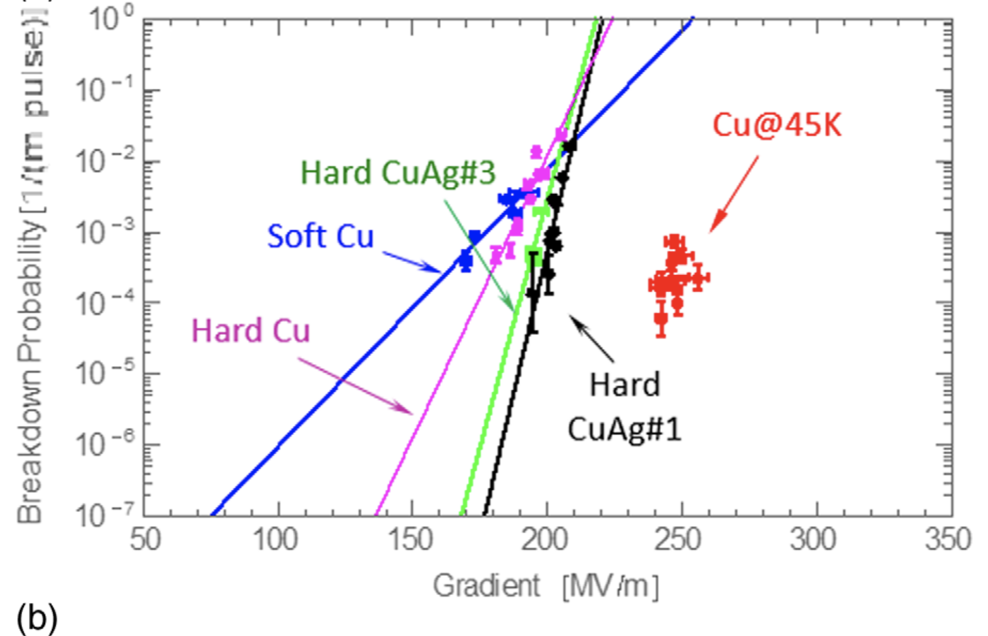
Transformative Impact for Efficient High-Gradient Operation with Cryo-Copper Accelerators
Surface resistance of copper at 5.71 GHz is reduced by factor 2.55 when cooling from 300 K to 77 K
Operation with liquid nitrogen is simple and practical
Cahill, A. D., et al. PRAB 21.10 (2018): 102002.

Slide 8
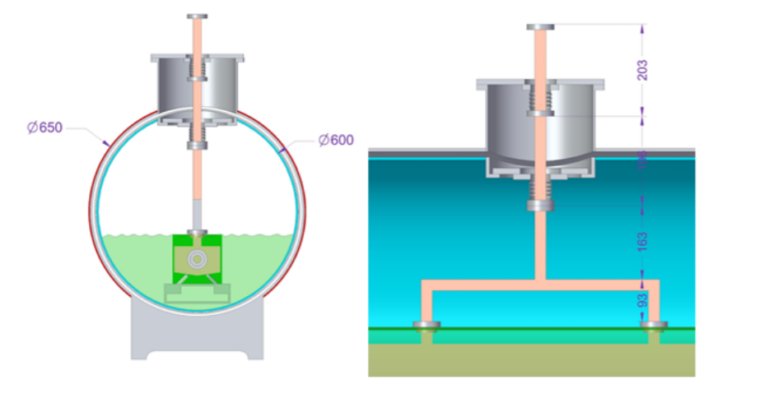
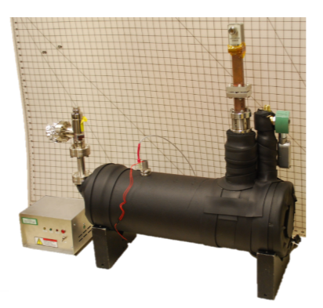

Slide 9
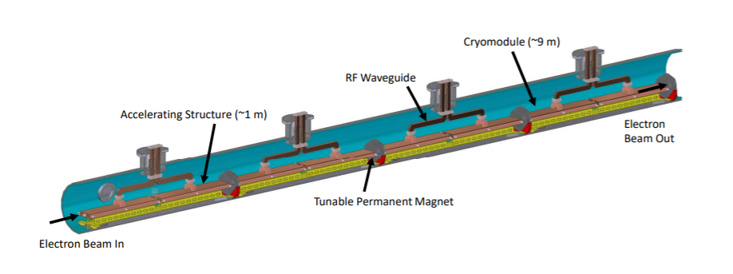
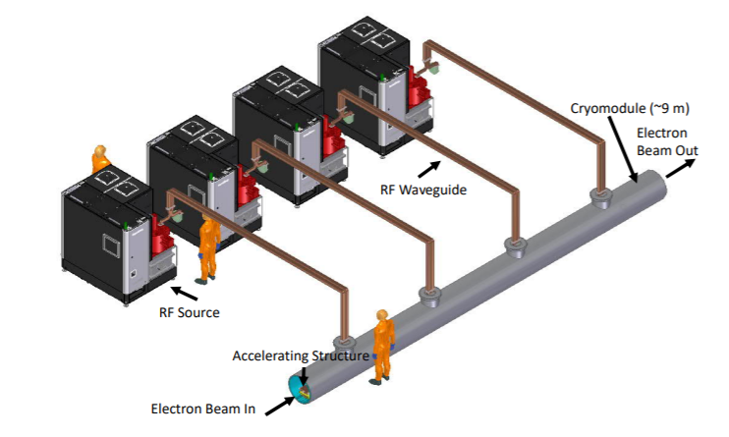
Next step (when funded) will be a complete cryo-module (8 of 1 m accelerating structures)
Fed by 4 commercial RF sources, C-band klystrons, which are steadily becoming more efficient and less expensive (Powerful world-wide collaboration between CERN, KEK, PSI, INFN, SLAC, Fermilab, IHEP, … and industry)

Slide 10
Next steps for C³
Would be helped by an authoritative comparison with ILC (hopefully without convening another ITRP). We hope to get an impartial expert (someone of the stature of Reinhard Brinkman) during the ‘Collider discussions’ sessions at Snowmass, 28-31 March, to provide a technical comparison between ILC and C³
Needs ~$100 M to produce a full cryo module (meanwhile, costs continue to fall, with ongoing klystron development)
Will need strong backing from DOE and the next Fermilab Director, in contrast to the ‘hadron alliance’ in 2008, which convinced the authorities to kill off the previous US-based proposal. Hoping to avoid further ‘scientific vandalism’. The Fermilab Site Filler Collider working group has given encouragement
Provisional schedule has 250 GeV machine operating from 2040, subject to funding, after Snowmass/P5 exercise now under way
Cost estimate for C³ 250 is $3.7B, plus lab labour and contingency. Many components of this estimate are derived from ILC and CLIC
------------------------------------------------------------------------------------------------------------------------------------------------------

Slide 11
The Silicon Pixel Tracker
Assuming ILC or C³ gets built, we need an excellent tracking system, with minimal material, including the forward region (due to the multi-jet nature of TeV-scale physics)
ILC Detector Review Panel in 2007 looked at proposals for tracking in Beijng, and we were concerned about all of them. Marcel Demarteau: ‘Tracking has always gone to Hell in the forward region’
By 2008, we had a proposed solution – the Silicon Pixel Tracker, SPT. Konstantin Stefanov, ILC Workshop, Sendai, Japan
Immediate reaction was ‘It’s a case of the better being the enemy of the good! We need to be running by 2020, so we’ll stick to the microstrip baseline’
Over the past decade, the SPT concept has become increasingly attractive, as a result of developments in pixel design (pinned photodiode) and MAPS-based tracking for ALICE (ITS-2, now moving to ITS-3)
By the time of LCWS-2021, when Konstantin presented an updated conceptual design, it was now considered to be clearly the technology of choice for ILC, at least by the SiD collaboration
So let’s review the design concept (which is also applicable to C³, though with a different time structure)

Slide 12
The SiD Microstrip Tracker
(previous baseline)
5 barrels with 4 forward disks at each end (ILC TDR 2013)

Slide 13
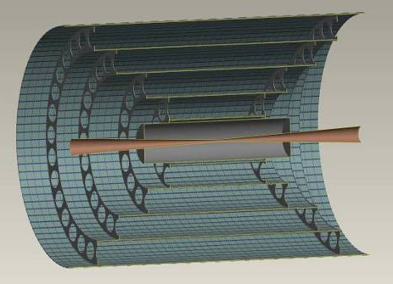
The SiD Silicon Pixel Tracker – SPT
(emerging baseline)
Tracking system with high transparency (≈3% X₀) times obliquity factor between 1.0 and 1.41 over full angular range
Featuring:
  Low mass tracking layers integrating signals through the bunch train, to minimise power
  Single bunch timing information from the vertex detector and a dedicated timing layer (just before ECAL) for robust pattern recognition
A major challenge is to minimise power dissipation, hence material
Air-cooled, power dissipation in tracking layers ~100 W
Sensors ≈100 μm thick, low mass support (total≈0.6% X₀ per layer)
Pixel size around 50 μm × 50 μm, pinned photodiode
Partly depleted, to deliver ~5 μm measurement precision – we hope!
(to be simulated)
Overall system 28 Gpix, 70 m² of silicon
Square pixels preferred due to equal importance of Rφ and RZ projections, for some purposes. Another opinion prefers 25x100 μm² (both to be simulated)
Each sensor is a 8x8 cm² MAPS
of 2.56 Mpixels
Time integrating tracking layers. Endcaps not shown

Slide 14
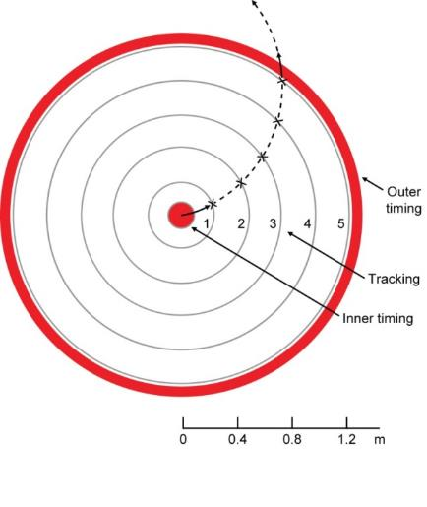
Outer timing layers (original plan)
3 closely spaced layers for redundancy
  Single bunch timing resolution (<554 ns for ILC, ~5 ns for C³)
  Material budget less critical due to proximity to ECAL
  Probably air-cooled
  150 µm pixels
Might now be combined with a RICH-type PID system (mentioned later)
The vertex detector will provide tracks with single-bunch timing at small radius
Track reconstruction performance to be simulated and tuned – possibly leading to a more compact tracker
Breaking news, 9 Feb: we hope to resurrect the SiD tracker simulation by end of March, as part of the Snowmass process (led by Andy White, UTA)
Outer timing layers
Vertex detector

Slide 15
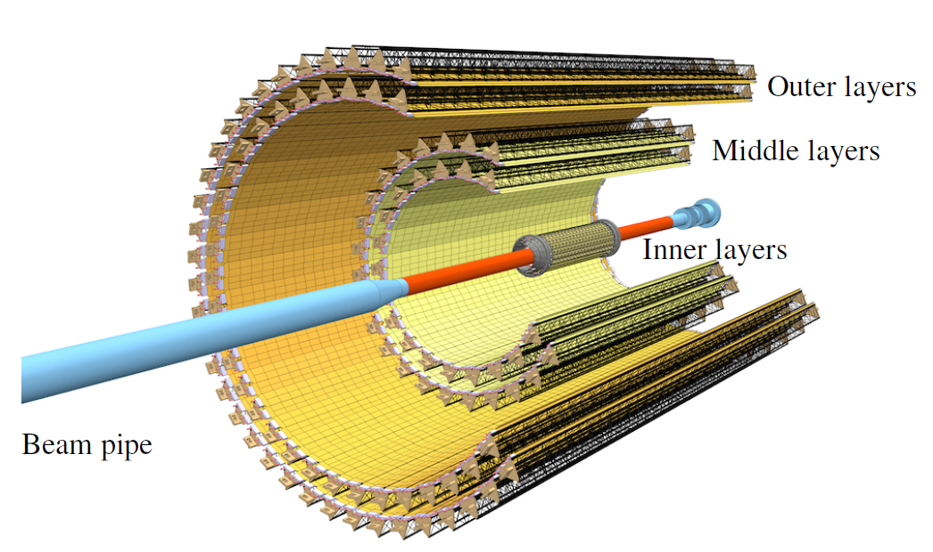
In 2008, we were a bit pioneering, but now we are on firm ground – ITS-2 (ALICE)
12.5 Gpixels
≈30×30 µm pixels, ALPIDE MAPS sensors
Outer barrel 1.48 m long
Total 10 m² silicon (cf 70 m² for SiD)
ALICE ITS2 TDR, CERN-LHCC-2013-024
And even more, the work of CERN WP1.2, led by Walter Snoeys, for stitched MAPS devices for ALICE ITS-3 at the TJ 65 nm technology node ….

Slide 16
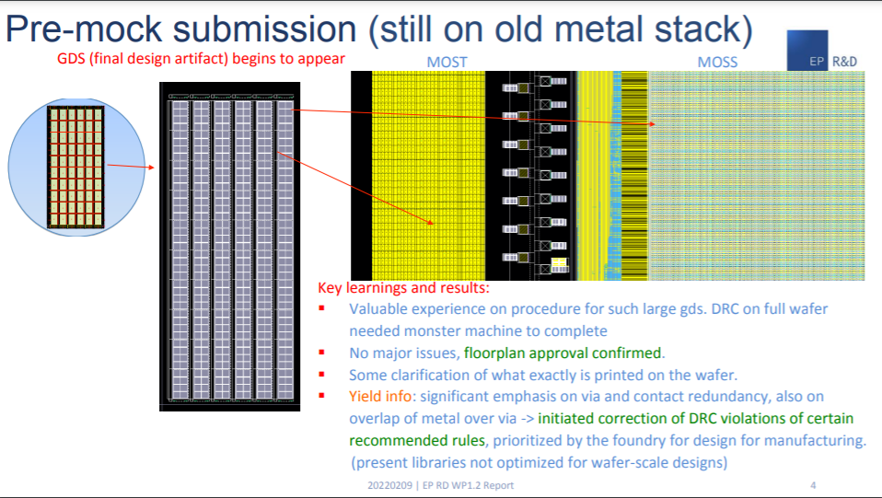
1-D stitching for first submission, each device is 10x2.5 cm by 1.4 cm
Ten ‘middles’ plus two ‘ends’
Walter Snoeys 9 Feb 2022

Slide 17
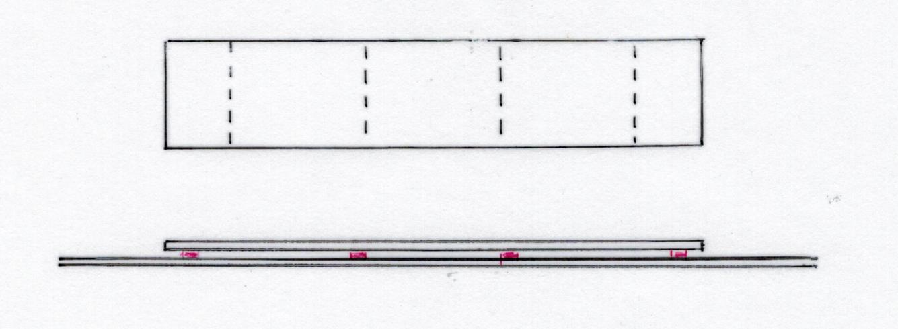

1993: David Burt: thanks to wonderful development of stitching at e2V, we could do a lot better – VXD3 with 307 Mpixels
Three ‘middles’ plus two ‘ends’
$μ^{+}μ^{−}$ event
R_{bp} = 2.4 cm
1990: SLD’s VXD2 with 120 Mpixels
Low power hence gas cooled, read out over 10 bunches
Bgd acceptable due to high granularity, in contrast to the Mark II microstrips which ‘brought SLC to its knees’

Slide 18
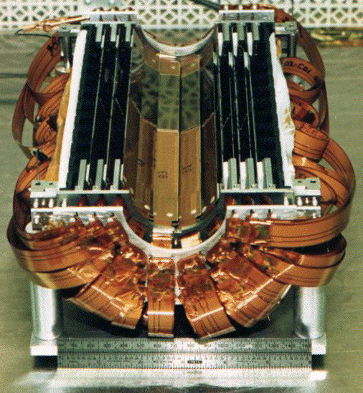

Slide 19
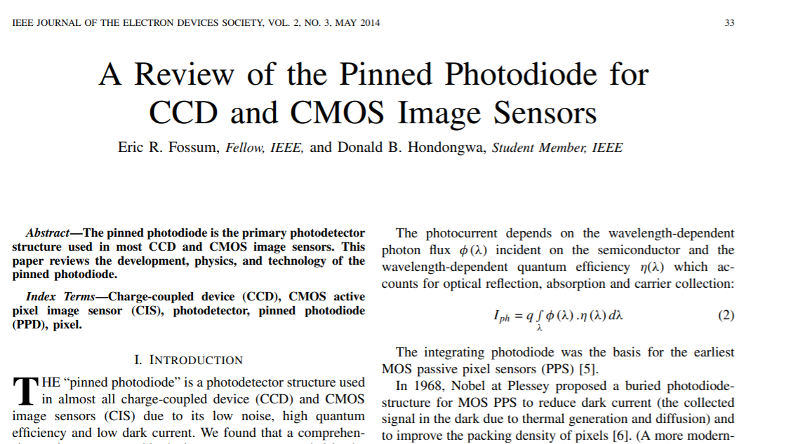
It’s in everyone’s phone cameras, yet it’s often overlooked by the HEP MAPS community, usually for a good reason …

Slide 20
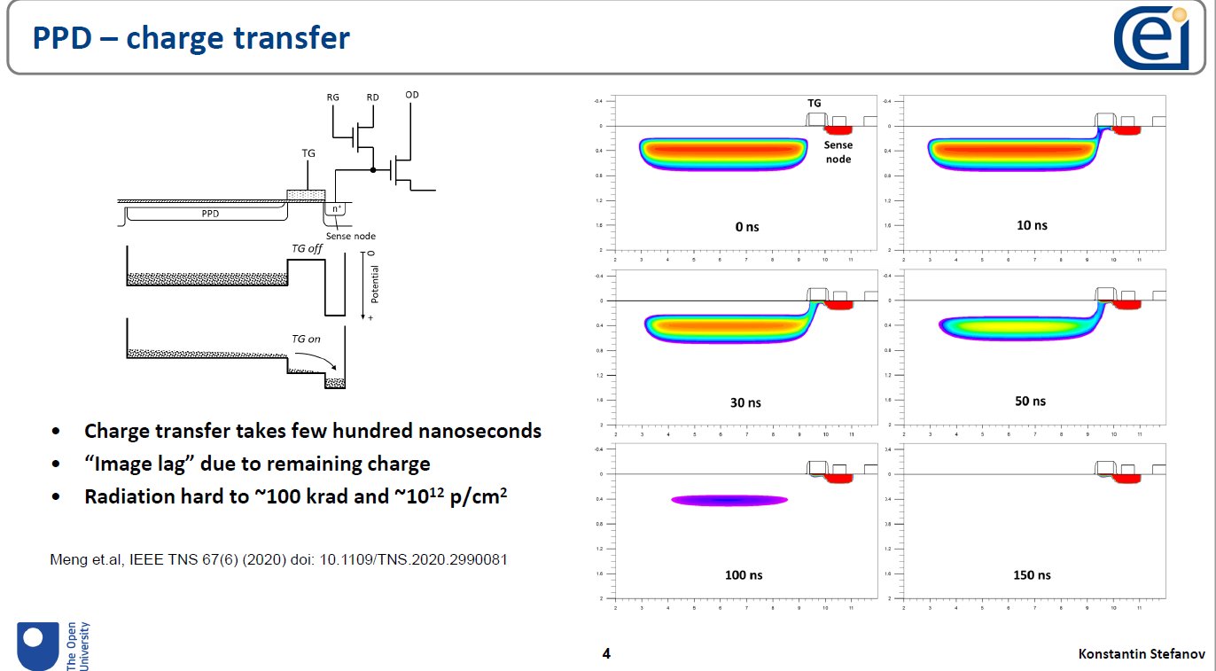
Combines 3T readout with pinned photodiode
  Low dark current – few pA/cm²
  High conversion gain – separate charge collection and conversion
  Low noise – sub e- is routine
Moderate radiation hardness - ~100 krads and ~10¹² n/cm²
Moderate speed
A very good match for the ILC/C³ tracker
Meng et al, IEEE TNS 67(6) (2020) doi: 10.1109/TNS.2020.2990081

Slide 21
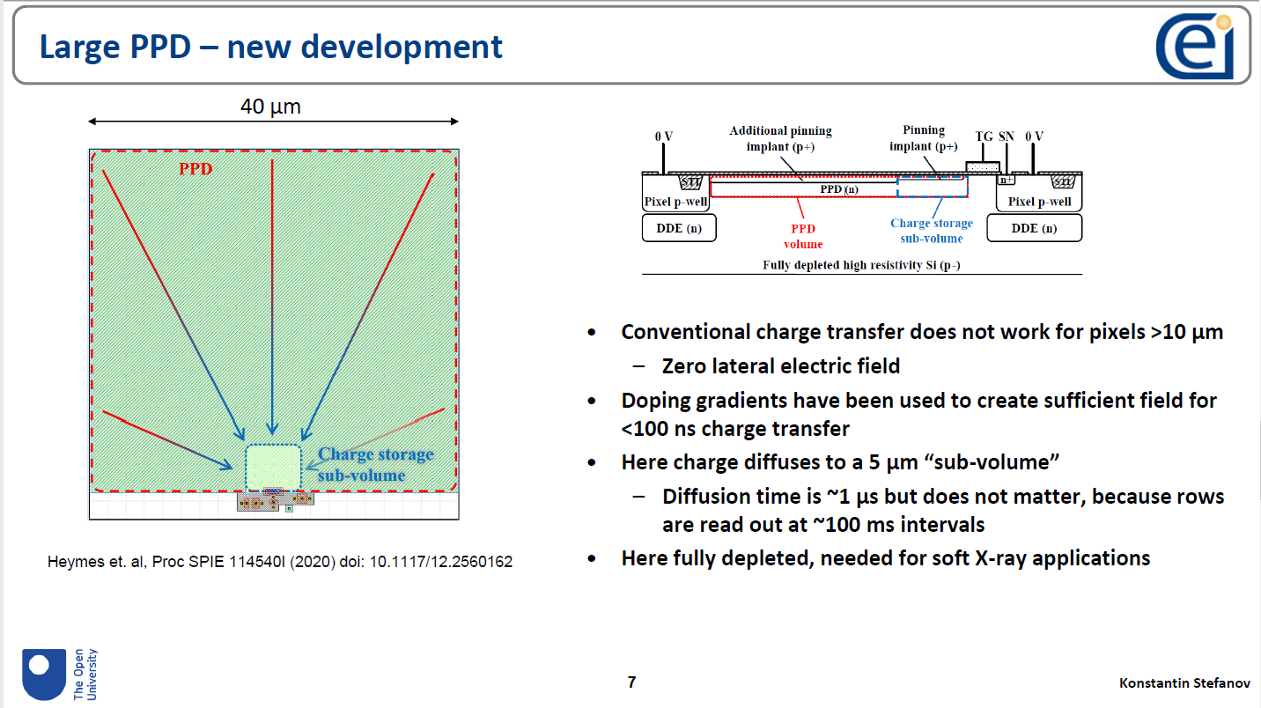
Details in Konstantin’s slides in Lorenzo Rota’s SiD CMOS meeting on Nov 11, 2021 https://indico.slac.stanford.edu/event/7000/

Slide 22
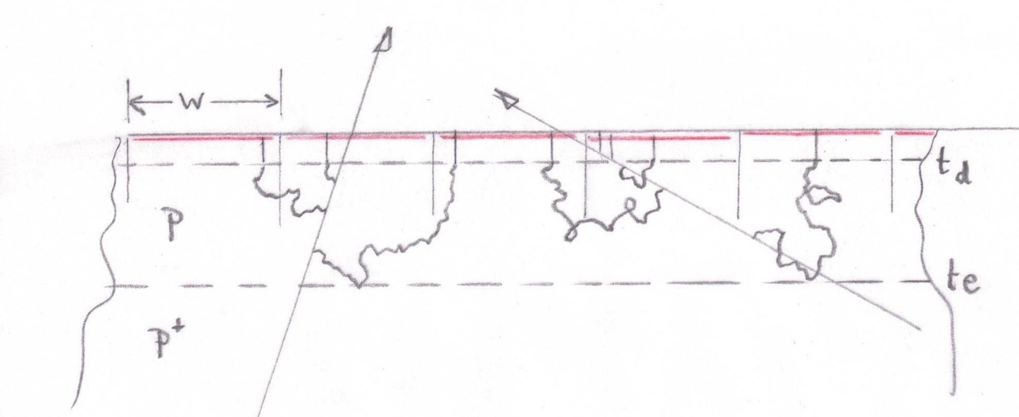
Critical question: can we achieve precision of ~5 μm in track measurement from 50 μm pixels?
(since 2008!)
Pinned photodiode, full charge collection over pixel area
Wonderful News:
Daniel Hynds of Oxford U OPMD, leader of AllPix Squared development, has the tools, and may extend to an experimental test using TimePix4 assemblies
Device thickness ~100 μm (determined by mechanical design)
Epi layer thickness t_{e} ~50 μm (to be optimised)
Depletion depth t_{d} ~10 μm (to be optimised)
Pixel size w ~ 50 μm square
Vary t_{d} and t_{e} to find optimal centroid determination, for incident angles 0 to ~60º wrt to the vertical
Second phase of simulation will be to study tracking performance with the suggested layout of tracking and timing layers. How compact can it be made? (can probably improve over microstrips)
Valentina Cairo of SLAC is ready to study this

Slide 23
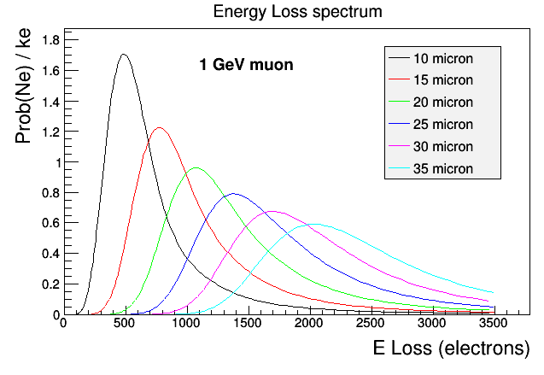
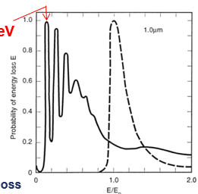
Single 17 eV plasmon
Su Dong, SLAC
Hans Bichsel RMP article: primary ionisation process of charged particle traversing silicon is generation of 17 eV plasmons. For very thin layers, the quantised nature of this process is apparent: probability of generating 0, 1, 2, … plasmons, which subsequently de-excite by generation of e-h pairs, heat (thermal phonons) etc. → yielding one e-h pair per 3.6 eV energy loss on average
These effects are important for oblique incidence (experience with ATLAS pixels – study by Su Dong)
--------------------------------------------------------------------------------
Readout:
  Each pixel stores analogue hit information on its sense node
  The detector is read out in between the bunch trains (simple rolling shutter)
  Low noise (~10 e-) readout with sparsification
Digitised (6-bit?) output signal from a 3×3 area round each above-threshold ‘trigger pixel’ to enable cluster centroid fitting
This also permits one to observe and routinely monitor X-ray backgrounds (this was very informative while running SLD)

Slide 24
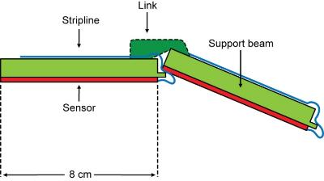
SPT Mechanical Design Concept
Geometry follows the SiD layout for now, but with quite different construction:
  Much less material
  Long ladders made from 4-8% SiC foam (5 mm thick, 0.24-0.48% X₀)
  SiC is a good thermal match to Si
  Self-supporting barrel with small foam links at intervals of ~40 cm
  Structure adhesive-bonded for minimal mass (silicone elastomer, not to be used for high radiation environments)
  Each half-barrel is attached to its half-endcap for adequate stability during assembly, then the pair of assembled half-barrels are clamped together for full operational stability
  Combination of optical survey and beam-based alignment completes the process
  Consistency checks between reconstructed 3-d tracks in the vertex detector and in the main tracker are valuable for fine-tuning track-based alignment of each of them.
Support beams run full length of tracker
Foam links about 1 cm wide at 40 cm intervals

Slide 25
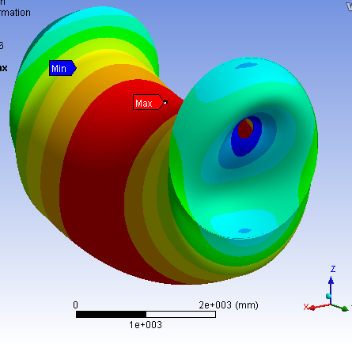
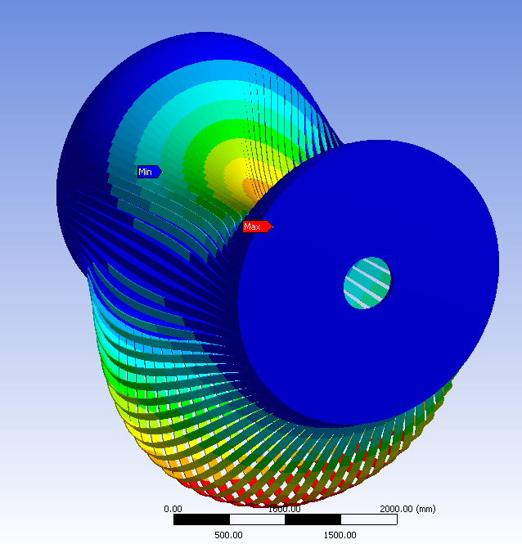
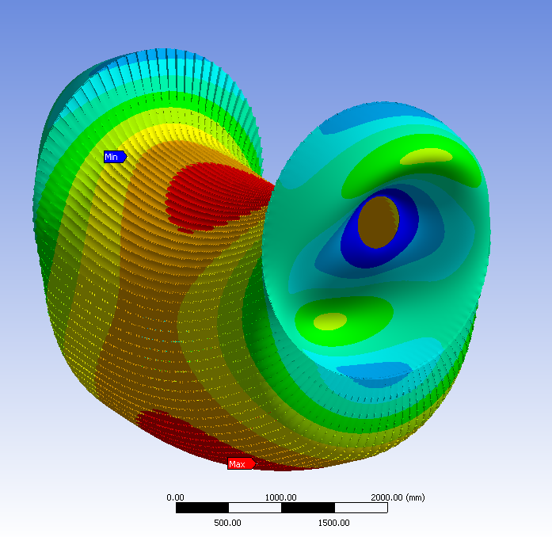
Layer 5
Continuous foam cylinder
Max deflection 10 μm
Separate foam ladders
Max deflection 20.5 mm
Ladders joined by small foam
piece every 40 cm
Max deflection 20 μm
Steve Watson - RAL

Slide 26
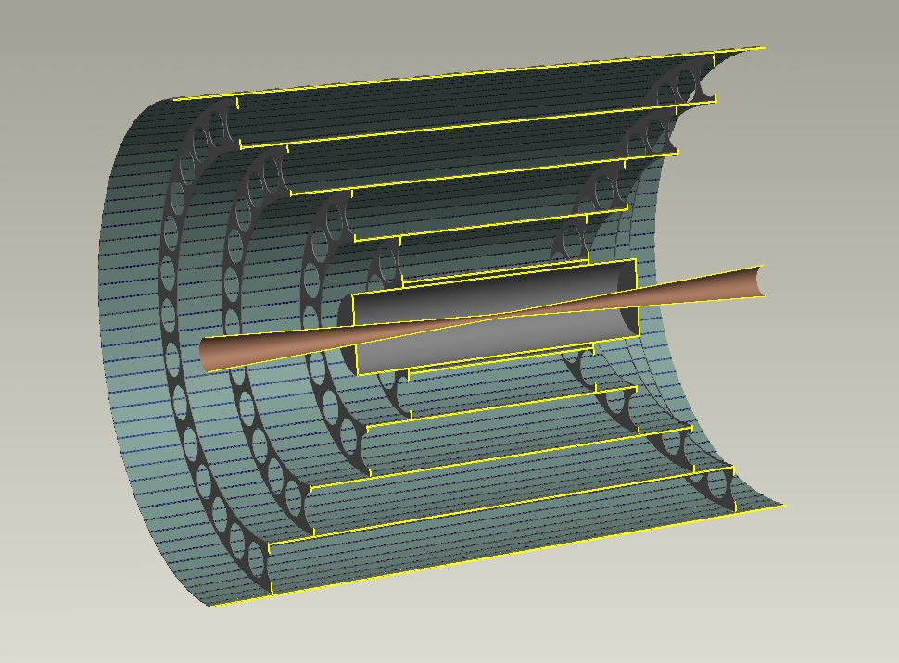
SPT- conclusions and plans
There’s a powerful physics case for a low mass, gas-cooled Silicon Pixel Tracker
Combining:
  Highly pixelated barrels and endcaps, time-integrating during the bunch train
  Single-bunch time stamping for every track from vertex detector and outer timing layers (maybe combined with PID in form of a compact RICH system – work in progress, led by Valentina Cairo and Jerry Vavra, last reported at FCC workshop on 8th Feb)
Sensors:
  Widely used MAPS technology (pinned photodiode pixels) appears well matched to the needs
  Measurement precision of the partly-depleted variant to be checked by simulation and experiment
  But there’s always room for new ideas. On the 15-year timescale, is it possible that the frontier for high performance tracking may have advanced to very rad-hard general purpose stacked devices, which have for some time dominated commercial CMOS Image Sensors (CIS devices)
  https://cerncourier.com/wp-content/uploads/2021/07/CERNCourier2021JulAug-digitaledition.pdf

Slide 27


Slide 28
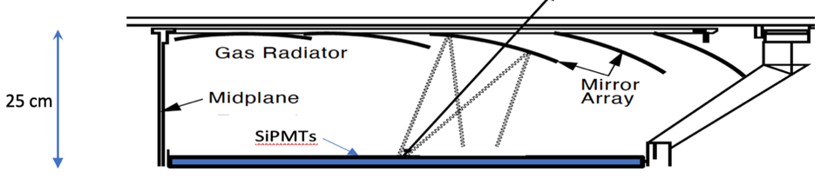
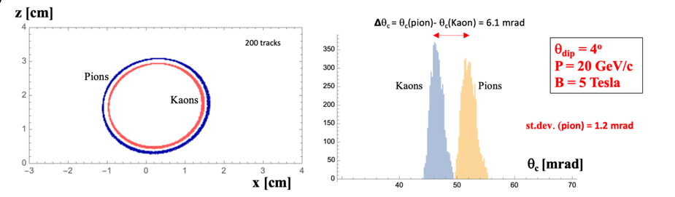
Need K/π discrimination from 8 GeV/c to about 30 GeV/c: beyond reach of TOF, cluster counting, and dE/dx in gas or silicon
Barrel RICH with appropriate radiator gas (probably C₄ F₁₀ at few degrees C), looks promising
Can be restricted to a thin shell, 25 cm or maybe as little as 10 cm radial space, given further advances in photodetectors
Material budget, including timing layer functionality, can probably be held below 0.2 X₀
(needs to be designed, simulated and tested)

Slide 29
Grzegorz Deptuch BNL
Fermilab/BNL stacked pixel detector for X-ray imaging. Functional sketch, not to scale. 3 layers, comprising a sensor tier (300 μm thick, for efficient X-ray response), an analog tier and a digital signal processing tier (each 15 μm thick). Direct bond interconnects (DBI) and through-silicon vias (TSVs) of dimensions 1 μm x 6 μm provide inter-tier electrical connections.
Also, an exciting collaboration between SONY and RIKEN (Takaki Hatsui) for advanced X-ray imaging systems.
NO public information, but look what SONY are doing for visible light imaging – camera chips.

Slide 30
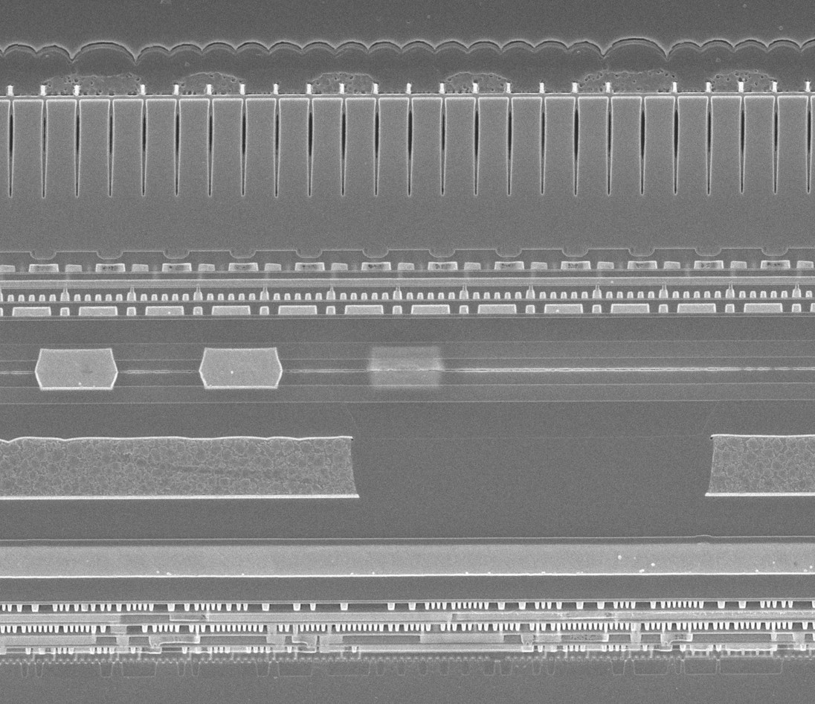
micro-lenses
colour filters
DTI
Imaging Tier
channel stops
7.8 μm
Numerous metal layers
copper-copper (DBI) bonds Note the wafer-to-wafer alignment!
Wafer-to-wafer bond
Image Signal Processing Tier
numerous metal layers
transistors
SONY chip cross-section
Processing and image from Tech Insights

Slide 31
Overall Conclusions
Maybe our Japanese friends will work a miracle, and get ILC off the ground, with strong Asian, European and North American participation.
If not, maybe the USA will back C³, and some other regions will join in.
In either case, the detector groups have at their disposal exciting ideas for advanced tracking performance, possibly combined with RICH-based particle ID.
Despite decades of development, weaker options (notably TPCs and drift chambers, still being pursued) are unlikely to succeed. Just my opinion
Whatever happens, there are some basic truths:
  the energy frontier won’t go away
  circular colliders can’t get there
  at the TeV scale one absolutely needs minimal material in the tracker over the full angular range
  A PID system for s-jet identification may be a game-changer for BSM physics
‘Nature cannot be fooled’.

Slide 32
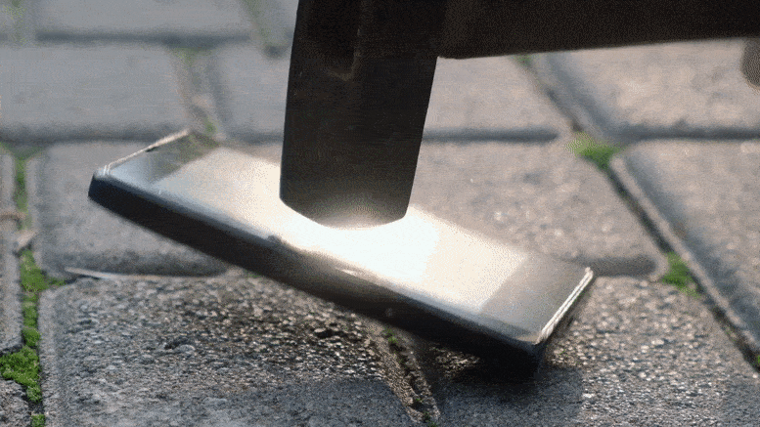
MIT Engineers Create the “Impossible” – New Material That Is Stronger Than Steel and As Light as Plastic
MIT Technology Review 27 Oct 2021

Slide 33
backup

Slide 34
Bunch structure at the ILC 250 GeV
0.2 s
554 ns
1312 bunch crossings
≈1 ms
C³ at 250 GeV has trains of 133 bunches, spaced at 5.26 ns, at train repetition rate of 120 Hz
This factor in train rate means that the tracking layers are 24 times cleaner than at ILC.
All needs full simulation, but we are pretty confident for both.

Slide 35
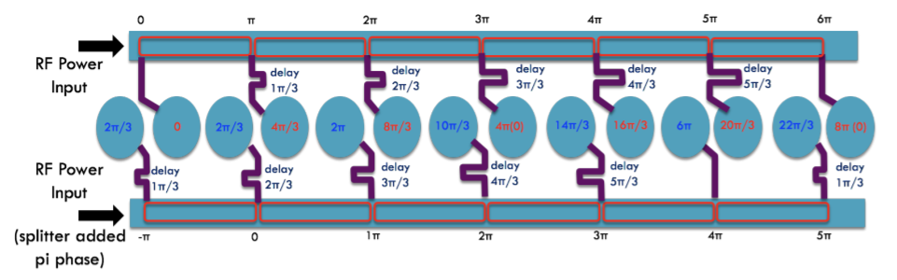
Variant with 120 degrees phase advance per cell
Optimal (from simulation) would be 135 degrees
Currently, π-mode, so 0, 180, 360, 540, ...

Slide 36
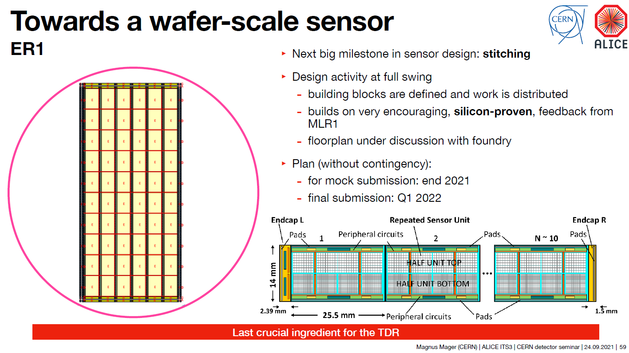

Slide 37
