Slide 1
CMS Experiment
C. H. Shepherd-Themistocleous

Slide 2
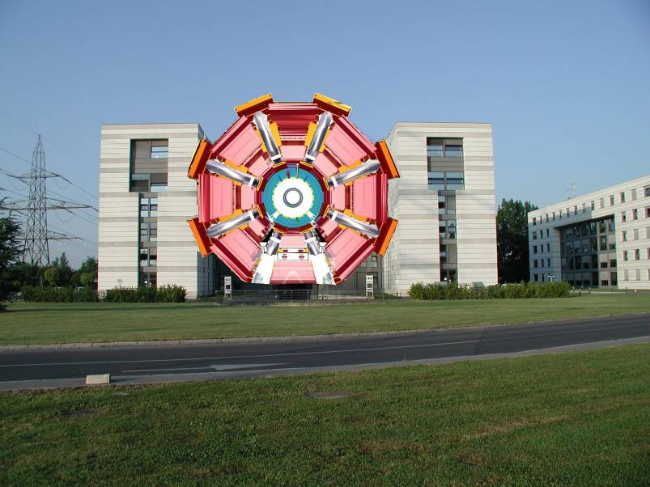
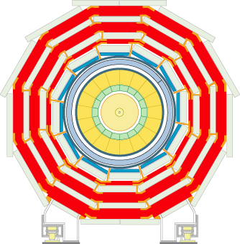
ATLAS
The Compact Muon Solenoid

Slide 3
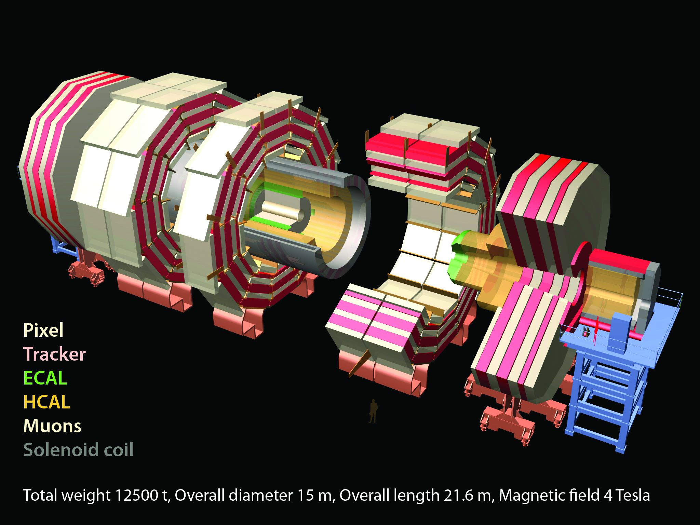

Slide 4
CMS : What we work on
Electromagnetic
Calorimeter
Trigger
(L1 & HLT)
Silicon Tracker
Computing
(T1 & T2)
Physics Analysis
Phenomenology
(NExT Institute)
Design
Construction
Operation
Upgrades

Slide 5
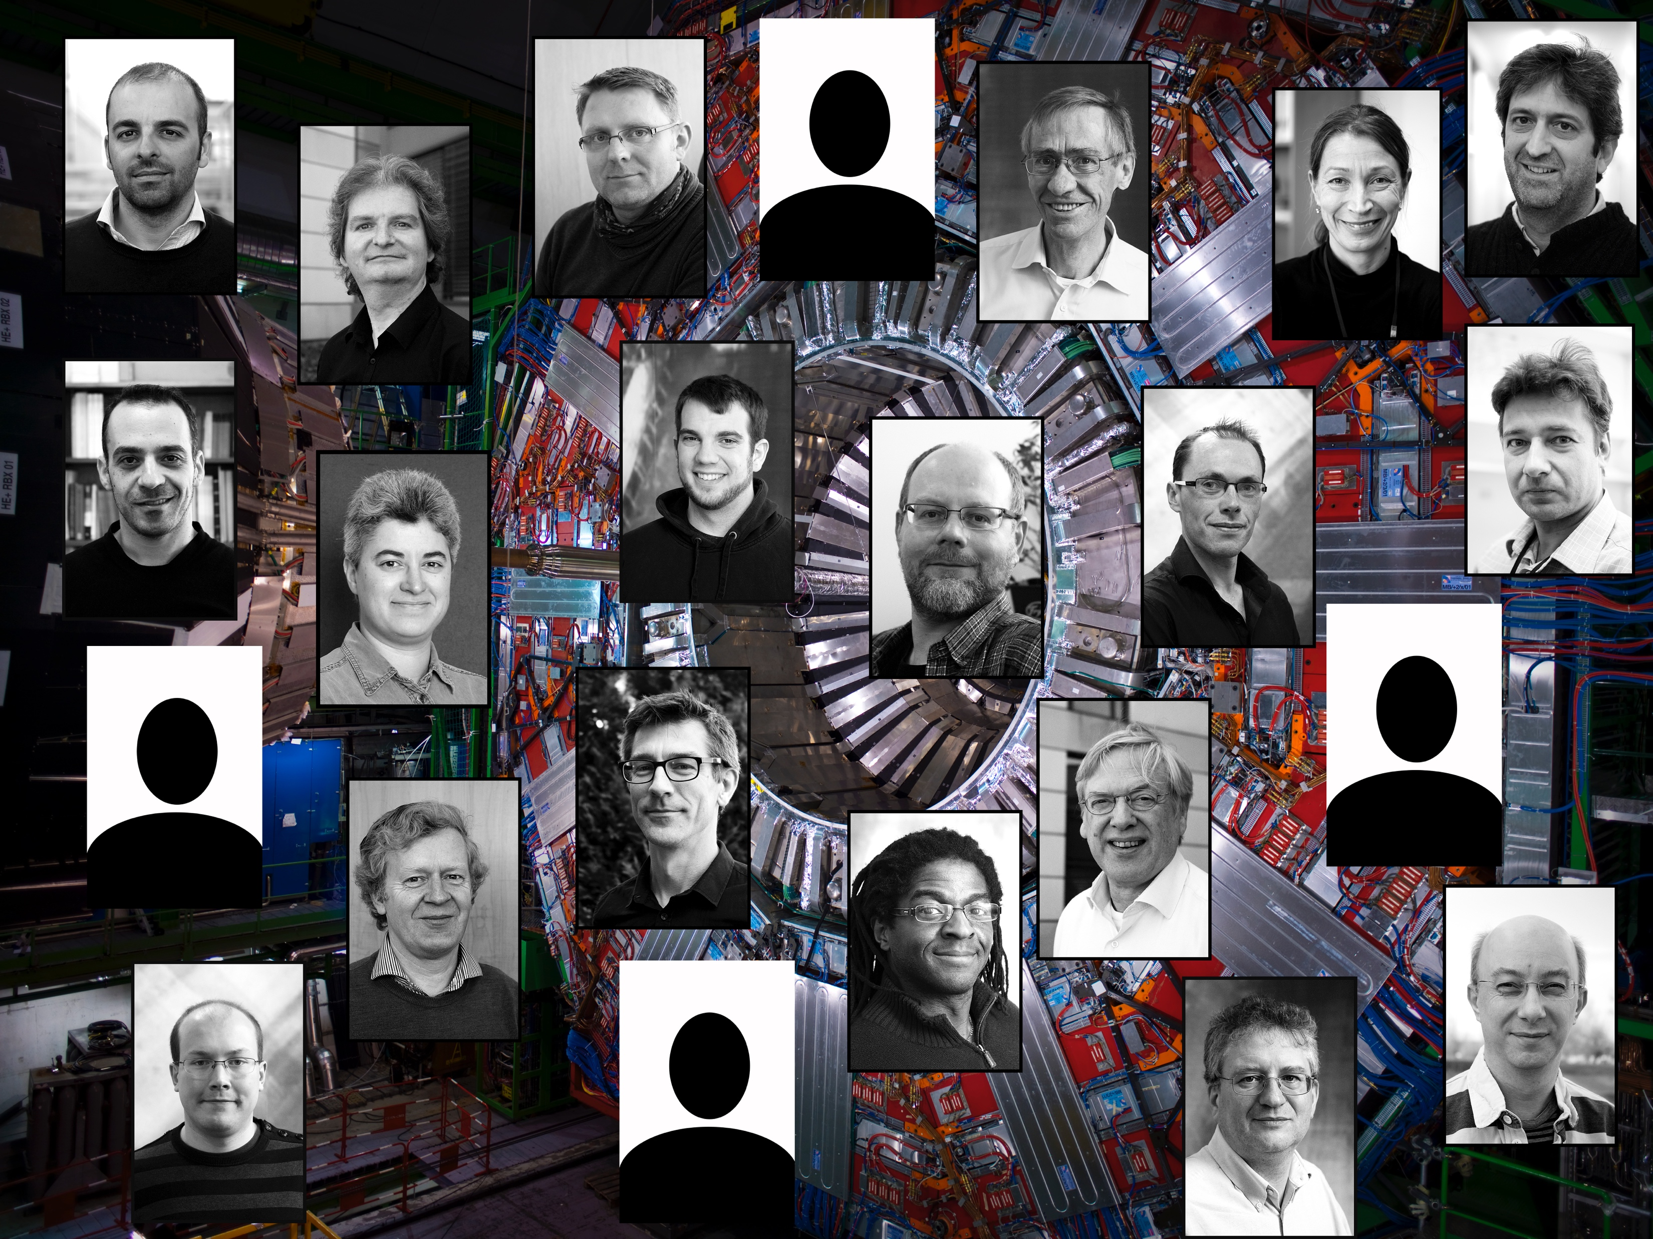
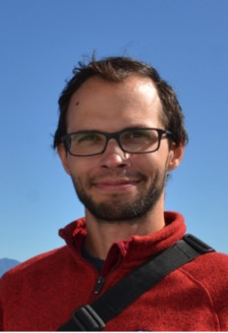
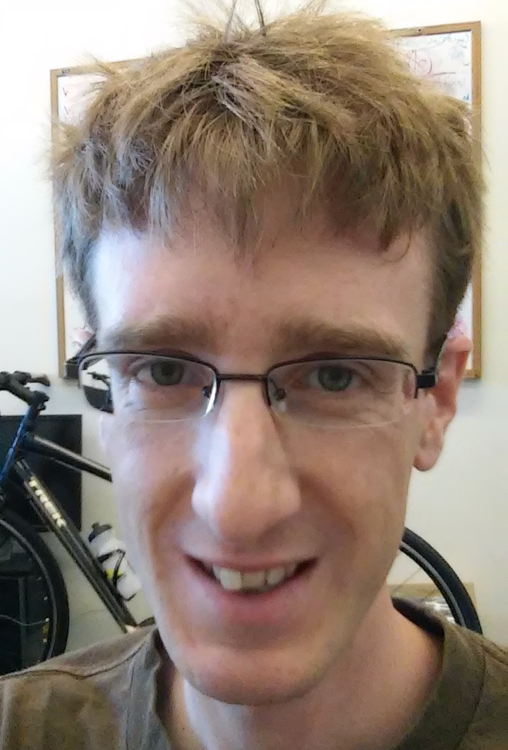
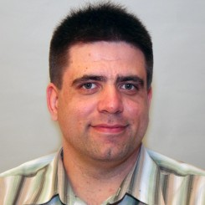
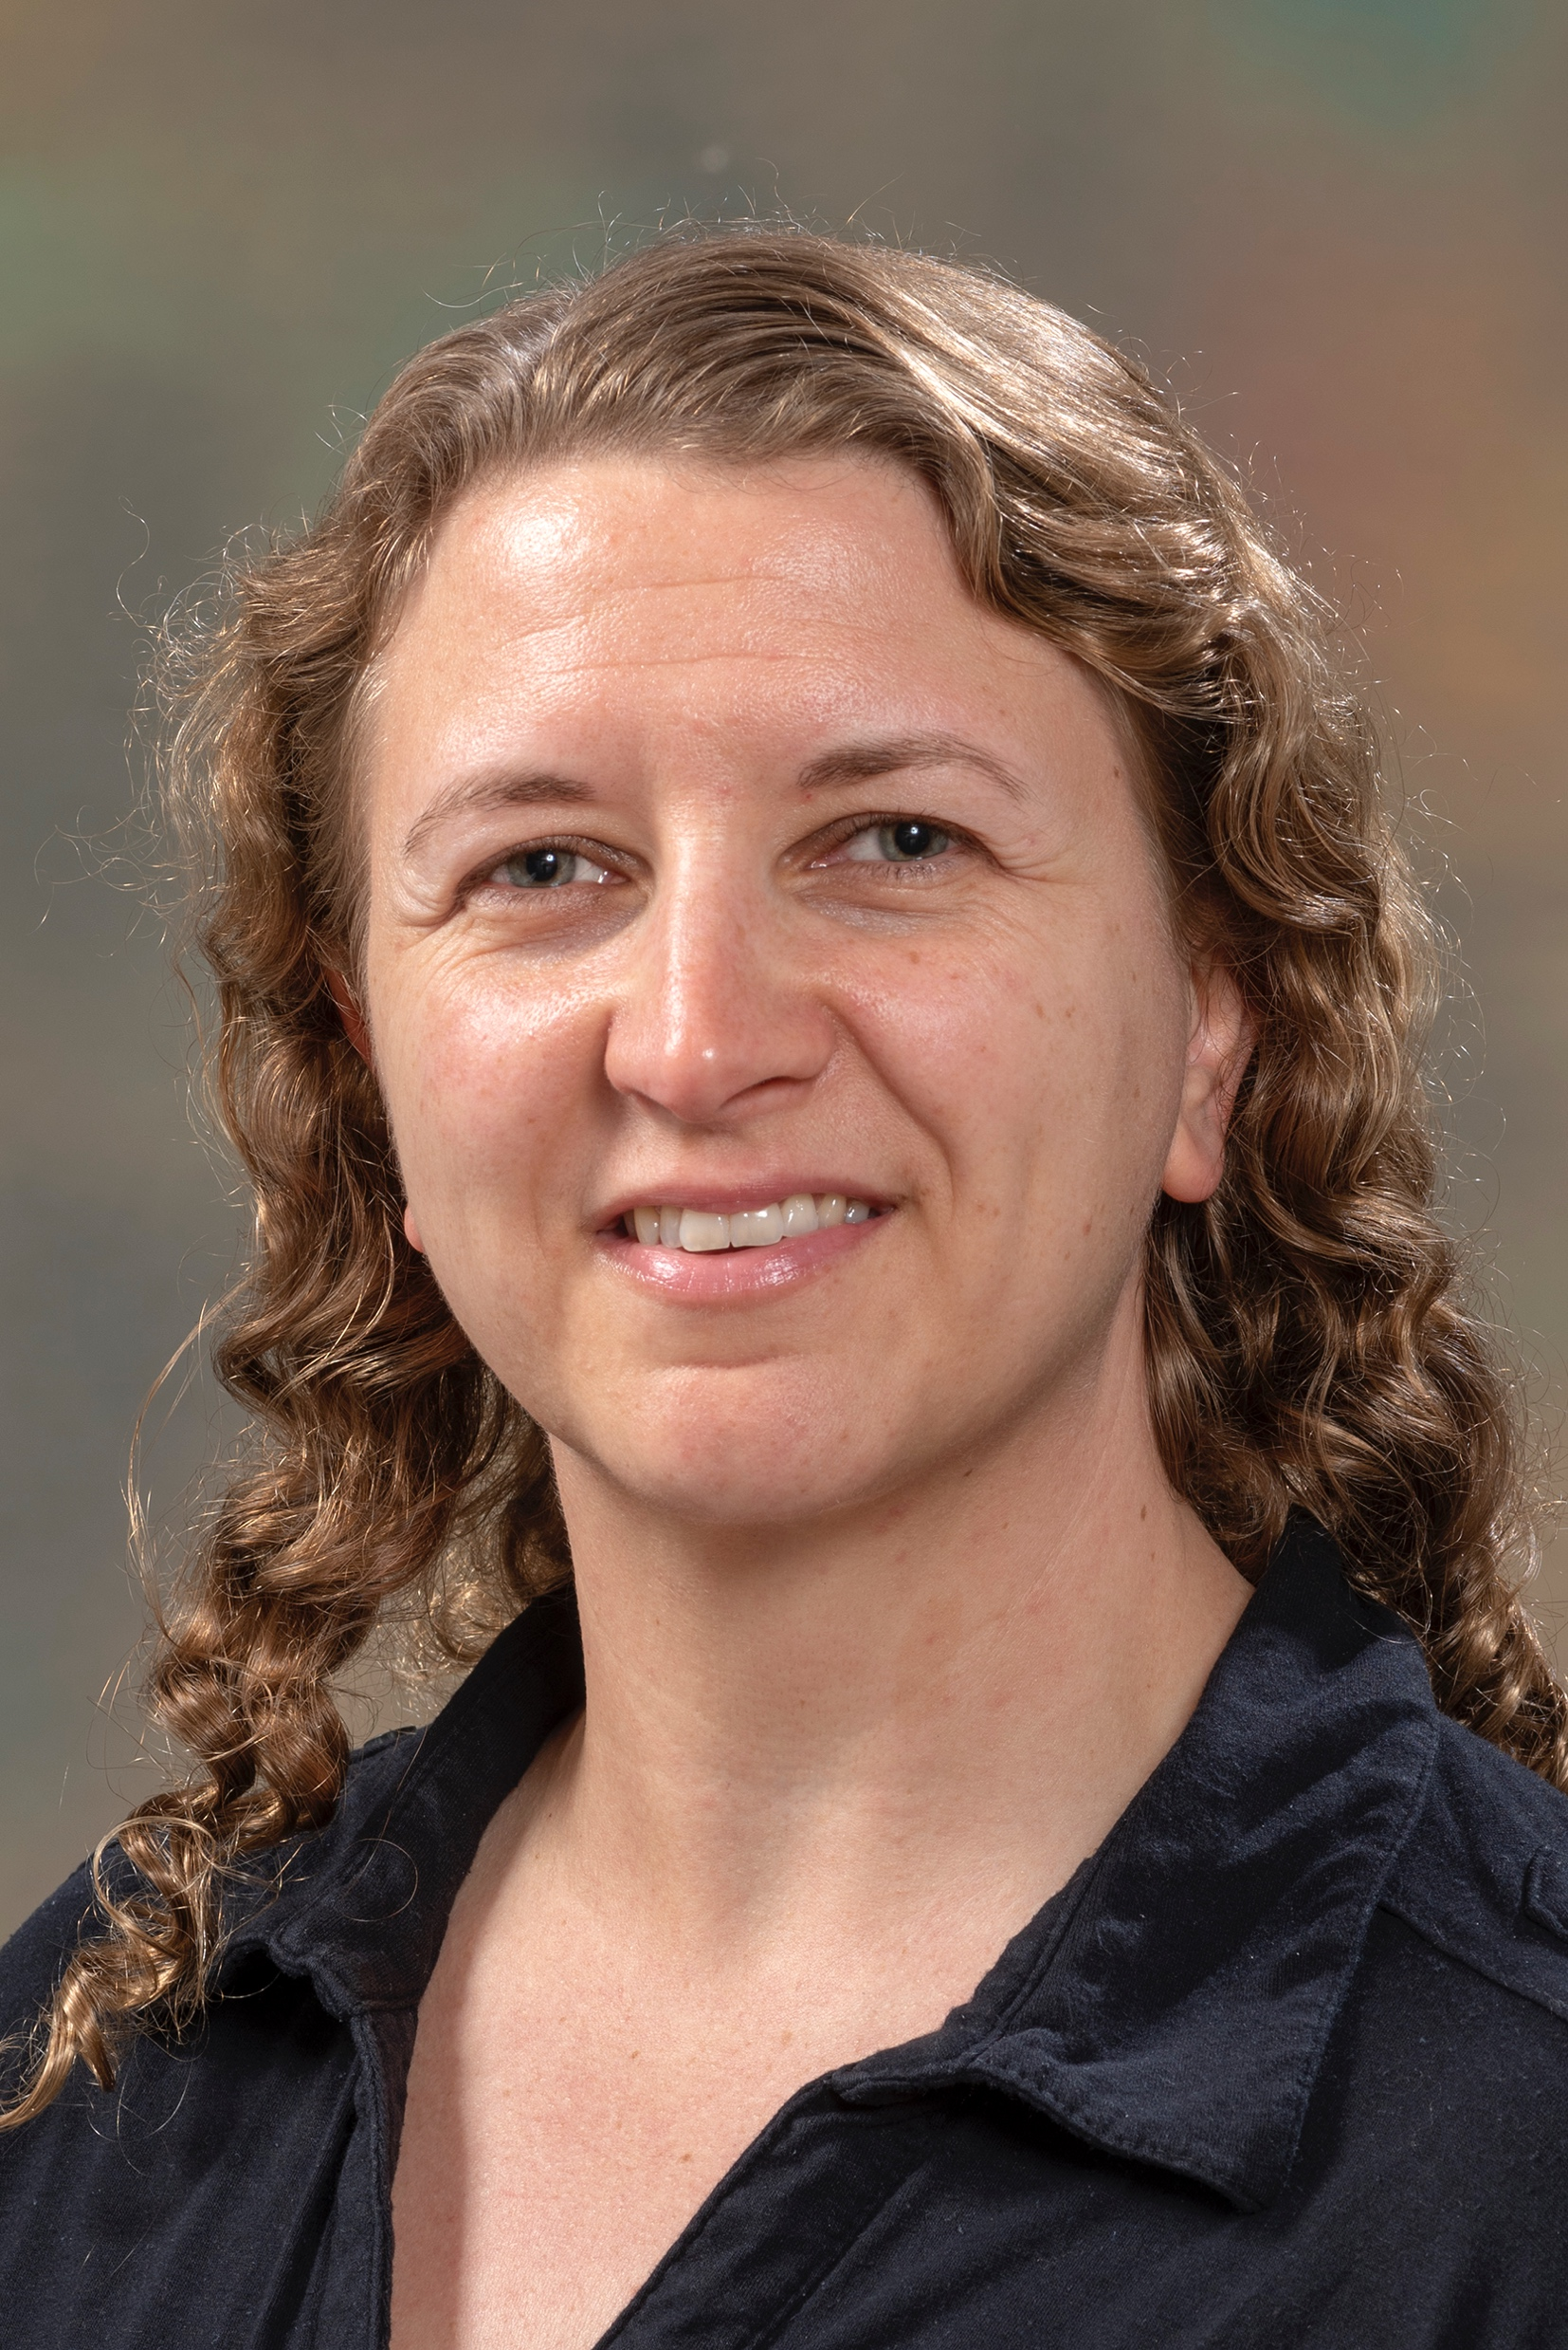

Slide 6
CMS PhD project
Project will encompass:
  1) A search for evidence of Physics Beyond the Standard Model (BSM).
    Extended Higgs sector (NMSSM)
    Machine Learning for boosted fat jets.
    Collaboration with Phenomenologists
  2) Level 1 Trigger upgrade for the HL-LHC
    Fast electronics and FPGAs

Slide 7
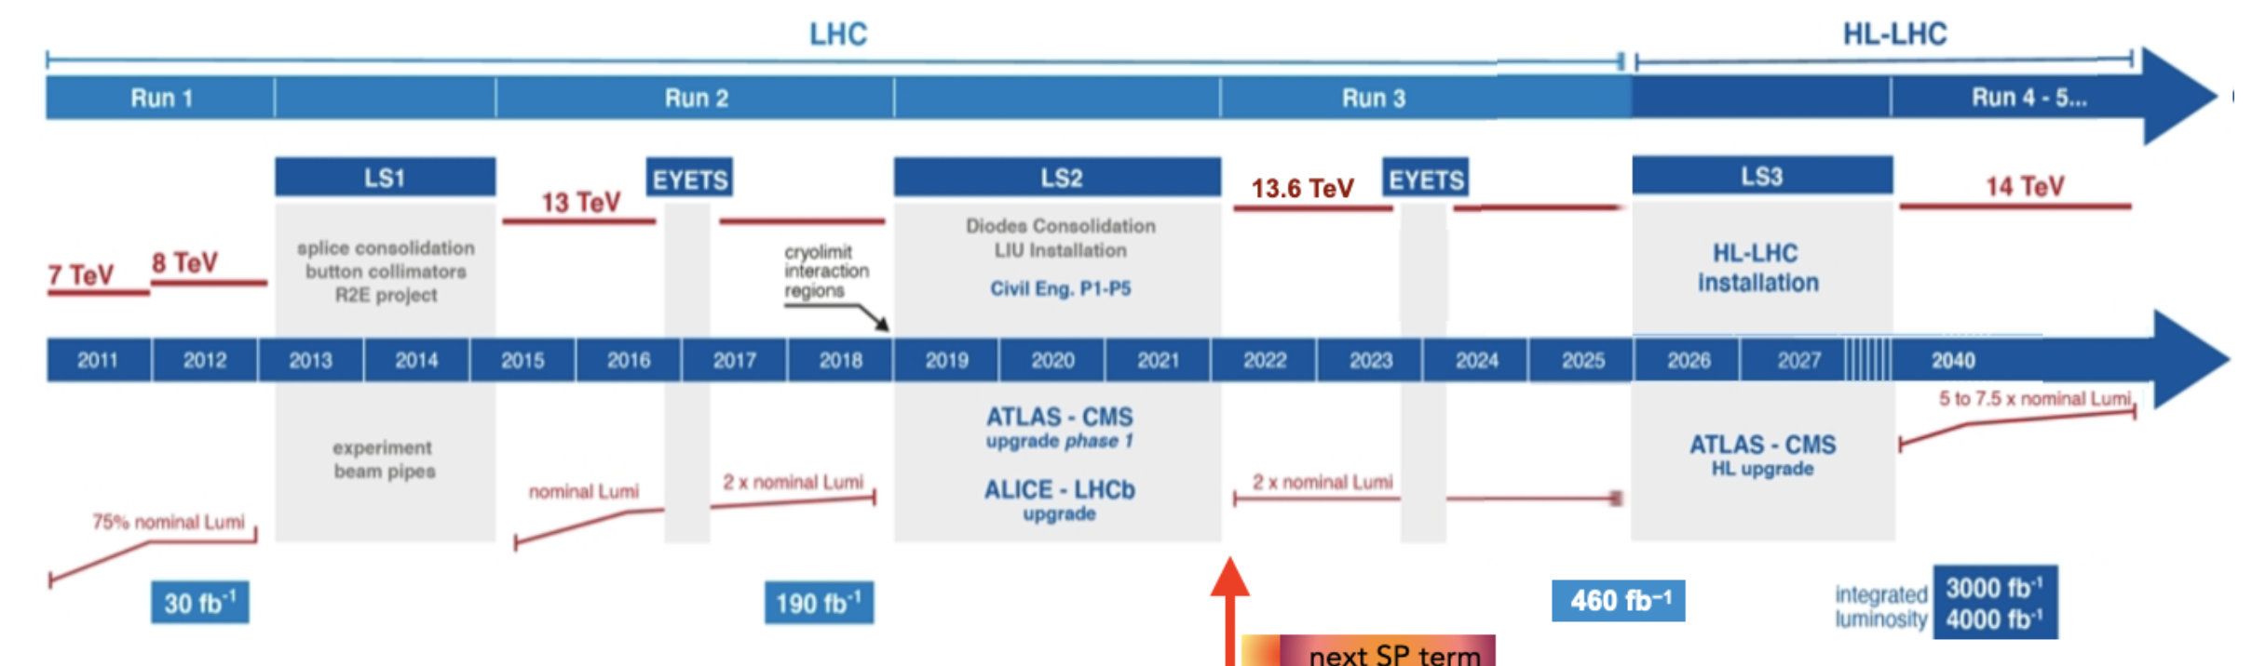
LHC and Run 3
Run 3 (2022-2025)
  More than double dataset 190 + 270 fb⁻¹
  Energy 13.6 TeV slightly higher
  Good detector performance enables sophisticated analysis techniques
  Perfect time for PhD to get most from Phase I data

Slide 8
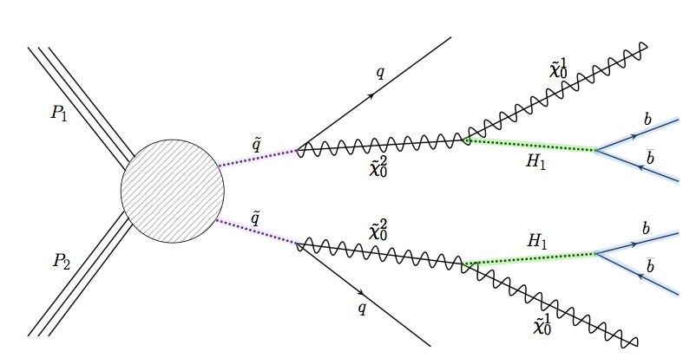
Physics Analyses
Fat Jet
Fat Jet
NMSSM Light Higgs – 7 Higgs bosons – found one so far ☺
This analysis would be the evidence of SUSY in this scenario
Particular feature no observable missing energy
“Fat jets” & double b-tagging. Use neural nets.
Initial analysis good. (Paper imminent). Will develop scenarios with theorists.

Slide 9
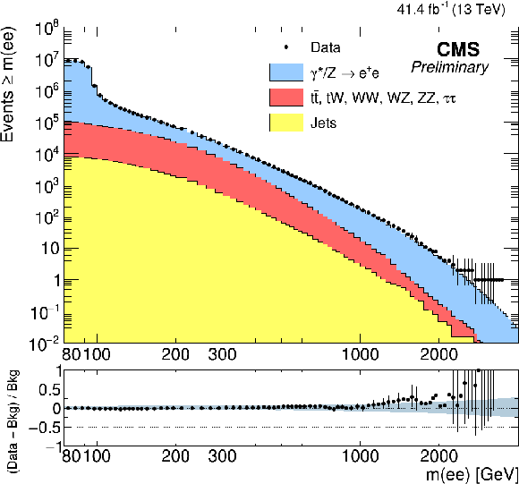
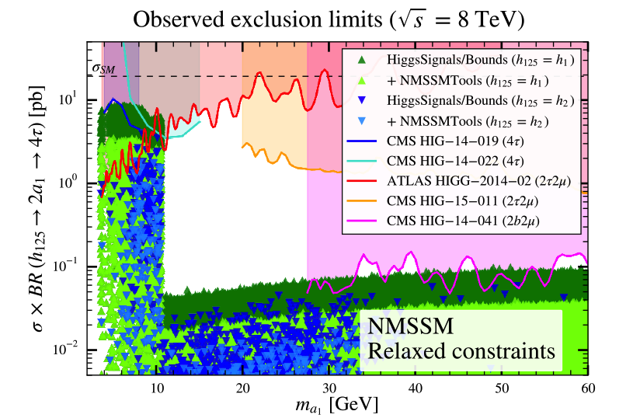
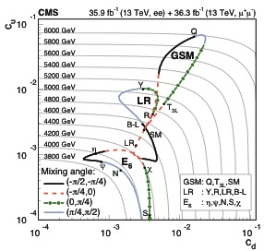
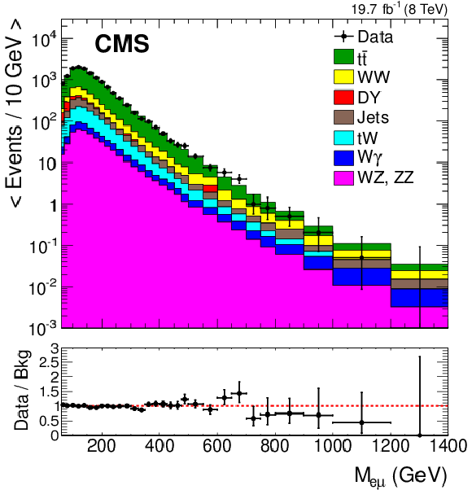
Past Physics Analyses & Phenomenology
Z’ search a long standing analysis. High energy electrons and HLT
Exploit eμ for QBH search
Boosted Z

Slide 10
HL-LHC Upgrades

Slide 11
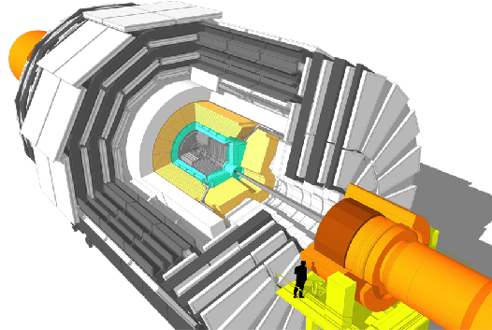
Upgrade of CMS for HL-LHC
L1-Trigger/HLT/DAQ
https://cds.cern.ch/record/2714892
https://cds.cern.ch/record/2283193
Tracks in L1-Trigger at 40 MHz
PFlow selection 750 kHz L1 output
HLT output 7.5 kHz
40 MHz data scouting
Barrel Calorimeters
https://cds.cern.ch/record/2283187
ECAL crystal granularity readout at 40 MHz with precise timing for e/γ at 30 GeV
ECAL and HCAL new Back-End boards
Muon systems
https://cds.cern.ch/record/2283189
DT & CSC new FE/BE readout
RPC back-end electronics
New GEM/RPC 1.6 < η < 2.4
Extended coverage to η ≃ 3
Calorimeter Endcap
https://cds.cern.ch/record/2293646
3D showers and precise timing
Si, Scint+SiPM in Pb/W-SS
Beam Radiation Instr. and Luminosity
http://cds.cern.ch/record/002706512
Bunch-by-bunch luminosity measurement: 1% offline, 2% online
Tracker https://cds.cern.ch/record/2272264
Si-Strip and Pixels increased granularity
Design for tracking in L1-Trigger
Extended coverage to η ≃ 3.8
MIP Timing Detector
https://cds.cern.ch/record/2667167
Precision timing with:
  Barrel layer: Crystals + SiPMs
  Endcap layer: Low Gain Avalanche Diodes

Slide 12
Upgrade of CMS for HL-LHC
L1-Trigger/HLT/DAQ
https://cds.cern.ch/record/2714892
https://cds.cern.ch/record/2283193
Tracks in L1-Trigger at 40 MHz
PFlow selection 750 kHz L1 output
HLT output 7.5 kHz
40 MHz data scouting
Barrel Calorimeters
https://cds.cern.ch/record/2283187
ECAL crystal granularity readout at 40 MHz with precise timing for e/γ at 30 GeV
ECAL and HCAL new Back-End boards
Muon systems
https://cds.cern.ch/record/2283189
DT & CSC new FE/BE readout
RPC back-end electronics
New GEM/RPC 1.6 < η < 2.4
Extended coverage to η ≃ 3
Calorimeter Endcap
https://cds.cern.ch/record/2293646
3D showers and precise timing
Si, Scint+SiPM in Pb/W-SS
Beam Radiation Instr. and Luminosity
http://cds.cern.ch/record/002706512
Bunch-by-bunch luminosity measurement: 1% offline, 2% online
Tracker https://cds.cern.ch/record/2272264
Si-Strip and Pixels increased granularity
Design for tracking in L1-Trigger
Extended coverage to η ≃ 3.8
MIP Timing Detector
https://cds.cern.ch/record/2667167
Precision timing with:
  Barrel layer: Crystals + SiPMs
  Endcap layer: Low Gain Avalanche Diodes

Slide 13
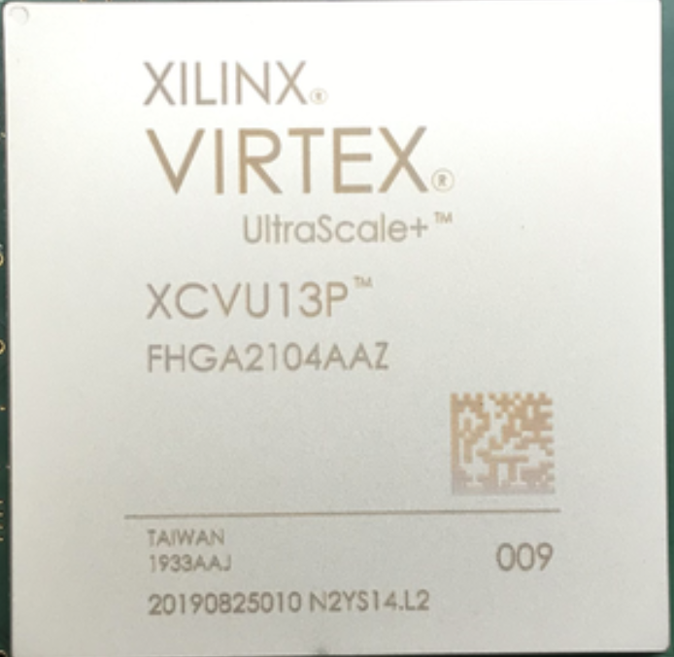
Upgrade of CMS for HL-LHC
L1-Trigger/HLT/DAQ
https://cds.cern.ch/record/2714892
https://cds.cern.ch/record/2283193
Tracks in L1-Trigger at 40 MHz
PFlow selection 750 kHz L1 output
HLT output 7.5 kHz
40 MHz data scouting
Barrel Calorimeters
https://cds.cern.ch/record/2283187
ECAL crystal granularity readout at 40 MHz with precise timing for e/γ at 30 GeV
ECAL and HCAL new Back-End boards
Muon systems
https://cds.cern.ch/record/2283189
DT & CSC new FE/BE readout
RPC back-end electronics
New GEM/RPC 1.6 < η < 2.4
Extended coverage to η ≃ 3
Calorimeter Endcap
https://cds.cern.ch/record/2293646
3D showers and precise timing
Si, Scint+SiPM in Pb/W-SS
Beam Radiation Instr. and Luminosity
http://cds.cern.ch/record/002706512
Bunch-by-bunch luminosity measurement: 1% offline, 2% online
Tracker https://cds.cern.ch/record/2272264
Si-Strip and Pixels increased granularity
Design for tracking in L1-Trigger
Extended coverage to η ≃ 3.8
MIP Timing Detector
https://cds.cern.ch/record/2667167
Precision timing with:
  Barrel layer: Crystals + SiPMs
  Endcap layer: Low Gain Avalanche Diodes

Slide 14
Electromagnetic Calorimeter

Slide 15
ECAL
PPD responsible for design, delivery, installation, operation.

Slide 16
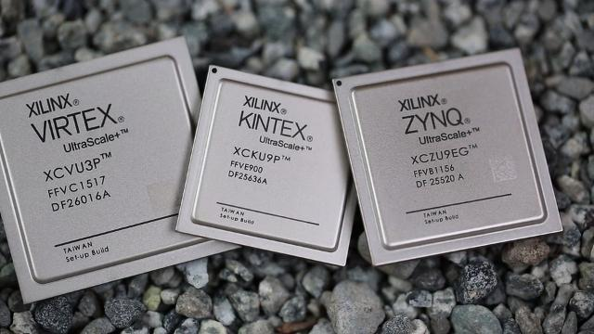
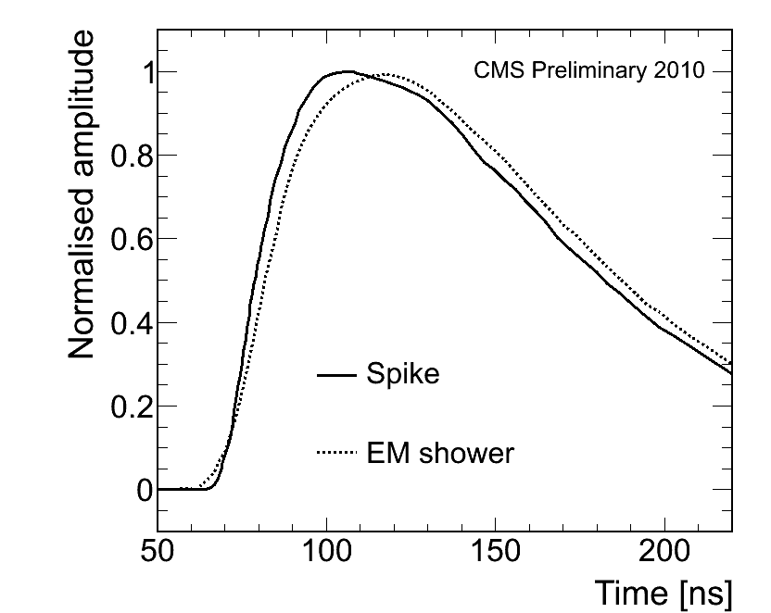
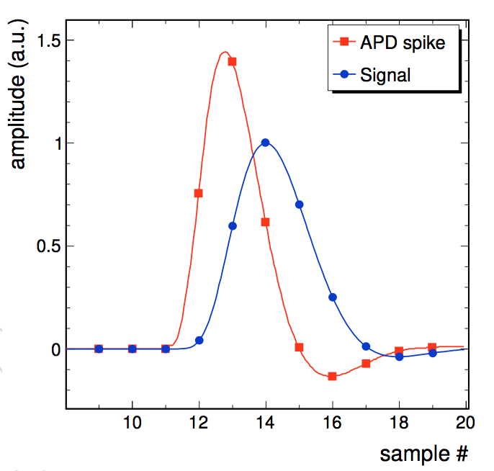
ECAL – HL-LHC
Current
Upgrade
APD
Much better “spike” rejection

Slide 17
Track Finder

Slide 18
Track Finder
Silicon tracker to be completely replaced for HL-LHC
Enables track finding at in Level 1 trigger.
Completely new capability

Slide 19
Level 1 Trigger

Slide 20
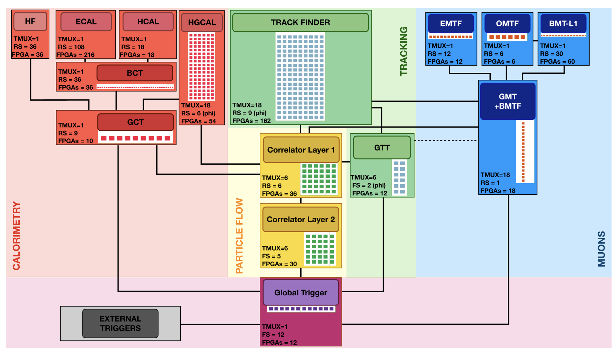
L1 Trigger – Bringing all together
ECAL
Tracker
Complex system of fast electronics

Slide 21
L1 Trigger – Bringing all together
Bringing offline online
All information from the detectors brought together in the Level 1 trigger.
Level 1 Trigger constructs elements for making the trigger decision
  Jets, electrons, photons, muons, missing energy
  Dealing with ~200 interactions a major challenge
  Sophisticated jet reconstruction possible.
Tracks available for the first time
Tracks alone can give interaction point
Track jets new concept

Slide 22
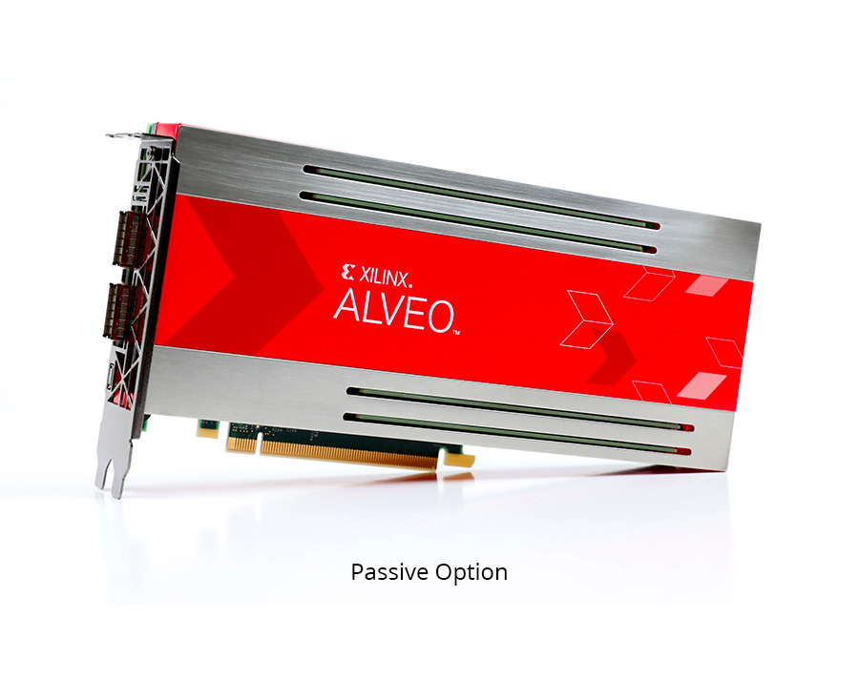
Use of FPGAs
Algorithms implemented in FPGAs
New tools (HLS) making this easier
FPGAs are evolving as accelerators in heterogenous computing systems. Opportunity during studentship

Slide 23
Project
Project will encompass:
BSM physics analysis focusing on more realistic models beyond MSSM.
Explore potential of NMSSM with enlarged Higgs sector.
Develop complex jet reconstruction and tagging. Exploit ML techniques
Develop algorithms for the HL-LHC upgrade of the L1 trigger. Exploit new structure concept and tracks never before available.
Challenge of reconstruction of jets online.
Make use of the information provided by other areas of group
Flexible project will be tuned to suit student selected
Supervisors: Prof. Claire Shepherd-Themistocleous, Dr. Henning Flaecher (Bristol)

