Slide 1
Exotic particle searches with ATLAS Run 3 data and preparing Tracking software for High Luminosity LHC
Tim Adye, Tracey Berry

Slide 2
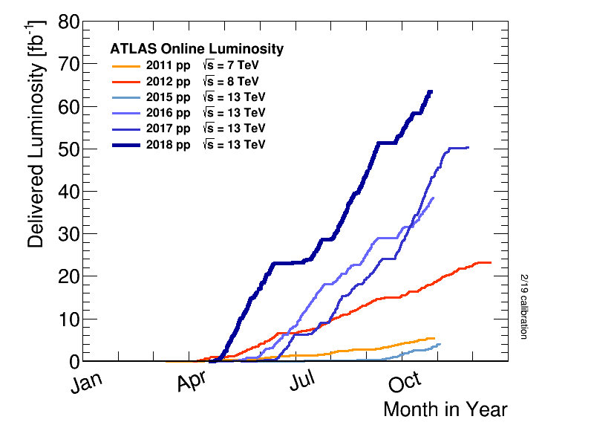
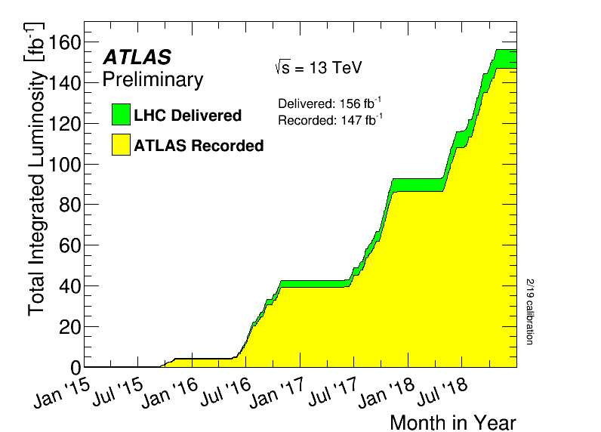
Large Hadron Collider
Runs 1–2
LHC first started serious data taking in 2011
​Run 1, ran at up to 75% nominal luminosity, culminated in discovery of Higgs boson
LHC Run 2 finished at end of 2018
Reached 2 times nominal luminosity, delivered over 5 times data of Run 1
Now completing Long Shutdown 2 for upgrade for Run 3 (2022-2026)
Machine consolidation, Phase-I upgrades to ATLAS
Long Shutdown 3 starting in 2026 for upgrade to HL-LHC
​Phase-II upgrades to ATLAS for 5–7 times nominal luminosity in Run 4 (from 2028).
Run 2

Slide 3
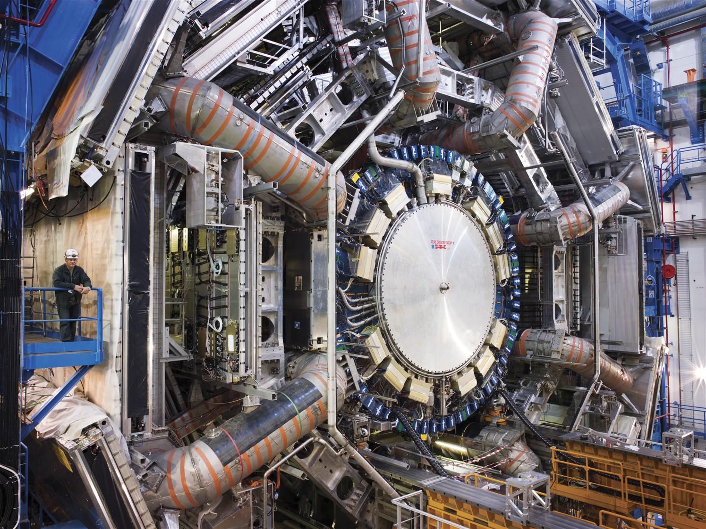
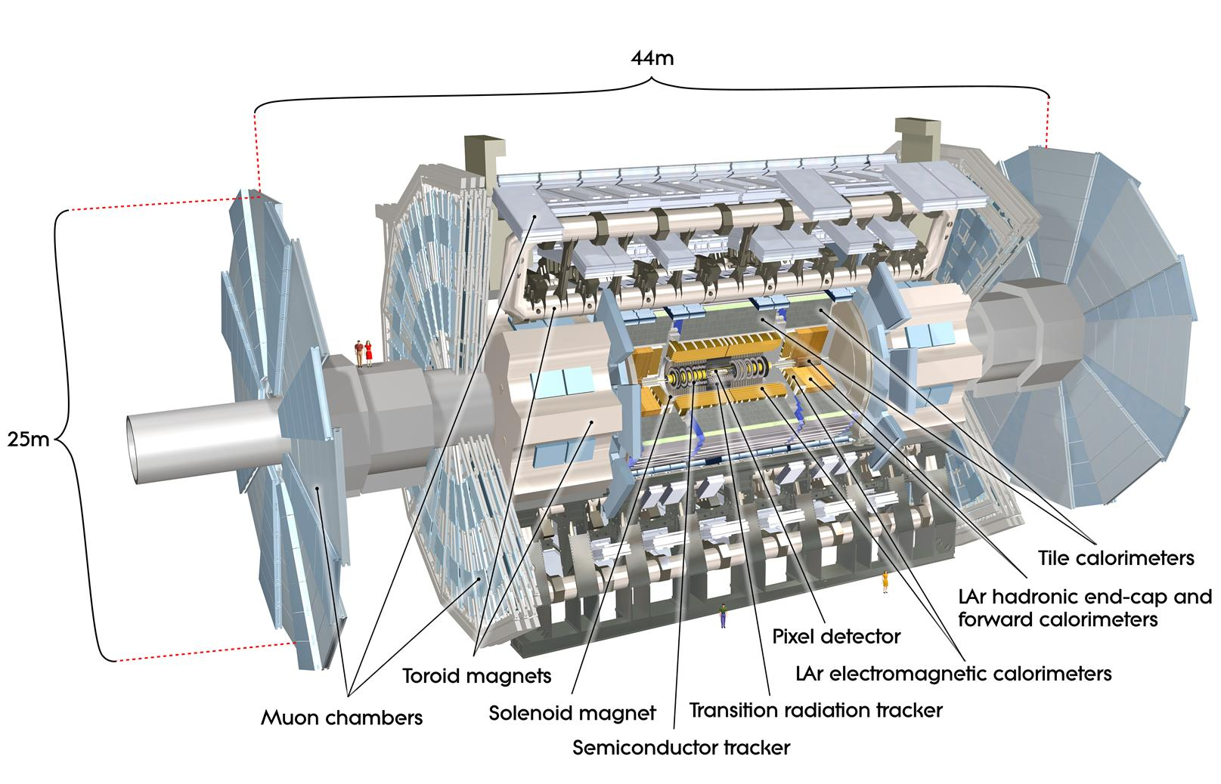
ATLAS
One of two general purpose detectors at the Large Hadron Collider
Different subsystems in layers around collision point to record: trajectory, momentum and energy of particles

Slide 4
ATLAS Collaboration
Worldwide effort
Beyond the scientific authorship, significant engineering effort: ~1000 people

Slide 5
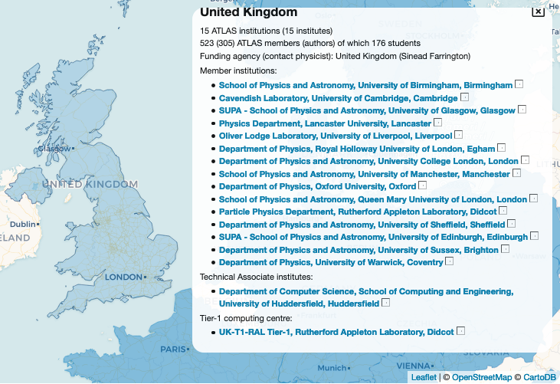
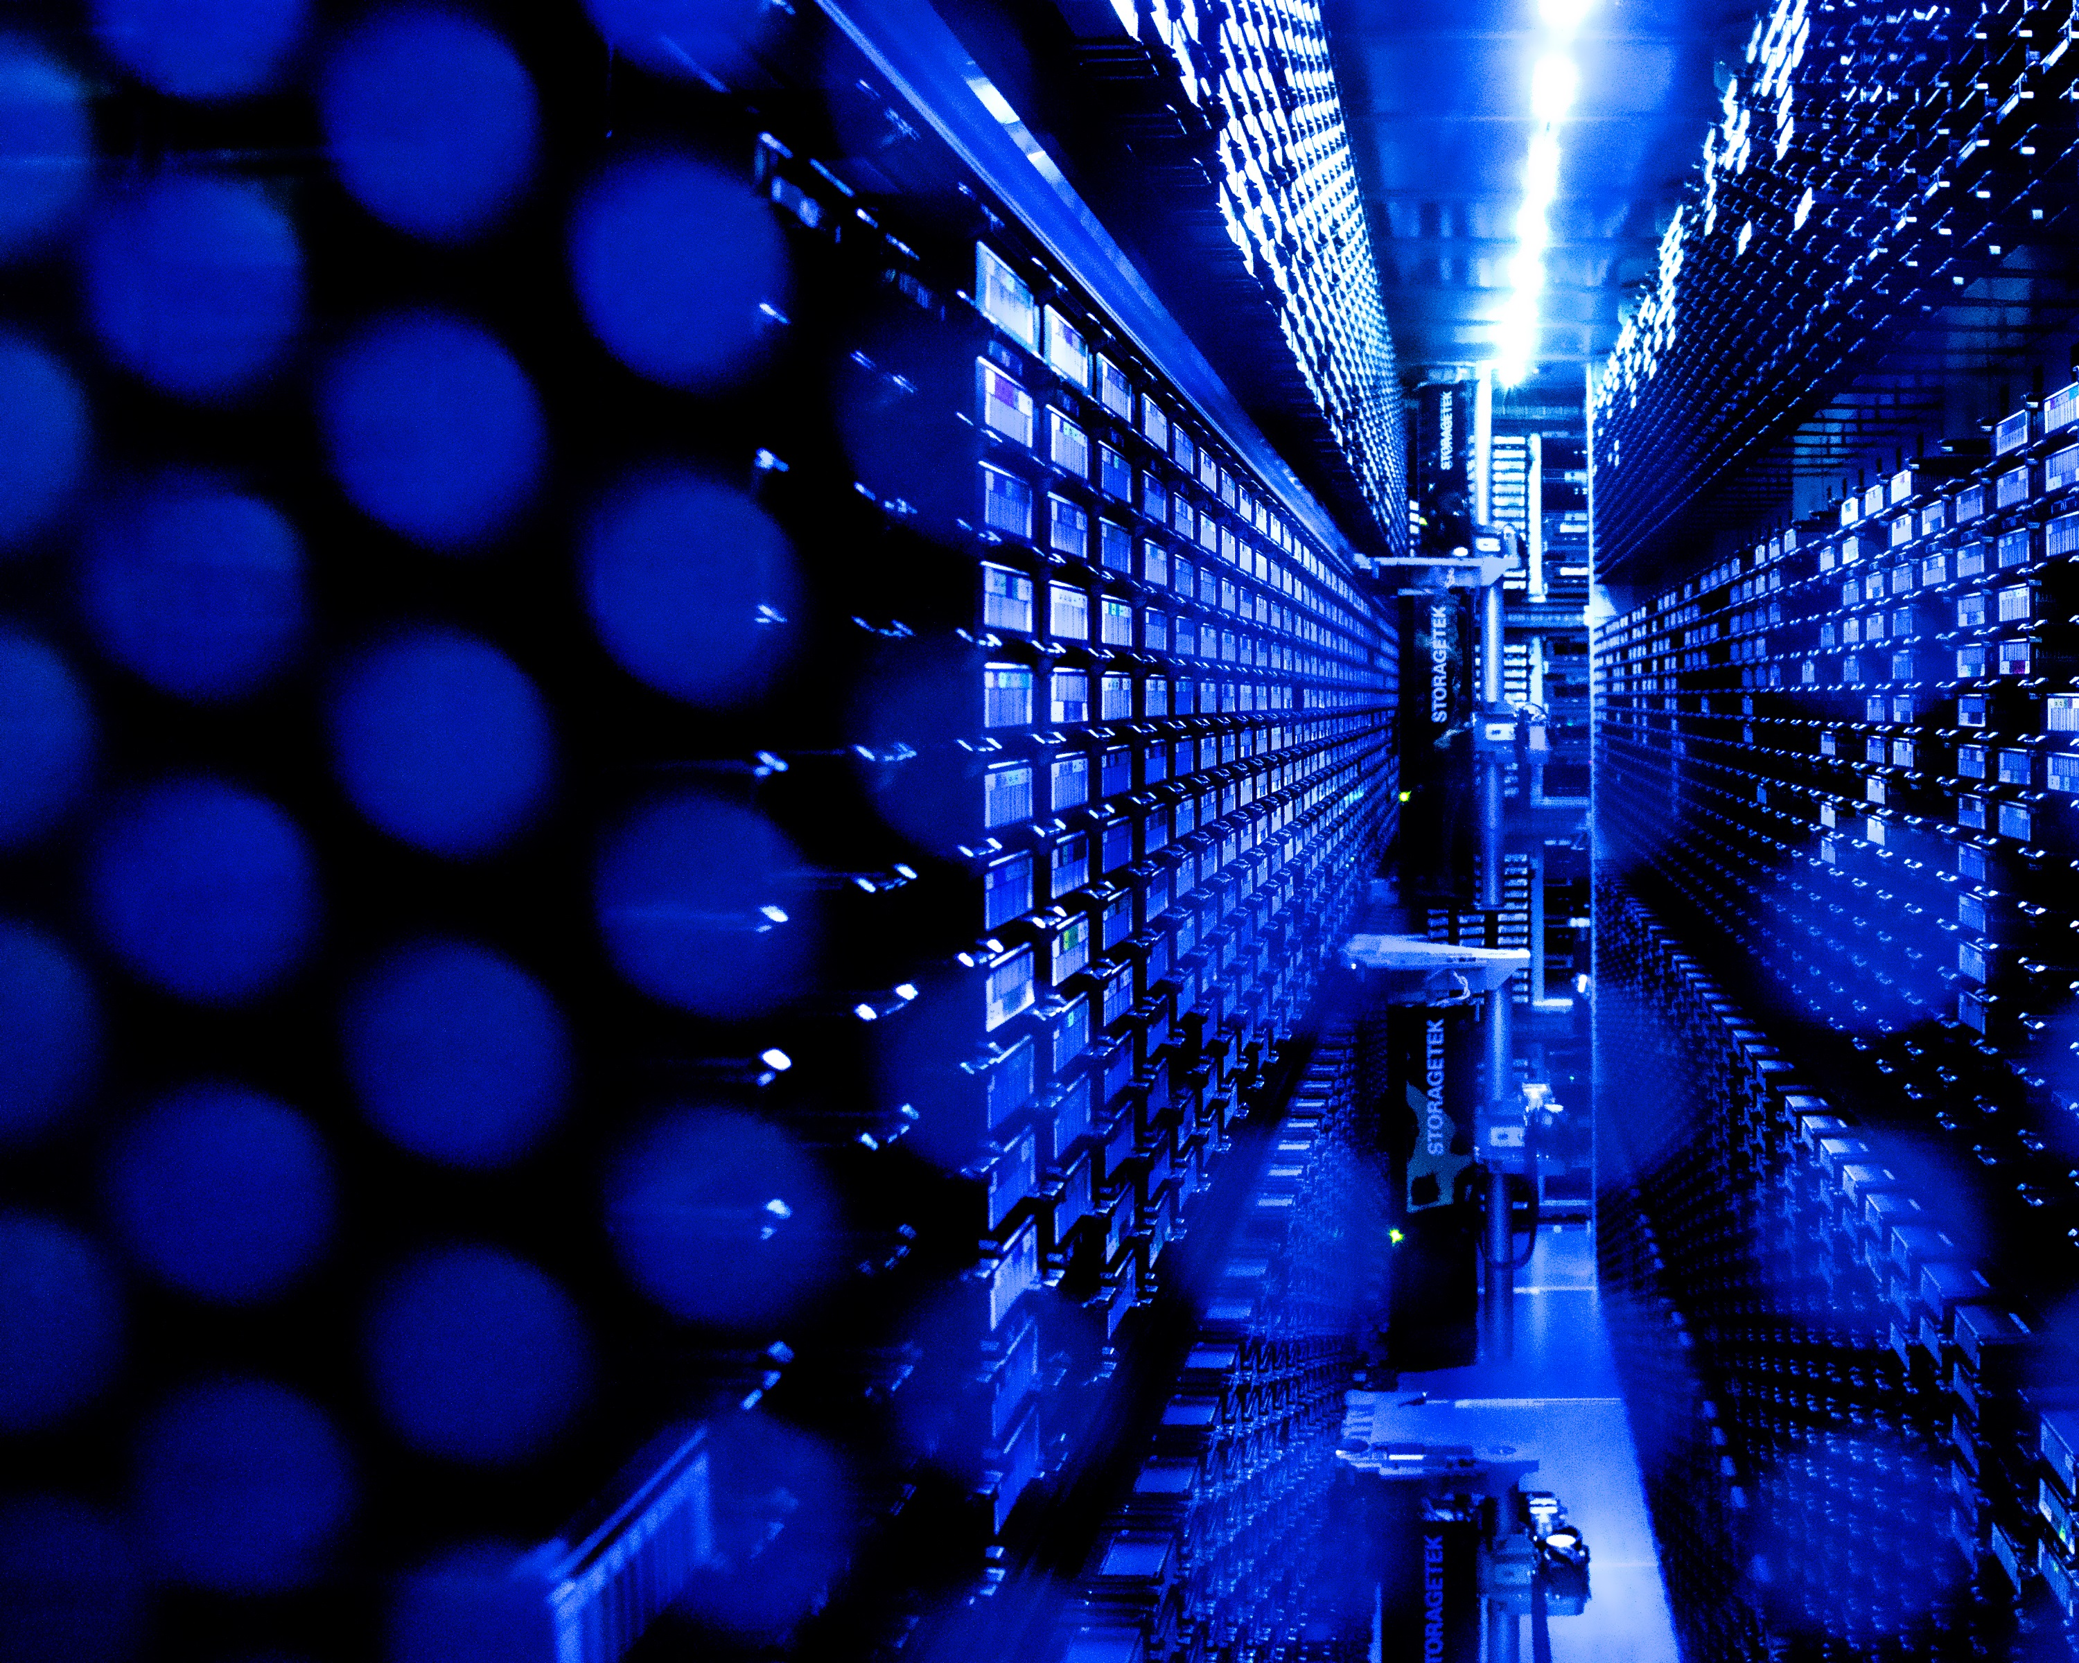
ATLAS UK
14 universities + RAL PPD
PPD has good links with all ATLAS UK universities
RAL also hosts the UK Tier-1 computing centre
Dedicated internet link to CERN
Complete copy of LHC raw data

Slide 6
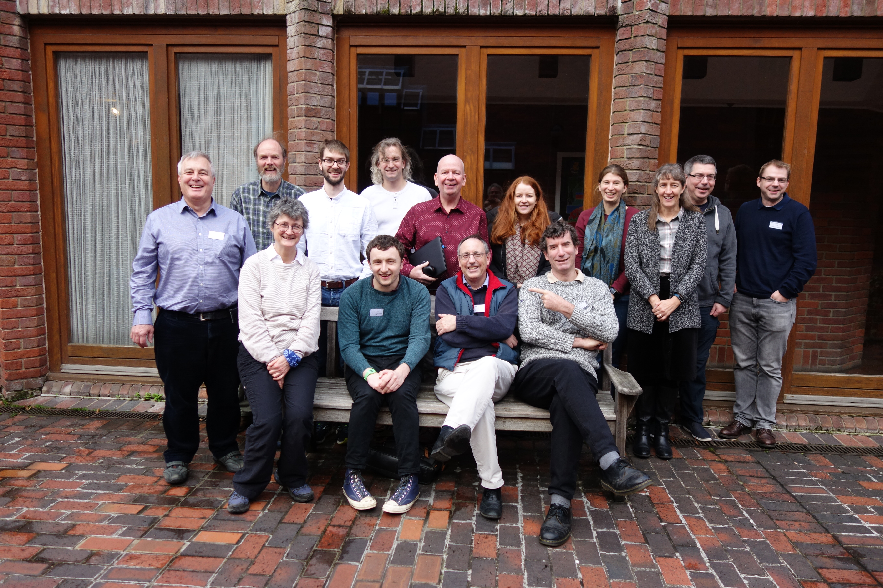
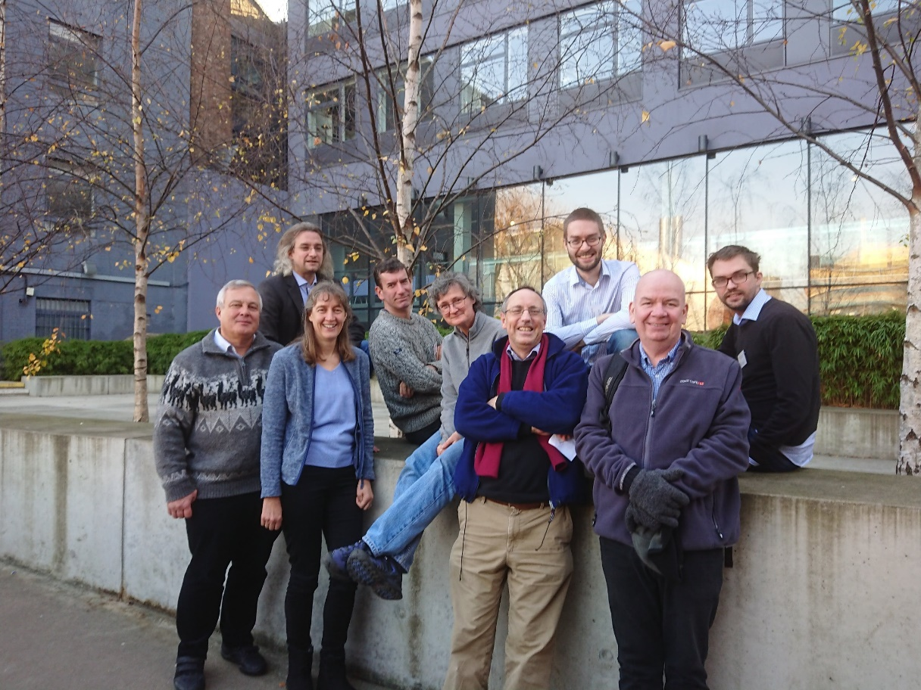
RAL ATLAS group
​21 staff (physicists, engineers)
​3 PhD students (with Glasgow, Warwick, Birmingham)
soon to be 5!
Photos not comprehensive
Notes:
Monika, Julie, Stewart supervising current students: Gareth, Eva, Elliot
Ben and Tim will supervise this year’s students

Slide 7
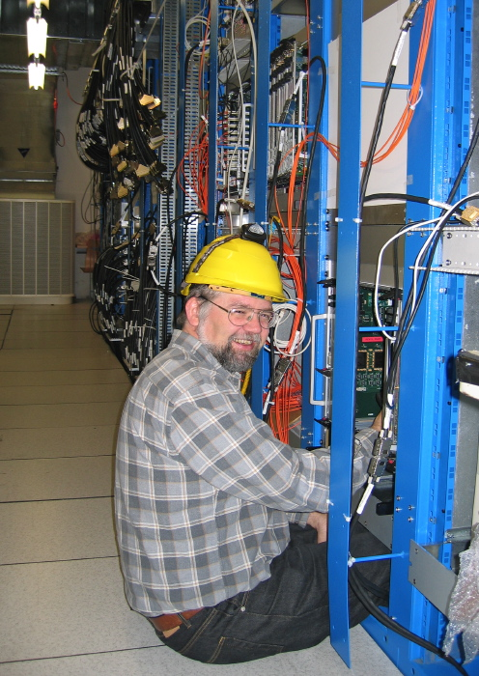
RAL activities
Built and operated SemiConductor Tracker and trigger systems in Run 1 and 2
Phase-I upgrades: now being installed for Run 3
​Level-1 Calorimeter Trigger and High Level Trigger
Phase-II upgrades: installation in 2026-8 for Run 4
​Level-0 Global Trigger, Event Filter and new Inner Tracker (ITk)
Diverse physics involvement:
Higgs, searches for new heavy bosons, B-physics

Slide 8
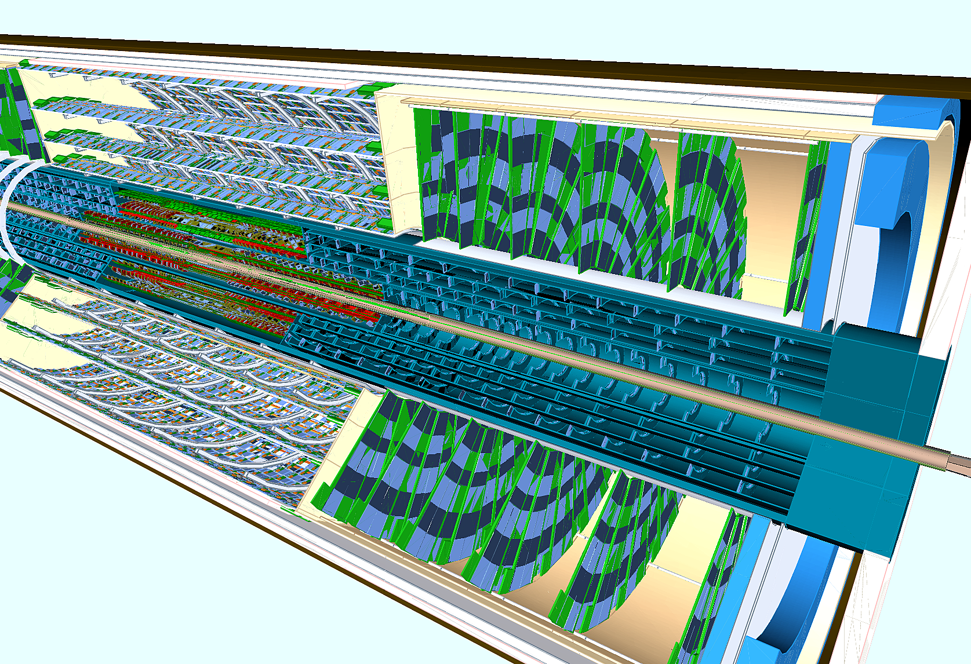
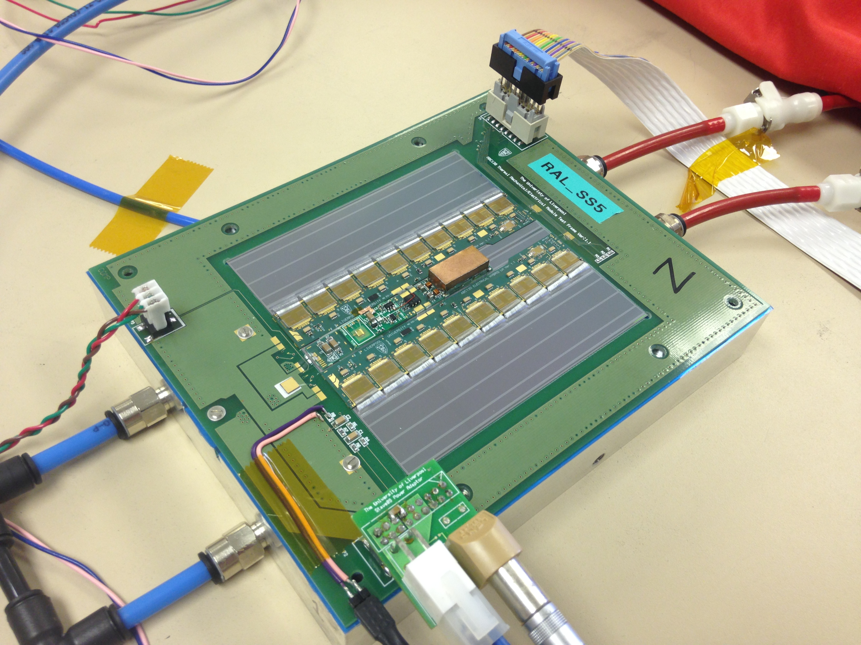
ITk (see Ben’s talk)
​Inner Tracker is a new all-silicon detector for ATLAS
will replace the current Inner Detector, when it reaches its end of life in 2026
RAL group working on barrel strips, endcap pixels, and overall reconstruction software
Design, data acquisition, assembly and eventually operation

Slide 9
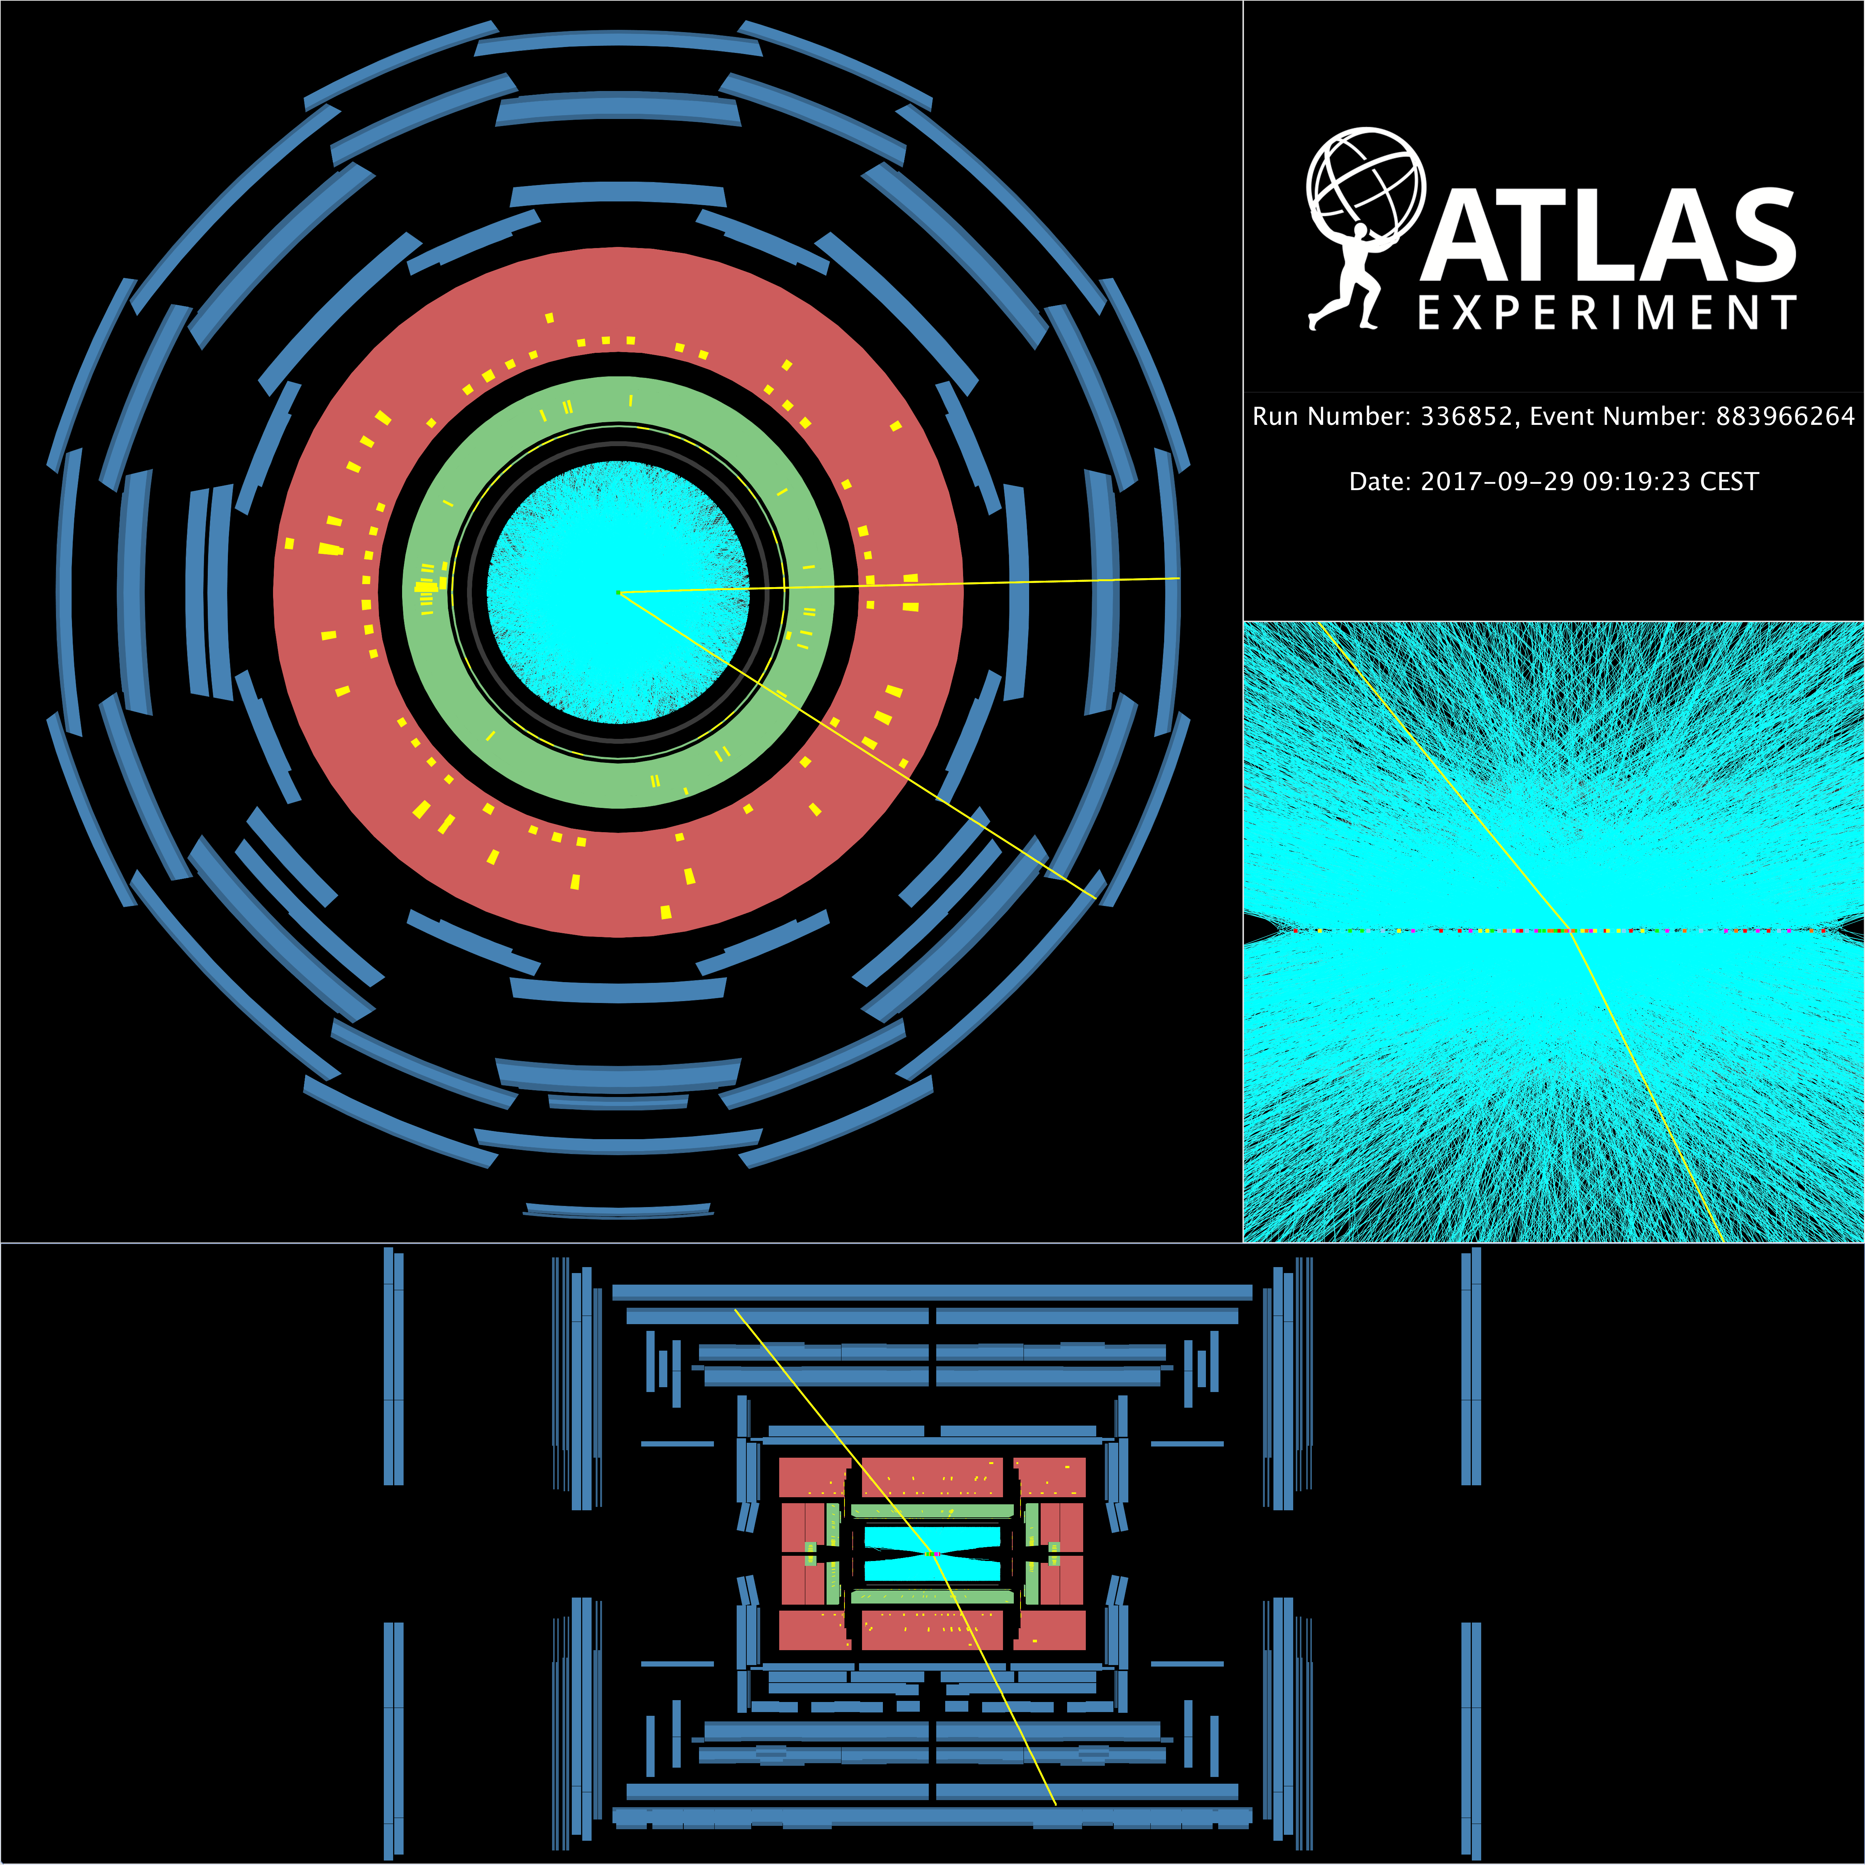
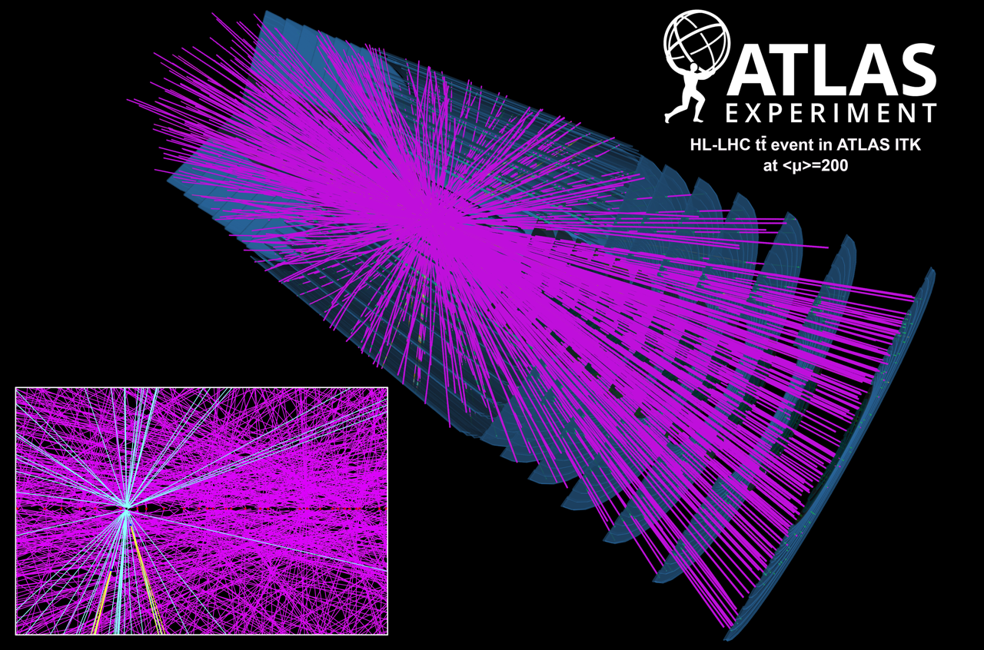
Wealth of ATLAS data
In Runs 2 and 3, LHC collides bunched beams of protons 40 million times per second
Every time the bunches cross, multiple protons collide
Typical “pile-up” of 35, but can be much more
e.g. real example from 2016 with 85 collisions
In Run 4, expect an average of 200 collisions each time bunches cross
Interesting collisions at much much lower rate
1 Higgs boson per 10 billion collisions, some processes only a few collisions per year ($N=σL$)
We want just the interesting collisions sitting in a sea of “pileup” collisions

Slide 10
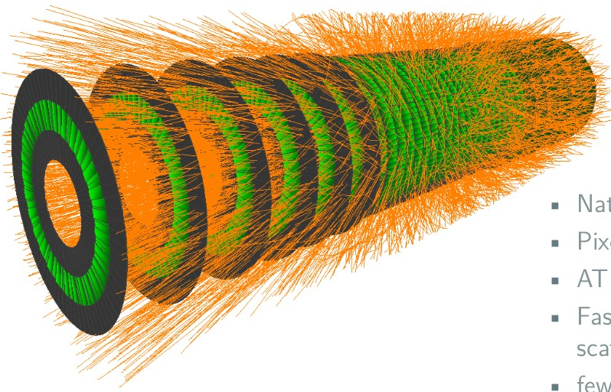
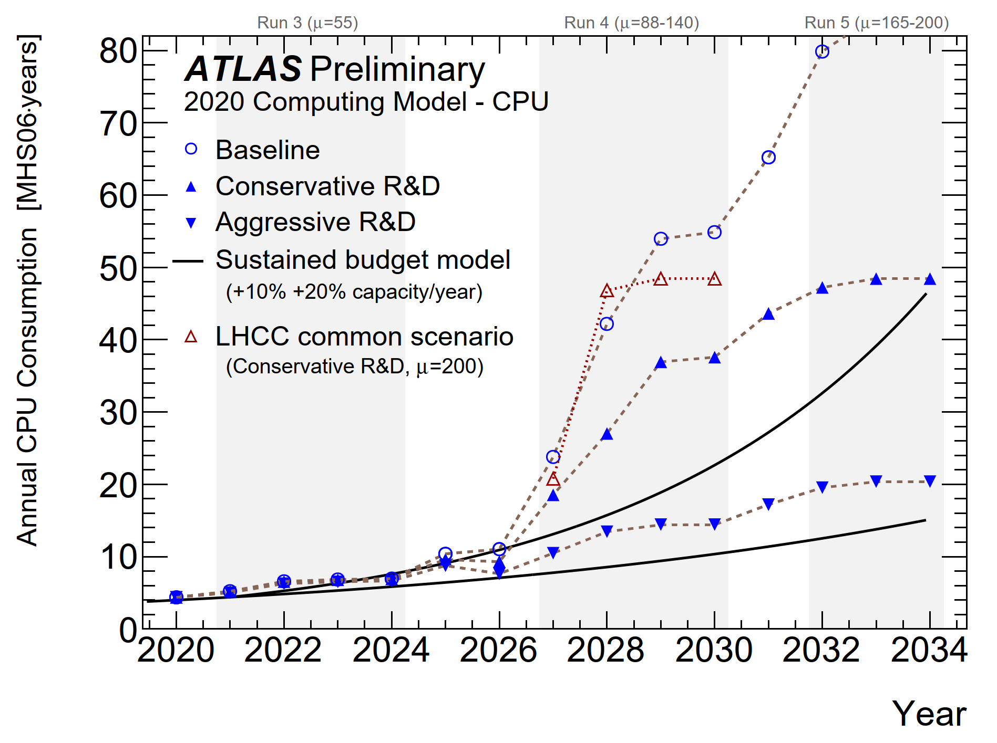
ATLAS Track Reconstruction for the HL-LHC
Once upgraded, ATLAS will read out ~300,000 measurements for each event
Need to identify and reconstruct the trajectories of ~4000 charged particles from this data
The High-Level Trigger needs to do this at an event rate of 1 MHz to select events of interest, writing them out at 10 kHz
Use an online farm, expanded from the current 60,000 CPUs
Maybe accelerated with GPUs or FPGAs
​Full/detailed reconstruction performed on the events selected by the Trigger
Even with the World-wide LHC Computing Grid, this will be challenging

Slide 11
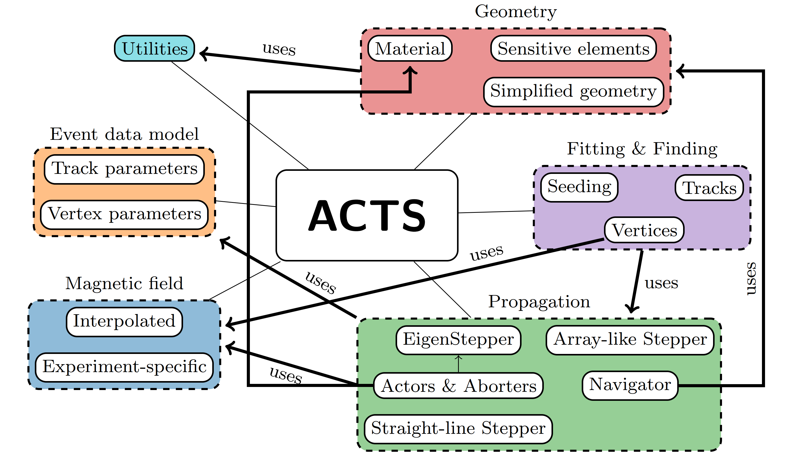
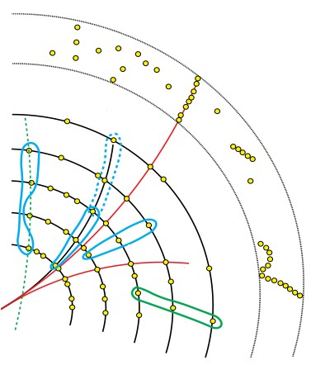
Improved track reconstruction for Run 4
We need aggressive R&D to handle the data volume from the new ITk detector
The ATLAS track reconstruction software is being rewritten
based on the Open Source ACTS project [1]
improved algorithms
modern software engineering practices
explicitly designed for multi-threaded and GPU applications
takes advantage of cross-experiment Machine Learning developments
[1] https://arxiv.org/abs/2106.13593

Slide 12
The RHUL Group
Group of 12 academics, 5 engineers/technical support staff, 14 postdoctoral researches and 23 postgraduate students
Active in many of the world-leading particle physics activities:
ATLAS on the LHC 5 academics
(Exotics, Higgs, Statistics, Top)
Particle Astrophysics 3 academics
(DM, neutrino and gravitational waves)
Accelerator Science 3 academics
(John Adams Institute, beams diagnostics for LHC upgrades and future accelerators)
Theory 2 academics
(LHC phenomenology, Dark Matter)
On ATLAS: Exotics, Higgs, Statistics, Top. Involved in the electronics of the data acquisition system trigger (experiment, upgrade and physics), computing

Slide 13
Why perform (Exotics) Dilepton Searches?
History of discovery: confirming Standard Model (SM)
The SM is extremely successful, but it leaves many questions unanswered.
????
Hierarchy problem (EW << Planck Scale)
Gravity is not included
Are quarks and leptons fundamental particles (contact interactions)?
Why is only 5 % of matter made of ordinary SM particles? – What is dark matter?
All can be investigated in the dilepton channels!
Resonant bumps
Non-resonant excesses
Or wiggles!

Slide 14
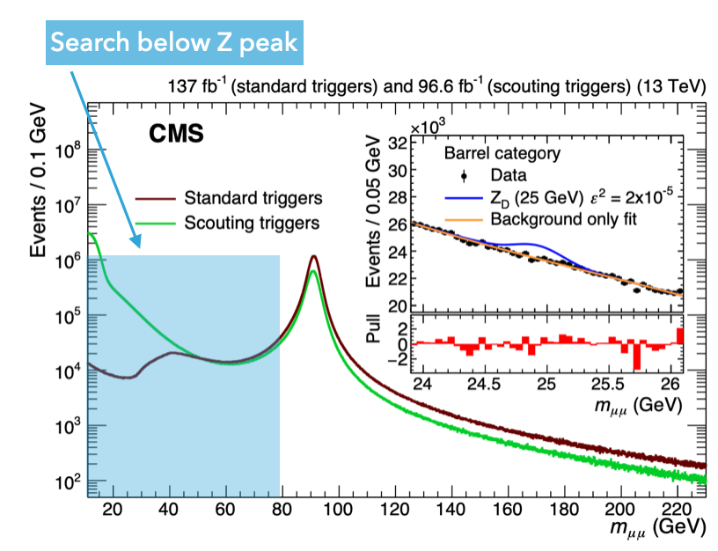
What is a Trigger Level Analysis (TLA)?
To search at low invariant mass:
Lots of SM backgrounds
Can’t keep all data on tape
Have limited dataset size can store
TLA:
Rather than writing out full data for a few events
Keep less data for more events
Run 2 ATLAS dijet TLA search
No Run 1 or 2 dilepton TLA
** NEW for Run 3!

Slide 15
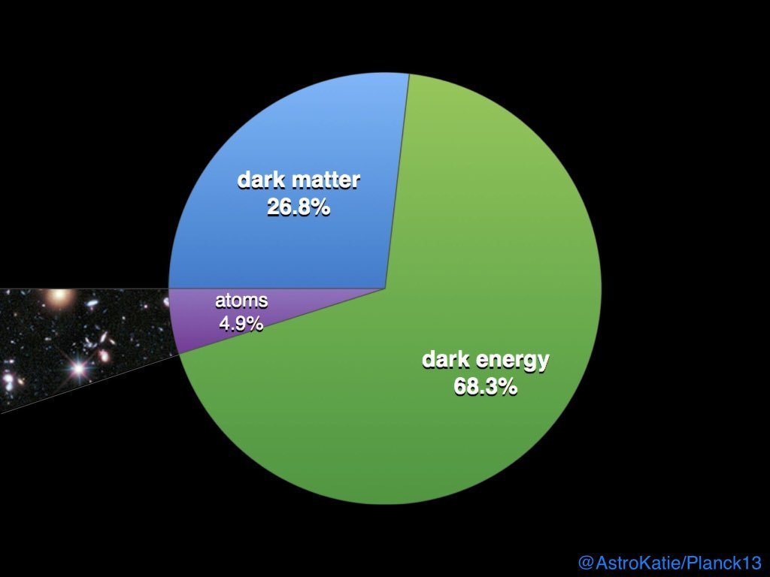
What can you search for using a TLA?
Enables search for low mass resonances
e.g. dark photons!
Ordinary Photons: A with coupling e
Dark Photons: A’ with coupling e’
Parameters: mixing ε
mass m_{A’} of dark photon
v
https://arxiv.org/pdf/2005.01515.pdf
https://arxiv.org/abs/1912.04776

Slide 16
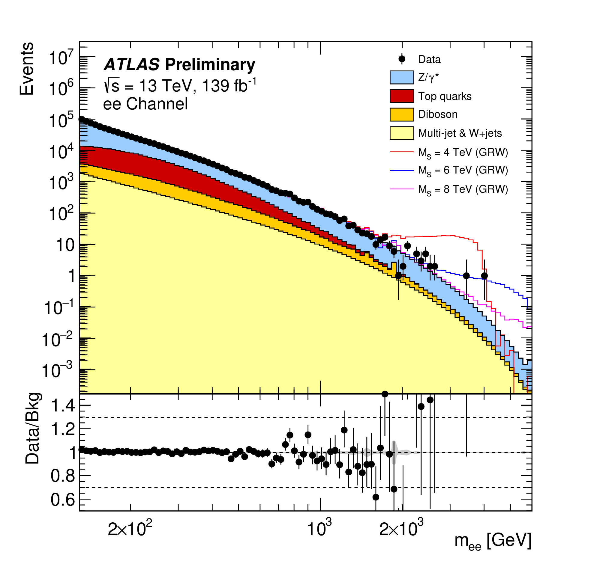
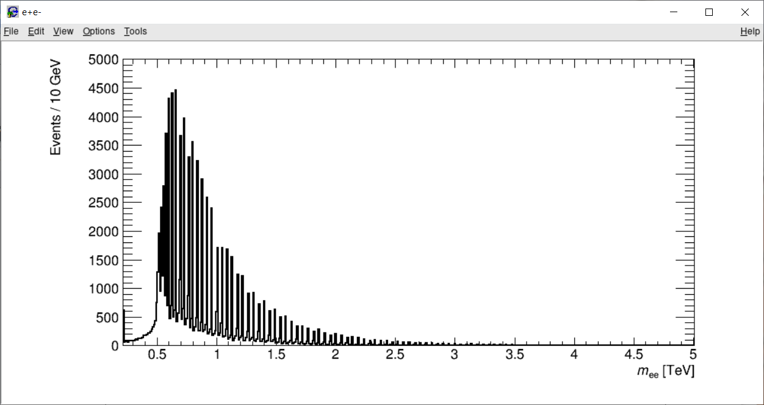
Exotics physics at RHUL
Nice group of people:
Exotics (1 academic + 1 post-doc + 1 PhD student + 1 PhD (2022 start))
Statistics (1 academic + 2 PhD students)
Large
Extra Dimensions
Clockwork Extra Dimension Search
TLA Dark Matter Software & Studies
Precise PhD analysis project flexible at this point
also allows to see how LHC schedule develops
https://www.epj-conferences.org/articles/epjconf/pdf/2016/25/epjconf_meson2016_01005.pdf

Slide 17
Studentship outline
Start at RHUL (~6 months)
Academic lecture and computing courses
Start work on HLT/tracking software – gain familiarity with project
Some time at RAL, then 12 months at CERN
Hands-on experience commissioning/operating HLT system during Run 3
control room shifts, expert on-call support
Join physics analysis group, foundation for physics analysis component of thesis
Return to RAL/RHUL
Finish physics analysis, write thesis

Slide 18
Thanks for listening! Any Questions?

Slide 19
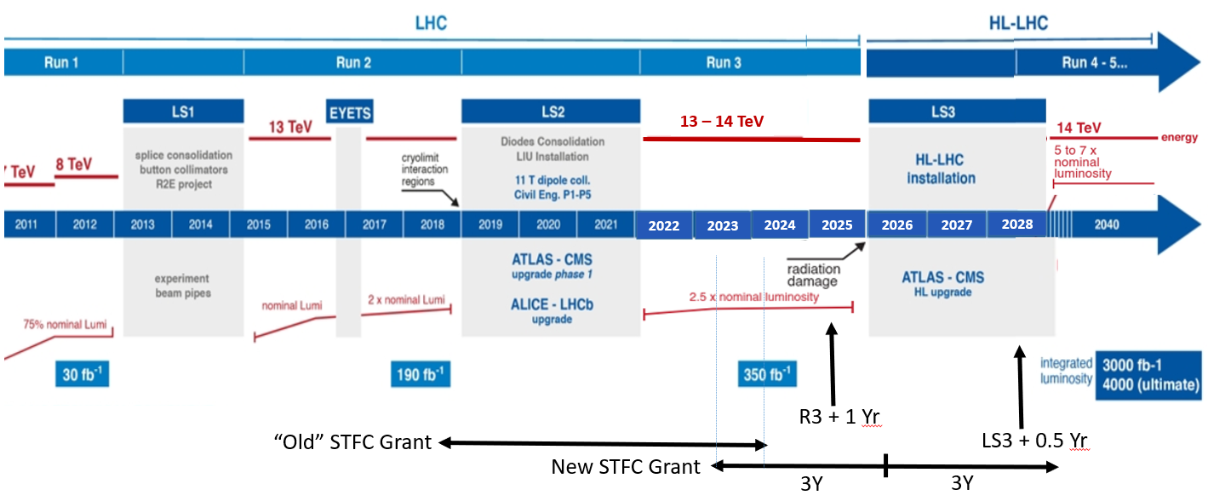
The Future… Run 3
Look forward to more data to come in 2022 with Run 3…

Slide 20
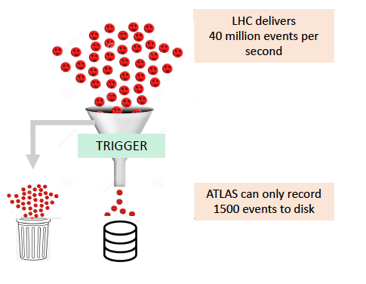
ATLAS Trigger
If we stored all the data that ATLAS generates from collisions, we would use every hard drive in the world within weeks
Store only the interesting collisions (1500/s)
Still record the equivalent of full Netflix catalogue every year
Use dedicated hardware (Level 1 Trigger) and 60,000 CPUs (High Level Trigger)

Slide 21
ATLAS High Level Trigger
During LS2 rewrote entire trigger code (nearly 1M lines of C++ and Python) to enable multi-threading and improve the selection algorithms
RAL interests:
Tracking – using machine learning techniques to find tracks quickly and efficiently
Core trigger software – flow of events/algorithms, control room tools, analysis tools, etc.
Validation of trigger software – are we finding the events we want efficiently? Resource usage – memory and CPU time?
Beyond CPUs: GPUs and FPGAs for Run 4

Slide 22
Testing the SM of Particle Physics & beyond!
In ee/μμ data can look for:
resonances or excesses
DM γ,
Z’,
RS G
ADD G, Contact Interactions (CI)
or
wiggles!
Clockwork ED

Slide 23
RHUL Leadership and Long-term Involvement in High Mass Dilepton Searches
Run 1 & Run 2 ee/μμ data has been used to search for
Resonant new physics
Spin 1 Z’
Spin 2 RS Gravitons
Non-resonant new physics
Contact Interactions
ADD (large extra dimensions)
Z’/G

Slide 24
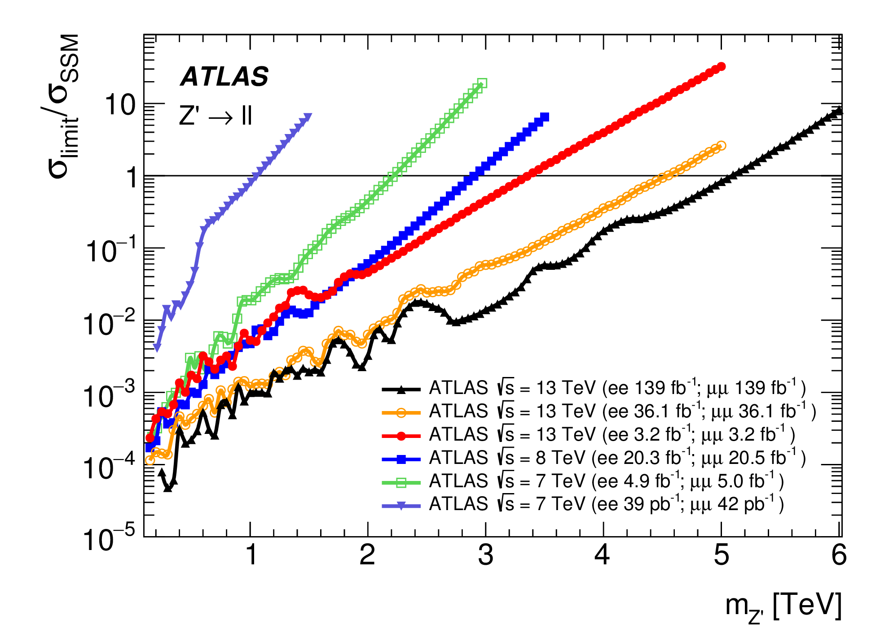
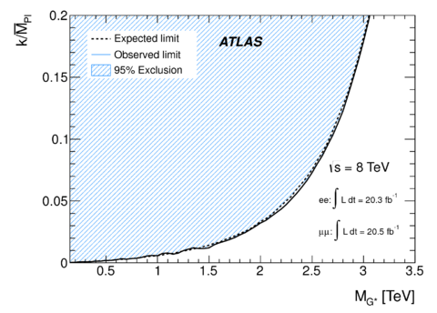
Resonant Dilepton Searches
Resonant new physics
Spin 1 Z’ Spin 2 RS Gravitons
Z’/G
extra dimensions
5.1 TeV
Plot made by RHUL
Phys. Lett. B 796 (2019) 68
Phys. Rev. D. 90, 052005 (2014)
JHEP 11 (2020) 005
DOI: 10.1007/JHEP11(2020)005

Slide 25
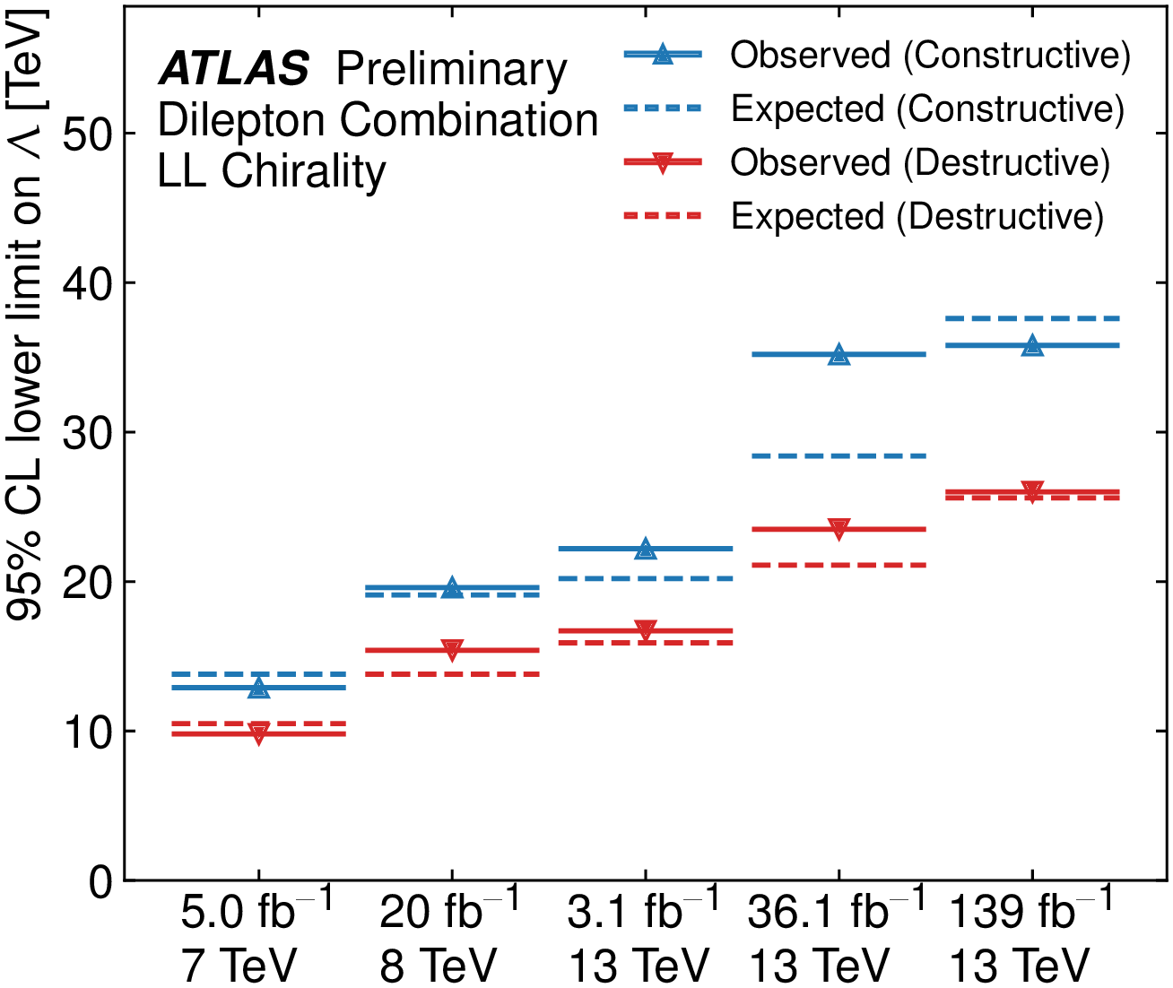
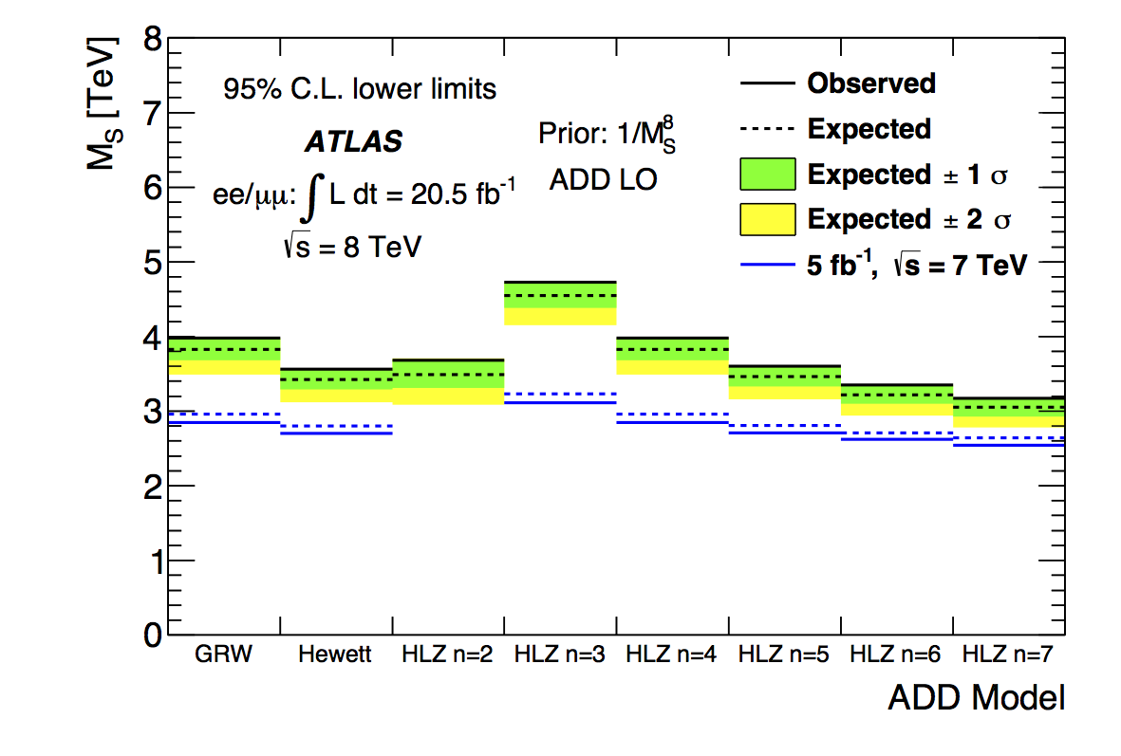
Non-resonant searches
Non-resonant new physics
Contact Interactions
ADD (large extra dimensions)
G
G
Plot made by RHUL
Plot made by RHUL
JHEP 11 (2020) 005
Eur. Phys. J. C (2014) 74:3134

Slide 26
RHUL Publications and Editor (**): Run 2
Resonant new physics
Dilepton Resonance Search 139 fb⁻¹
Both resonant and non-resonant new physics
In the dilepton final state 36.1 fb⁻¹
3.2 fb⁻¹
Non-resonant new physics
Non-resonant ADD dilepton search 139 fb⁻¹ **
Non-resonant dilepton search 139 fb⁻¹
Phys. Lett. B 796 (2019) 68
Z’/G
JHEP 10 (2017) 182
Phys. Lett. B 761 (2016) 372-392
Berry
ATL-PHYS-PUB-2021-021
JHEP 11 (2020) 005
Search for non-resonant high-mass phenomena in the dilepton final state
20 fb⁻¹
09-JUL-14

Slide 27
RHUL Publications and Paper Editor (**): Run 1
Resonant new physics
Dilepton resonances at √s= 7 TeV (~40 pb⁻¹)
Dilepton resonances at √s= 7 TeV (1 fb⁻¹)
Dilepton resonances at √s= 7 TeV (4.9 pb⁻¹)
Non-resonant new physics
Non-resonant CI & ADD dilepton search at √s = 7 TeV (~1fb⁻¹) **
Non-resonant CI & ADD dilepton search at √s = 7 TeV (~5fb⁻¹) **
Non-resonant CI & ADD dilepton search at √s = 8 TeV (~1fb⁻¹) **
Diphoton non-resonant new physics
Extra Dimensions using diphoton events in 7 TeV ( ~1fb⁻¹ ee + ~ 2fb⁻¹ γγ)
Extra Dimensions using diphoton events in 7 TeV ( ~5fb⁻¹)
arXiv:1103.6218, Phys.Lett.B700:163-180 (2011)
arxiv:1108.1582, Phys.Rev.Lett. 107 (2011) 272002
arxiv: 1209.2535, JHEP 1211 (2012) 138
arXiv:1112.4462, Phys.Lett. B712 (2012) 40-58.
Berry
Berry
arXiv:1211.1150, Phys.Rev. D87, 015010 (2013).
Berry
arXiv:1407.2410v3 Eur. Phys. J. C (2014) 74:3134
arXiv:1112.2194 Phys.Lett. B710 (2012) 538-556.
arXiv:1210.8389; NJP 15, 043007 (2013)
Z’/G

