Slide 2
Who are we?
Rutherford Appleton Laboratory is the UK’s largest National Laboratory.
Founded as a Particle Physics research laboratory it now houses the RAL Particle Physics Department for the whole of the UK.
Department has approximately 80 physicists and PhD 19 students 112 all told and new people arriving all the time.
PPD is on all major particle physics experiments in the UK.
Work with many other depts and extensively with -
Technology Department. Access to engineering expertise.
Scientific Computing dept. – hosts Tier 1.

Slide 3
Areas of Expertise – PPD & TD
High speed electronics and data acquisition architecture
Silicon sensors
Photon detection
ASIC chip design
Mechanical engineering for large scale complex stressed structures
High power target design
Cryogenics and noble liquids
High throughput and high performance large scale computing systems
Large scale calorimetry
Complex software for data processing and pattern recognition.
Data analysis

Slide 4
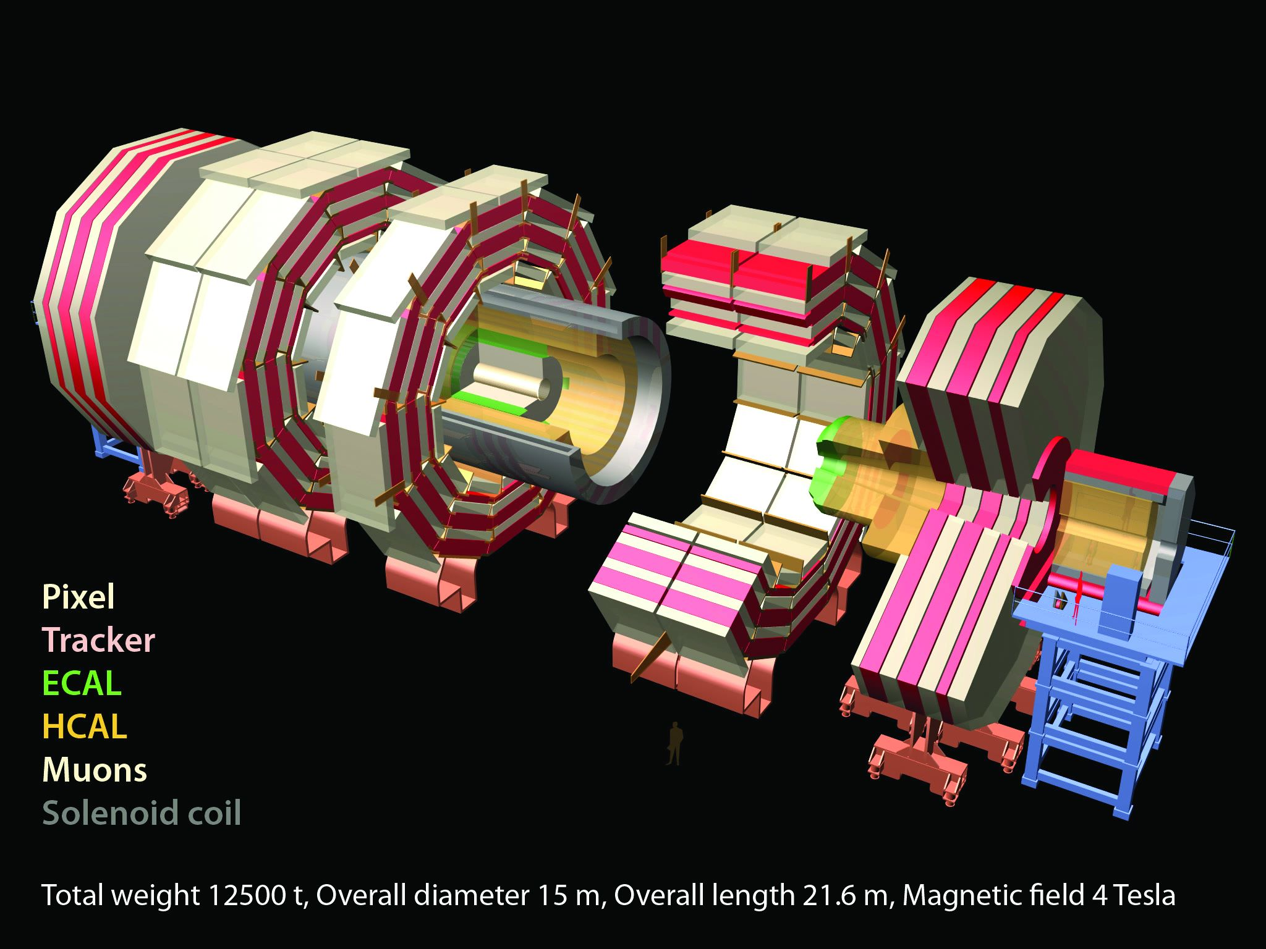
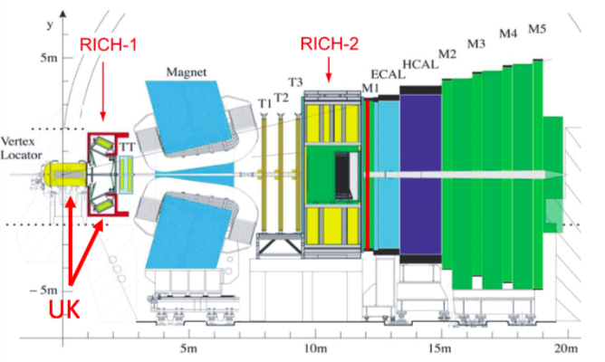
LHC experiments
Only place in the UK with ATLAS, CMS and LHCb groups

Slide 5
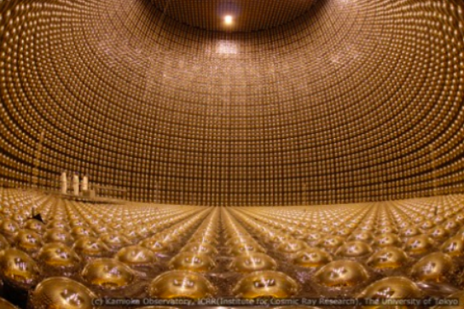
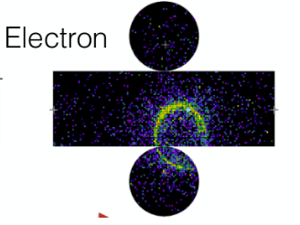
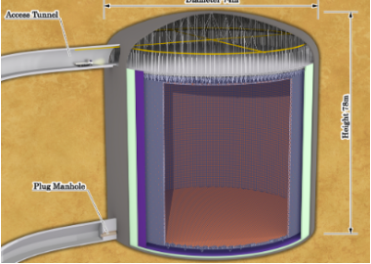
Neutrinos
SuperK
T2K
HK next generation
DUNE
Different technology
LAr TPCs

Slide 6
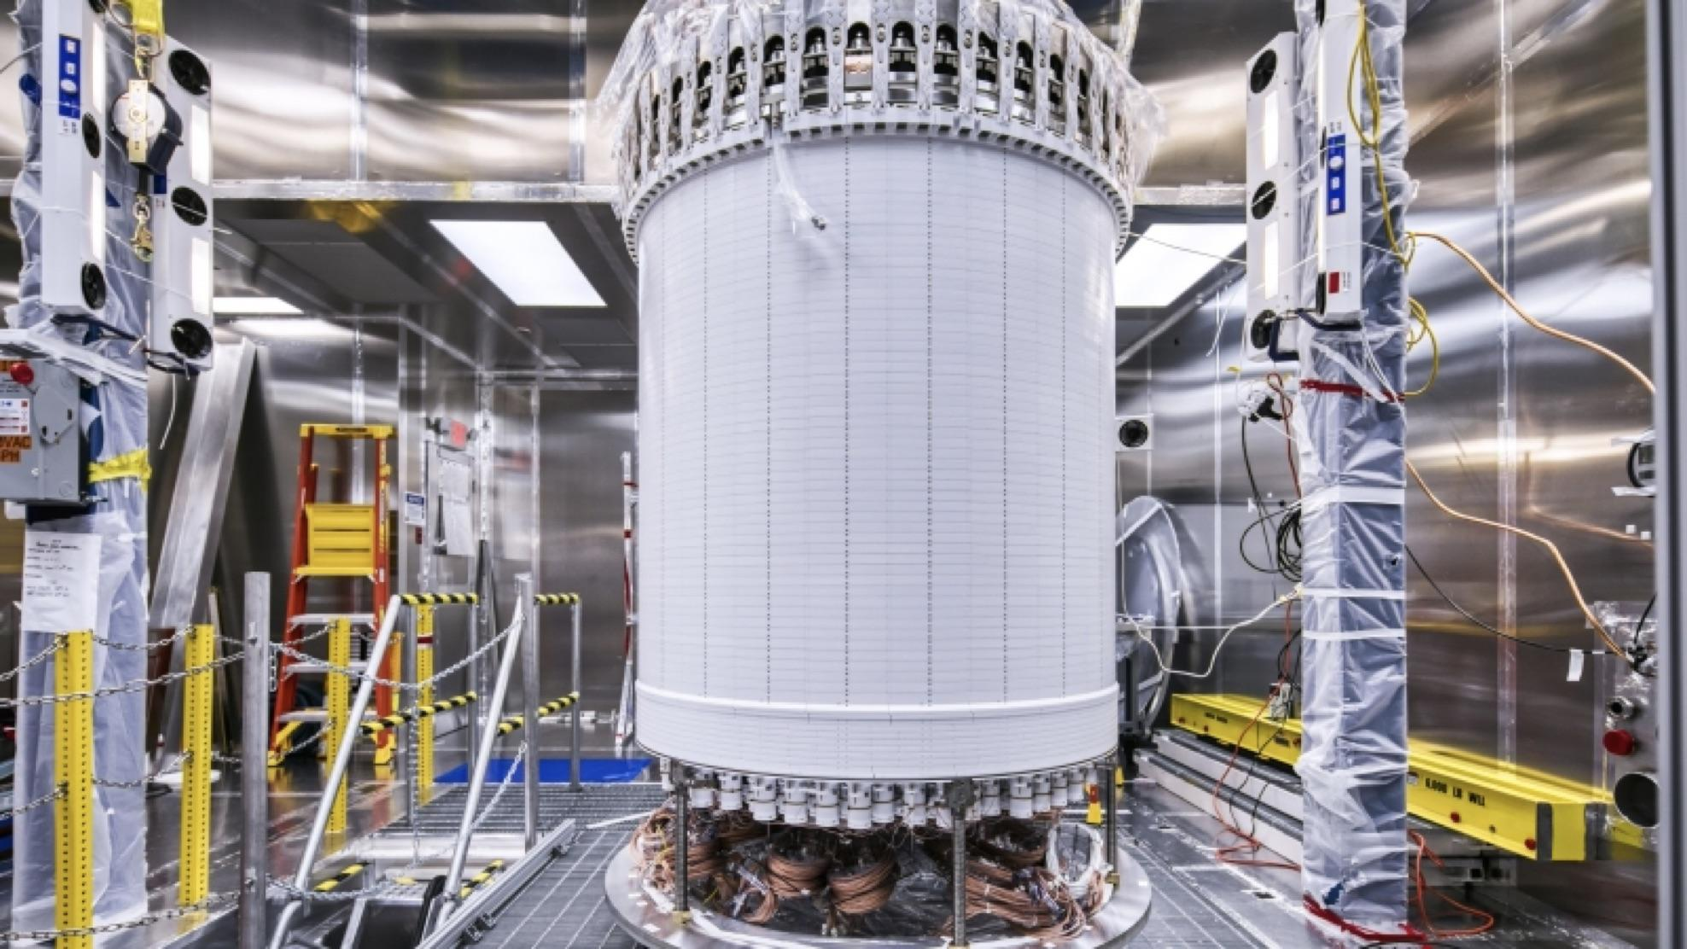
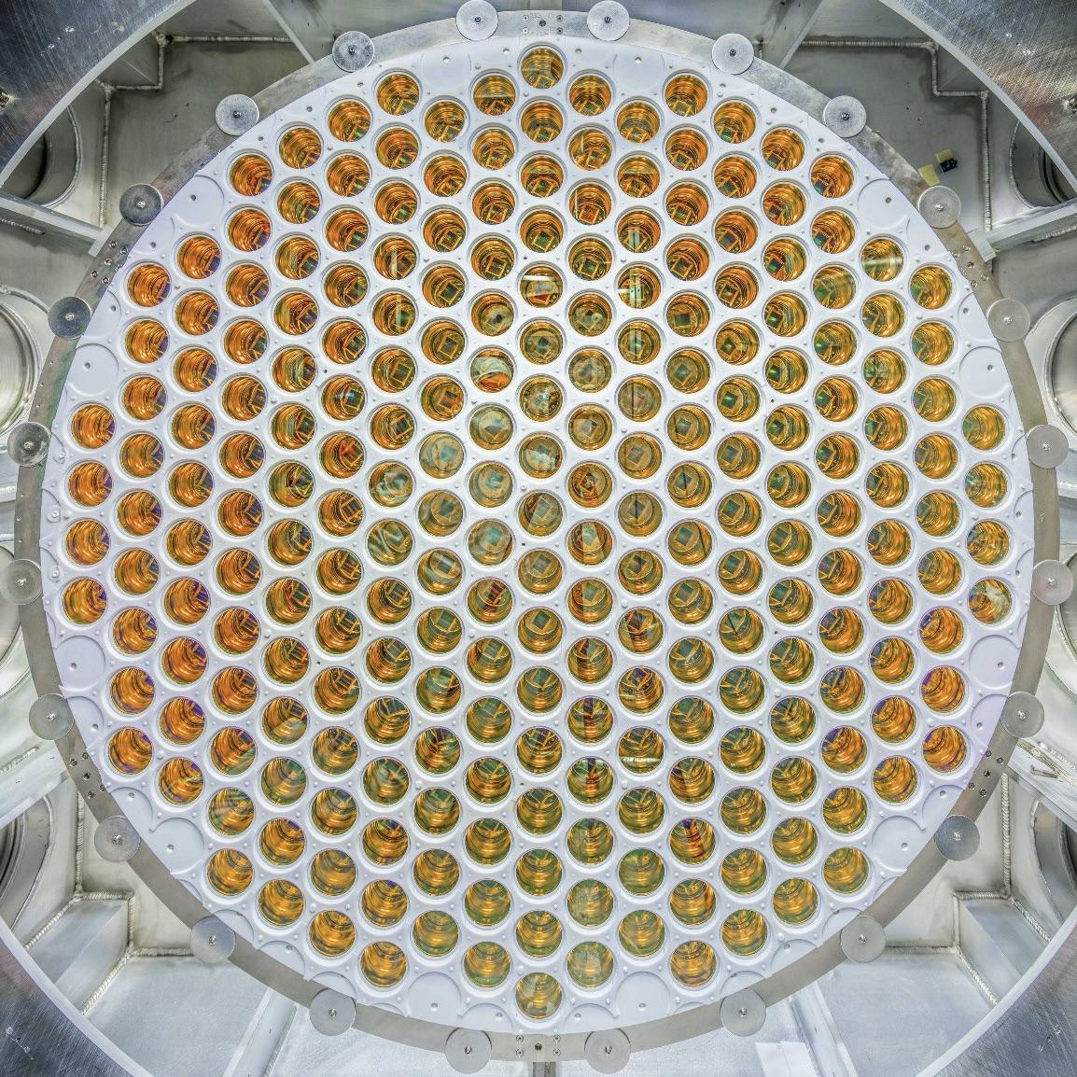
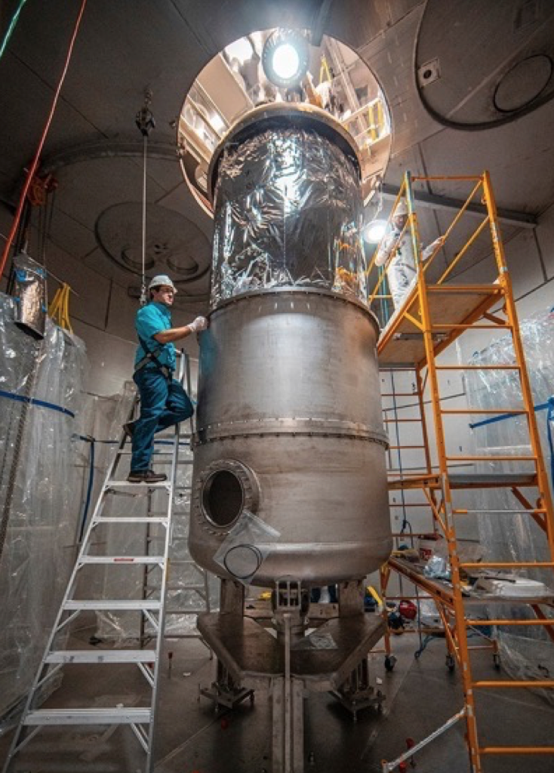
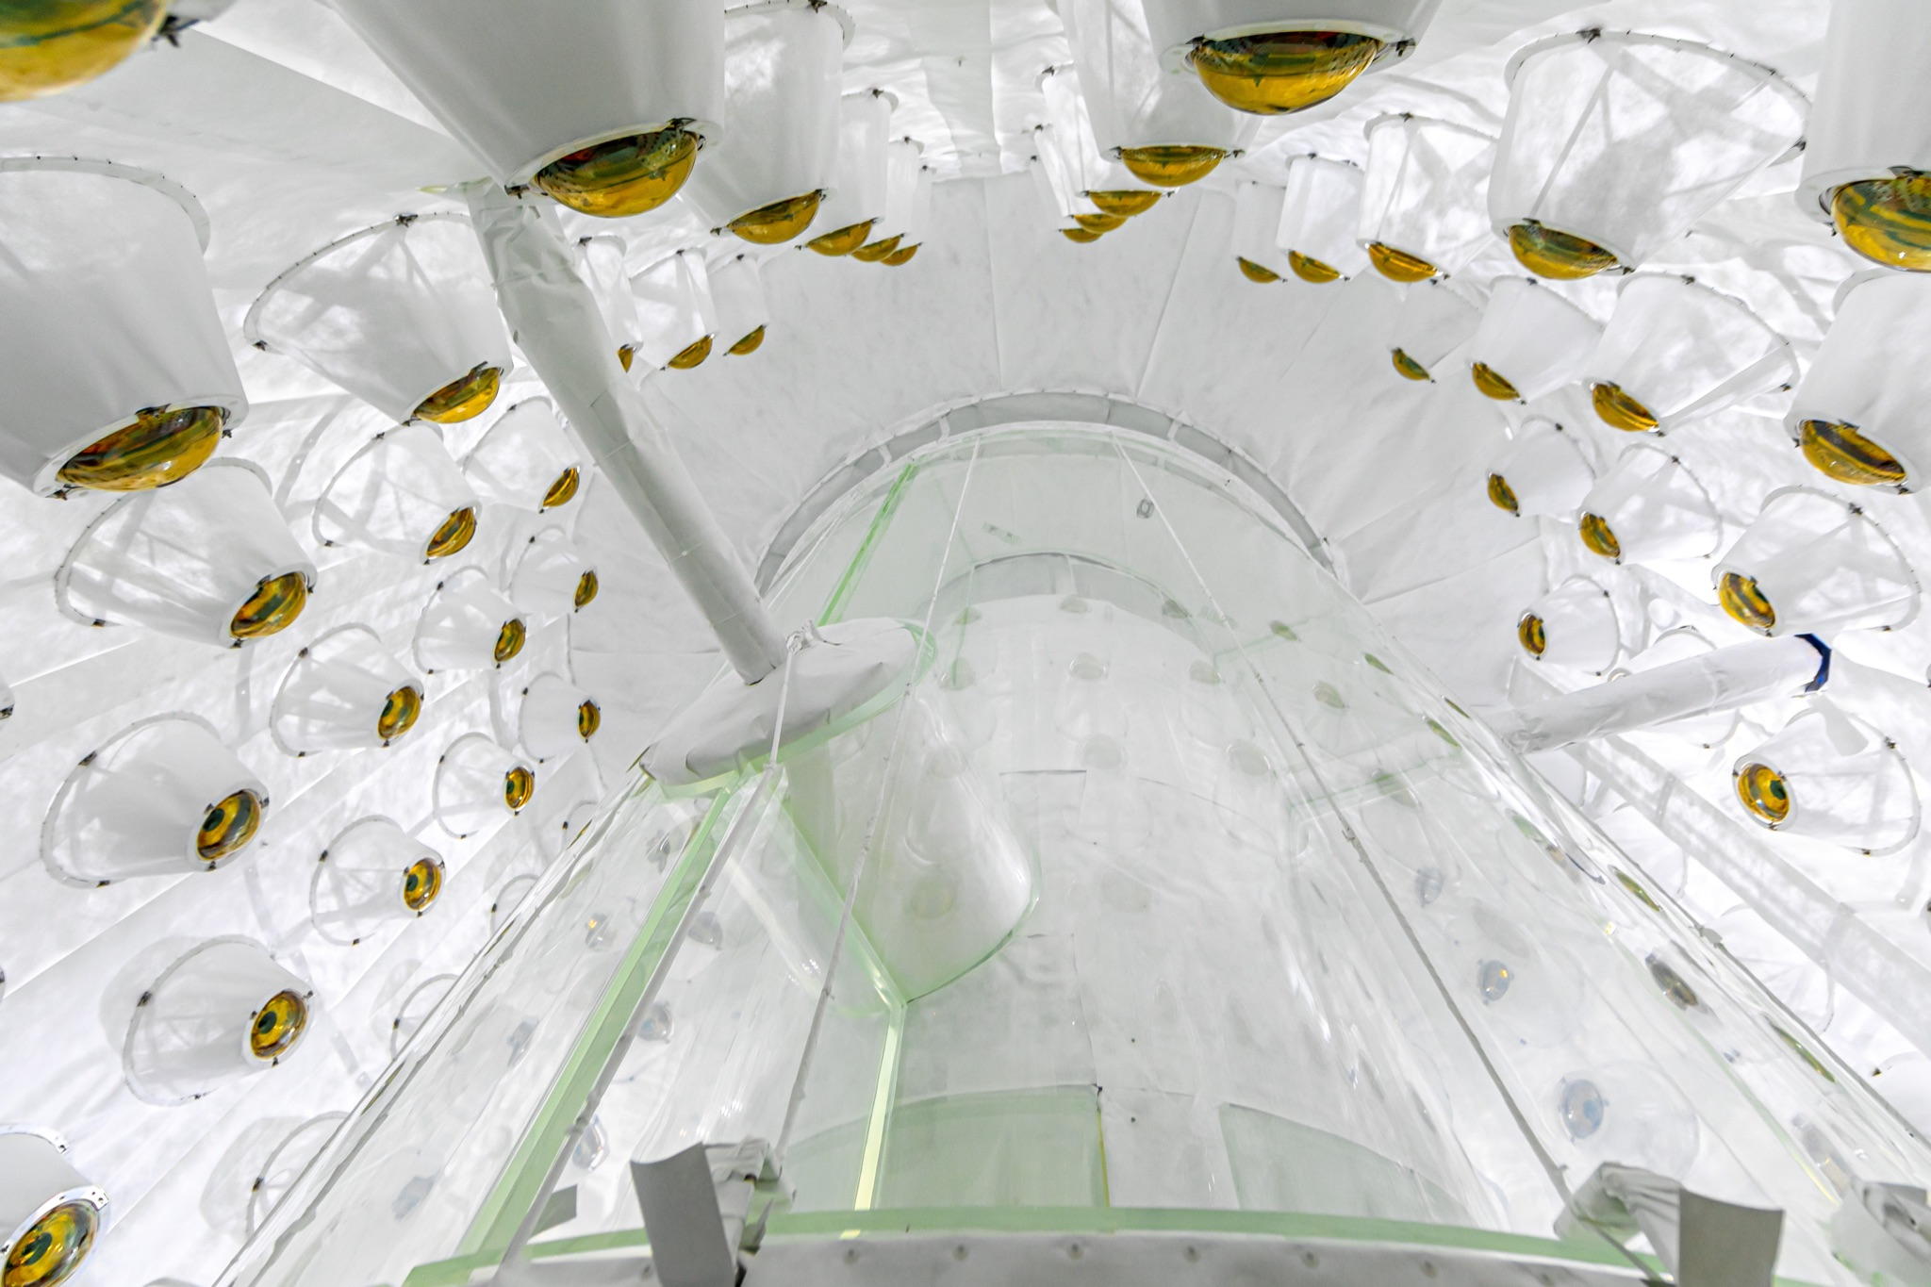
LUX-Zeplin
Dark Matter experiment located at SURF in South Dakota (US)
Detector filled with 10000 kg of liquid Xenon (largest concentration of Xenon in the world) and equipped with 500 PMTs
PPD delivered ultra-pure titanium cryostat and calibration source deployment system
TPC fully assembled in the cleanroom
Array of PMTs
Detector lowering into the cryostat
Outer detector

Slide 7
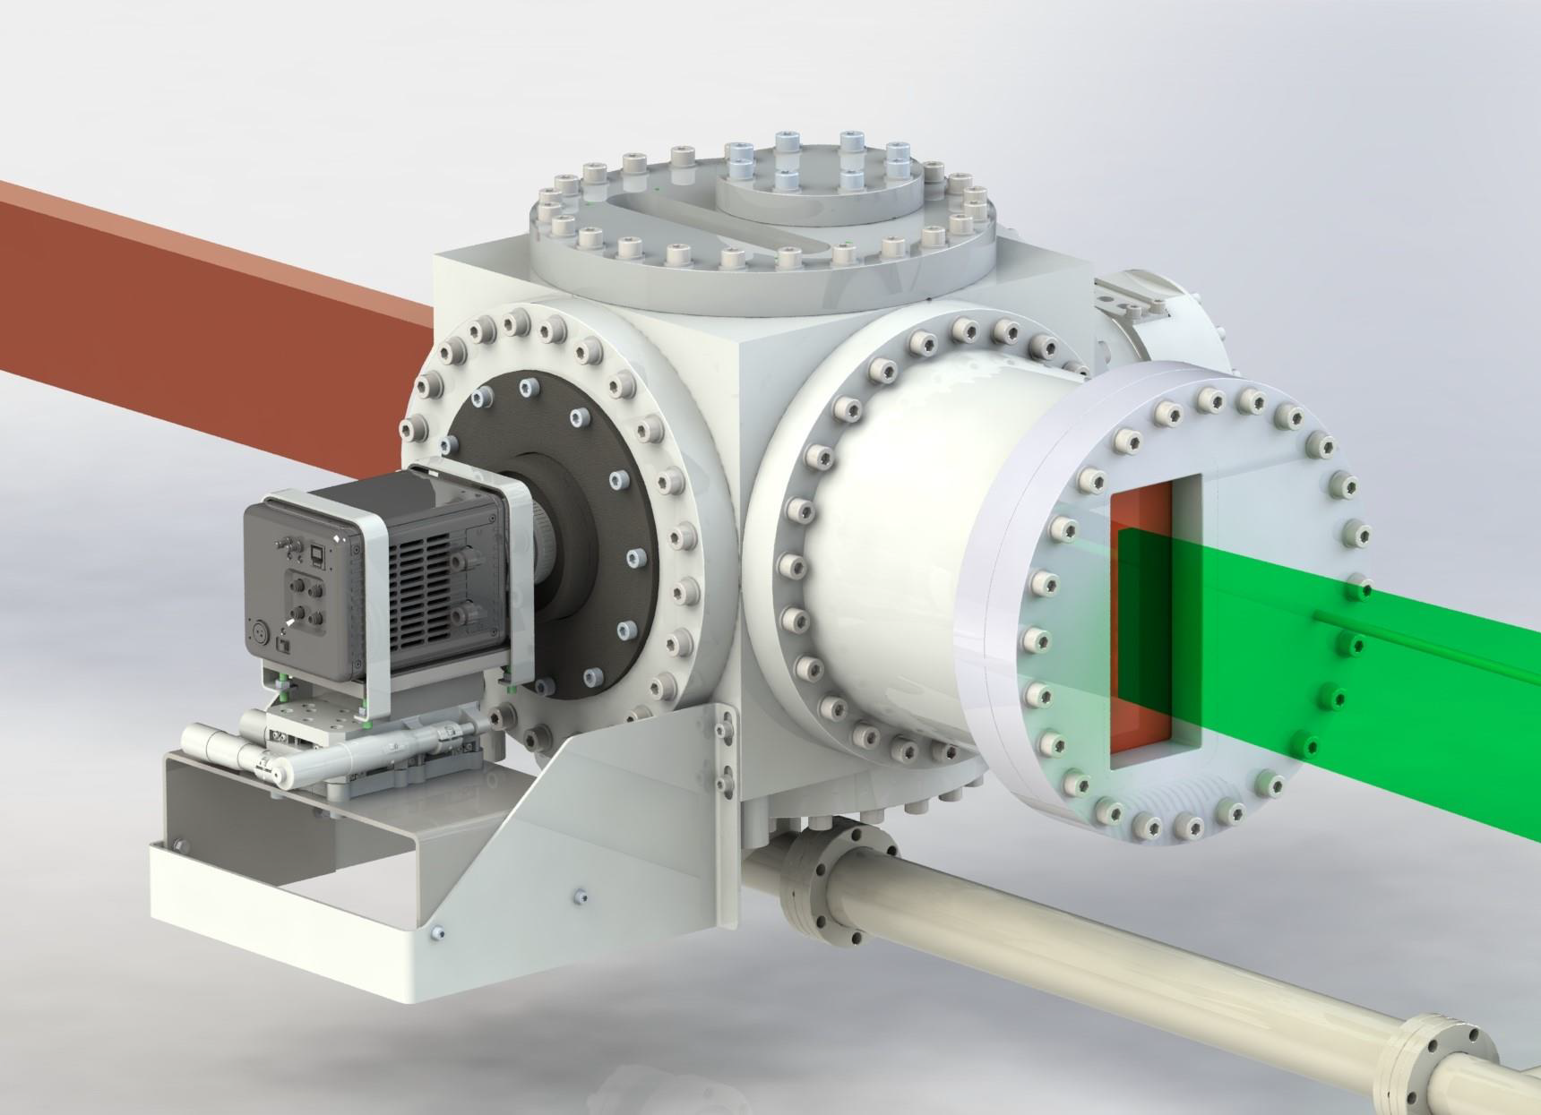
Migdal In Galactic Dark mAtter expLoration
Part of the XENON FUTURES R&D project for a global rare event observatory
Aiming to observe for the first time the Migdal effect - a rare atomic phenomenon (10⁻⁵) in nuclear scattering
Migdal effect increases sensitivity of DM experiments to low mass WIMPs
Low pressure Optical Time Projection Chamber

Slide 8
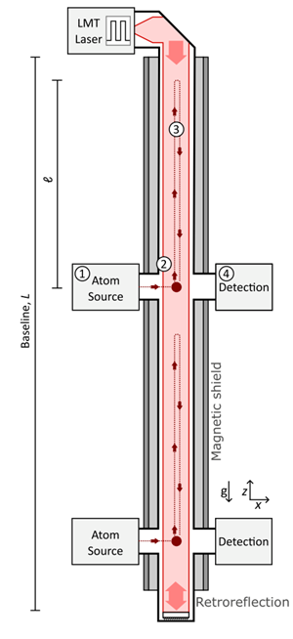
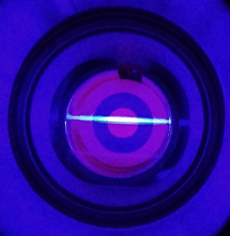
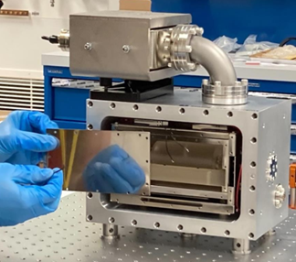
AION & Sr Lab @ RAL
Atom Interferometry Observatory Network (AION)
Collaboration: 7 UK institutions
Goals: Detect mid-band gravitation waves and ultra-light dark matter
Tech: Laser cooling and trapping of neutral Sr + atom interferometry
nasa.gov
Oxford ultracold
RAL
Sr Lab – one of five hosts of atom sources
Full suite of lasers for laser cooling and trapping of strontium

Slide 9
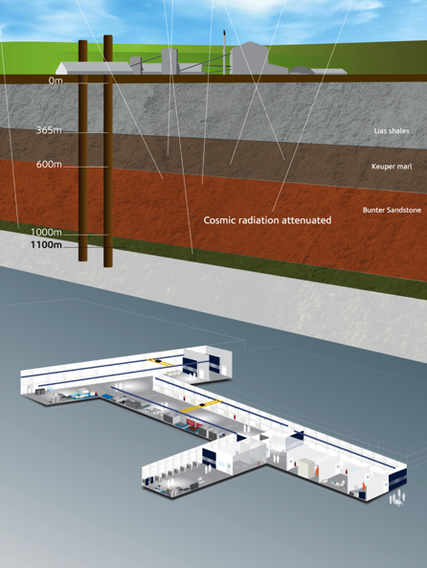
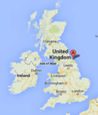
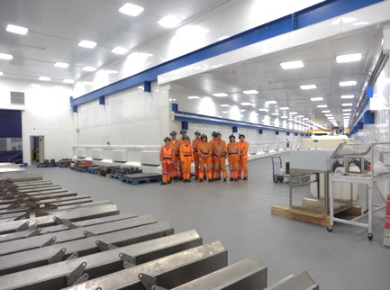
Boulby Underground Laboratory
The UK’s deep underground science facility operating in a working polyhalite and salt mine.
1.1km depth (2805 mwe). With low background surrounding rock-salt
Operated by the UK’s Science & Technology Facilities Council (STFC) in partnership with the mine operators ICL
New Lab open since 2017
Permian Evaporites
Factor ~10⁶ reduction in cosmic ray flux
vs. surface

Slide 10
Other things…
Detector R&D – Silicon sensors etc.
Computing faciltiies – T1 and T2 plus accelerated computing.
New experiments possibilities. ILC, next generation hadron colliders…

Slide 11
Studentships – Practical Info
PPD has 5 studentships available:
ATLAS - Exotic particle searches with Run 3 data and preparing Tracking software for High Luminosity LHC
ATLAS - High-Speed Data Acquisition for tracking upgrade
CMS - Search for BSM physics and HL-LHC trigger studies
Dark Matter - Observation of the Migdal effect in the atoms of noble gases
Dark Matter - AION and MAGIS - Development of the detection system
RAL does not award degrees therefore all studentships are in association with a university. Usually 2 supervisors
Studentships funded for 3.5 years. (All STFC for 3.5 years)
All UK and other nationals eligible. However only home fees available.
Travel is funded and expected to CERN and other experiment sites.
Discussion with supervisors for all posts.

Slide 12
Studentships – Practical info
The standard university eligibility and qualification criteria must be met.
Initial course work will usually be at the relevant university. Students will normally be resident at the univ. for the first two terms.
The rest of the studentship will either be at RAL or the experiment site (e.g. LTA for CERN experiments).

Slide 13
Today
Talks on experiments and PhD projects to follow.
Lunch....
In person visits this year.
Informal chats with current students
Slots for talking to supervisors follow

Slide 14
Important information
If you expressed an interest initially in a particular studentship but would like to consider others please sign up in the available slots.

Slide 15
Enjoy your day with PPD at RAL

Slide 16
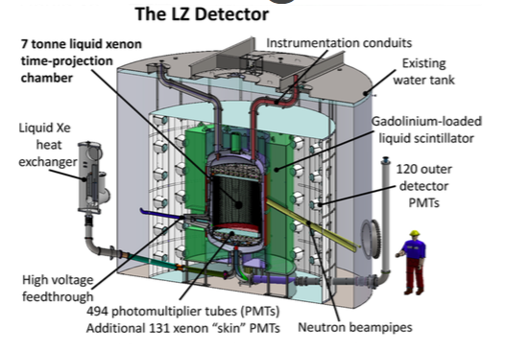
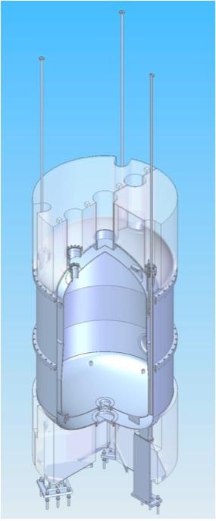
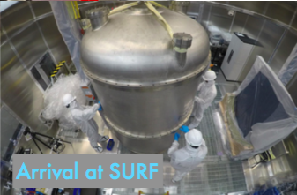
LZ experiment
Radiopure titanium
Not just DM
2β0ν
Solar ν
Delivered

