Slide 1
CMS Experiment
C. H. Shepherd-Themistocleous

Slide 2
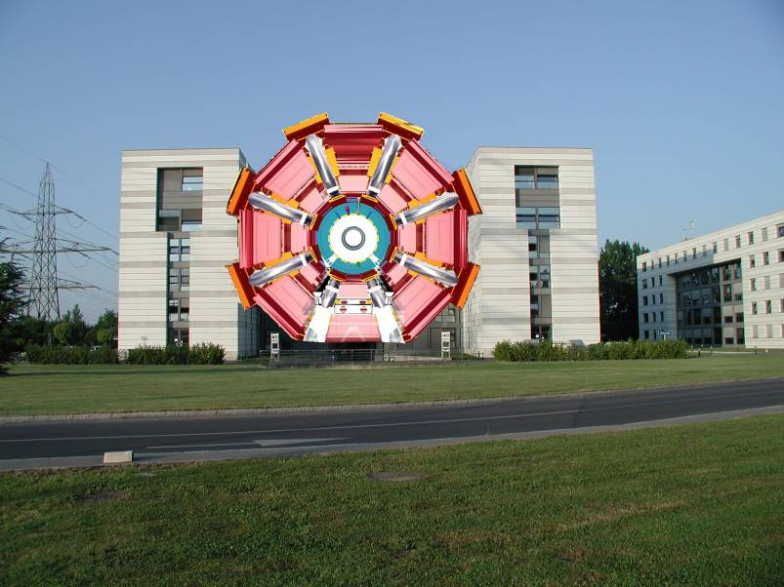
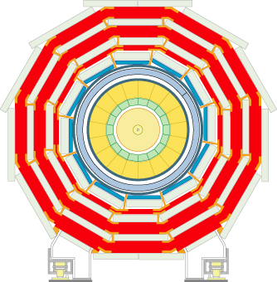
ATLAS
The Compact Muon Solenoid

Slide 3
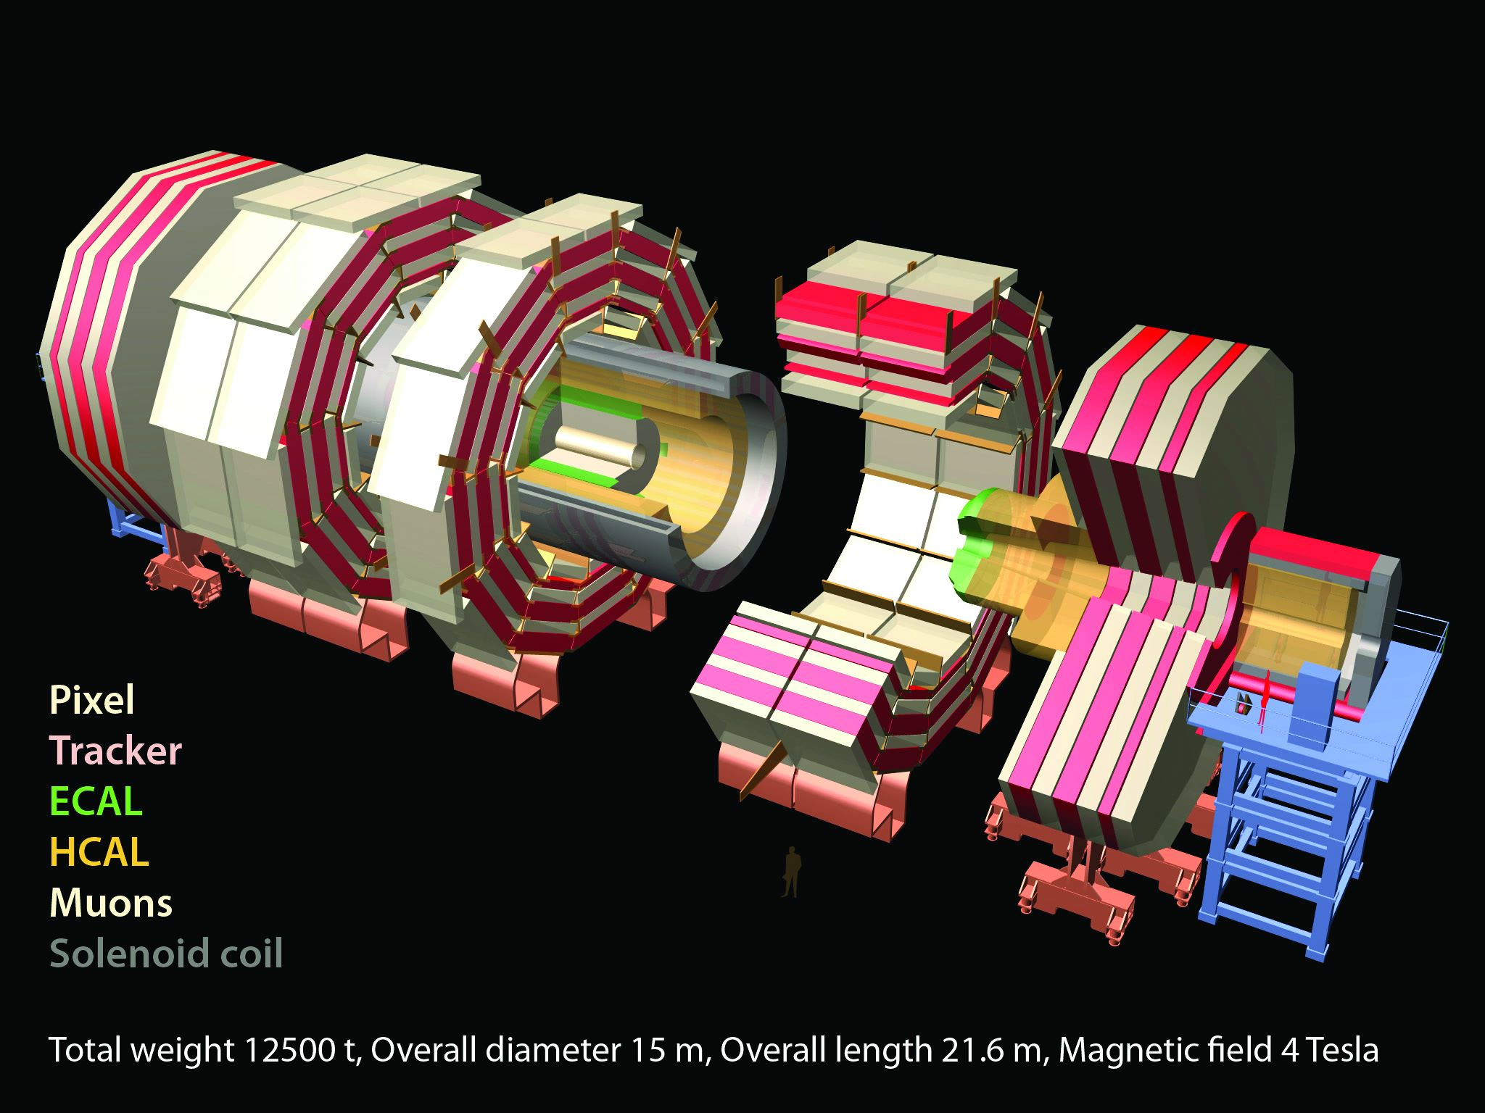

Slide 4
CMS : What we work on
Electromagnetic
Calorimeter
Trigger
(L1 & HLT)
Silicon Tracker
Computing
(T1 & T2)
Physics Analysis
Phenomenology
(NExT Institute)
Design
Construction
Operation
Upgrades

Slide 5
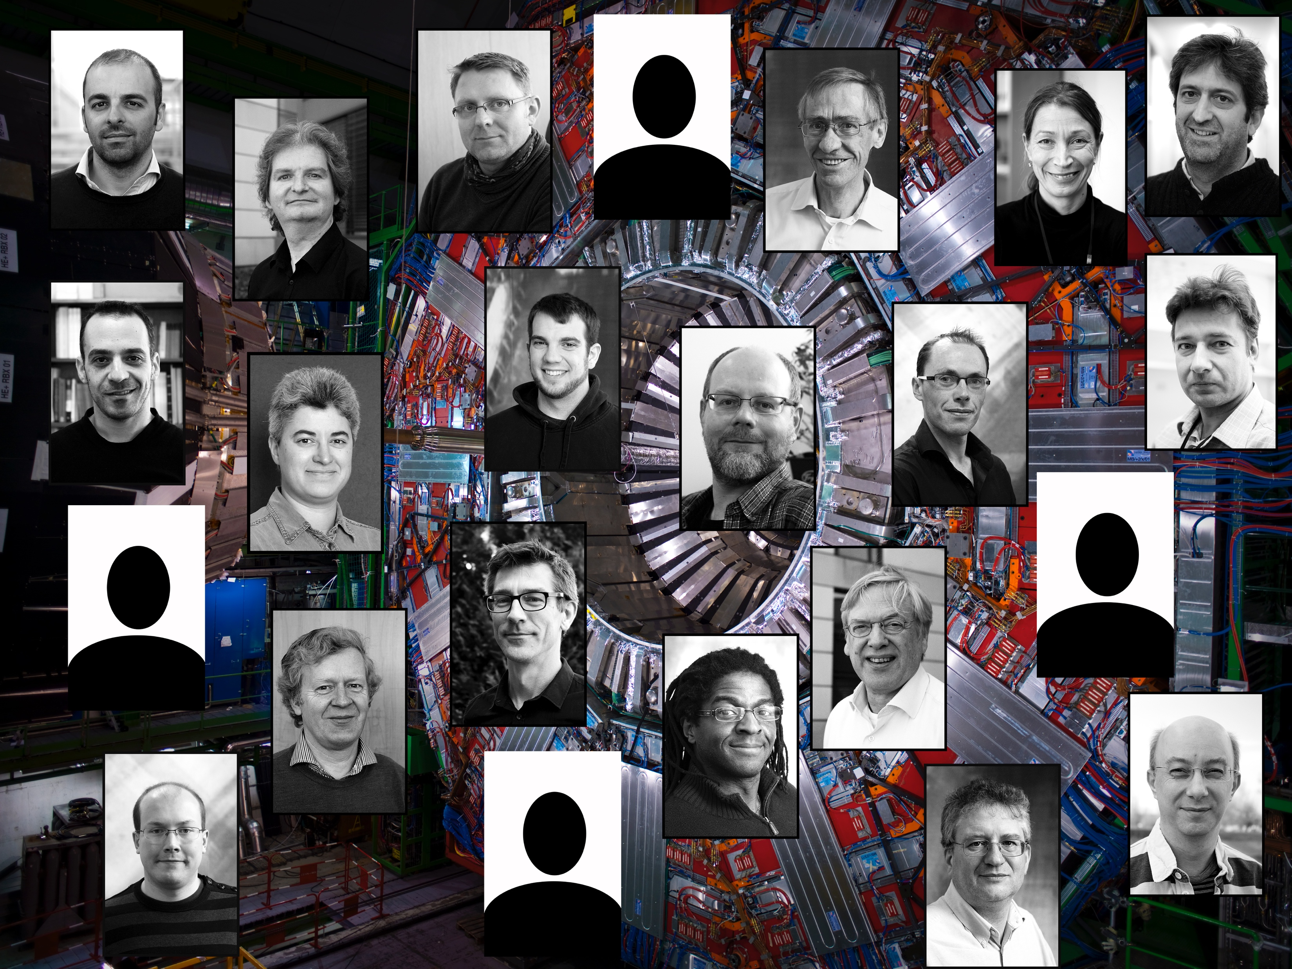
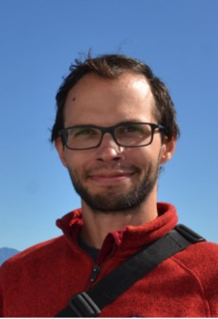
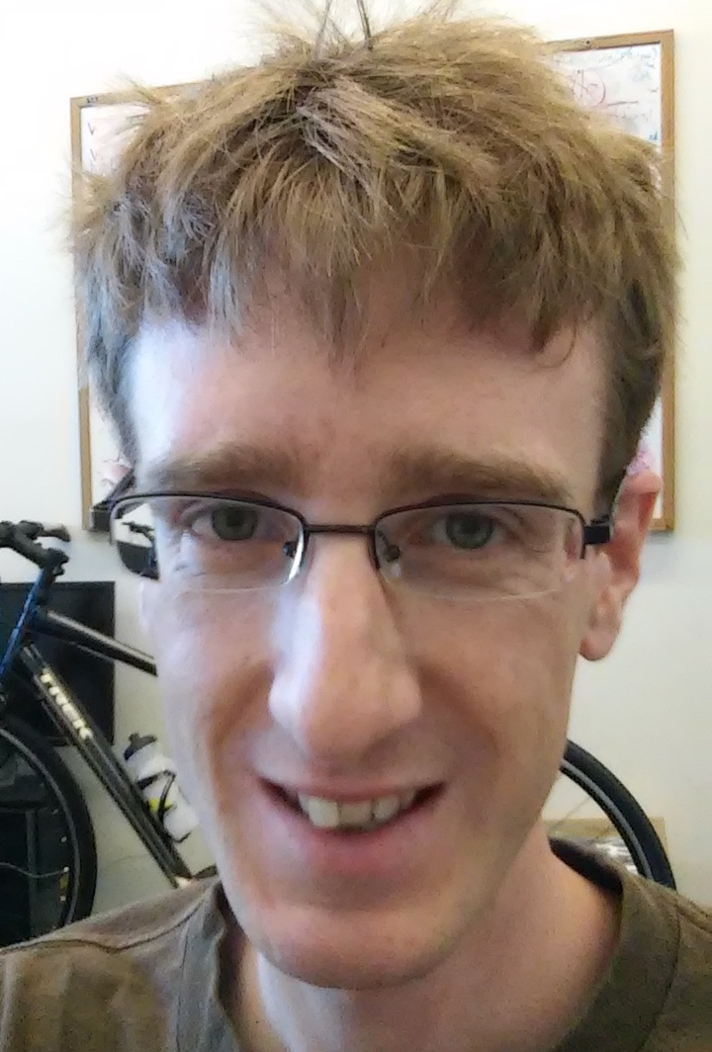
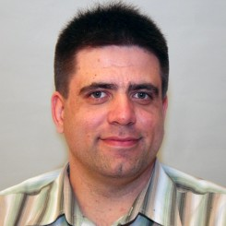
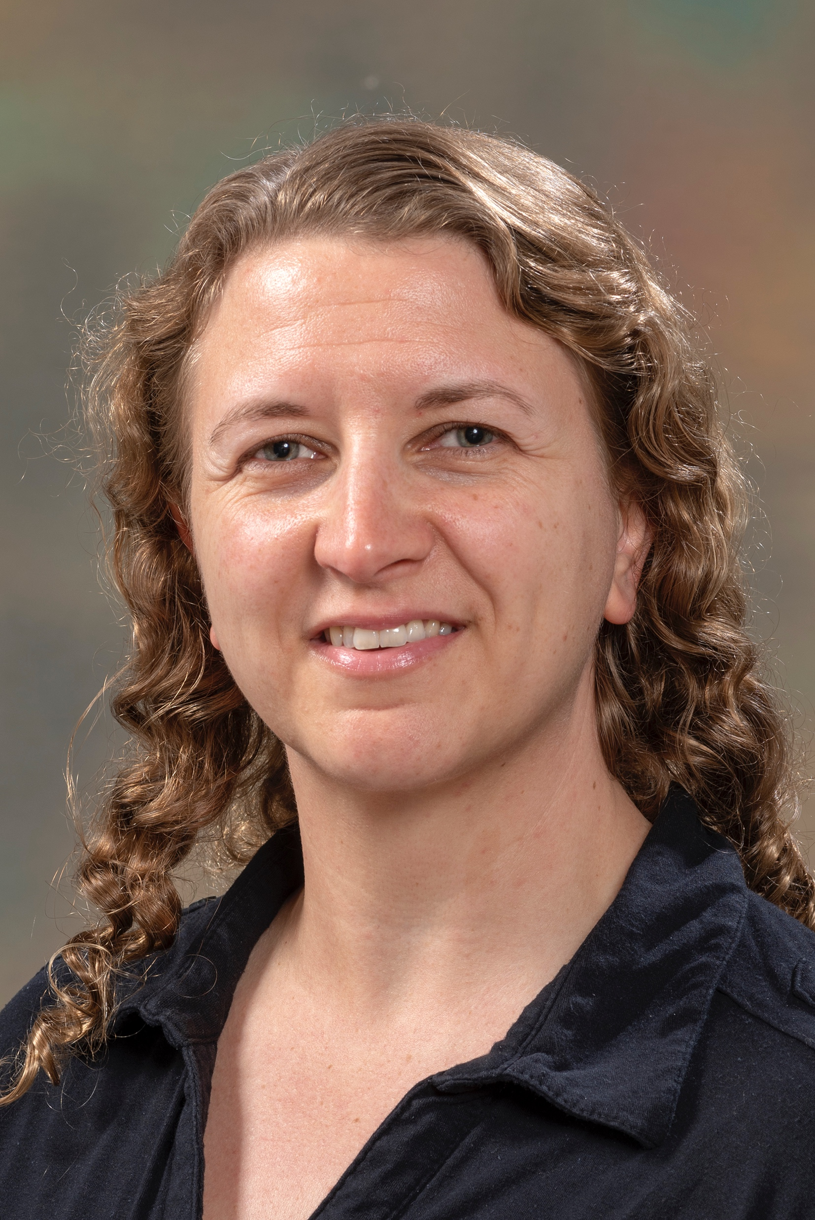

Slide 6
CMS PhD projects
Three studentships available.
  1) ECAL upgrade – Backend data processing for triggering.
  2) Tracker upgrade – Online track reconstruction
  3) Level 1 Trigger upgrade – Trigger algorithm development and physics analysis

Slide 7
ECAL
PPD responsible for design, delivery, installation, operation.

Slide 8
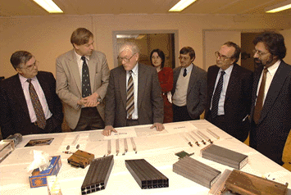
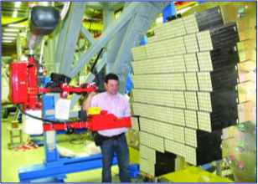
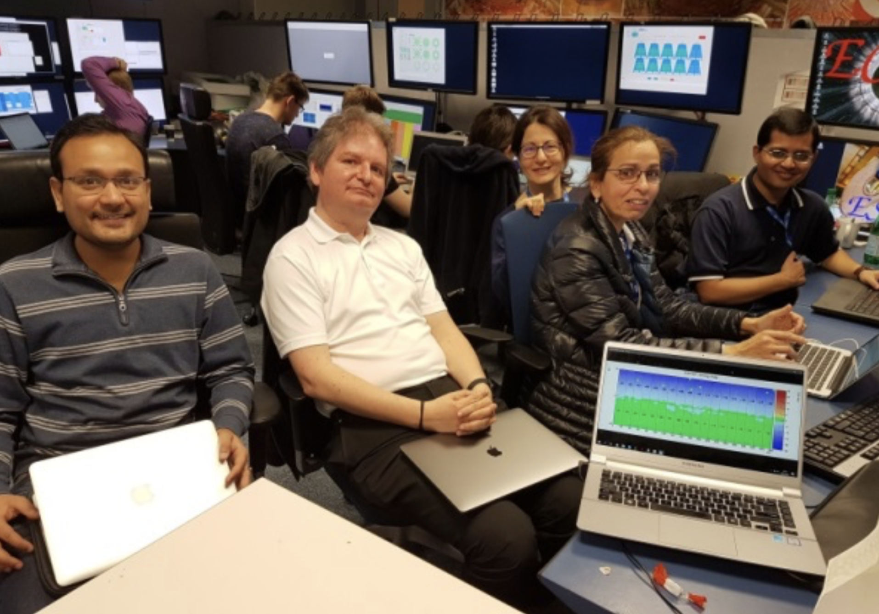
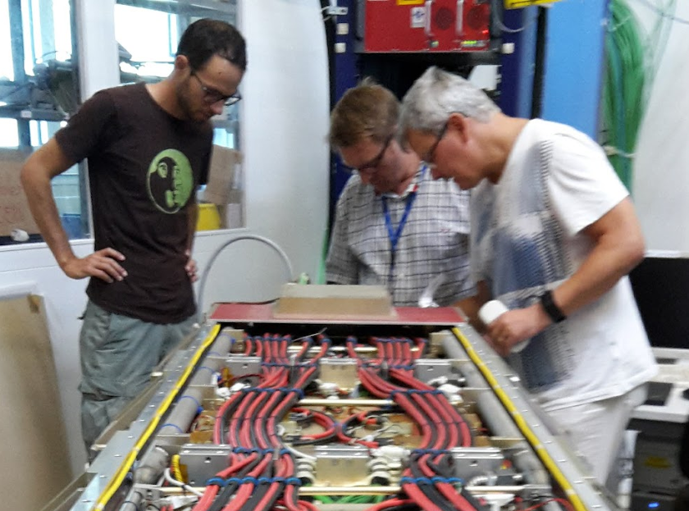
RAL: 30 years of ECAL leadership
Concept
Construction
Operations
Upgrades

Slide 9
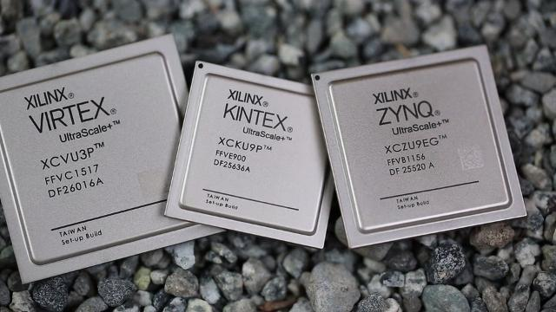
ECAL – HL-LHC
APD

Slide 10
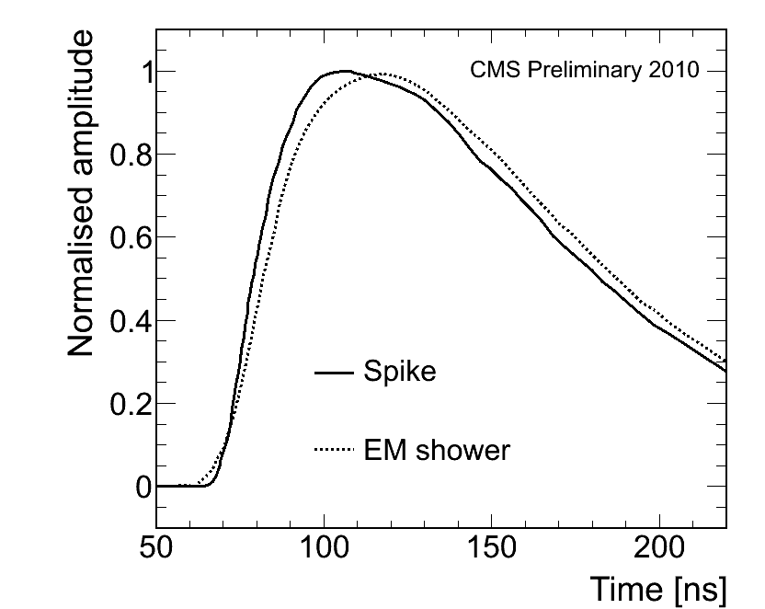
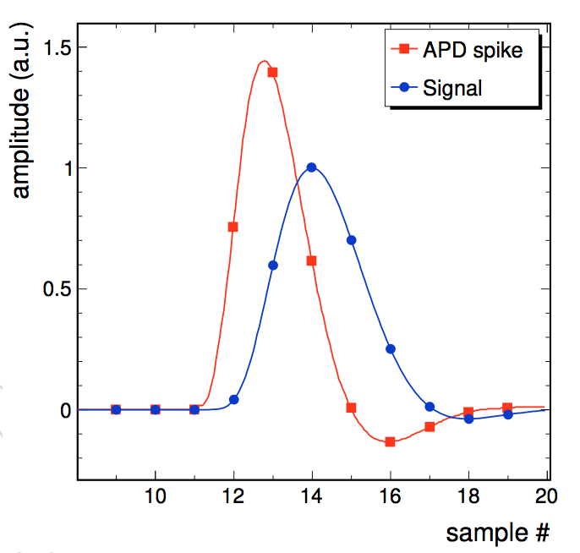


ECAL Project
Development of improved electron/photon trigger algorithms to harness the improvements offered by the ECAL upgrade
  - Factor of 25 better granularity available to Level-1 trigger
    Advanced clustering algorithms possible in powerful FPGAs
  - Much improved rejection of anomalous signals in the ECAL photodetectors
    due to new on-detector electronics with much shorter pulse shaping
Current
Upgrade
Current
Upgrade
25x better trigger granularity
Much better “spike” rejection
Supervisors: Dr. D. Petyt, Dr. H. Heath (Bristol)

Slide 11
Track Finder

Slide 12
Track Finder
Silicon tracker to be completely replaced for HL-LHC
Enables track finding at in Level 1 trigger.
Completely new capability

Slide 13
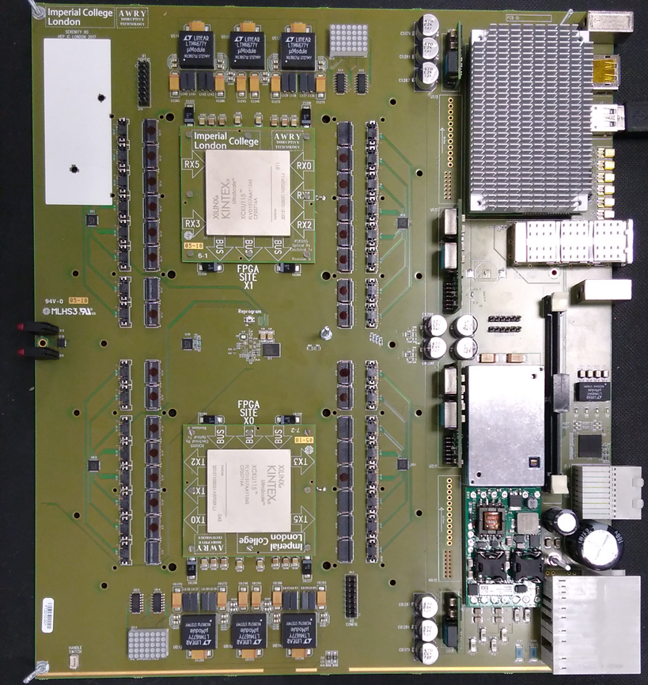
Track Trigger

Slide 14
Track Finder Project
The challenge:
Find tracks in events with 200 interactions every 25ns in 4us.
This capability does not currently exist in CMS.
High data rates, complex algorithms: Biggest challenge in fast electronics in all of Particle Physics.
Development of novel algorithms
Implementation in cutting edge FPGAs (VHDL, HLS)
Design of readout architecture
Supervisors: Dr. Ian Tomalin, Prof. Joel Goldstein (Bristol)

Slide 15
Level 1 Trigger

Slide 16
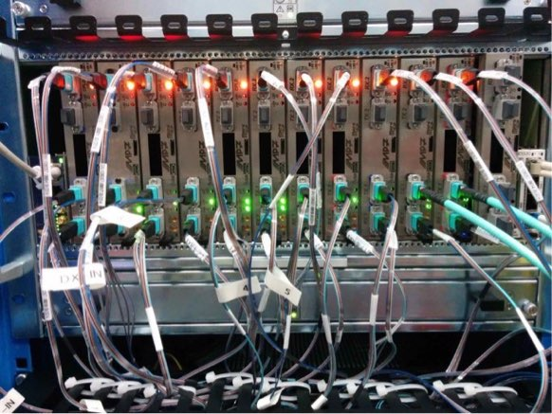
L1 Trigger – Phase I
Phase 1 upgrade to L1 Calorimeter trigger
  1st upgrade to CMS trigger.
  Novel architecture (Time Multiplex trigger)
    Whole event one location
  Use of large FPGAs
  First use of uTCA on CMS
  Build on experience for phase II upgrades

Slide 17
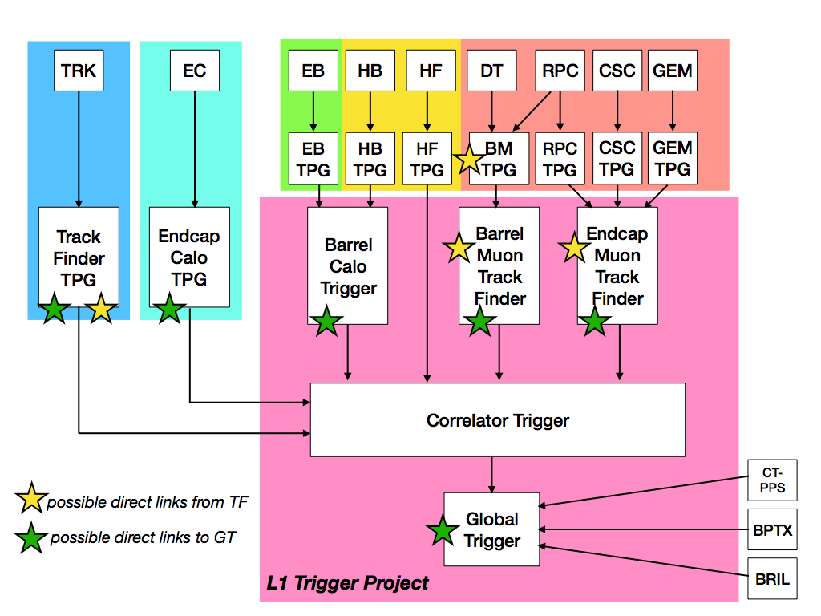
L1 Trigger – Bringing all together
Bringing offline online
All information from the detectors brought together in the Level 1 trigger.
Level 1 Trigger constructs elements for making the trigger decision
  Jets, electrons, photons, muons, missing energy
  Dealing with ~200 interactions a major challenge
  Sophisticated jet reconstruction possible. Tracks available for first time.

Slide 18
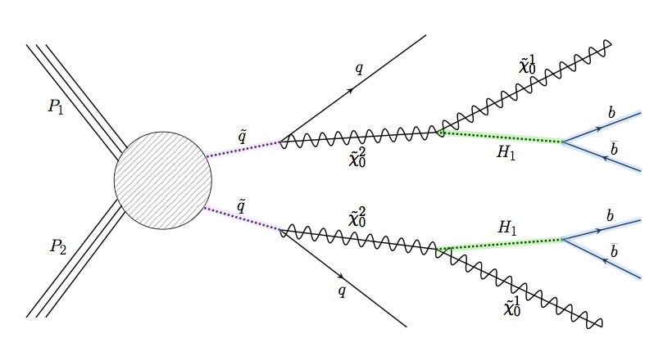
Physics Analyses
Fat Jet
Fat Jet
NMSSM Light Higgs
Would be evidence of SUSY
“Fat jets” & double b-tagging
Work of current CMS student Joe Taylor

Slide 19
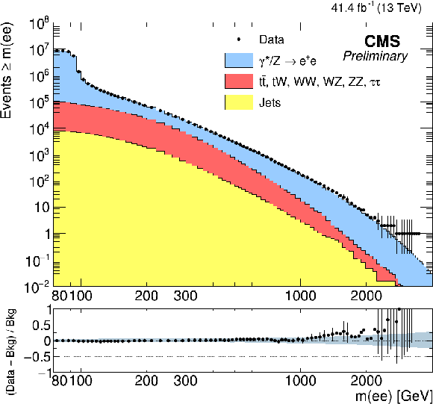
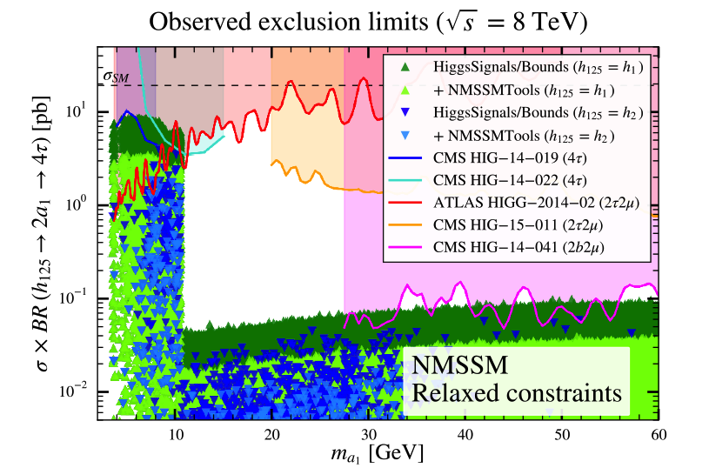
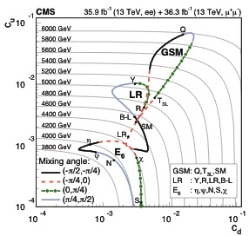
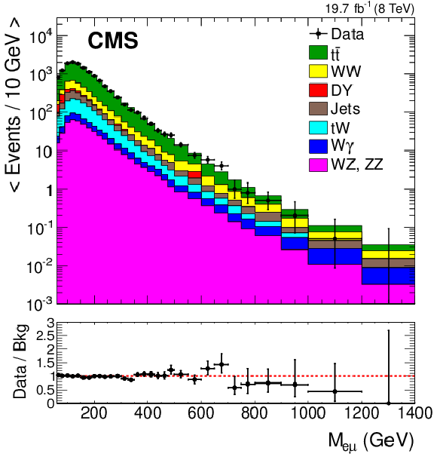
Physics Analyses & Phenomenology
Z’ search a long standing analysis. High energy electrons and HLT
Exploit eμ for QBH search
Boosted Z

Slide 20
Project
Development of algorithms for reconstruction and ultimately trigger decision.
Make use of the information provide by the other two CMS projects (tracks and calo clusters)
Challenge of reconstruction of jets online.
Novel jet ideas such as track-jets
Exploit machine learning techniques (e.g. neural nets) to develop algorithms and study jet structure.
Perform BSM physics analysis exploiting jet knowledge.
Requires good physics insight to design a good trigger.
Flexible project will be tuned to suit student selected
Supervisors: Prof. Claire Shepherd-Themistocleous, Prof. Stefano Moretti (Southhampton)

Slide 21
CMS projects
All three CMS projects involve the HL-LHC upgrade and fast electronics.
There is a close connection between all projects and the first level of trigger decision.
The cohort of CMS students will have common ground.

Slide 22
Backup

Slide 23
Physics – phenomenology – NExT
Heavy neutrino

Slide 24
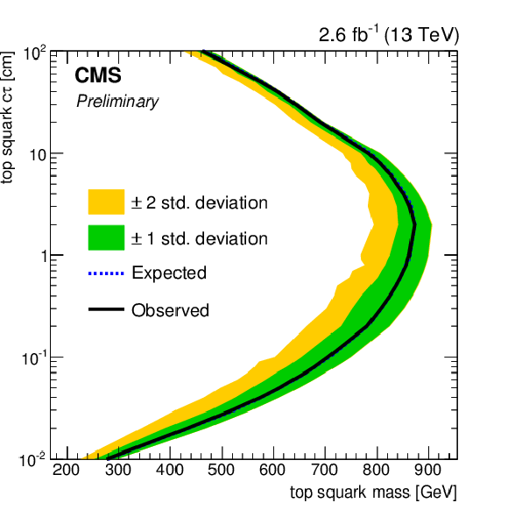
Physics analyses
Long lived particles decaying to leptons.
Stop → b + lepton (RPV) (eμ search)
Distributions sensitive to top spin use to constrain BSM effects
chromo-magnetic dipole moment of the top quark

Slide 25
Expertise in e/gamma reconstruction & ID
Expertise in HLT in particular in e/gamma
Use of HLS
Machine Learning

Slide 26

Computing
PPD supports RAL T1
CMS T2 run by PPD
  – housed in R89

Slide 27
Conclusion
Very active in operations, exploitation and upgrades
Upgrade about to move from R&D to construction grant
Exploiting commonalities to enable breadth of engagement
Many people involved in several activities
Expertise being deployed on DUNE

Slide 28
BACKUP

Slide 29
ECAL
Hardware task is the optical fibre router (patch panel)
Same technology as used for L1CALO phase I upgrade. No concerns here.
Depend on mapping definition that has strong dependence on others.

Slide 30
ECAL readout

Slide 32
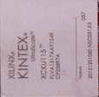
ECAL – HL-LHC

Slide 33
PPD on CMS
PPD on CMS since beginning (~1990)
Design, construction, operation and exploitation, Phase I & HL-LHC upgrades
    ECAL
    Tracker
    Trigger – L1 and HLT
    Computing – T1 and T2
    Physics analysis

Slide 34
Common Electronics
Common electronics requirements – Avoid reinventing the wheel
Common infrastructure requirements
Slow controls, Timing, I/O, DAQ interface
IPbus: Hardware control over Ethernet
Read and modify memory-mapped resources in FPGAs
Common framework, different algorithms

Slide 35
Track Finder - Algorithm
Shown to work in
demonstrator
HT
example
y = mx + c

Slide 36
Physics – phenomenology – NExT
Heavy neutrino

