Slide 1
Superconducting Magnets
Mike Courthold
Cryogenics and Magnetics Group
Applied Science Division

Slide 2
Why use Superconducting Magnets?
SC coils consume virtually no power, although they consume refrigeration power
energy costs are lower (~10x for large magnets)
SC coils achieve high current densities
compact windings
windings less obtrusive
more complex designs
easier to achieve very uniform fields
higher fields, without the need for iron (use more turns)
reduced bend radius for accelerators
smaller accelerator rings
reduced capital costs
new technical possibilities
higher field gradients
higher quadrupole gradients
All the above make physicists very happy

Slide 3
What’s the catch? 1
The highest engineering current densities are not easy to achieve (see later)
SC coils invariably take much longer to design, manufacture, and implement (7 years for Delphi)
Start-up costs and effort are significantly greater.
Need to be used for longer to achieve overall cost-savings (9 years for Delphi)
SC coils must be cooled, typically to LHe temps by a refrigerator or cold heads
Extra complexity and cost
SC coils must be firmly supported to resist the strong magnetic forces, as well as gravity, but thermally isolated from their surroundings
Important to get this right
Tiny movements can induce a Quench
Heat leaks can prevent SC operation or reduce the margin
2-stage cooling needed
1st stage – Cool radiation shields; and intercept and extract heat from current leads, instrumentation wiring, etc., which would otherwise undermine the 2nd stage cooling
2nd stage - Cool and maintain cold-mass at typically 4.2 K

Slide 4
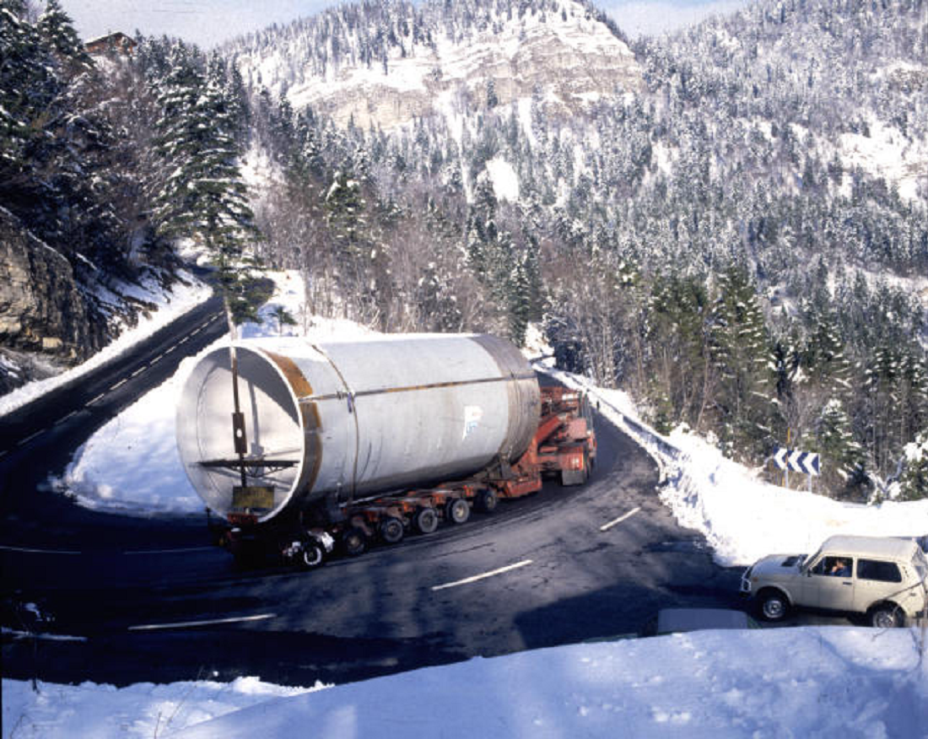
Example Magnets – Delphi Solenoid
Delphi
1.2 T
5.5m dia
6.8m long
110MJ

Slide 5
Example Magnets - Atlas

Slide 6
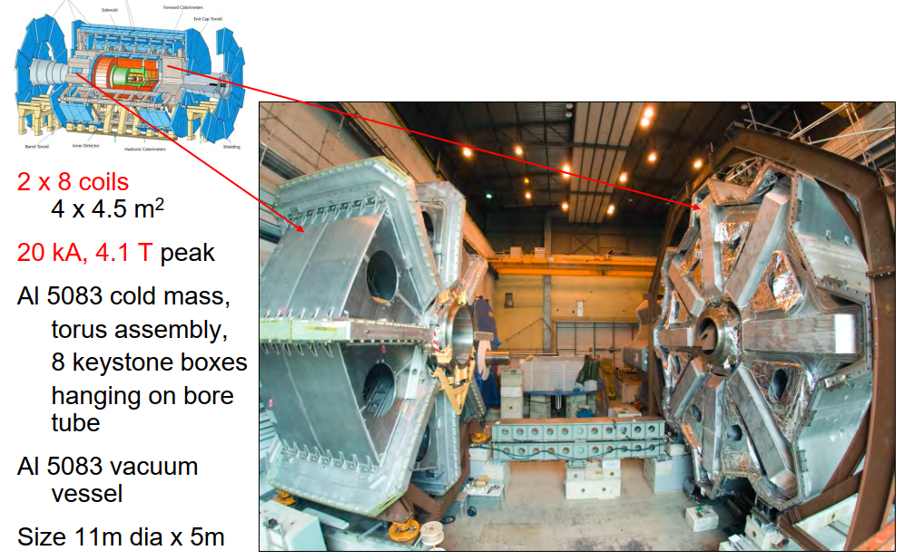
Example Magnets – Atlas End Cap Toroids

Slide 7
Typical Refrigerator / Cryo-Cooler Options

Slide 8
What’s the catch? 2
Quench detection and action must be:
Comprehensively designed and analysed
100% reliable, and over-engineered, but not over-sensitive – challenging!
SC magnets can easily be damaged by careless or inadequate care, monitoring, maintenance.
Faults and issues with SC coils can be very difficult and costly to rectify.
9 mnths re MICE Decay Solenoid current-lead failure during Quench Detector upgrade
9 mnths re Delphi Quench detection system, due to design fault creating coil movement when ramping
Several mnths re Delphi current-lead insulator failure, due to excessive cold shock
9 mnths re Aleph cryostat repair, following uncontrolled Quench, due to UPS failure
1 yr re LHC beamline repair, following uncontrolled Quench of multiple SC beamline magnets

Slide 9
LTS Properties – The Critical Operating Surface 1
This is a feature of all Low Temperature Superconductors (LTS) (see picture)
It is the boundary between superconductivity and normal resistivity in 3-dimensional space
Everywhere above/below the surface is resistive/superconducting respectively
Each alloy exhibits three important characteristics
Bc – the critical field at zero temperature and current
Tc – the critical temperature at zero field and current
Jc – the critical current density, which depends on how it has been processed

Slide 10
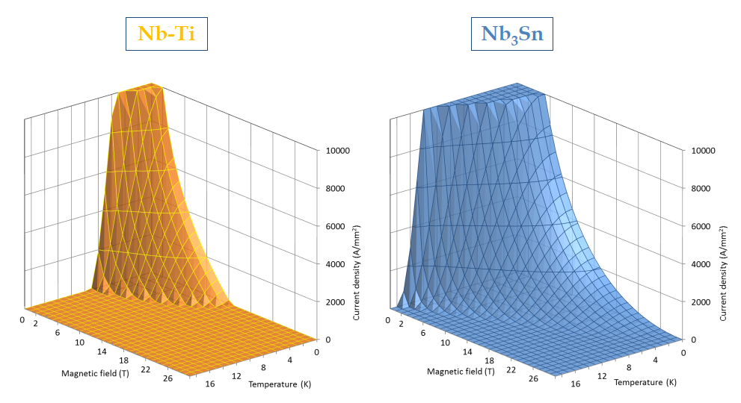
LTS Properties – The Critical Operating Surface 2

Slide 11
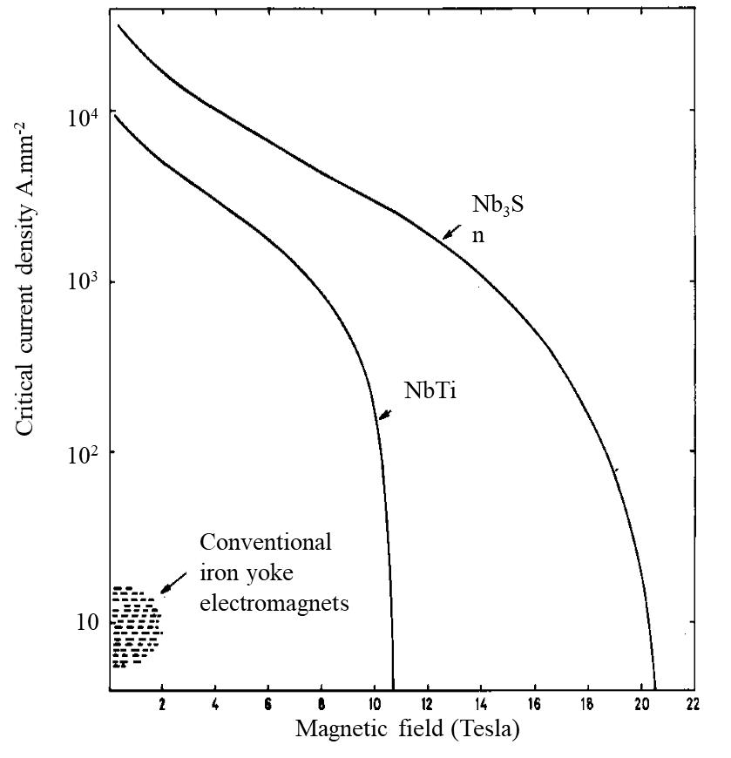
LTS Properties – The Critical Line at 4.2 K
LTS cable is usually operated at 4.2 K, so the Critical Surface is often reduced to a more-convenient curve of critical current (density) versus field at 4.2 K (see curve)
Low Temperature Superconductors (LTS)
NbTi
The alloy of choice for over 60 years
It is a ductile alloy (the only one)
Critical Current Bc is 9 T
Nb3Sn
Much higher critical current versus field than NbTi at 4.2 K
Critical Current Bc is 16 T
Unfortunately it is an intermetallic compound, and thus brittle, with poor mechanical properties
Martin Wilson

Slide 12
LTS Properties – Cable Composition 1
LTS wire comprises very fine SC filaments embedded in high purity copper stabiliser
To reduce flux jumps (magnetic instabilities)
To minimise field distortions due to SC magnetisation
NbTi wires are typically 0.3 – 2 mm diameter, comprising 30 – 56 filaments, each 30 - 150 um diameter.
Nb3Sn wires are typically 0.5 - 1 mm diameter, comprising 24600 filaments, each 1.5 – 3.3 um diameter.
The wires are twisted together like a rope, to form a cable (“Rutherford Cable”)
To reduce inter-filament coupling and AC losses
The cable is embedded in high purity aluminium
To protect the SC following a Quench
To reduce flux jumps

Slide 13
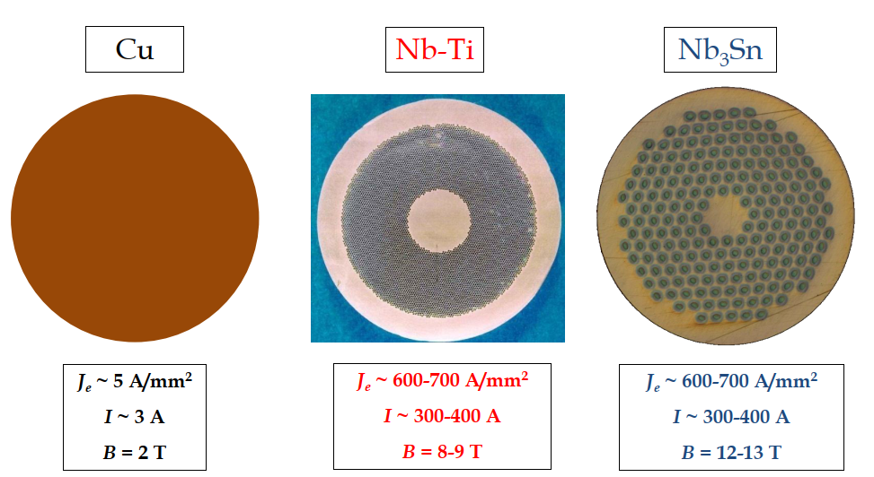
LTS Properties – Cable Composition 2

Slide 14
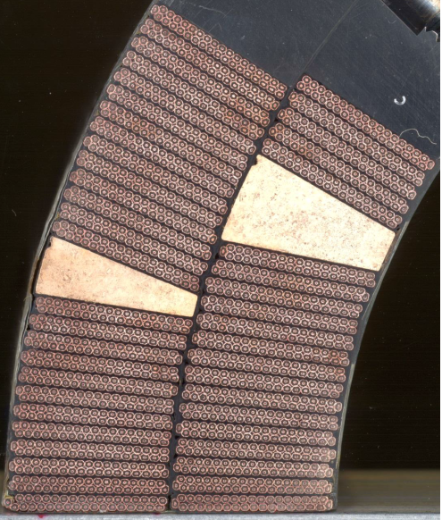
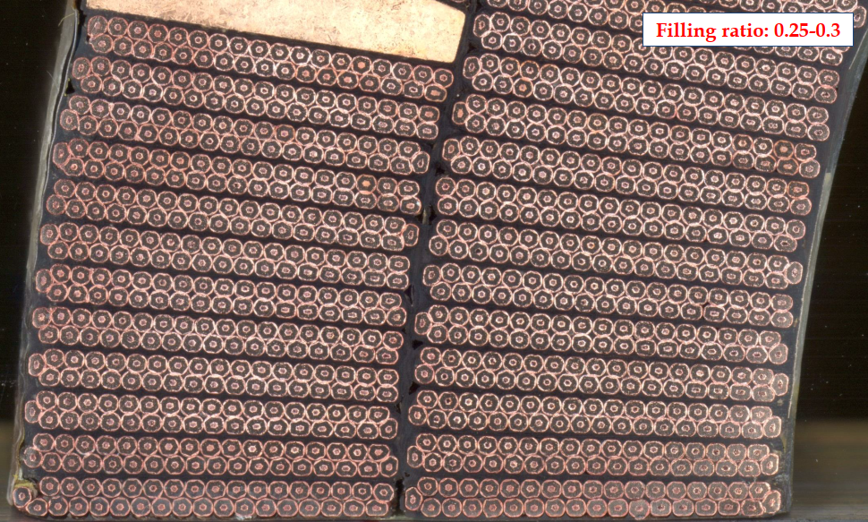
LTS Properties – Typical use of “Rutherford Cable”

Slide 15
HTS Properties
There are many High Temperature Superconductors (HTS) with Critical Temperatures conveniently above 90K, eg YBCO (YBa2Cu3O7)
Will thus operate in liquid nitrogen
Considerably cheaper and less complicated than LHe
HTS features a disappointing “Flux Flow” operating region, in which the material is resistive, whilst still superconducting, rather than a well defined Critical Temperature
HTS can still be used in regions of both high temperature and high field, but current density is a problem
HTS is produced as a tape
Frequently used for current leads within cryostats that use cold-heads
But temperature and field must be well monitored & controlled
For magnets utilising both HTS and LTS cables, HTS cables MUST have adequate Quench protection, including substantial current shunts
Minimises thermal load on the cold-head 1st stage
Increases efficiency of cold-head 2nd stage
Not needed with refrigerators, which cool current leads with return He gas

Slide 16
Engineering Current Density
When designing a magnet, the Engineering Current Density (Jeng) is the most important characteristic
The resultant field and hence the actual current is all that really matters
Engineering Current Density takes account of:
The actual proportion of SC in each wire (fill factor), typically 0.4 to 0.2
The fill factor of the wires in the coil pack, typically 0.7 to 0.8
(including insulation, cooling channels, stabiliser, mechanical reinforcement, etc)
Thus Jeng is realistically only 15% - 30% of Jsc
The actual coil pack volume is inversely proportional to Jeng/Jsc

Slide 17
Quenching
A magnet Quenches when it irreversibly changes from the superconducting to resistive state
Consequently, all the stored energy is converted into heat
through resistive heating of the SC cable, which is dissipated in the cold mass
with the option of extracting energy via external dump resistors
NB: The power circuit must be designed with care, if HTS current leads are used
All the liquid cryogens will also be rapidly expelled via relief valves
Superconductors have a very high normal-state resistivity
If Quenched, a very high temperature would be reached very quickly
The coil might suffer damage and/or delaminate at temperatures above 150K, and certainly above 250K
By embedding the SC filaments in a matrix of copper
The matrix helps to stabilise the SC against flux jumps
The matrix allows current to redistribute in the low-resistivity matrix
The peak temperature will be lower
The Quench detection system has more time to react and act on the power circuit

Slide 18
Quench Protection
Magnets should be designed to Quench very rarely, as each Quench causes stress
The anticipated Quench behaviour of the magnet must be designed and analysed meticulously
Quench protection circuits comprise some or all of the following:
Voltage taps that measure and compare the voltages between comparable parts of the coil circuit by means of sophisticated Wheatstone Bridges
These typically trip the power-circuit when a persistent imbalance of 1V is detected
The detection system must be 100% reliable, but avoid false signals – challenging!
Use hard-wiring, PLC, or Linux (in order of merit), but never Windows
NB: All such trips will result in an actual Quench, whether or not the signal was real
The detection system must compare overlapping segments, to avoid excluding joints
Pressure, temperature, and vacuum sensors, to react to Quench precursors with a “slow trip” and avoid an actual Quench where possible
Whenever a Quench is initiated/detected, it is imperative to force all circuits to Quench together, by means of Quench-heaters, to avoid hot-spots and/or unbalanced forces

Slide 19
Quench Causes
Rapid current-ramping
Causes eddy-current heating => Quench
Exceeding the Critical Current => Quench
Avoid exceeding 80% of the maximum current (Short-Sample Current)
Coil or current lead movements within the magnetic field
Can produce an artificial Quench signal
Cracking of the resin or flux jumping
Causes a transition, which allows some current to flow in the stabiliser
Can lead to a Quench, if not stabilised quickly enough
Resistive joint, creating heat
Thermal leak of the cryo-system
Training
All SC magnets undergo some “training”, whereby they progressively approach their theoretical Critical Current
Better-designed magnets suffer less training
NB: Warming-up a magnet can undermine previous training

Slide 20
Forces within Magnets
Static Forces
Suspension and tie rods are required to handle gravitational loads, as well as magnetic forces
The rods have to be strong enough to handle the forces
The rods must also be thermally insulting between the cold mass and its support frame
Forces during a Quench
Significant unbalanced forces can develop during a Quench due to:
Unbalanced or partly-delayed collapsing fields
Forces between the Quenching magnet and any neighbouring magnets

Slide 21
Beware Fringe Fields
Fringe fields produced by a non-shielded magnet can adversely affect:
Neighbouring instruments and equipment
The magnet’s own instrumentation, including its protection system
People in the vicinity
NB: The presence of ferrous objects can strongly enhance the local field beyond what might be predicted in air

Slide 22
Thank you
technologysi.stfc.ac.uk
@STFC_Matters
Science and Technology Facilities Council
Science and Technology Facilities Council

