Slide 1
The Front End Test Stand and Pre-injector Upgrade
FFA2022
29th September 2022
Alan Letchford
ISIS Head of Linear Accelerator R&D

Slide 2
Pre-injector upgrade
In 2004 the Cockcroft Walton DC pre-injector was replaced with an RFQ

Slide 3
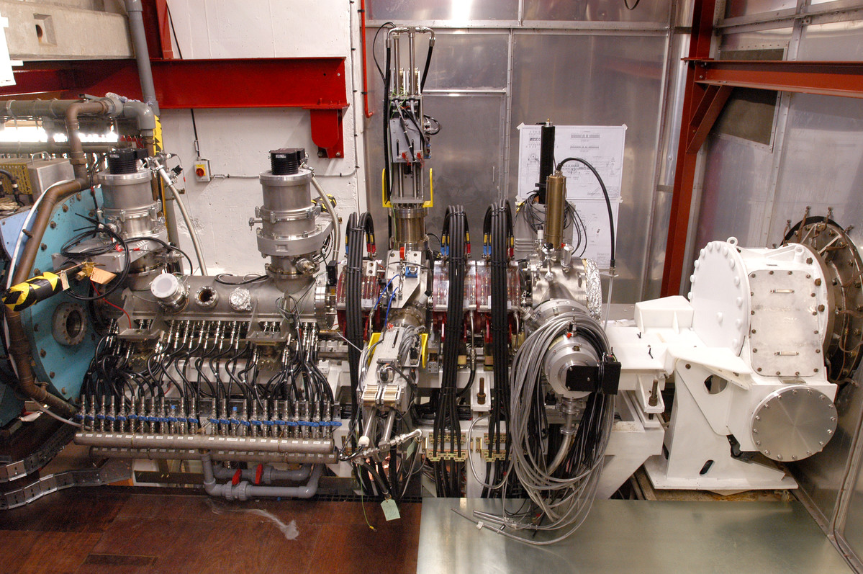
RFQ Pre-injector upgrade
When the RFQ was installed the available space was highly constrained.
It was always anticipated that we would eventually install a MEBT.
After a decade of almost faultless operation we decided it was perhaps time to take that risk.

Slide 4
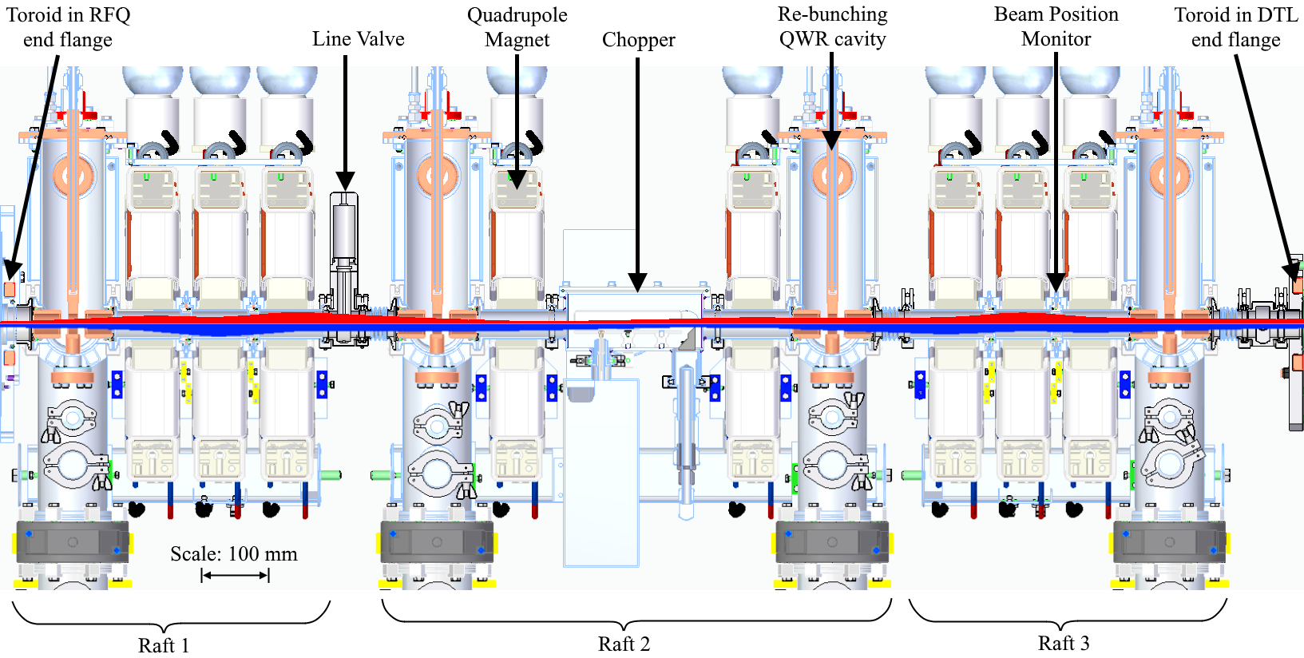
Even with extra space available to design of the MEBT is very constrained.
8 quadrupoles
4 bunching cavities
Beam chopper
4 BPMs
All in less than 2 m
The MEBT should achieve close to 100% transmission in Tank 1.

Slide 5
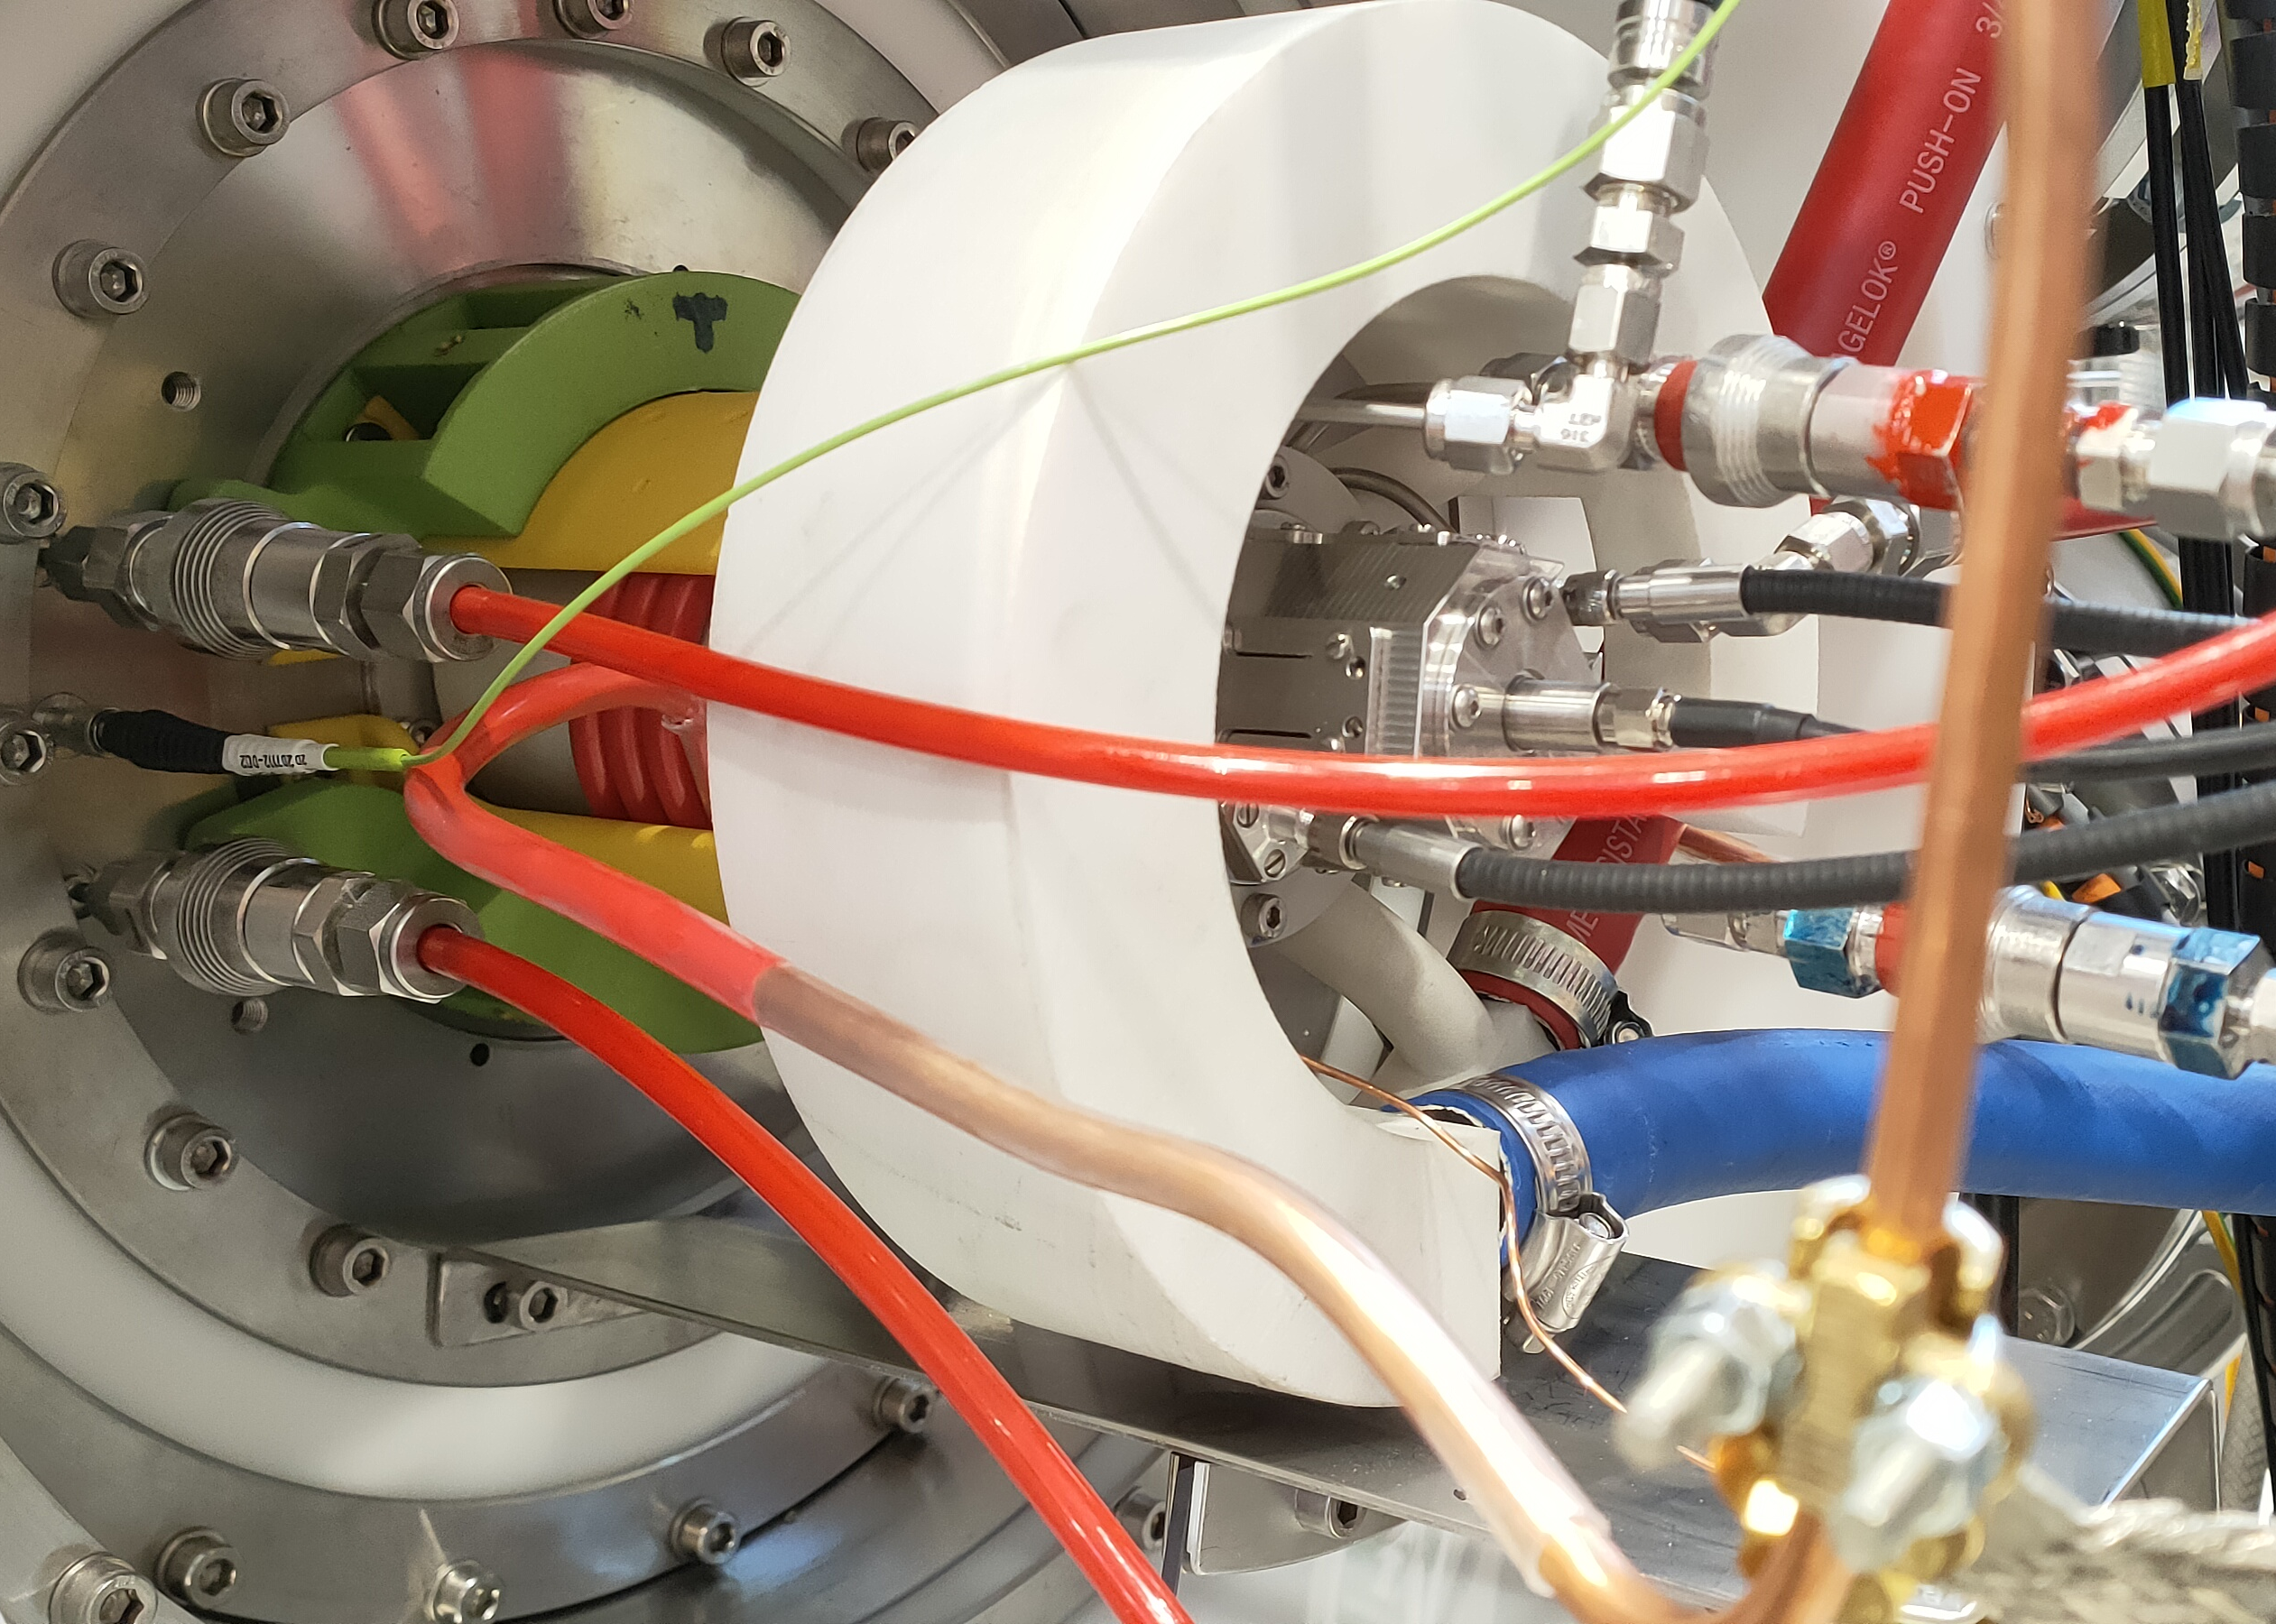
The improved performance of the pre-injector with the MEBT installed will reduce the demands on the ion source.
A new un-caesiated RF volume source is being developed in parallel with the MEBT.

Slide 6
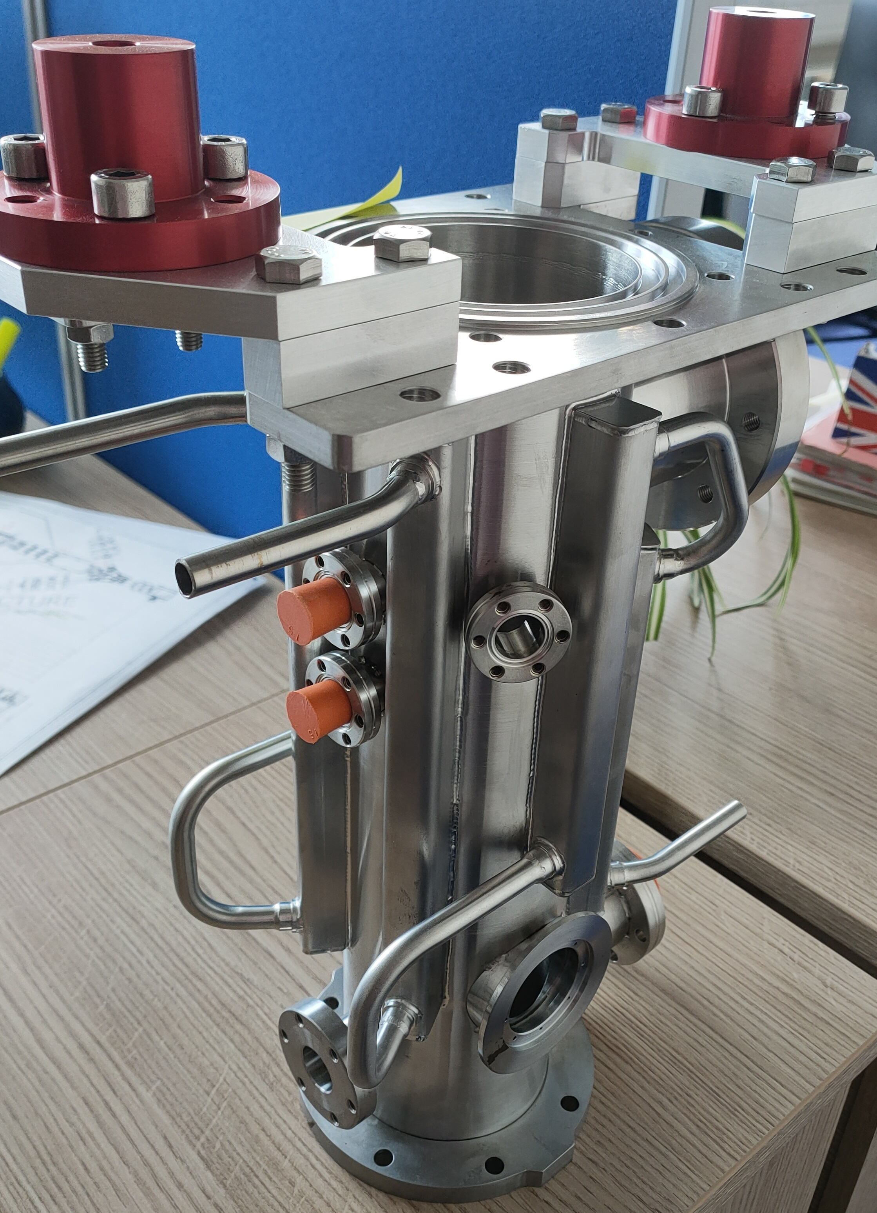
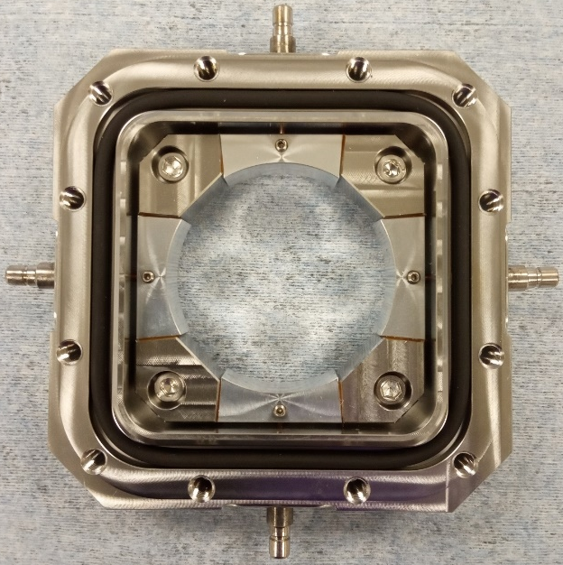
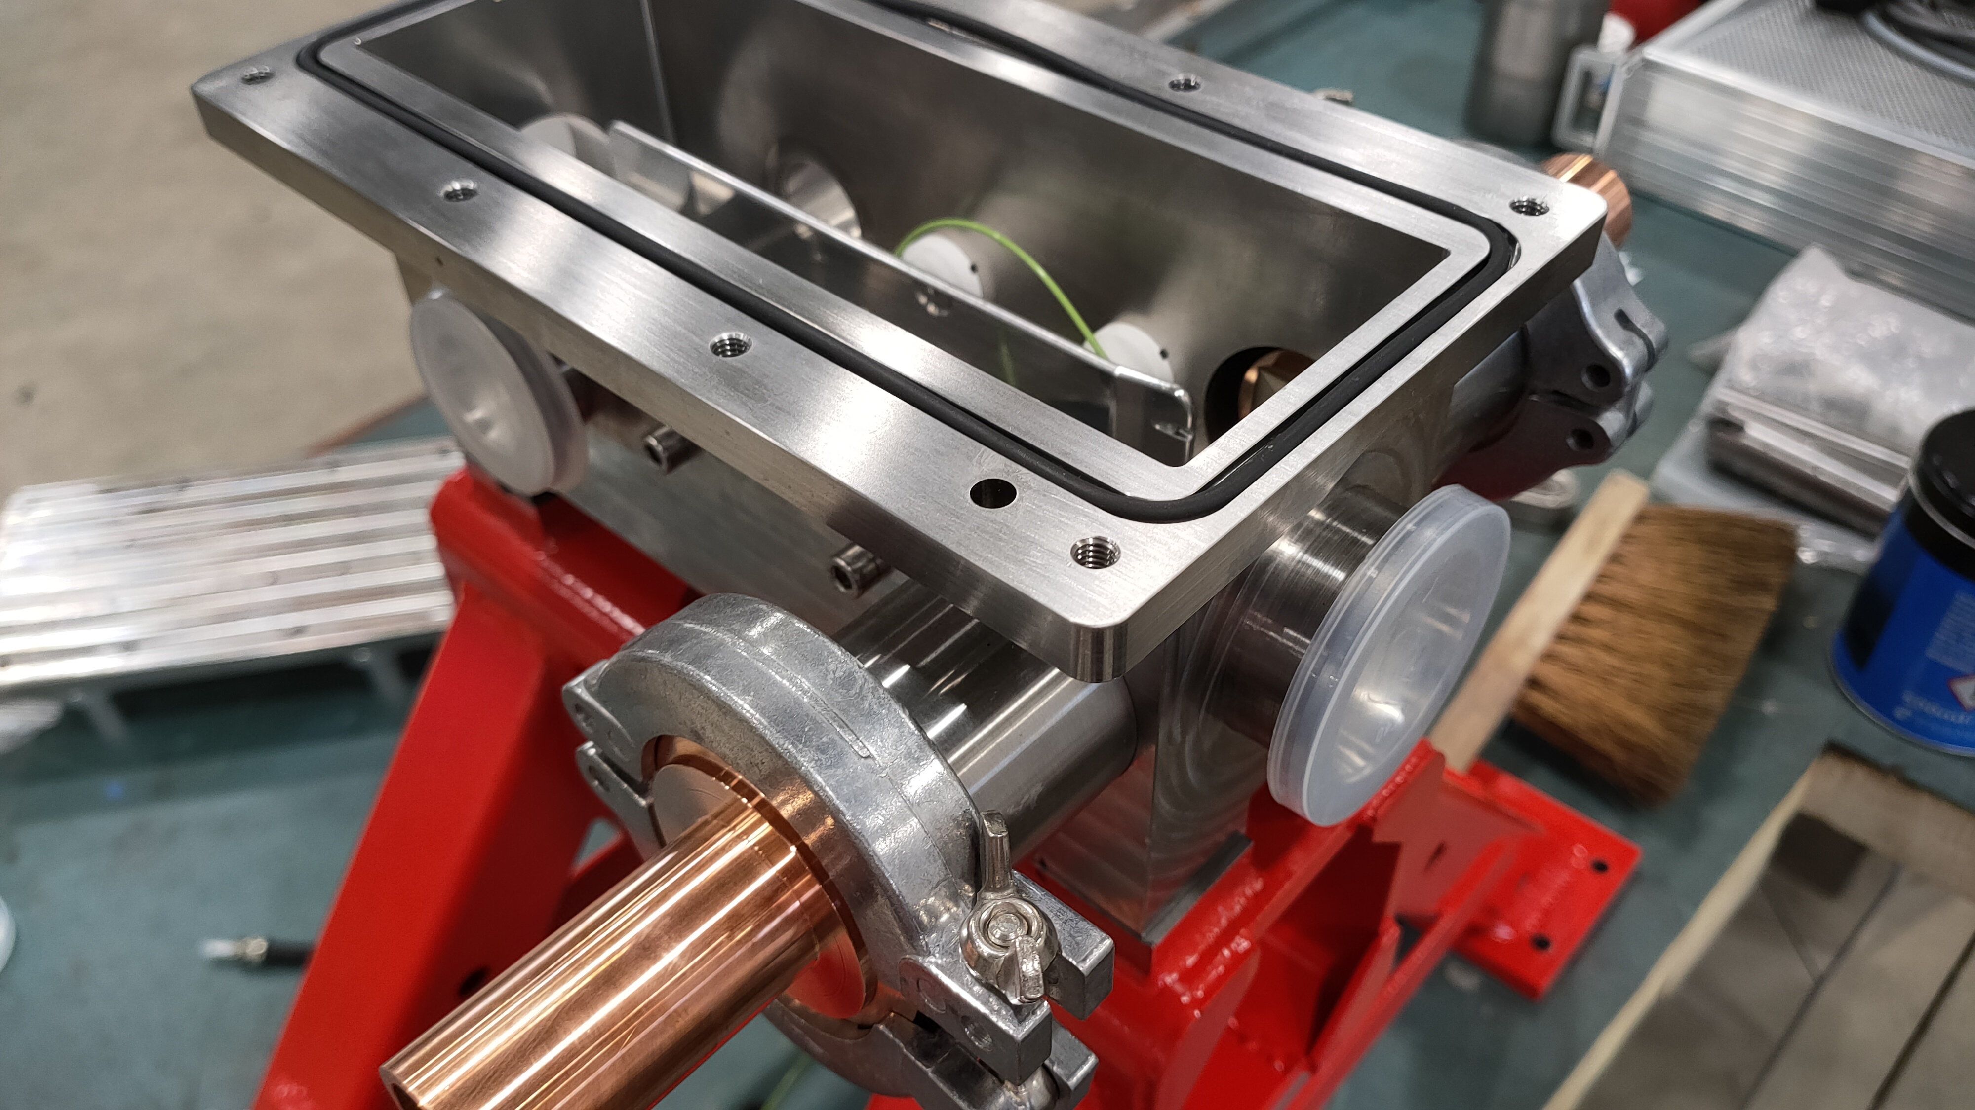
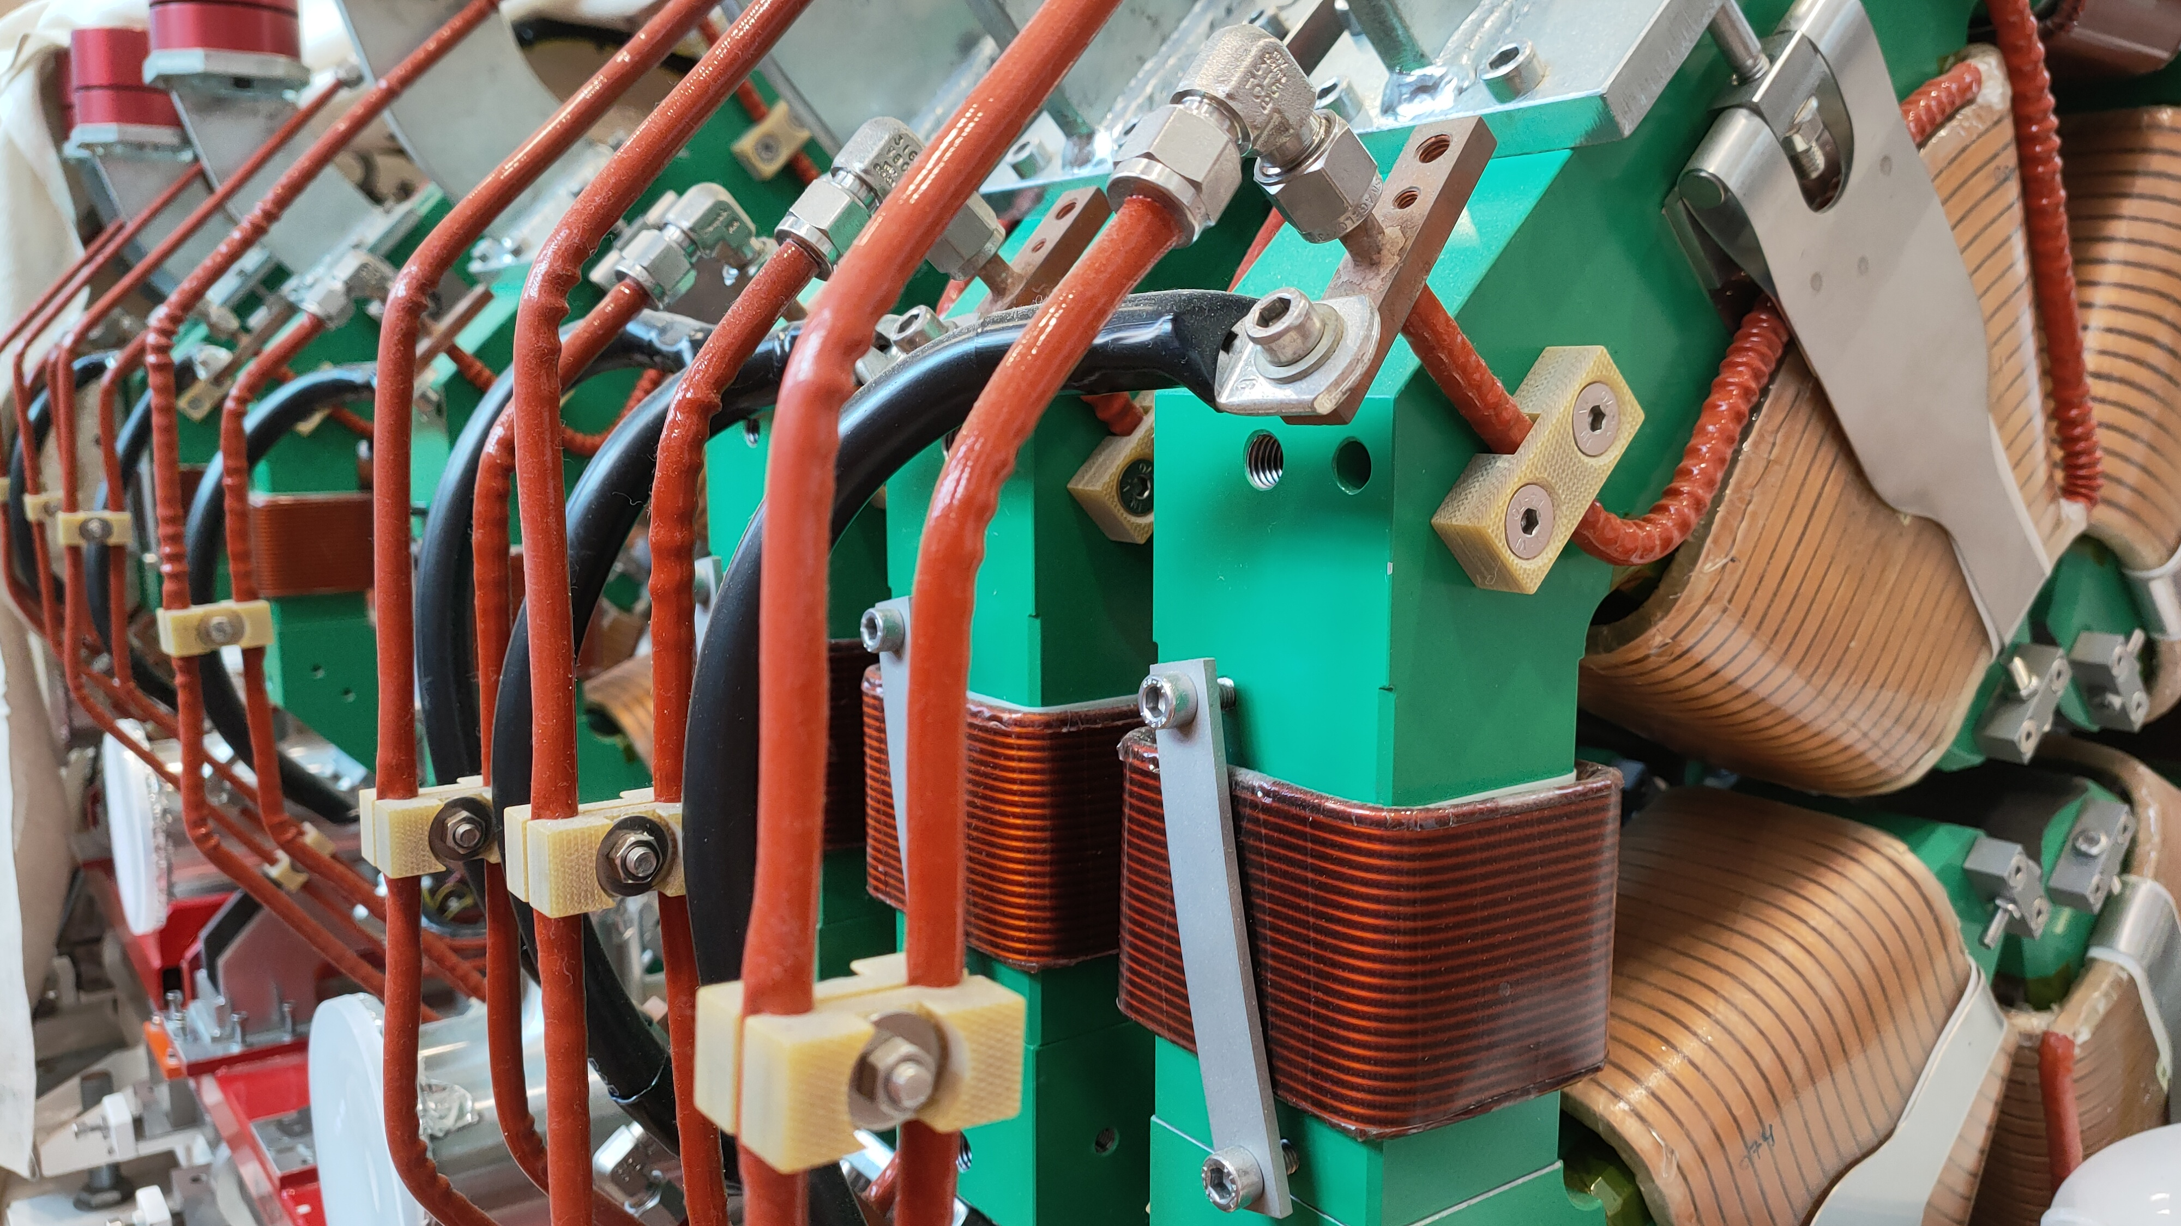
Most of the components are complete or in the final stages of manufacture.

Slide 7
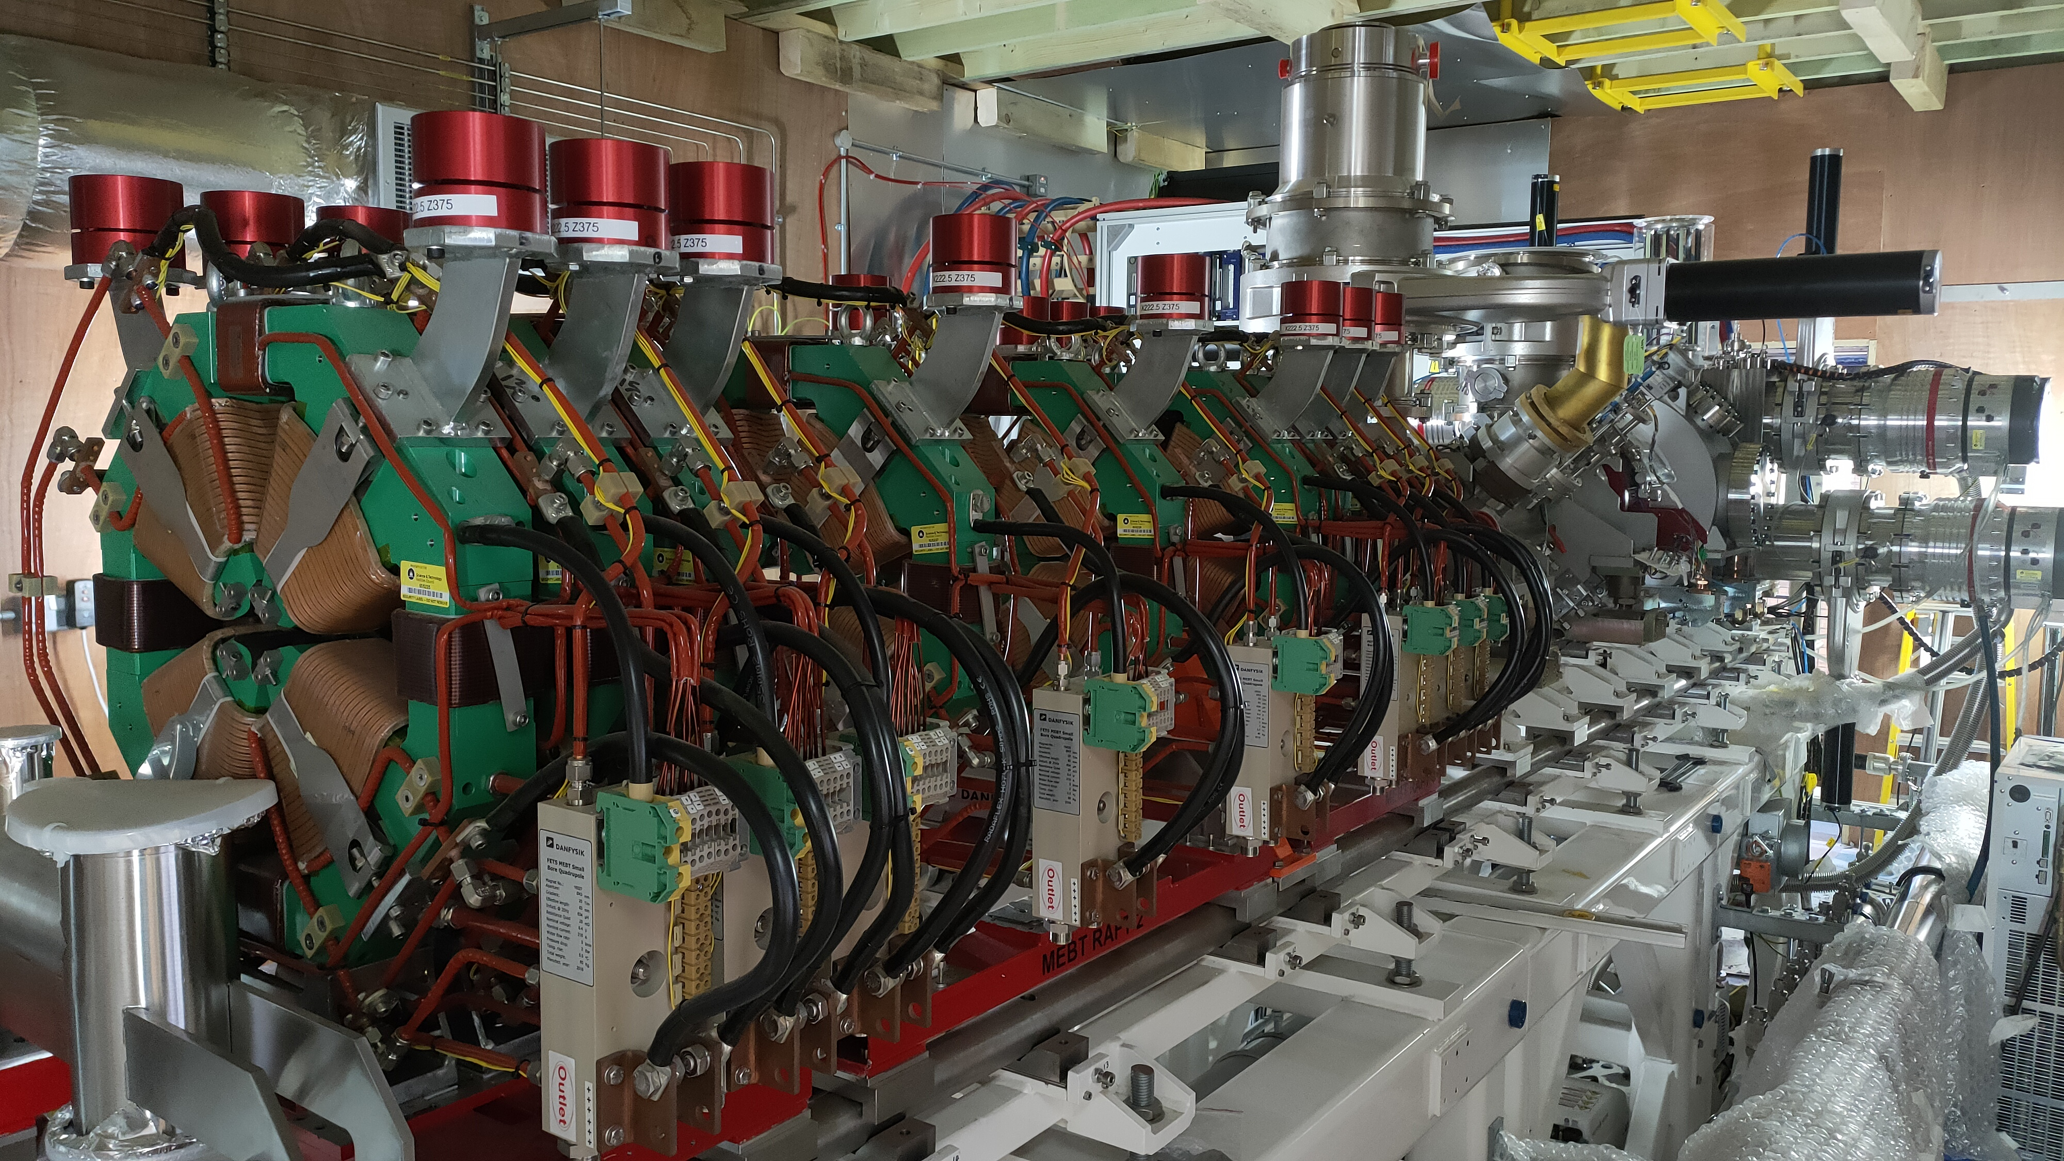
A test stand based around the spare RFQ is being built to allow commissioning and long term testing of the complete pre-injector.
First beam in anticipated in 2023 with installation possibly in 2024

Slide 8
Front End Test Stand
FETS will demonstrate front end technologies for future high power proton drivers
High power means 18 kW @ 3 MeV
=> 1 MW @ 180 MeV
FETS is generic – many possible applications

Slide 9
FETS Collaboration

Slide 10
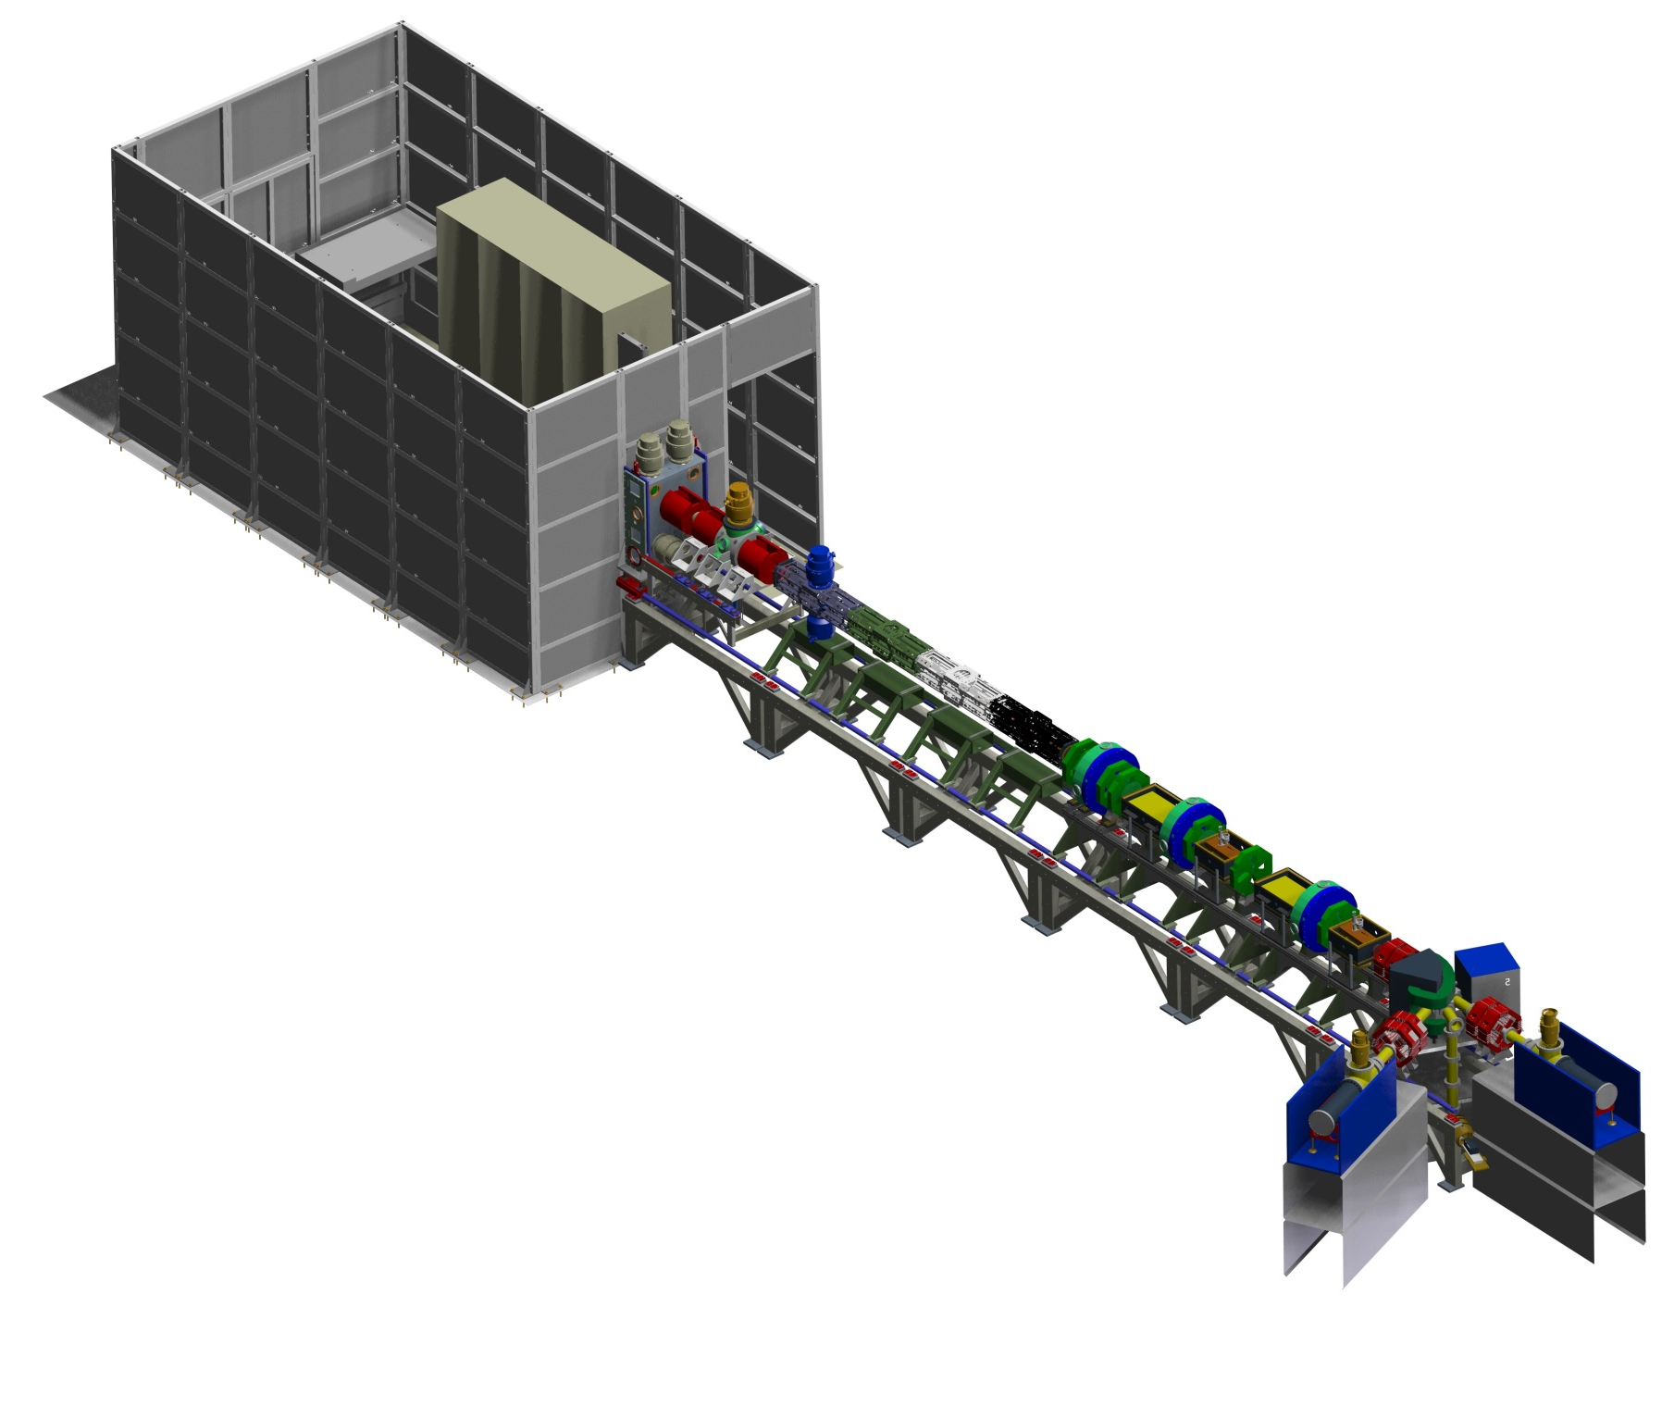
What is FETS?
Low Energy Beam Transport
Three-solenoid configuration
Space-charge neutralisation
5600 Ls⁻¹ total pumping speed
Medium Energy Beam Transport
Re-buncher cavities and EM quads
Novel ‘fast-slow’ perfect chopping
Low emittance growth
High brightness H– ion source
4 kW peak-power arc discharge
60 mA, 0.25 π mm mrad beam
2 ms, 50 Hz pulsed operation
Diagnostics
Non-interceptive
Well distributed
Laser-based
Radio Frequency Quadrupole
Four-vane, 324 MHz, 3 MeV
4 m bolted construction
High power efficiency
Beam Dumps
Defocussing quads
Water cooled cones
Pure Al
Notes:
F

Slide 11
H– Ion Source
High brightness Penning Surface Plasma Source (SPS)
Requirement is for 60 mA in 2 ms pulses at 50 HZ
Based on ISIS operational source with higher current and longer pulses

Slide 12
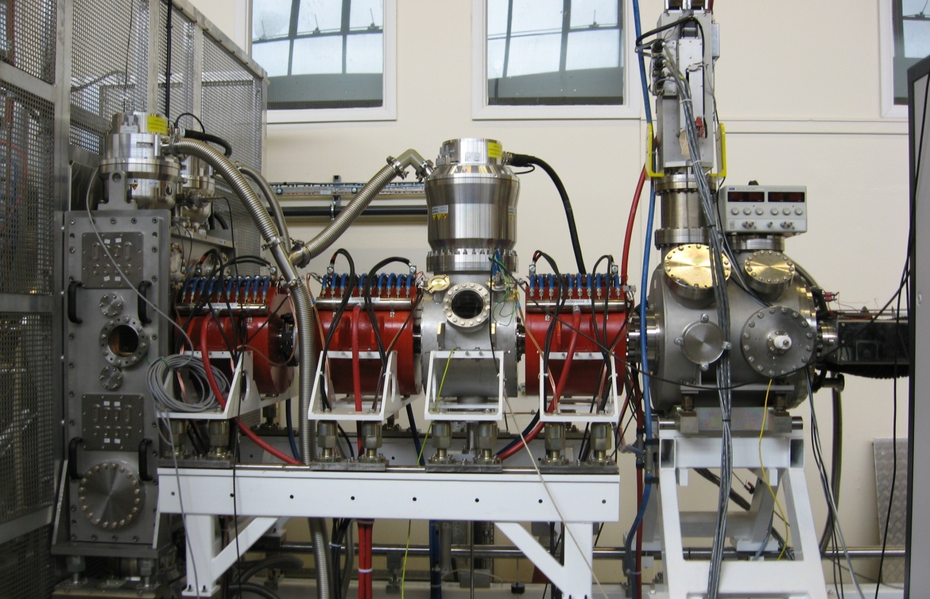
Low Energy Beam Transport (LEBT)

Slide 13
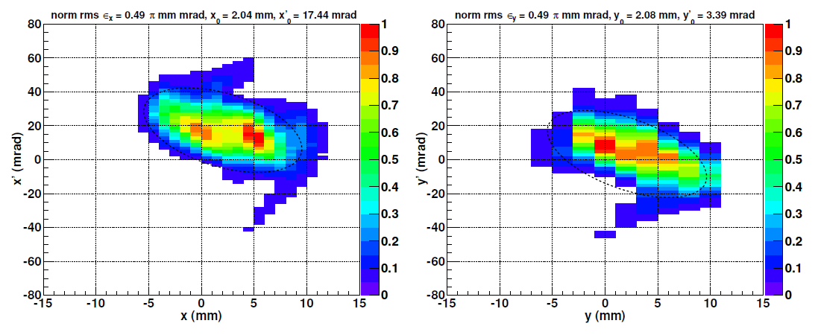
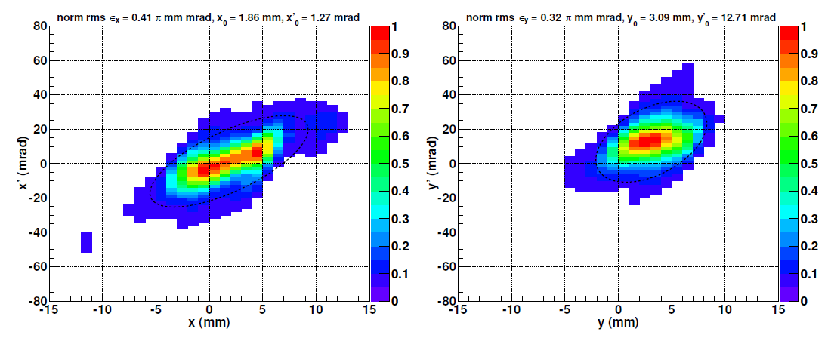
LEBT Matching
Following successful alignment of the ion source beam parametric studies of the LEBT were performed to demonstrate the ability to match the beam into the RFQ.
The LEBT beam can be taken through a focus (waist) at the RFQ matching plane.
This is a requirement for good matching.

Slide 14
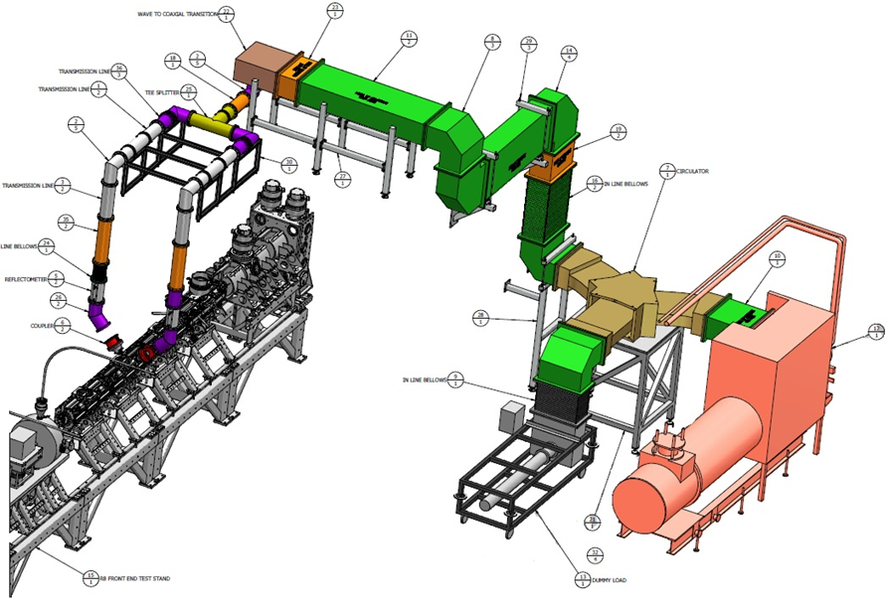
The FETS RFQ needs ~500 kW of RF power to excite the structure plus 175 kW to accelerate the beam. To give some overhead a 1 MW, 324 MHz klystron has been chosen.
RF Power Systems
The high power RF system consists of the klystron plus modulator, circulator and load, waveguide and coaxial transmission lines and the power couplers.

Slide 15
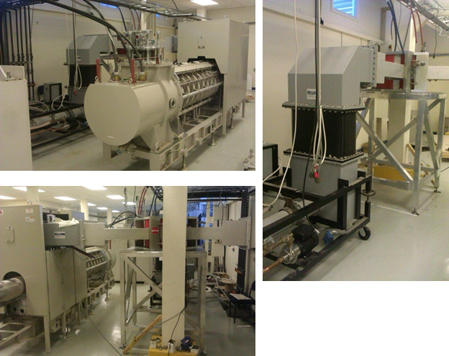
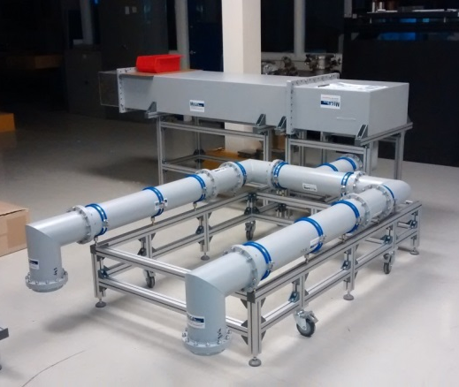
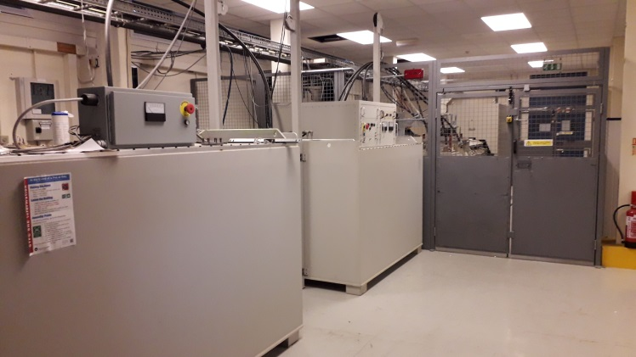
The klystron, modulator and circulator have been tested at full power into a dummy load.
A prototype digital LLRF system based on NI high speed FPGA cards has been tested and is being further developed.

Slide 16
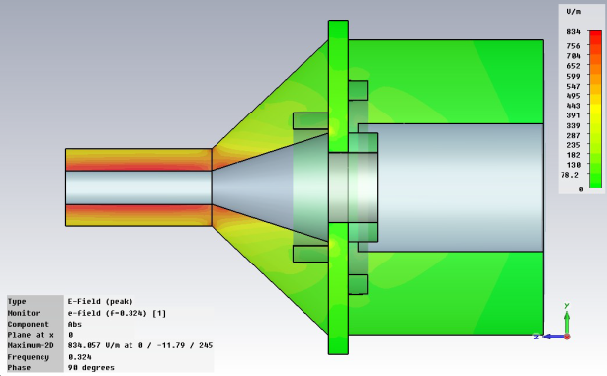
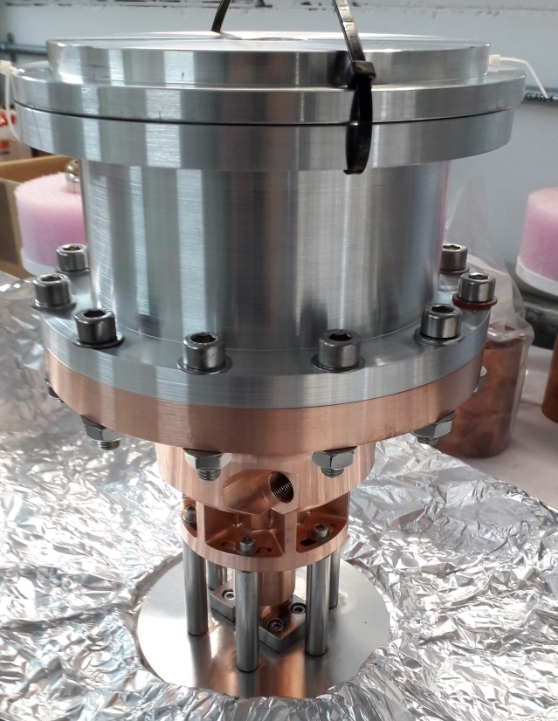
RFQ Power Coupler
The RFQ has 2 power couplers. Each one has to deliver 350 kW peak power.
An RF window maintains the RFQ vacuum and the shape helps match the transition from the 6” coaxial feed to the 40mm coupler port.
Significant simulation effort has resulted in a match better than -40dB at low power.

Slide 17
Medium Energy Beam Transport
Lattice Requirements:
Perfect chopping
Low beam loss: 3 MeV causes activation
Low emittance growth
Space for diagnostics
Minimize cost i.e. reduce:
Number of components
Magnet & RF power
Achieving all of the lattice requirements simultaneously proved to be challenging and time consuming.

Slide 18
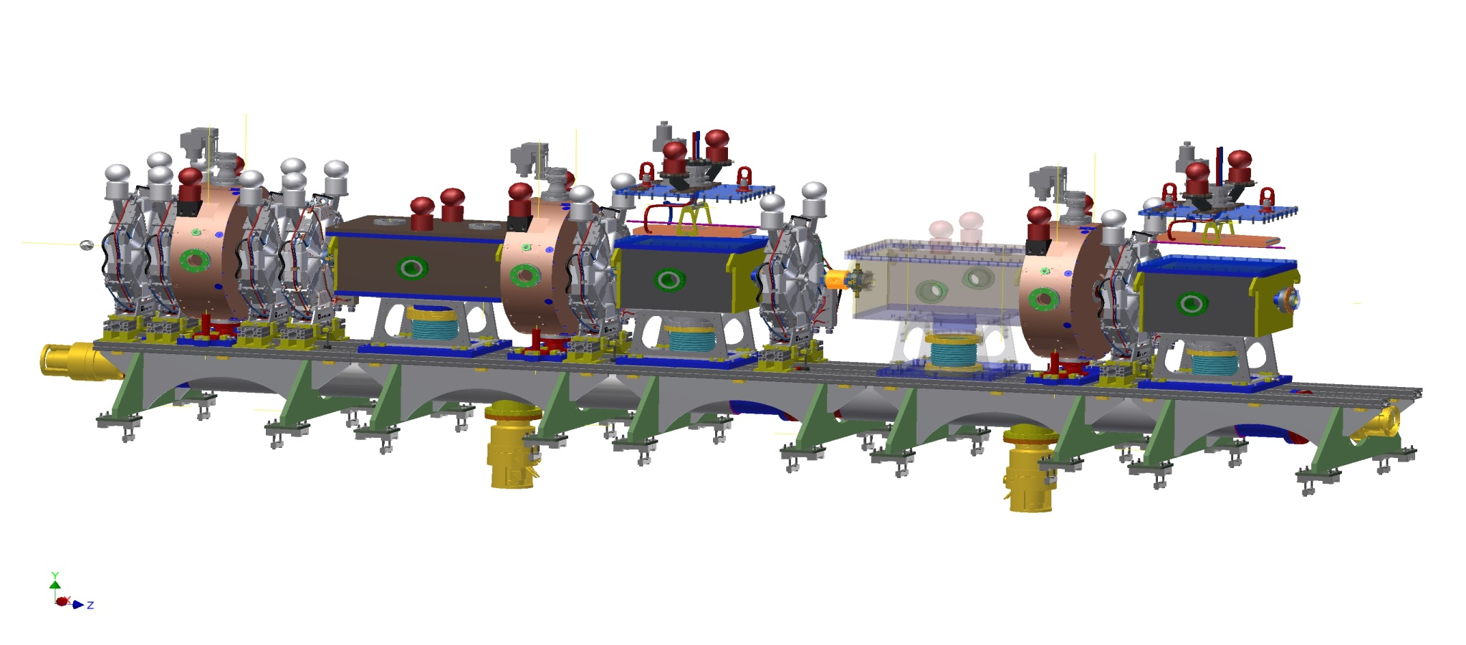
MEBT Elements
3 rebunching cavities
Fast chopper beam dump
Slow chopper beam dump
Fast chopper
Slow chopper
7 small bore quads

Slide 19
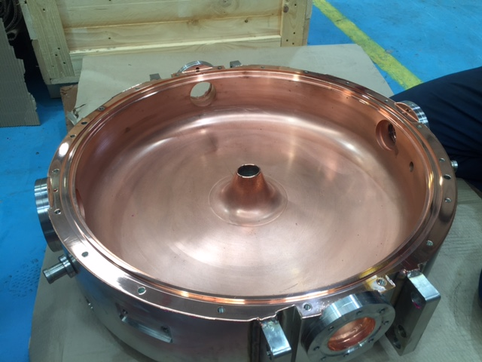
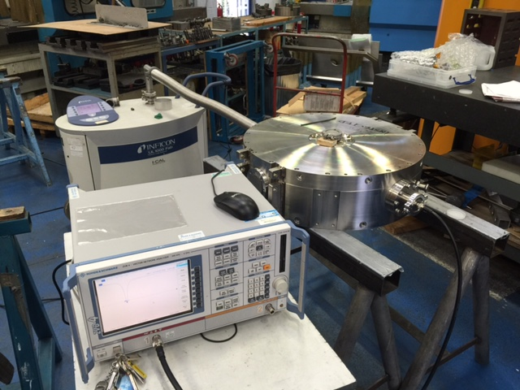
MEBT Rebunching Cavities
Re-bunching cavities:
Re-entrant type cavities
324 MHz, ~8 kW peak power
150 kV effective voltage
Copper plated stainless steel for lower cost
Dimensions and RF properties measured at various stages during manufacture to achieve required performance.

Slide 20
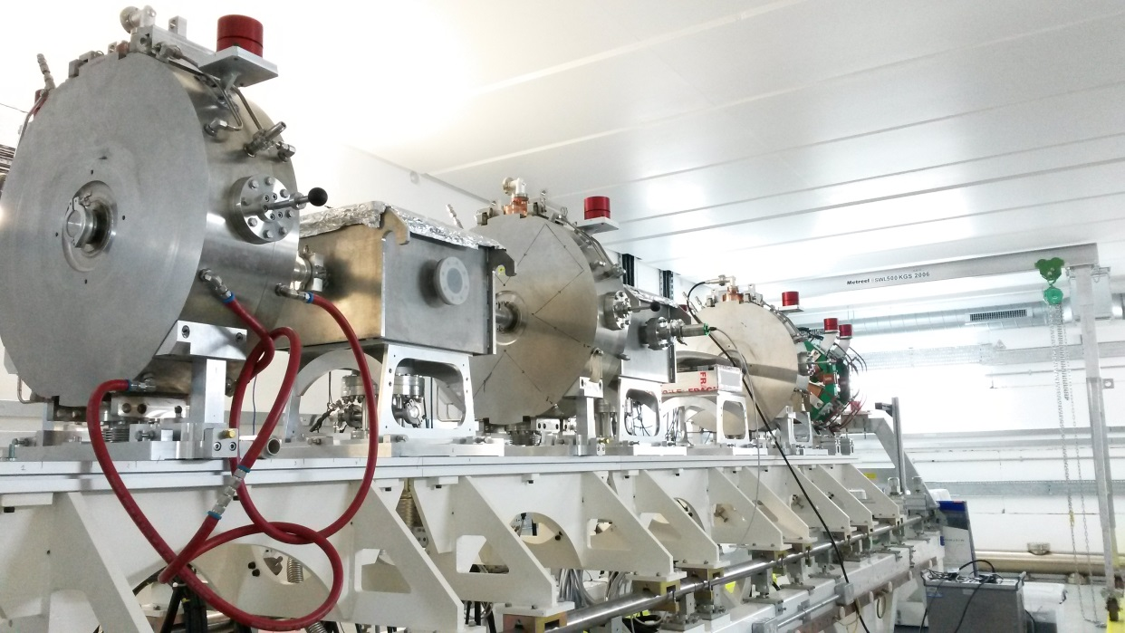
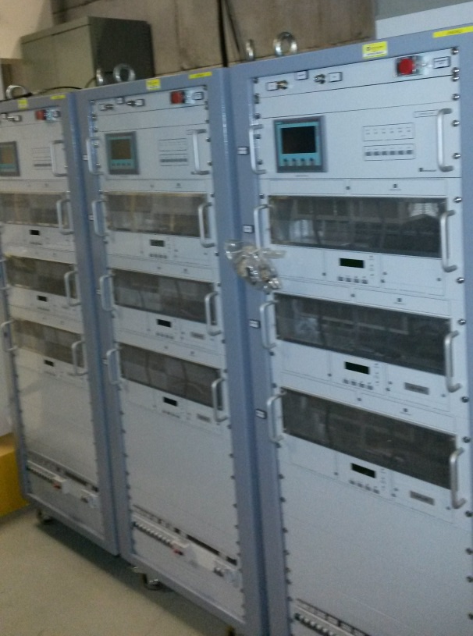
MEBT Rebunching Cavities
The 8 kW RF amplifiers have been tested and the cavities conditioned to full power.
The attention to detail during manufacture and assembly meant this was achieved in <1 day.

Slide 21
FETS Chopper
‘Perfect’ Electrostatic Chopping
The beam chopper removes sections of the bunch train to generate complex time structure.
‘Fast-slow’ chopping scheme:
Specification:
Adaptable chopping scheme
No partially chopped bunches
<2 ns rise time: between bunches
Up to 150 μs gap in bunch train
Up to 6 kW dumped beam power

Slide 22
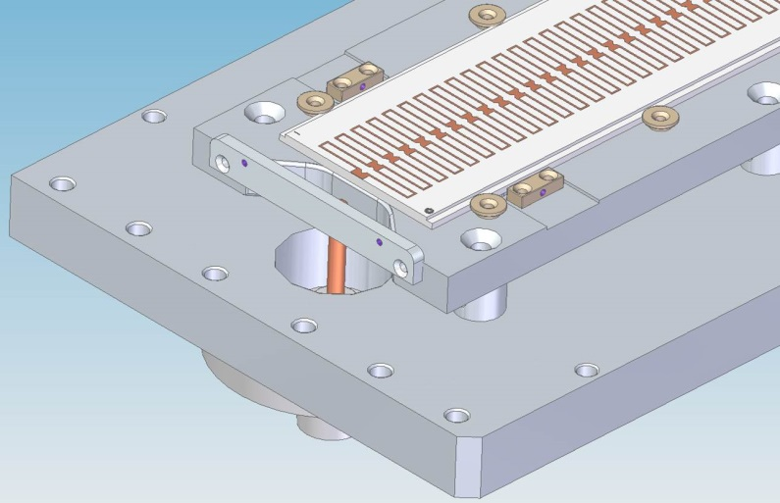
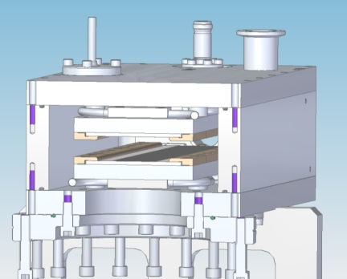
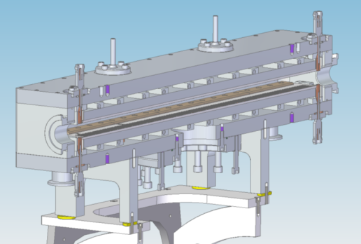
‘Fast’ Chopper
The ‘fast’ chopper is a wide bandwidth, slow wave, electrostatic deflector.
The wave-front in the deflector matches the velocity of the beam ions to ensure that bunches are either fully deflected or not deflected at all.

Slide 23
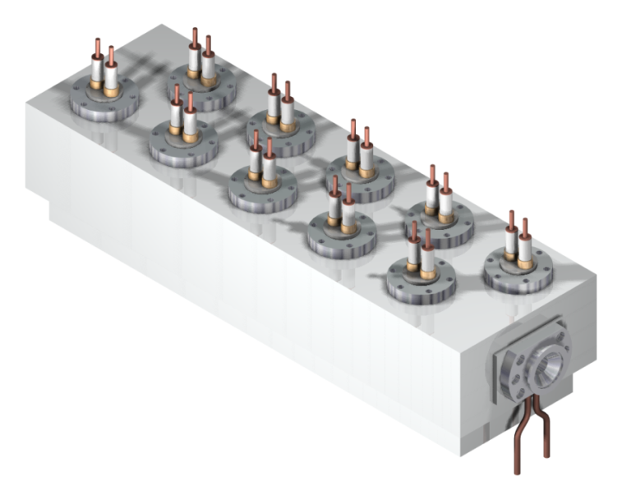
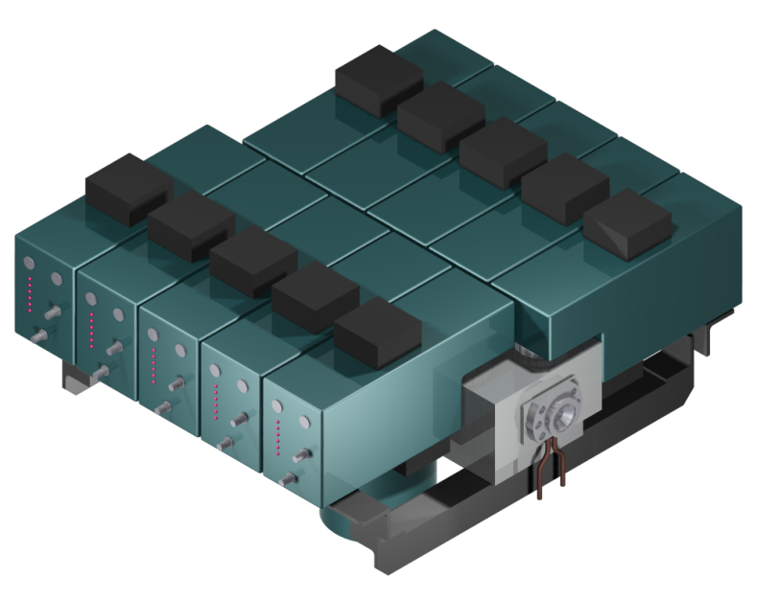
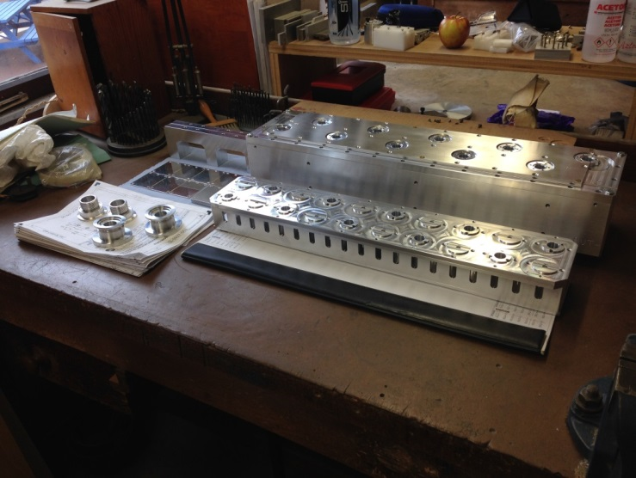
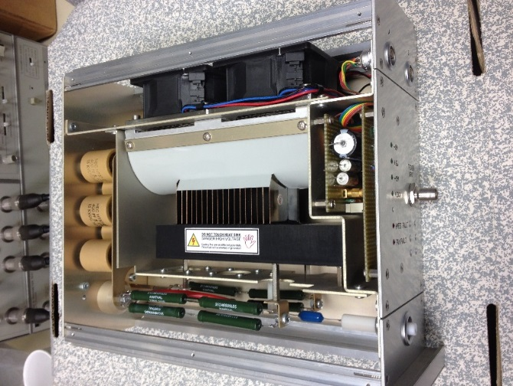
‘Slow’ Chopper
The ‘slow’ chopper is a lumped electrostatic deflector with a rise-time of 10 ns.

Slide 24
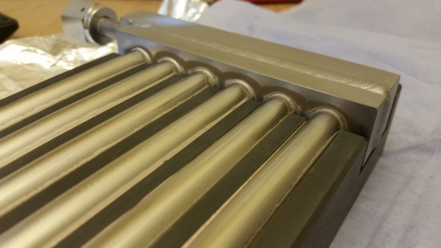
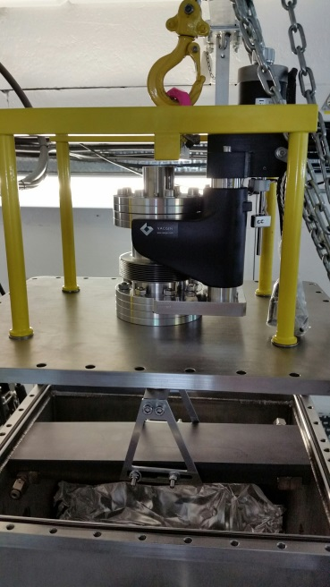
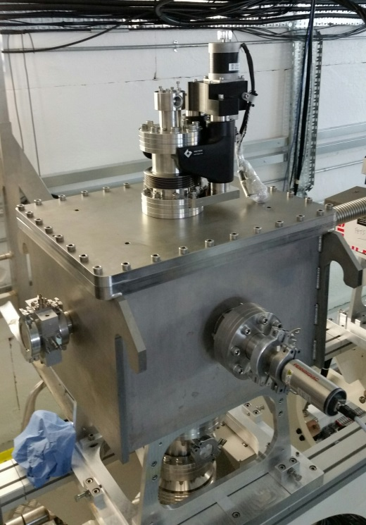
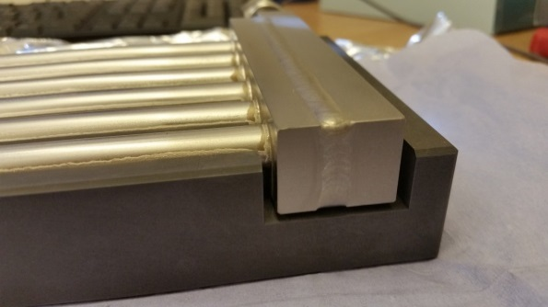
Chopper Beam Dumps
Up to 1/3 of the beam might be removed by the choppers and needs to be dumped somewhere.
Graphite was chosen as the dump material from radiological and thermal requirements. Titanium cooling pipes are brazed to the graphite.
A motorised mount precisely controls the position of the beam intercepting surface.

Slide 25
Radiation Protection
Every effort has been made to exclude radiologically ‘bad’ materials from FETS.
Even so significant shielding is required to protect personnel from the expected levels of gammas and to a lesser extent neutrons.

Slide 26
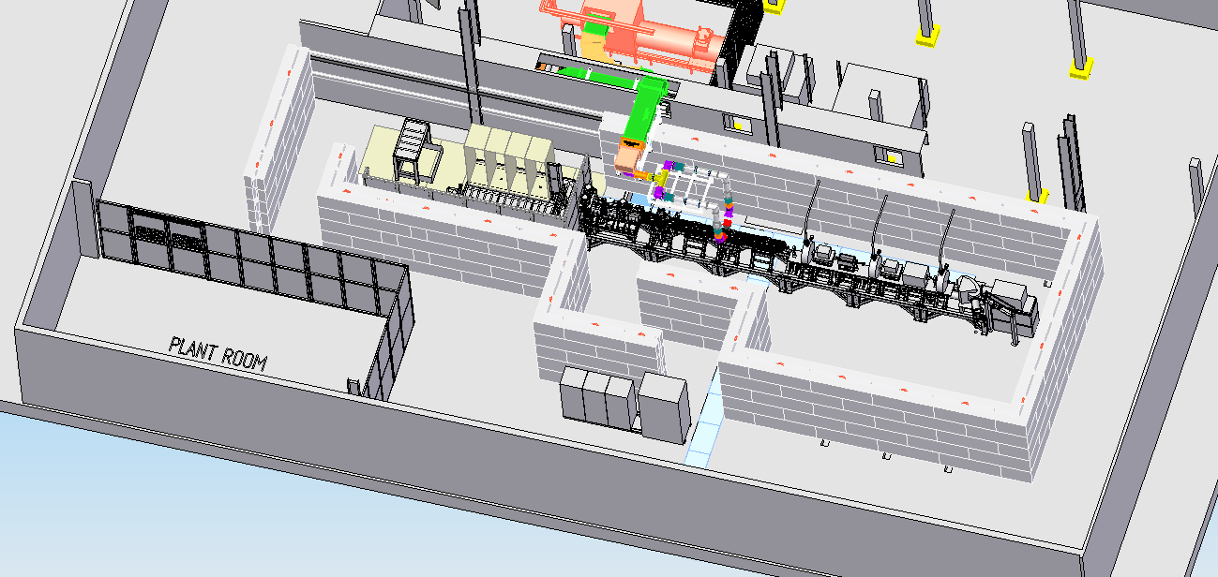
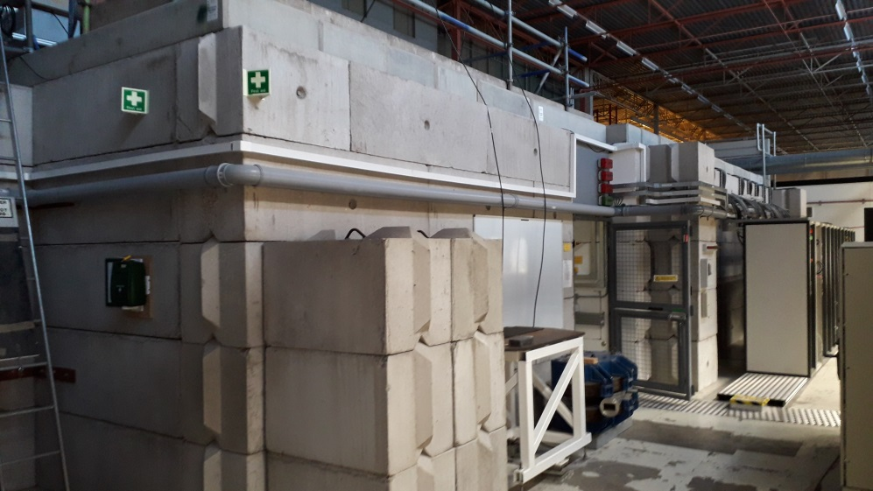
Radiation shielding
A shielding concept was developed and approved by RAL RPA
The shielding, interlocks and personnel protection systems are in place.

Slide 27
The FETS RFQ
324 MHz, 3 MeV, 4 vane, 4m long

Slide 28
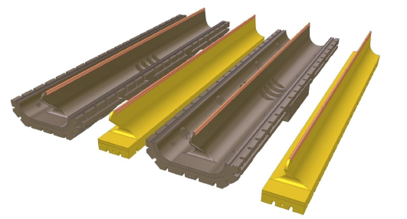
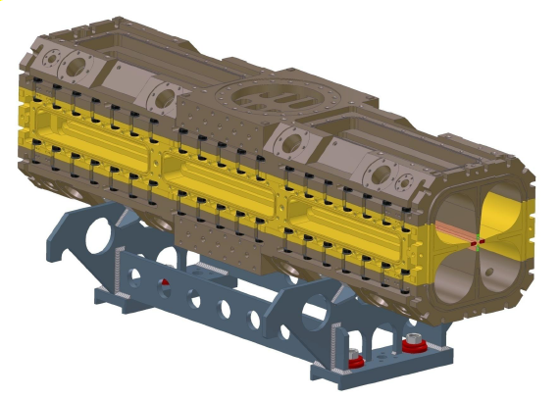
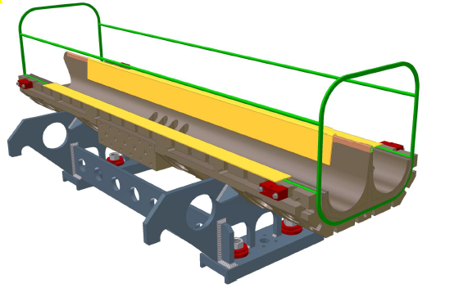
FETS RFQ Design
Sections made of 2 major and 2 minor vanes
Vanes bolted together to make 1 m sections
3D o-ring
4 x 1 m long sections bolted together

Slide 29
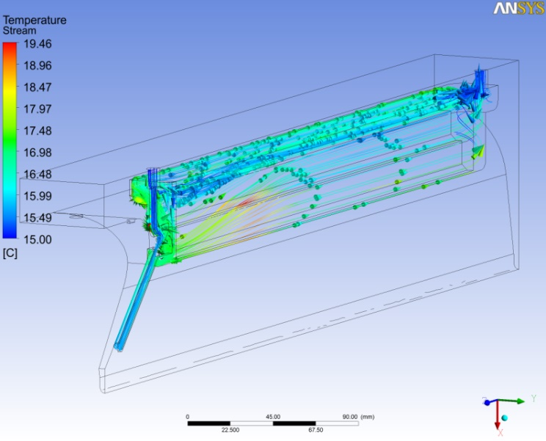
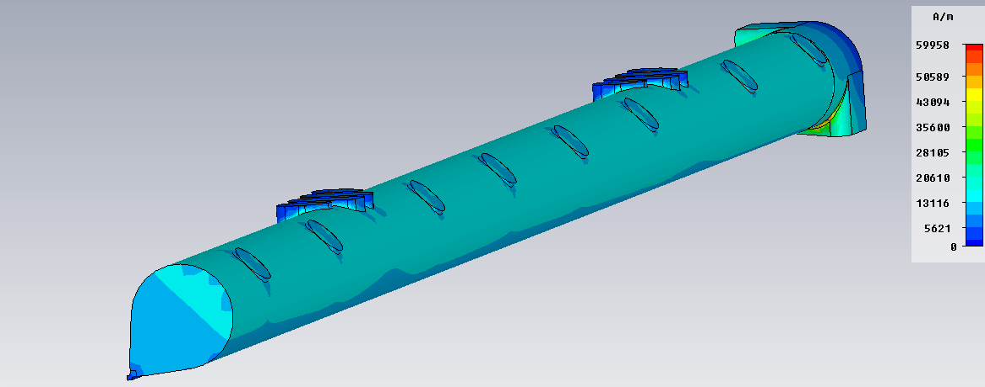
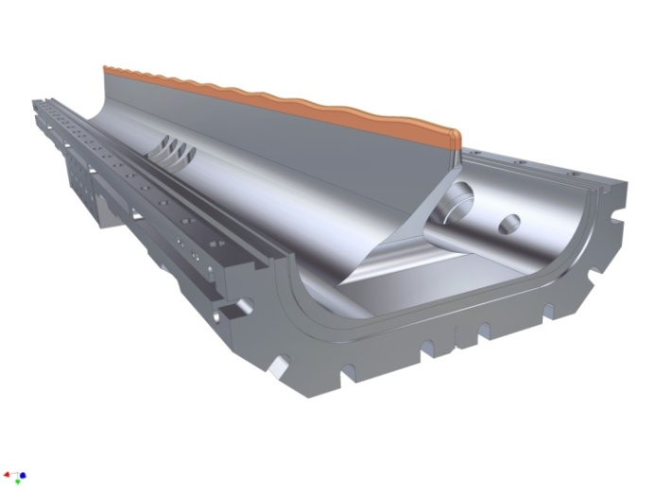
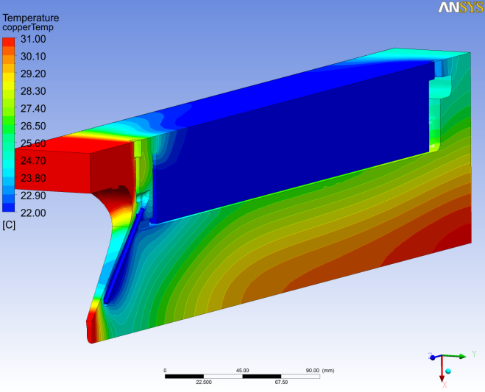
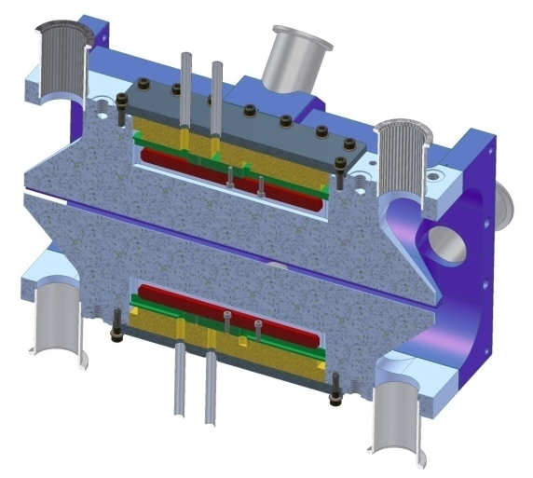
A significant amount of computational effort went into the RFQ design.
Mechanical, CFD and electromagnetic CAD systems were extensively used.
Prototypes and ‘cold’ models were used to confirm the modelling results.

Slide 30
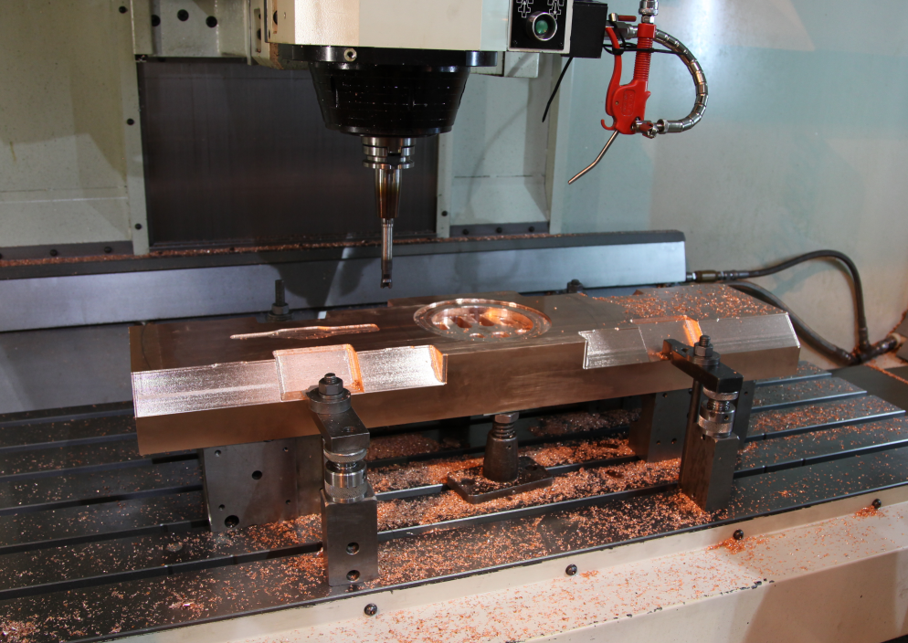
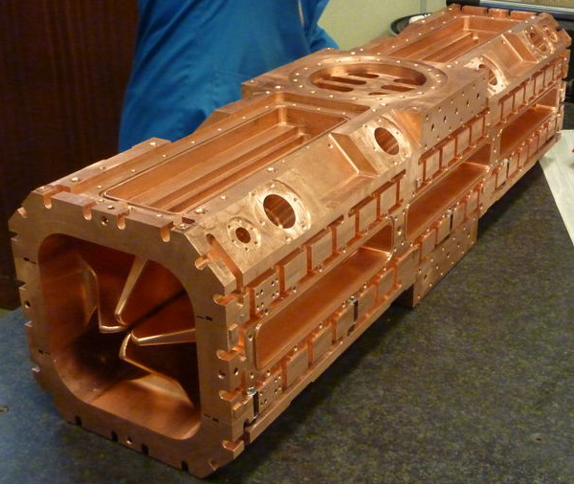
Machining and alignment tolerances are challenging for the 4m long RFQ structure:
Vane tip positional tolerance to achieve transverse beam dynamics: <100 μm
Vane tip positional tolerance to achieve required resonant frequency: 40 μm
Vane modulation length tolerance for 1° phase error at input: 20 μm
Vane to vane longitudinal position tolerance: 20 μm
Mating face flatness and parallelism tolerance: 10 μm

Slide 31
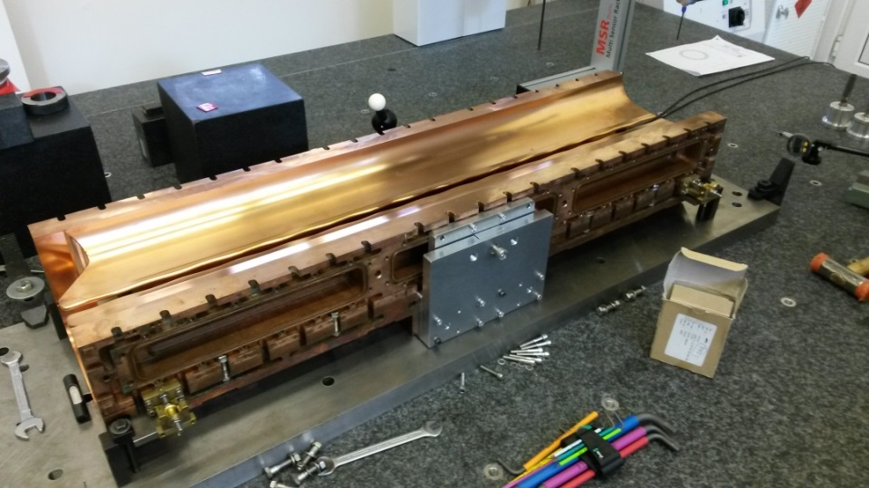
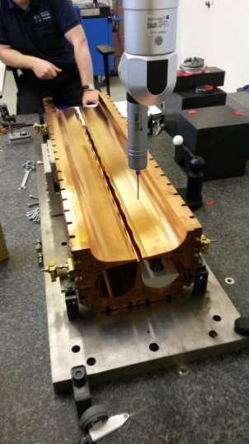
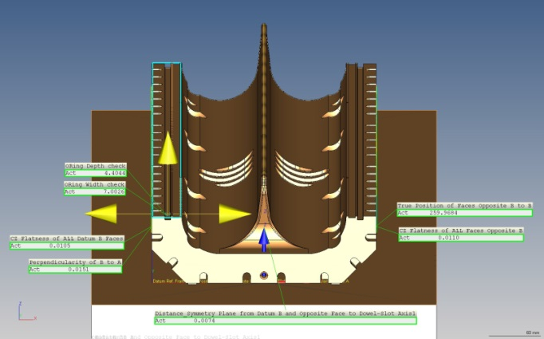
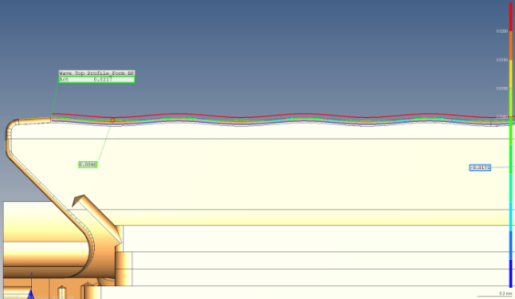
All of the manufactured pieces were inspected by CMM in the RAL metrology department producing copious dimensional reports.
Results from the inspection were put back into models to check consistency

Slide 32
Following individual inspection each section was assembled and aligned on the CMM referring external datums to internal features.
Modelling the RFQ with as measured errors demonstrated that the desired RF and beam properties can be achieved.

Slide 33
The RF properties of individual sections were checked.
Following assembly and alignment on the CMM each section was machined to length to achieve flat and parallel end faces. Dowel blocks were fitted to allow disassembly and reassembly while maintaining alignment.
Inspection checks demonstrated that the dowel system maintains alignment within the required tolerances.

Slide 34
After dowelling each section was assembled with the 3D o-ring and RF seals in place.
An ultimate pressure <1E-7 mbar was achieved after several days of pumping, validating the o-ring concept and design.

Slide 35
After vacuum tests on each assembled section the RFQ was built up, section by section, on the beam line.
A laser tracker system was used for alignment achieving better than 50 μm positional error between sections.
The RFQ assembly was vacuum tested after the addition of each section to check the inter-section o-ring seal.
A low power RF test confirmed the resonant frequency and Q factor.

Slide 36
Following final vacuum tests the RF properties of the completed RFQ were extensively investigated. Having confirmed that assembly and alignment appeared to be correct the structure was tuned and the field distribution corrected which involved iteratively adjusting each of 62 tuners.

Slide 37
With the RFQ tuned and the correct field distribution achieved the final stage was to plumb in all of the cooling water circuits and connect the high power RF feed lines.

Slide 38
The RFQ was successfully conditioned to full RF power in 2021.
Measurement of the x-ray spectrum confirmed the correct operating point of 85 kV electrode voltage at 545 kW.

Slide 39
First beam of 28 mA accelerated in August 2022
Initially at 50/32 PPS, 200 μs

Slide 40
Current Status
All of the components are manufactured with the exception of the choppers which are due for delivery soon.
All the delivered components have been installed on the beamline although some are currently reconfigured for initial beam tests.
Most components have been tested at full power.
The RFQ is complete and RF conditioned.
Following safety approval first beam has been achieved.
Permission agreed to run ‘at will’ contingent on satisfactory health physics surveys.

Slide 41
THE END.

