Slide 1
Progress towards modelling of the vFFA
Max Topp-Mugglestone

Slide 2
Contents
Intro to the vFFA
Hamiltonians
Closed orbits
Optical components & Harmonic Analysis
Overview
Numerical study
Next steps

Slide 3
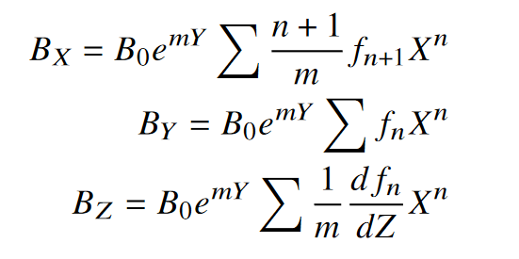
vFFA Concept
Successive higher energy orbits are stacked vertically
Constant tune achieved by condition $B\left(y\right)={B_{0}}^{my}$
Advantages
Strong focussing
Near-isochronous
But…
Magnetic fields from scaling law imply complicated optics

Slide 4
Approaching the vFFA
For hFFA, we have the following Hamiltonian:
$$h\sim \frac{{p_{x}}^{2}}{2}+\frac{{p_{y}}^{2}}{2}+\frac{x^{2}}{2}\frac{1−n}{ρ^{2}}+\frac{y^{2}}{2}\frac{n}{ρ^{2}}$$
Is there an equivalent for the vFFA?
(Question asked by Thomas at the FFA school)

Slide 5
The Fundamental vFFA Hamiltonian
$$h\sim \frac{{p_{x}}^{2}}{2}+\frac{{p_{y}}^{2}}{2}+\frac{x^{2}}{ρ}+xy\frac{m}{ρ}$$
Very simple and neat, but…
Only applicable on the midplane
Does not include fringe fields
The closed orbit for a vFFA cannot exist on the midplane*
Fringe fields dominate magnets in FETS-vFFA and ISIS-II designs

Slide 6
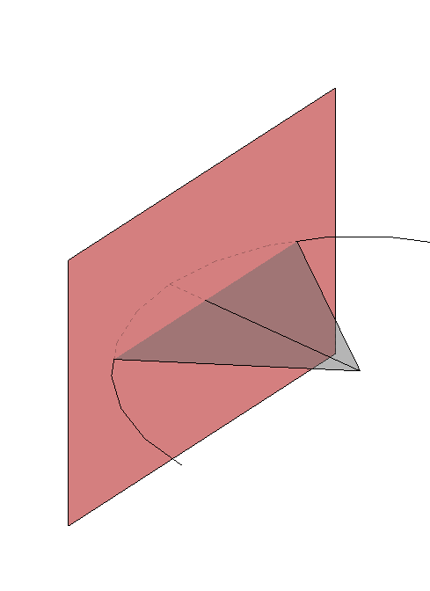
A Word on vFFA closed orbits
y
Midplane
hFFA:
Plane of curvature coplanar with magnet midplane
vFFA:
Plane of curvature perpendicular to magnet midplane
Orbit cannot be confined to magnet midplane*
Orbits are non-planar!
*This may not be the case for certain sector vFFAs…
$$ρ$$
$$B_{x}$$
$$x$$
Our vFFA Hamiltonian needs to reflect these properties!

Slide 7
A practical vFFA Hamiltonian
$$h\sim \frac{{p_{x}}^{2}}{2}+\frac{{p_{y}}^{2}}{2}+xy\frac{m}{ρ_{3D}}\left(1−\frac{m^{2}x_{0}}{2}\right)+\frac{x^{2}}{ρ_{3D}}\left(\frac{\cos{mx_{0}}}{ρ_{3D}}+\frac{m^{2}x_{0}}{2}\right)+\frac{y^{2}}{ρ_{3D}}\left(\frac{\sin{mx_{0}}}{ρ_{3D}}−\frac{m^{2}x_{0}}{2}+\frac{m^{4}{x_{0}}^{3}}{2ρ_{3D}}\right)$$
We can use this Hamiltonian to analytically describe a vFFA if:
We can parametrize the cell geometry in 3d and determine:
$x_{0}$ horizontal offset from magnet midplane
$ρ_{3D}$ Radius of curvature for a 3-dimensional bend
The magnets are long in comparison to the fringe
The radius of curvature is large
However, FETS-vFFA and ISIS-II designs do not meet these criteria…
So why doesn’t the model work? How must it be adapted?

Slide 8
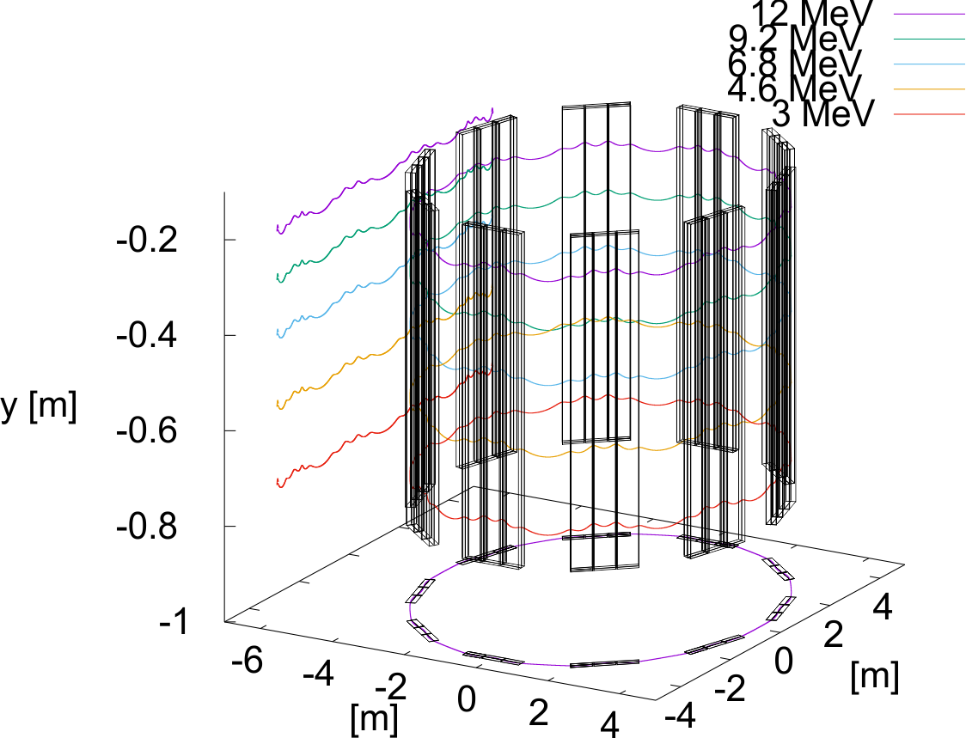
Test Lattice parameters
M-value | 4.0/m
Magnet length | 0.5m
FD ratio | 2
F-D offset | 0.02m
Cell length | 2.8m
FETS-like FDF Triplet
Highly nonplanar closed orbit
‘fringe-dominated’ magnets
Following results use a modified cell with zero bending angle

Slide 9
Method of Harmonic Analysis
Scan along closed orbit
Draw a circle at each point on orbit in a plane perpendicular to the tangent vector
Evaluate radial field component ($B∙\hat{r}$) on a number of points around the circle
Take Fourier transform of radial field around the circle
Obtain multipole coefficients for each integration step
Reconstruct optics using multipole kicks (thin lens transfer matrices) corresponding to the measured coefficient

Slide 10
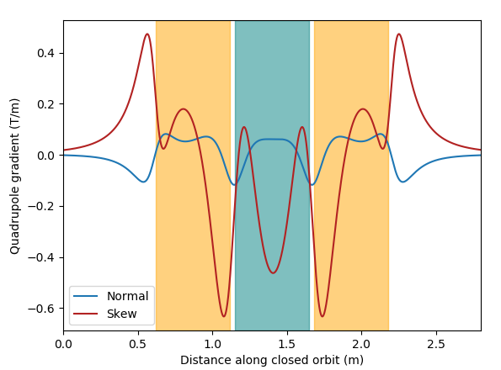
Quadrupole components
Field focusses in one transverse direction, defocusses in the other
 | Quadrupole-only tune | Full Numerical Tune (FIXFIELD)
qu | 0.137 | 0.247
qv | 0.124 | 0.182

Slide 11
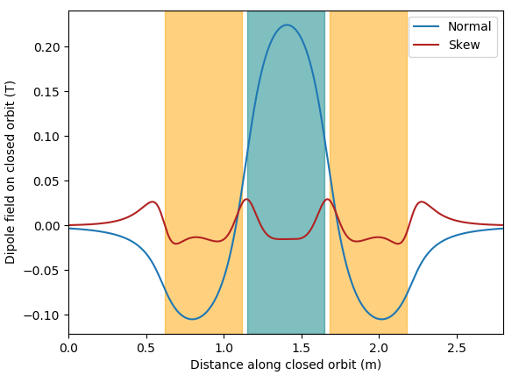
Dipole components
Geometric focussing effect perpendicular to dipole field (aka weak focussing)
 | Quad+dipole tune | Full Numerical Tune (FIXFIELD)
qu | 0.229 | 0.247
qv | 0.129 | 0.182

Slide 12
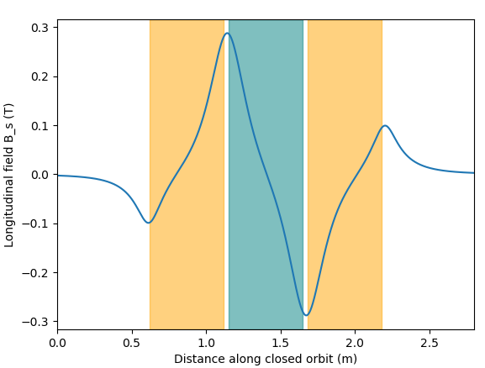
Longitudinal field components
Fields collinear with orbit
Induce a rotation of the transverse optical planes around the closed orbit – ‘Larmor rotation’
$$θ=\int{\frac{qB_{z}}{2P}}∙dz$$
 | Quad+dipole+longitudinal tune | Full Numerical Tune (FIXFIELD)
qu | 0.211 | 0.247
qv | 0.154 | 0.182

Slide 13
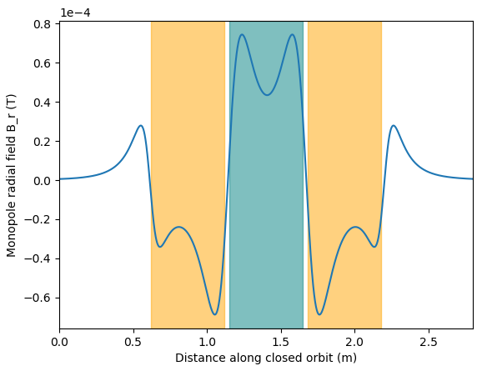
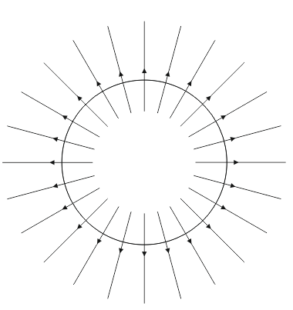
Radial field components
Imparts angular momentum to the beam
 | Quad+dipole+longitudinal+radial tune | Full Numerical Tune (FIXFIELD)
qu | 0.247 | 0.247
qv | 0.182 | 0.182

Slide 14
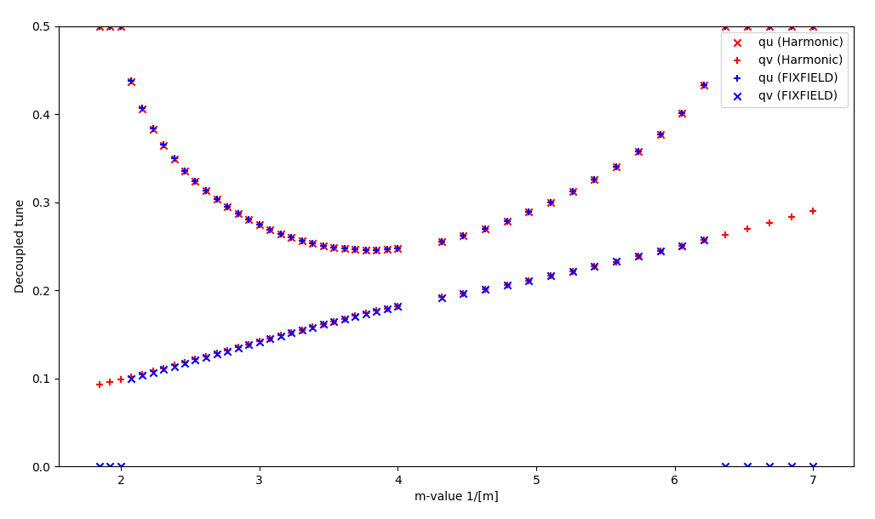
To demonstrate robustness of method across parameter space:

Slide 15
 | Q | D | L | R | Q+D | Q+L | Q+R | D+L | D+R | S+R | Q+D+L | Q+D+R | Q+L+R | D+L+R | Q+D+L+R
qu | 0.137 | 0.173 | 0.000 | 0.006 | 0.229 | 0.095 | 0.079 | 0.172 | 0.137 | 0.102 | 0.211 | 0.196 | 0.141 | 0.203 | 0.247
qv | 0.124 | 0.026 | 0.000 | 0.006 | 0.129 | 0.156 | 0.079 | 0.018 | 0.000 | 0.102 | 0.154 | 0.079 | 0.192 | 0.104 | 0.182
All field elements critical to reconstructing accurate tune in both planes
Can we quantify the importance of each element?
Can we explore how this changes across the parameter space?

Slide 16
Multipole Element Significance Study
Measure multipoles and construct optics as in Harmonic Analysis scheme outlined earlier
Take optical model and adjust strength of individual multipole by given amount
E.g. rerun kick-drift integration with quadrupole strength tweaked by 10%
Measure change in u and v tune and normalise ($\frac{∆q_{i}}{q_{i}}$)
Record data across the parameter space
Rough way of ‘quantifying’ importance of each field element

Slide 17
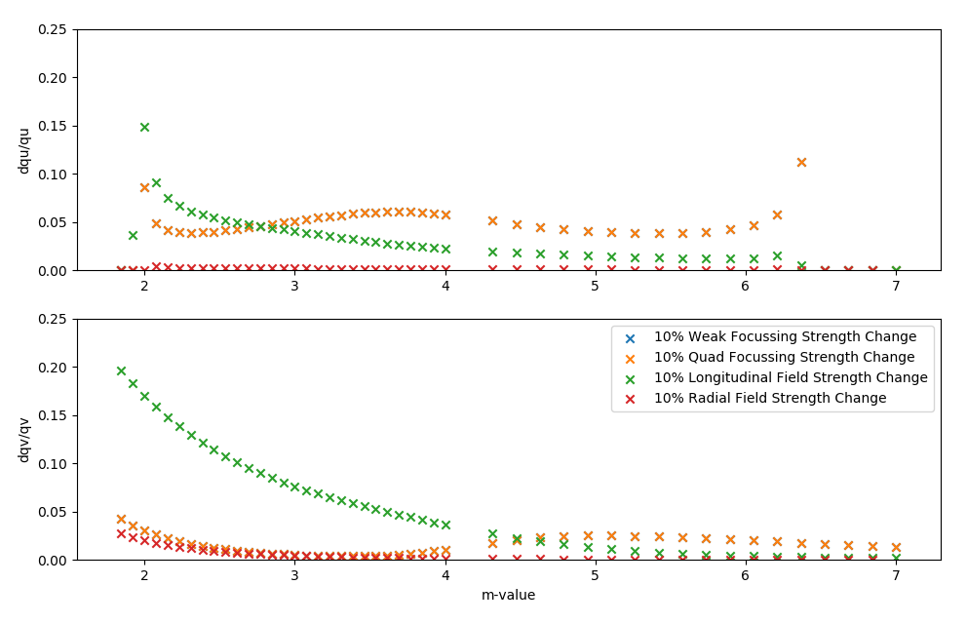
Multipole Element Significance Study
Evolution of harmonic analysis for straight triplet vFFA across upper stability region
FETS-vFFA operates in lower stability region

Slide 18
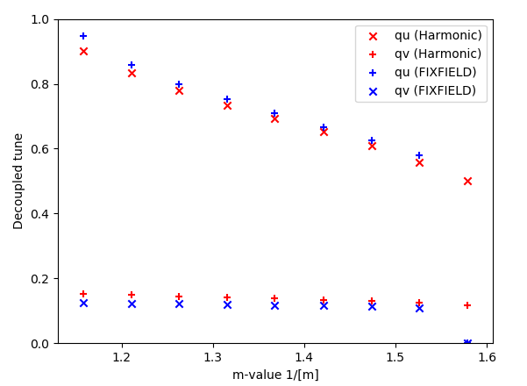
Harmonic analysis of FETS baseline
FETS baseline parameter scan
Lower stability region
Agreement isn’t quite as good as the previous results

Slide 19
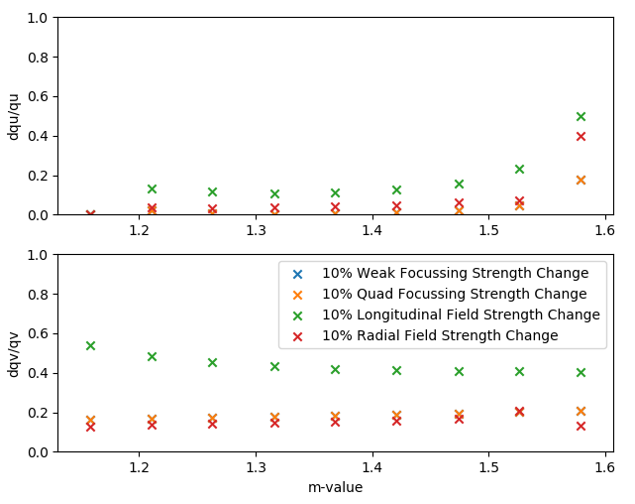
Preliminary results from FETS baseline
Dominated by longitudinal fields
Radial fields have similar order of effect to quadrupole
Dqu appears to decrease with increasing longitudinal field!
Interesting effect of Larmor angle?

Slide 20
Lattice dominated by longitudinal fields at low m
This dq/q metric is limited:
Useful for comparing regions of parameter space
Could be used to classify regimes of behaviour for a machine
Doesn’t give the full picture of how the optics behave

Slide 21
Effect of dipole and quadrupole focussing well-understood
Effect of longitudinal field can be expressed in terms of Larmor rotation
How do we understand the influence of the radial field?
Further exploration of vFFA parameter space needed
Can we define ‘fringe-dominated’ and ‘magnet-dominated’ regimes?
Can we design a planar vFFA?
What is the influence of longitudinal and radial fields in this case?

Slide 22
Apply harmonic study generally in FFA machines (hFFA etc…)
Further coupling study in vFFA
Use results of vFFA study to inform further modelling from an analytic perspective
Possible future study of harmonic elements on other properties of the accelerator
E.g. dynamic aperture

