Slide 1
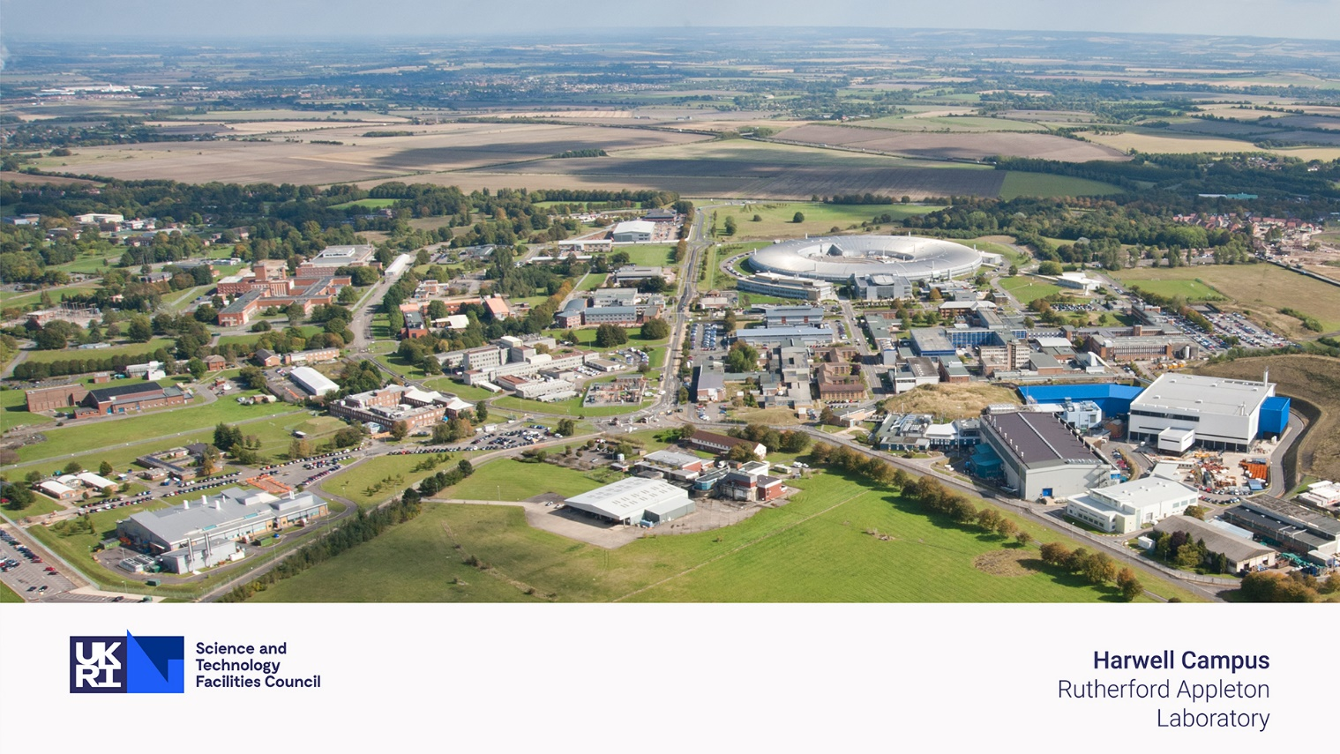

The Future of Neutron Sources – ISIS/ISIS-II/ESS
John Thomason, ISIS Neutron and Muon Source
(and SNS/J-PARC/CSNS)

Slide 2
ISIS

Slide 3


ISIS Neutron and Muon Source
ISIS is the UK’s neutron and muon facility, based at STFC’s Rutherford Appleton Laboratory in Oxfordshire.
ISIS supports a national and international community of more than 3000 scientists and gives unique insights into the properties of materials on the atomic scale, providing information which complements that provided by photon-based techniques.
https://www.isis.stfc.ac.uk/Pages/impact-of-neutron-scattering-brochure13478.pdf

Slide 4
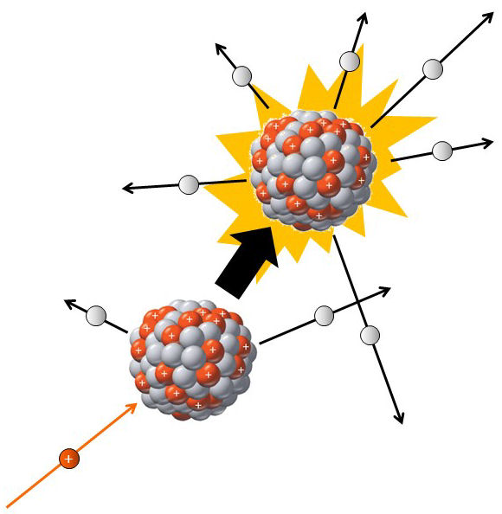
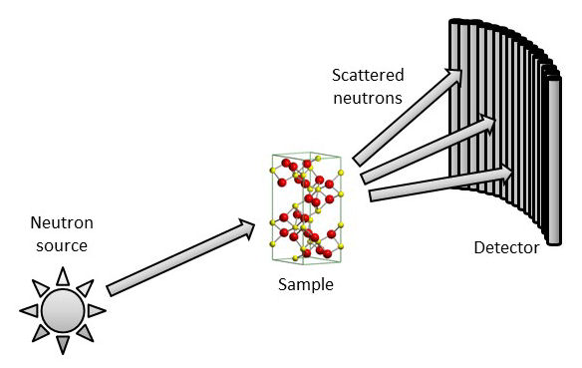
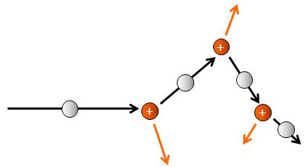

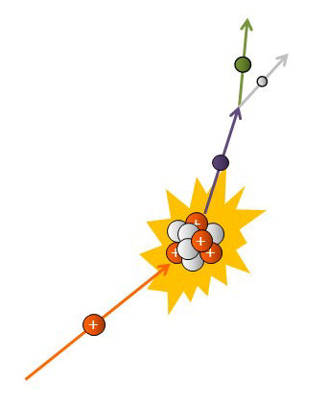
Neutron and Muon Production
Neutron Production
Spallation
Scattering
Moderation
Muon Production

Slide 5
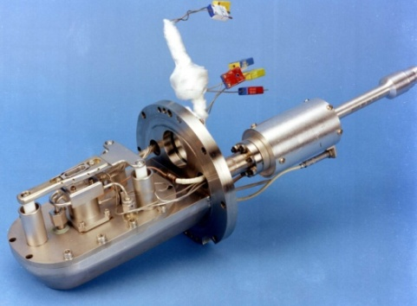
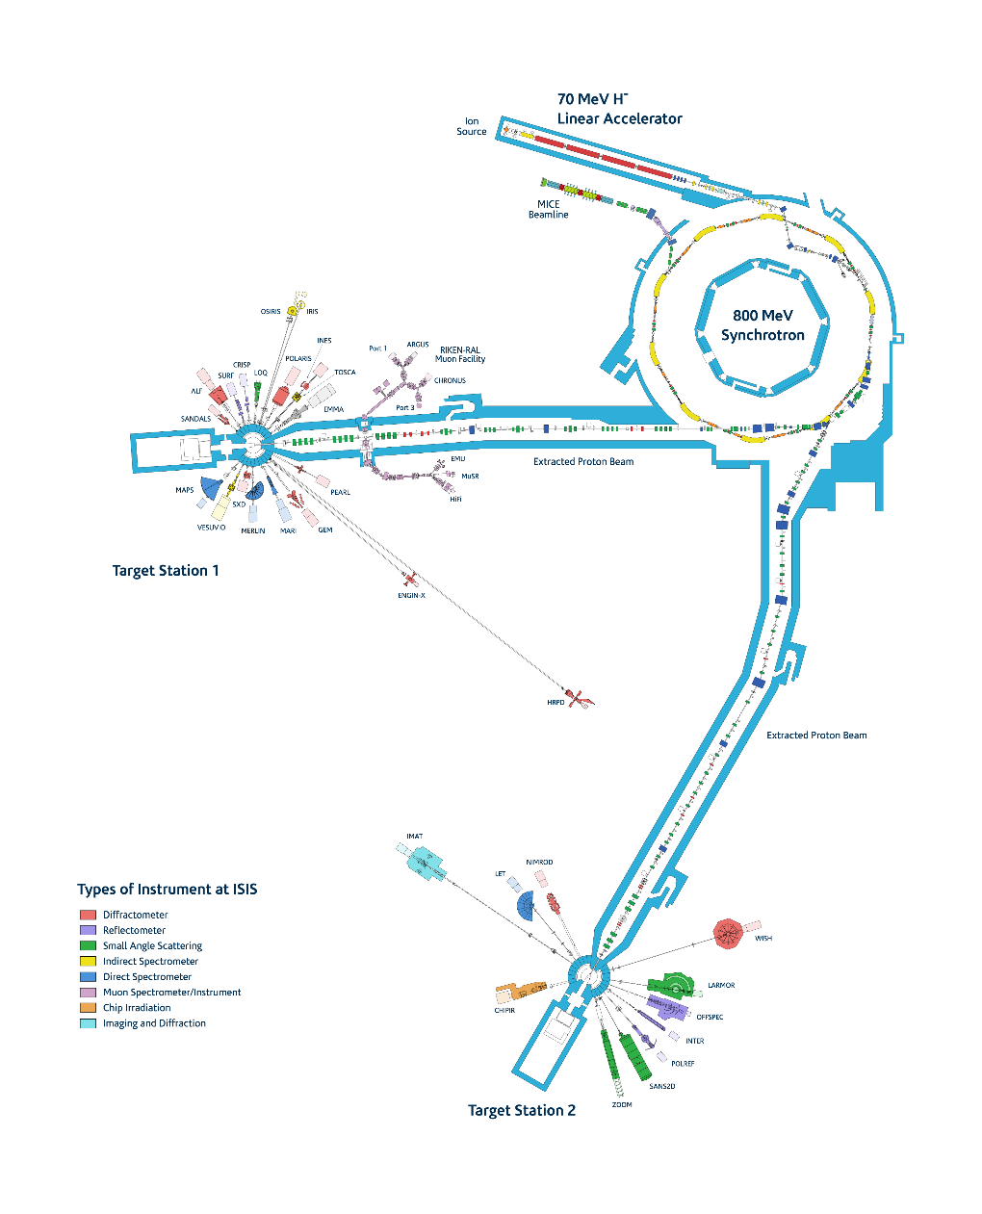
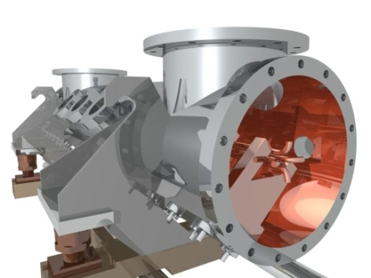
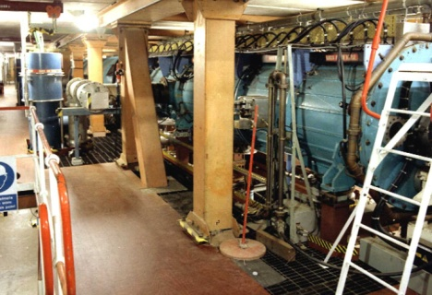
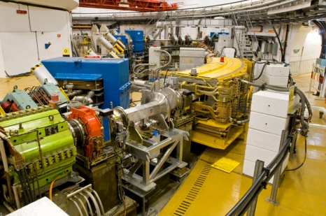
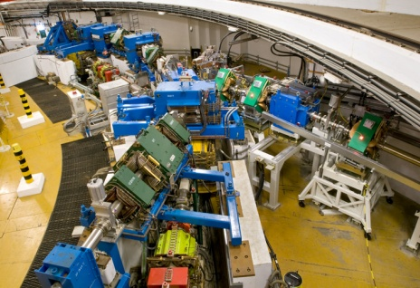
ISIS Accelerators
H⁻ ion source (35 kV)
665 kV H⁻ RFQ
70 MeV H⁻ linac
800 MeV proton synchrotron
Extracted proton beam lines
The accelerator produces a pulsed beam of 800 MeV (84% speed of light) protons at 50 Hz
Average beam current is 240 μA (3.0 × 10¹³ ppp) therefore 192 kW on target (160 kW to TS-1 at 40 pps, 32 kW to TS-2 at 10 pps)

Slide 6
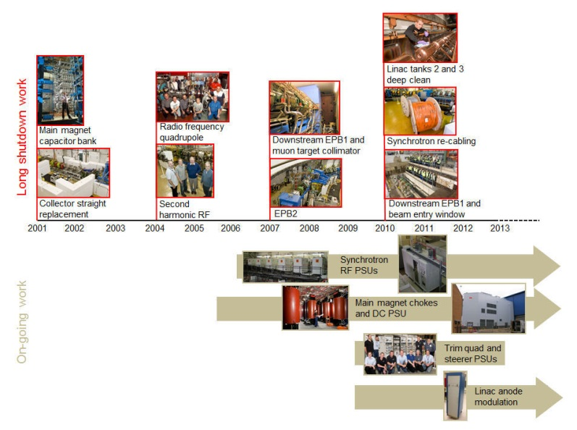
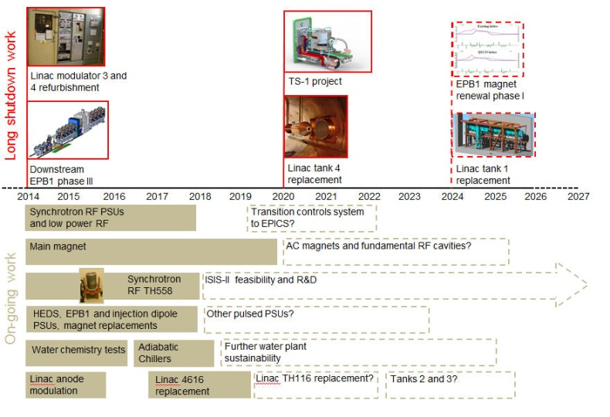
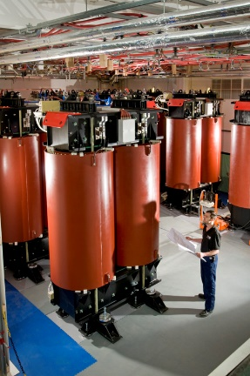
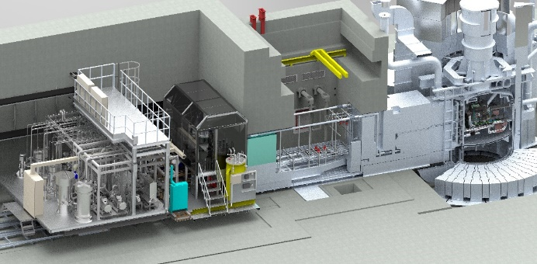
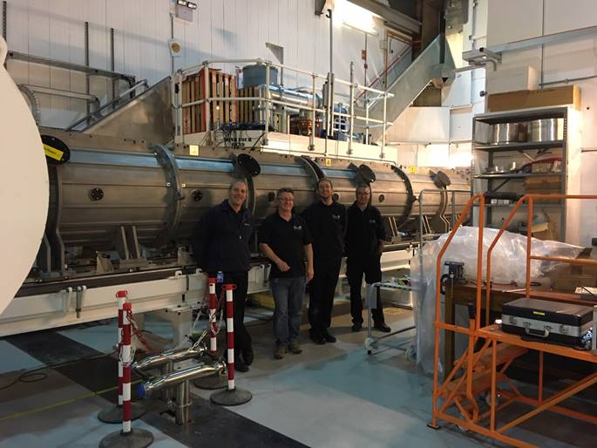
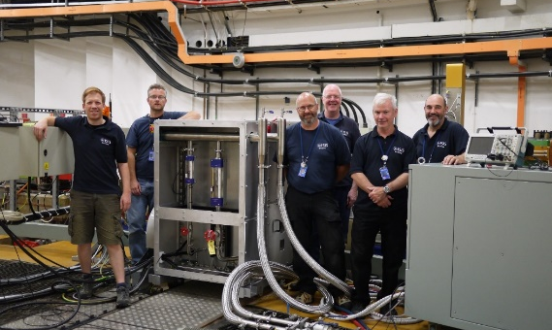
ISIS Operations and Sustainability
ISIS accelerator and target activities are principally aimed at facilitating the programme of equipment renewal and upgrades required to keep the present ISIS accelerators running optimally and sustainably for the lifetime of the facility.

Slide 7

Long Shutdown - Accelerator
Extensive programme or work, some the culmination of 10+ year projects, but with other elements required at shorter notice –
Linac tank 4 replacement
Replacement of synchrotron fundamental RF systems
Dipole 9
SRBD
EHB3
Muon collimator replacement
Electrical installation, interlocks, plant and vacuum work in support of accelerator, target and instrument work
Supported by Health Physics, Active Waste and RPA teams
Notes:
Please remove or amend the image credit if you are using a different image to the one provided.

Slide 8
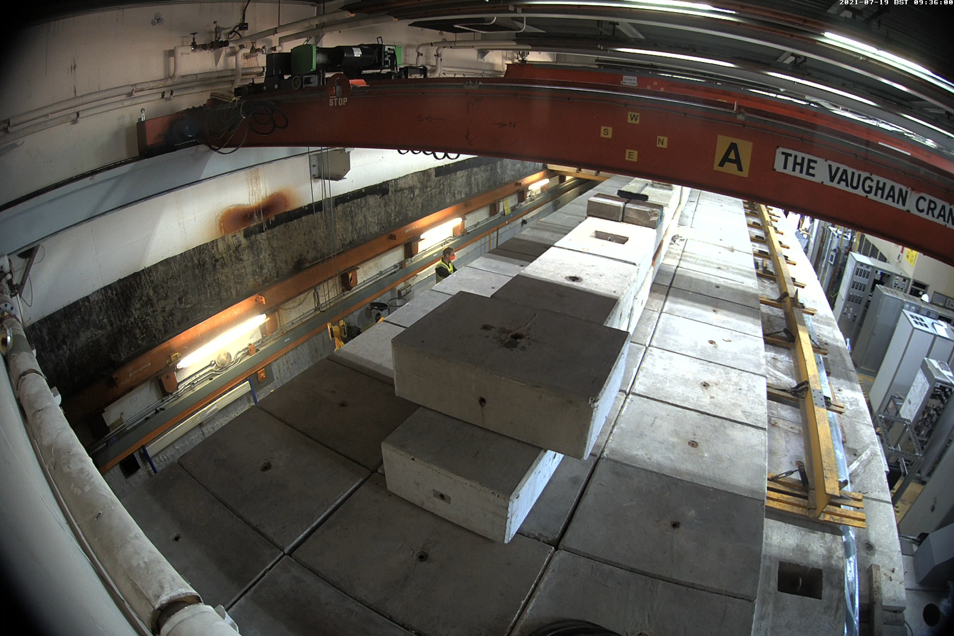
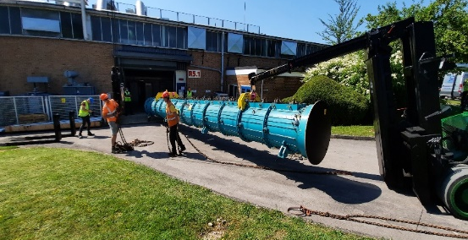
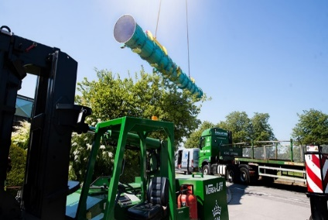
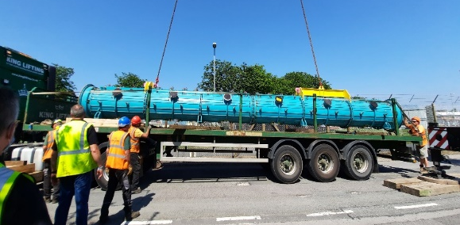
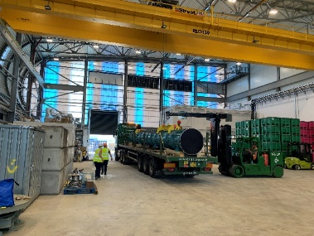
Linac Tank 4 replacement
Many months of planning and practice enabled the smooth and faultless extraction of the 12 m long, ∼7.5 T accelerating cavity before a final trailer journey to R105 for disposal
Notes:
Please remove or amend the image credit if you are using a different image to the one provided.

Slide 9
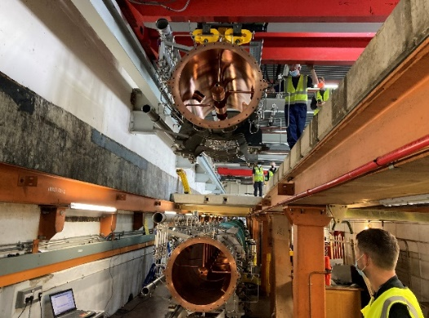
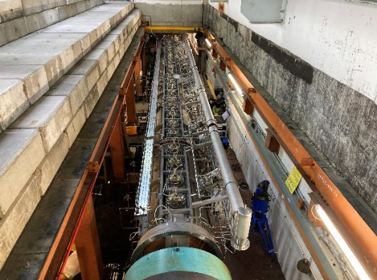
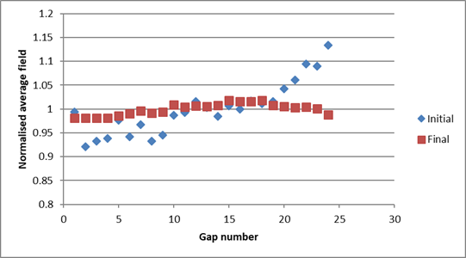
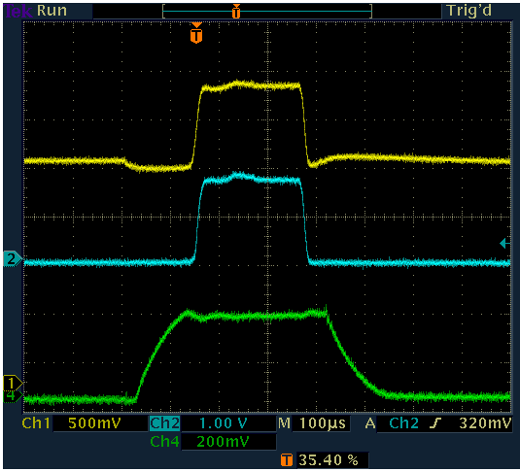
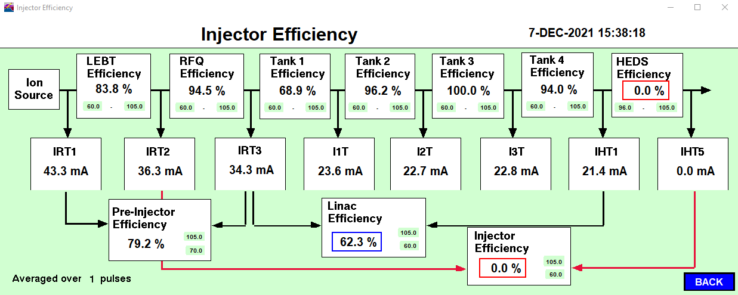
Linac Tank 4 replacement
The new tank 4 was installed, aligned, and vacuum checked. The bead-pull was been repeated in situ and low repetition rate beam was established 7/12/21 with 94% transmission at the first attempt.
The new tank 4 has now run for (nearly) 3 ISIS user cycles to TS-2, although with some RF window failures that have now been traced to a damaged auto-tuner.
Notes:
Please remove or amend the image credit if you are using a different image to the one provided.

Slide 10
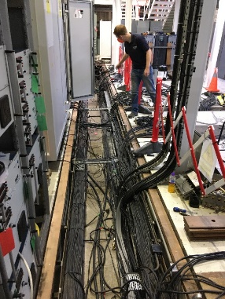
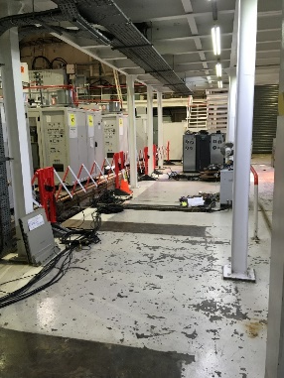
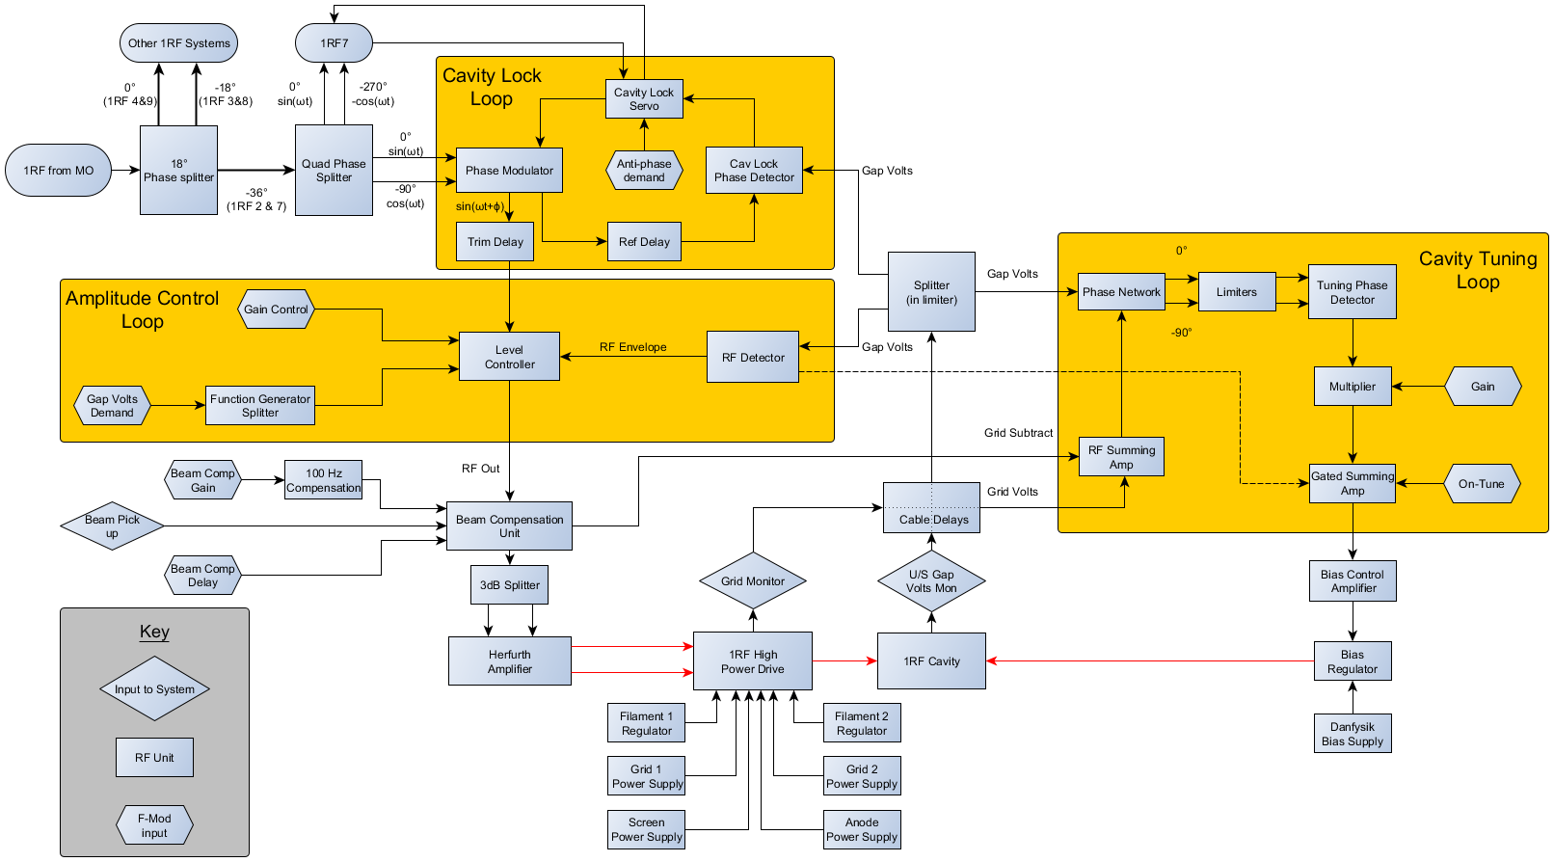
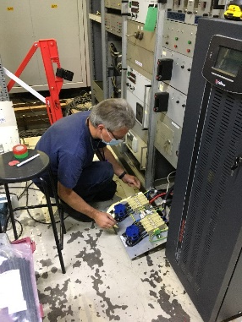
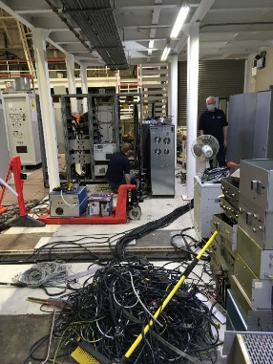
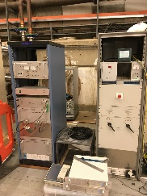
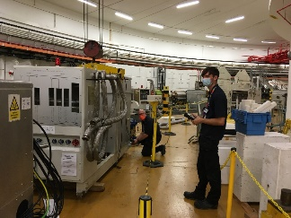
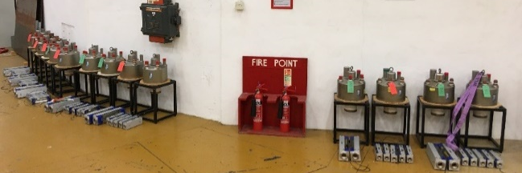
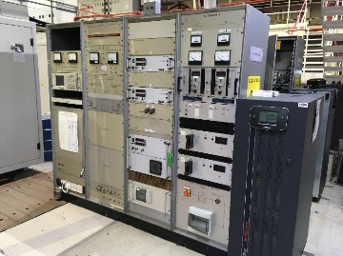
Synchrotron RF systems upgrade
Replacement of all six fundamental synchrotron RF systems
×6
4648s liberated from fundamental systems to be added to spares stock for second harmonic systems
Notes:
Please remove or amend the image credit if you are using a different image to the one provided.

Slide 11
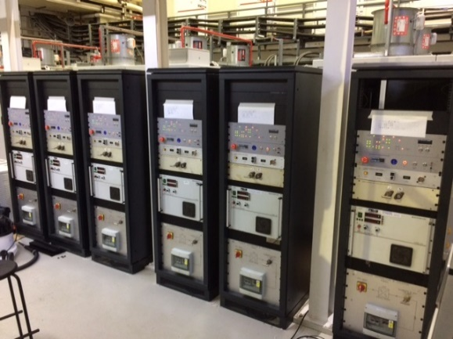
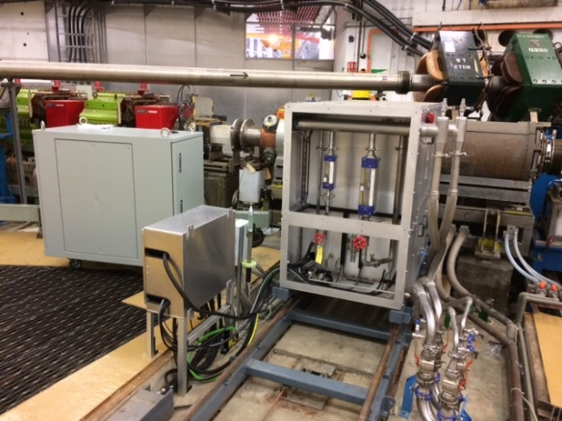
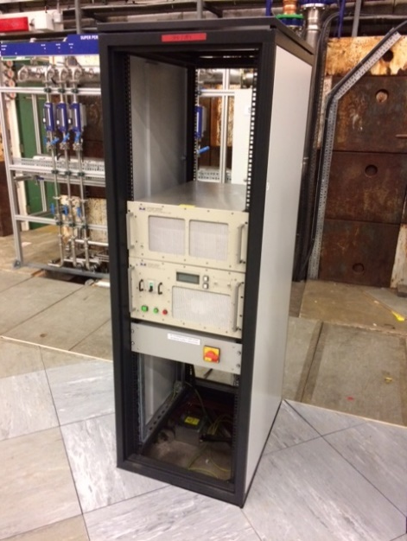
Synchrotron RF systems upgrade
All systems were at full voltage by 16/12/21, and have since run with no problem during ISIS user operations
Notes:
Please remove or amend the image credit if you are using a different image to the one provided.

Slide 12
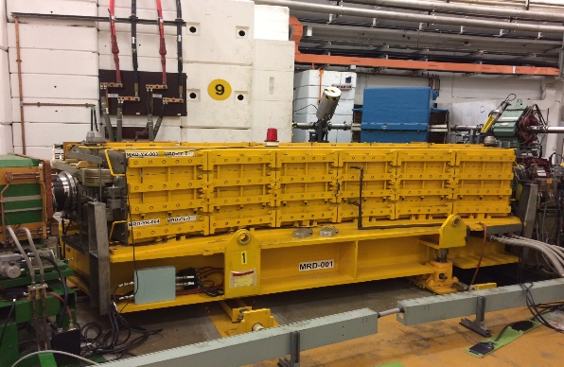
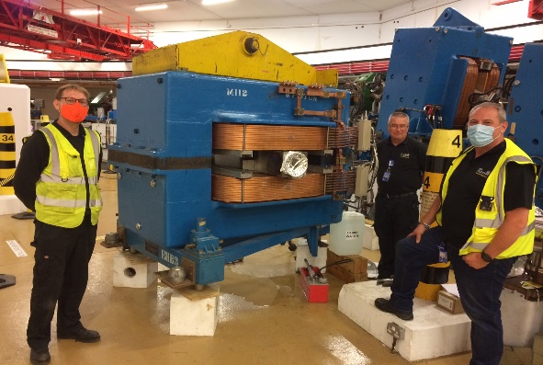
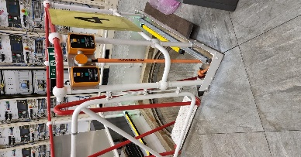
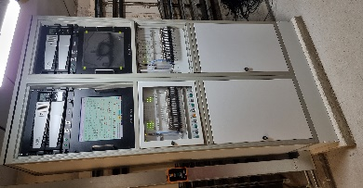
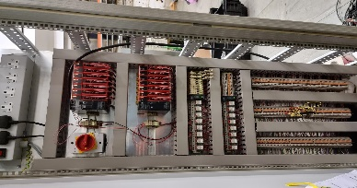
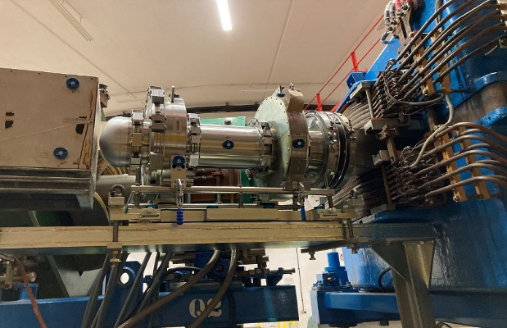
Other accelerator work
Other long shutdown work is complete, including –
Extensive interlock upgrades
Replacement of dipole in synchrotron SP9 and refurbishment of spare
Refurbishment of EHB3
Asbestos mitigation in tunnels
Sealing catacomb floors
Flooring in inner synchrotron
Synchrotron Room Beam Dump
Notes:
Please remove or amend the image credit if you are using a different image to the one provided.

Slide 13
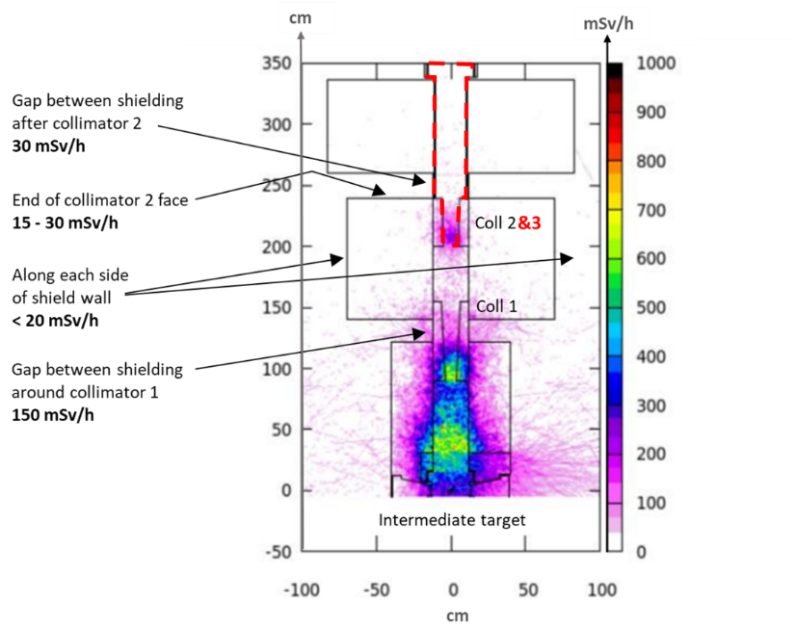
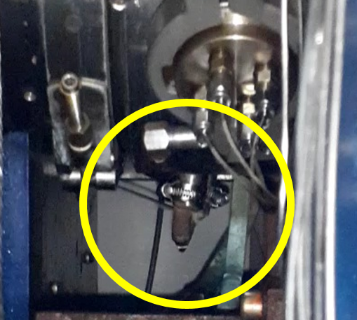
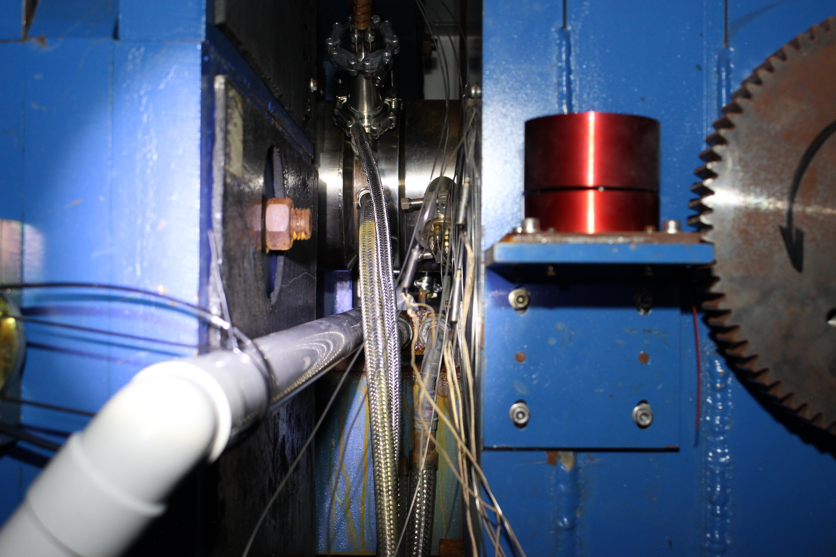
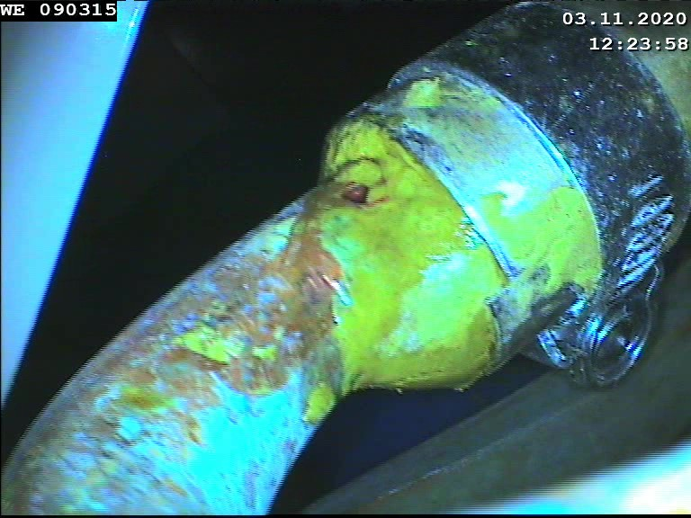
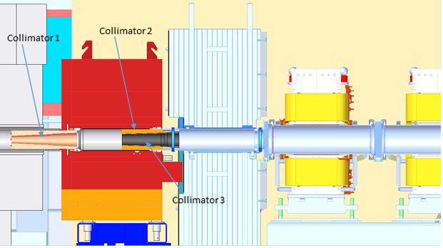
Muon collimator replacement
Water leak on muon collimator 2 found November 2020 –
Collimator has been replaced and is under vacuum awaiting first beam when TS-1 operations resume in September
Notes:
Please remove or amend the image credit if you are using a different image to the one provided.

Slide 14
ESS

Slide 15




ESS
The European Spallation Source (ESS) is a multi-disciplinary research facility based on what will be the world's most powerful pulsed neutron source. At least 17 European countries will act as partners in the construction and operation of ESS in Lund, Sweden. As the world's next-generation neutron source, ESS will enable scientists to see and understand basic atomic structures and forces at length and time scales unachievable at other spallation sources. ISIS will contribute to 3 ESS instruments (Loki, Freia and Vespa). UK accelerator contributions total £42M.

Slide 16







ESS
UK Accelerator In-kind Delivery
High Beta Cavities (88 Total) Linac Warm Units (75 Total) RF Distribution (146 HPRF Feeds)
✓
✓

Slide 17
Summary
ESS NCL Commissioning
Normal Conducting Linac commissioning ongoing in parallel with SCL installation
Ion Source, LEBT, RFQ, MEBT and first DTL tank installed and operated with beam.
DTL2,3&4 to be installed by end-2022
First commissioning of source and LEBT in 2018 showed larger than expected emittance
  Ion source repeller cable found disconnected, emittance now correct
RFQ RF conditioned and commissioned with beam in 2021
  Full average RF power and full peak beam current achieved
DTL RF conditioning and beam commissioning in 2022
  Full average RF power and full peak beam current achieved
  Vacuum leak on drift tube with integrated steerer - to be replaced
Essential diagnostics operational – BCMs, BPMs, faraday cups
  Other under test and development – BLMs, emittance scanners, optical profile monitors
Other systems under development but operational principles proven.
  LLRF feedback and adaptive feed-forward
  Cooling systems esp. RFQ
  Machine Protection

Slide 18



Summary
DTL1 RF Conditioning
Nominal cavity field reached with 10µs pulse in 1 week
Several weeks of 15hrs/day operation to reach full average power
Vacuum leak on drift tube with integrated steerer found
  Tube to be replaced by removal of end plate before DTL2 installed
Cavity Field (MV/m)
-3
Average RF Power (kW)
-50
100 days

Slide 19

Summary
DTL1 Beam Commissioning
Nominal, 62.5 mA peak beam current achieved with 100% transmission
Pulse length limited to 5 µs by Faraday cup
Preliminary vertical emittance measurement – calibrations being checked
  Measured in MEBT
  Appears better than 0.4 π.mm.mrad requirement
LLRF beam compensation tested with 62 mA
  +/- 0.2deg in phase
  +/- 0.5% field
MEBT BCM
DTL1 BCM
5 µs

Slide 20
SNS/J-PARC/CSNS

Slide 21








SNS
Operation at 1.4 MW from September 2018
Beam power administratively limited by target most of this time
Front-End:
Produce a 1-ms long, chopped,
H⁻ beam
Accumulator Ring: Compress 1 ms long pulse to 700 ns
1.4 MW
1 GeV LINAC
RF
2.5 MeV
87 MeV
186 MeV
1000 MeV
FE
DTL
CCL
SCL
Liquid Hg Target
Chopper system makes gaps
mini-pulse
Current
Current
1 ms macropulse
Design parameters: 60 Hz, 1.4 MW

Slide 22

SNS Upgrade Plans
FTS
24 instrument positions
19 instruments built
FTS
24 instrument positions
19 instruments built
STS
22 instrument slots
8 initial instruments
0.8 MW
1.4 MW
2 MW
Accelerator
today
Accelerator
after PPU
After STS Upgrade
Now
After PPU Upgrade
INJECTION DUMP
Re-assess 150 kW power rating
Add view screen imaging system
RING INJECTION
Replace 2 chicane magnets
Replace inj. dump septum magnet
Upgrade 8 inj. kickers
Add quad magnet to inj. dump beam line
RING EXTRACTION
Add 2 more kickers to the existing 14 kickers.
But there is another way: to upgrade the voltage capability of the existing 14 kickers -- prototype testing is in progress.
WARM LINAC KLYSTRONS
Upgrade DTL klystrons 3, 4, and 5 from 2.5 MW to 3.0 MW
SCL
Add 7 cryomodules
(28 cavities)
Add 28 klystrons and 3 modulators
Future beam line to second target station
STS STUB
Build first part of beam tunnel to future second target
RING UTILITIES
Increase water cooling capacity
TARGET
Increase power capability from 1.4 to 2.0 MW

Slide 23




J-PARC
The J-PARC proton beam is accelerated by a series of accelerators, which consists of:
  400 MeV H⁻ linear accelerator
  3.2 GeV rapid cycling synchrotron (RCS)
  50 GeV main ring (MR)
J-PARC have successfully demonstrated stable operation of the Materials and Life Science Experimental Facility at 1 MW from the RCS, but with duration limited by target performance.
Plans for second target station.

Slide 24




CSNS
The China Spallation Neutron Source (CSNS) conducted beam commissioning from 3 – 28 February 2020, achieving the design goal of 100 kW 18 months ahead of schedule. Since then it has conducted stable operations at 100 kW.
Now planning CSNS-II – upgrade to 500 kW and two target stations.

Slide 25
ISIS-II

Slide 26

Purpose and Business Case
Europe (including the UK) is a world leader in neutron-based science
Potential for a European neutron drought in the coming decade with reactor-based sources being shut down because of regulatory issues
ILL will not run beyond 2034

Slide 27
Purpose and Business Case
ESFRI Neutron Scattering Facilities in Europe Report
  …by far the most cost effective solution would therefore be to build a MW-class short pulse facility at ISIS, reusing existing infrastructure and facilities as well as drawing upon on-site competences. The current facility could operate until the new facility is operational with its initial suite of instruments.
STFC Accelerator Strategy Review
  Investment in high power proton beams and targets is recommended to support … neutron facilities research and development.
  Collaboration with international partners on facility development and accelerator research activities is recommended, where appropriate.
  The UK national laboratories should be charged with the co-ordination of research and development activities across stakeholders in development of future neutron sources.
STFC Neutron Science and Facilities – An Update to the 2017 Strategic Review
  The concept of an ISIS-II short pulse facility is exciting, and it has the potential to be very complementary to other sources. Continued exploration is strongly encouraged as a long-term option.
  …the concept demonstrates visionary forward thinking and could create an exciting technical challenge to engage the whole UK community in.

Slide 28

ISIS-II Project
Phase 1
Phase 2
Phase 3
2019
2021
2027
2031
2040
Feasibility, design studies and R&D
Integrated facility technical design
ISIS-II construction
Phase 1.1
Physics design
Small-scale prototypes
Phase 1.2
Physics design
Large-scale prototypes
Announcement of £5.1m UKRI infrastructure funding for ISIS-II Feasibility, Design Studies and R&D – ‘Phase 1.2a’ to cover the next several years.

Slide 29
Options Analysis
Long list options analysis
  Do nothing, invest in ESS/ILL, compact sources, CW sources, continue ISIS as-is, full ISIS-II, etc.
  Analyse this long list using the methodology developed for the Endeavour (ISIS instrument upgrade programme) Business Case.
Short list options analysis
  Do nothing, ISIS-II with fixed targets, ISIS-II with rotating targets, ISIS upgrade
  Criteria: economic and science impact, risks, costs, sustainability, timescales

Slide 30







Design Progress and Prototypes

Slide 31

ISIS-II Phase 1.2a Starting
High-Level requirements
Resource Planning
Environmental sustainability estimates
Targets design
Neutronics design
RCS and AR accelerator design
FFA accelerator design
Linac design
Muon and proton irradiation solutions
ISIS upgrade (180 MeV) feasibility
Engineering prototypes
Siting options and planning
Accelerator and target designs are being progressed alongside facility-wide ISIS-II parameters discussions to establish the overall specification of the new facility
Significant engagement with RAL Estates and the Harwell Campus Joint Venture to reserve appropriate land for ISIS-II
A further funding bid for ‘Phase 1.2b’ is expected in ∼2024/25 and will cover all work required to move forward to ‘Phase 2’ – production of a full Technical Design Report

Slide 32
Accelerator Options
Low energy linac with rapid cycling synchrotron (RCS) to bunch compress and accelerate up to 1.2 GeV
Low energy linac with fixed-field alternating-gradient accelerator (FFA) to bunch compress and accelerate up to 1.2 GeV
Full energy linac with accumulator ring (AR) to bunch compress at 1.2 GeV
Fall back option: 180 MeV linac upgrade to ISIS

Slide 33




Linac Options
3 MeV front end based on the FETS project
180 MeV linac suitable for ISIS upgrade option
800 MeV linac could be curtailed to lower energy for injection into RCS or FFA, or increased to 1.2 GeV for injection into AR

Slide 34




Ring Options
Pulse compression rings to create <1 µs pulse with acceleration as needed
RCS
FFA
AR

Slide 35

ISIS-II Phase 1.2b Plan
Construction of a small FFA test ring on the end of the Front End Test Stand (FETS) at RAL in order to explore the beam dynamics fully.
Completion of compression ring designs.
Linear accelerator design integrated with choice of pulse compression ring.
Completion of target, moderator and shielding design for high and low repetition rate neutron targets and a muon target.
Production of an optimal concept design with credible initial cost estimates.

Slide 36

What might ISIS-II look like?

Slide 37

What might ISIS-II look like?

Slide 38
Thank You

