Slide 1
  FFAs for Health
  Roger Barlow, David Bruton, Rob Edgecock, Carol Johnstone and Jordan Taylor
  FNAL & University of Huddersfield
From two theses:
David Bruton, “Investigation of a Compact Accelerator for Radioisotope Production”, 2018
Jordan Taylor, “The Design of Helium Ion Accelerators for External Ion Beam Cancer Therapy”, 2018
Both available from the Huddersfield repository

Slide 2

Motivations - Radioisotopes
Two isotopes of interest: ^{99m}Tc and ²¹¹At
^{99m}Tc:
  Single photon emitter for SPECT
  Most commonly used radioisotope
  Production route: reactor produced ⁹⁹Mo as a generator
Cooling problems in main two reactors caused shortage in 2008/2009
Motivated investigations of other production routes
Various studies of accelerator use undertaken

Slide 3
Motivations - Radioisotopes
¹⁰⁰Mo target
Reaction: ¹⁰⁰Mo(p,2n)^{99m}Tc
Proton accelerators
⁹⁸Mo target
Reaction: ⁹⁸Mo(n,γ)⁹⁹Mo
Heavy nucleus target
n
²³⁵U target
Reaction: ²³⁵U(n,f)⁹⁹Mo
Particle accelerators
²³⁸U target
Reaction: ²³⁸U(γ,f)⁹⁹Mo
Electron accelerators
Bremsstrahlung target
γ
¹⁰⁰Mo target
Reaction: ¹⁰⁰Mo(γ,n)⁹⁹Mo
Deuteron accelerators
Carbon target
n
¹⁰⁰Mo target
Reaction: ¹⁰⁰Mo(n,2n)⁹⁹Mo
Short term: <2017
Primary particle
Secondary particle
Med term: 2017-2025
Nuclear Energy Agency: direct production ¹⁰⁰Mo(p,2n)^{99m}Tc
Long term: >2025

Slide 4
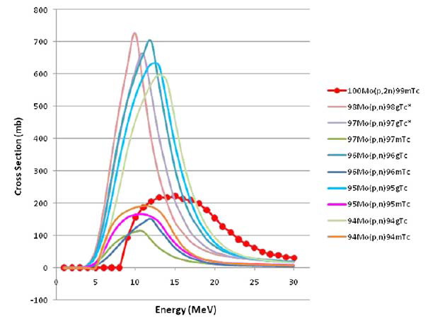
Motivations - Radioisotopes
Basic parameters
  Energy: 20-25 MeV range
  Beam current: > 200µA, as large as losses, target, etc, allow

Slide 5
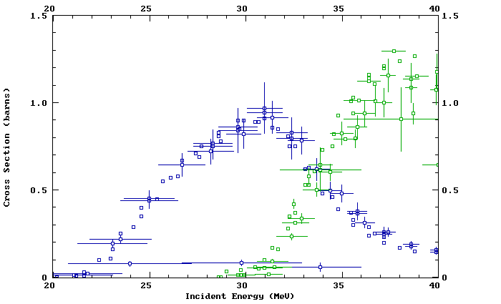
Motivations - Radioisotopes
Therapeutic isotopes – not being fully exploited
²¹¹At: single α emitter
28 MeV He ions, high current
²⁰⁹Bi(α,3n)²¹⁰At
²⁰⁹Bi(α,2n)²¹¹At

Slide 6
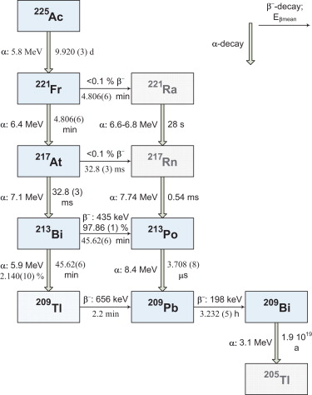
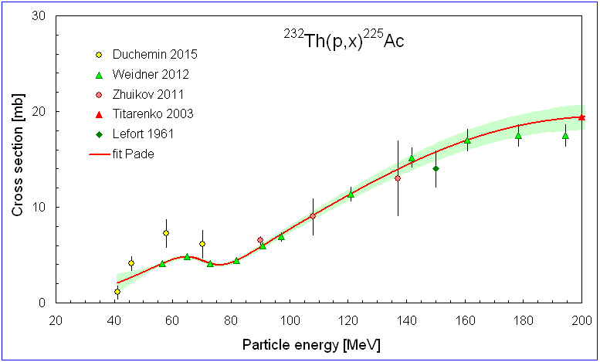
Motivations - Radioisotopes
Recent interest in ²²⁵Ac
218 keV
440 keV

Slide 7
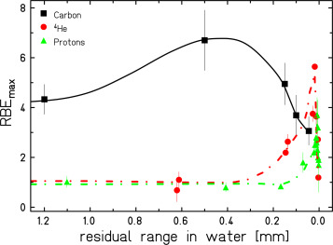
Motivations – Cancer Therapy with Helium

Slide 8
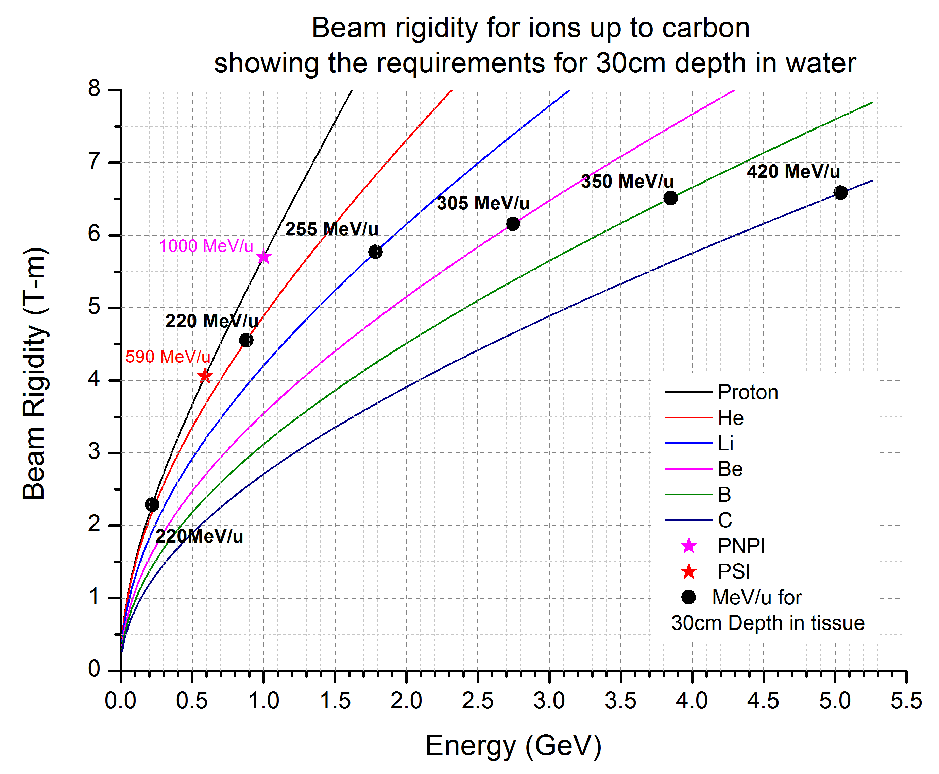
Motivations – Cancer Therapy with Helium

Slide 9
FFA Design Technique
Employs the Carol method
Non-linear, non-scaling FFAGs
Wedge-shaped magnets, so gradient, edge and weak focussing
Magnetic field profile:
Machine design involves selecting
  Magnet number, shape and size
  Field profile parameters, n and b_{i}
Much flexibility to get flat(ish) tunes and pseudo-isochronicity

Slide 10
Method
Starting parameters calculated by Carol via her script
Optimisation in Cosy Infinity
Implemented in FACT( Carol and Pavel Snopok):
  Calculates field map, including edge fields
  Finds stable equilibrium orbits as a function of energy
  Calculates tunes, path lengths, etc
  Allows tof to be calculated
(Many!) iterations required to achieve optimal design
Tracking, acceleration and space charge studies done with Opal
Also PyZoubi for radioisotope machine

Slide 11
Baseline Radioisotope Proton FFAG
75 keV (89mm) to 28 MeV (1687mm)

Slide 12
Baseline Radioisotope FFAG
CW operation

Slide 13
Baseline Radioisotope FFAG RF
2 x 7.5 MHz, λ/2 cavities, each 100 kV
Use on 5th harmonic to reduce size, but also phase slip

Slide 14
Helium Ion Acceleration
For non-relativistic energies, beam rigidity of helium ≈ protons
0.9% different at 28 MeV

Slide 15
Helium Ion Acceleration
Tunes and DA very similar
TOF is 2 times bigger and spread about 1.5%
Works with the same parameters as protons
Can be improved with small tweaks to the field profile

Slide 16
Space Charge for Protons
Studied with ± 2cm aperture
Above 20 mA, very large losses
Emittances at 20 mA:

Slide 17
Space Charge for Protons
Studied with ± 2cm aperture
Above 20 mA, very large losses
Emittances at 20 mA:

Slide 18
Space Charge Losses

Slide 19
Proton Injection and Extraction
Radial injection seems to work, with additional small magnet
For extraction, orbit separation at 28 MeV
Not large enough for clean extraction

Slide 20
Internal Target Studies for ¹⁰⁰Mo(p,2n)^{99m}Tc
Moly target placed at radius of maximum cross-section, 14 MeV
Aperture of ± 2cm used
Yield is essentially independent of target thickness

Slide 21
Internal Target Studies for ¹⁰⁰Mo(p,2n)^{99m}Tc

Slide 22
Internal Target Studies for ¹⁰⁰Mo(p,2n)^{99m}Tc
Calculated yield exceeds that measured with ASIC 24 MeV
Can be improved (in principle):
  Wedge-shaped target
  Re-acceleration

Slide 23
Helium Ion Therapy - Heather
Final design
  Injector: to 1 MeV
  Stage 1: to 400 MeV
  Transfer line
  Stage 2: to 900 MeV

Slide 24
Heather Stage 1

Slide 25
Heather Stage 1

Slide 26
Heather Stage 2

Slide 27
Heather Stage 2

Slide 28
Heather Stage 2

Slide 29
Heather RF Studies
Stage 1:
  Uses 2 delta-type λ/2 double gap resonators
  Gap voltage 300 kV
  Kilpatrick says works with a 4cm gap
  Already used at Riken
  5th harmonic to keep cavity size down
Stage 2:
  Single gap resonators
  Gap voltage 500 kV
  Larger values achieved in operating cyclotrons

Slide 30
Heather RF Studies

Slide 31
Heather Extraction Studies
Aim was to see if the PSI technique would work
Optimisation of injection to increase final orbit separation

Slide 32
Heather Extraction Studies – Stage 1

Slide 33
Heather Extraction Studies – Stage 2
With parameter optimisation to maximise separation of last orbit

Slide 34
Conclusions
Designs of two non-linear, non-scaling FFAGs performed
One for high current p and He acceleration for radioisotope production
One for He ion cancer therapy
Both look promising so far, but much more work required
The method used (Carol’s!) is very flexible
The non-linearity and non-scaling nature of the accelerators give many opportunities

