Slide 1
Fixed Tunes Fast Cycling FFA Synchrotrons Dejan Trbojevic - BNL
Abstract: We present a novel concept of the Fixed-Field-Alternating (FFA) small racetrack proton accelerator with kinetic energy range between 10-250 MeV made of permanent magnets. The horizontal and vertical tunes are fixed within the energy range providing very fast cycling with a frequency of 1.3 KHz. The injector is 10 MeV commercially available cyclotron with RF frequency of 65 MHz. The permanent magnet synchrotron RF frequency is 390 MHz and acceleration uses the phase jump scheme.

Slide 2
Applications: Proton Drivers, Cancer therapy accelerator for FLASH, ADS
OUTLINE
CBETA successful commissioning
Small, ‘green’ energy efficient, fastest cycling synchrotron, cost effective
CBETA Follow up: Fast Cycling FFA permanent magnet Synchrotron 1.3 kHz
APPLICATIONS and ADVANTAGES:
Significant Power Consumption Savings due to Fixed Magnetic Field
VERY FAST ACCELERATION as it depends only on RF
Synchrotrons for EIC (reduction in cost, savings in power, large dynamical aperture, small magnets)
SPIN-OFFS in Medical applications
Proton Drivers

Slide 3
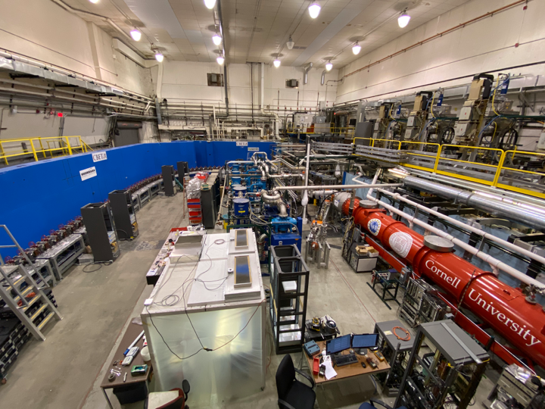
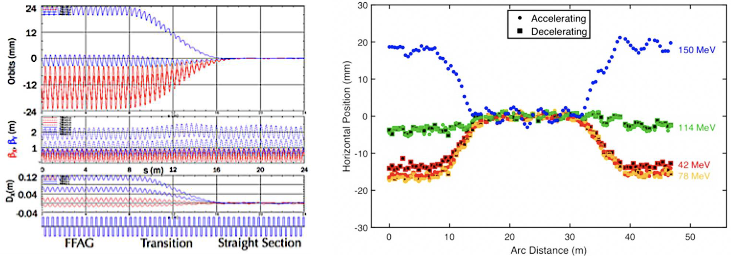
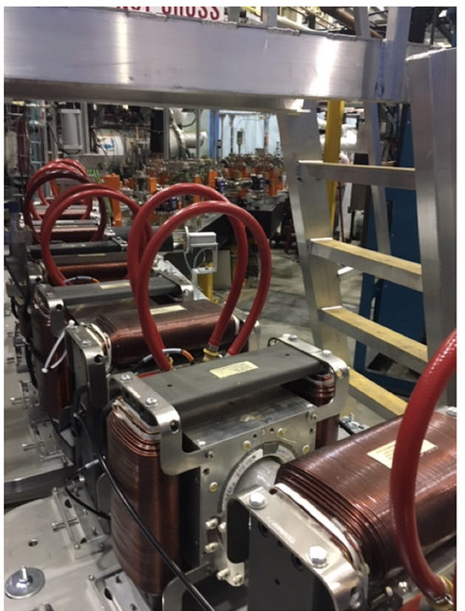
Cornell University Brookhaven National Laboratory Electron Test Accelerator - CBETA
Full proof of principle for the Non-scaling Fixed Field Alternating Gradient
Merging multiple energy orbits into a single straight-line orbit
Development of the new permanent magnet technology

Slide 4
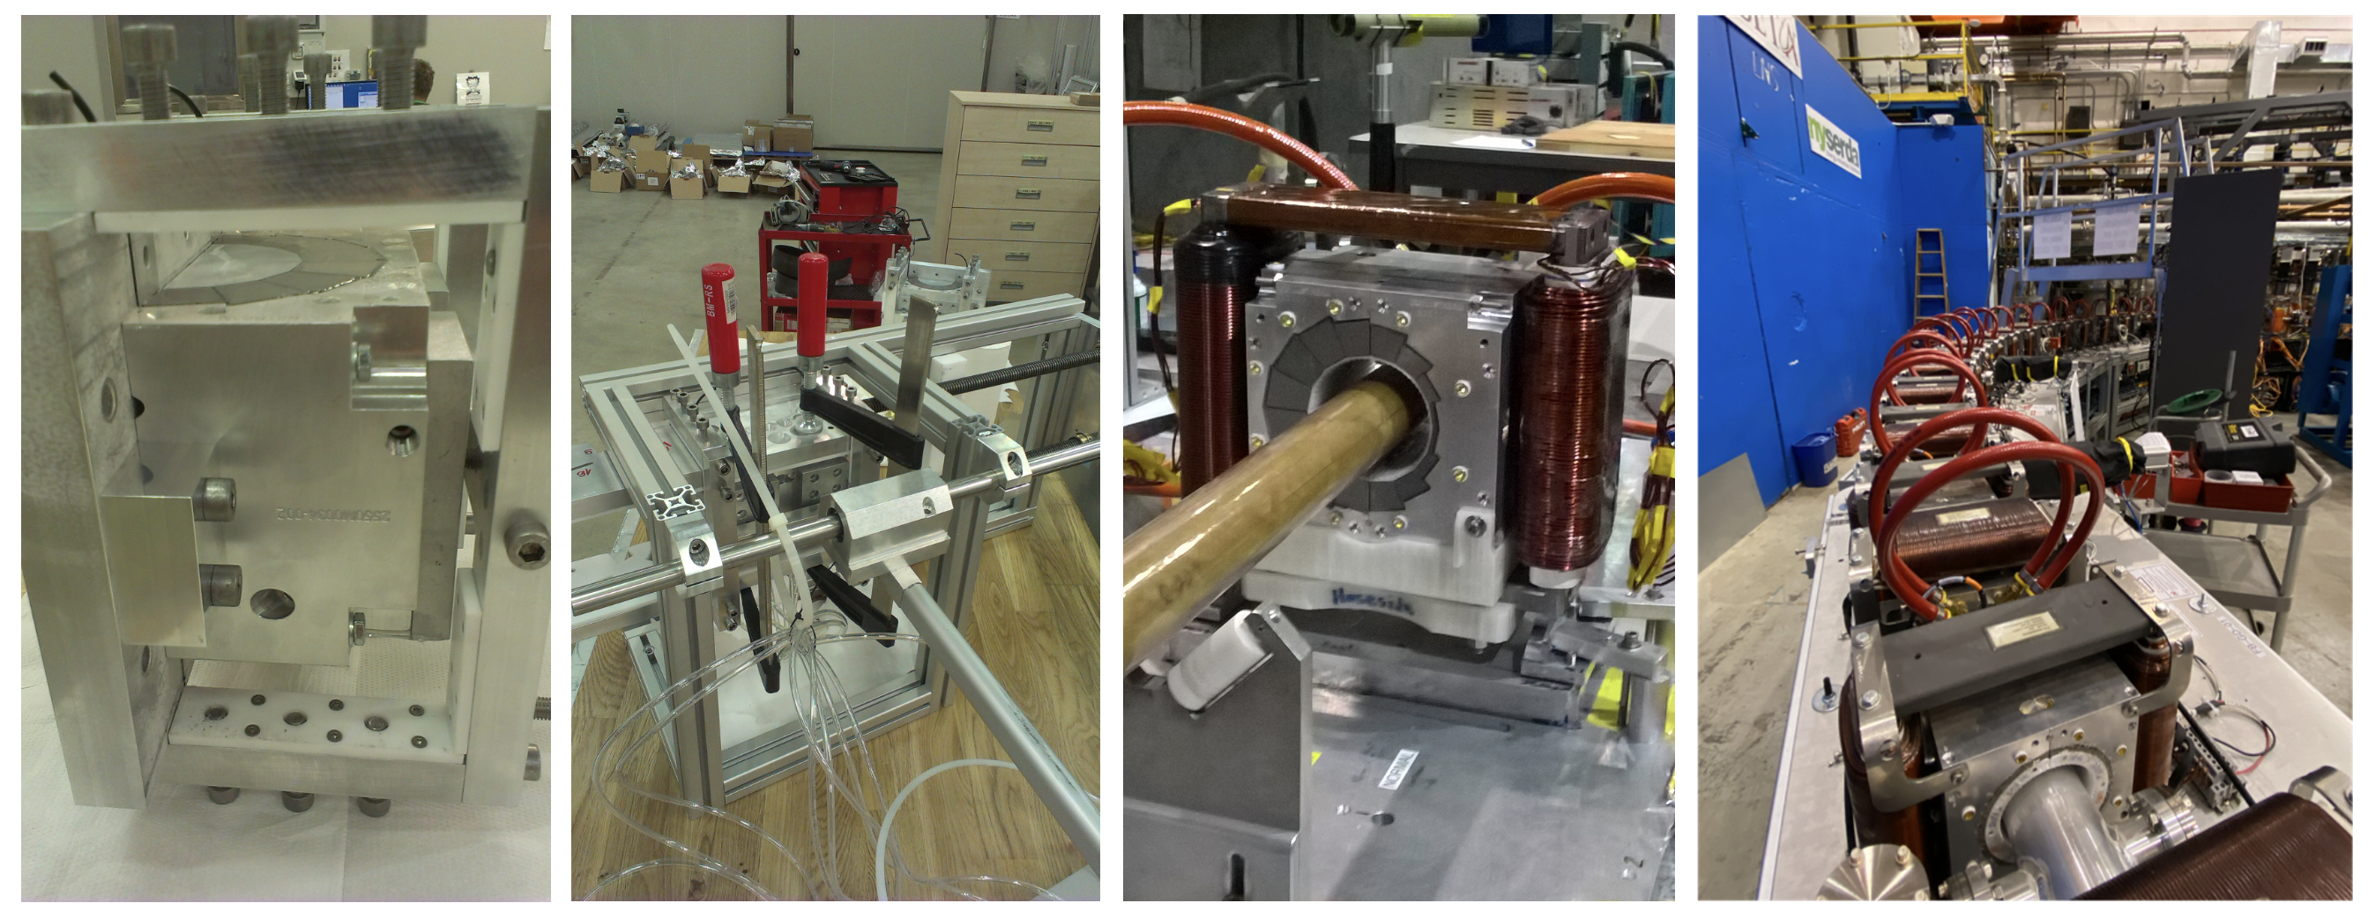
Established new permanent magnet technology

Slide 5
FLASH Therapy Requirements
The beam of 1.9 x 10¹¹ protons is equivalent for dose delivery at FLASH rates to a charge of ∼30 nC, as the dose is delivered in 100 ms,
This corresponds to a beam current of 300 nA at the patient, or a dose rate of 20 Gy/s.
Only isochronous cyclotrons are capable of delivering such a sustained current only at the highest energies (see Table bellow): losses in the beam transport between accelerator and patient also reduce the intensity at the patient, particularly at low energies. However, the commonly accepted definition is for dose rates above 40 Gy/s.

Slide 6
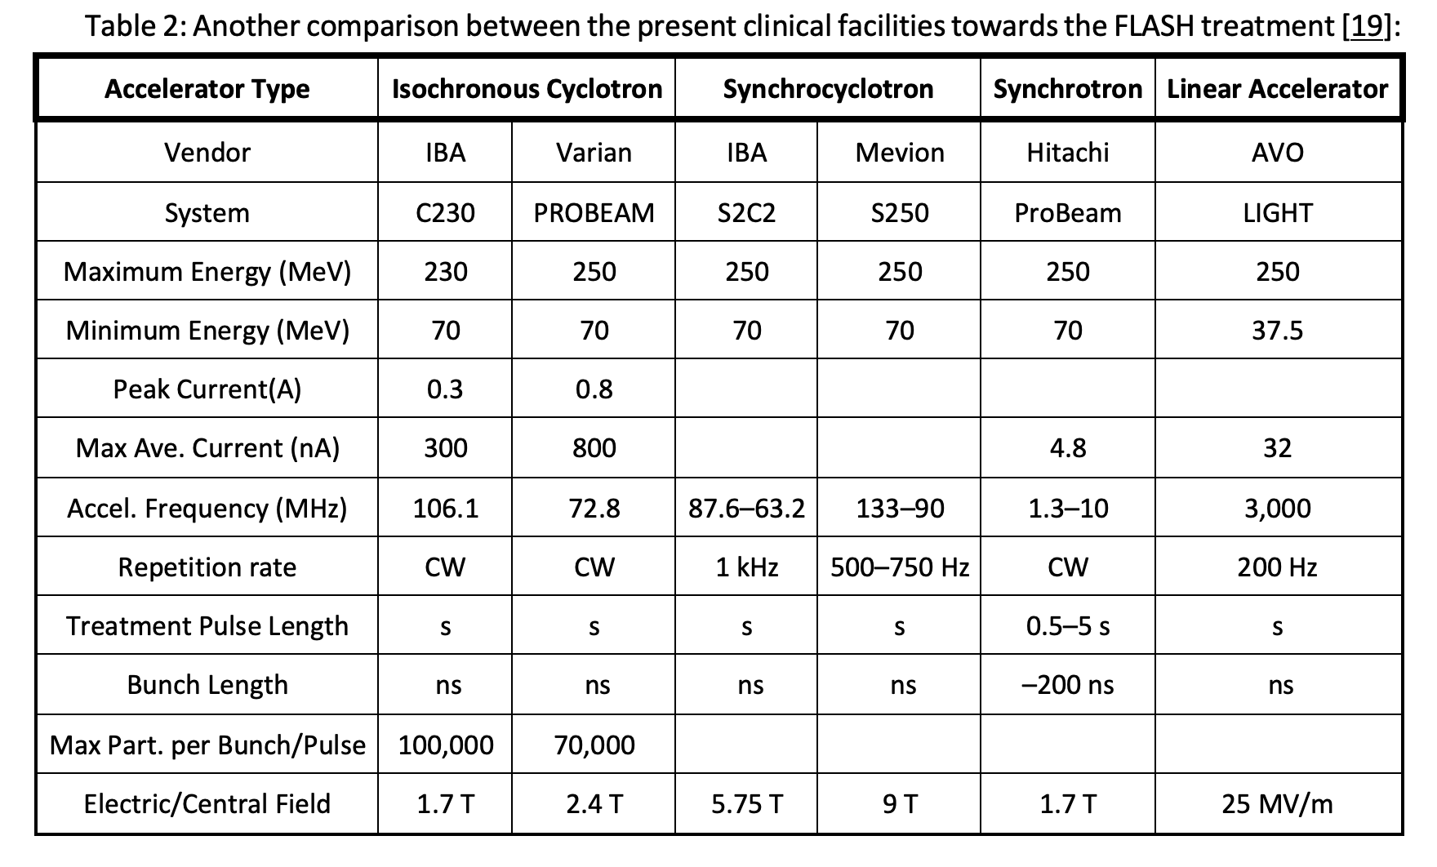
Limits of the Present Facilities
FLASH REQUIREMENTS: 300 nA, 30 nC, 1.9 x 10¹¹ protons, in 100 ms
FFA SYNCHROTRON
FFA synchrotron
250
10
650 nA
390 MHz
1.3 kHz
515.9 pC
1.8 T
A total charge circulating in the permanent magnet proton synchrotron 28 proton bunches per cycle each with 1.2x10⁸ protons makes for a total of 28x1.15x10⁸=3.22x10⁹ protons or 515.9 pC or 515.9pc/783 μs = 658.9 nA. To get the required dose of 60 nC would require 60 nC/515.9 pC = 116 cycles of the fast proton synchrotron. As each cycle is 783 μs long this makes for the total time of treatment T_{TREATMENT}=116x783 μs = 90 ms.

Slide 7
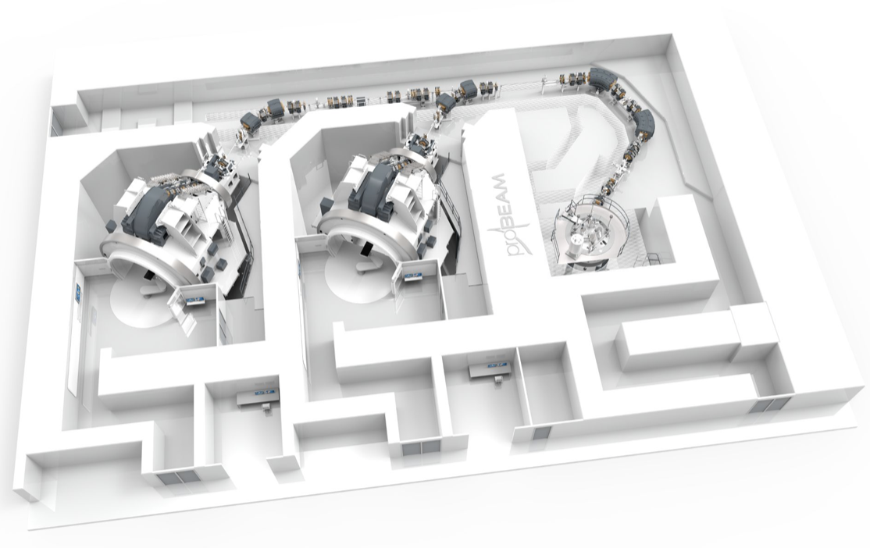
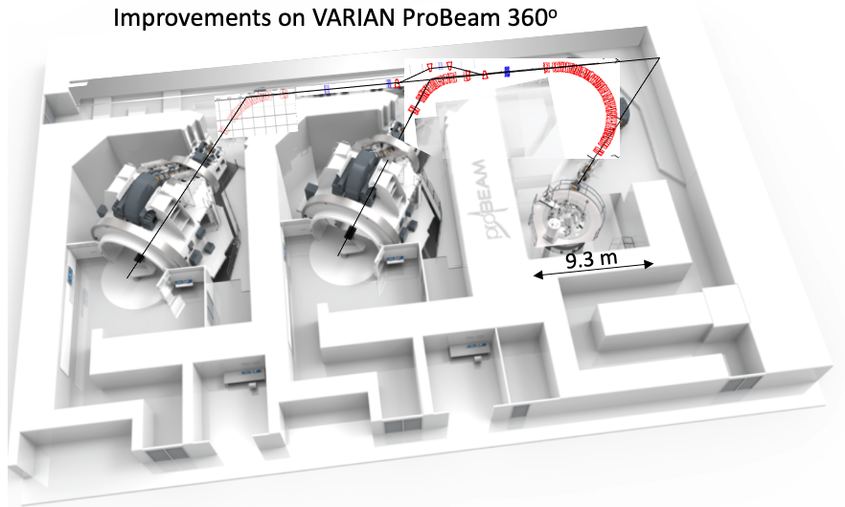
Improvements for the FLASH therapy in the existing proton therapy systems

Slide 8
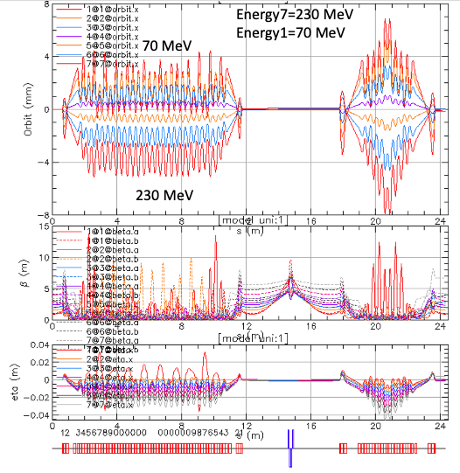
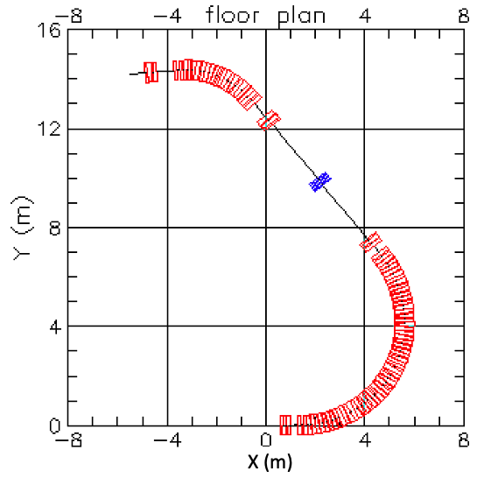
FFA Beam lines with 70—250 MeV kinetic energy range

Slide 9
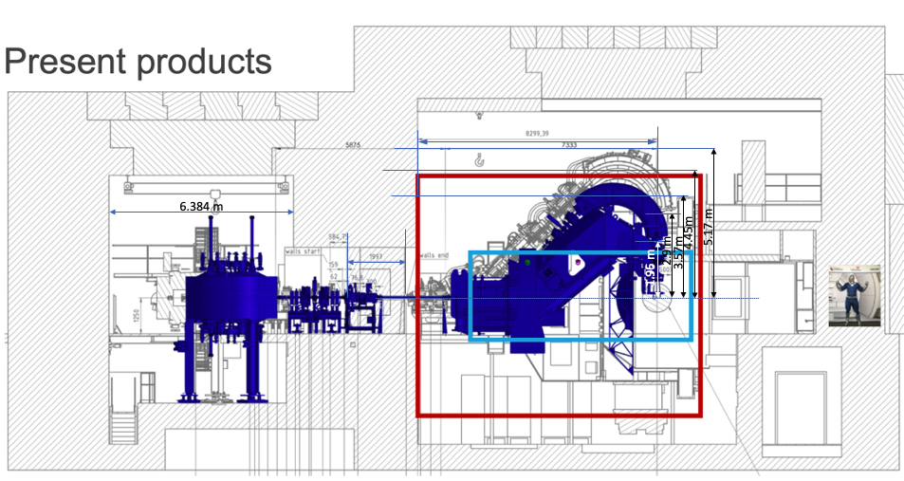
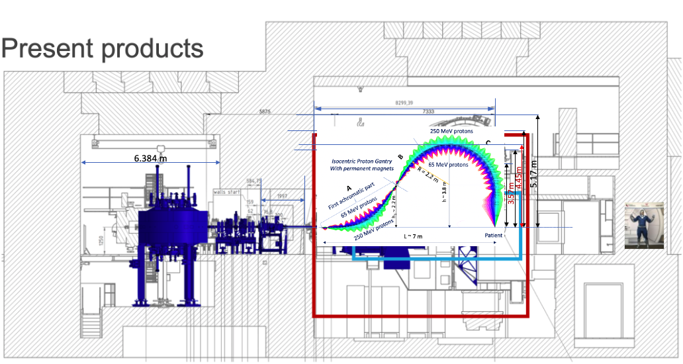
Present VARIAN-SIEMENS gantry

Slide 10
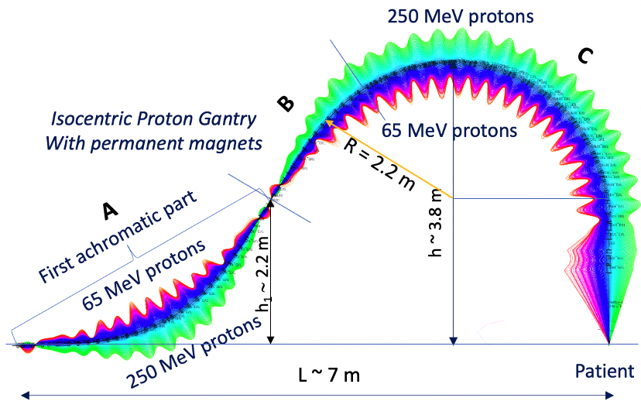

Slide 11
Replace the 230 fixed energy Cyclotron with the fast cycling FFA synchrotron

Slide 12
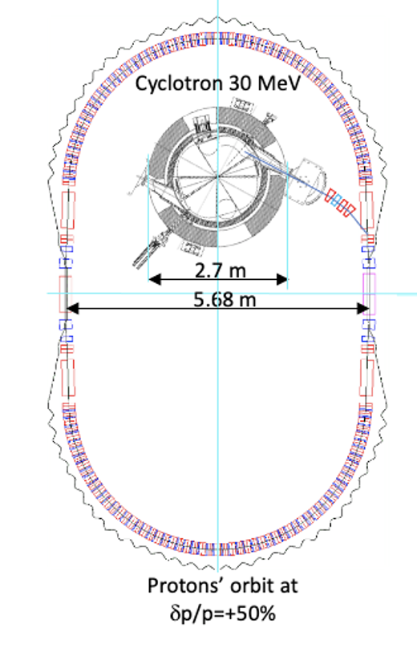
Fast Cycling FFA Synchrotron
The proposal is based on the existing US patent by the PI of this proposal:
D. Trbojevic, Title: “Non-scaling fixed field alternating gradient permanent magnet cancer therapy accelerator”, patent number: US 9661737 B2, Date of the patent: May 23, 2017 (belongs to the DOE) .
https://patentimages.storage.googleapis.com/42/5e/92/f7da1cf617d6e3/US9661737.pdf
Cyclotron 10 MeV

Slide 13
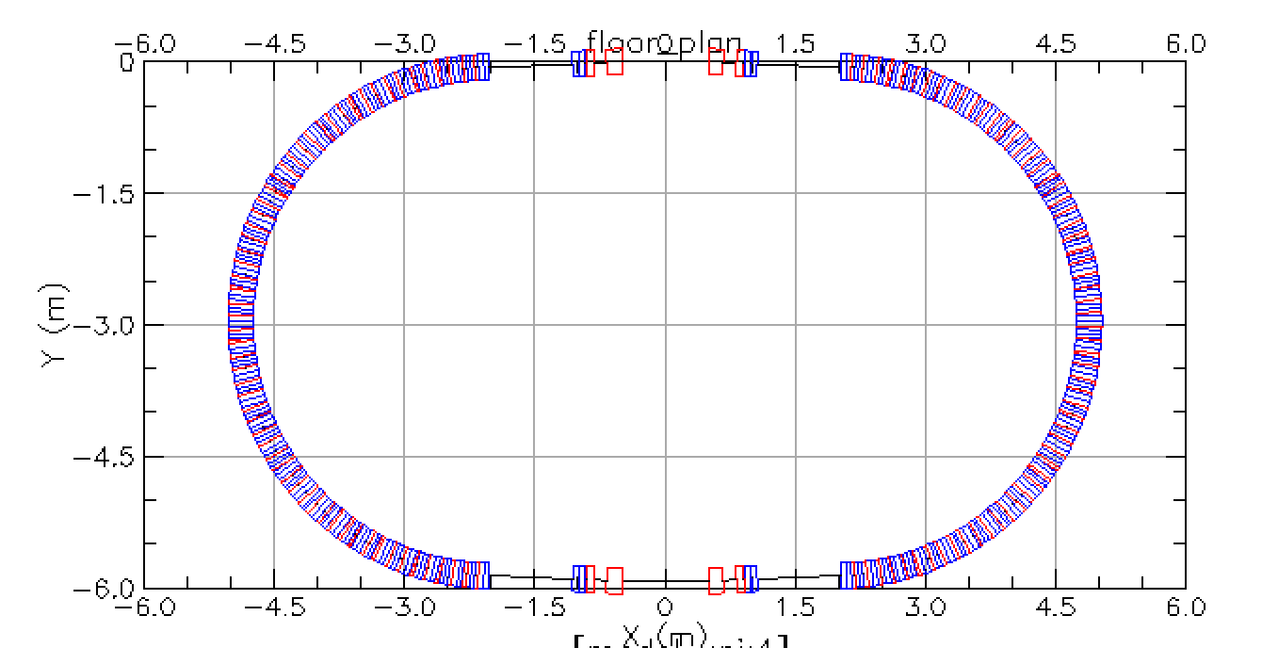
Fast Cycling FFA Synchrotron 10-250 MeV
5.8 m
S (m)
10 m

Slide 14
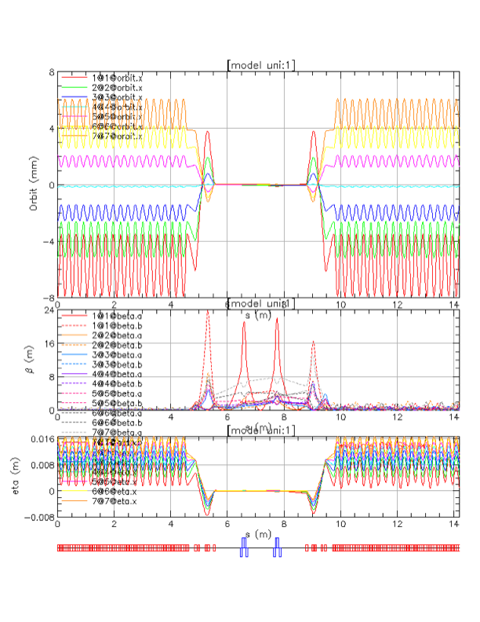
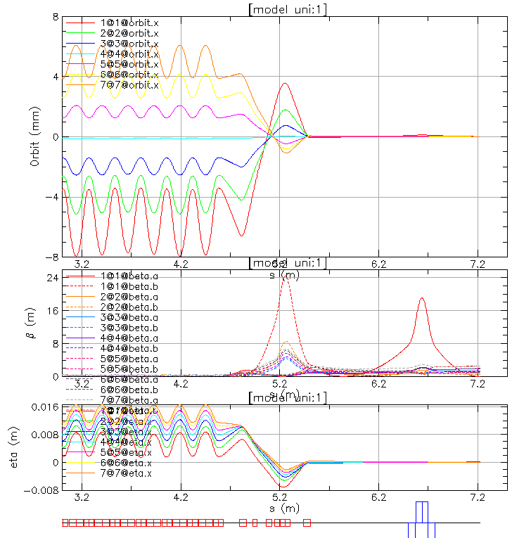
Orbit Offsets, Betatron Functions, and Dispersions
Very Strong Focusing
Very Small Dispersion
Combined Function Permanent Magnets
+ 6 mm
E_{k}=250 MeV
-8 mm
E_{k}=30 MeV
D_{xmax}=1.6 cm

Slide 15
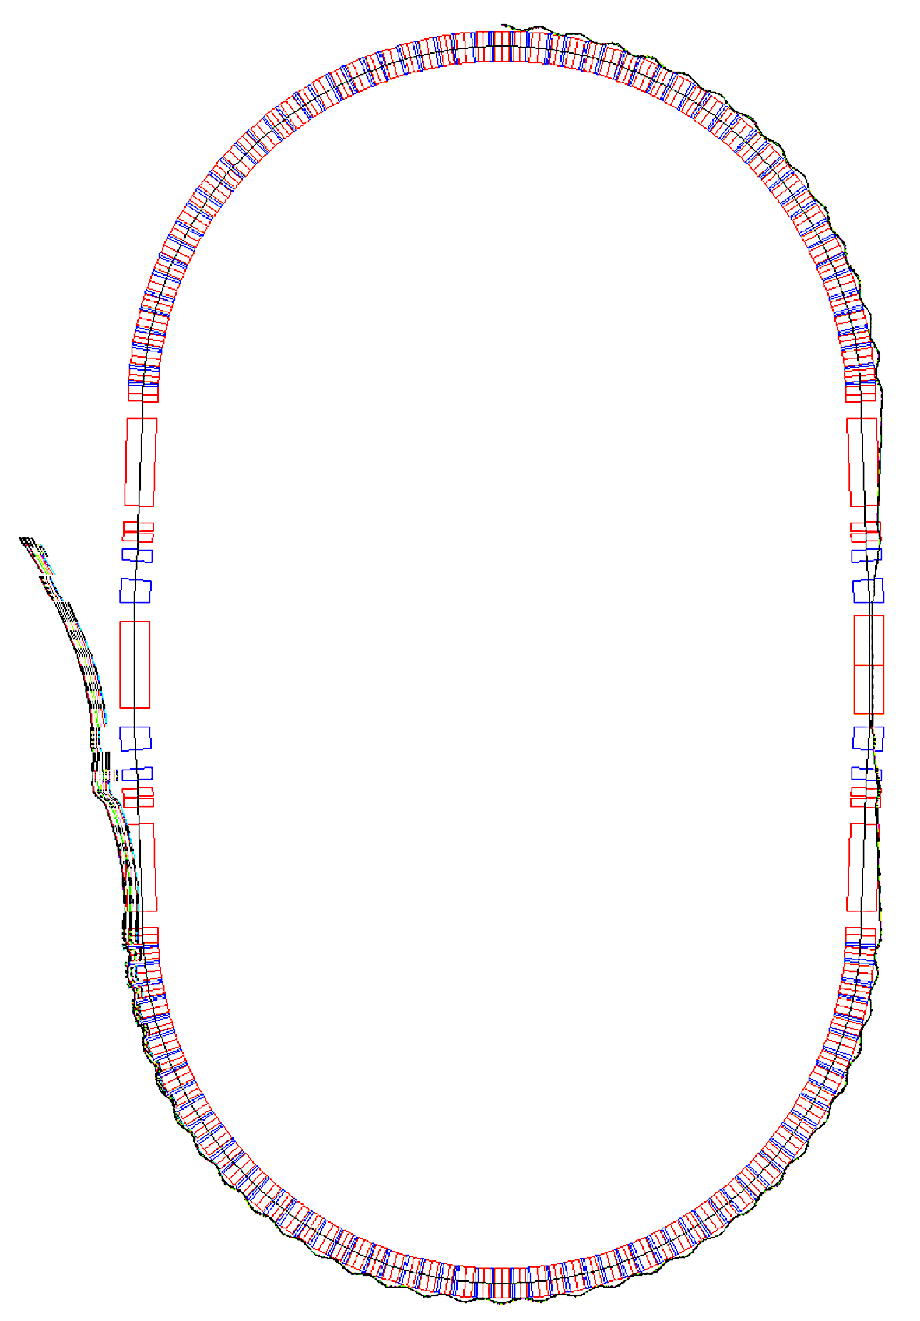
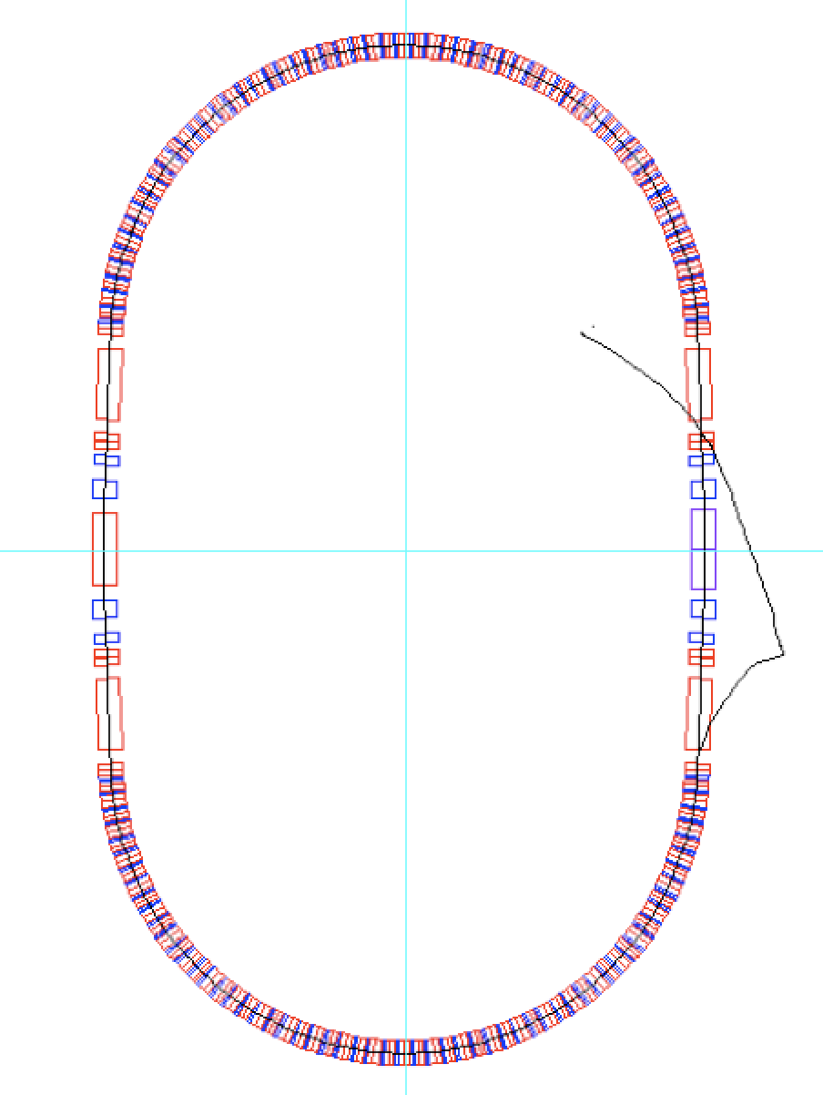
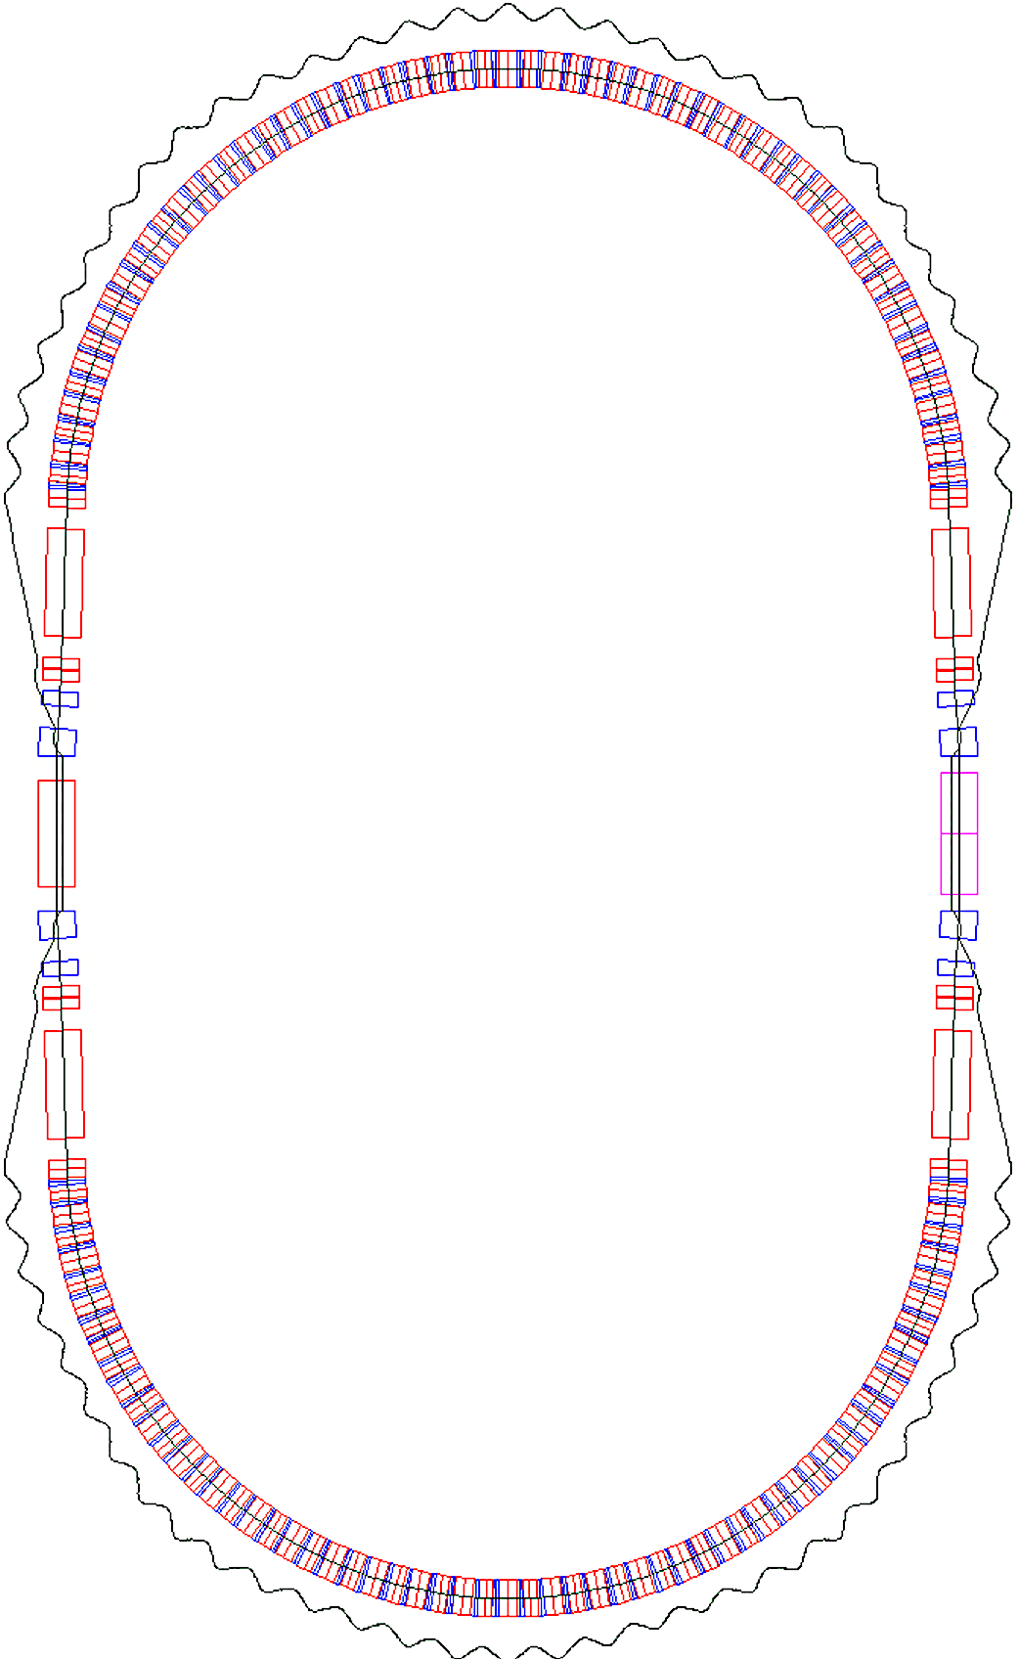
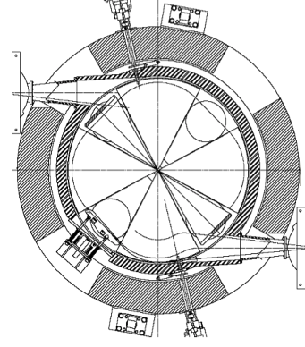
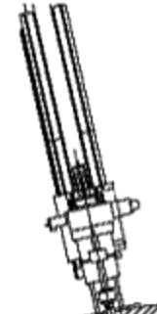
Injection, Extraction and three RF cavities
Cyclotron 30 MeV
RF-1
Magnified injection
orbit
Magnified extraction
orbit
RF-2
2.7 m
5.68 m
RF-3
Protons’ orbit at δp/p=+50%

Slide 16
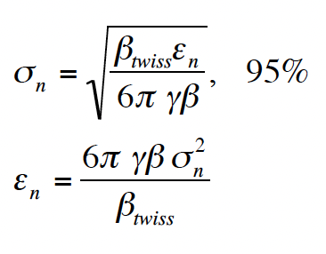
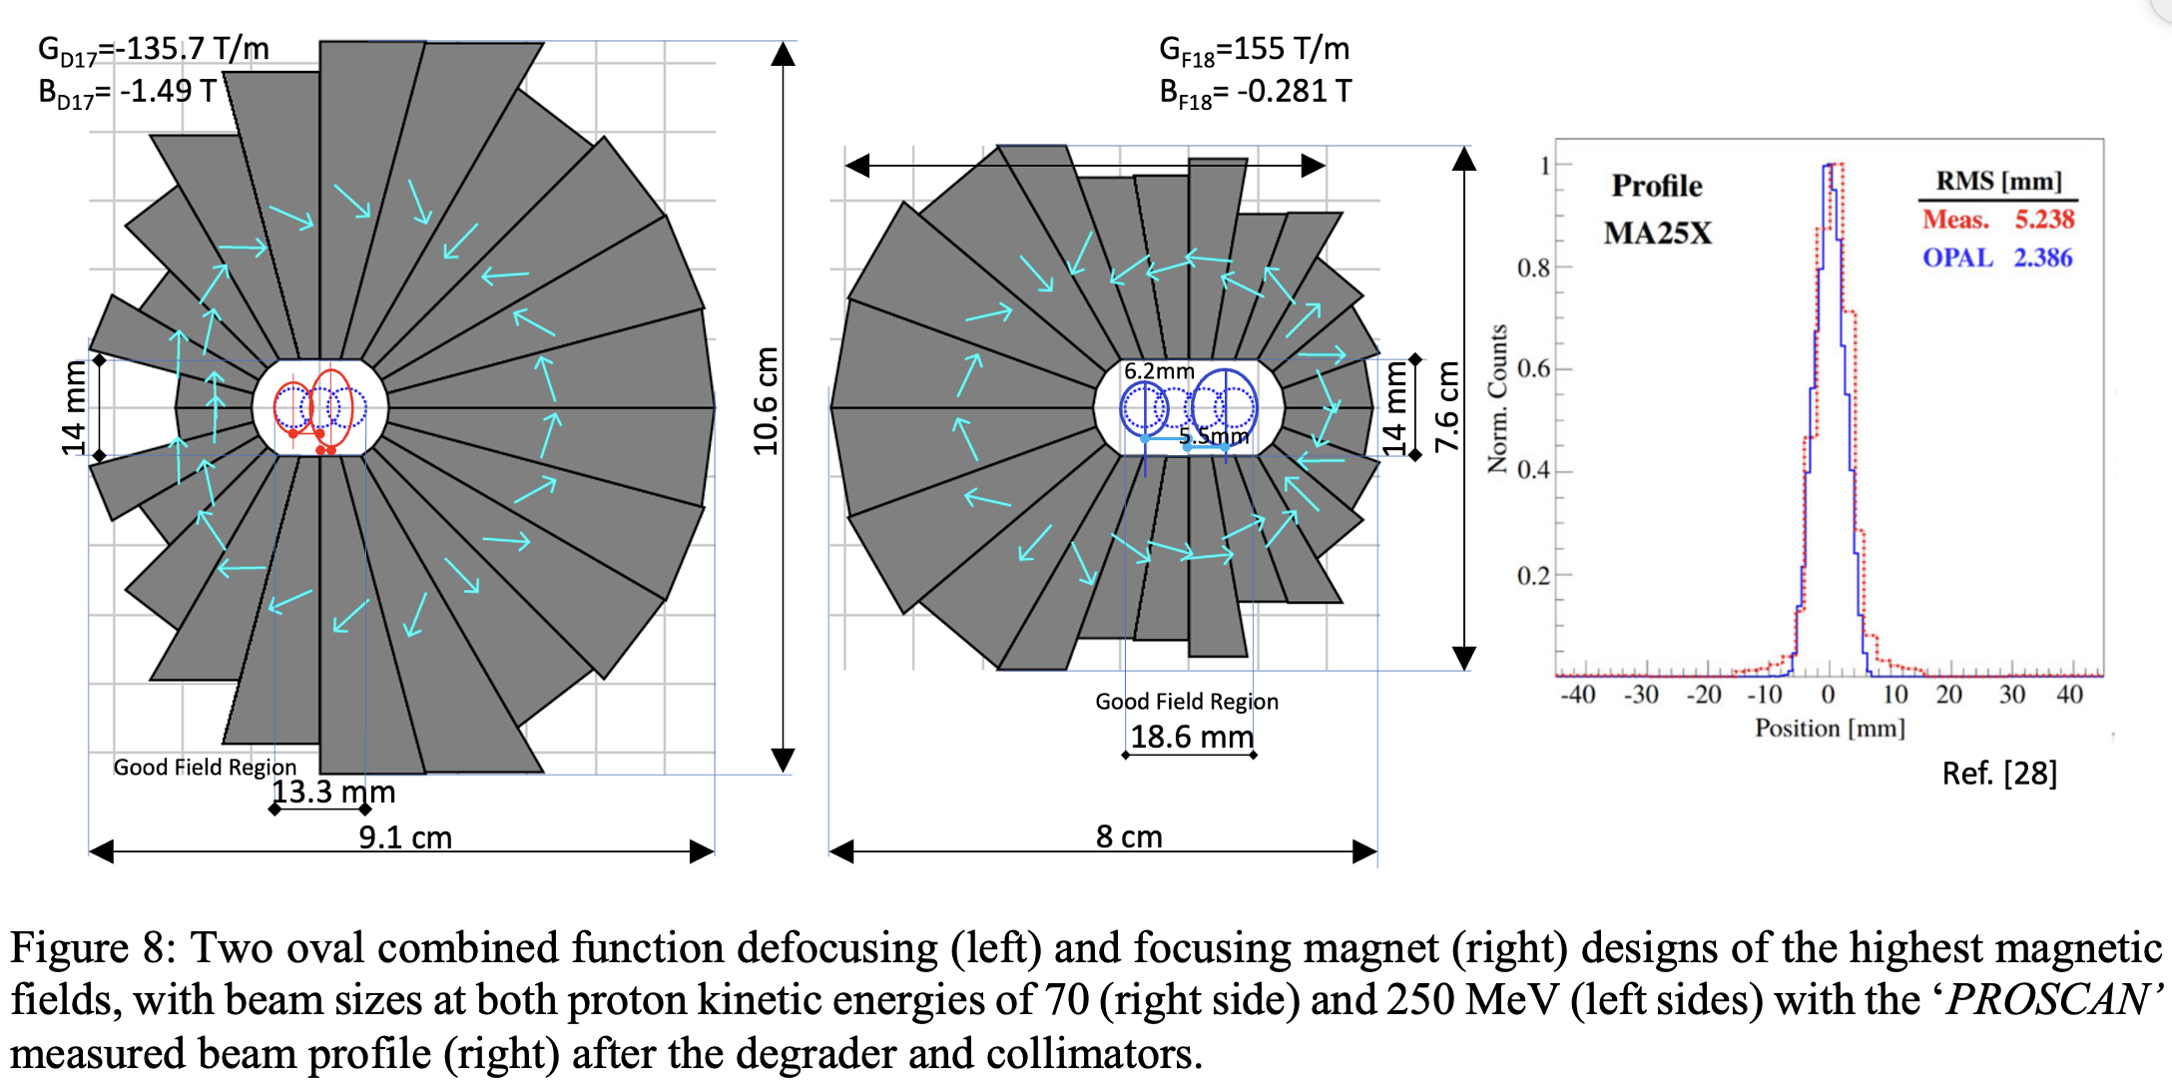
Synchrotron Beam Size Estimates from the 10 MeV cyclotron
Input beam is assumed to come from
the 10 MeV cyclotron
Measured emittance ~5 π mm mrad
β_{x}∼ 0.4 m
β_{y}∼ 1 m
At Injection kinetic energy is 10 MeV
= 1.010657 γβ=0.14484
γβ = ⎷ γ²-1 /γ
σ_{x} =1.517 mm
σ_{y} =2.398 mm

Slide 17
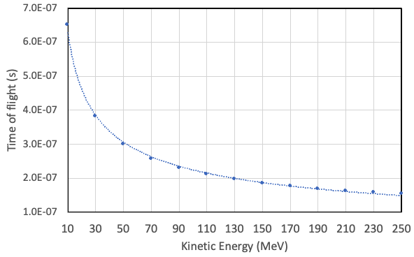
Time of flight dependence during acceleration

Slide 18
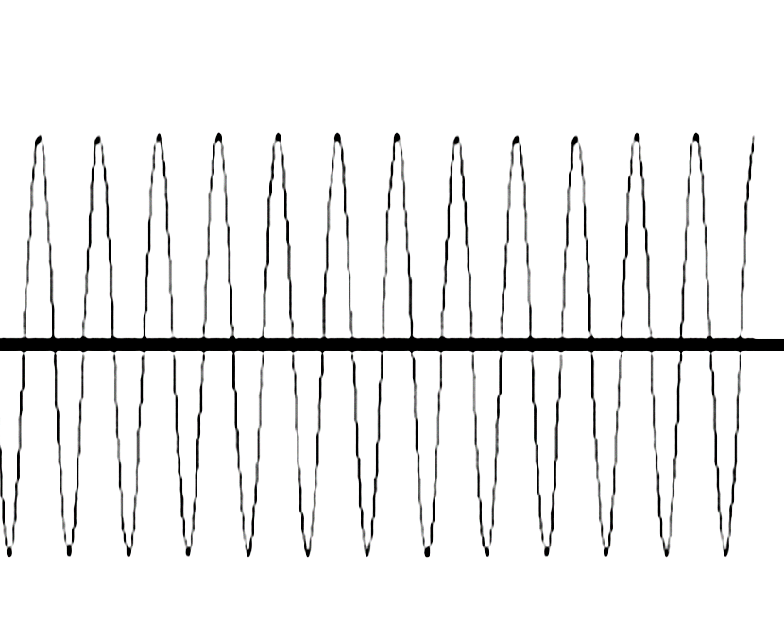
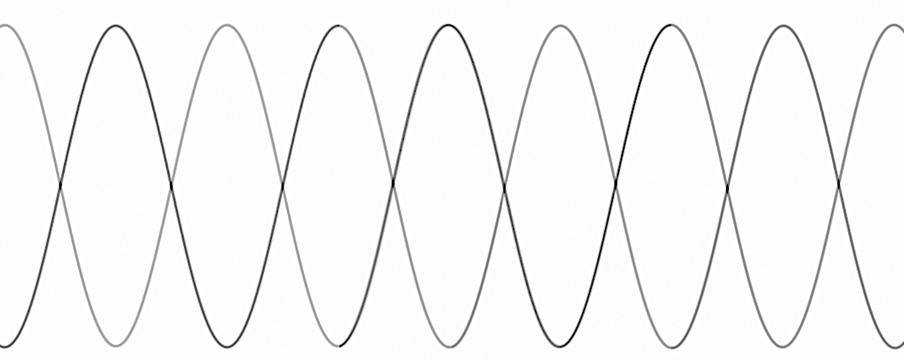
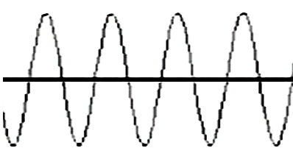
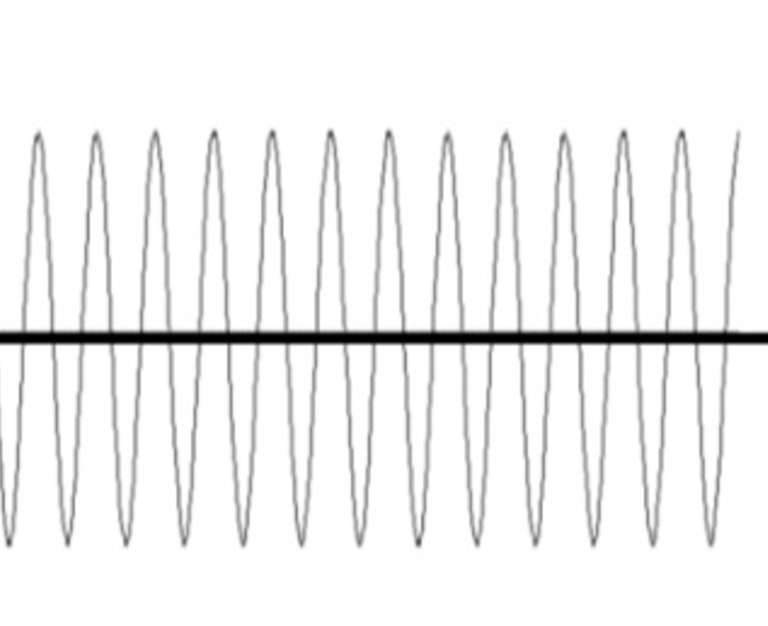
Injection from CYCLOTRON to FFA
Available 149 RF cycles of synchrotron RF 390 MHz = 382.2 ns @ injection
Cyclotron RF 65 MHz
#1
#2
#3
#4
#5
#6
60 RF cycles @ top 250 MeV energy
28 bunches
32 cycles=82.05ns

Slide 19
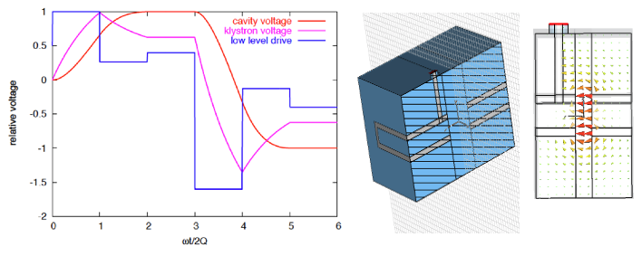
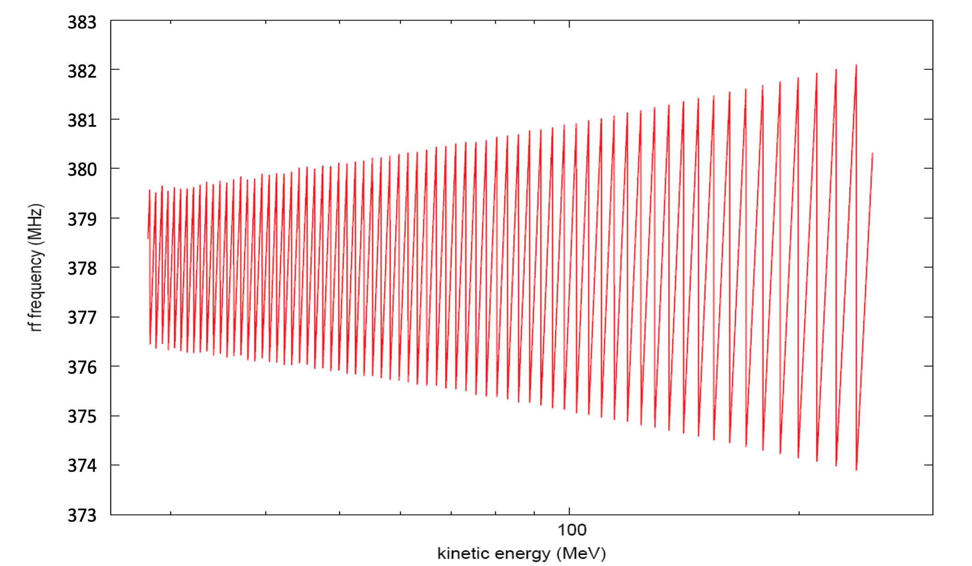
Acceleration in Fast-Cycling FFA synchrotron Phase Jump acceleration with Pill Box RF Cavities
Michael Blaskiewicz
- The Phase Jump Acceleration (PJA) method is proposed by M. Blaskiewicz and follows a previous proposal by D. Boussard from CERN.
Acceleration is performed by adjusting the RF phase each turn. The phase jump during acceleration with a fixed frequency. The RF frequency needs to be in a high range, ~370-395 MHz, because of the required large number of RF cycles between the passages of bunches, to achieve higher values of Q. The basic idea is to accelerate a train of bunches with a gap. During the gap the RF phase is adjusted so that when next the bunch train arrives, the phase is correct for acceleration.

Slide 20
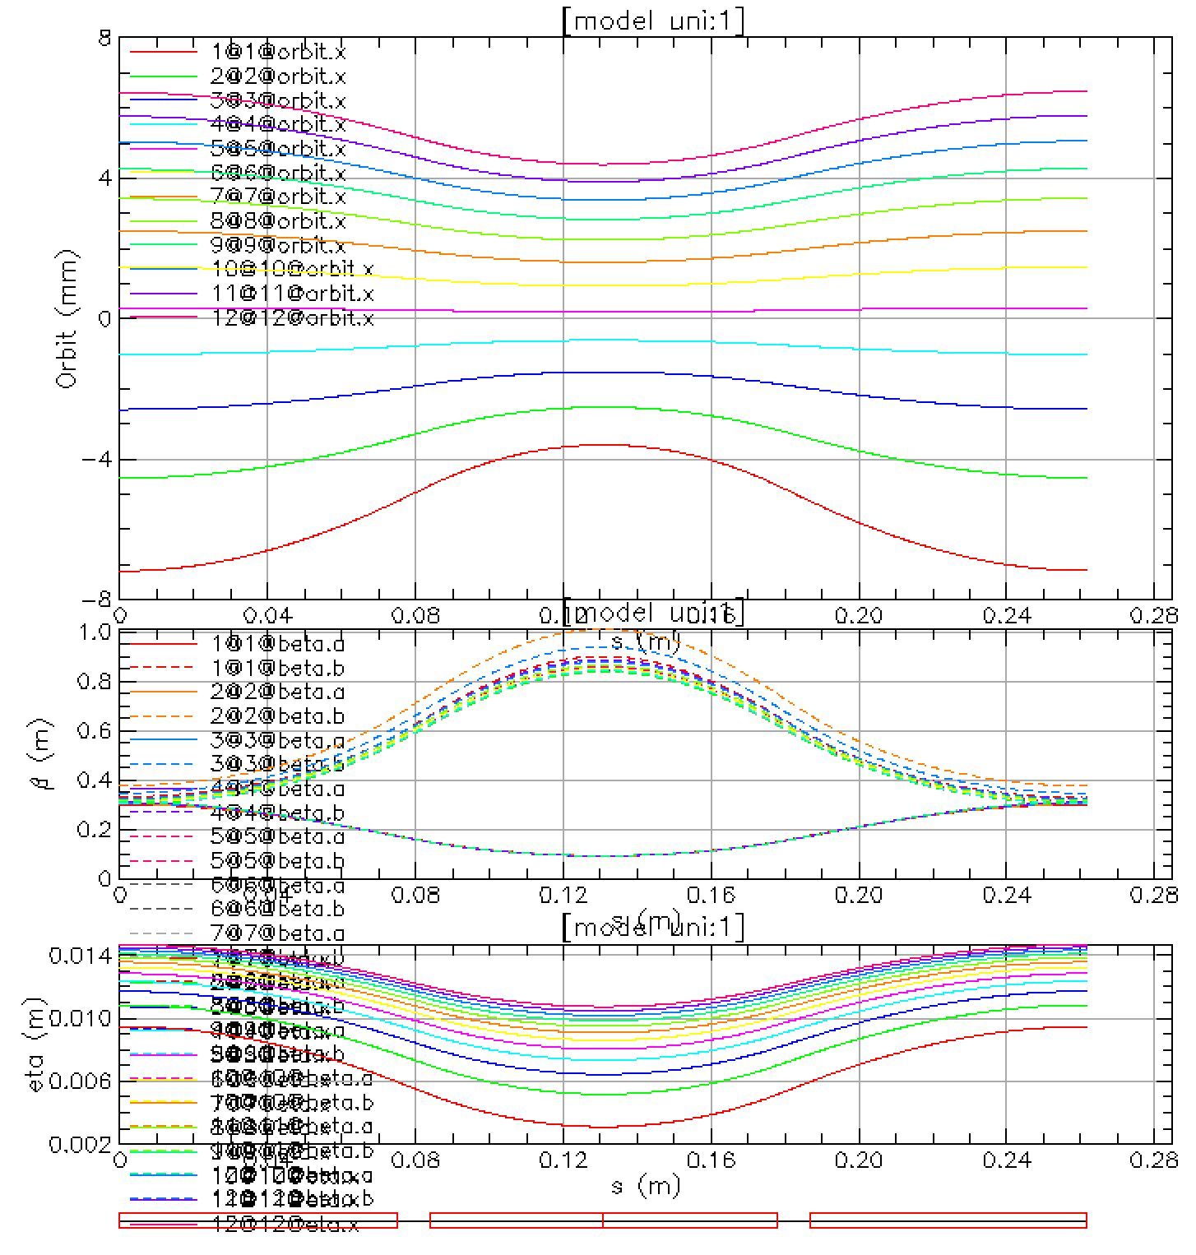
Orbits and betatron function in the Arc Cell

Slide 21
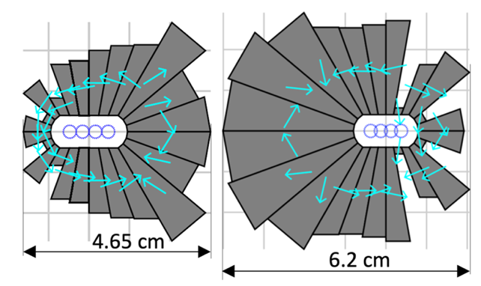
Permanent Magnets with additional Multipoles

Slide 22
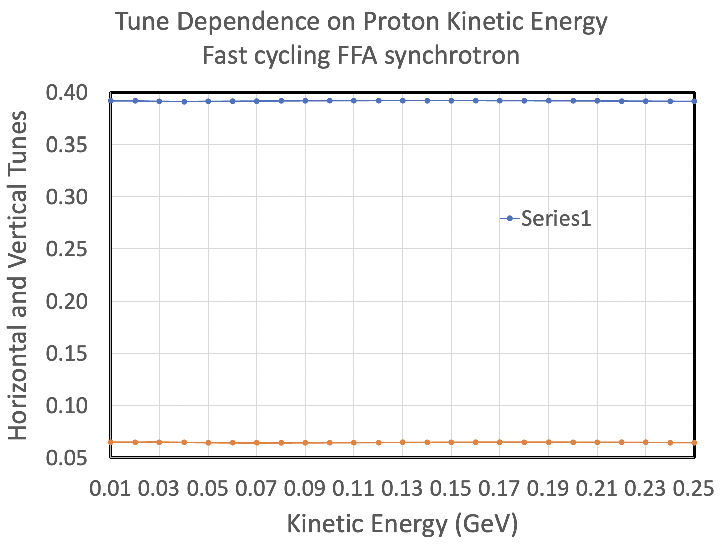
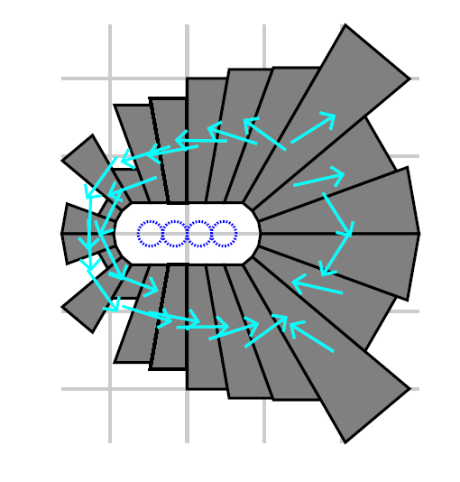
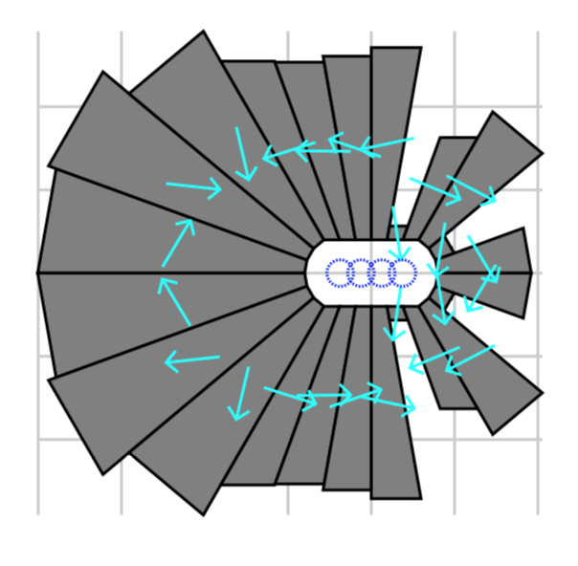
Extended kinetic energy range from 10 – 250 MeV
Initial Design of Focusing
combined function magnet
Initial results for tunes vs. energy. Usual FFA design cannot get this energy range and tunes vary from initial 0.38 down to 0.04. This dependence removes crossing multiple resonances and increase of the beam emittance or beam loss.
Initial Design of Defocusing
combined function magnet
6 cm

Slide 23
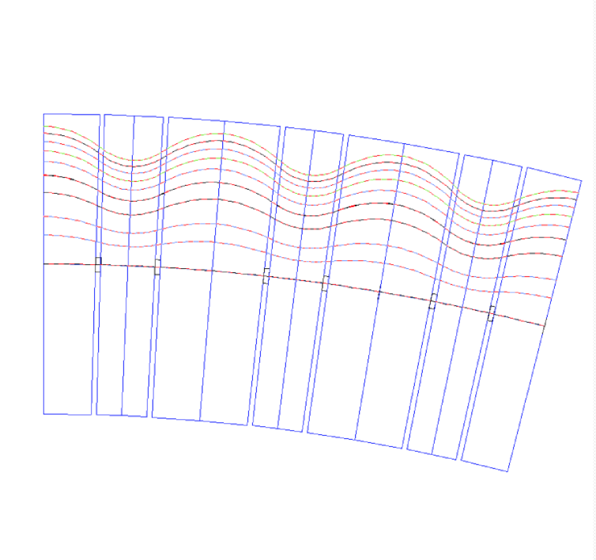
Orbits in the FFA synchrotron After Dynamical Aperture Improvements
25 -40 mm
0 mm

Slide 24
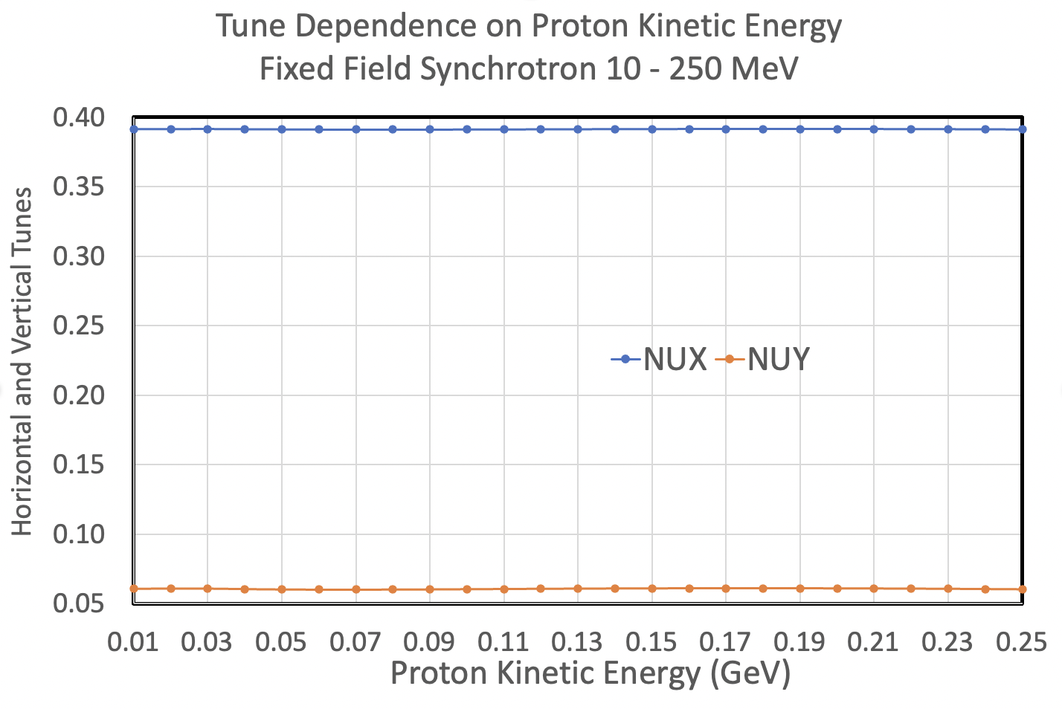
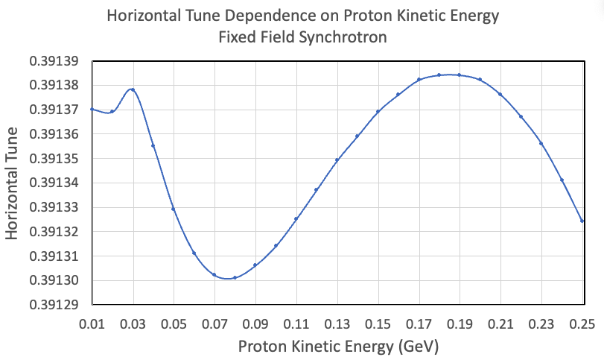
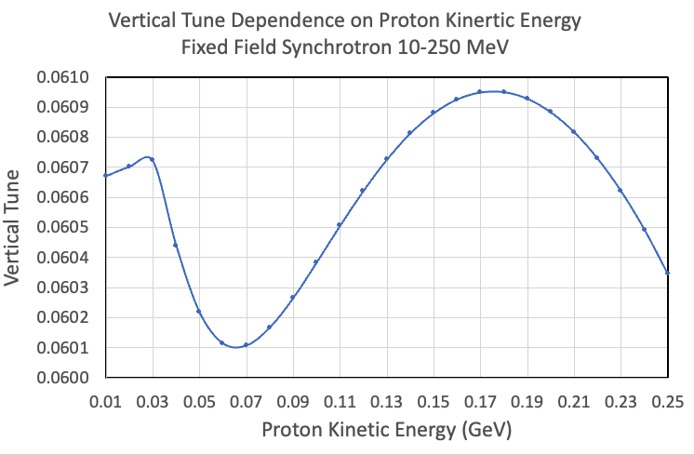
Tunes on Energy Dependence

Slide 25
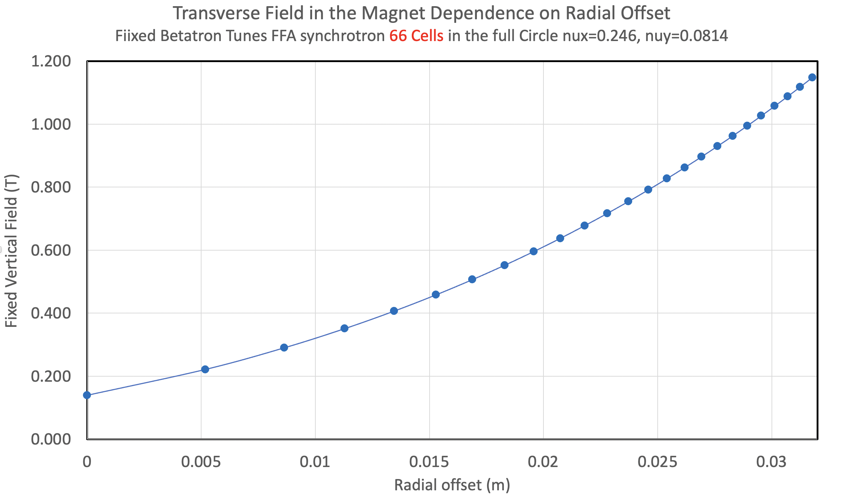
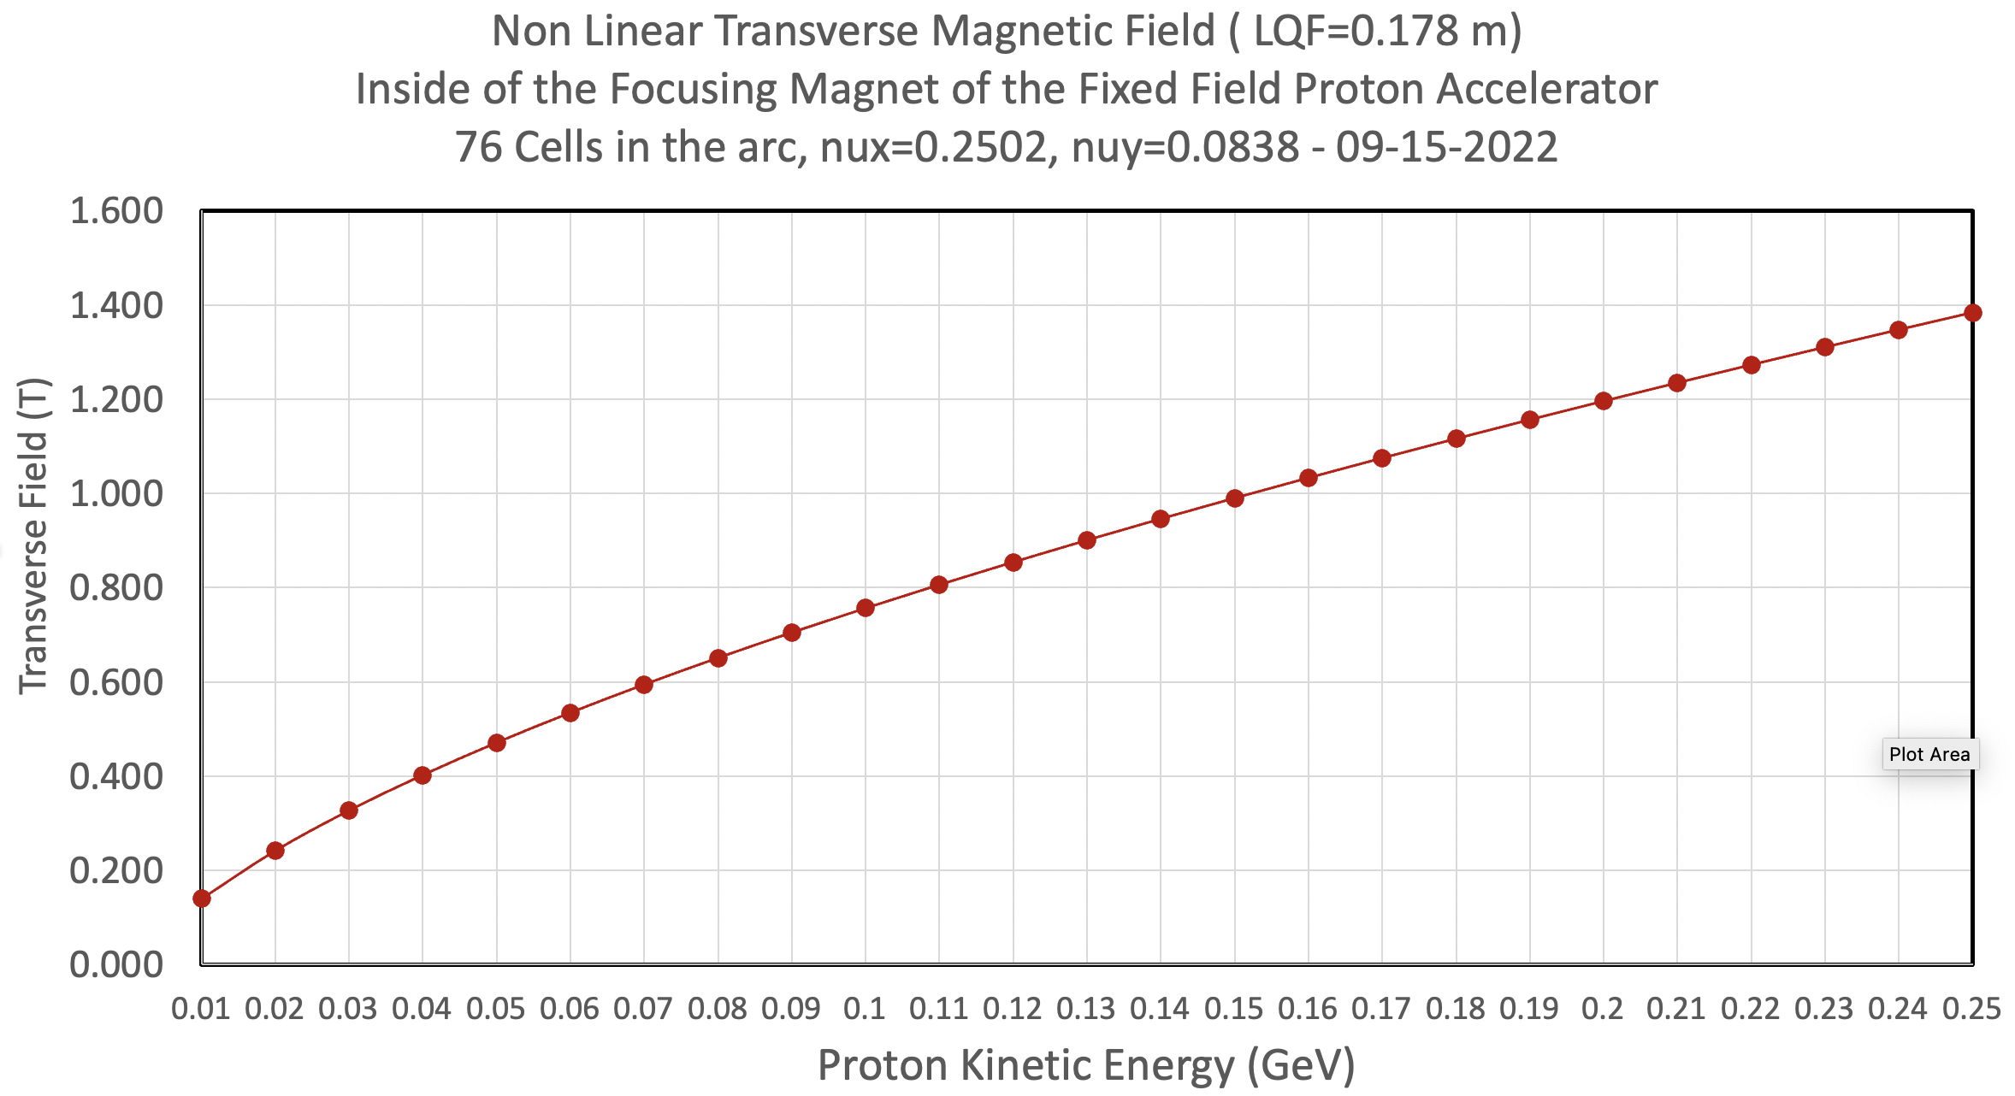
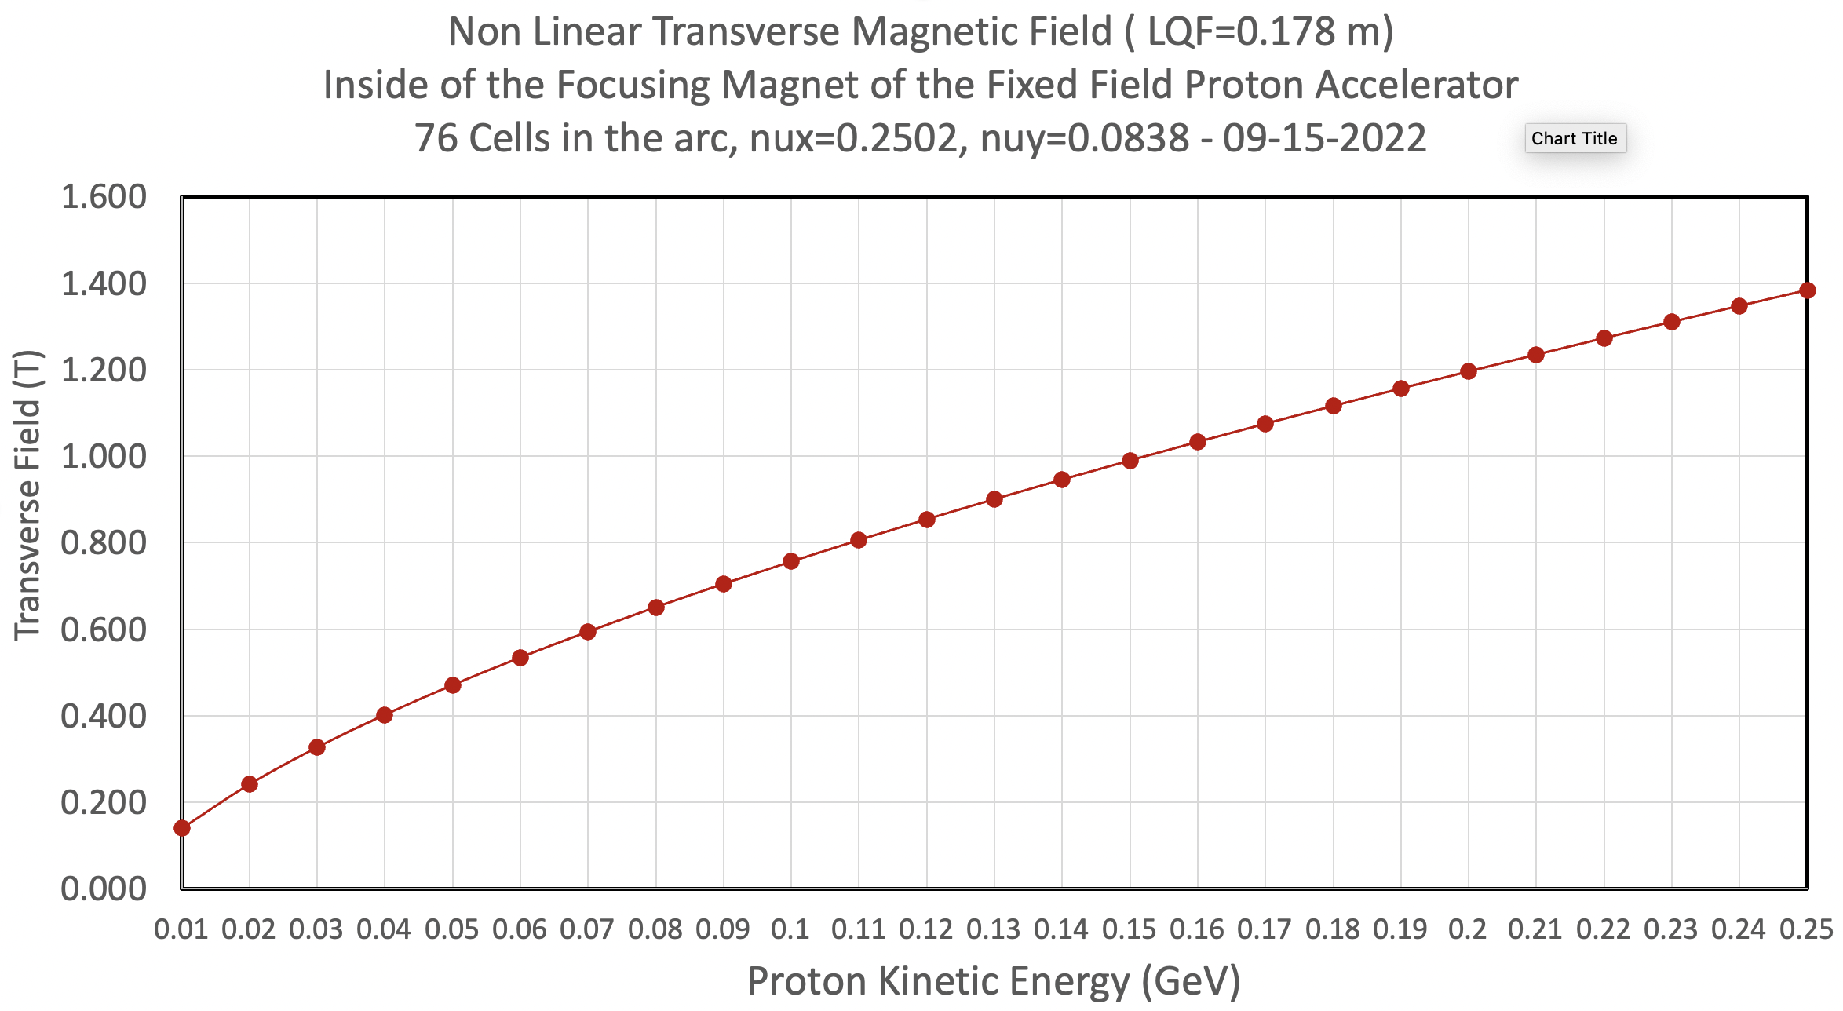
Dynamical Aperture Studies

Slide 26
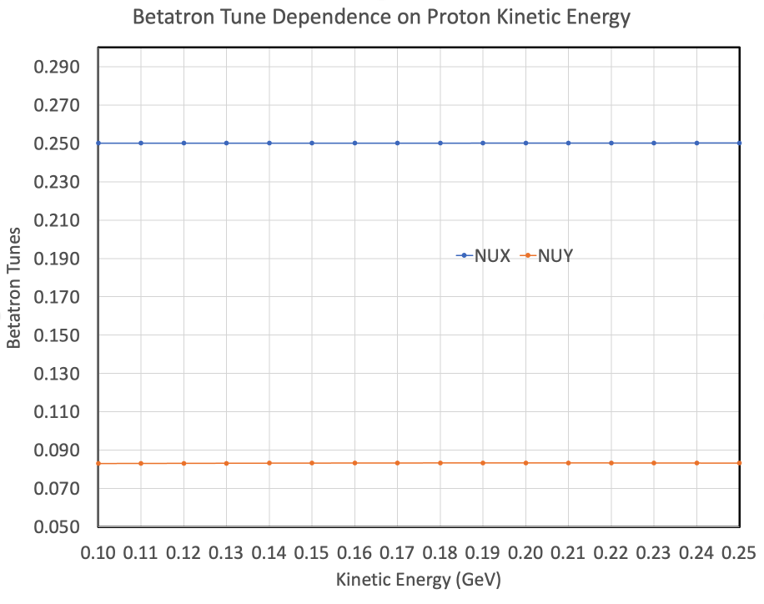
First Attempt to improve dynamical aperture by adjusting the x and y phases per cell to reduce amplitude tune shift

Slide 27
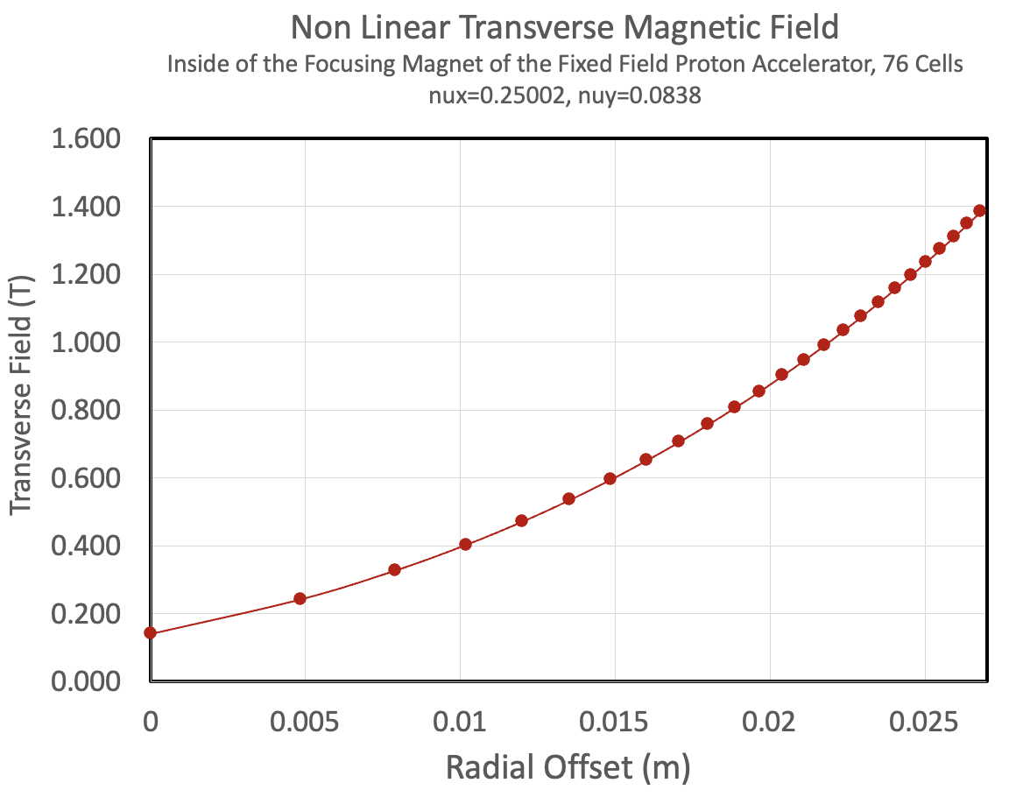
Vertical Magnetic Field

Slide 28
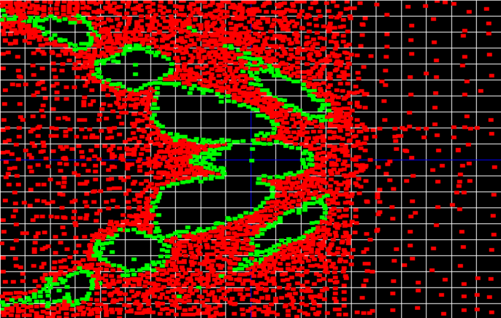
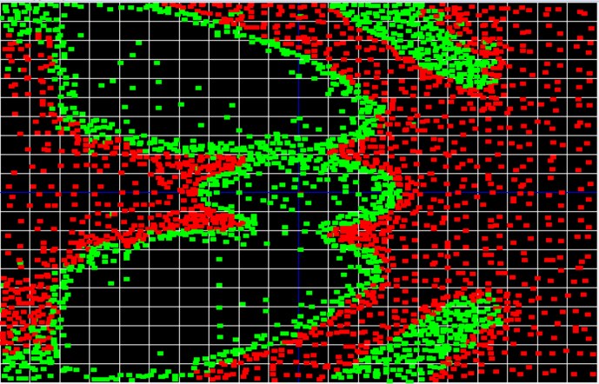
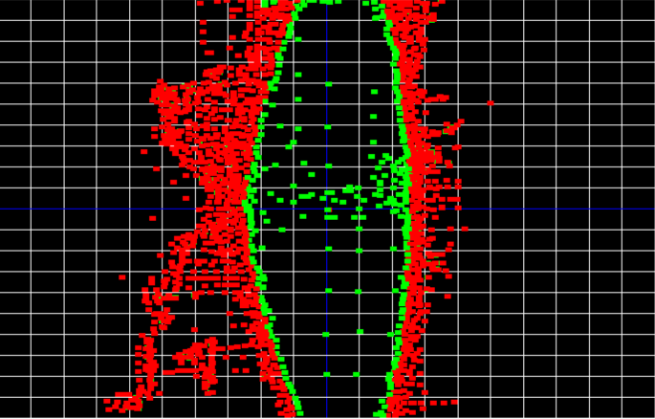
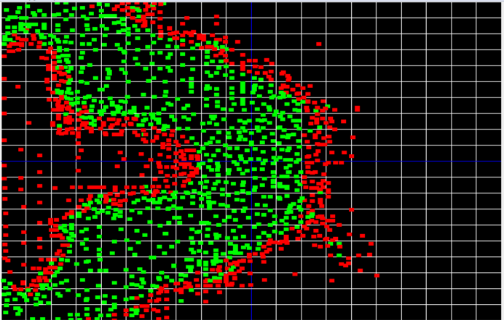
Dynamical Aperture Studies
Sept 15, 2022

Slide 29
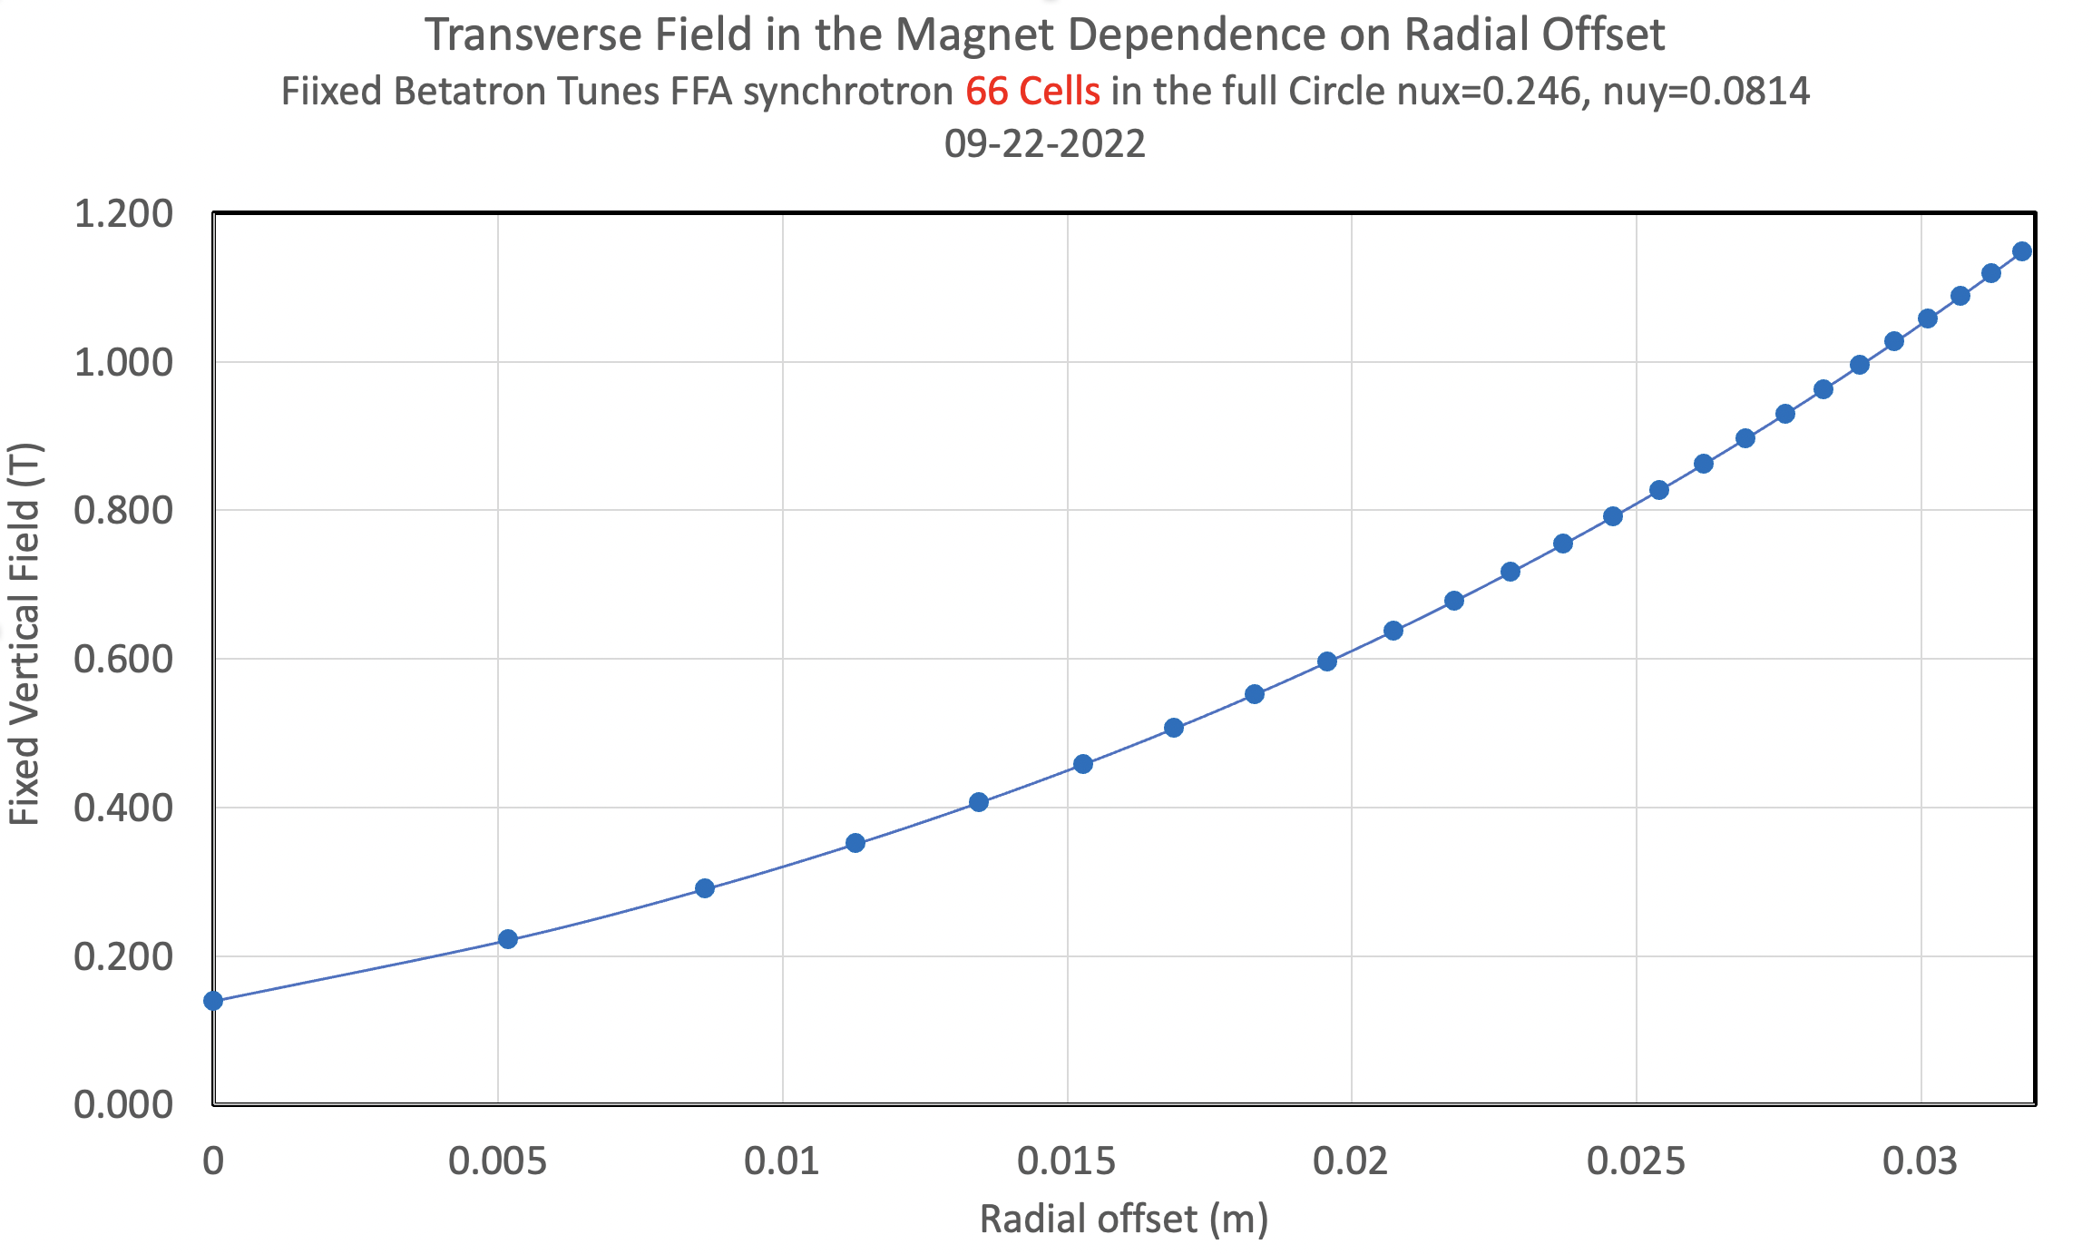
Dynamical Aperture Studies

Slide 30
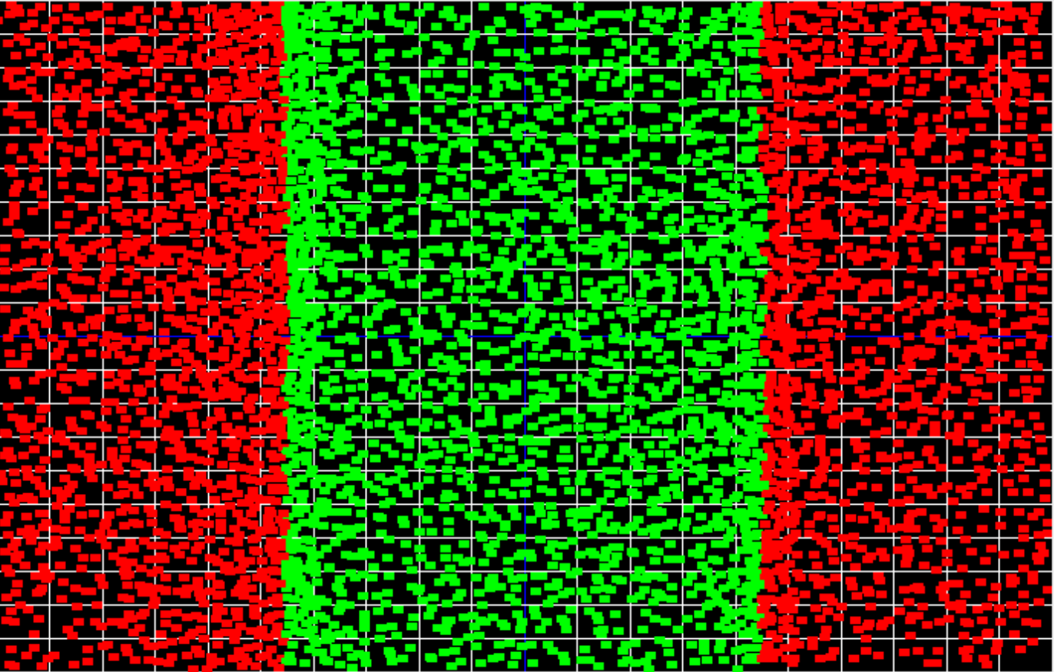
Dynamical Aperture Studies
66 Cells, Tunes ν_{x}=0.246, ν_{y}=0.0814, Maximum Orbit Offset 32.7 mm

Slide 31
Dynamical Aperture Studies

Slide 32
Magnetic field dependence on Energy

Slide 33
Application of Fast-Cycling FFA Synchrotron for Proton Cancer FLASH Radiation Therapy
FLASH cancer therapy: Multiple biological studies and even few patients’ treatments around the world in recent years confirmed significant improvements in the cancer treatment results; termed FLASH radiotherapy, involves delivering the same treatment dose but in much shorter time intervals — fractions of a second as opposed to minutes — and in far fewer fractions or even a single fraction and therefore at dose rates that are thousands of times higher [1].
The 10 MeV commercially available cyclotron has frequency of 42 MHz and provides 120 mA. This makes 1.8x10⁷ protons per bunch. As the synchrotron accelerates 30 bunches this makes per each synchrotron cycle N_{PROTONS} = 1.15 x 10⁸ x 30 = 5.4 x 10⁷. To achieve the 3.8 x 10¹¹ protons for FLASH therapy it is required to run the synchrotron per one FLASH treatment N=3.8 x 10¹¹/3.23 x 10⁹~ 700. The total time for the FLASH treatment is t_{FLASH}=700 x 898 μs = 632 ms!
[1] Konrad P. Nesteruk and Serena Psoroulas, “FLASH Irradiation with Proton Beams: Beam Characteristics and Their Implications for Beam Diagnostics”, applied sciences, 2021, 11, 2170, https://doi.org/10.3390/app11052170

Slide 34
SUMMARY
The 10-250 MeV fast cycling proton synchrotron with cycling of 1.3 kHz is the fastest synchrotron proposed. The synchrotron rates are in a range are 15-60 Hz.
In proton acceleration within the non-relativistic energy range the main problem is the limitation on the speed of magnetic field response to the change of energy. This limitation is now eliminated by using the permanent magnets for the same energy range.
One of possible application is in FLASH cancer radiation therapy.
This proof of principle accelerator would enable new areas of research using the same principle but building the magnets with multi-layer superconducting wires.
Advantages:
The Fast-cycling permanent magnet synchrotron with 6x10 m area is the best possible synchrotron for the cancer proton FLASH radiation therapy it is cost efficient, does not require electrical power, magnets are very small and light.
Small, energy efficient, and fast cycling proton drivers for NPP and HEP.
Future Fast cycling synchrotron accelerator driven system (ADS) for transmutation of nuclear waste.

