Slide 1



Flash Radiotherapy
Iain Tullis

Slide 2
Why the big interest in FLASH?
Radiation delivered at ultra-high dose rates (FLASH)
  Potential Benefits for Radiotherapy:
    Enables full treatments (or fractions) in a few hundreds/tenths of a second.
    No motion during treatment.
      Could minimize treatment (PTV) margins related to motion.
        Less normal tissue exposed to the treatment dose.
  Pre-clinical studies show:
    Less normal tissue toxicity, i.e. the “FLASH effect”
      Dose modifying factor: 1.1-1.5
    Similar tumour control.
      Dose modifying factor: 1
  Challenges to meet before clinical implementation:
    What specific beam parameters that induces a FLASH effect
    What environmental conditions affect the response
    What are the radiobiological mechanisms involved
  To maximise the therapeutic index – more preclinical work needed
    Need to understand when/why we get 0% sparing (tumours), 10-20% sparing or 30-50% sparing of normal tissues?
    Can we increase the therapeutic index further, e.g. by combining FLASH radiotherapy with immunotherapy
What are the optimal beam parameters for the FLASH effect?
Wilson et al.
Front. Oncol. 2020

Slide 3
Why the big interest in FLASH?
Radiation delivered at ultra-high dose rates (FLASH)
Potential Benefits for Radiotherapy:
Enables full treatments (or fractions) in a few hundreds/tenths of a second
No motion during treatment
Less normal tissue exposed to the treatment dose
Favaudon et al, Science Translational Medicine 2014
Notes:
Favaudon 2014 coined FLASH name
Buzzword for getting money

Slide 4
Why the big interest in FLASH?
Pre-clinical studies show:
Less normal tissue toxicity, i.e. the “FLASH effect”
Dose modifying factor: 1.1-1.5
Dose modifying factor = the ratio of the FLASH dose to the conventional dose rate dose, both resulting in the same assay end point.
Vozenin et al. Clin Oncol (R Coll Radiol). 2019
Wilson et al, Frontiers in Oncology, 2020
Notes:
Dose modifying factor = the ratio of the FLASH dose to the conventional dose rate dose, both resulting in the same assay end point, i.e. both exposures are isoeffective. If instead the dose delivered was the same in both cases, the survival level after the FLASH dose would be higher by an amount dependent on the slope of the resistant component of the dose–response curve.

Slide 5
Why the big interest in FLASH?
Challenges to meet before clinical implementation:
What specific beam parameters that induces a FLASH effect
What environmental conditions affect the response
What are the radiobiological mechanisms involved

Slide 6
Why the big interest in FLASH?
To maximise the therapeutic index – more preclinical work needed
Need to understand when/why we get 0% sparing (tumours), 10-20% sparing or 30-50% sparing of normal tissues?
Can we increase the therapeutic index further, e.g. by combining FLASH radiotherapy with immunotherapy

Slide 7
Why the big interest in FLASH?
What are the optimal beam parameters for the FLASH effect?

Slide 8
Average (Mean) Dose Rate
Total Delivery Time
Notes:
Typical single treatment is 50 to 70 Gy, delivered in 2 Gy fractions at 0.1 Gy/s (6 Gy/min). IE 1.8-2 Gy fractions per day over 5 days per week for a period of 5-7 weeks
Current machines deliver 1 -25 Gy / min
Maximum treatable dose is 30 Gy and for FLASH want delivery in < 0.1 s
No particle or energy effect.

Slide 9
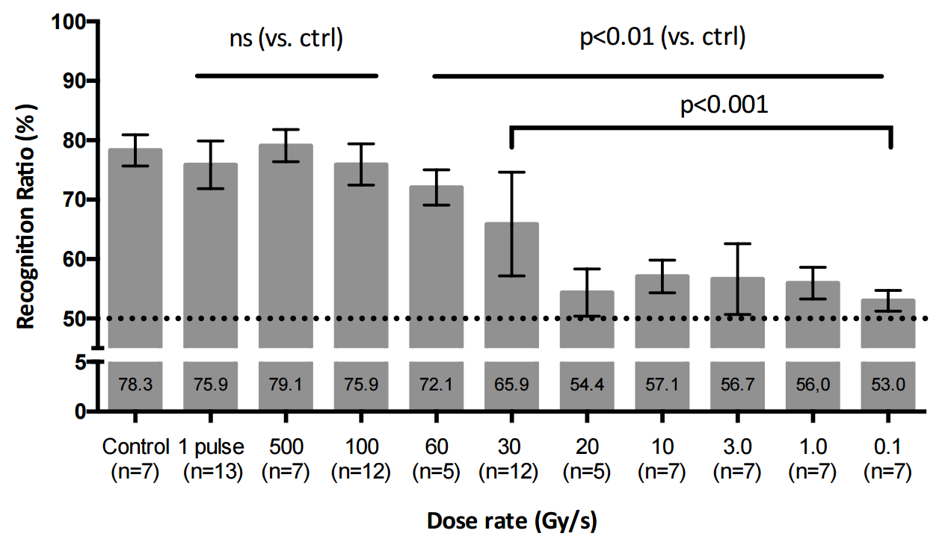
Normal tissue toxicity – 10 Gy Whole Brain Irradiation in mice
Novel Object Recognition test: 2 Months post RT
T=0.1 s
Recognition Index (%)
Recognition Index (%)
Recognition Index (%)
T=0.5 s
Control
(n=7)
1 Pulse
(n=13)
500 Gy/s
(n=7)
100 Gy/s
(n=12)
60 Gy/s
(n=5)
30 Gy/s
(n=12)
20 Gy/s
(n=5)
10 Gy/s
(n=7)
3 Gy/s
(n=7)
1 Gy/s
(n=7)
0.1 Gy/s
(n=13)
    Montay-Gruel & Petersson et al. Radiother. Oncol. 2017

Slide 10
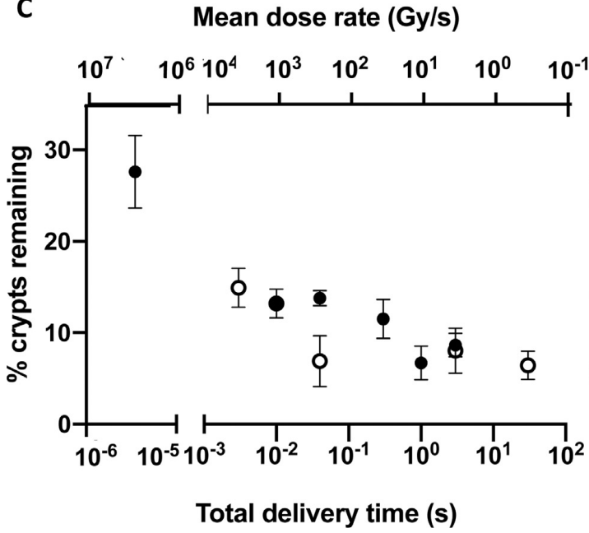
Normal tissue toxicity in mice following whole abdominal irradiation
3 days post IR
11.2 Gy
Ruan et al. IJROBP 2021
    Loo et al.
    IJROBP 2017
    Abstract ARS meeting

Slide 11
Total Delivered Dose
Notes:
For flash need > 10 Gy to see effect

Slide 12
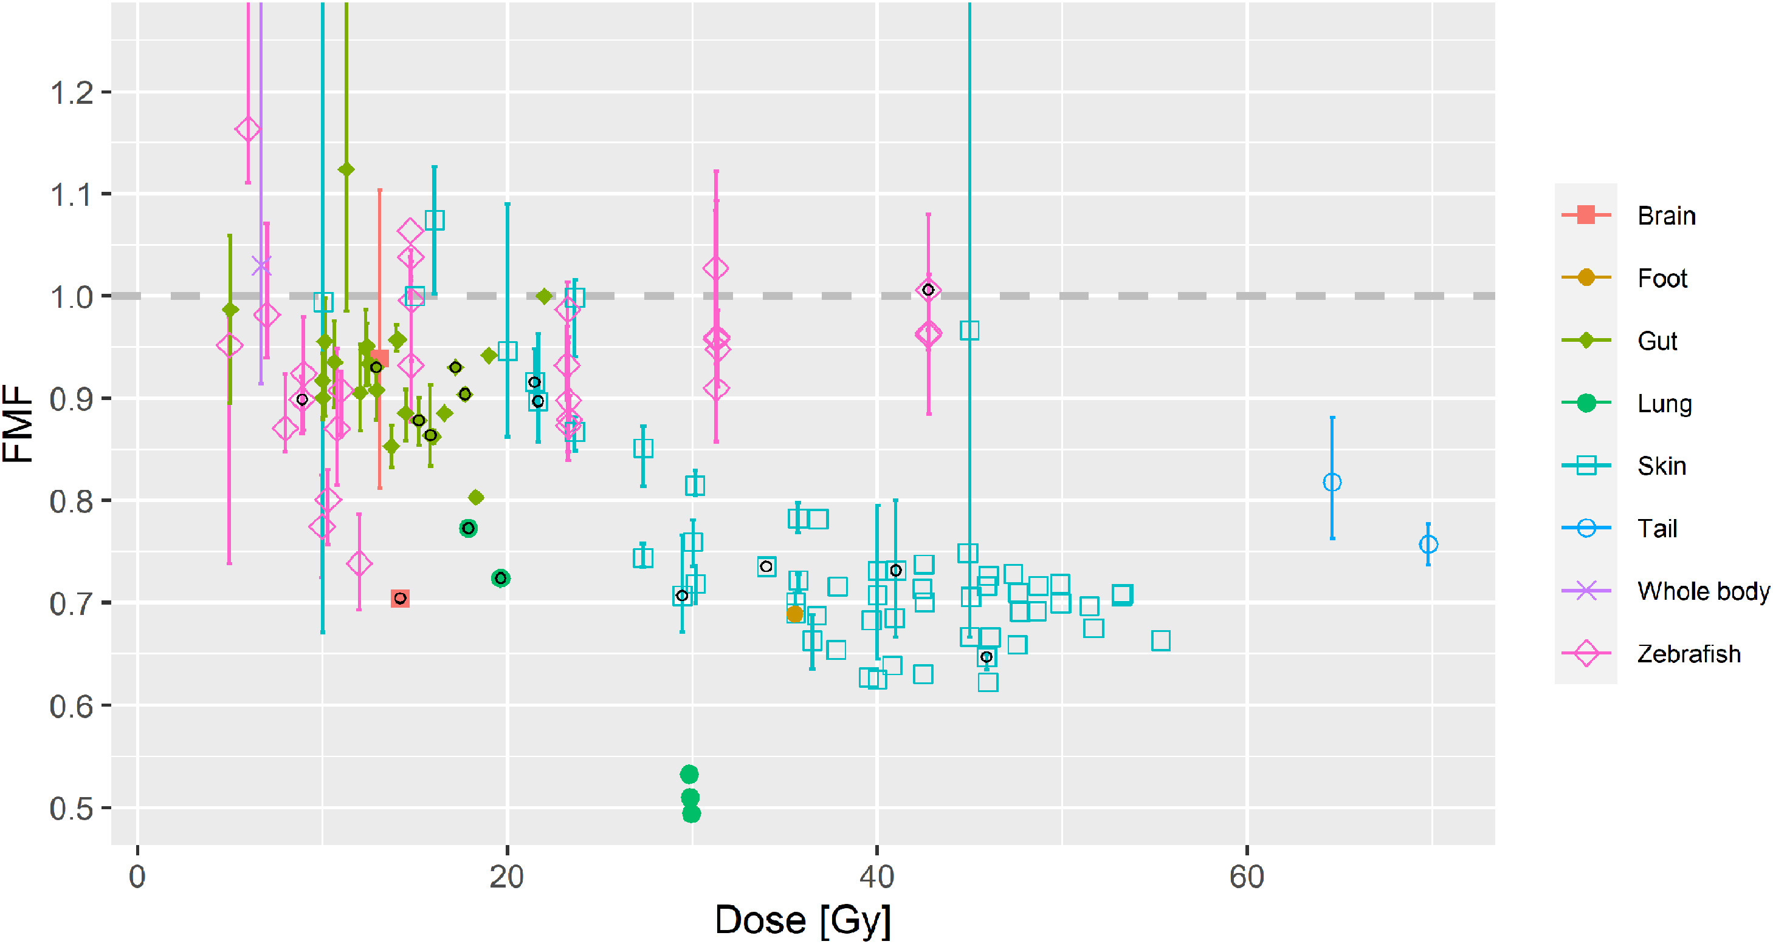
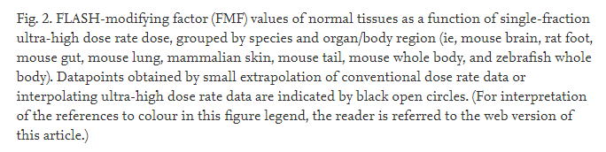
0.83
0.91
1.0
1.1
1.25
1.43
1.7
2.0
DMF
(FMF)
Böhlen et al. IJROBP 2022

Slide 13
Pulse structure

Slide 14
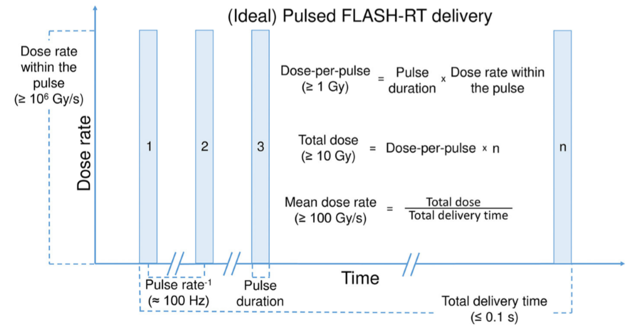
Wilson et al. Front. Oncol. 2019

Slide 15
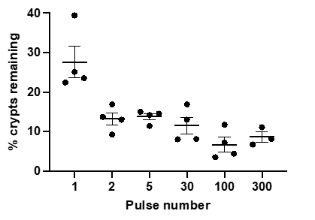
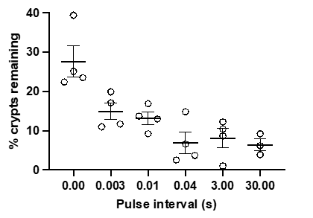
Normal tissue toxicity in mice following whole abdominal irradiation
All graphs show mean with SEM. ​
* p < 0.05, ** p < 0.01, analysed by t test (two tailed). ​
    Ruan et al.
    IJROBP 2021
Quicker delivery = better
DMF = 1.1
Total dose constant
2 pulses,
Dose per pulse constant,
Time between varied
Total dose constant,
Pulse number varied time varies (100 Hz)

Slide 16
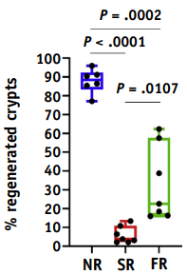
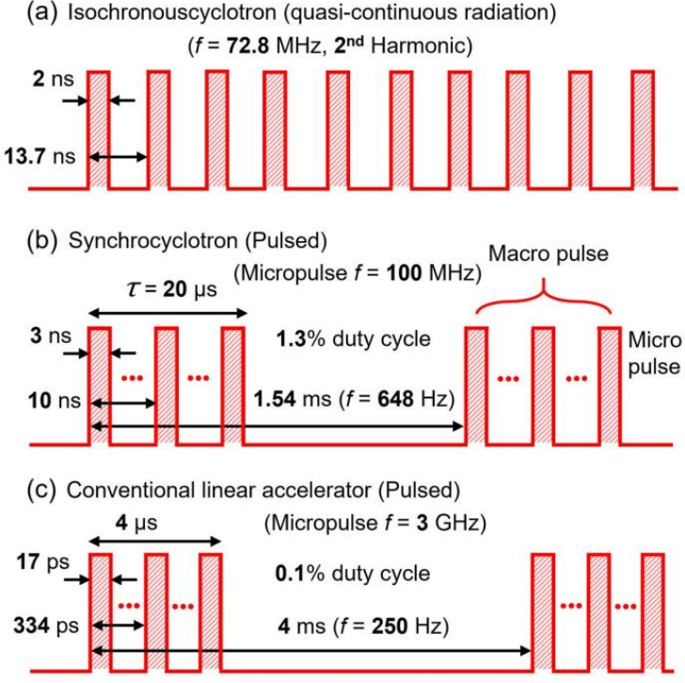

Normal tissue toxicity in mice following whole abdominal irradiation
FLASH (63-94 Gy/s) vs. Conv Proton Therapy
    Diffenderfer et al.
    IJROBP 2020
    Kim et al. IEEE 2022

Slide 17
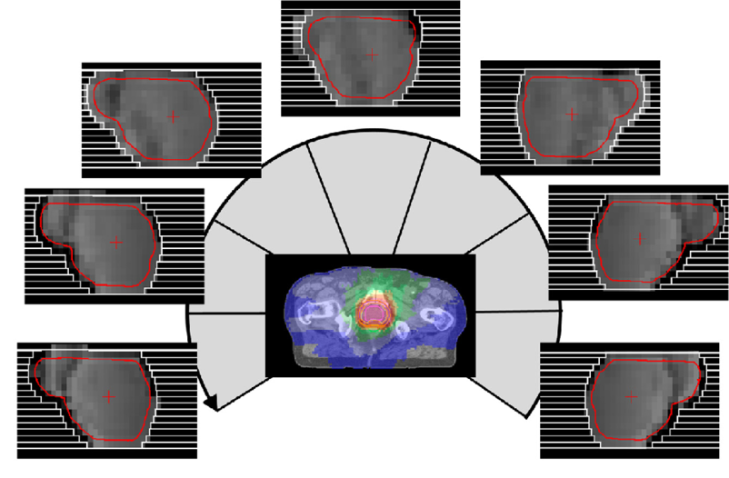
Multileaf collimator and Intensity Modulated Radiotherapy (IMRT)
Show slide of normal treatment
Multileaf collimator
IMRT
Bedford et al.
Radiother Oncol 2016

Slide 18
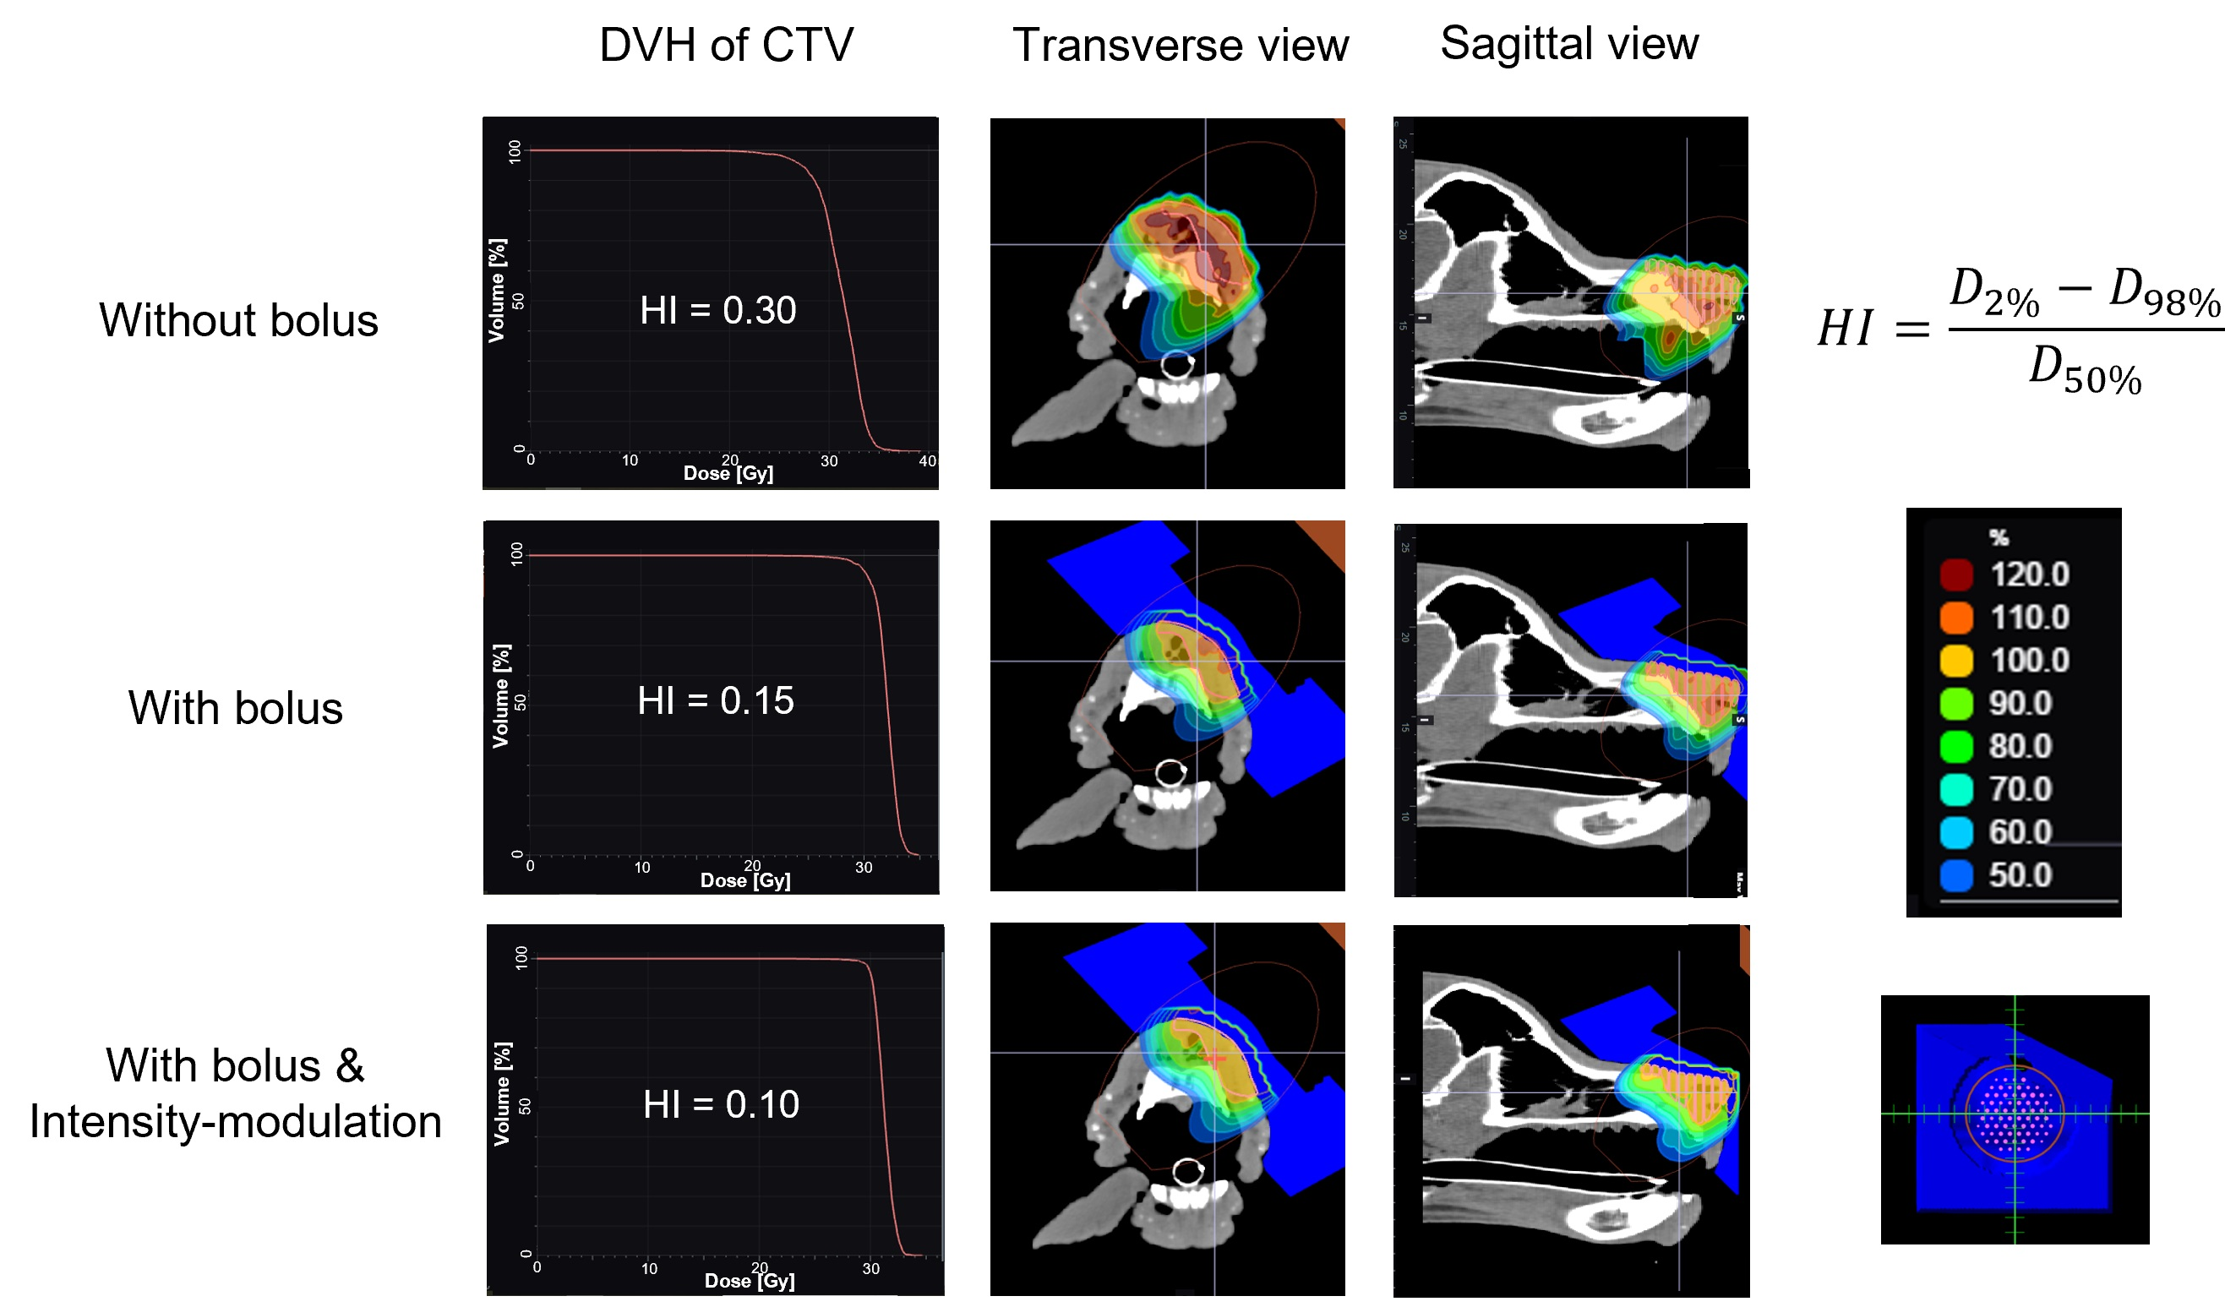
CT-based individualised 3D bolus and intensity modulation
    Konradsson et al.
    FRPT 2022
Notes:
Flash radiotherapy doesn’t allow time for IMRT

Slide 19
Fractionation?
Redistribution
Cells are most sensitive to radiation in the cell division phase (M and late G2)
Re-oxygenation
Hypoxic tumour cells are less susceptible to the indirect effects of radiation. Fractionation allows time for relatively hypoxic cells to improve their oxygen supply.
Repair
Healthy cells have a greater ability to repair DNA damage than malignant cells.
Healthy cells an opportunity to repair sublethal damage
malignant with impaired DNA repair pathways are less able to recover from radiation damage to their DNA.
Notes:
Redistribution
The radiosensitivity of cells depends on their stage in the cell cycle. Cells are most sensitive to radiation in the M and late G2 phase of their cycle and most resistant in the late S phase.
Since a group of malignant cells are at various points in their cell cycle, delivering the entire dose of radiation in a single fraction is ineffective against a proportion of the tumour cells. Dividing the total dose of radiation into multiple fractions maximises the probability of irradiating cells when they are in the most radiosensitive period of their cell cycle.
Re-oxygenation
When tumour cells are hypoxic they are less susceptible to the indirect effects of radiation. Fractionating radiotherapy allows cells which are closer to sources of oxygen to be killed first, and the intervening time between fractions allows the relatively hypoxic cells to improve their oxygen supply. These cells are then more sensitive to subsequent doses of radiation.
Repair
Fractionation increases the destructive effect on tumour cells while minimising damage to healthy cells due to the different ability of normal cells and malignant cells to repair DNA damage. Healthy cells have a greater ability to repair DNA damage than malignant cells. As such, splitting the total radiation dose allows healthy cells an opportunity to repair this sublethal damage between fractions. Meanwhile, malignant with impaired DNA repair pathways are less able to recover from radiation damage to their DNA.

Slide 20
Non-beam related
Oxygen content
Tissue-type
Irradiated Volume
End-point
Immune status
Species
...

Slide 21
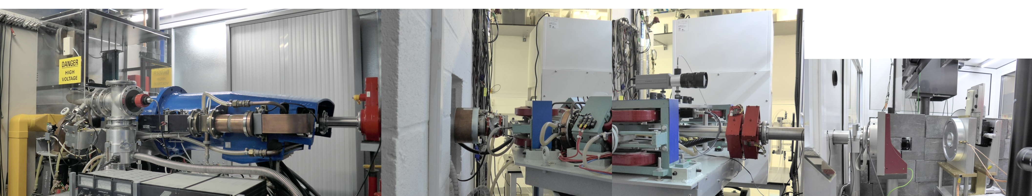
Resources in Oxford – 6 MeV electron linear accelerator
Electron gun
Waveguide + focus
RF dump
Gate valve
Animal enclosure
@ ~35 deg C
Toroidal charge monitor
Animal cradle
Collimator + film dosimeter
Animal X-Y position
≥6 MeV
electron accelerator
Energy monitor
Magnetron and isolator
Vacuum system
Switching magnets
Quadrupoles
Beam exit

Slide 22
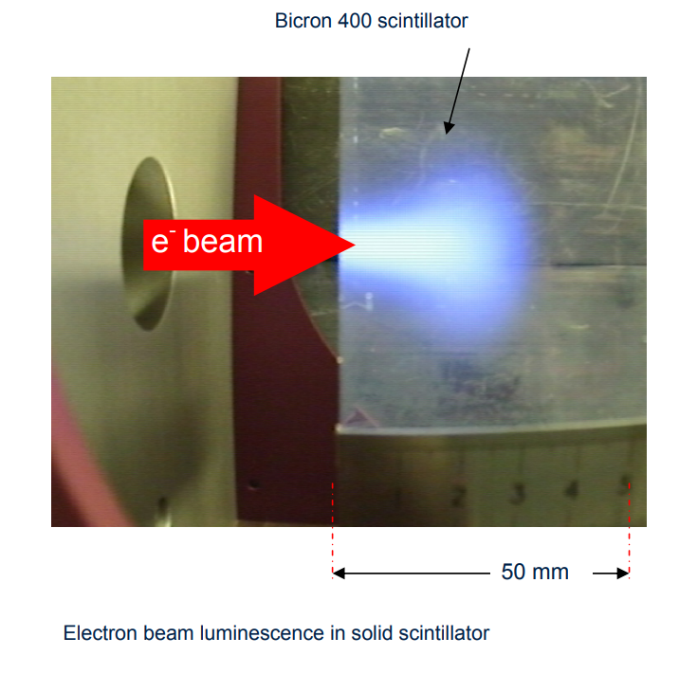
Beam Characteristics Oxford electron linac
Bicron 400 scintillator
6 MeV electron beam ≈ homogeneous dose
  0-20 mm depth,
  depth >30 mm ≈ no dose
Maximum beam size: 50 mm Ø
Average dose rate:
  few Gy/min to 30 000 Gy/s
Dose/pulse: mGy to >100 Gy
Highly suitable for pre-clinical FLASH radiation studies!
Not suitable for clinical studies!
Electron beam luminescence in solid scintillator
    Berne et al. PMB (2021)

Slide 23
In Summary
  FLASH has huge Potential Benefits for clinical translation:
    Enables full treatments (or fractions) in a few hundreds/tenths of a second.
      No motion during treatment.
      Could minimize treatment (PTV) margins related to motion.
        Less normal tissue exposed to the treatment dose.
  Pre-clinical studies show:
    Less normal tissue toxicity, i.e. the “FLASH effect”
      Dose modifying factor: (1.1) 1.2-1.5
    Similar tumour control.
      Dose modifying factor: 1
  Optimal beam parameters for the FLASH effect
    Average (Mean) Dose rate / Total Delivery Time is a key parameter
      Higher / shorter → Better
    Dose
      Higher → larger effect (but likely levels off at a maximum)
    Beam scanning
      Higher dose rate in the scanned beam → Better
    Pulse structure (Dose-per-pulse): Of less importance
    Dose conformity & Fractionation - Still very important

Slide 24
Summary
FLASH has huge Potential Benefits for clinical translation:
Enables full treatments (or fractions) in a few hundreds/tenths of a second.
No motion during treatment.
Could minimize treatment – planned target volume margins related to motion.
Less normal tissue exposed to the treatment dose.
  FLASH has huge Potential Benefits for clinical translation:
    Enables full treatments (or fractions) in a few hundreds/tenths of a second.
      No motion during treatment.
      Could minimize treatment (PTV) margins related to motion.
        Less normal tissue exposed to the treatment dose.
  Pre-clinical studies show:
    Less normal tissue toxicity, i.e. the “FLASH effect”
      Dose modifying factor: (1.1) 1.2-1.5
    Similar tumour control.
      Dose modifying factor: 1
  Optimal beam parameters for the FLASH effect
    Average (Mean) Dose rate / Total Delivery Time is a key parameter
      Higher / shorter → Better
    Dose
      Higher → larger effect (but likely levels off at a maximum)
    Beam scanning
      Higher dose rate in the scanned beam → Better
    Pulse structure (Dose-per-pulse): Of less importance
    Dose conformity & Fractionation - Still very important

Slide 25
Summary
Pre-clinical studies show:
Less normal tissue toxicity, i.e. the “FLASH effect”
Dose modifying factor: (1.1) 1.2-1.5
Similar tumour control.
Dose modifying factor: 1
  Pre-clinical studies show:
    Less normal tissue toxicity, i.e. the “FLASH effect”
      Dose modifying factor: (1.1) 1.2-1.5
    Similar tumour control.
      Dose modifying factor: 1
  Optimal beam parameters for the FLASH effect
    Average (Mean) Dose rate / Total Delivery Time is a key parameter
      Higher / shorter → Better
    Dose
      Higher → larger effect (but likely levels off at a maximum)
    Beam scanning
      Higher dose rate in the scanned beam → Better
    Pulse structure (Dose-per-pulse): Of less importance
    Dose conformity & Fractionation - Still very important

Slide 26
Summary
Optimal beam parameters for the FLASH effect
Average (Mean) Dose rate / Total Delivery Time is a key parameter
  Higher / shorter → Better
Dose
  Higher → larger effect (but likely levels off at a maximum)
Beam scanning
  Higher dose rate in the scanned beam → Better
Pulse structure (Dose-per-pulse): Of less importance
Dose conformity & Fractionation - Still very important

Slide 27
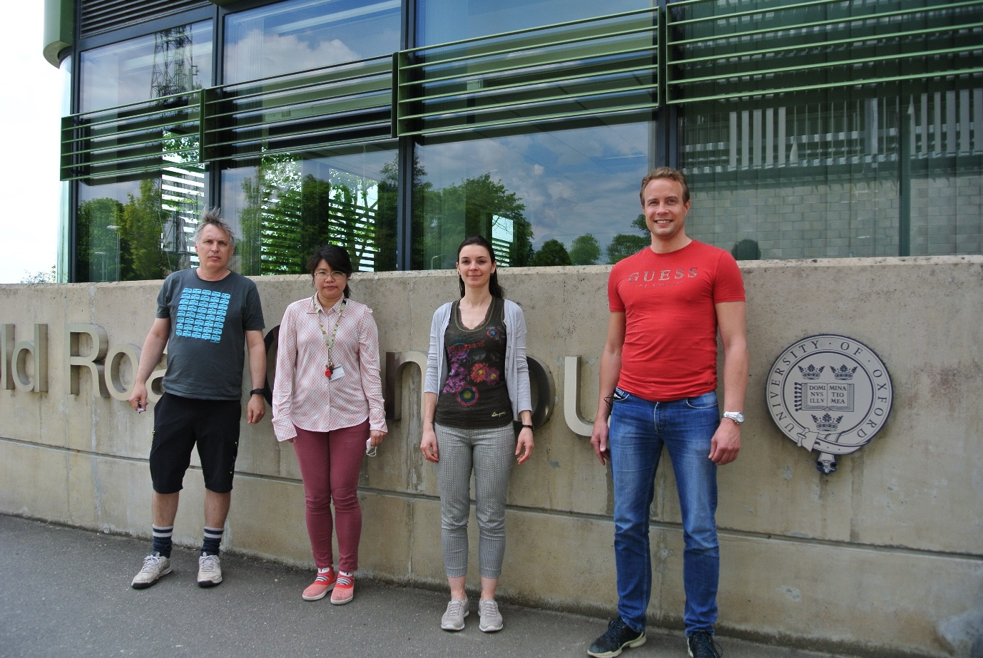
I. Tullis
J. Ruan
S. Paillas
K. Petersson
Oxford Team

