Slide 1
Muon Collider Status and Plans
FFA2022 Abingdon, 27th September 2022
Christian Carli on behalf of the International Muon Collider Collaboration (IMCC)
Present status of ideas on muon colliders based on several studies in the past and, in particular, the MAP study. Many of the images taken from MAP publications.

Slide 2
Content
Introduction
Design baseline overview
Muon production and capture
Muon cooling
Acceleration
Muon collider ring
Neutrino radiation issue
Summary

Slide 3
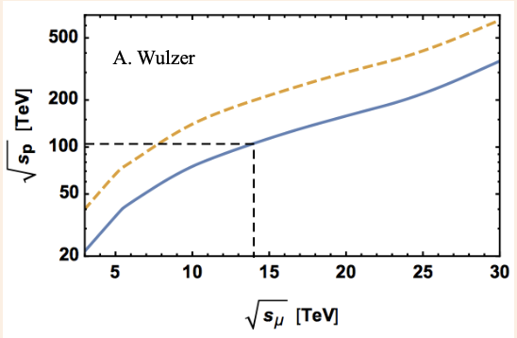
Introduction
High energy lepton colliders precision and discovery machines
Given physics reach with at lower energies than for proton colliders
Electron-positron collider energy limited by particle mass
Energy loss from synchrotron radiation for circular colliders
Length for linear colliders
Collide muons – leptons with mass ~105 MeV
Feasible lepton circular collider
Same (higher) physics reach at lower beam energy than hadron collider
Drawbacks and limitations
Effort to generate useful muon beams, still resulting in large emittance
Low life-time of ~2.2 us in muon rest frame => Fast (ionization) cooling and acceleration (e.g., by pulsed synchrotrons) => Still majority of muons decay before collisions
Proton and muon collider energy for about equal cross section

Slide 4
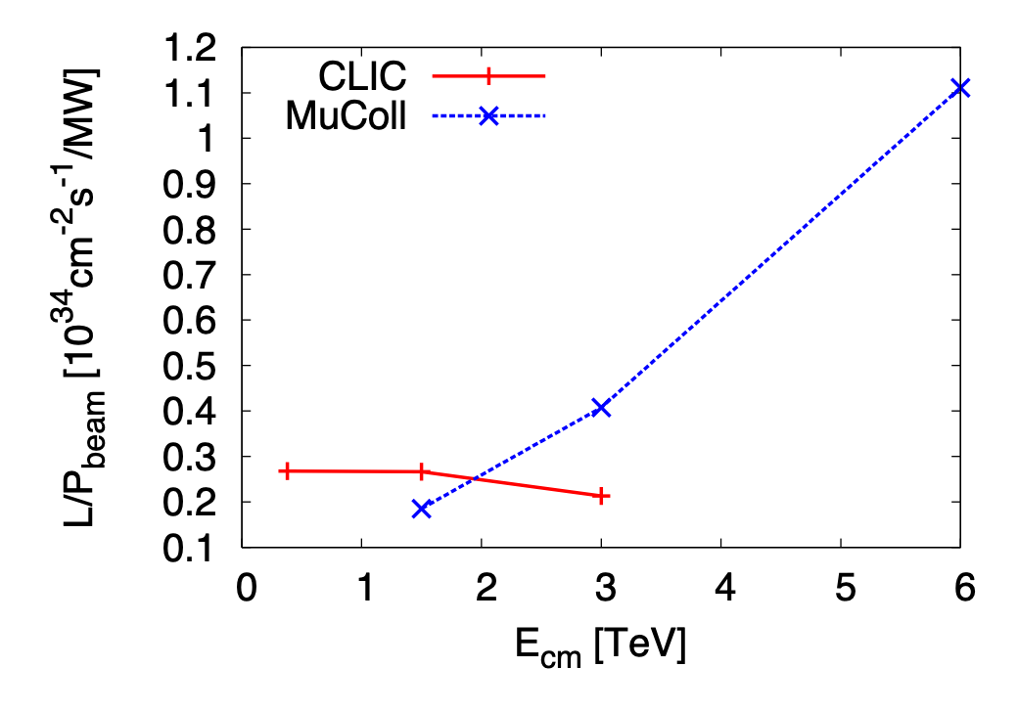
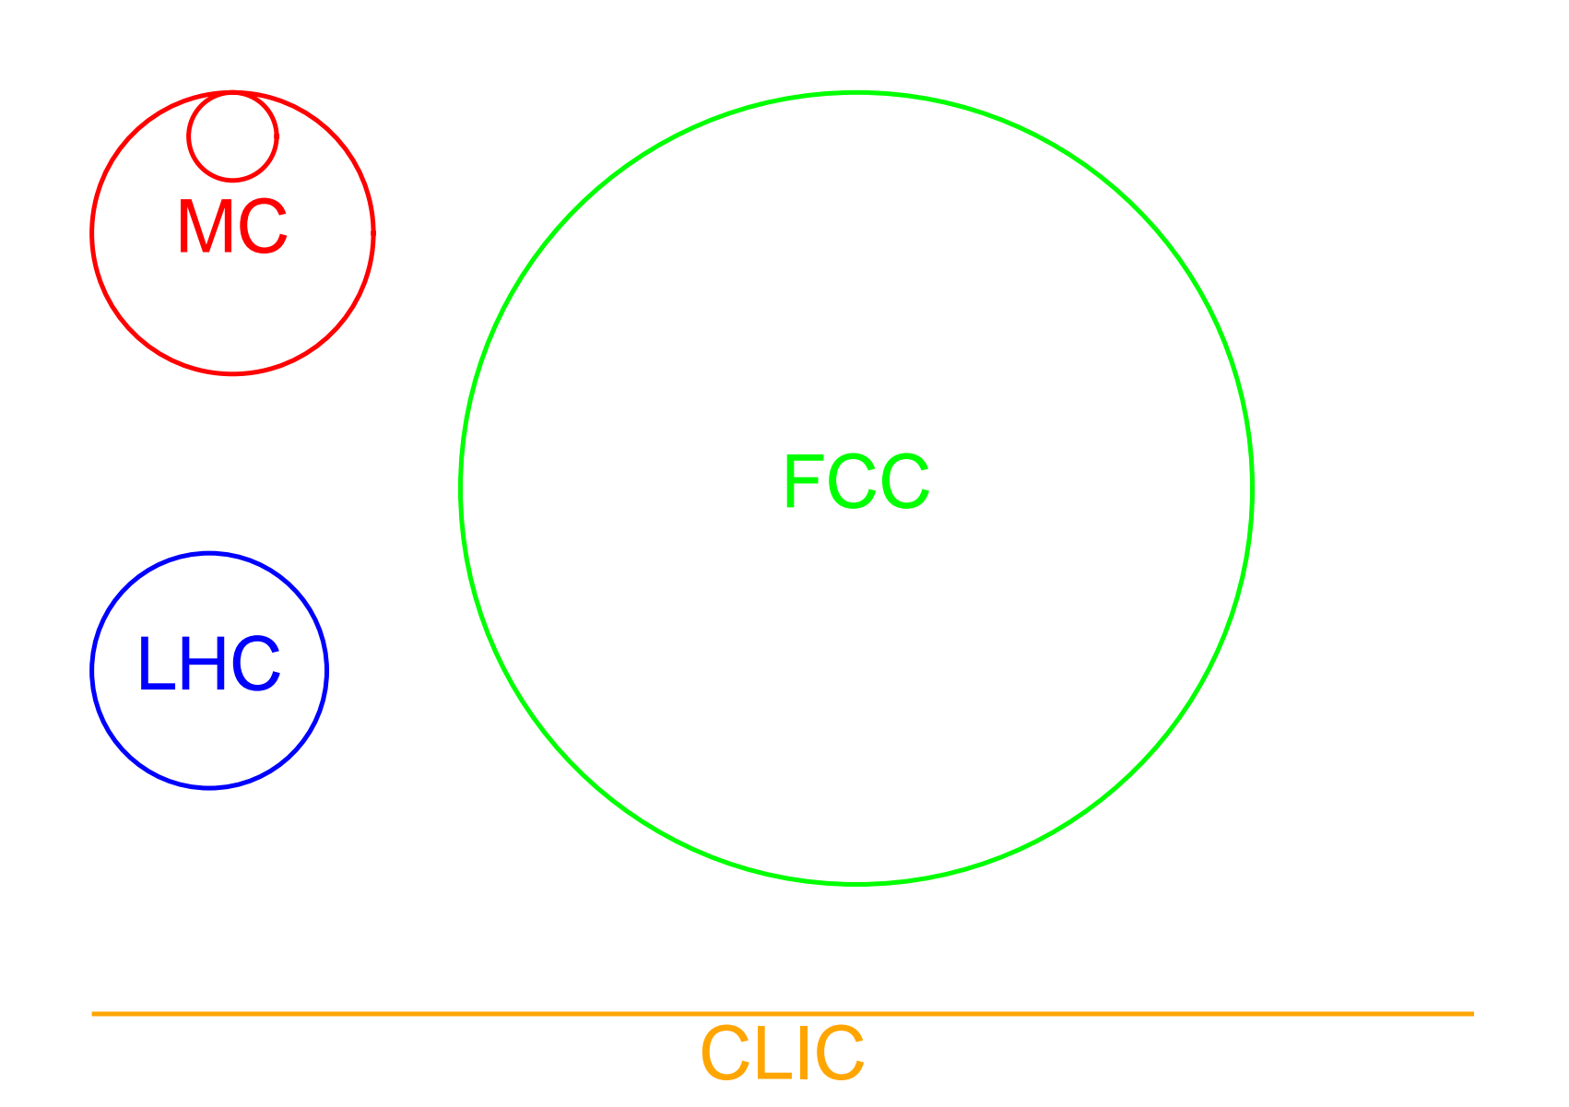
Introduction
Muon collider studies since decades (Russia, US, later at CERN …)
Muon Accelerator program initiative launched in 2011
International Muon Collider Collaboration IMCC working on 10+ TeV scheme
Facility footprints for different high energy physics projects
10 TeV muon collider footprint comparable to 3 TeV CLIC with physics potential comparable to FCC-pp
Luminosity per beam power as function of beam energy
Ratio of luminosity to beam power increases with beam energy
Attractive in particular for high energies

Slide 5
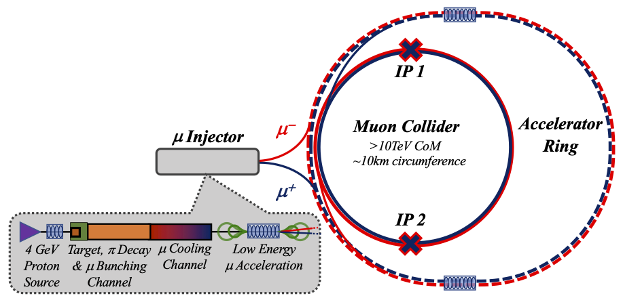
Design Baseline Overview
Short muon beam life-time: => Ionization cooling, fast acceleration, high RF gradients and high field magnets!
Acceleration in a sequence of pulsed synchrotrons
(last one larger than collider)
Collider: tightly packed high field magnets to minimize circumference
and maximize luminosity
Few MW production beam: short intense bunches on target generating
πs decaying into μs.
Target and capture channel: large energy
μ beam transformed
to sequence of bunches
Cooling stages and merging of μ bunches
into one bunch
Low energy acceleration
In recirculating Linacs

Slide 6
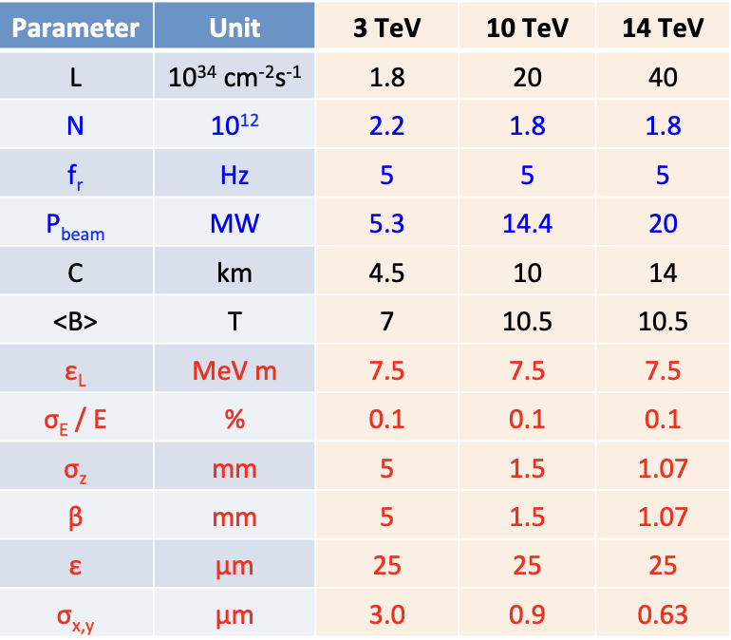
Design Baseline Overview tentative parameter list for IMCC study
High (average) magnetic field
Relative energy spread
kept constant at 10⁻³
Bunch length and β* decreasing with beam energy

Slide 7
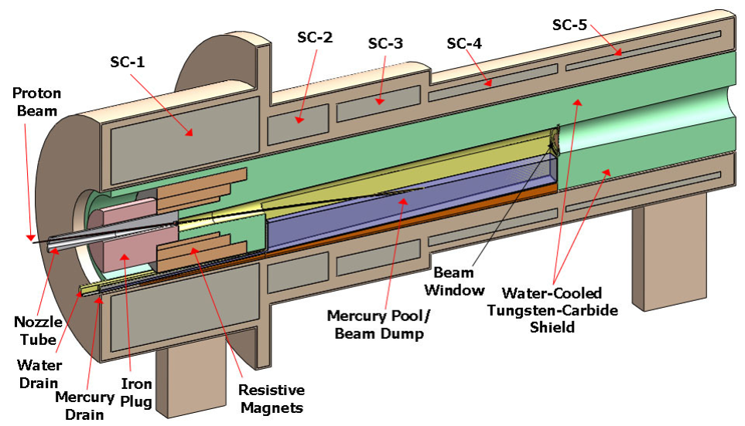
Muon Production and Capture
Production beam
A few (1-4) MW proton beam with a few GeV beam energy
Short bunch length of a few ns and lowish repetition rate of f_{r} ≈ 5 Hz
Could be a SC linac followed by accumulator and compressor rings
FFAs an alternative (possibly combined with compressor ring)?
Target
Options: graphite, liquid metal jet (mercury tested with MERIT experiment or powder)
p + N -> π + X followed by decay with charged πs decaying into μs
Large divergence and energy distribution of muons
Magnetic field taper
Aim: collection of muons in range 50 MeV to 400 MeV
Target in high field ~20 T to minimize transverse emittance
Reduction to ~2 T over ~10m length a compromise between transverse and long. blow-up
From MAP study

Slide 8
Muon Production and Capture
Transformation of large energy spread muon beam into sequence of bunches
Target and drift followed by chicane to remove most unwanted particles
Be absorbed stopping protons in momentum range of selected muons
Drift: generation of correlation between energy and longitudinal position
RF cavity section to create longitudinal structure (bunches)
Muon distribution still becoming longer => RF frequency decreasing over buncher section
Phase-energy rotation: accelerate low energy bunches coming late, decelerate high energy bunches coming early
Appropriate choice of RF frequency and phase
Again frequency varying over over phase-energy rotation section
Result: train of bunches with about equal energy suitable for ionization cooling
From MAP study

Slide 9
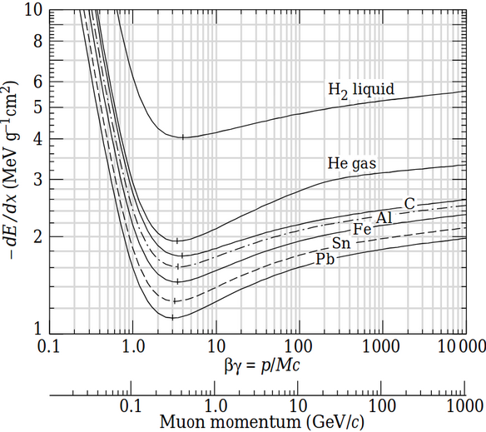
Muon Cooling Principle
Principle of (transverse) ionization cooling
Absorber: reduction of both the longitudinal and transverse momentum
Cavities: acceleration, i.e., increase of only longitudinal momentum
Net effect: reduction of transverse momentum and, thus, beam cooling
Scattering leads to beam blow-up – need for strong focusing solenoids and low Z absorbers
Longitudinal cooling (or heating)
Dependence of energy loss on energy
Dispersion and wedge shaped absorber
Bending generating dispersion
Absorber slowing down high (low)
momenta more (less)

Slide 10
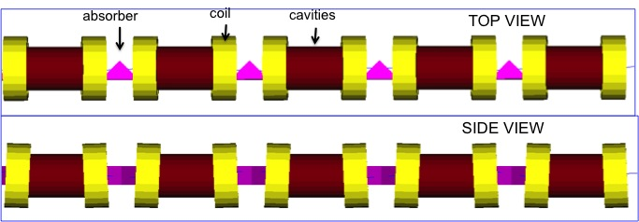
Muon Cooling 6D Cooling Channels
High field solenoids for focusing
Minimum Twiss betatron function β_{T} at absorber location
Tilting of solenoids
Dispersion from vertical magnetic field for longitudinal cooling
Solenoid polarity reversals
Low Z absorbers: Liquid H₂ and LiH
Cavities in high magnetic field region
6D cooling
Between muon capture and bunch merging
Interleaved with separation of μ⁺ and μ⁻
Between bunch merging and final cooling
From MAP study
Last section of 6D cooling after bunch merge

Slide 11
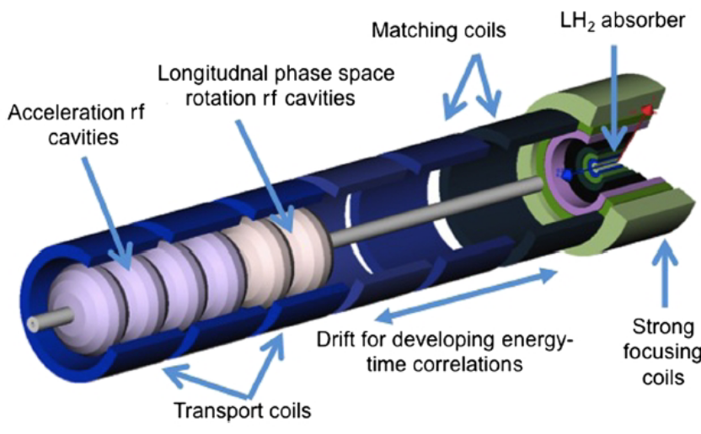
Muon Cooling Bunch merging and final cooling
Bunch merging – transformation of train of 21 bunches into one bunch
Longitudinal gymnastics combining three bunches, resulting in 7 bunches
Transverse merging
Followed by another 6D cooling channel
Equilibrium transverse emittances too large, small longitudinal emittance
Final cooling channel
Gradually decreasing energy for smaller transverse emittances
Absorber liquid H₂
No longitudinal cooling resulting in significant blow-up
High magnetic field (~30T) at absorber location
From MAP study

Slide 12
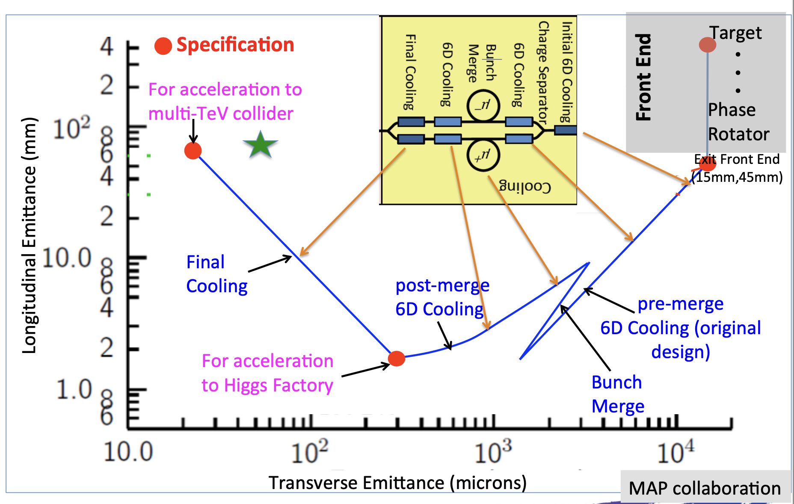
Muon Cooling Emittance evolution
Missing factor 2 between emittances obtained in simulations and expected for collider
to be gained by optimized final cooling design
From MAP study

Slide 13
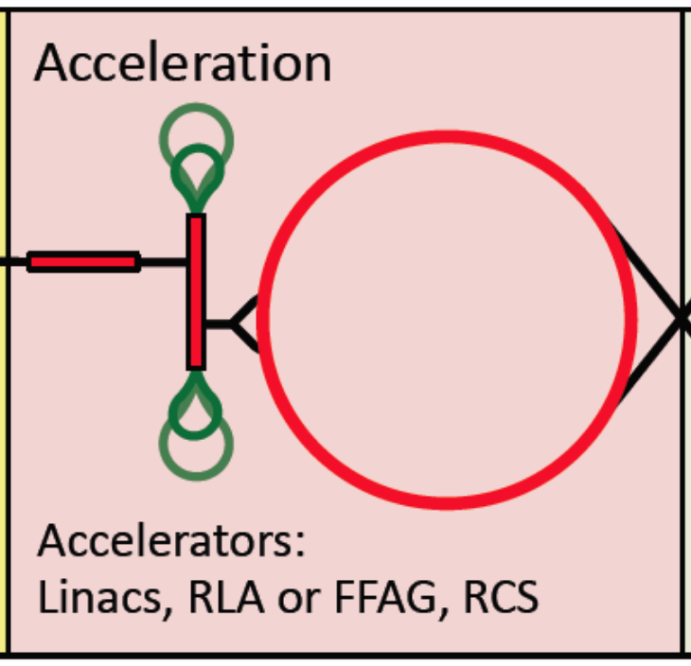
Acceleration
Fast acceleration and high (average) RF gradients needed to avoid muon losses due to decay
Starting with (re-circulating) Linacs
Followed by “pulsed synchrotrons”
Acceleration within few tens of turns!
Combination of static SC bends and pulsed conventional bends (changing polarity)
Ongoing work:
Orbit excursions – minimization of resulting circumference variation for RF
Magnet powering and Eddy currents a challenge, in particular, for lower energy rings
FFAs a possible alternative

Slide 14
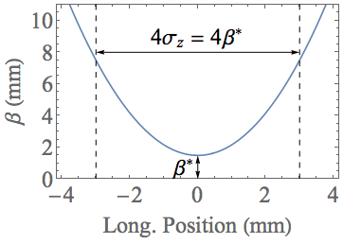
Muon Collider Ring
Assumptions and parameters
Lattice study concentrating on 10 TeV com collider => beam E = 5000 MeV
Increase in energy compared to previous studies
High magnetic fields and ≈10 km circumference for high luminosity
Beam characteristics
Rms rel. momentum spread σ_{δ} ≈ 10⁻³
Twiss beta at IP and bunch length β* = σ_{z} = ε_{l}/(σ_{δ} E) = 1.5 mm (bunch length 5 ps!)
Hour glass effect becoming significant (lumi reduction f_{gh} ≈ 0.76)
Challenging conditions for collider lattice design!
Small β* at high beam rigidity enhancing chromatic effects
Extrapolation to higher energies gives β* and bunch length proportional to 1/E
Large beta-functions at locations with superconducting magnets
Short bunch length to be kept for ≈ 1000 turns

Slide 15
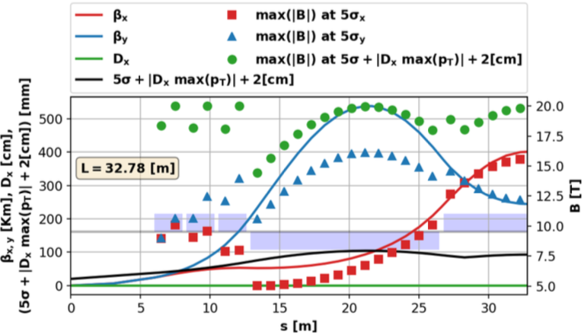
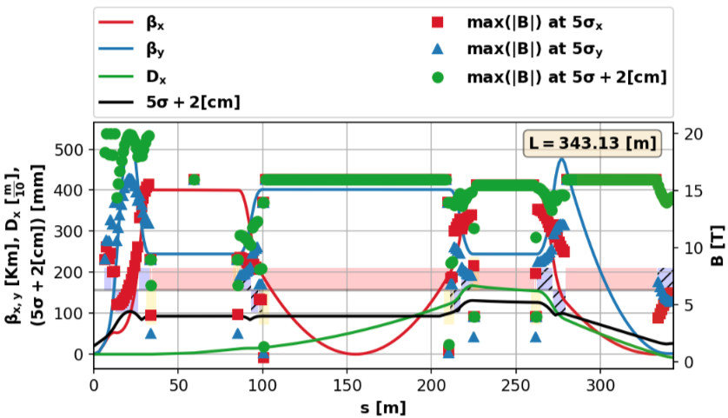
Muon Collider Ring
Interaction region
Small β* and high beam rigidity (energy)
Long quadrupole triplet and large maximum β
Large chromatic effects with quad strength depending on momentum
Different versions without or with dipolar (bending) field components
Local chromaticity correction
Sextupoles in regions with dispersion to correct chromaticity
In pairs to cancel non-linearities to first order
Version here without dipolar fields
From K. Skoufaris

Slide 16
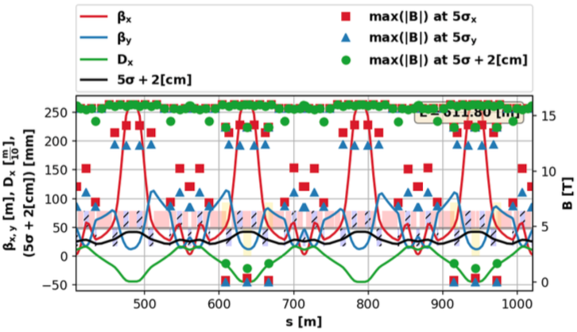
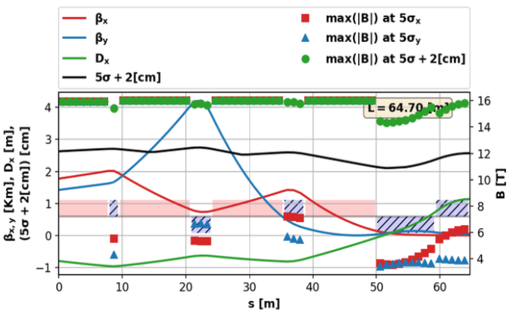
Muon Collider Ring
Flexible Momentum Compaction arc cells
Dispersion oscillations
Slightly negative momentum compaction
Vanishing (almost) momentum slip factor for complete lattice
Matching section
Linking chromatic compensation section to arc
Status of collider ring design
Linear lattice with chromatic compensation available and looking reasonable
Study on issues with non-linear effects
Work in progress!
dispersion
From
K. Skoufaris

Slide 17
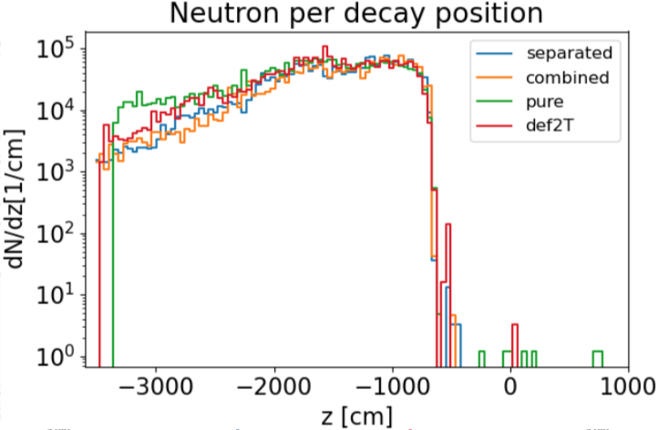
Muon Collider Ring Beam Induced Background
Interaction region
Beam Induced Background (BIB): particles from decays seen by detector and perturbing data taking an issue
MAP study (lower energy) concluded that dipolar fields mitigate
Similar shape of particle flux versus decay position for different species
Only week reduction of BIB seen for 10 TeV lattice with FLUKA
From D. Calzolari,
A. Lechner et al.

Slide 18
Neutrino Radiation Issue
Radiation due to showers generated by neutrinos reaching the earth surface
Matter in front (“shielding”) does not help but makes situation even worse
Narrow radiation “cone” for a short piece of the machine with length
Strong increase with muon energy
Cross sections about proportional to energy
Typical energy per interaction of neutrino with matter proportional to muon energy
Opening of radiation inversely proportional to muon energy
Depends on lattice details
E.g., straight sections (other than IR) to be avoided
Positioning such that neutrinos from IR reach earth surface in uncritical areas
Thorough study on-going
Radiation cone
Collider ring
18
18

Slide 19
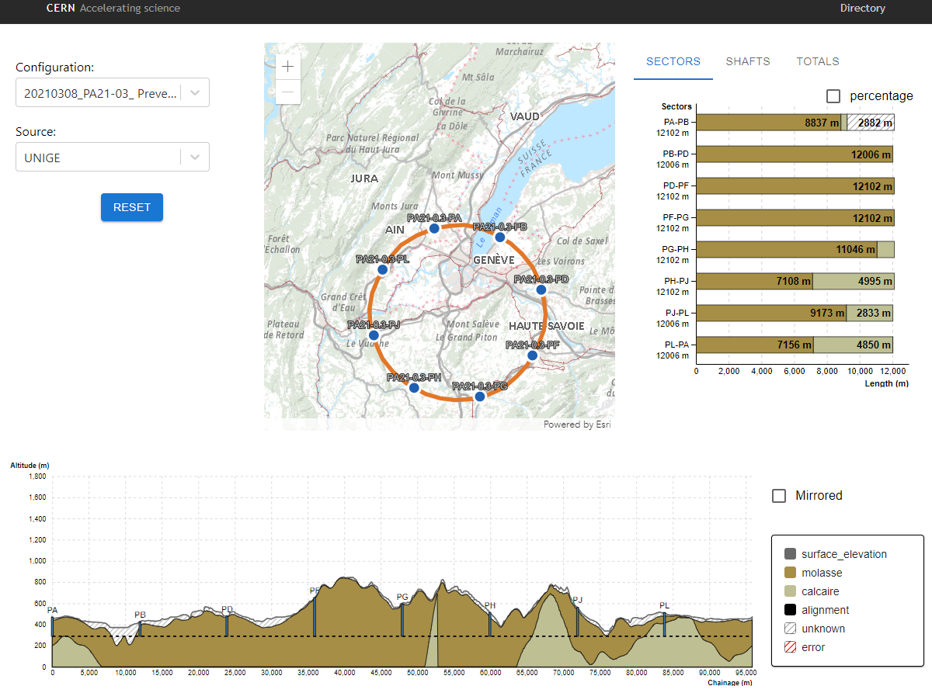
Neutrino Radiation Issue Geoprofiler tool for suitable collider positioning
* Unrealistic positioning, for illustrative purposes only!
Geoprofiler Application – currently focused on geological analysis
Edit and reposition the ring
Detailed knowledge of shape of earth surface
Recalculation of the geology along the tunnel
Positions where tangential to ring reaches earth surface
Information about impacted areas (rights, urbanization …)
* Prototype, for illustrative purposes only!
From
G. Lacerda et al.

Slide 20
Summary
Muon Collider an attractive option for a future high energy project
Circular lepton collider not limited by synchrotron radiation
Challenges mainly related to effort to generate muon beams and short life-time
Proton drive beam, muon cooling and acceleration, radiation, collider ring design, high field magnets, RF system in high magnetic fields ..
Not as mature as other projects as CLIC, ILC, FCC
Still feasibility to be shown and many R&D topics to be addressed
IMCC aiming at a conceptual design of 10+ TeV com. muon collider
Based on many studies made over several decades and, in particular, MAP
FFAs interesting options at various stages of complex
Drive proton beam generation
Fast acceleration of muons
No issues with eddy currents and power needed for magnet cycling
Larger apertures needed
Proposals for collider ring based on FFAs
The talk used materiel from several sources and, in particular, MAP
Special thanks to D. Schulte and E. Fol for helping with the preparation of the talk

