Slide 1


RF Linear accelerators L6: Low beta linacs (a day trip to the zoo)
Dr G Burt Lancaster University
with some slides borrowed from
M. Vrentinar Linear Accelerators CERN Accelerator School
and
F. Geirigk Cavity Types CERN-2011-007, pp. 277-298 arXiv:1111.4897

Slide 2
Low Beta
As the beam velocity is reduced the cell period decreases as L=βλ/2.
This means the number of discs loading the waveguide per metre is given by N=2/λβ
Each disk is a source of losses so the shunt impedance decreases.
The disk thickness is required for mechanical stability and heat removal so this cannot be decreased. These take up a space 2d/λβ where d is the disk thickness.
This means the useable accelerating length is reduced
Also at low beta space charge forces are important and we want to minimise RF defocusing so low frequency is preferred.
L
d

Slide 3
Low Beta Linacs
The solution is to use a structure with no end walls.
Three solutions exist
Use a structure with two separate conductors carrying out of phase voltages (Widroe)
Use a single long cavity and shield the beam from the decelerating fields (Alvarez)
Use alternative modes (TE or TEM modes)

Slide 4
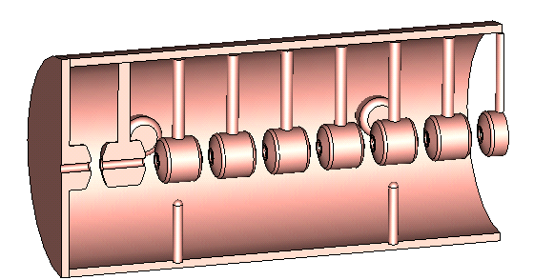
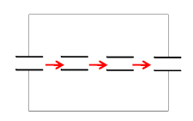
Alvarez drift tube linac (DTL)
A DTL uses a single long TM010 mode cavity such that the length is much longer than L=βλ/2.
The when the transit time causes the field to be decelerating the beam will be shielded in drift tubes (small cylinders), hence the DTL will only operate at a single gradient.
Each DTL is supported by a stem which has a low current on it. High coupling between cells as no walls.
At higher frequencies the field starts to vary along the drift tube/stem and the DTL becomes inefficient. Size increases at low frequency so range is 200-400 MHz

Slide 5
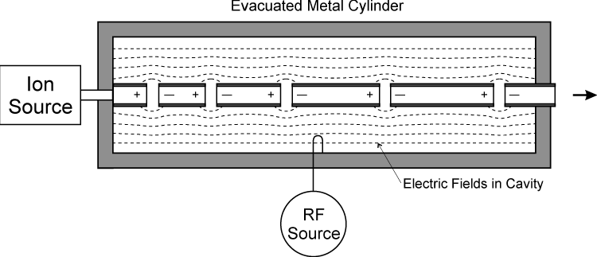
Alvarez DTL
The DTL has a phase advance between the gaps of 0/360 degrees.
The beam theresfore is shielded from the fields at least 50% of the time normally more.
This results in a low gradient of 3-5 MV/m.
Inefficient because of this at beta > 0.5.
Difficult to fit in drift tubes and focussing at really low beta so 0.05<beta<0.5
E-field
B-field

Slide 6
Synchronous particle
Imagine we have a series of gaps. The phase change between two gaps when the beam arrives is given by
Where ϕ_{a} is the phase advance, (the phase difference between adjacent coupled cavities)
Hence the distance between cells should be
In a linac we choose a synchronous phase φ_{s} and design the lengths so that the synchronous particle sees the desired phase (not always constant)

Slide 7
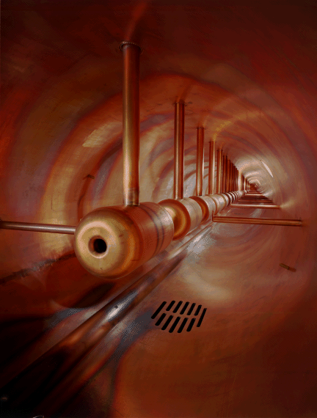
Tuning posts
In SCL we use a resonant coupling (side cells) to provide more stable operation (more tolerant to manufacturing errors).
In DTL’s we can do something similar by having a resonant element between each gap.
This is commonly achieved by using λ/4 coax lines called post couplers.
The electric field of the post and magnetic field of the cavity create a longitudinal Poynting vector and hence energy flow.
This shifts the TE11 mode frequency in confluence with the TM01 mode.

Slide 8
DTL Focussing
As DTL’s work at low frequencies and the drift tube are fairly long (d~βλ/2) we usually have enough space to fit a focusing quadropole inside the drift tube.
Often if more focussing is required some or all drift tubes are made to be 3βλ/2 long. If it is only every 2nd or 3rd drift tube that contains the quadrupole it is known as a quasi-Alvarez linac.

Slide 9
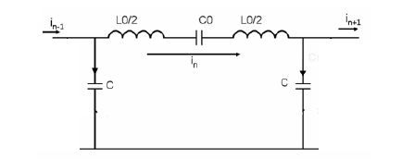
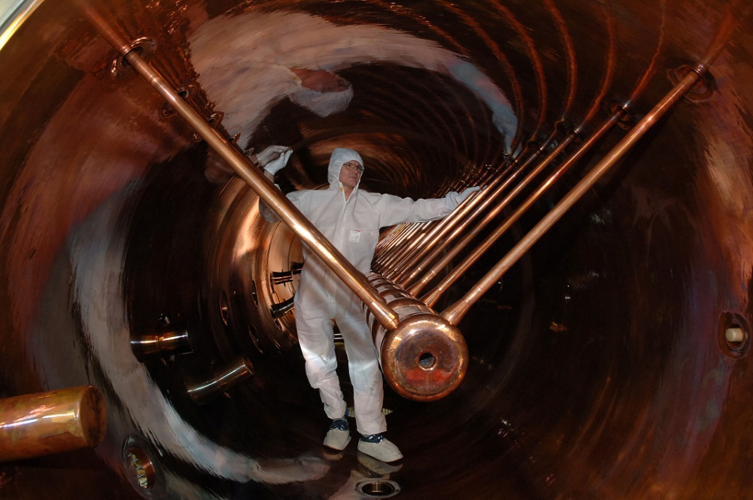
Equivalent circuit
The top row contains the inductance of the stems and the tube to tube capacitance.
The parallel capacitance is the tube to wall coupling.
For a drift tube diamter, d and gap,g. The capacitance is roughly
If the outer vessel diamter is D then the inductance is
And the resonant frequency is

Slide 10
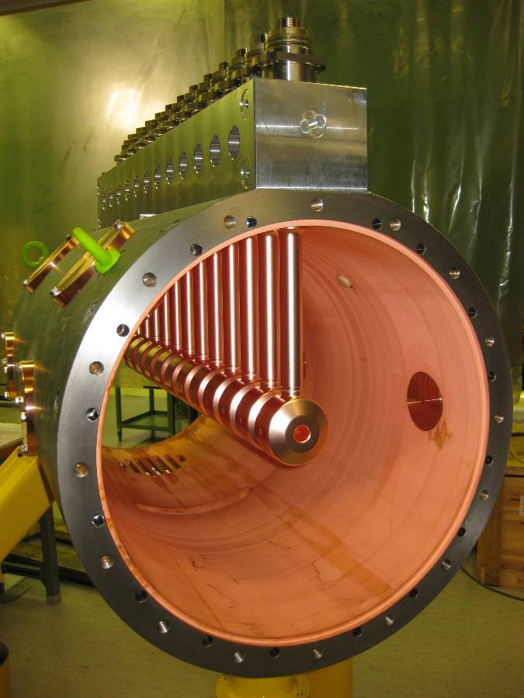
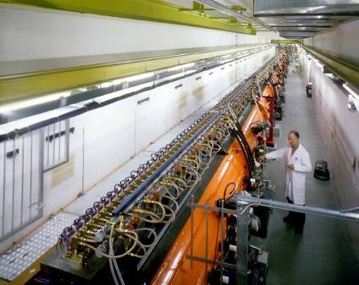
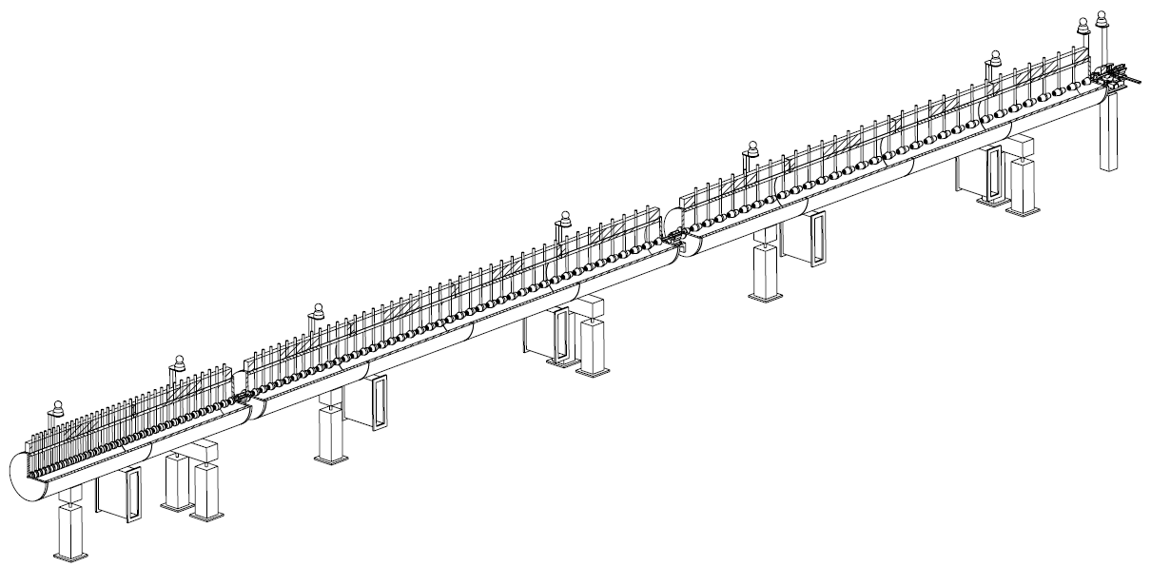
The Linac4 DTL
352 MHz frequency
Tank diameter 500mm
3 resonators (tanks)
Length 19 m
120 Drift Tubes
Energy 3 MeV to 50 MeV
Beta 0.08 to 0.31 → cell length (βλ) 68mm to 264mm
→ factor 3.9 increase in cell length
beam

Slide 11
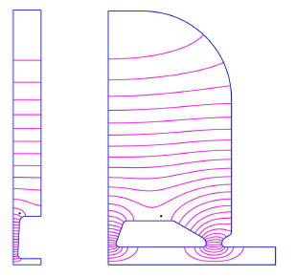
CC-DTL
The bests elements of a drift tube and a coupled cavity linac are combined in a coupled-cavity drift tube linac (CC-DTL).
Each cell has a drift tube inside it.
It has a higher shunt impedance than an Alvarez DTL as you get three gaps per drift tube as the field goes to zero at the CC aperture, but allows smaller drifts with larger spacing between walls.
Can also have quadrupoles in the drift tubes.
Not so good at very low beta.

Slide 12
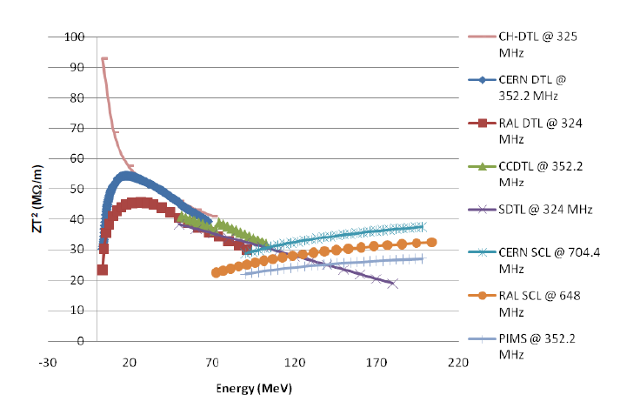

Slide 13
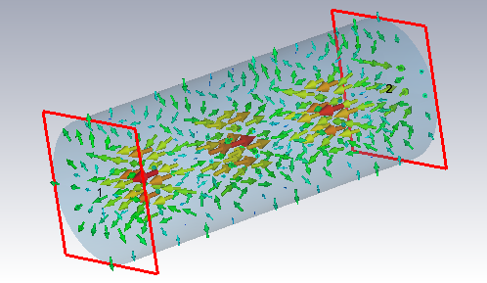
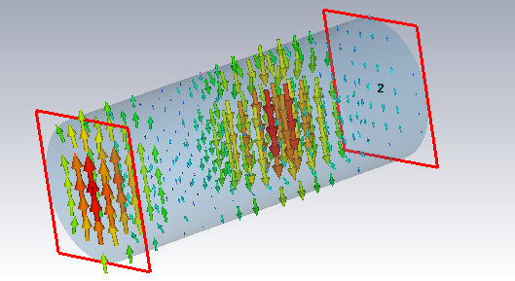
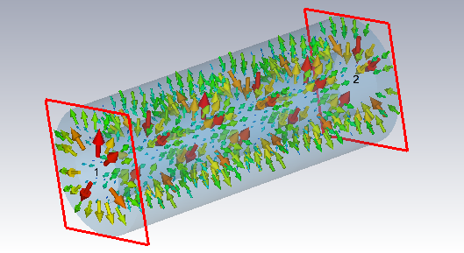
TM, TE and TEM modes
Transverse magnetic modes (TM) only have transverse magnetic fields but always have longitudinal electric fields (good for accelerating)
E field
E field
Transverse electric (TE) modes only have transverse electric fields (Ez=0).
They are smaller than TM mode cavities.
E field
Transverse electromagnetic modes (TEM) have no longitudinal fields.
They need two isolated conductors.
Frequency is not dependant on transverse size so can work at very low frequencies.

Slide 14
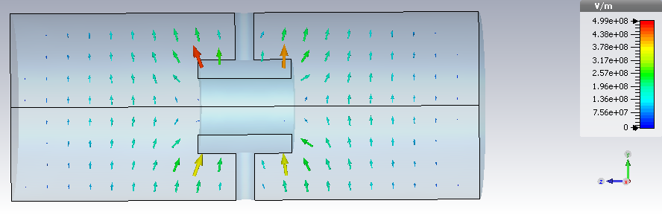
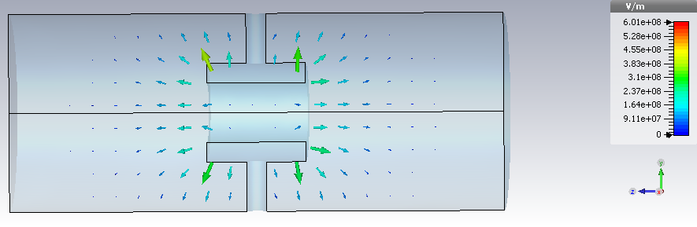
TE and TEM drift tube structures
The definitions TE and TEM (Ez=0) are only strictly true in cavities of constant cross-section. Any discontinuities cause the field to bend round the discontinuity giving rise to hybrid mode components. One method is to use drift tubes.
TE mode with drift tube.
These modes have low magnetic fields on the walls so have low losses.
TEM mode with drift tube
These modes have very low frequencies so less RF defocussing.

Slide 15
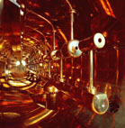
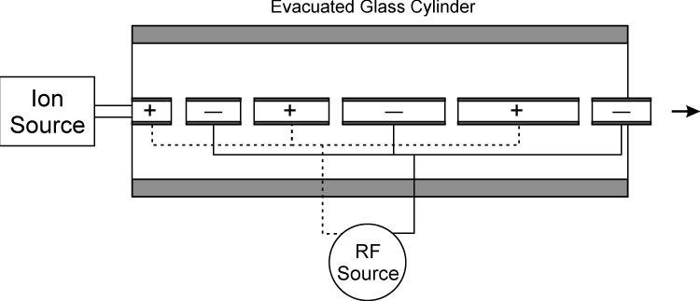
Widroe Linac
In a widroe linac we uses two conductors supporting a TEM similar to biaxial transmission line. This was the first linac structure and is still in use today.
Each conductor has a number of electrodes which contain the beam apertures.
The electrodes from each conductor are alternated so that an electric field is created between them, and the field alternates at each gap (like a pi mode).
The distance between gaps is a L=βλ/2 as in a pi mode structure.
As the transverse size is not dependant on frequency the structure can work at very low frequencies.
Still used for very low beta (heavy ion) injectors.
GSI Unilac Widroe

Slide 16
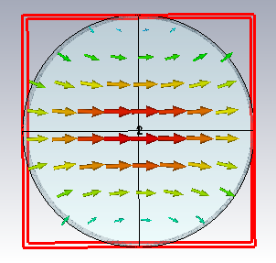
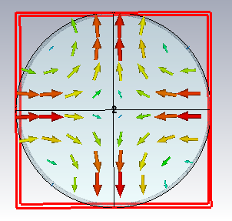
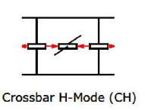
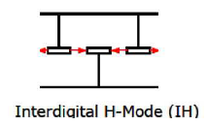
CH and IH structures
One such set of TE cavities are the H-mode cavities (some people call TE modes H modes).
They can operate in the TE11 mode (Interdigital) or TE21 mode (crossbar)
They have very high shunt impedances at low energy
At high energy the voltage is low as the gaps get longer and the H-mode only has Ez near the drift tube ends

Slide 17
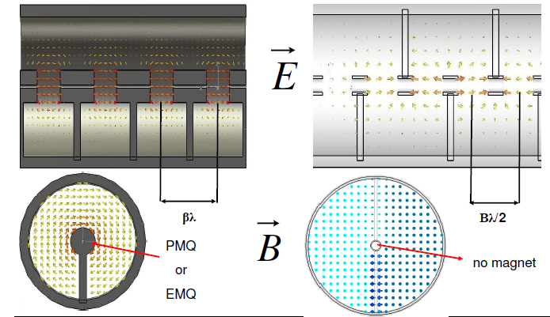
Alvarez vs CH DTLs
Image from W. Barth

Slide 18
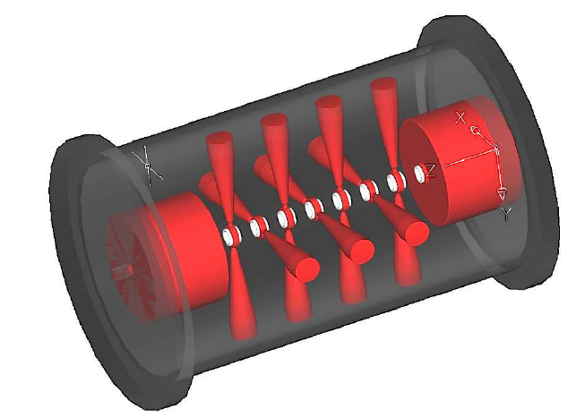
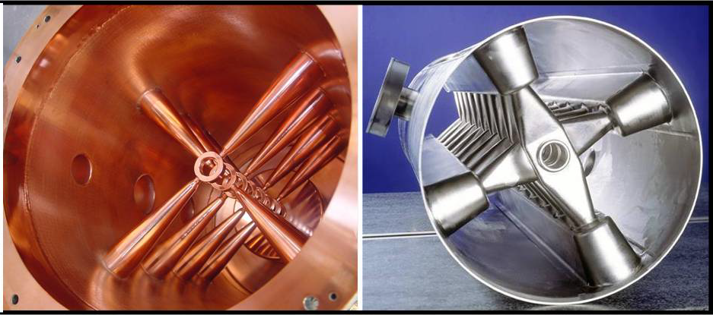
Frankfurt CH-DTL
Smaller than an Alvarez DTL at 350 MHz and higher shunt impedance as it operates in a pi-mode.
This allows smaller drift tubes (high shunt impedance) but doesn’t allow magnets to be put in the drift tubes.
Cannot have large aperture.
Superconducting and normal conducting versions exist.
Will be used for the first time at FAIR.
At high beta the gaps get larger and the CH structure becomes less efficient. 3-100 MeV (up to beta=0.3c)

Slide 19
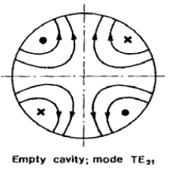
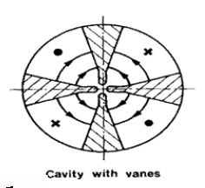
Radio frequency Quadropole (RFQ)
At very low energy focussing and bunching is critical
It would be really useful if we could make a structure that focussed, bunched and accelerated at the same time.
Magnetic fields are not ideal for focussing at low energy as the lorentz force is q(E+vxB), hence electric focussing is preferred.
We can create an RF electric quadrupole by using a TE21 mode.
In an RFQ we load the cavity
with rods or vanes to make
the TE21 the lower in
frequency and increase
focussing.

Slide 20
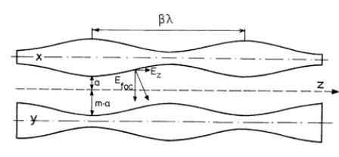
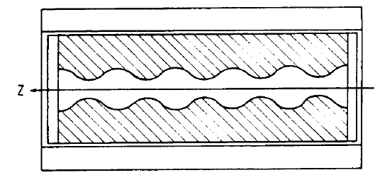
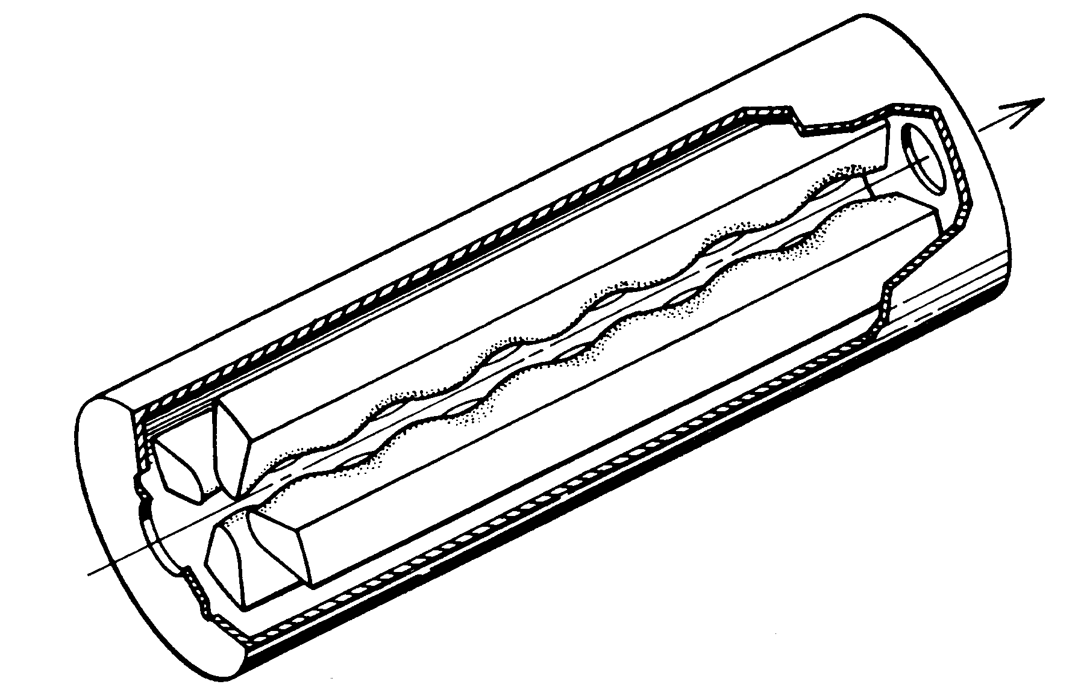
RFQ 4 vane
However the TE21 mode has no longitudinal electric field.
In order to create an electric field the vanes are corrugated to create a longitudinal component.
The depth of corrugation increases acceleration but decreases the focussing.

Slide 21
Accelerating fields
The accelerating field depends on the modulation depth.
The accelerating voltage is always less than potential between the vanes
While the electric focussing is very useful at low energy, the low gradient is not suitable at high energy.
RFQ’s work between beta=0.01c -0.06c

Slide 22
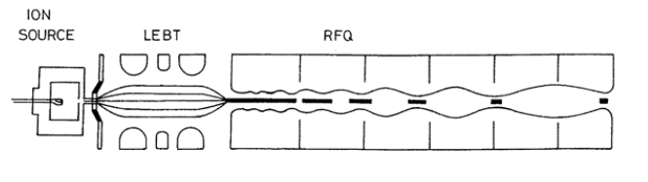
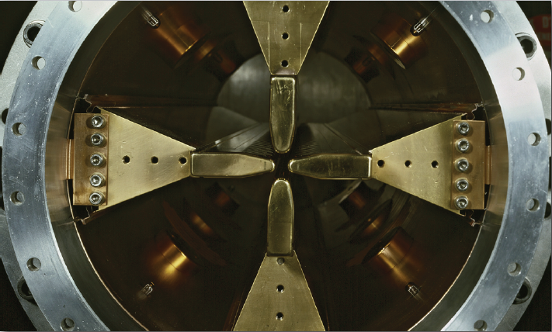
Adiabatic Bunching
The amplitude and synchronous phase is slowly increased along an RFQ.
The beam is injected at φ_{s}=-90 degrees to provide bunching and it slowly drifts towards φ_{s}=0 deg.
This allows adiabatic bunching and avoids large space charge forces which limit older buncher cavities.

Slide 23
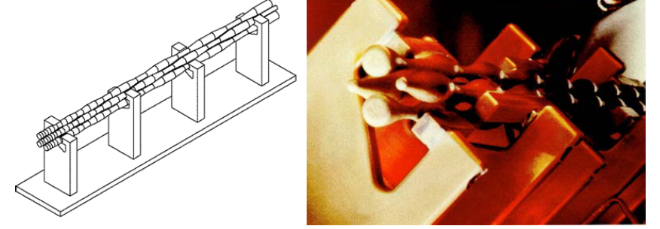
Four Rod RFQ
If a lower frequency is preferred (for more focussing) the four vane structure can get quite large.
A four rod structure (similar to a widroe linac) can be used which support TEM waves.
These structures are harder to cool but do allow compact low frequency RFQ’s.

Slide 24
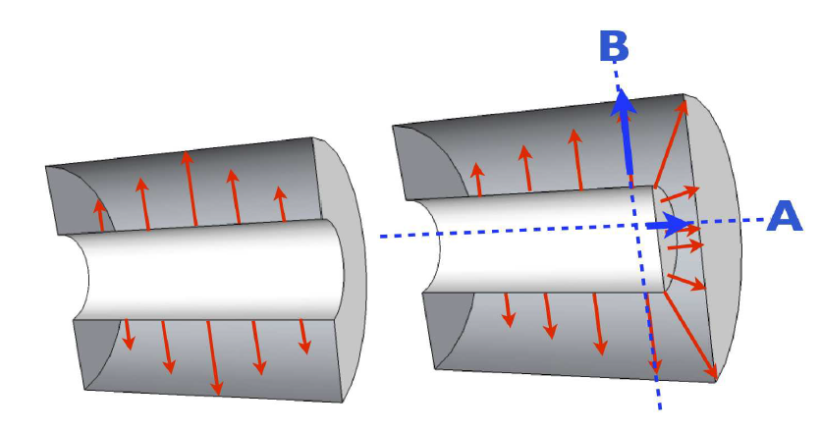
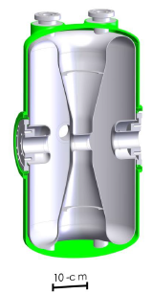
Half-wave resonators
We can also use a half-wave resonator (HWR) consisting of a λ/2 coaxial line with a TEM mode in it.
The beam enters the cavity along the direction of the electric field.
Has two gaps for acceleration.
Mechanically stable
Difficult to clean for SRF applications.
Really difficult to tune
Mostly beta=0.1-0.3
150-300 MHz

Slide 25
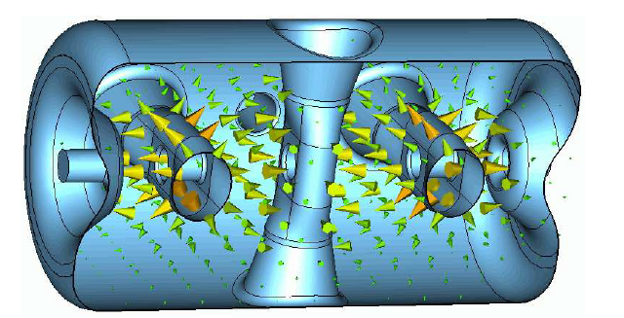
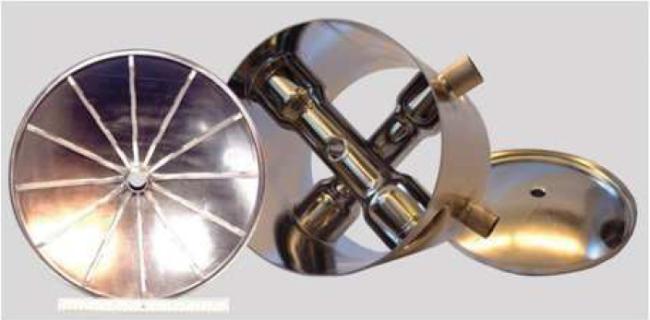
Spoke cavities
Triple spoke FZJ
We can make multicell half-wave resonators called spoke cavities.
Work well at intermediate beta (0.15-0.62).
They are also being investigated for beta=1 applications due to their small size.
Single spokes also exist, they are different from HWR due to their outer can shape.
Larger that a HWR so do not work below 350 MHz
RIA multi-spoke

Slide 26
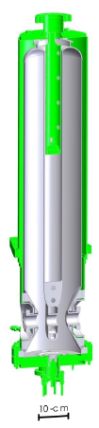
Quarterwave cavities
To make the cavity shorter we can add an open circuit at one end to make a quarter wave resonator (QWR).
As the magnetic fields are only at one end they have half the power losses.
However as the cavity is asymmetrical the field is not a pure monopole and contains dipole components that will kick the beam.
Can be susceptible to vibrations
For normally beta 0.01-0.15 but some higher beta cavities exist. Normally 50-150 MHz.

Slide 27
Lower frequency = Lower Beta
Borrowed from M. Kelly

Slide 28
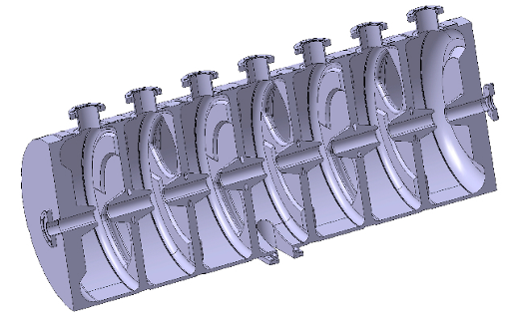
The normal conducting zoo
For normal-conducting, the goal is designing high-efficiency structures with a large number of cells (higher power RF sources are less expensive).
Two important trends:
Use π/2 modes for stability of long chains of resonators → CCDTL (Cell-Coupled Drift Tube Linac), SCL (Side Coupled Linac), ACS (Annular Coupled Structure),....
Use alternative modes: H-mode structures (TE band) → Interdigital IH, CH
DTL
SCL
CH
28
CCDTL
PIMS
Notes:
Help you to find your way inside the zoo…

Slide 29
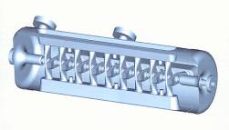
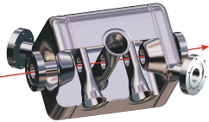
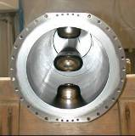

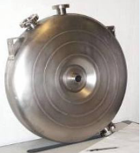
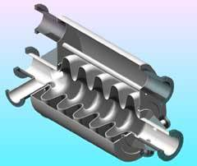
The superconducting zoo
Spoke (low beta)
[FZJ, Orsay]
CH (low/medium beta)
[IAP-FU]
QWR (low beta)
[LNL, etc.]
10 gaps
2 gaps
4 gaps
Re-entrant
[LNL]
HWR (low beta)
[FZJ, LNL, Orsay]
4 to 7 gaps
2 gaps
1 gap
Superconducting structure for linacs can have a small number of gaps → used for low and medium beta.
Elliptical structures with more gaps (4 to 7) are used for medium and high beta.
Elliptical cavities [CEA, INFN-MI, CERN, …]

Slide 30
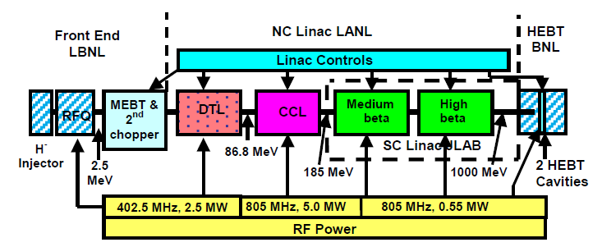
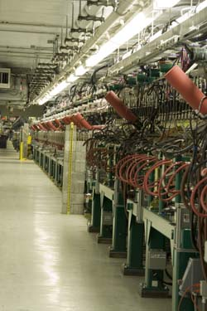
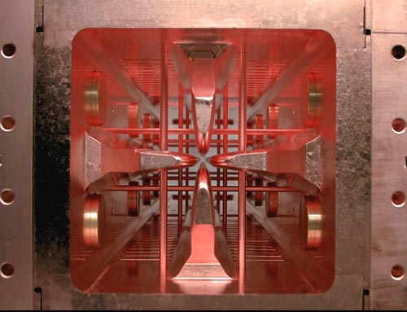
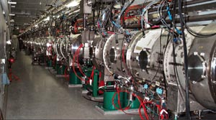
SNS

Slide 31
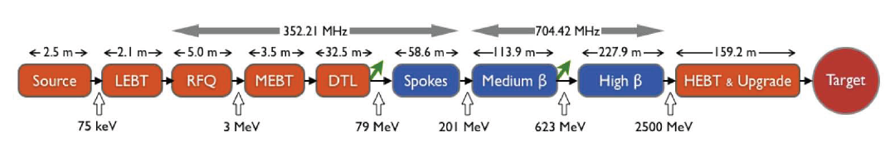
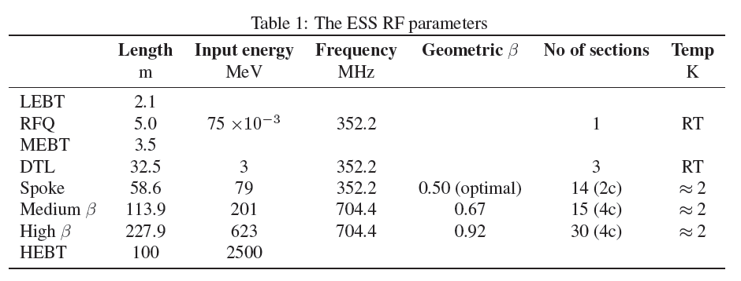
ESS
1

Slide 32



Linac 4 (CERN)

Slide 33

Warm to Cold transition
SRF structures are more efficient but add complexity, the energy at which the linac should switch from normal conducting to superconducting typically depends on duty cycle and hence wall plug power.

Slide 34

Cyclinac
To save cost for a flexible linac TERA are investigating injecting into a linac from a cyclotron. Options include DTL to SCC or just a low beta SCC. Capture and bunching isn’t great so beam losses are very large.

