Slide 1


RF Linear accelerators L4: Travelling wave structures
Dr Graeme Burt
Lancaster University

Slide 2
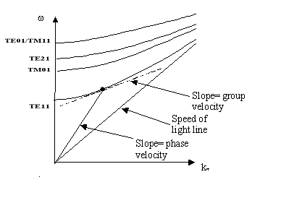
Dispersion Diagrams
If we plot out the axial wavenumber as a function of frequency we get a dispersion diagram.
The relationship between the magnitude wavevectors in each direction is given by the summation of vectors.
k² = k_{z}² + k_{T}²
k is the free space wavenumber/vector and is given by
k=ω/c
If k is less than k_{T} then k_{z} is imaginary. This means the mode decays exponentially. This leads to a cut-off frequency below which no wave can propagate.

Slide 3
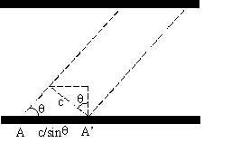
Phase and Group velocities
The wave will propagate at the speed of light in the filling medium, however in the direction of guiding it will appear as if the wave is travelling at a slower (group) velocity
v_{g}=c sin θ = dω/dk_{z}
However it will appear as if the wavefront is actually moving faster than the speed of light, v_{p}=c / sinθ = ω/k_{z}. It should be noted that the wave doesn’t travel faster than c, it only appears to and information travels at the group velocity.
In a smooth walled waveguide v_{p} v_{g} =c²

Slide 4
Acceleration in a smooth walled waveguide
The phase velocity in a smooth walled waveguide is given by
Which is always greater than c. In order to not over mode the waveguide we will operate at vp>1.35c
If we insert a beam of velocity βc at the Ez maxima the phase will slip by
This limits the maximum length of acceleration to around two wavelengths for beta=1 or less for low beta. This is clearly too short and also inefficient.

Slide 5
Floquet theorem
We can modify the TM01 modes field pattern and dispersion by inserting periodic isis along the length of the waveguide.
This creates a z dependance in the field pattern
E_{z}=E_{p}(z,r)exp[i(ωt-k_{z}z)]
Floquet theorem states that
“In a given mode of an infinite periodic structure, the fields at two different cross sections that are separated by one period differ only by a constant factor, which in general is a complex number.”

Slide 6
Brilliouin Diagrams
The periodicity causes a number of spacial harmonics on the dispersion diagram separated by 2nπ/L where L is the distance between iris
At each intersection there is a forward and backwards wave coupled. This has the solution that no wave can propagate and any wave entering the structure will be reflected. The coupling creates a “stopband” in the dispersion diagram (or avoided crossing) and we find the same solution as found with the standing wave structures.

Slide 7
Brillioun diagrams
Stopband
Axial wavenumber is related to wavenumber by φ=k_{z}L.
This is the same as bragg scattering in X-ray crystallography.

Slide 8
Iris loaded structure
The spacial harmonics in periodically loaded structures means there is a wave with a phase velocity equal to or less than the speed of light
Synchronism is met when the beam and waves velocities are equal and the two travel down the structure together.
The beam always see’s the same field and doesn’t see any variations.
Note that the group velocity is now much less than c. (typically between 0.5-10%)

Slide 9
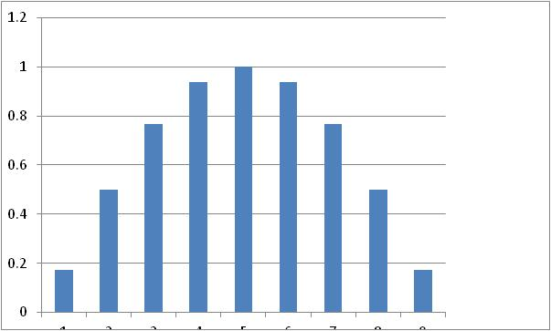
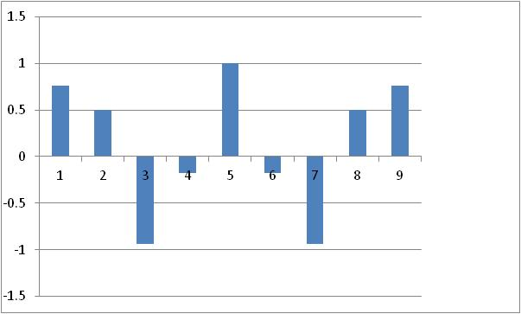
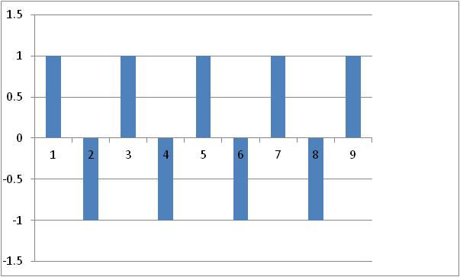
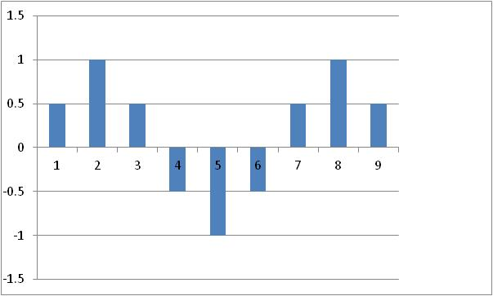
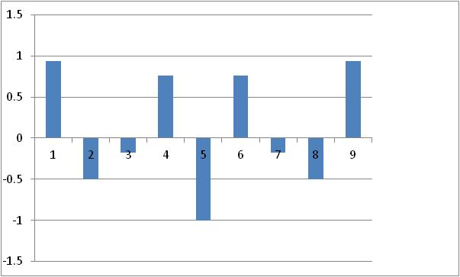
Longer structures
If we have N cells in a cavity we get N eigenmodes (q=1-N). If we adjust the end capacitance to give field flatness. The frequencies and amplitudes are given by
9 cell cavity with ω_{π/2}=1 and k=0.1
n=3
n=7
n=1
n=5
n=9

Slide 10
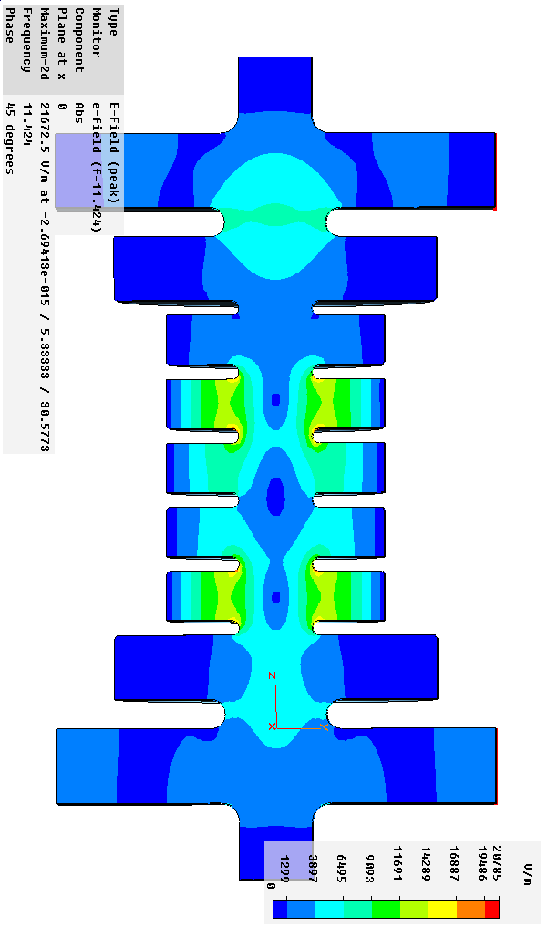
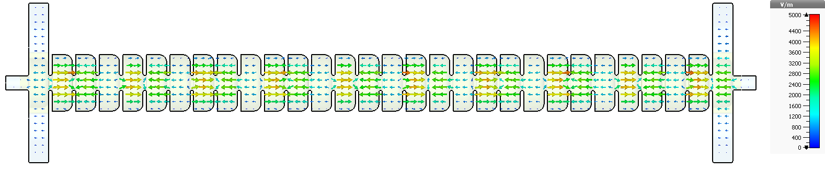
Phase Advance
CLIC crab cavity prototype 2π/3
In a travelling wave structure the phase advance is the axial wavenumber multiplied by the iris spacing (φ=k_{z}L)
An iris loaded structure will have a group velocity of zero (standing wave structures) at phase advances of 0 and π.
At all other phases the group velocity is non-zero and will travel.
If we can avoid reflections at the input and output then the wave will move through the structure.
Eg a π/2 travelling wave structure will have all cells filled at some point, but at any instant every 2nd cell is unfilled
A π/2 standing wave structure always has every 2nd cell unfilled.

Slide 11
Phase advance
π-mode
π/2-mode
standing
0 deg
90 deg
π/2-mode
travelling
0 deg
90 deg

Slide 12
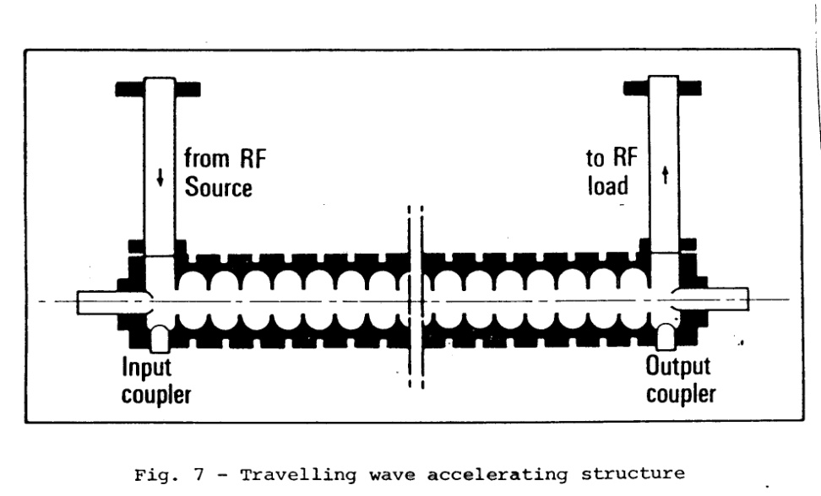
Travelling wave structures
Power can flow through all the cavities and out the other side, very low Q.
Power is also dissipated in the cavity walls.
Due to conservation of energy the power lost in the walls must equal the difference in input and output power.
The group velocity is also the power flow velocity per unit length giving
P_{w}=v_{g}U/L
Stating this as a differential equation gives (where r_{L} is the impedance per unit length)

Slide 13
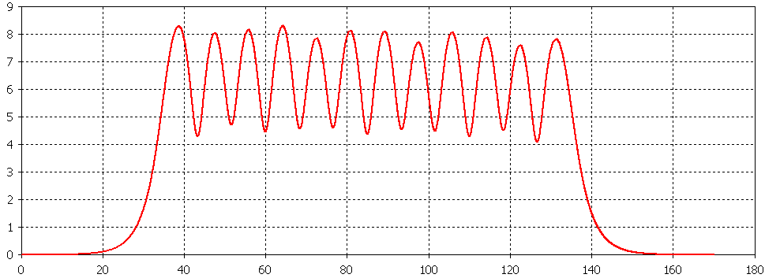
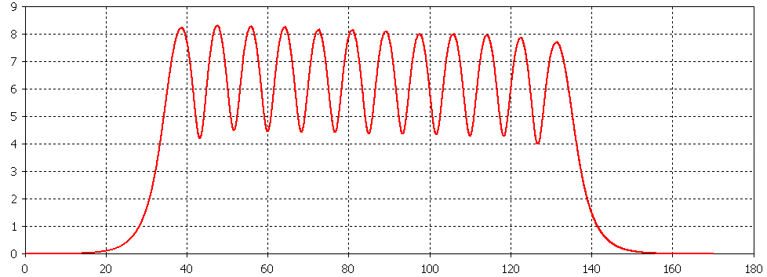
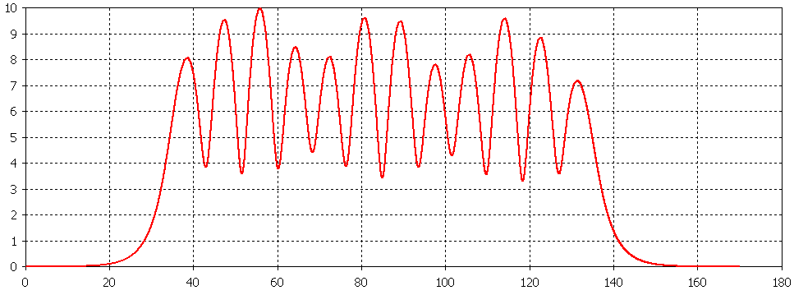
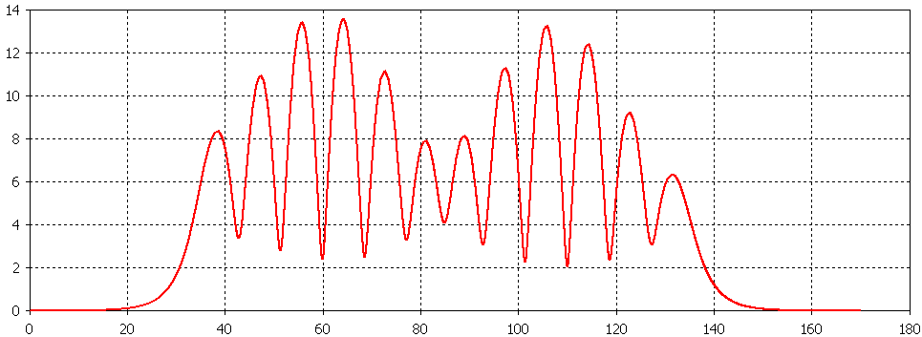
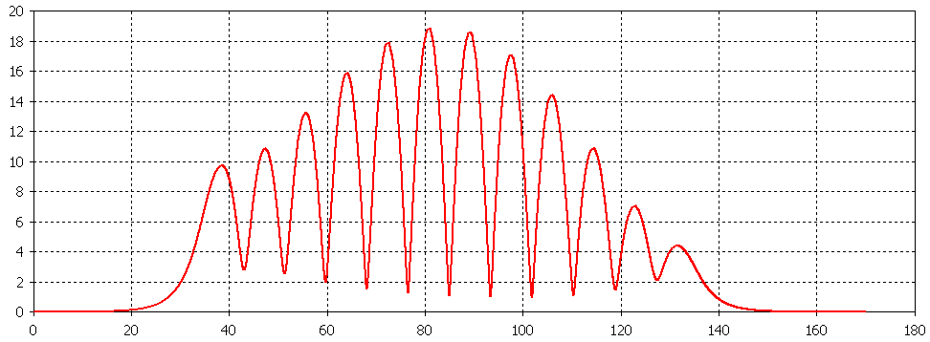
True travelling wave
12.004 GHz
119.14⁰
If a standing wave is made up of two travelling waves and only one direction couples to the beam then isn’t a travelling wave always better than a standing wave?
Yes but a travelling wave cavity isn’t a real travelling wave, the amplitude does vary with position.
This is because each cell is a standing wave structure, which travels from cell to cell.
A true travelling wave structure would require v_{g}.v_{p}=c² hence it would have v_{g}=c to meet synchronism which limits E_{z}
11.995 GHz
119.48⁰
11.962 GHz
141.46⁰
11.933 GHz
158.38⁰
11.917 GHz
173.93⁰

Slide 14
Attenuation
We define the field attenuation per unit length as α₀=ω/2Qv_{g}
This gives the power as
This leads to a power flow that decays along the structure by
Where P₀ is the input power
This leads to a gradient that decreases along the structure

Slide 15
Energy gain
The gradient decreases as
We define the total power attenuation per structure as τ₀=α₀L=ωL/2Qv_{g}
The energy gain is given by
Or using the shunt impedance per unit length r_{L} and the input power P₀

Slide 16
Reflections Output power
The power decays along the structure and any remaining power at the end is dissipated in a load, P_{L}.
However there are no reflections at the input coupler in an ideal cavity.
The required input power for a travelling wave structure is hence
P₀=P_{c}+P_{L}
Hence the group velocity should be tailored to avoid wasted power.
A 1 meter structure will have a lower group velocity (more losses but higher gradient for a given input power) than a 3 meter structure.

Slide 17
Filling time
Due to the group velocity the structure takes a set time for the wave to propagate from the start to the end of the structure given by
τ_{f}=L/v_{g}
Due to the high power flow between cells the filling time is long compared to the time to fill each individual cell (τ_{f}>2Q/ω). CLARA τ_{f} ~900 ns, 2Q/ω ~ 50 ns
A travelling wave structure will fill one cell at a time while a standing wave structure has all cells fill at the same time. The filling time is short compared to the time to fill each individual cell (τ_{f}<2Q/ω). CLARA gun 2Q/ω ~800ns
Standing wave filling
Travelling wave filling

Slide 18
Constant Impedance/Gradient
We can also adjust the iris radii to change the group velocity across the structure. It is assumed that the shunt impedance keeps roughly constant.
E_{z}²=ωr_{L}P_{w}/Qv_{g}
E_{z}²=r_{L}(-dP_{w}/dz)
If the power flow varies linearly along the surface we find we can have a constant gradient rather than a constant power. This also means a constant heat load.
Where P_{L} is the output power.
In practice r_{L} is not constant so this needs adjustment.

Slide 19
Constant Gradient Attenuation
This gives the power as
This leads to an output power at the end of the structure of
where
Inserting this into the linear power flow gives

Slide 20
Constant Gradient Energy gain
The energy gain is given by
Or using the shunt impedance per unit length r_{L} and the input power P₀
The filling time is given as

Slide 21
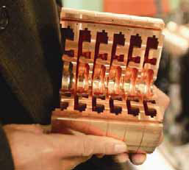
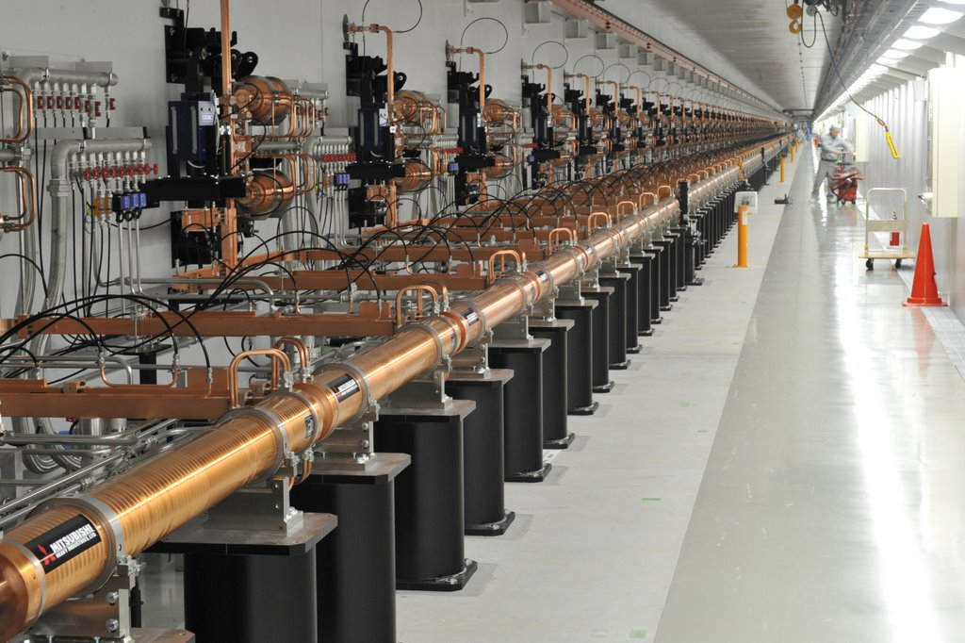
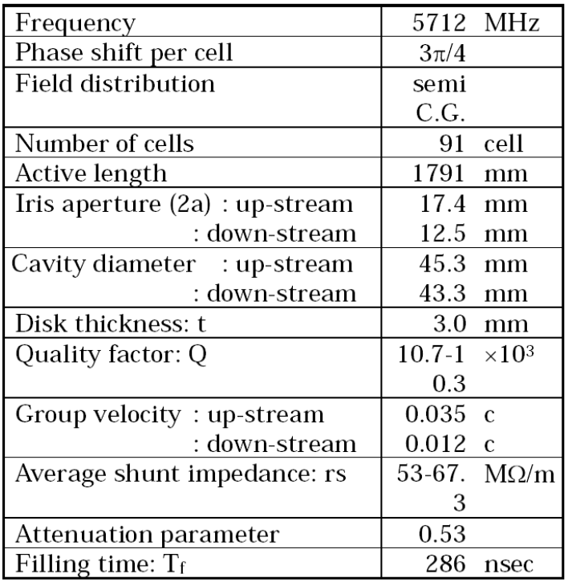
C-band RF LINAC for XFEL/SPring-8

Slide 22
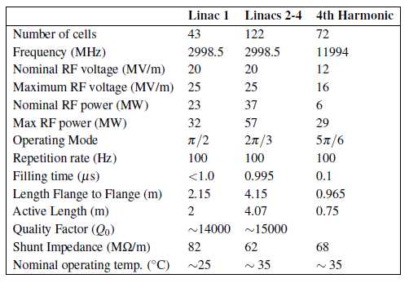
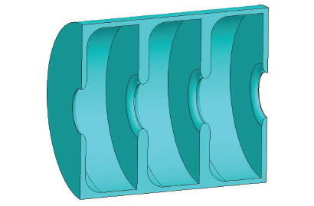
CLARA TWS
The further 3 linac accelerating sections are to be kindly provided by PSI from the SwissFEL Injector facility.
The linac sections are 4.15 m long from flange to flange, and are constant 2π/3 TW structures based on the mechanical design of linac II DESY structures.
To meet the SwissFEL requirements the shunt impedance was increased to reduce the peak RF drive power required to provide the accelerating gradient and the RF symmetry is maintained with a split input coupler.
It is a constant gradient structure (well almost)

Slide 23
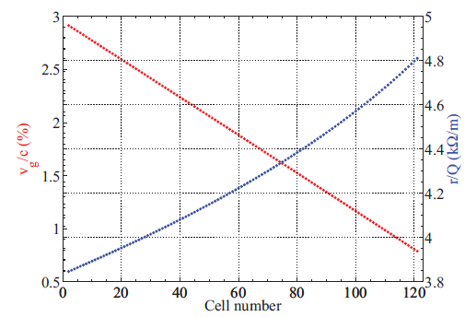
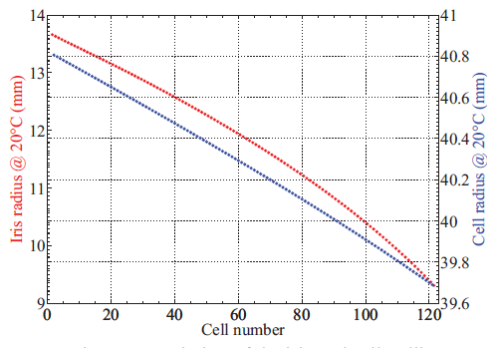
CLARA Parameters
v_{g}=L/τ_{f}=4.07/995 ns
v_{g}=1.4% c (not quite right as its not constant impedance)
α=ω/2v_{g}Q =0.15
τ₀ = τ_{F}ω/2Q=0.68
P_{L}=P₀*exp(-2τ₀)= 9.5 MW
Pc= 27 MW
Ptot= 37 MW

Slide 24
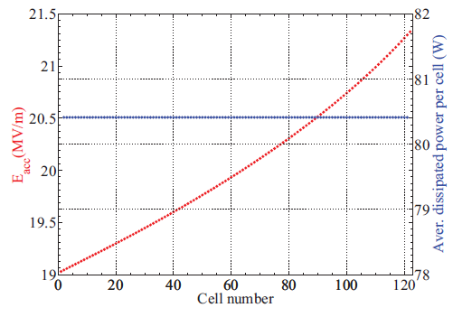
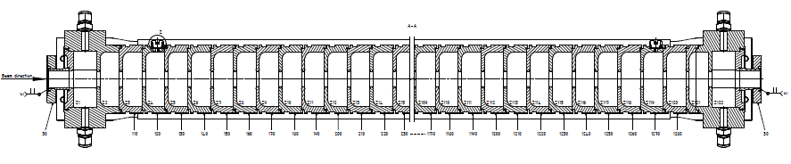
CLARA structure
The CLARA linac is not constant gradient or constant impedance, its constant power dissipation.
This is because the shunt impedance is not constant so constant power dissipation and constant gradient cannot be achieved at the same time.
As its high rep rate heating is an issue so the design aims to provide a constant heat load in each cell.

Slide 25
Matched Couplers
In order for the structure to contain a travelling wave we must ensure that there are low reflections at the input and output couplers. Ie that reflections are cancelled locally.
This is not the same as S₁₁=0 (global matching) as the reflected power at one coupler could be cancelled by reflections at the other coupler, while containing a standing wave in the cavity due to internal reflections.
For a true travelling wave there is no reflection at the start of the pulse.
In order to verify a structure is matched we must measure the fields inside the cavity.

Slide 26
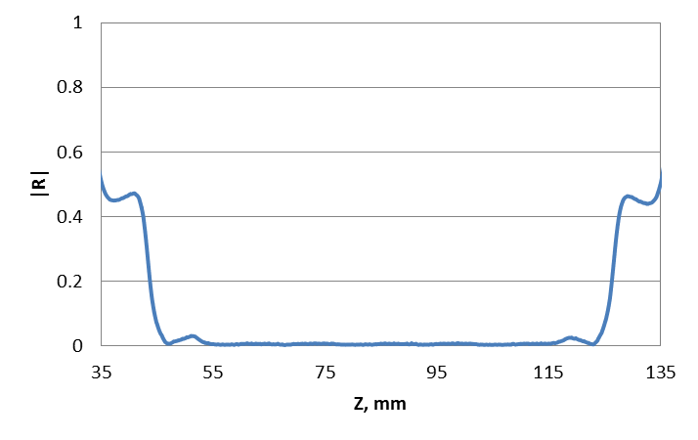
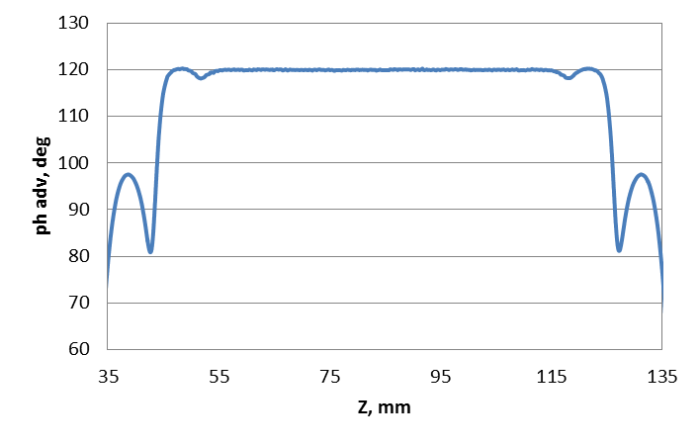
Floquet Theorem II
By measuring how the field varies between a cell and its nearest two neighbours we can use Floquet theorem to calculate the phase and internal reflections. For a TWS |R|=0.
E = field
P = cell length
R = reflection coefficient
ψ = required phase advance
CLIC crab cavity

Slide 27
Matched Couplers
For a matched coupler we must consider the matching of each cell rather than the entire structure. As before a coupler is matched if Q_{e}=Q_{internal}
Here
As Q₀ >> Q_{flow}

Slide 28
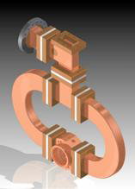
CLARA coupler
Phase advance = 2π/3
Group velocity = 3 % c at the input
Qe = 70
This is a very low Q compared to that of a standing wave cavity which gives the fast filling time and large bandwidth.
This is not power loss but power flow so the structure can still be efficient if made sufficiently long.

Slide 29
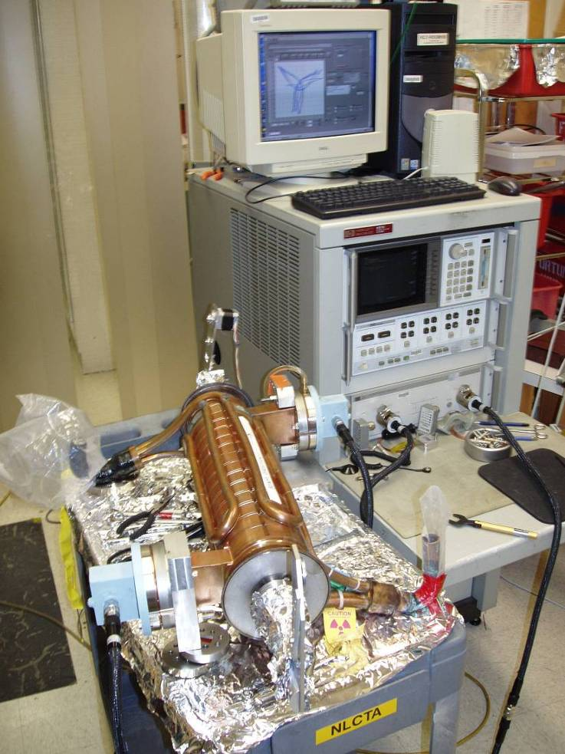
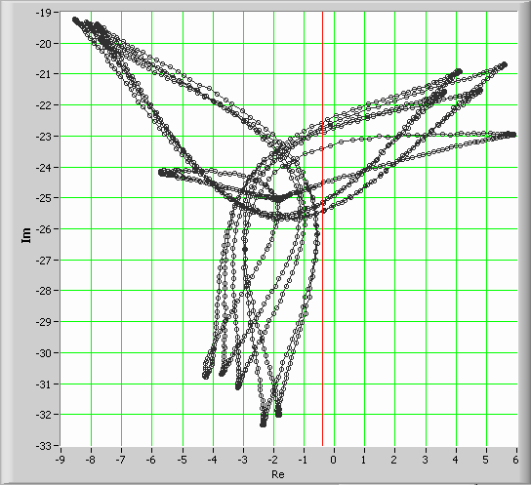
Measuring Phase Advance and Match
If we look at the phase of reflections from a beadpull measurement we can find the amplitude and phase of each cell.

Slide 30
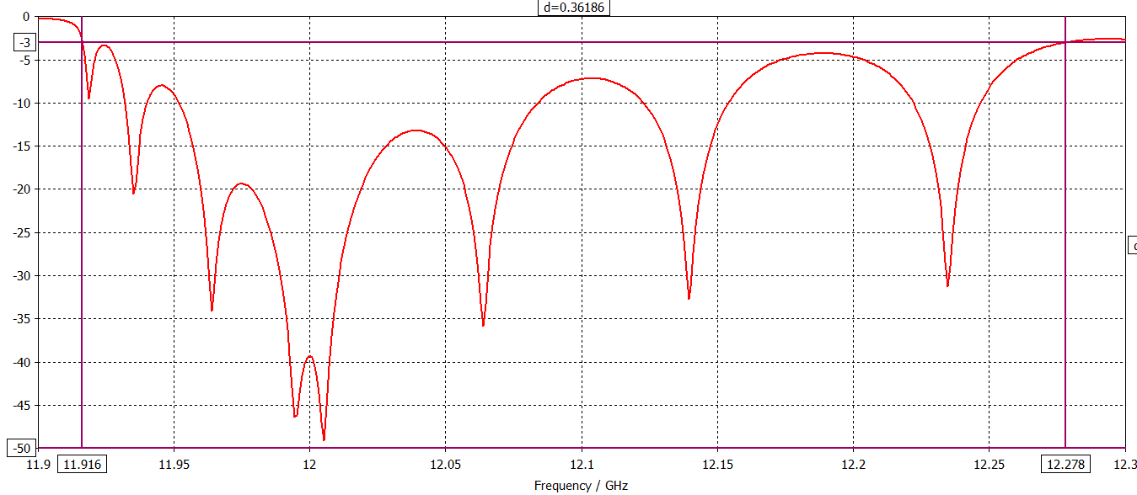
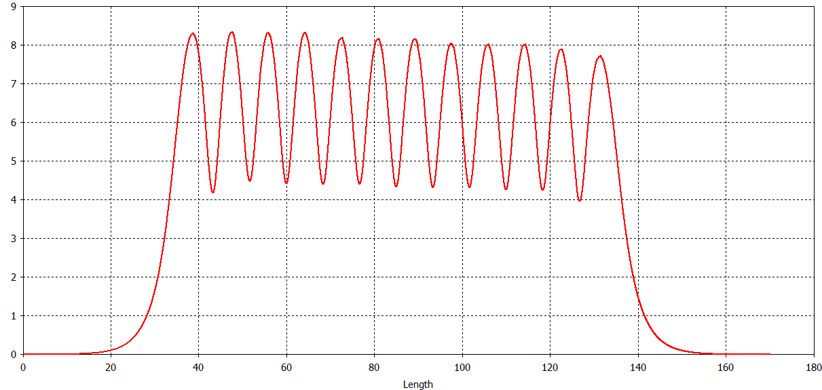
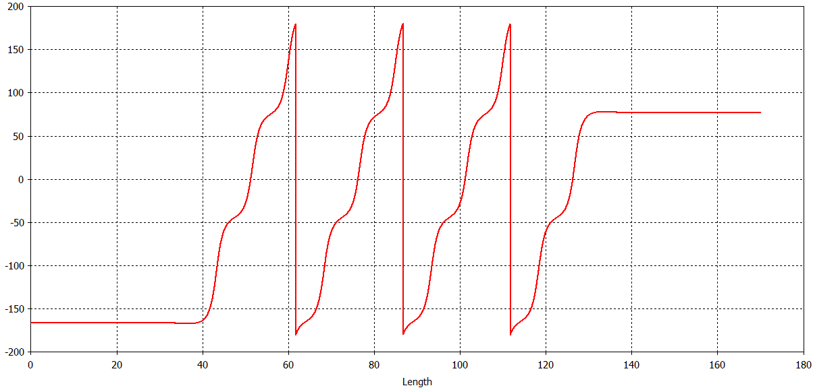
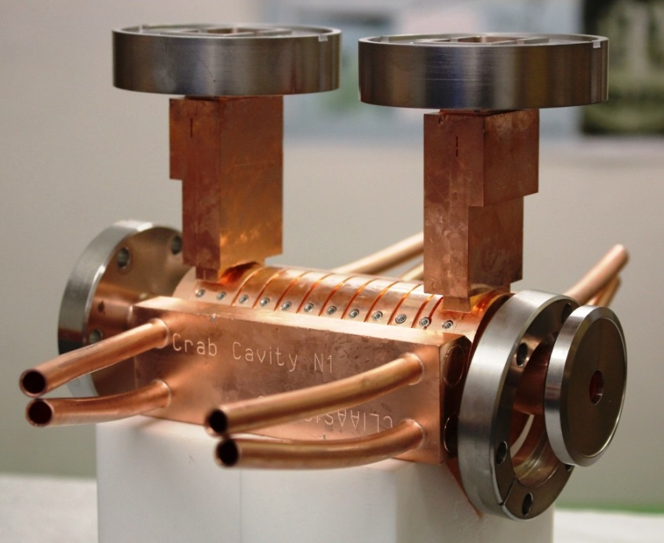
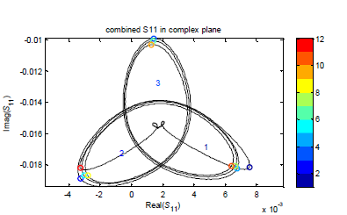
Twelve cells in CLIC crab cavity
119.87⁰

Slide 31
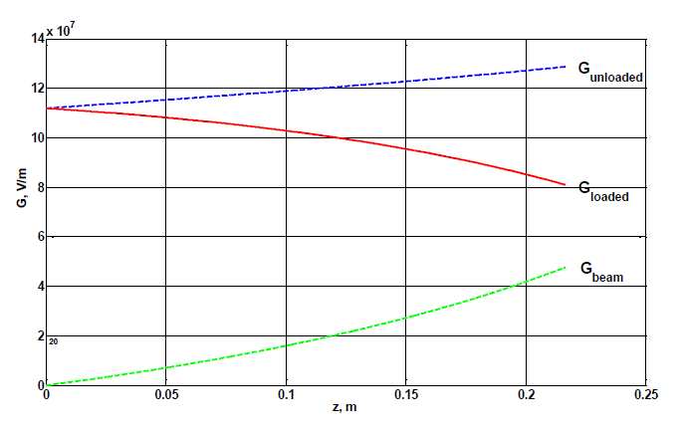
Beamloading
Beamloading in CLIC main linac
As we have a travelling wave structure any fields induced by the beam will also travel down the structure.
This leads to a reduction in the gradient along the structure with higher fields at the input coupler
This increases the peak field for a given gradient.

Slide 32
Advantages of travelling wave
Fast filling time (shorter pulses)
No reflections (circulator not required)
Better stability to manufacturing tolerances than π mode structures (so can be longer)
Small frequency changes can be used to vary beam voltage in industrial linacs.
Disadvantages of travelling wave
Power loss at output port
Beamloading leads to asymmetric loading of fields
Needs two couplers

