Slide 1


RF Linear accelerators L3: Coupling to Standing wave cavities
Dr Graeme Burt
Lancaster University

Slide 2
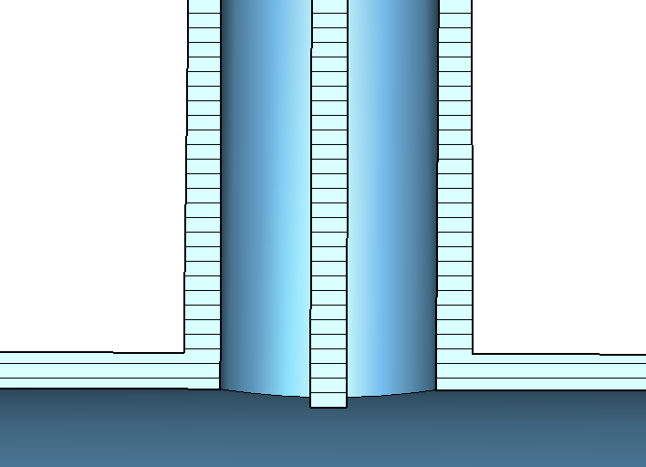
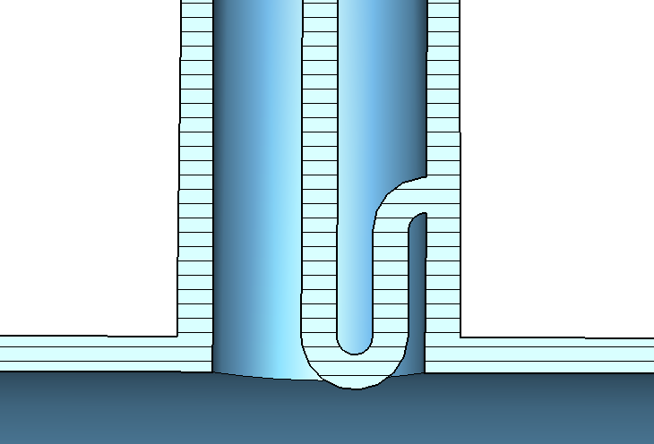
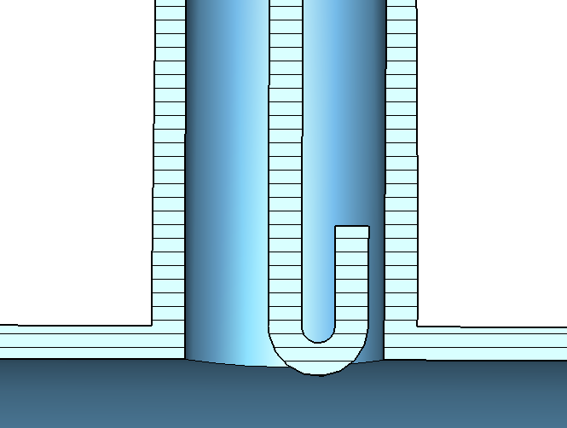
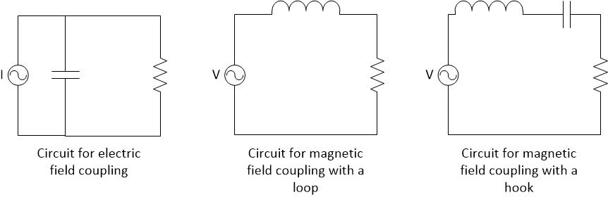
Cavity Coupling
Probe
Loop
Hook

Slide 3
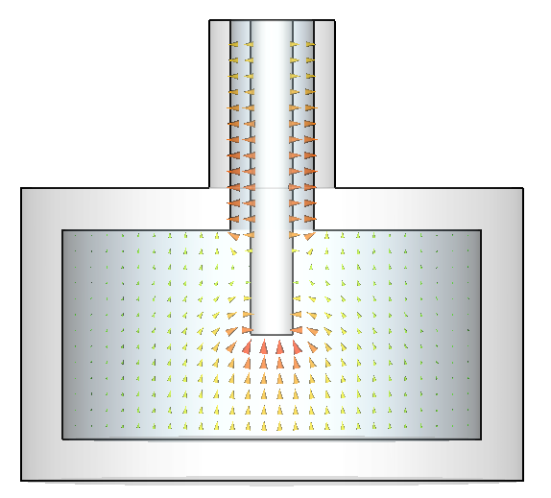
Electric coupling use J
From Gauss’ law
Integrated over the tip of the inner conductor.
The equivalent circuit for electric coupling is a current source in parallel with a capacitance.
The top rail represents the inner conductor and the ground plane is the cavity body and outer conductor.

Slide 4
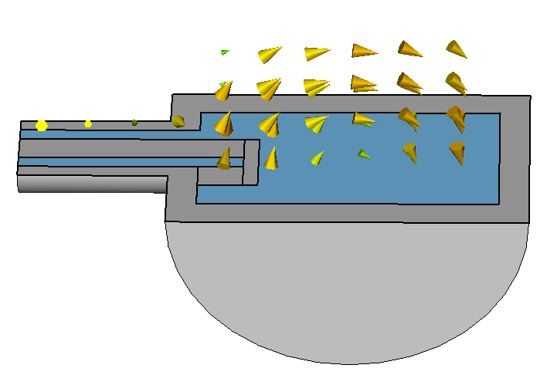
Magnetic coupling use J
From Faradays law
The equivalent circuit for magnetic coupling where the inner conductor loops round and is connected to the outer conductor is a voltage source in series with an inductor capacitance.
If the loop isn’t physically connected then there is also a series capacitance making a band pass filter.

Slide 5
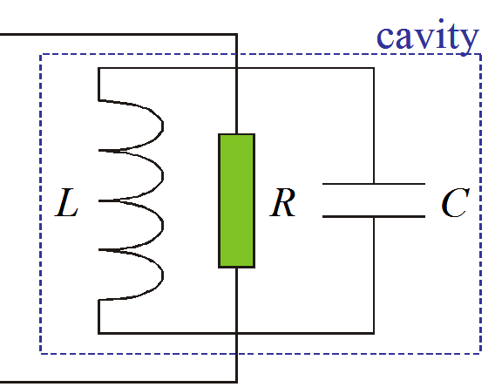
Parallel resonant circuit
A resonator can be modelled as a parallel LRC circuit. Here we drive it with a current source.
Applying Kirchoff’s loop law gives.
Solving for sinusoidal varying I and V yields (Q=ωRC)
where

Slide 6
Resonant Bandwidth
P
1
ω₀
Δ ω=
=
t_{L}
Q_{L}
ω-ω₀
SC cavities have much smaller resonant bandwidth and longer time constants. Over the resonant bandwidth the phase of S₂₁ also changes by 180 degrees.

Slide 7
Impedance and filling
The cavity impedance is given as the voltage divided by the current.
If the RF is turned off the voltage will decay exponentially as the losses are proportional to the stored energy.

Slide 8
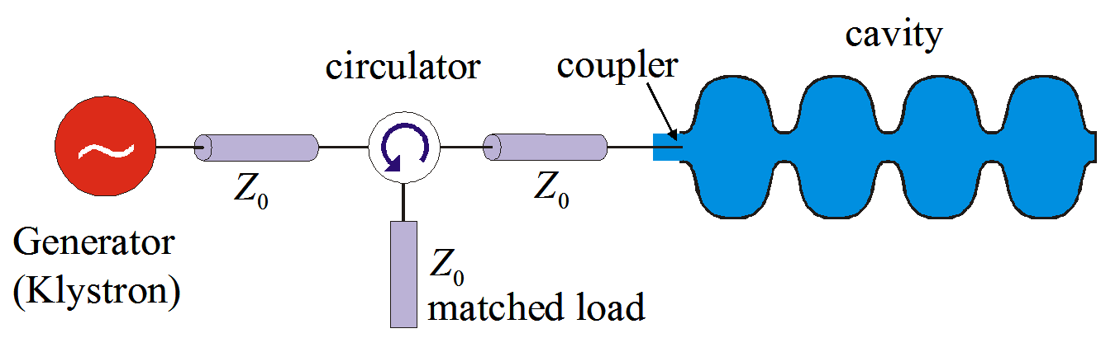
Couplers
However the RF source has an impedance (plus the inductance of the coupler) which isn’t always matched to the cavity. This can be represented as a transformer.
The RF source is represented by a ideal current source in parallel to an impedance and the coupler is represented as an n:1 turn transformer.
Typically Z₀ is 50 Ohms but the cavity shunt impedance, R, is ~Mohms.

Slide 9
The transformer makes the load impedance seen smaller by a factor of n²
By varying the coupling we vary n allowing us to set the load impedance.
I=I_{s}/n
Z₀n²
When on resonance the cavity impedance equals the shunt impedance (Z_{c}=R)
We can then simply model the circuit as two parallel resistors.

Slide 10
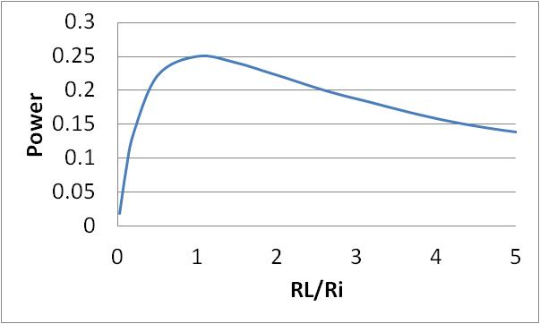
Power Transfer Theory
V_{s} = I_{s} R_{i}R_{L}/(R_{i}+R_{L})
P_{L}=V_{s}² / R_{L} (the power delivered to the load)
P_{L} = I_{s}² R_{i}²R_{L}/ (R_{i}+R_{L})²
P_{L}= I_{s}² R_{i}² / (R_{i}²/R_{L} +2R_{s}+R_{L})
I_{s}
R_{i}
R_{L}
The minimum peak power occurs when
Which occurs when R_{L}=R_{i}
In this case the load
dissipates a peak power
P_{L}=I_{s}²R_{i}/4

Slide 11
Generator Power
It makes sense that the generator power from the RF source is the maximum power that can be delivered to the cavity rather than power delivered from the current source.
This occurs when
In this case the rms power delivered, P₊, is
As the coupler (n) changes or the cavity impedance changes the power from the current source will vary but we ignore this. We only care about the power dissipated in the cavity and the generator power which is fixed as above.

Slide 12
Travelling waves
Most circuit theory makes the assumption that the voltages do not depend on cable lengths
At higher frequencies this assumption is no longer true and waves propagate along the cables.
Waves can propagate forwards, V₊, or backwards, V₋,
The voltage at any point is a superposition of both waves
V=V₊+V₋
The same happens with current where
I=I₊-I₋
The generator is a source of forward current, I₊, not current, I, hence why we only took part of the power produced earlier.
V+
V-

Slide 13
External Q factor
Ohmic losses are not the only loss mechanism in cavities. We also have to consider the loss from the couplers. We define this external Q as,
Where P_{e} is the power lost through the coupler when the RF sources are turned off.
We can then define a loaded Q factor, Q_{L}, which is the ‘real’ Q of the cavity

Slide 14
Cavity Voltage
The generator power is given by:
Where I use the circuit definition of R.
Rearranging this gives the current
The voltage is given by
Hence

Slide 15
Reflected Power
The reflected power in steady state operation is the power supplied to the cavity minus the power that is dissipated in the cavity.
Here we assume a matched system and look at the power dissipated in the cavity resistance by looking at the power lost in two parallel resistors.
I_{s}
R_{i}
R_{L}

Slide 16
Scattering Parameters
When making RF measurements, the most common measurement is the S-parameters.
Black Box
Input signal
S_{1,1}
S_{2,1}
input reflection coefficient
forward transmission coefficient
The S matrix is a m-by-m matrix (where m is the number of available measurement ports). The elements are labelled S parameters of form S_{ab} where a is the measurement port and b is the input port.
S₁₁
S₁₂
S =
S₂₁
S₂₂
The meaning of an S parameter is the ratio of the voltage measured at the measurement port to the voltage at the input port (assuming a CW input).
S_{ab} =V_{a} / V_{b}

Slide 17
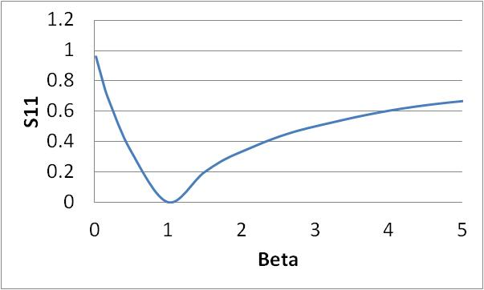
Reflected Voltage
where
S11
Δf

Slide 18
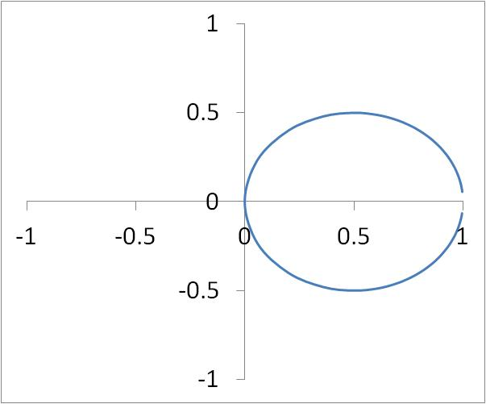
Polar plot of S11
Plotting the Re and imaginary components give a polar plot.

Slide 19
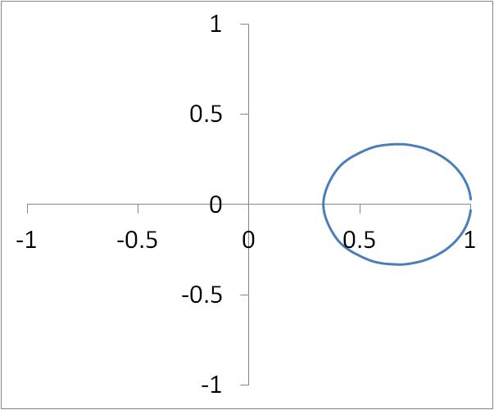
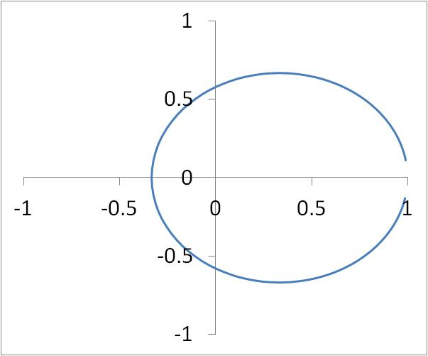
Under and Over coupled
Beta=Q₀/Q_{e} < 1
Beta = 1
Beta > 1
We can tell if beta is greater or less than 1 from the polar plot.
If the circle doesn’t circle the origin then beta is less than 1 (undercoupled)
If the circle does circle the origin then beta is greater than 1 (overcoupled)

Slide 20
Cavity Coupling
Cavity Behaviour examples
Steady state
The most important behaviour we must understand is when the cavity is in steady state (ie when the cavity stored energy is constant and U=U₀). We can use the definitions of beta and Q to derive,
We can also get voltage by using R/Q (remember the overvoltage). From this equation we can see that the cavity energy is maximum when β=1 (also when the reflections are zero and all power is dissipated in the cavity)

Slide 21
Filling time
The cavity fills with time as 1-e^{-t/τ} where t is the filling constant/time.
The filling constant is
τ=2Q_{L}/ω
The higher the loaded Q the higher the stored energy but the longer it takes to fill.

Slide 22
Transient reflections
The reflections are also not constant. They actually vary with time.
When we first apply a pulse all the wave is reflected, but as the cavity fills its emitted power cancels the reflected signal.
As we know the voltage increases as 1-e^{-t/τ} with time
Using the definition of reflected voltage and knowing that V₊ is constant

Slide 23
Cavity Filling
When filling, the impedance of a resonant cavity varies with time and hence so does the match this means the reflections vary as the cavity fills.
note:
No beam!
As we vary the external Q of a cavity the filling behaves differently. Initially all power is reflected from the cavity, as the cavities fill the reflections reduce.
The cavity is only matched (reflections=0) if the external Q of the cavity is equal to the ohmic Q (you may include beam losses in this).
A conceptual explanation for this as the reflected power from the coupler and the emitted power from the cavity destructively interfere.

Slide 24
Coupling Strength
Excited by a square pulse
critically coupled
under coupled
over coupled

Slide 25
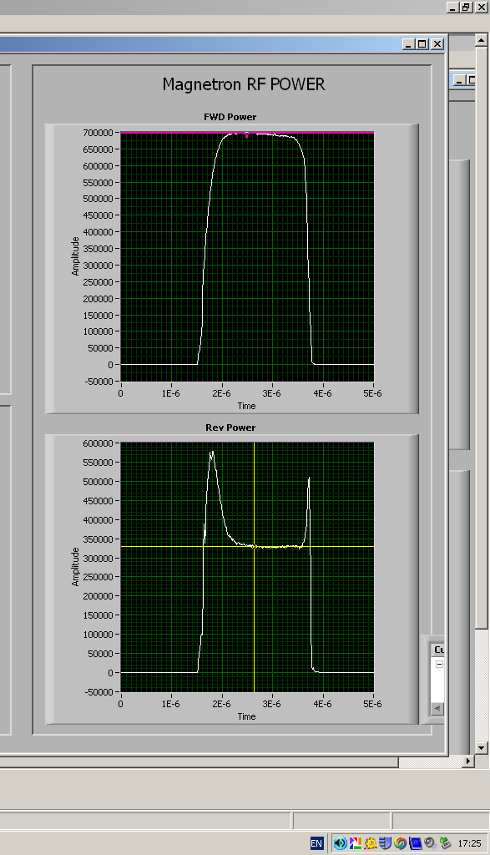
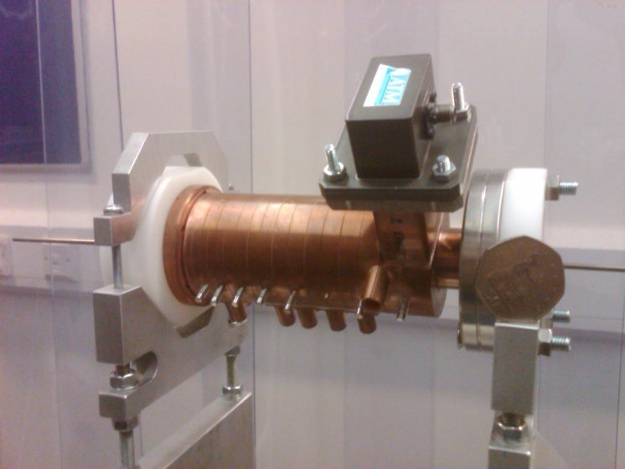
Excitation of the CI compact linac
LHS shows the filling of the cavity off tune.

Slide 26
Microphonics
Microphonics cause the cavity resonant frequency to oscillate in time.
As we have seen before the reflections are dependant on the difference between the drive and natural frequencies.
S11
As the detuning angle is proportional to the Q factor it leads to an optimal coupling for SRF cavities, which have high Q’s.
This has been an issue in the DICC.
Δf

Slide 27
Microphonics
As can be seen if the microphonics cause a detuning larger than the cavity bandwidth the power demand to keep the cavity at the required voltage is large.
To avoid this a lower external Q is chosen than the ohmic Q, ie the coupler is not matched.
This leads to higher reflections without microphonics but much lower reflections in practice
Power demand for 1 watt ohmic heating in ALICE

Slide 28
Beam Loading
In addition to ohmic losses we must also consider the power extracted from the cavity by the beam.
The beam draws a power P_{b}=V_{c} I_{beam} from the cavity.
I_{beam}=q f, where q is the bunch charge and f is the repetition rate
This acts as a current source in series with the cavity
I=I_{s}/n
I_{b}
Z₀n²

Slide 29
Coupling with Beam Loading
The rf source will not see any difference between the power dissipated in the cavity walls and the power extracted by the beam hence we can calculate a new Q factor, Q_{cb}.
this Q_{cb} will replace Q₀ when calculating cavity filling. This means the match will change as well as needing more power.
Normally we aim for β=1 with beam and have reflections when filling.

Slide 30
Detuning
In many RF systems the beam is not accelerated on crest, but at a phase slightly above or below the maximum voltage.
In this case the beam induces a current in the cavity which is out of phase with the main RF and hence changes the cavity phase
This causes a phase (and frequency) shift as the imaginary part remains the same. Phase shift = atan [(I_{b} R/Q)/V_{g}]
Beam V
V before beam arrives

Slide 31
Solution to detuning
The phase/frequency shift is effectively adding a capacitance to the cavity circuit.
This can be fixed by detuning the cavity so that we reduce the cavities capacitance accordingly.
Lets assume the case of a bunch in quadrature with the RF system.
The cavity phase is advanced between bunches because it is at a higher frequency (real part becomes finite and negative).
The beam causes a phase (and frequency) shift as the imaginary part remains the same. Phase shift = atan [(I_{b} R/Q)/V_{g}]
The two phase shifts cancel if
If correct cavity frequency is chosen beam loading is reduced as the real parts cancel. However imaginary part also changes.
However without beam the cavity has the wrong frequency.

Slide 32
Required Power with beam
In this case the power is
Where
Normally the 2nd term on the RHS is neglected.
In an ERL the loading due to the injected and spent beam exactly cancel. This means that the beamloading can be neglected

Slide 33
Beamloading (no microphonics)

Slide 34
Beamloading (200 Hz microphonics)

Slide 35
SRF Couplers
Also a limited power in SRF couplers.
WG limited to 500 kW due to multipactor (electron cloud).
Coax is limited to a similar amount by limited cooling of inner coax.

