Slide 1


RF Linear accelerators
L1&2: Introduction: DC and coupled cavity linacs
Dr Graeme Burt
Lancaster University

Slide 2
Electrostatic Acceleration
+
-
-
-
-
-
-
-
+
+
+
+
+
+

Slide 3
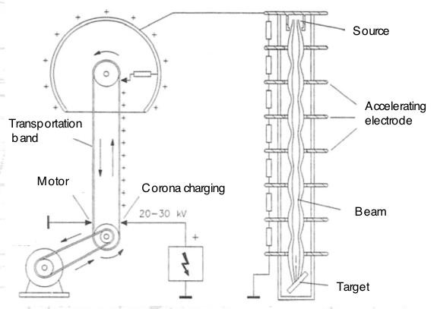
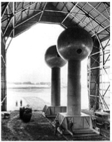
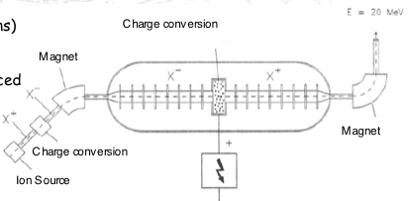
Van-de Graaff - 1930s
A standard electrostatic accelerator is a Van de Graaf
These devices are limited to about 30 MV by the voltage hold off across ceramic insulators used to generate the high voltages (dielectric breakdown).

Slide 4
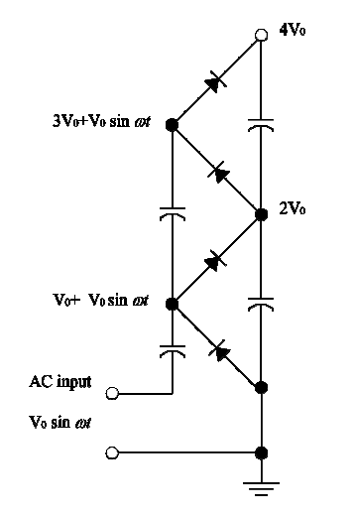
Cockcroft-Walton
Since we are in the Cockcroft Institute Walton Rooms no review of DC accelerators would be complete without mentioning the Cockcroft-Walton.
This is a simple voltage multiplier where a AC voltage charges capacitors in parallel so each stage provides a potential of 2V_{0.}
The first capacitor charges on an anti-clockwise current and on a clockwise loop the 2nd capacitor is charged by both the source and the discharging first capacitor
Adding more stages increases the voltage until the breakdown voltage is reached.

Slide 5
Cockcroft-Walton
Since we are in the Cockcroft Institute Walton Rooms no review of DC accelerators would be complete without mentioning the Cockcroft-Walton.
This is a simple voltage multiplier where a AC voltage charges capacitors in parallel so each stage provides a potential of 2V_{0.}
The first capacitor charges on an anti-clockwise current and on a clockwise loop the 2nd capacitor is charged by both the source and the discharging first capacitor
Adding more stages increases the voltage until the breakdown voltage is reached.

Slide 6
Cockcroft-Walton
Since we are in the Cockcroft Institute Walton Rooms no review of DC accelerators would be complete without mentioning the Cockcroft-Walton.
This is a simple voltage multiplier where a AC voltage charges capacitors in parallel so each stage provides a potential of 2V_{0.}
The first capacitor charges on an anti-clockwise current and on a clockwise loop the 2nd capacitor is charged by both the source and the discharging first capacitor
Adding more stages increases the voltage until the breakdown voltage is reached.

Slide 7
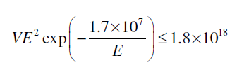
Kilpatrick Criterion
The breakdown (max) voltage for electrostatic accelerators is given by the Kilpatrick criterion. Above this voltage a plasma forms
DC accelerators are very simple but the achievable gradient is very low for voltages above 10 MeV (around 3 MV/m).
Higher gradients are possible for smaller gaps and hence lower voltages.
In addition it is difficult to generate the high voltage in the first place.

Slide 8
RF Acceleration
By switching the charge on the plates in phase with the particle motion we can cause the particles to always see an acceleration
- + - +
- + - +
You only need to hold off the voltage between two plates not the full accelerating voltage of the accelerator. Gradients of 20-100 MV/m are possible.

Slide 9
Early Linear Accelerators (Drift Tube)
Proposed by Ising (1925)
First built by Wideröe (1928)
Alvarez version (1955)
Replace static fields by time-varying fields by only exposing the bunch to the wave at certain selected points. Long drift tubes shield the electric field for at least half the RF cycle. The gaps increase length with distance.
More on these later.

Slide 10
Cavity Linacs
At high β it is more efficient to use cavities so that you do not need to waste space with long drift tubes.
If individually powered the phase can be individually set for each cavity.

Slide 11
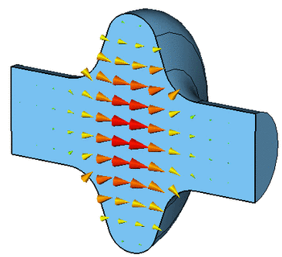
Transit time factor
An electron travelling close to the speed of light traverses through a cavity. During its transit it sees a time varying electric field. If we use the voltage as complex, the maximum possible energy gain is given by the magnitude,
Where T is the transit time factor given by
For a gap length, g.
For a given Voltage (=E₀L) it is clear that we get maximum energy gain for a small gap.

Slide 12
Multi-cell structures
It is simpler to drive multiple cavities (cells) with a single RF source. This requires the separation between cells to be adjusted to achieve the correct phasing of cavities to achieve maximum acceleration.
Once β~1 all cavities are a half wavelength apart,

Slide 13
β for protons and electrons
Where E₀ =938 MeV/c² for protons and E₀ = 511 keV/c² for electrons.
Electrons are fully relativistic at about 1 MeV

Slide 14
Synchronous particle
Imagine we have a series of gaps. The phase change between two gaps when the beam arrives is given by
Where ϕ_{a} is the phase advance, (the phase difference between adjacent coupled cavities)
Hence the distance between cells should be
In a linac we choose a synchronous phase φ_{s} and design the lengths so that the synchronous particle sees the desired phase (not always constant)

Slide 15
Low beta electron synchronism
For electron guns and industrial/medical linacs the electrons are injected at a beta less than one and are accelerated to beta=1 in the first cell.
However at X-band (9-13 GHz) the gaps are small hence the first few cells are non-relativistic, hence

Slide 16
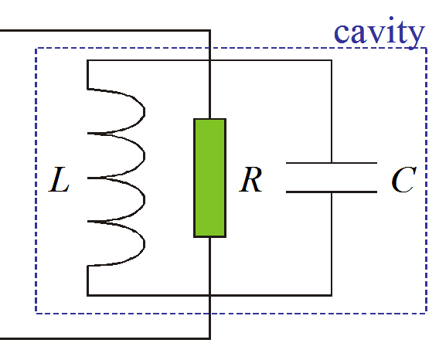
Equivalent circuits
To increase the frequency the inductance and capacitance has to be increased.
The stored energy is just the stored energy in the capacitor.
The voltage given by the equivalent circuit does not contain the transit time factor, T. So remember
V_{c}=V₀ T

Slide 17
Equivalent circuits
These simple circuit equations can now be used to calculate the cavity parameters such as Q and R/Q.
In fact equivalent circuits have been proven to accurately model couplers, cavity coupling, microphonics, beam loading and field amplitudes in multicell cavities.

Slide 18
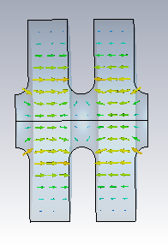

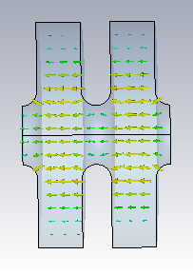
Cell-to-cell coupling
Kirchoff’s voltage law:
V_{c}= IZ = (I₁-I₂) Z = 0
k
I₁
I₂
k
I₁
I₂
V_{c}= IZ = (I₁+I₂) Z = 2I₁Z
If we move two resonators close to each other they become capacitively coupled. The potential drop across this capacitor is dependant on the phase difference between the resonators.
This results in a different resonant frequency.

Slide 19
T-network
A periodic array of impedances of the form below, is called a T-network
Kirchoffs law gives
and has the solution
Z_{n-1}
Z_{n}
Z_{n+1}
Y_{n-1}
Y_{n}
Y_{n+1}

Slide 20
Electric coupling
We can couple via an inductance (Y=1/ωL₂) or a capacitance (Y=ωC₂) depending on where we place our coupling slots. Lets start with capacitive
If we set
And insert into the T-network equation we obtain
Which gives

Slide 21
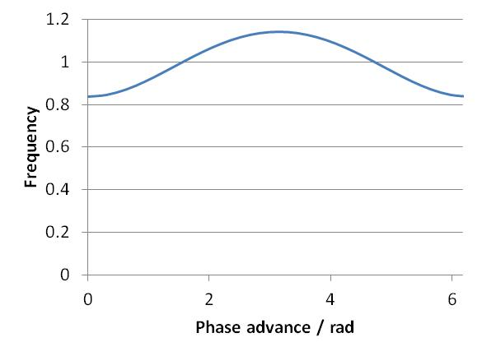
Electric coupling
If we set
We obtain for k<<1
Hence when k<<1, k can be found by

Slide 22
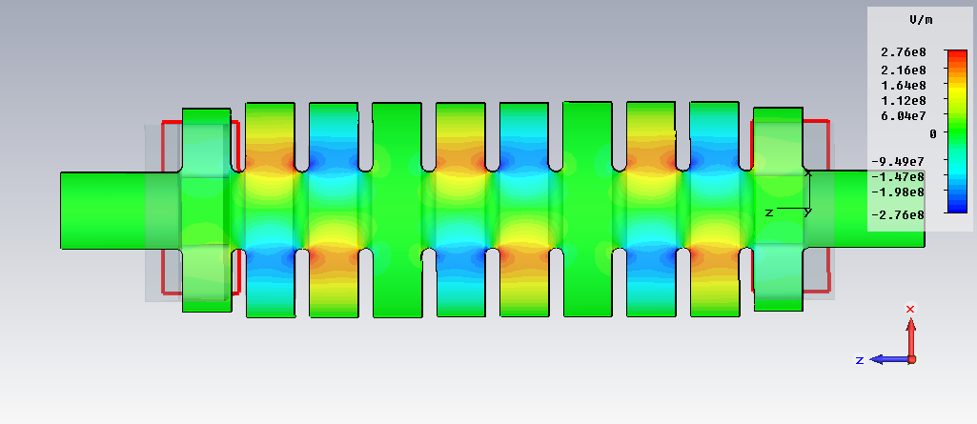
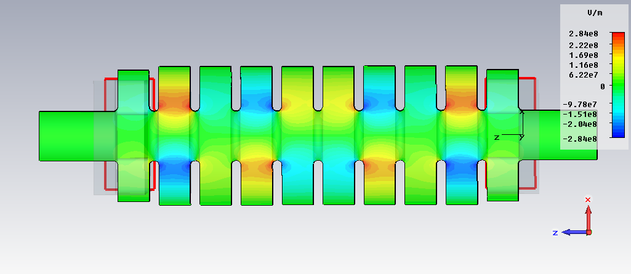
Phase advance
Phase advance is the phase difference between adjacent cells.
In standing wave cavities this means that all cells have different amplitudes (except in 0 or pi phase advances).
In the pi/2 mode every 2nd cell is empty.
Amplitude is given by
A=sin(nϕ_{a})cos(ωt)
where n is the cell number
pi/3 mode deflecting cavity
2pi/3 mode deflecting cavity

Slide 23
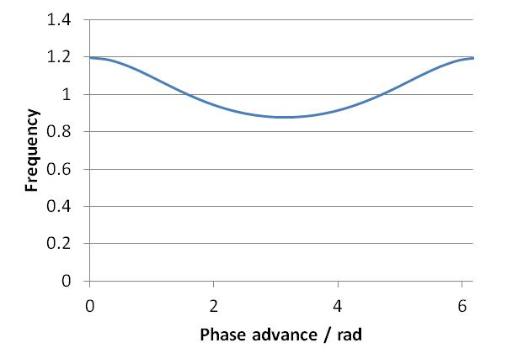
Magnetic coupling
If we follow the same procedure for an inductive coupling we obtain
where
Hence when k<<1,
k can again be found by

Slide 24
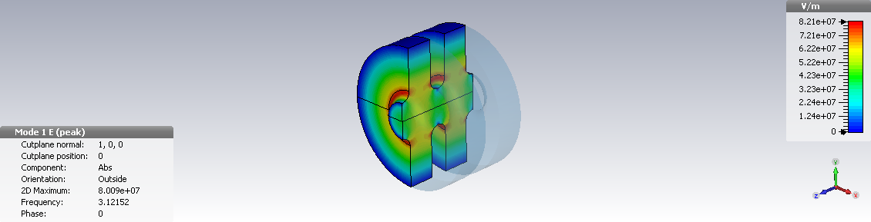
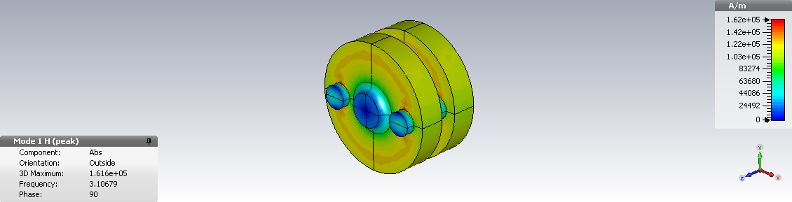
Coupling Cells
If we wish capacitive coupling we couple through the beam tubes. This needs a large aperture which often results in higher peak fields and a lower shunt impedance.
If we want magnetic coupling we need to cut coupling slots in the cavity walls near the peak magnetic field on the equator. This allows strong coupling without affecting the fields.

Slide 25
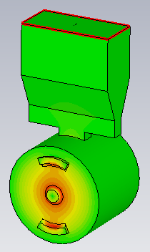
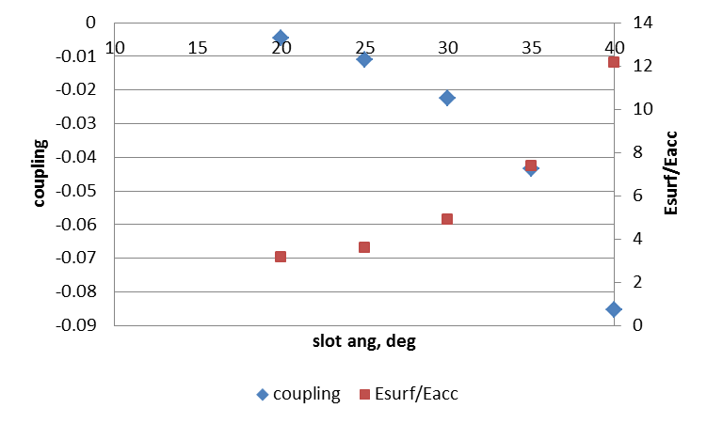
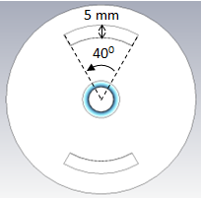
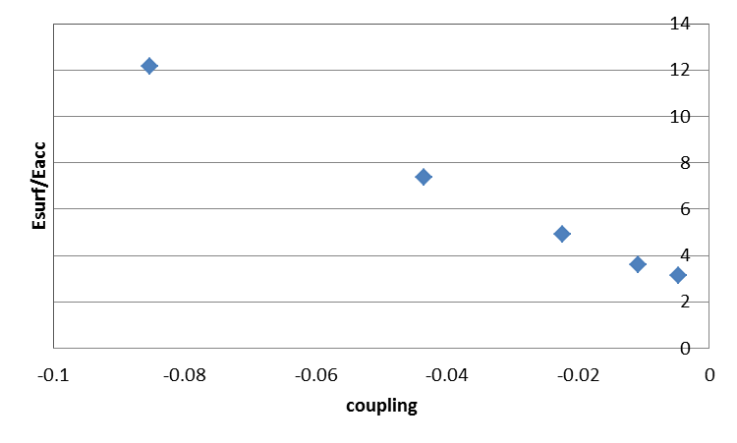
Slot coupling
Coupling=(fpi-f0)*2/(fpi+f0)
Each point is at 3 GHz
The electric field comes from coupling to the TE11 mode in the slot.
Sensitivity to manufacturing errors is proportional to the coupling

Slide 26
Three cell cavity example
We can set up Kirchoff’s law as a matrix and solve for the eigenvalues, x, which is a normalised current
We get three eigenmodes of the system
q=0,1 and 2 (ϕ_{a} = 0, π/2, π)

Slide 27
Coupled Harmonic Oscillator
Forms the same equations as a coupled harmonic oscillator.
Has as many modes as there are degrees of freedom, and all other patterns can be made by combining these modes (but they have different frequencies so they beat)
Each cell is a degree of freedom
http://www.falstad.com/coupled/
https://www.youtube.com/watch?v=YyOUJUOUvso

Slide 28
End of lecture 1

Slide 29
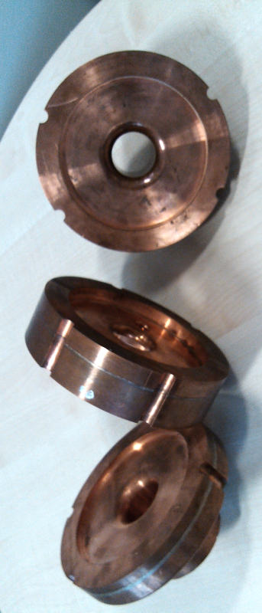
Manufacturing tolerances
Normal Uni machine shop 100 μm
Good machine shop in a Uni 50 μm
Precision manufacturing 15 μm
Diamond tipped lathes 5 μm
This is related to frequency errors by
Hence the proportional frequency error is proportional to frequency. This is the main limit on going to higher frequency linacs.

Slide 30
Perturbation theory
We can study the effects of frequency errors by applying perturbation theory. δω₁ is the frequency error of the mid cell and δω₀ is the error of the end cells
The effects are that a new eigenvector is created containing corrections from mixing from all the unperturbed eigenvectors.

Slide 31
Fields stability
It can be seen that the amplitude in the π mode varies as
While the π/2 mode varies as
It can be seen in both cases the perturbation is inversely proportional to k so strong coupling is desired.
Also that the π/2 mode is more stable than the π mode by a factor of (normally 10-100 times smaller error)

Slide 32
Power-flow phase shift
So far we have not included cavity losses or power coupling.
If we add a generator on one side and add resistance to the circuit we can investigate the effects. We implement these in the form Ae^{jφ}
The π mode has a phase droop and the π/2 mode has an amplitude droop
Mode | Amplitude | Phase
0 | 1
π/2 | 1/kQ
π | -1
Cell 2
Mode | Amplitude | Phase
0 | 1
π/2 | -1 +2/(kQ)² | 0
π | 1
Cell 3

Slide 33
π/2 mode stability
Why is a π/2 mode so stable
Each mode in the passband contributes a small error term to the excitation of any one particular mode when there are frequency errors. Having a larger mode spacing, by increasing k, reduces this error term.
For the π/2 mode the error terms for the higher frequency modes almost exactly cancels the contributions from the lower frequency modes.
For this reason most long standing wave structures work in the π/2 mode.

Slide 34
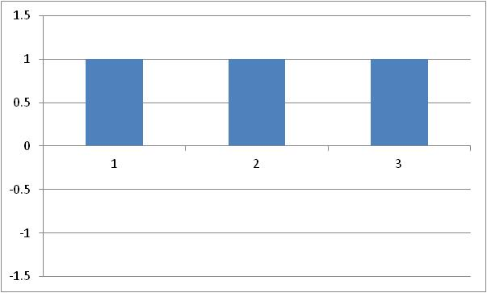
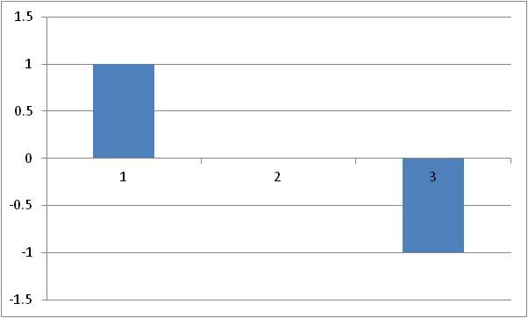
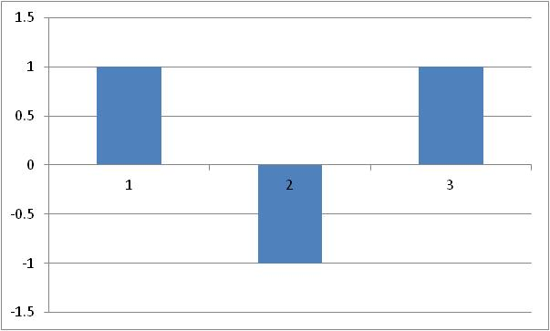
Field profiles
0 mode
π/2 mode
π mode
The 0 and π modes have field in every cell, hence every cell contributes to the acceleration.
However in order to meet synchronism conditions the 0 mode and the transit time factor a zero mode needs long drift tubes which makes lowers the average accelerating gradient as the beam is not accelerated in the drift tubes.
The π/2 mode has the middle cell empty hence only the two end cells will contribute to acceleration
For these reasons the π mode gives the highest accelerating gradient.

Slide 35
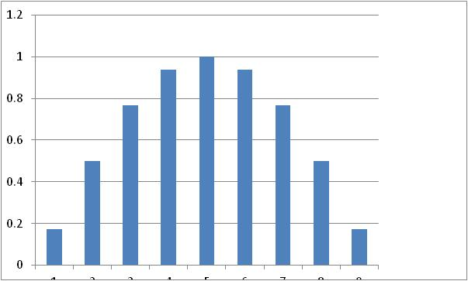
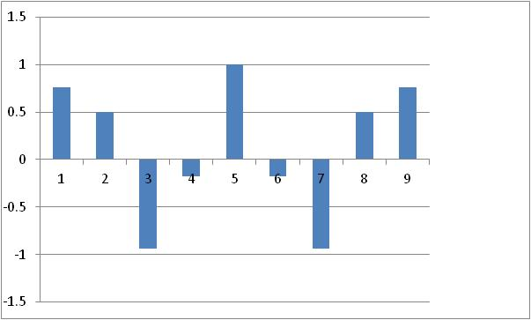
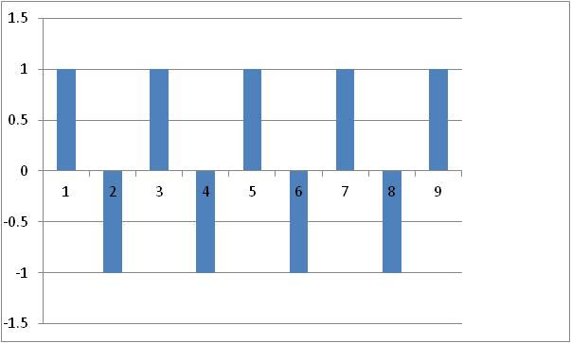
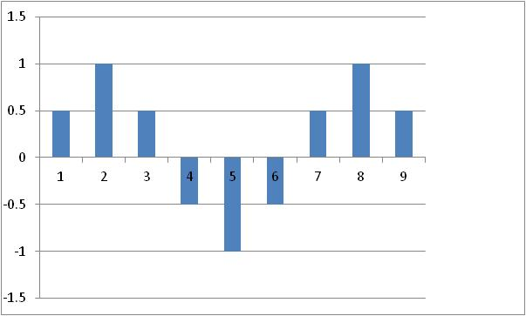
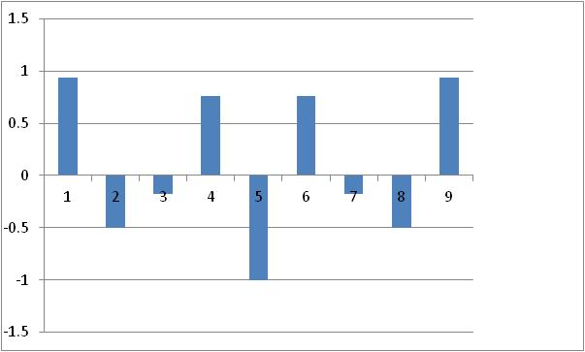
Longer structures
If we have N cells in a cavity we get N eigenmodes (q=1-N). If we adjust the end capacitance to give field flatness. The frequencies and amplitudes are given by
9 cell cavity with ω_{π/2}=1 and k=0.1
n=3
n=7
n=1
n=5
n=9

Slide 36
Mode frequency spacing
For a pulsed system the fourier transform of the RF pulse gives a bandwidth of the pulse. It is important that only a single mode is within that bandwidth to maintain good phase stabilisation.
The mode spacing and min pulse duration for a π mode is approximately
Also each mode has a bandwidth so the spacing must be at least
For CW systems we get microphonics which cause the frequency of the cavity to oscillate due to vibrations (eg due to vacuum pumps) so good spacing must also be conserved.

Slide 37
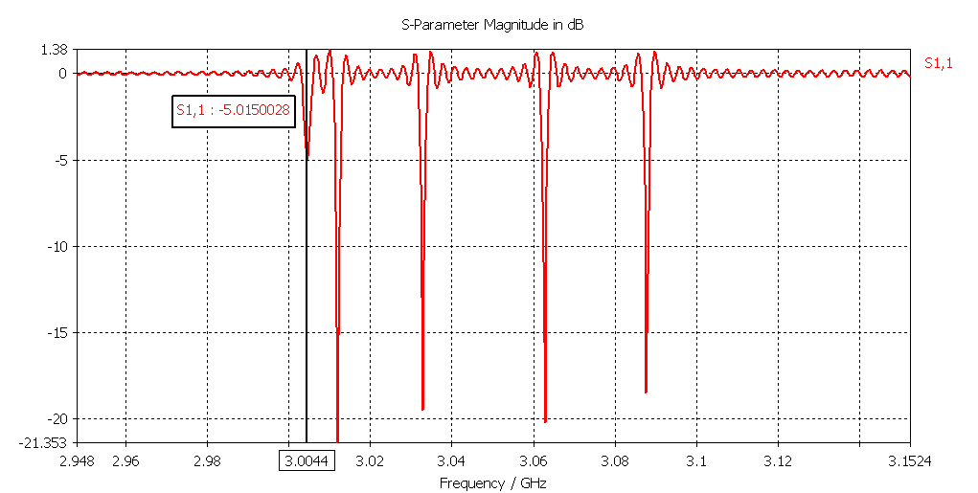
Mode frequency spacing
k is normally 1% to 10% so that k/N² is around 0.1%.
At S-band this leads to a minimum pulse length of ~100 ns for a 9 cell cavity.
Due to the Q factor the maximum number of cells is around 16.

Slide 38
π mode errors
For an N cell cavity in the pi mode the power-flow phase shift between the first and last cell is
This means k can be chosen to limit the phase shift.
The amplitude stability is given by
Where Δω is the frequency shift due to manufacturing errors. In this case we can use a lower k but our machining will cost more (ie HEP machines), or have a larger k and have looser tolerances (ie medical linacs)

Slide 39
Effect of cell errors on amplitude
Below is an example of the effect of end cell frequency errors in a pi mode structure fed from the central cell.
This leads to early onset of breakdown in the central cell limiting gradient.

Slide 40
π/2 mode structures
As we have seen π/2 modes are more tolerant to frequency errors (due to manufacturing tolerances) than π mode structures.
We can adjust the cell length to make the π/2 mode synchronous using
But the mode still has a low efficiency as every 2nd cell is unfilled
high shunt impedance
π-mode
high field stability
π/2-mode

Slide 41
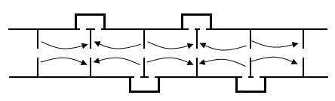
Side coupled or bi-periodic cavity
We can improve the shunt impedance by making the coupling and accelerating cells have different geometries for π/2 mode structures.
Side coupled structures move the coupling cells off axis
Bi-periodic cavities use very short coupling cells
high shunt impedance
π-mode
high field stability
π/2-mode
π/2-mode
Side coupled
both !
π/2-mode
bi-periodic
both !
Beam sees a π-mode→ high acceleration
RF sees a π/2-mode field→ highly stable
L

Slide 42
On-axis coupled infinitely periodic BPC
Structure
Dispersion relation
ω_{c}
ω_{c}
ω_{a}
ω_{a}
ω_{a}
k=coupling constant between acc and coup cells
ω_{a}=natural freq. of acc. cell
ω_{c}=natural freq. of coup. cell
ω_{m}= frequency of mode m
2N coupling cells
2N+1 accelarating cells
If we use a bi-periodic structre the benefits of the π/2 mode are only received if the frequency of both accelerating and coupling cells are the same.
If they are different we just get a weakly coupled π mode which is worse than a normal π mode
Dispersion diagram contains a stop band at π/2 of width δω=ω_{a}−ω_{c}

Slide 43
π/2 modes errors
For a cavity with 2n+1 cells with the coupler located in cell m the field amplitudes in the accelerating cells are given by
Where Δω is the frequency difference between the coupling and accelerating cells. The first term is the power-flow droop and the 2nd is the power-flow phase shift.
As the error is proportional to (m2-n2) it is often best to locate the coupler in the centre of the structure
And the field in the coupling cells are given by

Slide 44
Shunt Impedance
A useful definition is the shunt impedance,
This quantity is constant for a given cavity and gives the relationship between accelerating voltage and power lost as heat.
This quantity is useful for equivalent circuits as it relates the voltage in the circuit (cavity) to the power dissipated in the resistor (cavity walls).
Shunt Impedance is also important as it is related to the power induced in the mode by the beam (important for unwanted cavity modes)

Slide 45
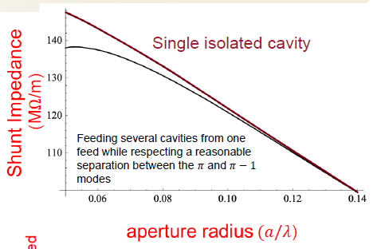
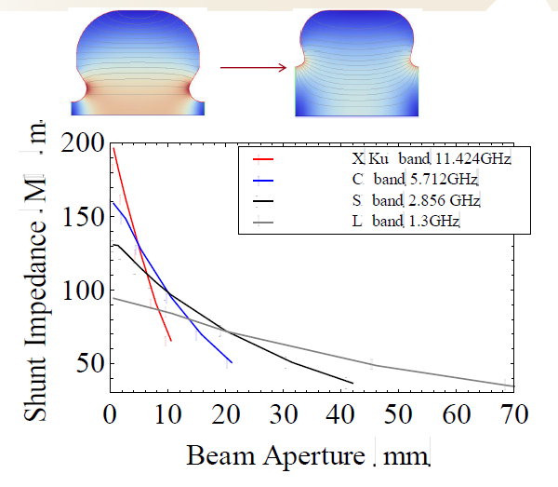
Cavity geometry
The shunt impedance is strongly dependant on aperture
Similarly larger apertures lead to higher peak fields.
Using thicker walls has a similar effect.
Higher frequencies need smaller apertures as well
Figures borrowed from Sami Tantawi

Slide 46
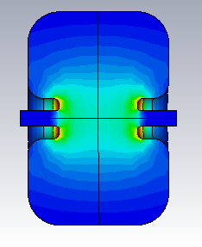
Nose-Cones
If we decrease the accelerating gap, while keeping the same voltage between the gap, the effective accelerating voltage increases due to the transit time factor.
However if we just use a small gap we get high magnetic fields on the walls which decreases R removing the benefit of increasing T.
Instead we can just decrease the gap near the beam by using nose-cones
As the gap is smaller the field strengths must increase for the same voltage, which is good where the beam is but bad elsewhere.
Applications where power loss is important use nose-cones but applications where gradient is important do not.
Electric field

Slide 47
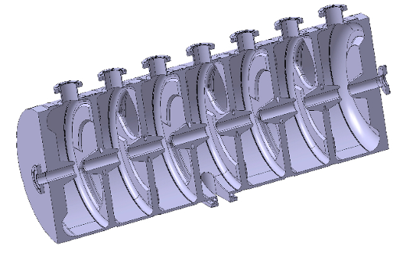
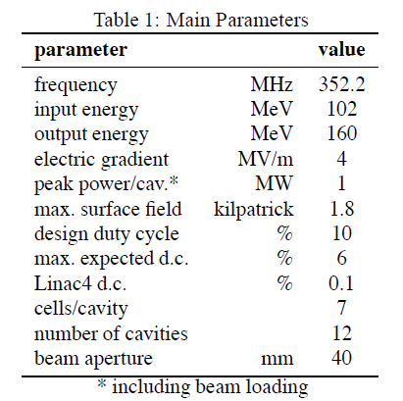
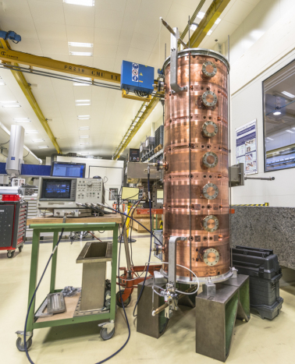
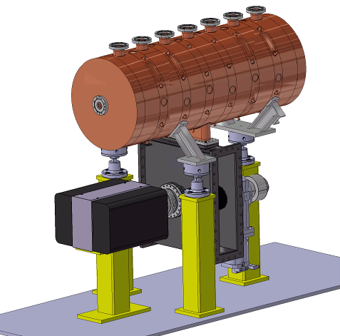
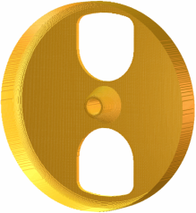
A 7-cell magnetically-coupled structure: the PIMS
PIMS = Pi-Mode Structure, will be used in Linac4 at CERN to accelerate protons from 100 to 160 MeV
This structure is composed of 7 accelerating cells,
magnetically coupled.
The cells in a cavity have the same length, but
they are longer from one cavity to the next, to
follow the increase in beam velocity.
RF input

Slide 48
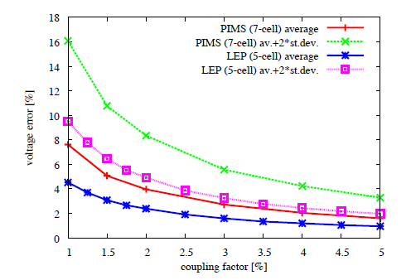
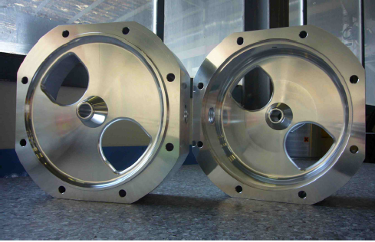
Example: Linac4 PIMS
Based on standard manufacturing errors of 25 kHz the voltage error as a function of coupling can be calculated.
For an error of 11% in shunt impedance the coupling factor was chosen to be 5%.
Other effects are expected to further reduce the shunt impedance such as surface roughness and the effect of the coupler

Slide 49
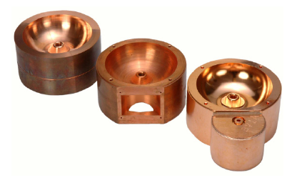
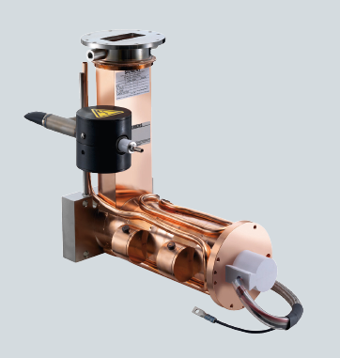
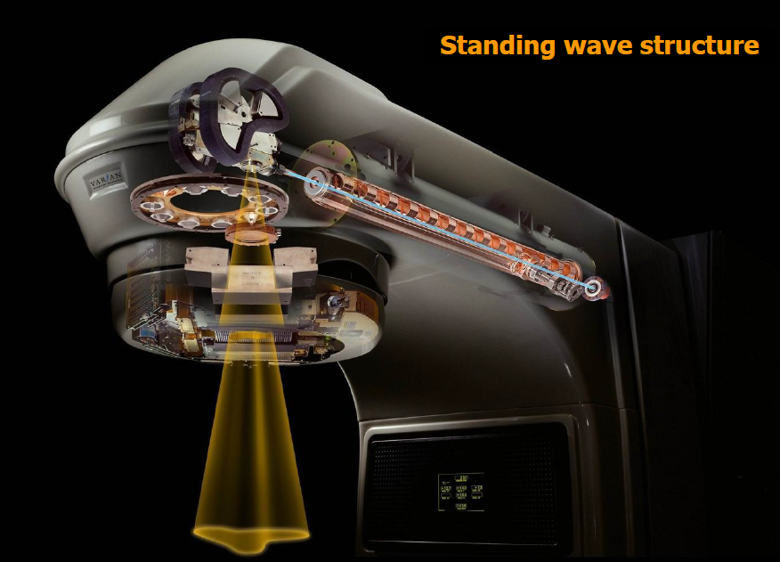
Example: Industrial & medical side-coupled linac
SAMEER structure
Siemens 6 MeV SILAC
Mass produced commercial cavities need to be manufactured cheaply
Ie side-coupled pi/2
Varian Clinac

Slide 50
SRF Linacs
In SRF linacs we have to be careful to minimise disruption to the bulk with welding. This means structures have to be simple.
The peak fields achievable are also much lower so peak fields are a concern (~100 mT, 50 MV/m).
This leads to only π modes structures with beampipe coupling being used.
Also the spread in maximum field is quite large and varies cell to cell so having more cells adds a statistical risk of lower gradients.

Slide 51
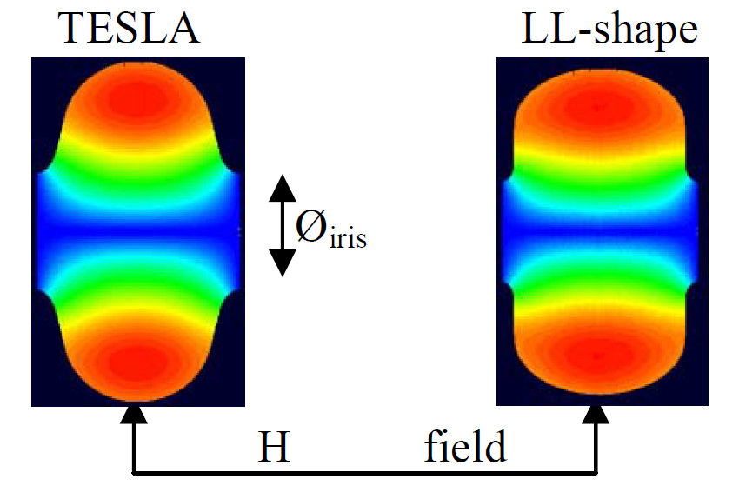
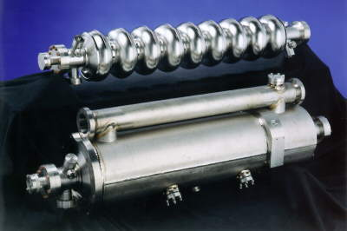
Example: TESLA cavities
Cavities need low surface fields, strong coupling and a large aperture for HOMs.
9 cells is about the maxiumum.
TESLA aims for a ratio of peak B field to peak E field of just over 2 so that it should be limited by field emission and quench at the same gradient.
Modern cleaning now makes this happen at a ratio of about 1.5.

Slide 52
Cryogenic systems
All refrigerators have a technical efficiency, η_{T} of 20%-30%
The Carnot efficiency is given by
The dynamic heat load, P_{c}, is the rf power dissipated in the cavity walls.
A static heat load, P_{s}, adds an additional heating
Liquid helium transfer lines require 1W per metre, so total loss is length L (More efficient lines can be used)
It is standard to fill to an overcapacity, O
Total Power for N cryostats= O N (P_{c} +P_{s} +L) / (η_{T} η_{c} )

Slide 53
Gradient vs Cost
The power required for both SRF and NCRF increases as E². This power must be both supplied by klystrons or Tetrodes and cooled.
The length of a linac for a given energy decreases as E⁻¹. One of the largest cost of an accelerator is the tunnel or buildings.
Optimum gradient is somewhere inbetween 20-100 MV/m depending on rep rate, beam current, frequency energy and many other factors.

