Slide 1
Electron Sources and Injectors. Lecture VI
Dr. Boris Militsyn
STFC Accelerator Science and Technology Centre (ASTeC)
Notes:
To add overall slide about electron source applicability

Slide 2
Outline
Beam dynamic simulation in the electron injector codes
ASTRA
GPT
OPAL
Modern electron injectors for particle accelerators
AmPS
Diamond
CLARA
PERLE

Slide 3
Beam dynamic simulation in the injectors
Most of the codes are based on particle in cell (PiC approach)
Ability of simulation beam dynamics in both emittance dominated and space charge dominated regime
General reequipments for injector beam dynamic simulations
Generation of particles with different 6D distribution
Accurate simulation of beam emission
Accurate beam dynamic simulation in various range of beam energy with variable time step
Taking in to account surface physics effects in photoemission

Slide 4
ASTRA - free
This 2D with 3D extensions code has been developed and maintained at DESY under lead of Klaus Floettmann
Avalable on Windows and Linux
Code is written in FORTRAN and uses namelist input format
Simulation consists of 3 Stages
Particle generation
Particle tracking
Postprocessing
Fast and flexible code with good tunability
Beam emission – phenomenological with given initial 6D distribution
Has many models of distributions corresponding to different types of cathodes including photocathodes
Cons
Command line interface
3D option is limited

Slide 5
General Partcle Tracker (GPT) - commercial
Honest and very flexible 3D open source code allowing extensions. C-type interface with advanced Windows GUI. Recently updated for multiprocessor operation
Written originally in C and recently ported to C++
Available on Windows and Linux (CLI)
Phenomenological beam emission description with limited number of distributions. Although import of distributions, generated by another codes, is available
Adaptive time step control
Cons
Requires special format of external field map. Converter from many popular codes is avalalble
Slow

Slide 6
OPAL - free
Modern 3D originally multiprocessor Linux code with MAD-like interface developed by collaborators mostly from PSI, HZB and other organisations
Available for Linux and MacOS
Phenomenological injection simulation. Different type of models and distributions. Some is compatible with ASTRA
Actual physical emission model
Cons
Linux CLI only
Need field maps in T7 format
H5hut output for H5root which is not supported anymore. Replaced by a Python package

Slide 7
Goals and objectives of the electron injector
What do we call injector?
Generation, processing and transport of the electron beam with the goal to achieve required parameters at the entrance of main accelerator
Electron generation
Temporal modulation of the electron beam
Spin manipulation of polarised electrons
Longitudinal bunch compression/bunching
Preliminary accelerator/booster
Additional bunch compression

Slide 8
Injector of the Amsterdam Pulse Stretcher AmPS I
F.B. Kroes et al., "Improvement of the 400 kV LINAC electron source of AmPS", in Proc. of EPAC1992, pp. 1032-1034

Slide 9
Injector of the Amsterdam Pulse Stretcher AmPS II
Electron source – 400 kV triode thermionic gun with a control electrode pulse modulated by 6 kV DC pulses
Microstructure is defined by 476 MHz chopper-collimator scheme, which skips 120° bunch length to the buncher
Two stage bunching scheme
Subharmonic buncher – 476 MHz single cell
Buncher/Booster – 2.86 GHz 38 cell accelerates the bunches to 6 MeV/c

Slide 10
Injector of DIAMOND Light Source I
C. Christou et al, “The Pre-Injector LINAC for the DIAMOND Light Source”, Proc. LINAC2004, Lübeck, Germany, pp. 84-86

Slide 11
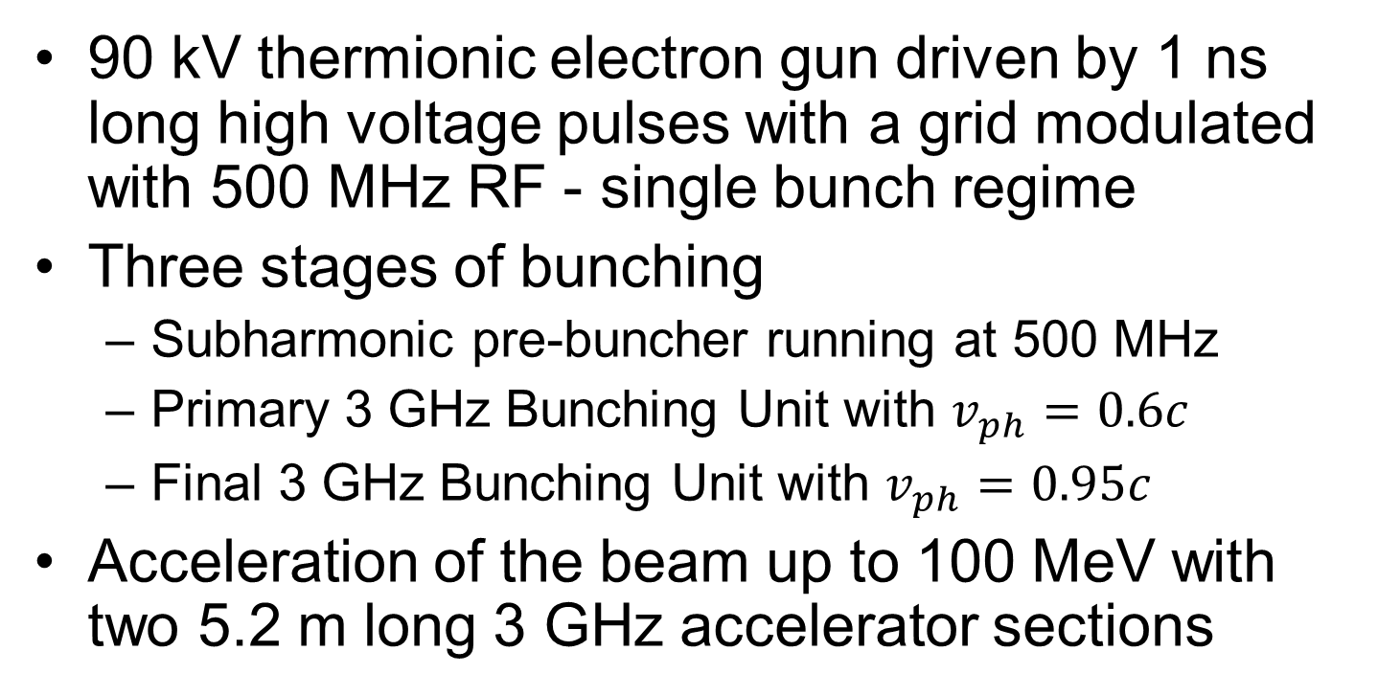
Injector of DIAMOND Light Source II
90 kV thermionic electron gun driven by 1 ns long high voltage pulses with a grid modulated with 500 MHz RF - single bunch regime
Three stages of bunching
Subharmonic pre-buncher running at 500 MHz
Primary 3 GHz Bunching Unit with $v_{ph}=0.6c$
Final 3 GHz Bunching Unit with $v_{ph}=0.95c$
Acceleration of the beam up to 100 MeV with two 5.2 m long 3 GHz accelerator sections

Slide 12
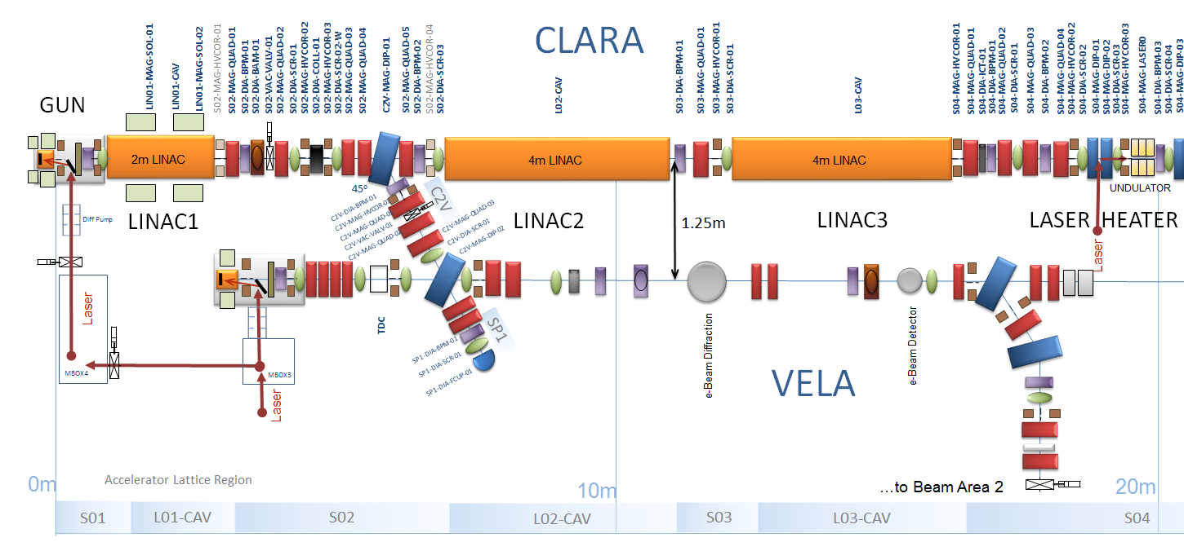
Electron injector of the accelerator facility CLARA I

Slide 13
Electron injector of the accelerator facility CLARA II
Ultra High brightness High Repetition Rate Photocathode gun
1.5 cell 3 GHz standing wave RF structure
Operates with interchangeable metal photocathode
Time structure and charge of the beam are defined by time structure and energy of the laser pulse
The gun deliver bunches with a charge of up to 250 pC, a momentum of up to 4 MeV/c and a repetition rate of up to 400 Hz
Buncher/Booster
A 2 meter long 3 GHz 2π/3 travelling wave accelerating structure operating at a repetition rate of 400 Hz and accelerating and/or compressing of the beam up to momentum of 40 MeV/c

Slide 14
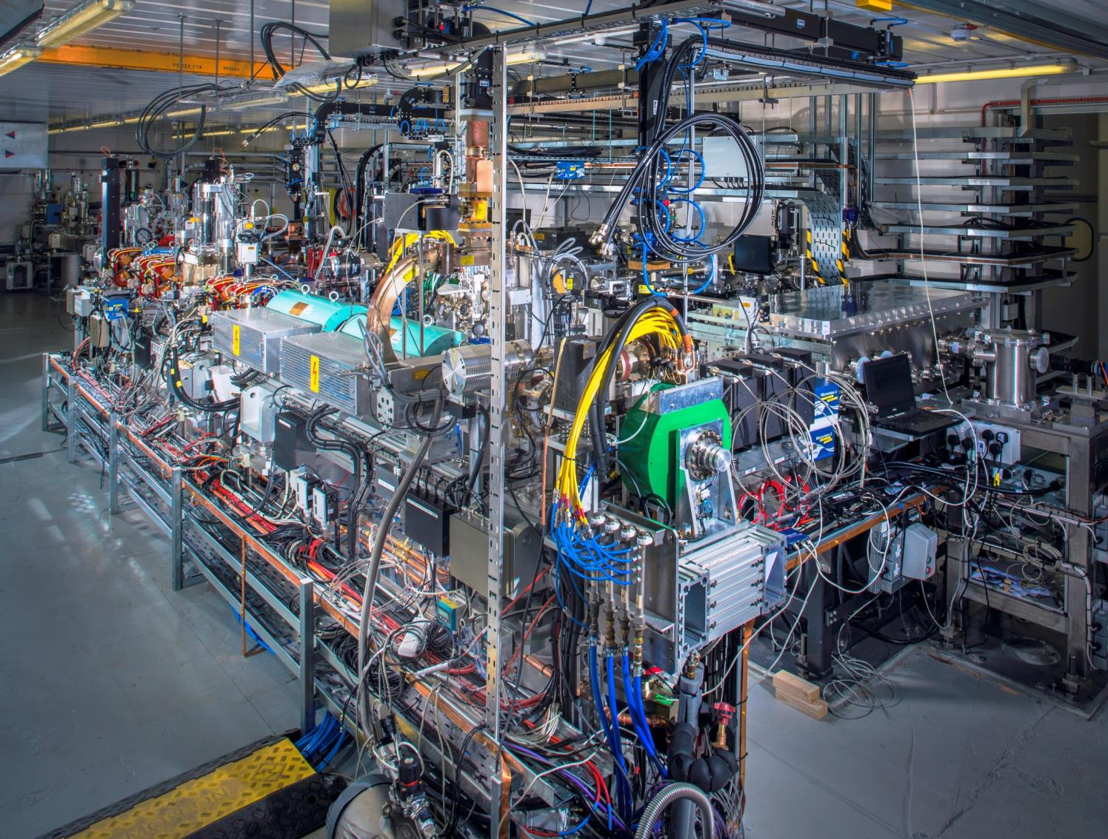
Electron injector of the accelerator facility CLARA III
D. Angal-Kalinin et al.,“Design, specifications, and first beam measurements of the compact linear accelerator for research and applications front end”, PR AB, 23, 044801 (2020)

Slide 15
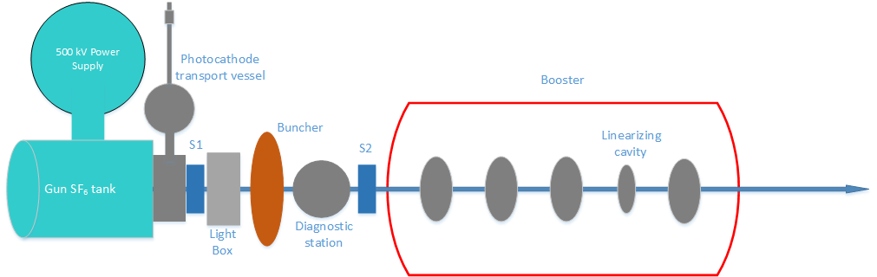
Electron injector of the LHeC prototype PERLE I
B. Hounsell et al., “Optimization of the PERLE injector”, in Proc. of ERL’2019, Berlin, Germany,16-20 September 2019

Slide 16
Electron injector of the LHeC prototype PERLE II
DC photoemission electron gun
The gun operates with Sb-based photocathode and should deliver 500 pC bunches with an energy of 350 keV following with a repetition rate of 40 MHz
The gun is equipped with a photocathode interchange system which allows for quick replacement of the photocathodes
A bunching and focusing section
A pair of solenoids transport the beam to the entrance of the booster
A 401 MHz normal conducting subharmonic buncher cavity
A Superconducting RF booster
Booster consists of 5 single cell 802 MHz cavities accelerating the beam up to 7 MeV/c
Amplitude and phase of each cavity is controlled individually for fine tuning longitudinal phase space of the bunches
For polarised operation spin manipulation section will also need to be added

Slide 17
Literature
C. Christou et al., “The Pre-Injector LINAC for the DIAMOND Light Source”, in Proc. LINAC2004, Lübeck, Germany, pp. 84-86
F.B. Kroes et al., "Improvement of the 400 kV LINAC electron source of AmPS", in Proc. of EPAC1992, pp. 1032-1034
D. Angal-Kalinin et al.,“Design, specifications, and first beam measurements of the compact linear accelerator for research and applications front end”, PR AB, 23, 044801 (2020)
B. Hounsell et al., “Optimization of the PERLE injector”, in Proc. of ERL’2019, Berlin, Germany,16-20 September 2019

