Slide 1
Electron Sources and Injectors.
Lecture V
Dr. Boris Militsyn
STFC Accelerator Science and Technology Centre (ASTeC)
Notes:
To add overall slide about electron source applicability

Slide 2
Beam Dynamics in the Electron sources
Beam dynamics in DC guns
  Acceleration
  Beam focusing
  Emission in the magnetic field
  Space charge effects
  Emittance compensation
Beam dynamics in the RF guns
  Transverse beam dynamics

Slide 3



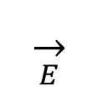
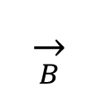
Typical thermionic DC gun based electron injector
Booster
accelerator
Anode
$$−U$$
$$d$$
$$\overset{→}{B}$$
$$E=\frac{−U}{d}$$
$$\overset{→}{E}$$
Cathode
0
Focusing
solenoid
Buncher
Chopper-
collimator

Slide 4
Photocthode DC gun based electron injector
Booster
accelerator
Anode
$$−U$$
$$d$$
$$\overset{→}{B}$$
$$E=\frac{−U}{d}$$
$$\overset{→}{E}$$
Cathode
0
Focusing
solenoid
Buncher

Slide 5
Photocathode RF gun based electron injector
Booster
accelerator
$$d$$
$$\overset{→}{B}$$
Cathode
$$\overset{→}{E}$$
RF cavity
Focusing
solenoid

Slide 6
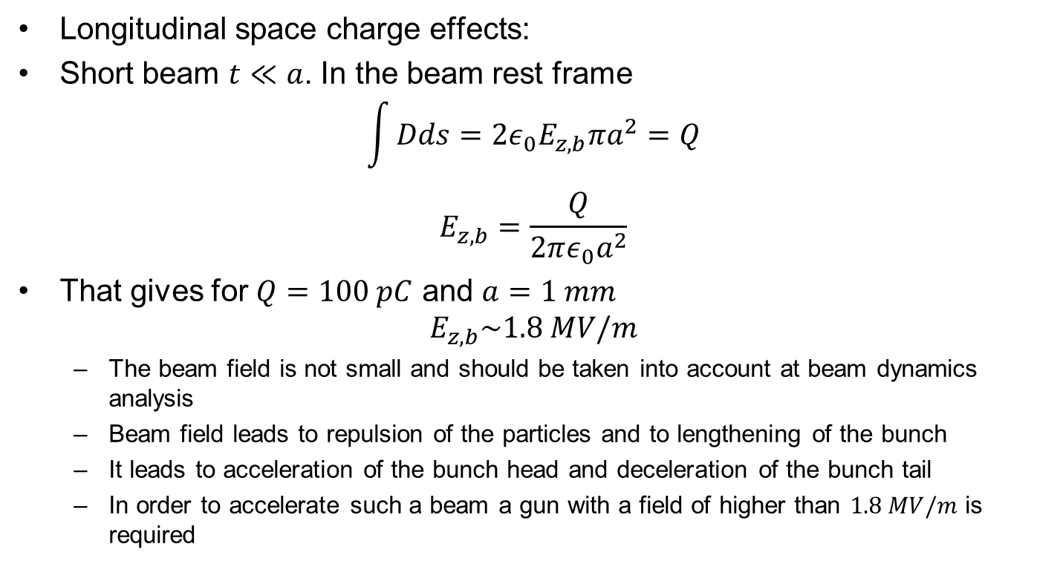


Space charge effects. Longitudinal effects I
Longitudinal space charge effects:
Short beam $t≪a$. In the beam rest frame
$$\int{Dds={2ε}_{0}E_{z,b}πa^{2}=Q}$$
$$E_{z,b}=\frac{Q}{2πε_{0}a^{2}}$$
That gives for $Q=100 pC$ and $a=1 mm$
$E_{z,b}\sim 1.8 MV/m$
  The beam field is not small and should be taken into account at beam dynamics analysis
  Beam field leads to repulsion of the particles and to lengthening of the bunch
  It leads to acceleration of the bunch head and deceleration of the bunch tail
  In order to accelerate such a beam a gun with a field of higher than $1.8 MV/m$ is required
$$2a$$
$$2t$$

Slide 7
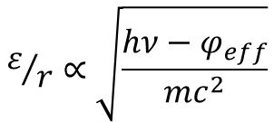


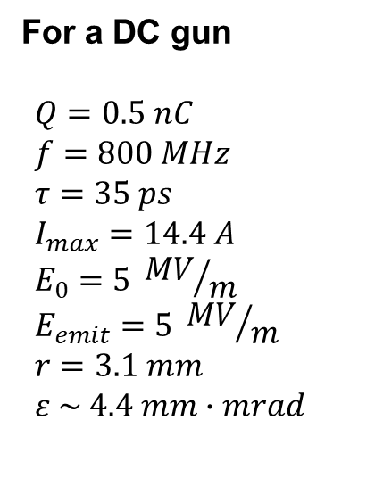
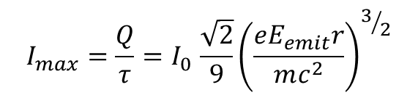
“Cigar” emission
For a DC gun
$$Q=0.5 nC \\ f=800 MHz \\ τ=35 ps \\ I_{max}=14.4 A \\ E_{0}=5 {MV}/m \\ E_{emit}=5 {MV}/m \\ r=3.1 mm \\ ε \sim 4.4 mm∙mrad$$
$$2r$$
$$τ={T_{RF}}/{36}$$
Photocathode
$$I_{max}=\frac{Q}{τ}{=I}_{0}\frac{\sqrt{2}}{9}{\left(\frac{eE_{emit}r}{mc^{2}}\right)}^{3/2}$$
$$ε/r∝\sqrt{\frac{hν−φ_{eff}}{mc^{2}}}$$
          * - D. Filippetto et al., Phys. Rev. ST Accel. Beams 17, 024201 (2014)
Notes:
This formula does not take into account beam lengthening during propagation from cathode to the exit of the gun

Slide 8
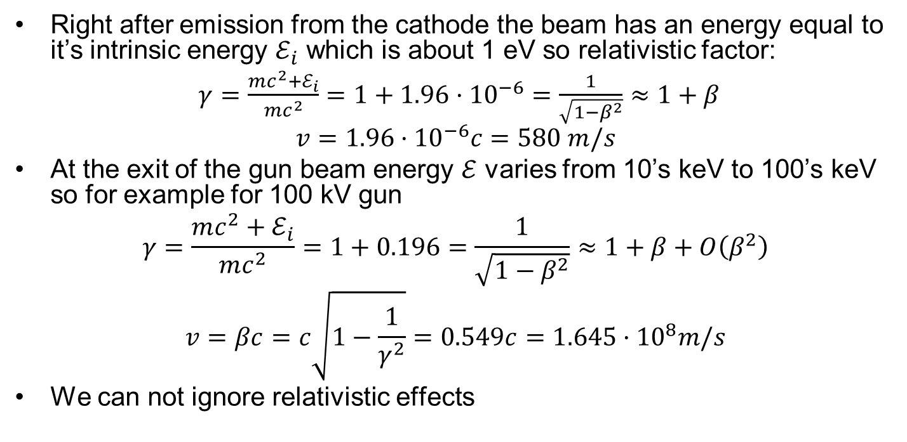
Acceleration in uniform DC electric field I
Right after emission from the cathode the beam has an energy equal to it’s intrinsic energy $ℰ_{i}$ which is about 1 eV so relativistic factor:
$γ=\frac{mc^{2}+ℰ_{i}}{mc^{2}}=1+1.96·{10}^{−6}=\frac{1}{\sqrt{1−β^{2}}}≈1+β$
$$v=1.96·{10}^{−6}c=580 m/s$$
At the exit of the gun beam energy $ℰ$ varies from 10’s keV to 100’s keV so for example for 100 kV gun
$$γ=\frac{mc^{2}+ℰ_{i}}{mc^{2}}=1+0.196=\frac{1}{\sqrt{1−β^{2}}}≈1+β+O\left(β^{2}\right)$$
$$v=βc=c\sqrt{1−\frac{1}{γ^{2}}}=0.549c=1.645·{10}^{8}m/s$$
We can not ignore relativistic effects

Slide 9
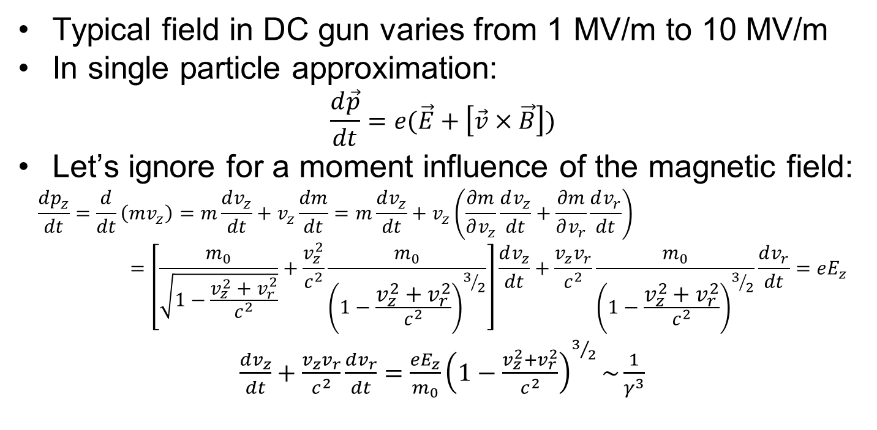
Acceleration in uniform DC electric field II. Longitudinal motion
Typical field in DC gun varies from 1 MV/m to 10 MV/m
In single particle approximation:
$$\frac{d\vec{p}}{dt}=e(\vec{E}+\left[\vec{v}×\vec{B}\right])$$
Let’s ignore for a moment influence of the magnetic field:
$$\frac{dp_{z}}{dt}=\frac{d}{dt}\left(mv_{z}\right)=m\frac{dv_{z}}{dt}+v_{z}\frac{dm}{dt}=m\frac{dv_{z}}{dt}+v_{z}\left(\frac{∂m}{∂v_{z}}\frac{dv_{z}}{dt}+\frac{∂m}{∂v_{r}}\frac{dv_{r}}{dt}\right)=\left[\frac{m_{0}}{\sqrt{1−\frac{v_{z}^{2}+v_{r}^{2}}{c^{2}}}}+\frac{v_{z}^{2}}{c^{2}}\frac{m_{0}}{{\left(1−\frac{v_{z}^{2}+v_{r}^{2}}{c^{2}}\right)}^{3/2}}\right]\frac{dv_{z}}{dt}+\frac{{v_{z}v}_{r}}{c^{2}}\frac{m_{0}}{{\left(1−\frac{v_{z}^{2}+v_{r}^{2}}{c^{2}}\right)}^{3/2}}\frac{dv_{r}}{dt}=eE_{z}$$
$\frac{dv_{z}}{dt}+\frac{v_{z}v_{r}}{c^{2}}\frac{dv_{r}}{dt}=$ $\frac{eE_{z}}{m_{0}}{\left(1−\frac{v_{z}^{2}+v_{r}^{2}}{c^{2}}\right)}^{3/2}\sim \frac{1}{γ^{3}}$

Slide 10
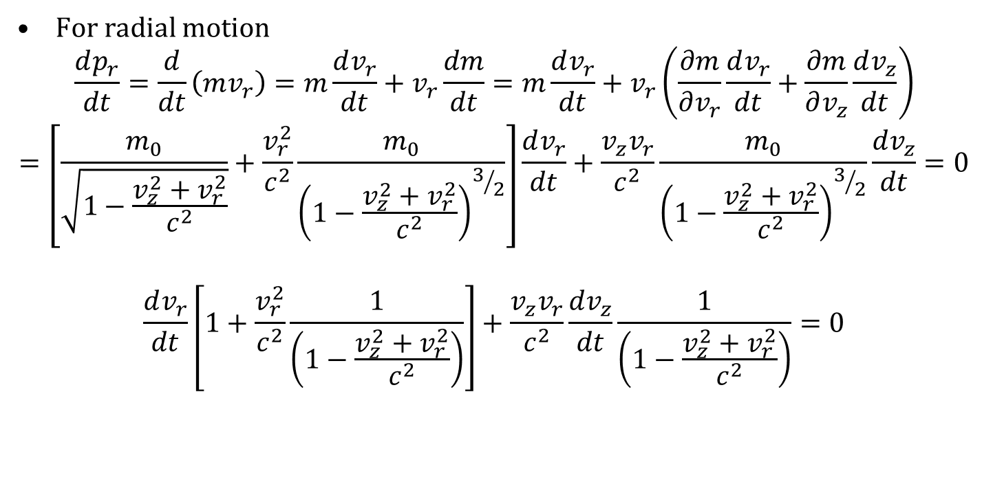
Acceleration in uniform DC electric field III. Transverse motion
For radial motion
$$\frac{dp_{r}}{dt}=\frac{d}{dt}\left(mv_{r}\right)=m\frac{dv_{r}}{dt}+v_{r}\frac{dm}{dt}=m\frac{dv_{r}}{dt}+v_{r}\left(\frac{∂m}{∂v_{r}}\frac{dv_{r}}{dt}+\frac{∂m}{∂v_{z}}\frac{dv_{z}}{dt}\right)=\left[\frac{m_{0}}{\sqrt{1−\frac{v_{z}^{2}+v_{r}^{2}}{c^{2}}}}+\frac{v_{r}^{2}}{c^{2}}\frac{m_{0}}{{\left(1−\frac{v_{z}^{2}+v_{r}^{2}}{c^{2}}\right)}^{3/2}}\right]\frac{dv_{r}}{dt}+\frac{{v_{z}v}_{r}}{c^{2}}\frac{m_{0}}{{\left(1−\frac{v_{z}^{2}+v_{r}^{2}}{c^{2}}\right)}^{3/2}}\frac{dv_{z}}{dt}=0$$
$$\frac{dv_{r}}{dt}\left[1+\frac{v_{r}^{2}}{c^{2}}\frac{1}{\left(1−\frac{v_{z}^{2}+v_{r}^{2}}{c^{2}}\right)}\right]+\frac{v_{z}v_{r}}{c^{2}}\frac{dv_{z}}{dt}\frac{1}{\left(1−\frac{v_{z}^{2}+v_{r}^{2}}{c^{2}}\right)}=0$$

Slide 11
Acceleration in a 350 kV DC gun as calculated with GPT
Longitudinal electric field
Transverse electron velocity
Total beam energy
Longitudinal electron velocity

Slide 12
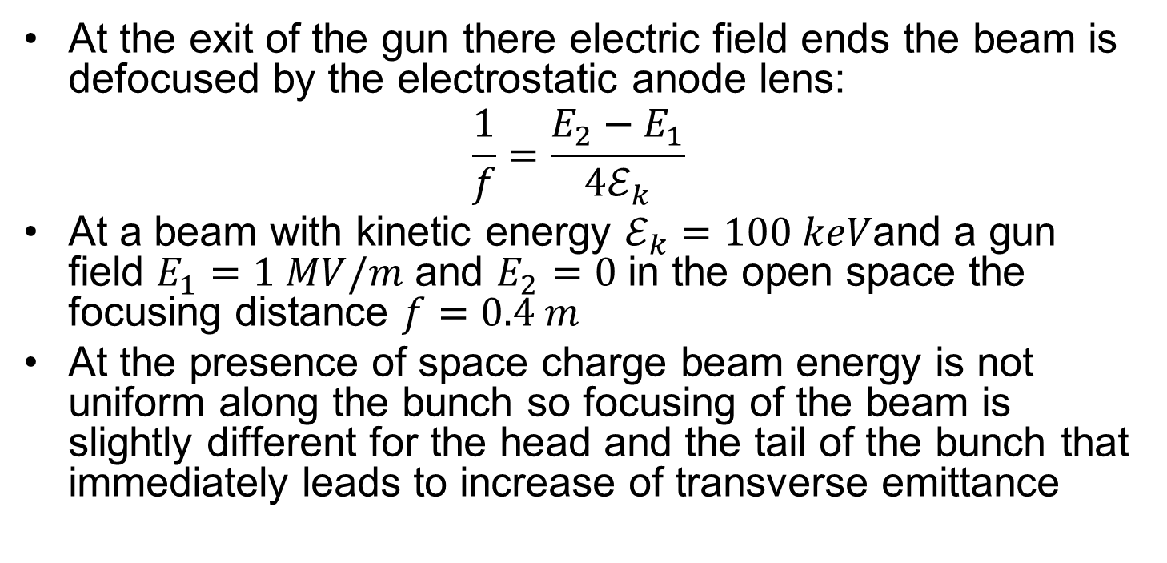
Acceleration in a DC gun. Beam defocusing.
At the exit of the gun there electric field ends the beam is defocused by the electrostatic anode lens:
$$\frac{1}{f}=\frac{E_{2}−E_{1}}{4ℰ_{k}}$$
At a beam with kinetic energy $ℰ_{k}=100 keV$and a gun field $E_{1}=1 MV/m$ and $E_{2}=0$ in the open space the focusing distance $f=0.4 m$
At the presence of space charge beam energy is not uniform along the bunch so focusing of the beam is slightly different for the head and the tail of the bunch that immediately leads to increase of transverse emittance

Slide 13
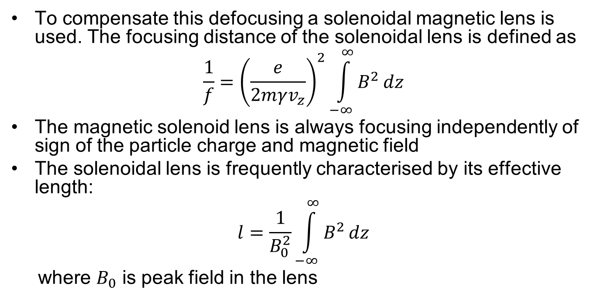
Acceleration in a DC gun. Beam focusing I
To compensate this defocusing a solenoidal magnetic lens is used. The focusing distance of the solenoidal lens is defined as
$$\frac{1}{f}={\left(\frac{e}{2mγv_{z}}\right)}^{2}\int_{−∞}^{∞}{B^{2}}dz$$
The magnetic solenoid lens is always focusing independently of sign of the particle charge and magnetic field
The solenoidal lens is frequently characterised by its effective length:
$$l=\frac{1}{B_{0}^{2}}\int_{−∞}^{∞}{B^{2}}dz$$
where $B_{0}$ is peak field in the lens

Slide 14
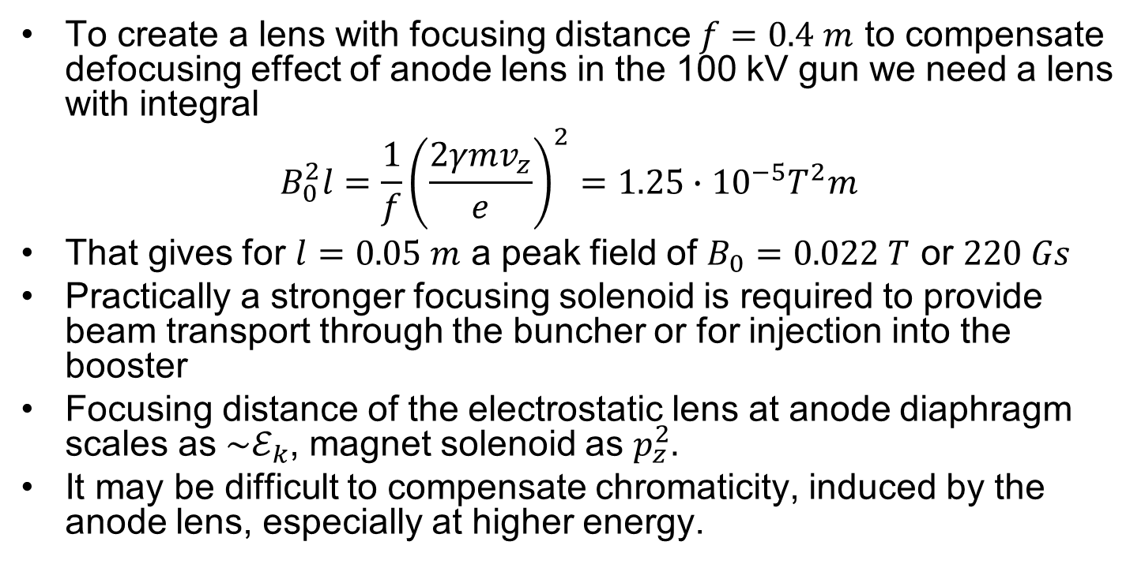
Acceleration in a DC gun. Beam focusing II
To create a lens with focusing distance $f=0.4 m$ to compensate defocusing effect of anode lens in the 100 kV gun we need a lens with integral
$$B_{0}^{2}l=\frac{1}{f}{\left(\frac{2γmv_{z}}{e}\right)}^{2}=1.25∙{10}^{−5}T^{2}m$$
That gives for $l=0.05 m$ a peak field of $B_{0}=0.022 T$ or $220 Gs$
Practically a stronger focusing solenoid is required to provide beam transport through the buncher or for injection into the booster
Focusing distance of the electrostatic lens at anode diaphragm scales as${\sim ℰ}_{k}$, magnet solenoid as $p_{z}^{2}.$
It may be difficult to compensate chromaticity, induced by the anode lens, especially at higher energy.

Slide 15
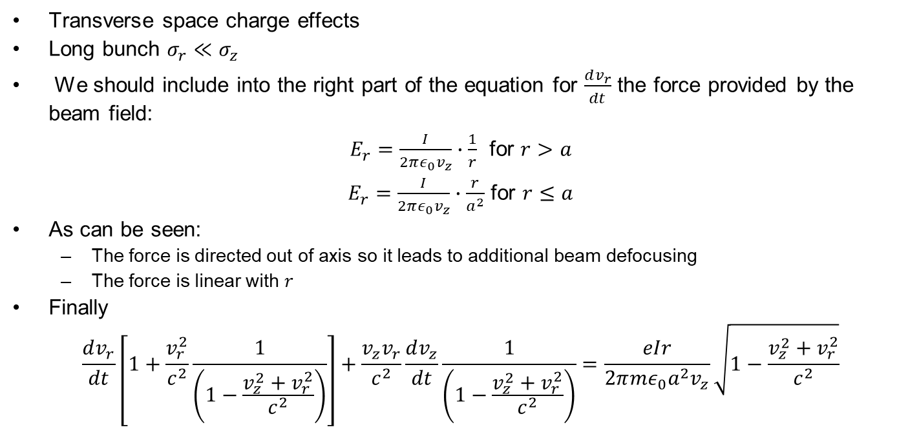
Acceleration in the DC gun. Space charge effects
Transverse space charge effects
Long bunch $σ_{r}≪σ_{z}$
We should include into the right part of the equation for $\frac{dv_{r}}{dt}$ the force provided by the beam field:
$E_{r}=\frac{I}{2πε_{0}v_{z}}∙\frac{1}{r}$ for $r>a$
$E_{r}=\frac{I}{2πε_{0}v_{z}}∙\frac{r}{a^{2}}$ for $r≤a$
As can be seen:
  The force is directed out of axis so it leads to additional beam defocusing
  The force is linear with $r$
Finally
$$\frac{dv_{r}}{dt}\left[1+\frac{v_{r}^{2}}{c^{2}}\frac{1}{\left(1−\frac{v_{z}^{2}+v_{r}^{2}}{c^{2}}\right)}\right]+\frac{v_{z}v_{r}}{c^{2}}\frac{dv_{z}}{dt}\frac{1}{\left(1−\frac{v_{z}^{2}+v_{r}^{2}}{c^{2}}\right)}=\frac{eIr}{2π{mε}_{0}a^{2}v_{z}}\sqrt{1−\frac{v_{z}^{2}+v_{r}^{2}}{c^{2}}}$$

Slide 16
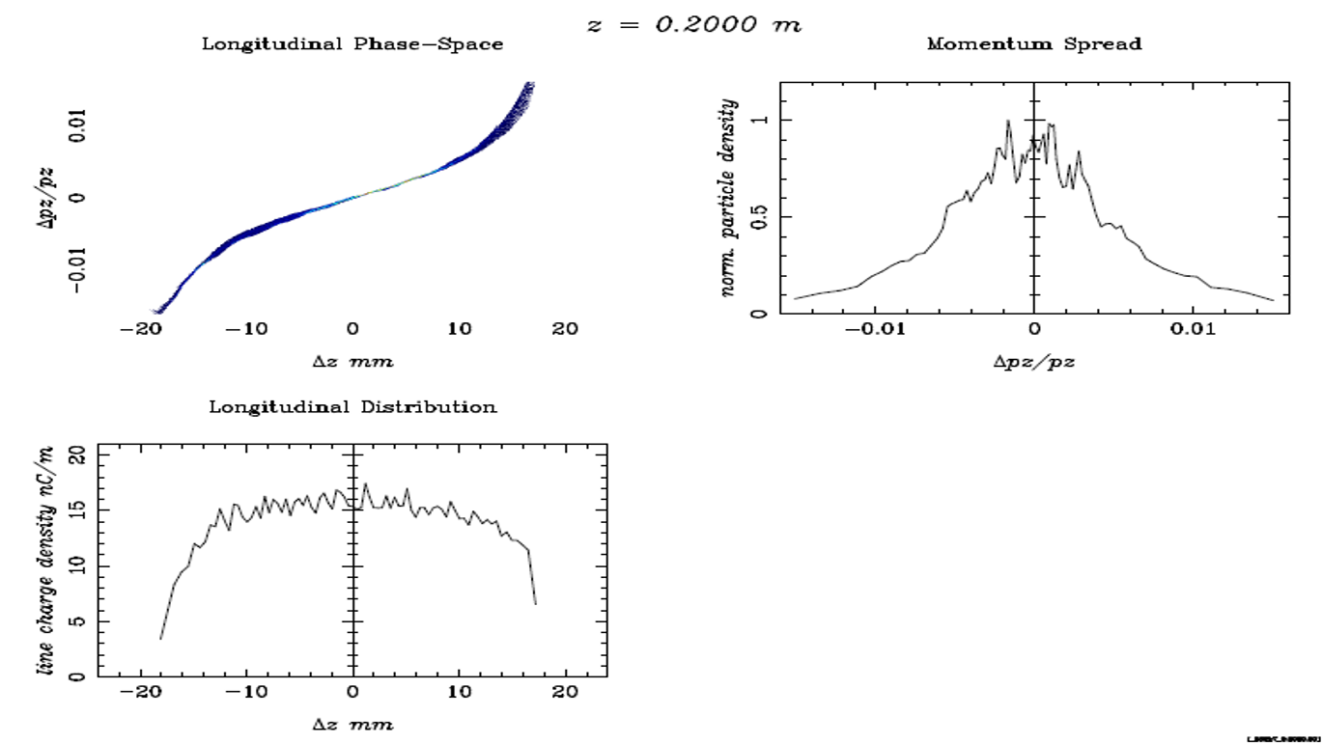
Space charge effects. Longitudinal effects II
Longitudinal phase space at the exit of the 350 kV DC photocathode gun as calculated with ASTRA code.
Bunch charge 500 pC

Slide 17
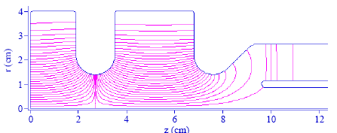
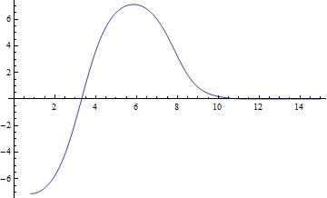
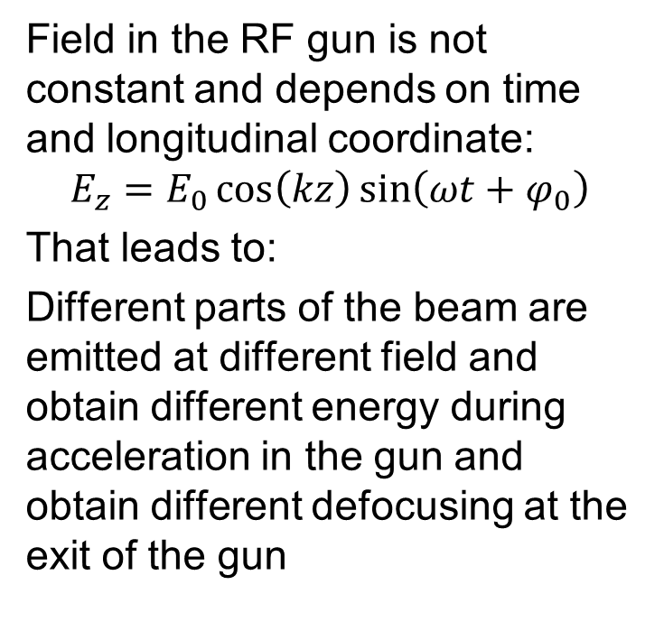
Acceleration in RF guns. Longitudinal dynamics
CLARA 1.5 cell RF gun
Field in the RF gun is not constant and depends on time and longitudinal coordinate:
$$E_{z}=E_{0}\cos\left(kz\right)\sin\left(ωt+φ_{0}\right)$$
That leads to:
Different parts of the beam are emitted at different field and obtain different energy during acceleration in the gun and obtain different defocusing at the exit of the gun

Slide 18
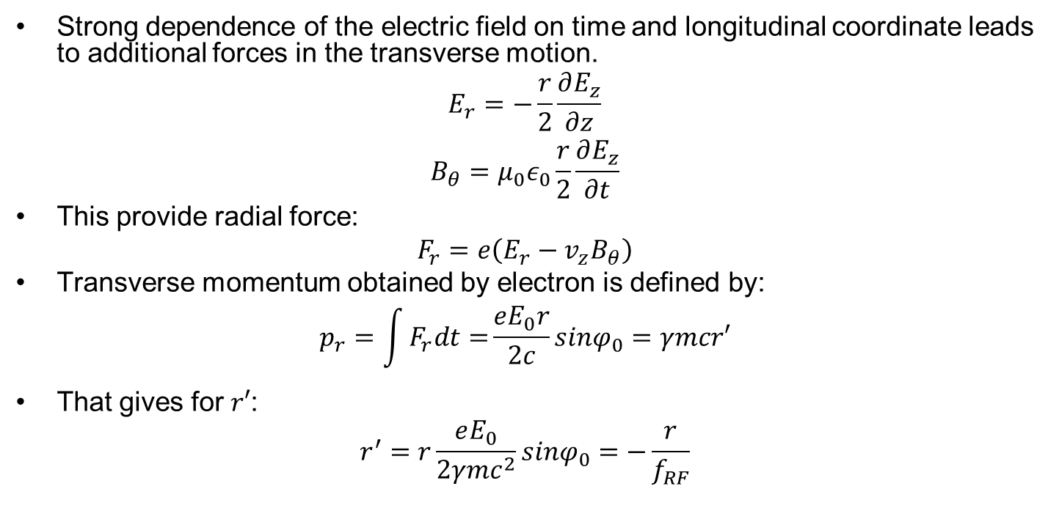
Acceleration in the RF guns. Transverse dynamics I
Strong dependence of the electric field on time and longitudinal coordinate leads to additional forces in the transverse motion.
$$\begin{matrix}E_{r}=−\frac{r}{2}\frac{∂E_{z}}{∂z} \\ B_{θ}=μ_{0}ε_{0}\frac{r}{2}\frac{∂E_{z}}{∂t}\end{matrix}$$
This provide radial force:
$$F_{r}=e\left(E_{r}−v_{z}B_{θ}\right)$$
Transverse momentum obtained by electron is defined by:
$$p_{r}=\int{F_{r}dt=}\frac{eE_{0}r}{2c}sinφ_{0}=γmcr′$$
That gives for $r′$:
$$r^{′}=r\frac{eE_{0}}{2γmc^{2}}sinφ_{0}=−\frac{r}{f_{RF}}$$

Slide 19
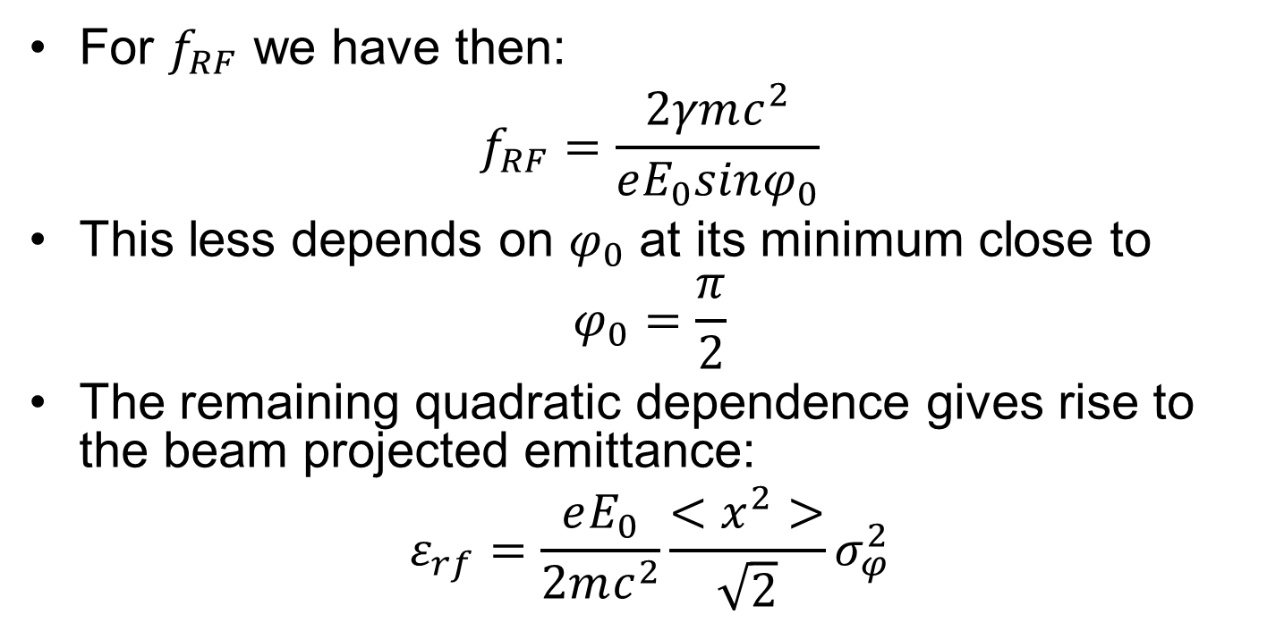
Acceleration in the RF guns. Transverse dynamics II
For $f_{RF}$ we have then:
$$f_{RF}=\frac{2γmc^{2}}{eE_{0}sinφ_{0}}$$
This less depends on $φ_{0}$ at its minimum close to
$$φ_{0}=\frac{π}{2}$$
The remaining quadratic dependence gives rise to the beam projected emittance:
$$ε_{rf}=\frac{eE_{0}}{2mc^{2}}\frac{<x^{2}>}{\sqrt{2}}σ_{φ}^{2}$$

Slide 20


Space charge effects. Emittance compensation I
Due to the space charge effects after leaving the gun electrons in the bunch have different energy and differently focused and defocused in the beam line.
Different parts of the beam (slices) will occupy different position in the phase space. This results that at attempt to measure emittance with a not time resolved method, and after integration over the bunch we obtain “projected” emittance which will be higher than emittance of each individual slice.
$x$’
Head
z
$$x$$
Tail
Projected
emittance

Slide 21
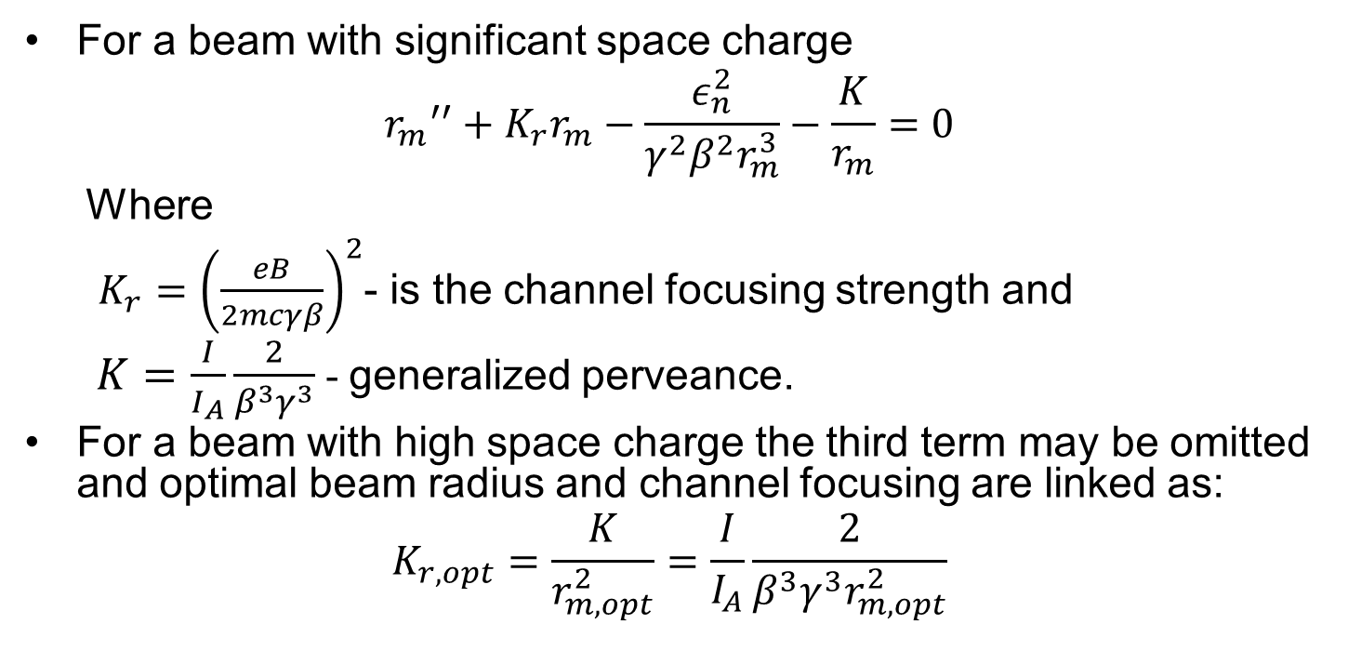
Space charge effects. Emittance compensation II
For a beam with significant space charge
$${r_{m}}^{′′}+K_{r}r_{m}−\frac{ε_{n}^{2}}{{γ^{2}β^{2}r}_{m}^{3}}−\frac{K}{r_{m}}=0$$
  Where
  $K_{r}={\left(\frac{eB}{2mcγβ}\right)}^{2}$- is the channel focusing strength and
  $K=\frac{I}{I_{A}}\frac{2}{β^{3}γ^{3}}$ - generalized perveance.
For a beam with high space charge the third term may be omitted and optimal beam radius and channel focusing are linked as:
$$K_{r,opt}=\frac{K}{r_{m,opt}^{2}}=\frac{I}{I_{A}}\frac{2}{β^{3}γ^{3}r_{m,opt}^{2}}$$

Slide 22
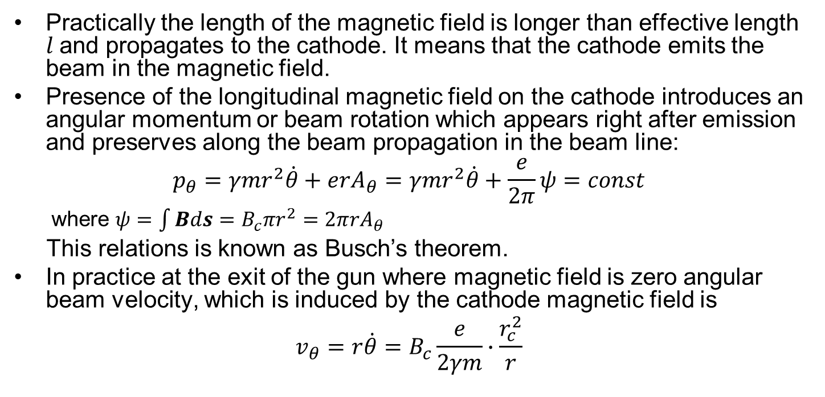
Emission in the magnetic field.
Practically the length of the magnetic field is longer than effective length $l$and propagates to the cathode. It means that the cathode emits the beam in the magnetic field.
Presence of the longitudinal magnetic field on the cathode introduces an angular momentum or beam rotation which appears right after emission and preserves along the beam propagation in the beam line:
$$p_{θ}=γmr^{2}\dot{θ}+erA_{θ}=γmr^{2}\dot{θ}+\frac{e}{2π}ψ=const$$
  where $ψ=\int{Bds}=B_{c}πr^{2}=2πrA_{θ}$
This relations is known as Busch’s theorem.
In practice at the exit of the gun where magnetic field is zero angular beam velocity, which is induced by the cathode magnetic field is
$$v_{θ}=r\dot{θ}=B_{c}\frac{e}{2γm}∙\frac{r_{c}^{2}}{r}$$

Slide 23
Compensation of the cathode field I
The presence of the angular velocity also known as “beam shear” has negative impact on the beam quality. There are two ways to mitigate cathode magnetic field:
  To move solenoid lens as far as possible from the cathode – the method used in DC and SRF guns
  To compensate residual field with an additional solenoid frequently referred as “bucking coil” – used in NCRF guns

Slide 24
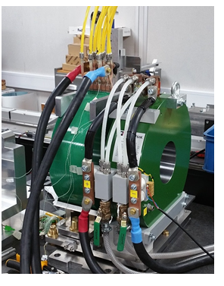
Compensation of the cathode field II
Compensation of the cathode field with bucking coil

Slide 25
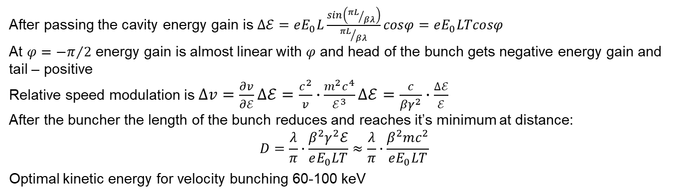
Velocity bunching
Before
buncher
After
buncher
Optimal compression
Excessive
compression
After passing the cavity energy gain is $∆ℰ=eE_{0}L\frac{sin\left({πL}/{βλ}\right)}{{πL}/{βλ}}cosφ=eE_{0}LTcosφ$
At $φ={−π}/2$ energy gain is almost linear with $φ$ and head of the bunch gets negative energy gain and tail – positive
Relative speed modulation is $∆v=\frac{∂v}{∂ℰ}∆ℰ=\frac{c^{2}}{v}∙\frac{m^{2}c^{4}}{ℰ^{3}}∆ℰ=\frac{c}{{βγ}^{2}}∙\frac{∆ℰ}{ℰ}$
After the buncher the length of the bunch reduces and reaches it’s minimum at distance:
$$D=\frac{λ}{π}∙\frac{β^{2}γ^{2}ℰ}{eE_{0}LT}≈\frac{λ}{π}∙\frac{β^{2}mc^{2}}{eE_{0}LT}$$
Optimal kinetic energy for velocity bunching 60-100 keV

Slide 26
Literature
M. Raiser, Theory and Design of Charged Particle beams, WILEY-VCH Verlag GmbH & Co, 2008, ISBN 987-3-527-40714-5
Kwang-Je Kim, RF and Space-Charge Effects in Laser-Driven RF Electron Guns, NIM A275 (1989)201-218
Luca Serafini & James B. Rosenzweig, Envelope analysis of intense relativistic quasilaminar beams in rf photoinjectors: A theory of emittance compensation, Phys. Rev. E 55, 7565(1997)
S.G. Anderson et al., Velocity bunching of high brightness electron beams, PRST AB, 8, 014401 (2005)

