Slide 1
Electron Sources and injectors.
Lecture IV
Dr. Boris Militsyn
STFC Accelerator Science and Technology Centre (ASTeC)

Slide 2
Photoelectron versus Thermionic sources
Advantages
  Very high emission current density
  Relatively easy controllable time structure of the beam
  Achievable high beam brightness
  Ability to generate polarised beams
Disadvantages
  Expensive
  Relatively unreliable
  Usually require (ultra/extra) high vacuum conditions
  Relatively high emittance

Slide 3
Photocathode based electron sources
Photocathode operational parameters
  Operational wavelength of drive laser
  Quantum Efficiency
  Lifetime
DC photocathode guns
RF photocathode guns
  NCRF
  SRF
Generation of polarised electrons

Slide 4
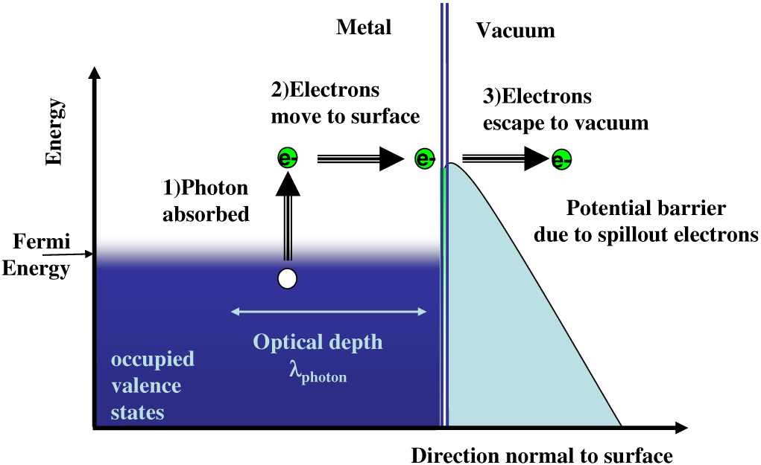
Three-step model of photoemission
Picture from D.H. Dowell and J.F. Schmerge, PR ST AB 12, 074201 (2009)
Notes:
To insert a slide about PEA, NEA and Variable Electron Affinity photocathodes

Slide 5
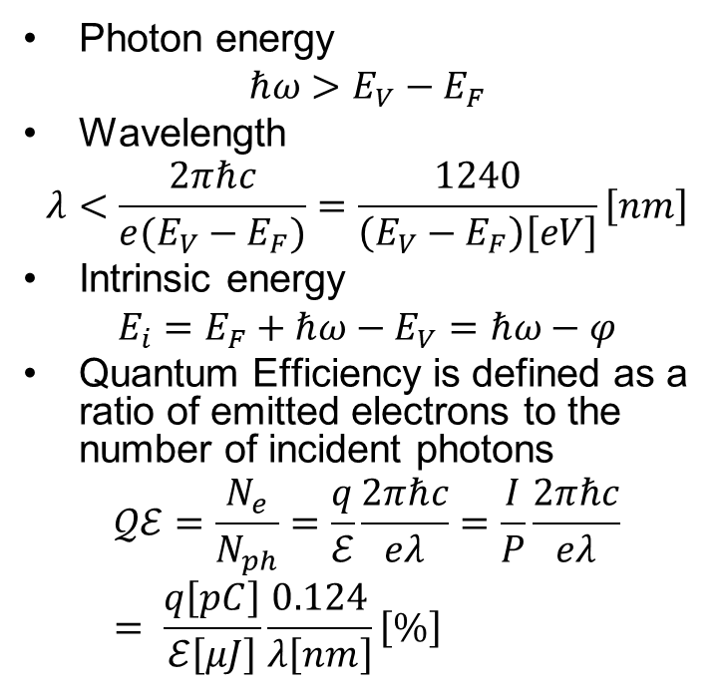

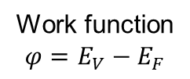





Operational wavelength and Quantum Efficiency
Photon energy
$$ℏω>E_{V}−E_{F}$$
Wavelength
$$λ<\frac{2πℏc}{e(E_{V}−E_{F})}=\frac{1240}{\left(E_{V}−E_{F}\right)\left[eV\right]}\left[nm\right]$$
Intrinsic energy
$$E_{i}=E_{F}+ℏω−E_{V}=ℏω−φ$$
Quantum Efficiency is defined as a ratio of emitted electrons to the number of incident photons
$$𝒬ℰ=\frac{N_{e}}{N_{ph}}=\frac{q}{ℰ}\frac{2πℏc}{eλ}=\frac{I}{P}\frac{2πℏc}{eλ}= \frac{q\left[pC\right]}{ℰ\left[μJ\right]}\frac{0.124}{λ\left[nm\right]}\left[\%\right]$$
$$E_{F}+ℏω$$
$$E+ℏω−E_{V}$$
$$E+ℏω−E_{B}$$
$$E_{V}$$
$$E_{B}$$
Work function
$$φ=E_{V}−E_{F}$$
$$E_{F}$$
$$E$$
Notes:
To insert a slide about PEA, NEA and Variable Electron Affinity photocathodes

Slide 6
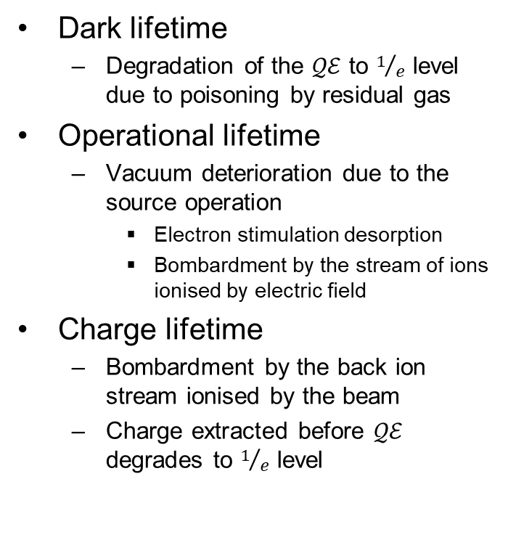
Photocathode Lifetime
Dark lifetime
  Degradation of the $𝒬ℰ$ to $1/e$ level due to poisoning by residual gas
Operational lifetime
  Vacuum deterioration due to the source operation
    Electron stimulation desorption
    Bombardment by the stream of ions ionised by electric field
Charge lifetime
  Bombardment by the back ion stream ionised by the beam
  Charge extracted before $𝒬ℰ$ degrades to $1/e$ level

Slide 7
Photocathodes summary
Material | Typical operation wavelength | Quantum efficiency | Lifetime | Beam parameters stability
Metal (Cu, Mo) | 260 nm | 10⁻⁴ – 10⁻⁶ | High | Stable
Low work function metals (Pb, Mg) | 260 nm | 10⁻³ – 10⁻⁴ | High | Stable
Te-based PEA semiconductors | 260 nm | 0.01-0.1 | 10⁻³ mbar·l·s | Stable
Sb-based PEA semiconductors | 530 nm | 0.01-0.2 | 10⁻⁵ mbar·l·s | Stable
NEA semiconductors | 530-800 nm | 0.01-0.3 | 10⁻⁸ mbar·l·s | Unstable

Slide 8
DC photocathode sources
Photoemitted electrons are accelerated by DC electric field applied to the cathode
Originally developed for Polarised Electron Sources up to recently operated with GaAs family photocathodes (SLAC, TJNAF, MIT, University of Mainz, KEK, NIKHEF and others)
Eventually used in CW electron sources for CW linear and Energy Recovery Linear (ERL) Accelerators (TJNAF, Cornell, JAEA/KEK, STFC, BNL, SMART)
Recently started to use with Sb-based photocathodes (Cornell)
Maximum average current reached 65 mA (Cornell)
Maximum operational voltage 500 kV (JAEA/KEK)
Lowest beam emittance reported 0.3 π·mm·mrad (Cornell)
Used mostly for ERL where high average current is required

Slide 9
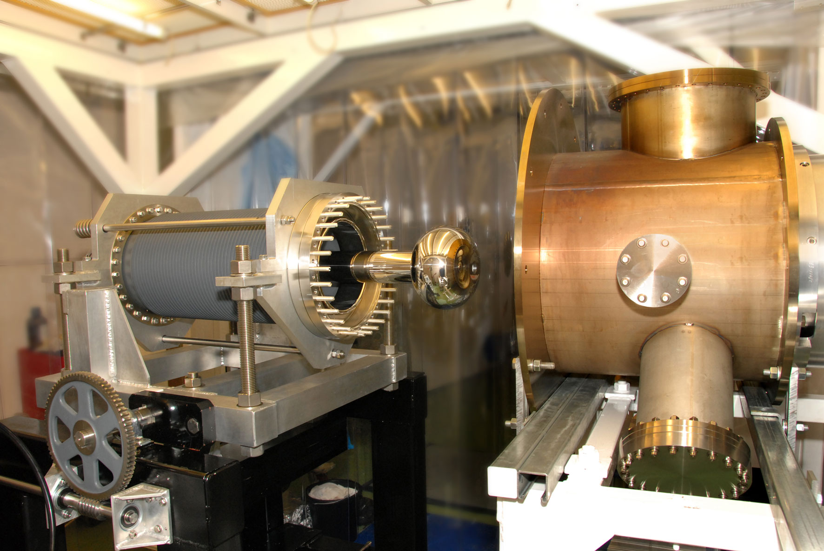
STFC (ALICE) photocathode gun
The gun developed for ALICE ERL on the basis of TJNAF IR FEL design
Gun operated with GaAs photocathodes activated inside the gun
Was used for ALICE/EMMA facility for many years
Now transferred to France to use in ongoing LHeC prototype Power Energy Recovery Linac Experiment (PERLE)

Slide 10
ALICE gun operation modes
Gun operation mode | Gun voltage, kV | Micropulse charge, pC | Micropulse repetition rate, MHz | Train length, µs | Train repetition rate, HZ
Single pulse ERL mode | 320 | Up to 200 | 81.25 | Single micropulse | Up to 10
FEL Mode | 320 | 60 | 16.25 | 100 | 10
THz mode | 320 | 60 | 40.125 | 100 | 10
EMMA injection mode | 320 | 40 | 81.25 | Single micropulse | 5
PERLE injection mode | 320 | 500* | 40 | CW | -
*-Upgraded gun with antimonide photocathode

Slide 11
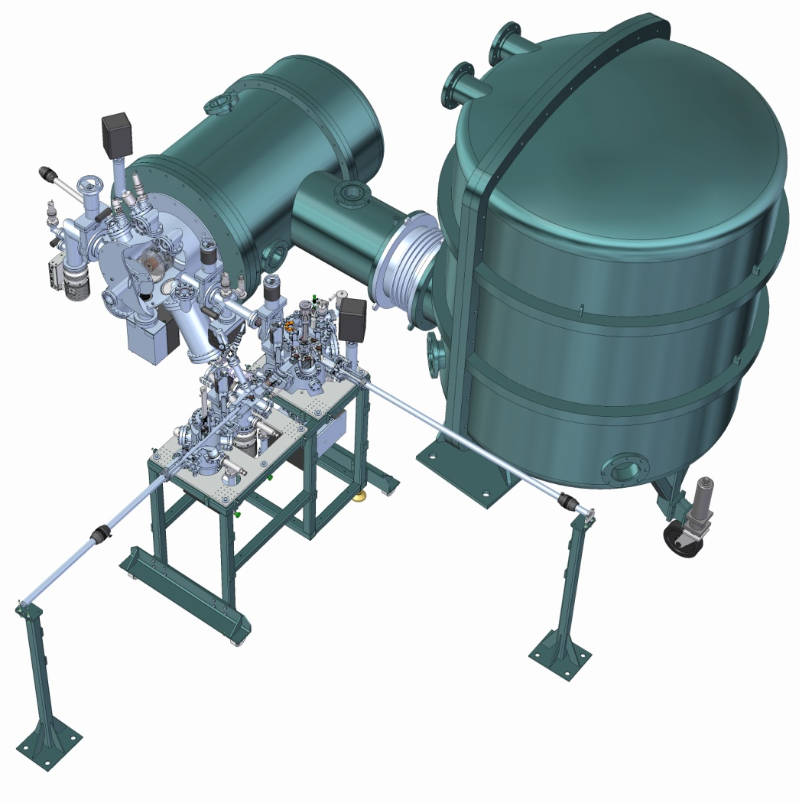
ALICE gun upgrade
Photocathode gun
Remove photocathode activation out of the gun
Reduce the down time required for activation of the photocathode and allows ALICE for operation with higher bunch charge.
Improve operational vacuum in the gun
Reduce contamination of the high voltage electrodes with Cs and other products of photocathode preparation
Make photocathode activation more controllable
Allows for experiments with different types of photocathodes
Photocathode
preparation facility
500 kV power
supply

Slide 12
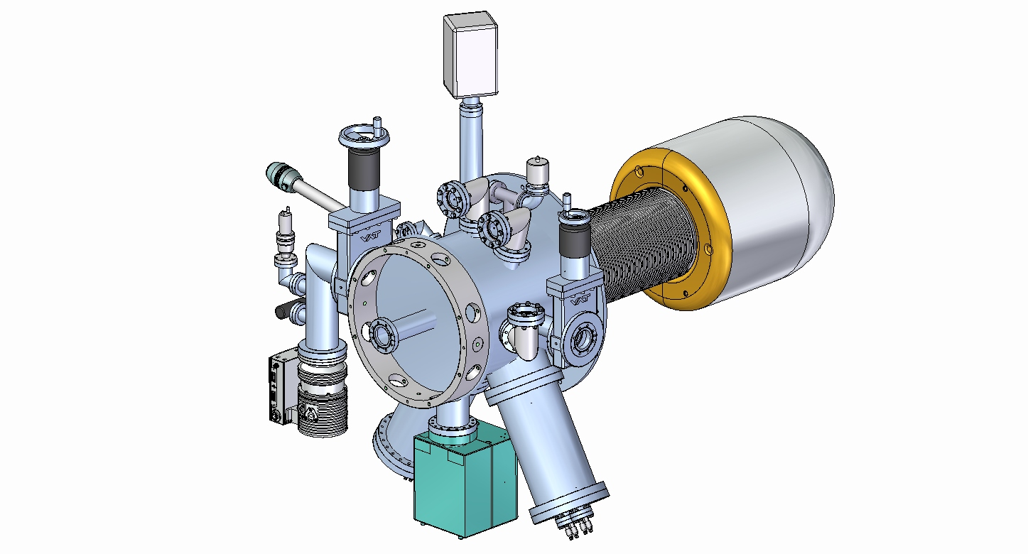
Vacuum chamber of the ALICE gun upgrade
Transfer arm for
winding cathode forward
RGA
Viewing ports
Dedicated pumping
port for bakeout
Ceramic
Electrons
NEG pumping

Slide 13
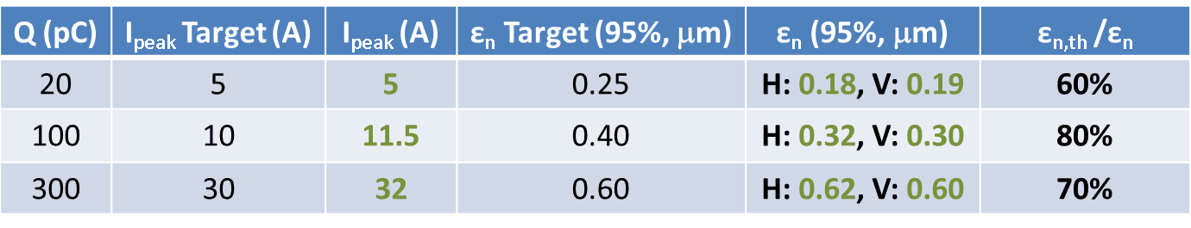
Vertical gun design, Cornell University
Operational parameters
Conditioning voltage | 500 kV
Operational voltage | 400 kV
Operational current* | 4 mA
* - in the booster cryomodule
REVIEW OF SCIENTIFIC INSTRUMENTS 85, 093306 (2014)
Design, conditioning, and performance of a high voltage, high brightness
dc photoelectron gun with variable gap
Jared Maxson, Ivan Bazarov, Bruce Dunham, John Dobbins, Xianghong Liu,
and Karl Smolenski
Cornell Laboratory for Accelerator-Based Sciences and Education, Cornell University, Ithaca,
New York 14853, USA

Slide 14
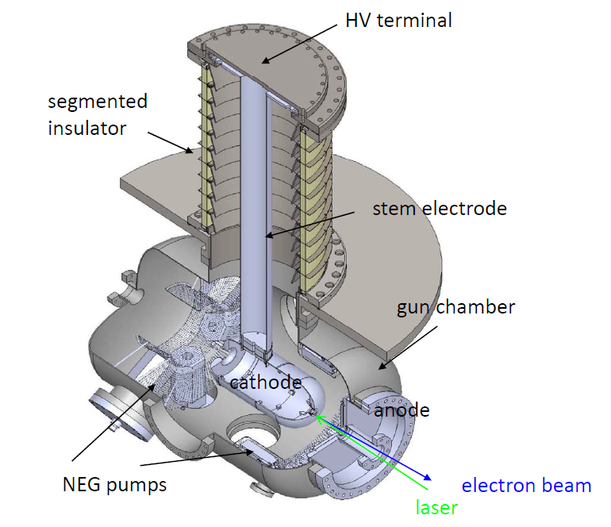
JAEA photocathode gun
Maximum voltage achieved – 548 kV, operational voltage – 450 kV
Maximum design current – 10 mA
Photocathode – GaAs
Photocathode preparation system (not shown) integrated with the gun
For protection of the ceramic insulator from field emission and scattered electrons it has been made segmented

Slide 15
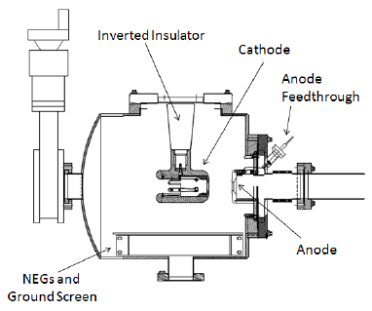
Inverted DC gun
Originally proposed at SLAC and further developed at TJNAF for CEBAF and BNL polarised electron source
Used industrial HV cable environment
Cheap industrial insulator
Easy obtain extra-high vacuum required for GaAs photocathodes
Commissioned up to 350 kV
Notes:
To add one of my photos

Slide 16
RF photocathode sources. NCRF
Normal conducting RF
  Operated at frequency range from 200 MHz (LBNL) to X band (SLAC), operation at 100s GHz and THz is under development
  Operated with highly robust photocathodes – metal or Cs₂Te
  Typically very low emittance
  Generate beams in MeV range energy
  At low frequency (200 MHz) may be used for CW operation, at high (GHz) – for train pulsed or pulsed operation
  CW operation mode is possible at low frequency only as it’s limited by heat load in the gun cavity

Slide 17
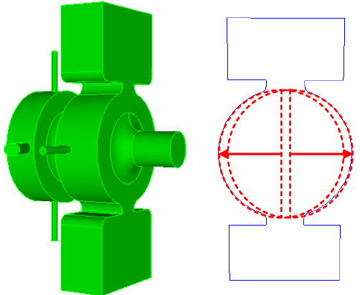
LCLS 1.6 cell S-band photocathode gun
Designed for Linac Coherent Light Source (LCLS) at SLAC
Typical S-band photocathode gun
Operated in single pulse mode
Maximum designed cathode field up to120 MV/m, typical operational field is 115 MV/m

Slide 18
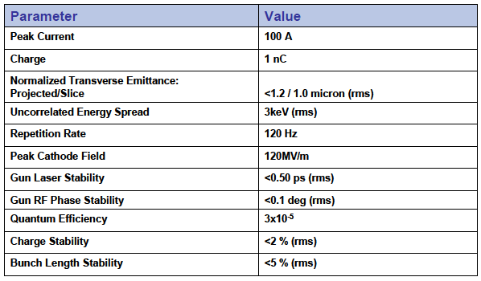
LCLS gun specifications

Slide 19
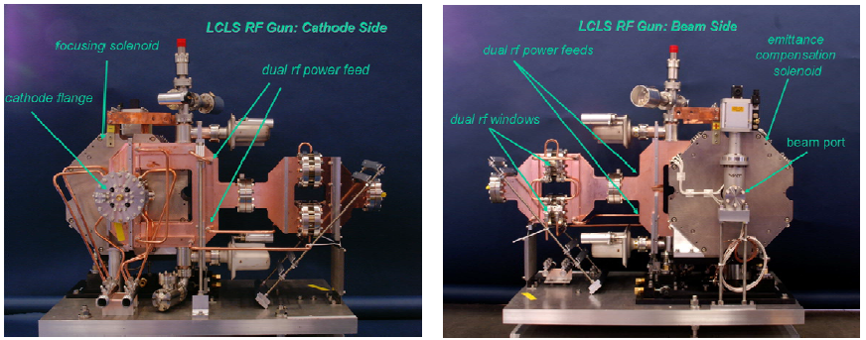
LCLS gun official photo

Slide 20
European XFEL L-band gun
Operated at 1.3 GHz (L-band)
Originally designed for TESLA linear collider, later on has been updated for operation with X-FEL
Natively designed for operation with 1.3 GHz SRF linear accelerator
Operated with low train repetition rate but with long RF pulse and train length
Operated with metal or Cs₂Te photocathodes
Has been tested and delivered 4 generations of the gun. The first 5th generation gun is under commissioning
Most advanced gun characterisation facility is located at Zeuthen (Brandenburg, Germany)

Slide 21
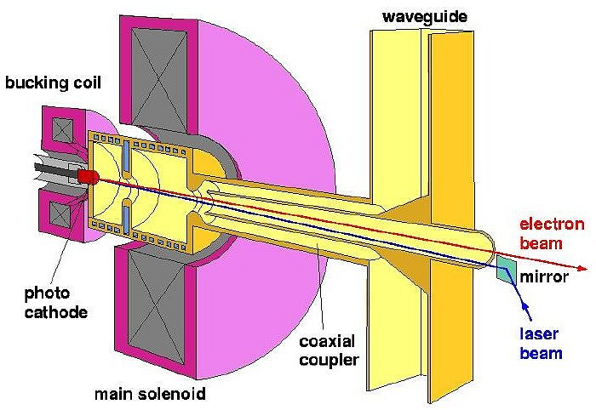
European XFEL gun design
Distribution of accelerating RF and
focusing magnetic field in the gun

Slide 22
European XFEL gun specifications
 | TESLA | X-FEL
Gun design | 1.5 cell | 1.5 cell
Gun RF frequency, GHz | 1.3 | 1.3
Cathode field, MV/m | 40 | 60
Gun operation mode | Train pulsed | Train pulsed
Maximum beam energy, MeV | 4.5 | 7
Train repetition rate, Hz | 5 | 10
Bunch repetition rate, MHz | 3 | 4.5
Bunches per train | 2820 | 650
Bunch charge, nC | 3 | 1
Beam emittance, π·mm·mrad | <10 | <0.9

Slide 23
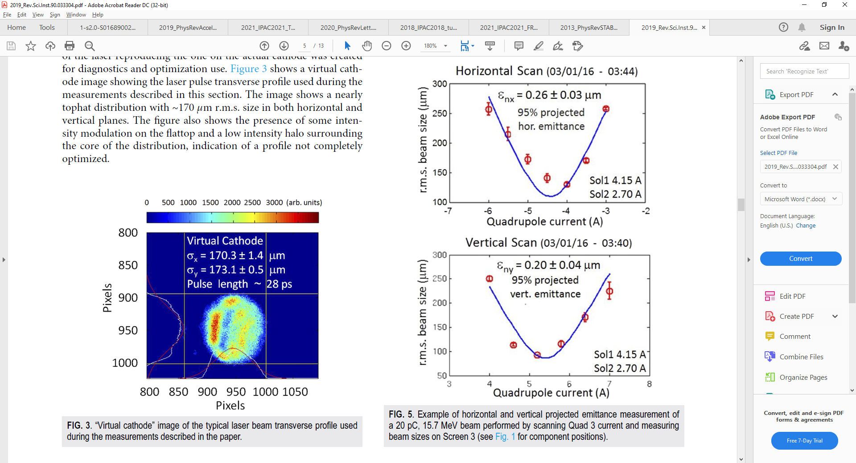
NCRF VHF photocathode guns, LBNL-SLAC
Operates with Cs₂Te or Cs₂KSb photocathodes
APEX Phase-II main parameters
Gun frequency 185.714 MHz
Gun operation mode CW
Max beam energy at gun exit 0.8 MeV
Nominal operational energy 0.75 MeV
Field at the cathode
at 0.75 MeV 20 MV/m
Emittance measurements of 20 pC bunches generated by LBNL Cs₂KSb photocathode
Rev. Sci. Instrum. 90, 033304 (2019)

Slide 24
Superconducting RF photocathode sources
Superconductive RF
  Mostly considered for CW mode of operation at high average current
  Operated at a frequency range from 100 MHz (BNL) to L-band (HZDR, HZB, DESY)
  Operated with metal (Pb,Mg), Te- or Sb-based photocathodes, though operation with GaAs is under investigation
  SRF Gun developed at Helmholtz Zentrum Dresden-Rossendorf and running with Mg photocathode demonstrated real operation in ELBE user facility

Slide 25
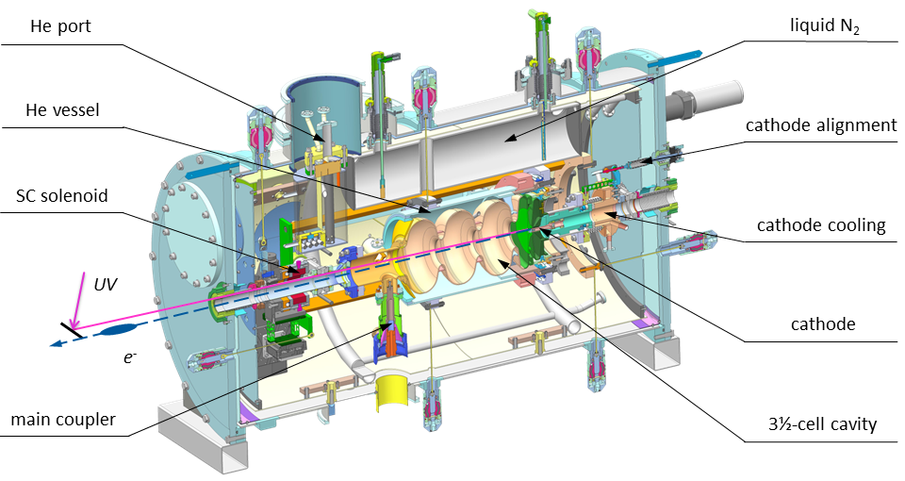
HZDR SRF photocathode gun

Slide 26
HZDR gun parameters
Phys. Rev. Acc. Beams 24, 033401

Slide 27
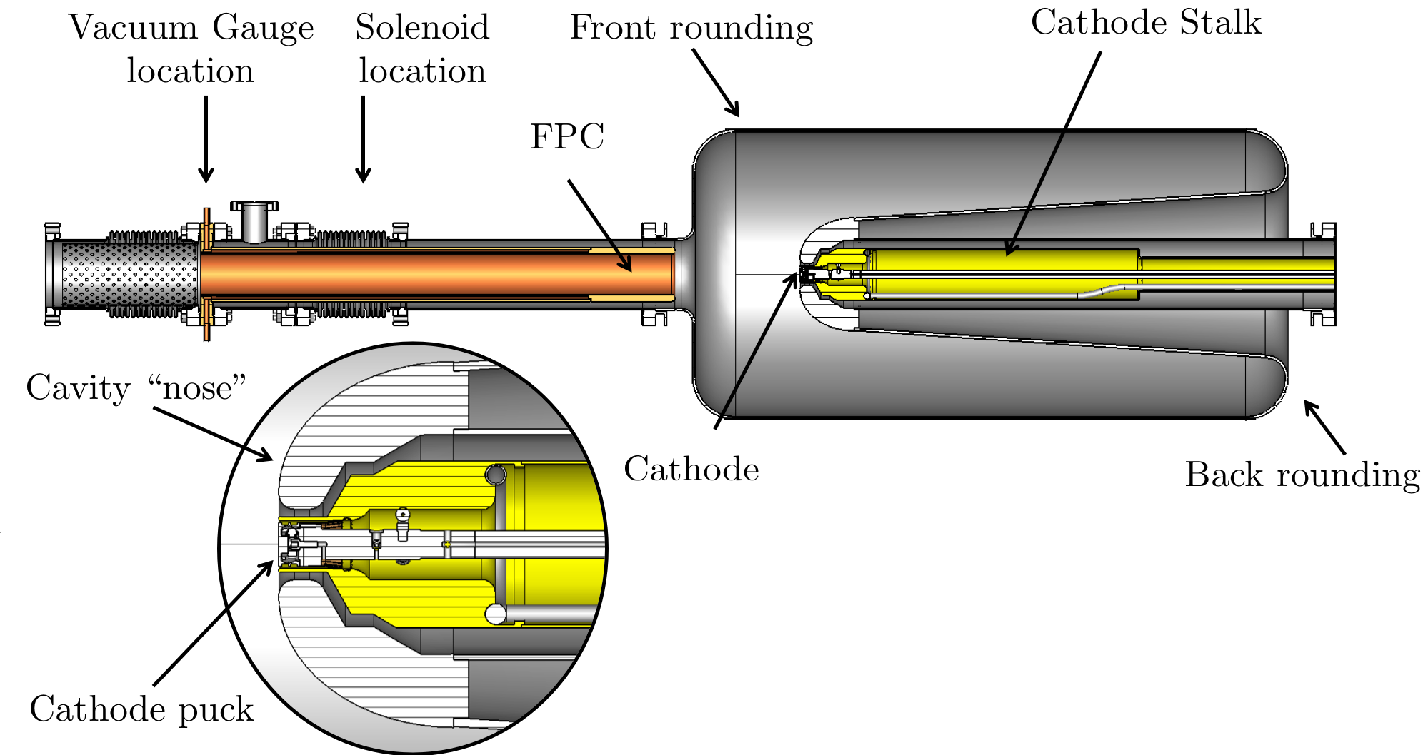
SRF Quarter Wave photocathode gun, BNL
Operates with Cs₂KSb photocathodes
Parameters | Value
Gun Voltage, MV | 1.25
Charge per Bunch, pC | 100-20,000
Average Beam Current, mA @ 1500 pC | 0.15
Normalized transverse RMS slice emittance @ 100 pC, mm-mrad | 0.15
Normalized transverse RMS projected emittance @ 100 pC, mm-mrad | 0.3
Longitudinal RMS slice emittance @ 100 pC, keV-ps | 0.7
Quantum Efficiency, % | 1-4
DOI: 10.1103/PhysRevLett.124.244801
Notes:
Photocathode operates at room temperature.
Bunch length 400 ps that leads to requirements of very accurate bunching, may be two stage.

Slide 28
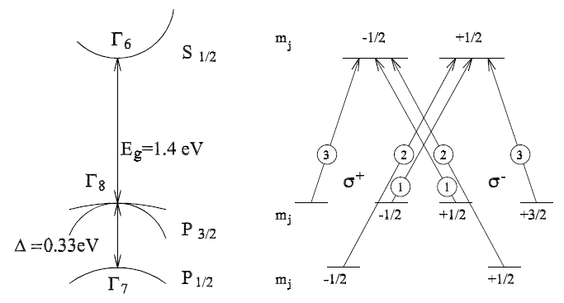
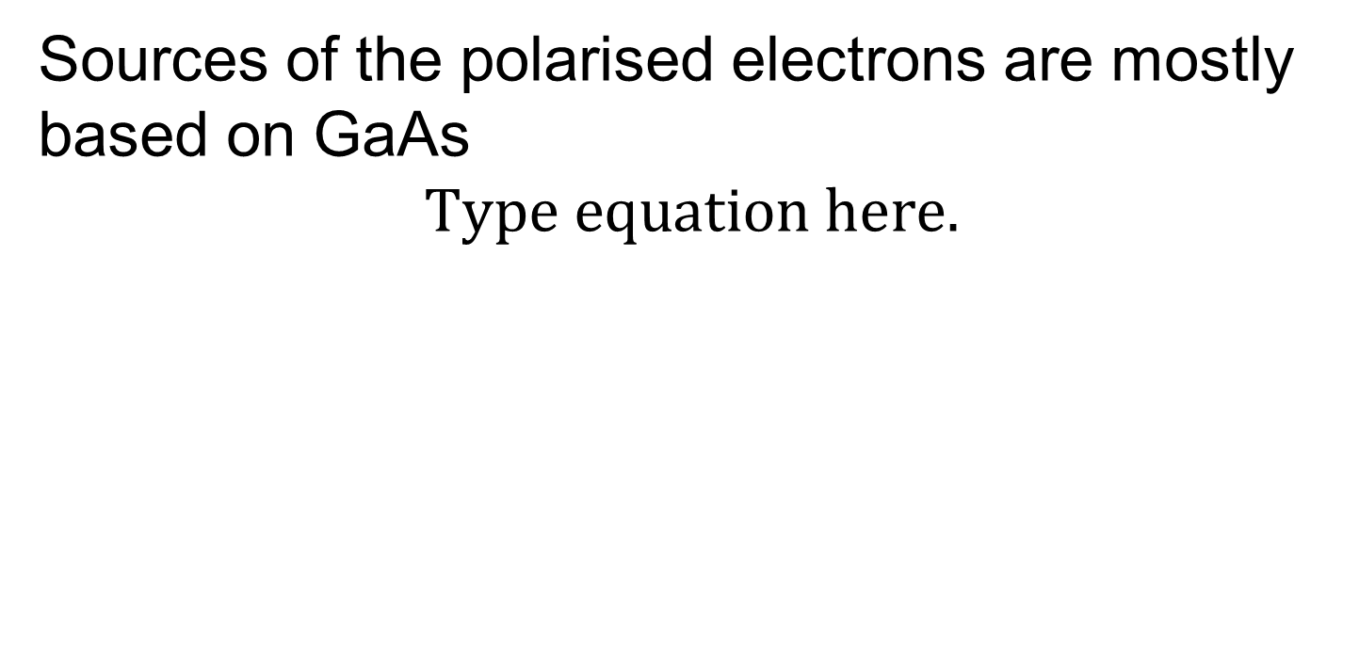
Generation of polarised electrons
Sources of the polarised electrons are mostly based on GaAs
-3/2

Slide 29
Generation of polarised electrons
Theoretical polarisation of electrons, emitted from GaAs is defined by difference probability of transition to final state with different spin orientation and equal to 50%. Experimental value is typically not more than 40%
Strain layer GaAs allows for increasing of polarisation up to 75% with Quantum Efficiency of about 0.1%
Recently developed superlattice photocathodes allow for increase of polarisation to 85-90% with Quantum Efficiency of about 1%.

Slide 30
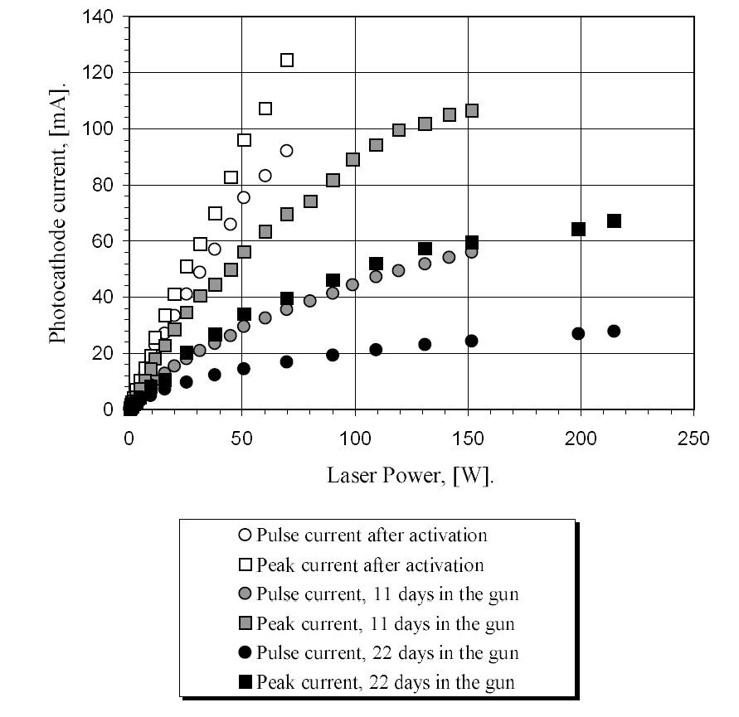
Generation of polarised electrons.
Amsterdam Pulse Stretcher(AmPS), 1998
5 µs pulses with an amplitude of 120 mA of highly polarised beam has been demonstrated from 1.7 eV bandgap
InGaAsP photocathode
B.L. Militsyn, ISBN 90-386-0777-6, 1998
Notes:
Photocathode operated in unique pulsed HV gun that allowed weeks photocathode lifetime delivered 15 mA 5 µs pulses followed with a frequency of 1 Hz

Slide 31
Literature
D.H. Dowell et al., Cathode R&D for future light sources, NIM A 622, 685-697(2010)
B. Dunham et al. ERL2011 Summary of Working Group 1: progress with DC photoemission electron sources, In Proc. of ERL2011 workshop, Tsukuba, Japan, 2011, www.jacow.org
N. Nishimori, et al., “Development of a 500-kV photocathode DC gun for ERLs”, J. Phys.: Conf. Ser. 298 (2011) 012005
P. Adderley ett al., CEBAF 200kV inverted electron gun, in Proc. of PAC’2011
D.H. Dowell et al., The Development of the Linac Coherent Light Source RF Gun, SLAC-PUB-13401,2008
http://pitz.desy.de
http://www.hzdr.de
A. Arnold and J. Teichert, Overview on superconducting photoinjectors, Physical Review Special Topics – Accelerators and Beams 14,(2011) 024801
R. Suleiman et al., Operation of Jefferson Lab Polarized Electron Sources at High Currents. Challenges and Lessons learned, EIC’14, Newport News, USA

