Slide 1
Electron Sources and injectors.
Lecture III
Dr. Boris Militsyn
STFC Accelerator Science and Technology Centre (ASTeC)
Notes:
To add overall slide about electron source applicability

Slide 2
Thermionic electron sources
Thermionic cathodes
  Metal cathodes
  Dispenser cathodes
  Oxide coated cathodes
  Boride cathodes
Gun with directly and indirectly heated cathodes
High current DC thermionic guns
Beam modulated thermionic guns

Slide 3
Metal cathodes
At earlier age tungsten used as a thermionic electron source. As work function of tungsten is very high it has to be heated to 2500 °K to actively emit electrons
Back in 1923 Irvin Lengmuir discovered that if tungsten is coated with thorium it emits more electrons at lower temperature. This cathode also lasts longer than pure tungsten
Since then the most commonly used metal cathode is thoriated tungsten.
They are used in nearly all high-power vacuum tubes for radio transmitters
Advantage: Thoriated filaments can have very long lifetimes and are resistant to the ion bombardment that occurs at high voltages, because fresh thorium continually diffuses to the surface, renewing the layer
Disadvantage: Though work function of thoriated W is about 2.4 eV to reach required current the cathodes have to be operated at 2000 °K that requires very high heater power for emission
Notes:
A small amount of thorium is added to the tungsten of the filament. The filament is heated white-hot, at about 2400 °C, and thorium atoms migrate to the surface of the filament and form the emissive layer.
Heating the filament in a hydrocarbon atmosphere carburizes the surface and stabilizes the emissive layer.

Slide 4
Oxide coated cathodes
The lowest temperature thermionic cathodes are oxide coated metal cathodes
In order to increase emission a metal surface is coated with alkaline earth metal oxide which significantly lowers work function
At earlier time barium oxide was widely used, now days oxides of calcium and strontium and/or aluminium are added as well.
Strontium and Oxide-coated cathodes operate at a temperature of 800-1000 °K. They are used in most small glass vacuum tubes
Advantage: Relatively high emissivity at low operational temperature
Disadvantage: The coating is easily destroyed by bombardment of positive ions accelerated by the high voltage of the gun
Notes:
The earliest material used was barium oxide; it forms a monatomic layer of barium with an extremely low work function.
More modern formulations utilize a mixture of barium oxide, strontium oxide and calcium oxide. Another standard formulation is barium oxide, calcium oxide, and aluminium oxide in a 5:3:2 ratio. Thorium oxide is used as well.
For manufacturing convenience, the oxide-coated cathodes are usually coated with carbonates, which are then converted to oxides by heating. The activation may be achieved by microwave heating, direct electric current heating, or electron bombardment while the tube is on the exhausting machine, until the production of gases ceases.
The purity of cathode materials is crucial for tube lifetime. The Ba content significantly increases on the surface layers of oxide cathodes down to several tens of nanometres in depth, after the cathode activation process.
The lifetime of oxide cathodes can be evaluated with a stretched exponential function.
The survivability of electron emission sources is significantly improved by high doping of high‐speed activator.

Slide 5
Dispenser cathodes
Developed in about 1955 and up to now actively used in many applications
Manufactured from the porous tungsten
Impregnated with BaO CaO and Al₂O₃ in proportions 5-3-2
Around 1964 it has been discovered that additional coating with a thin layer of osmium, iridium, ruthenium or rhenium greatly enhanced the emission properties
Widely used in the RF tubes
Advantage: Easily machined to high mechanical tolerance. Very robust – lifetime up to 100,000 hours.
Disadvantages: Very complicated manufacturing technology

Slide 6
Boride cathodes
LaB₆ and CeB₆ are refractory ceramic materials with a melting point of 2500 °K
Having a work function of 2.5 eV they demonstrated highest thermal electron emissivity known
Used as a crystal or as a coating
Cerium hexaboride cathodes have a lower evaporation rate at 1700 °K than lanthanum hexaboride, but they become equal at temperatures above 1850 °K. They also have one and half the lifetime of lanthanum hexaboride, due to the former's higher resistance to carbon contamination.
Adventures: Very high emissivity, low evaporation rate, long lifetime (10 times longer than W)
Disadvantage: Evaporated material coats surrounding electrodes and they begin to emit
Notes:
The principal use of lanthanum hexaboride is in hot cathodes, either as a single crystal or as a coating deposited by physical vapor deposition.
Hexaborides, such as lanthanum hexaboride (LaB₆) and cerium hexaboride (CeB₆), have low work functions, around 2.5 eV.
Hexaboride cathodes are about ten times "brighter" than tungsten cathodes, and have 10–15 times longer lifetime.
Devices and techniques in which hexaboride cathodes are used include electron microscopes, microwave tubes, electron lithography, electron beam welding, X-ray tubes, and free electron lasers.
Lanthanum hexaboride slowly evaporates from the heated cathodes and forms deposits on the Wehnelt cylinders and apertures.

Slide 7
Overview of the thermionic cathodes
Material | Operating temperature | Work function | Specific emission
Tungsten | 2500 K | 5 eV | 500 mA/cm²
Thoriated tungsten | 2000 K | 2.4 eV | 5 A/cm²
Oxide coated | 1300 K | 1.5 eV | 10 A/cm²
Dispenser cathodes | 1500 K | 1.5-2.0 eV | 10 A/cm²
Boride cathodes | 1700 K | 2.5 eV | 30 A/cm²
Notes:
Work function of dispenser photocathodes strongly depends on temperature and at operational temperature rises up to 2 eV.

Slide 8
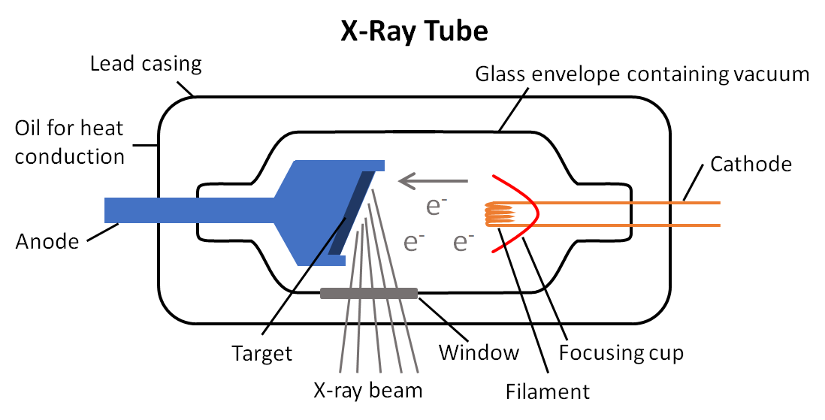
Directly heated thermionic cathodes
Filament itself is the source of electrons
Used in the first vacuum tubes
Used mostly with metal and oxide coated cathodes
Disadvantage: distribution of the potential along the filament
Now mostly used in fluorescent and X-ray tubes
www.google.com

Slide 9
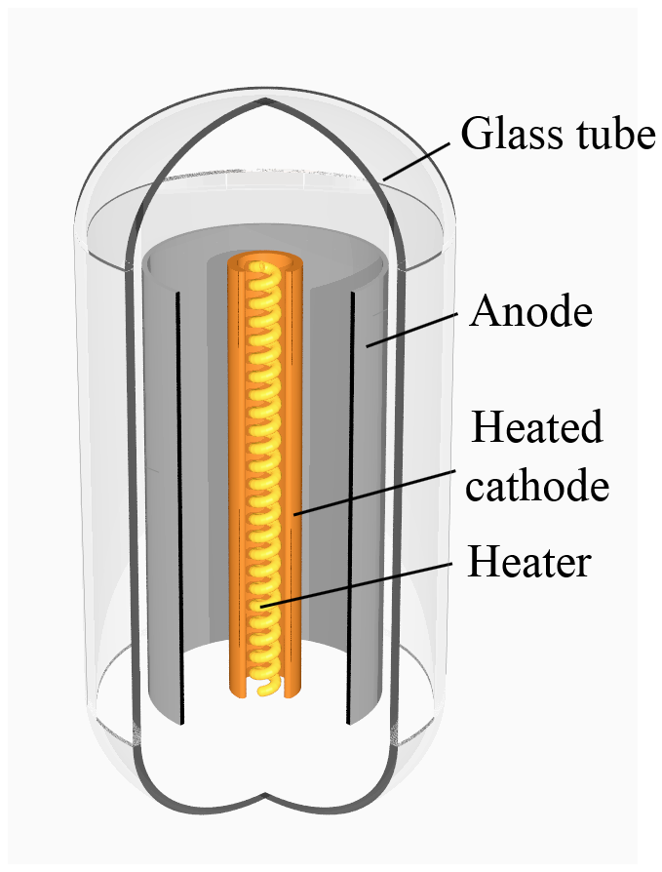
Indirectly heated thermionic cathodes
Filament and cathodes are separated and filaments heats the cathode which emits electrons
Basic design for vacuum tubes is a metal cathode heated by a tungsten filament
Filament (heater) is electrically isolated from the rest of the circuit
AC current may be used for the cathode heating
Can be used with oxide and boride cathodes

Slide 10
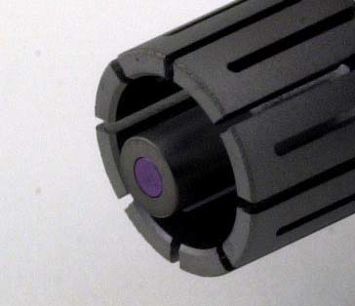
Indirectly heated boride source
4 mm CeB₆ pressed into the graphite heater
Maximum current density 30 A/cm²
Used in the pulsed thermionic injector of the SACLA SASE X-FEL in Japan
Courtesy T. Shintake

Slide 11
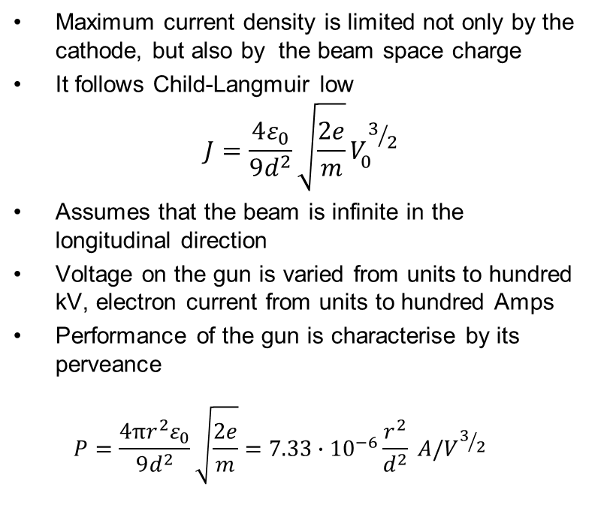
High current DC thermionic guns
Maximum current density is limited not only by the cathode, but also by the beam space charge
It follows Child-Langmuir low
$$J=\frac{4ε_{0}}{9d^{2}}\sqrt{\frac{2e}{m}}V_{0}^{3/2}$$
Assumes that the beam is infinite in the longitudinal direction
Voltage on the gun is varied from units to hundred kV, electron current from units to hundred Amps
Performance of the gun is characterise by its perveance
$P=\frac{4πr^{2}ε_{0}}{9d^{2}}\sqrt{\frac{2e}{m}}=7.33∙{10}^{−6}\frac{r^{2}}{d^{2}} A/V^{3/2}$
Cathode electrode
Anode
Cathode
DC voltage

Slide 12
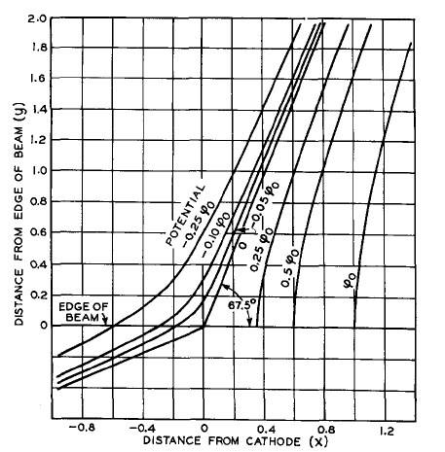
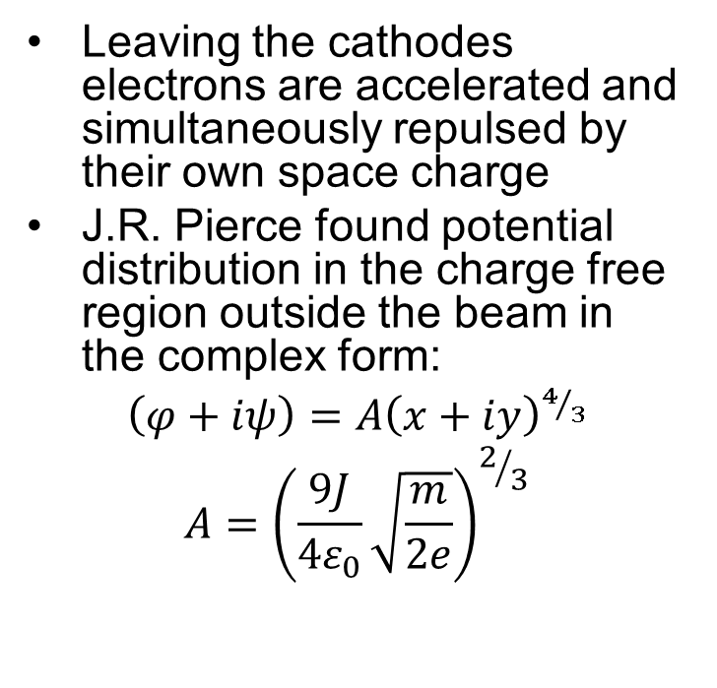
Pierce gun
Leaving the cathodes electrons are accelerated and simultaneously repulsed by their own space charge
J.R. Pierce found potential distribution in the charge free region outside the beam in the complex form:
$\left(φ+iψ\right)=A{\left(x+iy\right)}^{4/3}$
$$A={\left(\frac{9J}{4ε_{0}}\sqrt{\frac{m}{2e}}\right)}^{2/3}$$

Slide 13
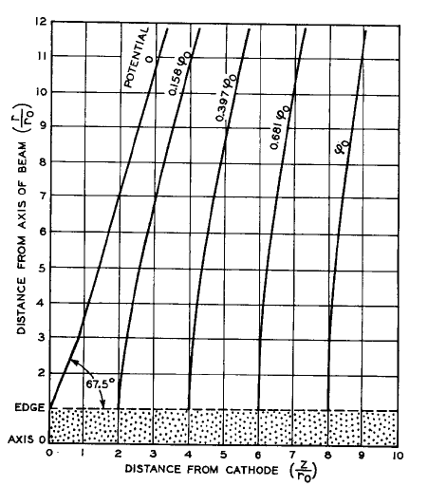
Pierce electrodes
Pierce proposed to compensate repulsion effect simulating the missing part of the beam with a system of discrete external electrodes
Cathode electrode tilted to 22.5 degrees to the cathode is now called Pierce electrode, and such gun design is called Pierce gun

Slide 14
Time structured electron beams
Many accelerator applications require time structured beams
 | Operation mode | Bunch charge | Bunch/Train repetition rate | Number of bunches in the train
NCRF Linear accelerators | Single pulse/train pulsed | 0.1-2 nC | 3 GHz/50 Hz | 1000’s
CW SRF linear accelerators | CW | 0.1-1 nC | 0.1-1MHz | N/A
Pulsed SRF linear accelerators | Train pulsed | 0.1-1 nC | 5 MHz/10 Hz | 1000’s
ERL’s | CW | 0.1-1 nC | Up to 1.3 GHz | N/A

Slide 15
Pulsed thermionic electron source
Low repetition rate
Relatively long electron pulse
High bunch charge
Beam energy 100’s kV
Used in many medical and industrial accelerators
Cathode electrode
Anode
Cathode
Pulsed high
voltage

Slide 16
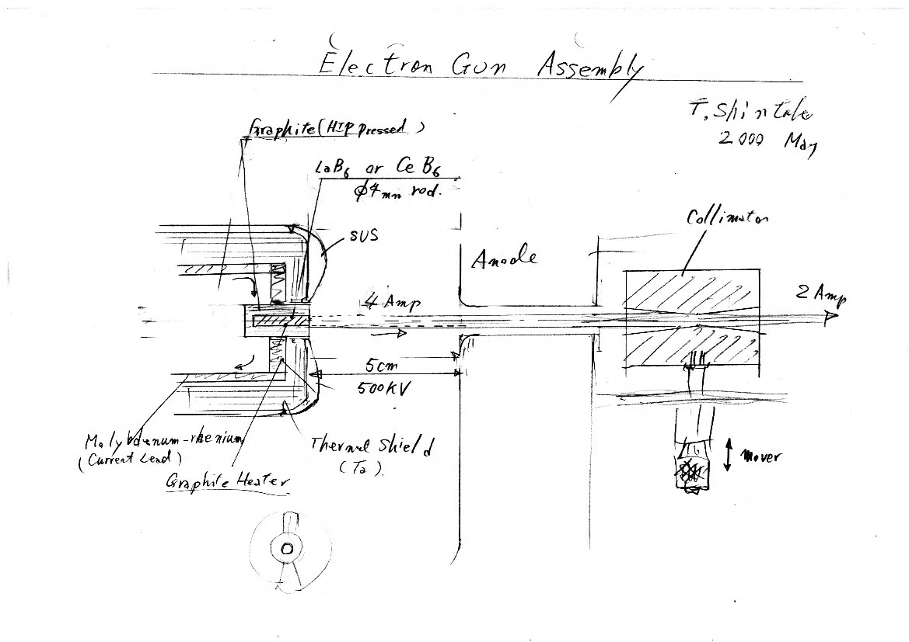
SACLA electron source
Courtesy T. Shintake

Slide 17
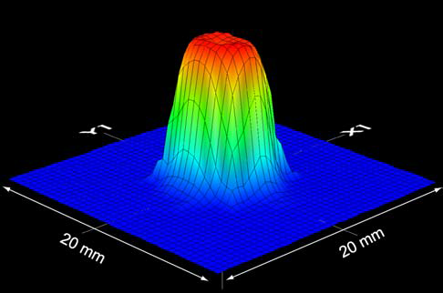
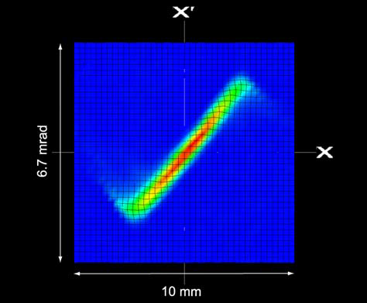
SACLA source performance
Pulse length – 3 µs
Peak current – 1 A
Beam Energy 500 keV
Beam emittance 1.1 π mm mrad
K. Togawa et al., APAC 2004

Slide 18
Grid modulated thermionic guns
Main gun voltage remains DC
Modulated voltage is applied to the mesh grid located close to the cathode
There are two types of modulation:
  Pulsed – microseconds range
  RF – GHz frequencies
In order to prevent leakage of electrons at absence of modulated voltage bias voltage applied as well
Combination of modulated and bias voltage allows for varying bunch length and/or bunch charge
Widely used in RF tubes and IR FEL injectors
Disadvantage: Presence of the grid seriously spoiled the beam emittance
Cathode electrode
Anode
Cathode
Grid
DC voltage

Slide 19
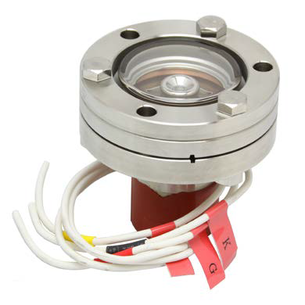
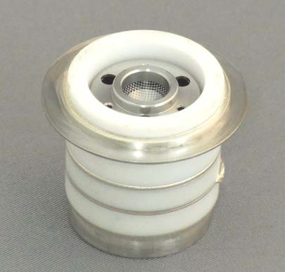
Examples of industrial electron sources
Grid modulated electron source with 4 mm Ir coated dispenser cathode with specific emission of 10 A/cm²
Grid modulated source with
6.3 mm cathode

Slide 20
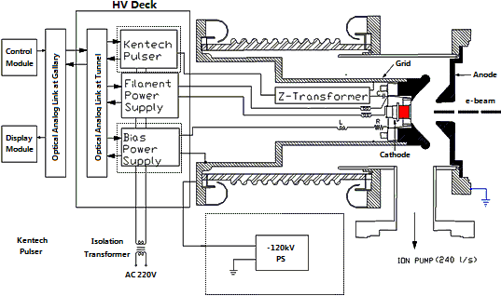
DC pulse grid modulated electron gun
Z. Zhou et al., DESIGN STUDIES ON NSC KIPT ELECTRON GUN SYSTEM, IPAC2013

Slide 21
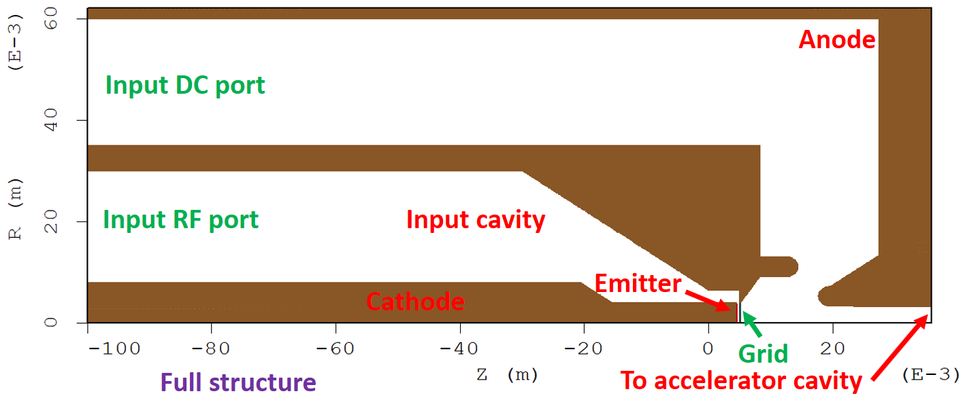
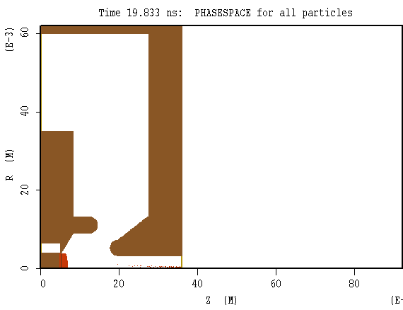
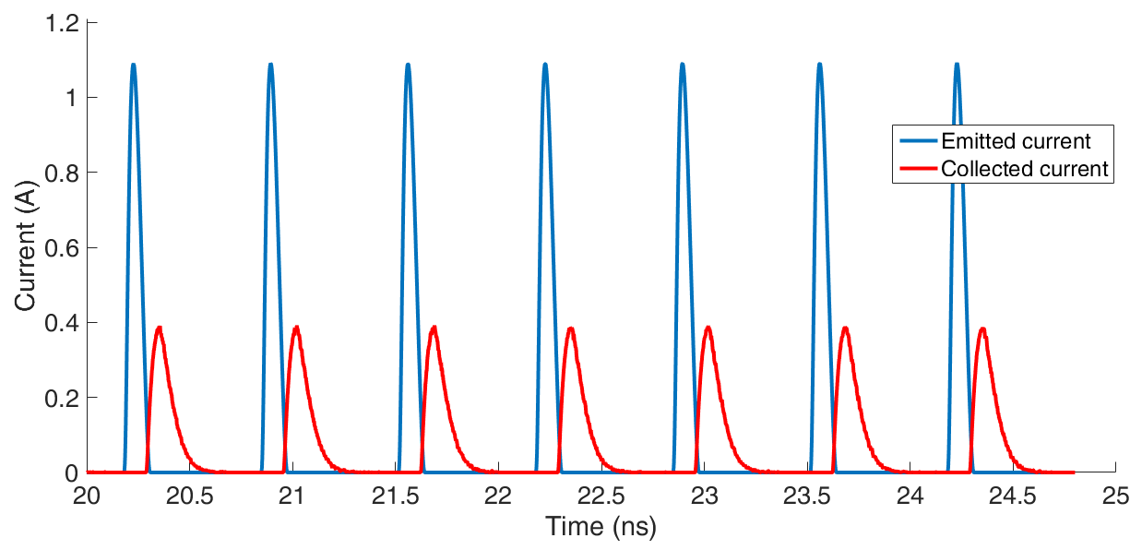
RF grid modulated gun
Liang Zhang et al., EEE TRANSACTIONS ON ELECTRON
DEVICES, VOL. 67, NO. 1, 2020

Slide 22
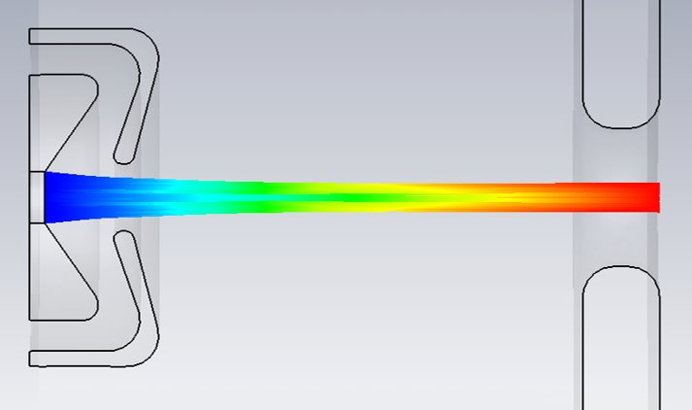
Gate modulated gun
Modulation and bias voltage are applied to the special gate electrode also known as Wehnelt electrode
In order to prevent beam emittance deterioration the gate electrode should be build as a Pierce potential line
Disadvantages: Both bias and modulated voltage should be at a level of kVs

Slide 23
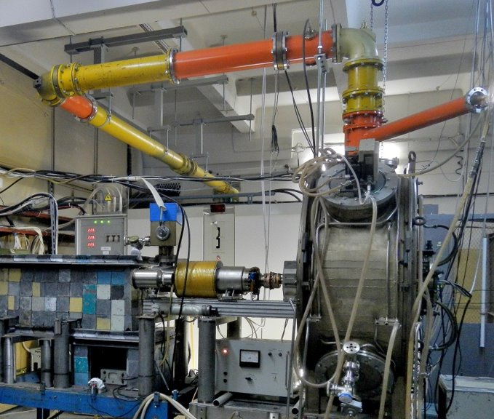
RF thermionic gun
RF
Cathode
Cathode is placed inside an RF cavity
High repetition rate - cavity is operated at CW mode at a 100’s MHz frequency which is restricted by power density, dissipated in the cavity
Beam energy is up to 1 MeV
Limited bunch charge
Constant bunch length
Considered for IR ERL’s and CW SRF accelerators

Slide 24
Literature
www.wikipedia.org
www.cathode.com
Cronin J.L., Modern dispenser cathodes, Solid-state and Electronic Devices, vol. 128,(1981)19-32
Hermann l.G. and Wagener P.S., The oxide-coated Cathodes, Chapman and Hall, London, 1951
www.a-p-tech.com
J.R. Pierce, Rectilinear Electron Flow in Beams, J. Appl. Phys., v.11 (1940) 548-554
P.N. Ostroumov et al., Development of ultra-low emittance injector for
future X-ray FEL oscillator, LINAC 2008
K. Togawa et al., Emittance measurement on the CeB₆ electron gun for the SPring-8 compact SASE source FEL project, APAC 2004

