Slide 1
Electron Sources and injectors.
Lecture II
Dr. Boris Militsyn
STFC Accelerator Science and Technology Centre (ASTeC)
Notes:
To add overall slide about electron source applicability

Slide 2
Physics of electron emission
Phenomenological description of electron emission
Thermionic emission
  Richardson’s low
  Child low
Photoemission
  Metal photocathodes
  Semiconductor photocathodes
  Positive electron affinity (PEA) and Negative electron affinity (NEA) photocathodes
Field emission
  The Fowler-Nordheim equation
Impact on emission process on beam parameters

Slide 3


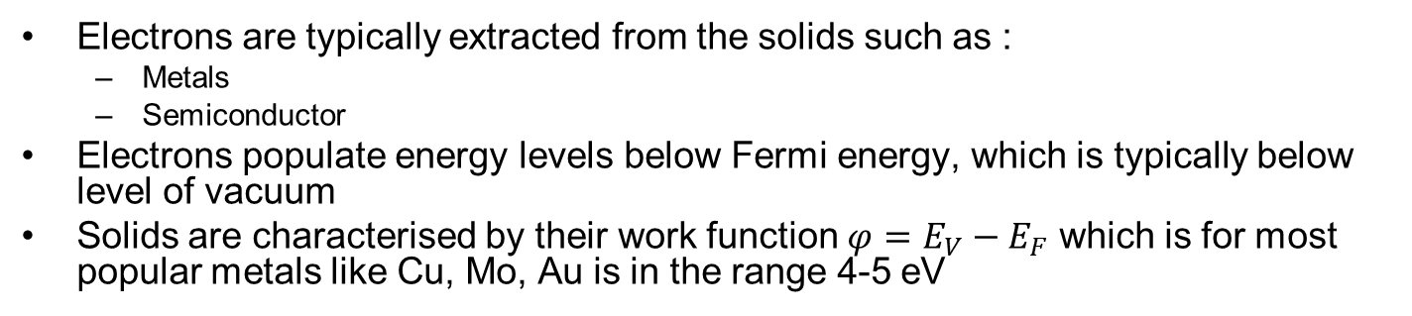


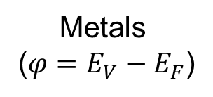
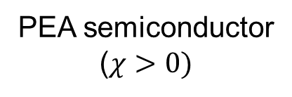

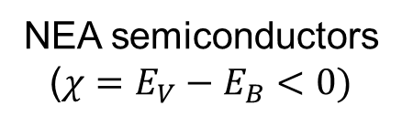


Electrons in solids
Electrons are typically extracted from the solids such as :
  Metals
  Semiconductor
Electrons populate energy levels below Fermi energy, which is typically below level of vacuum
Solids are characterised by their work function $φ=E_{V}−E_{F}$ which is for most popular metals like Cu, Mo, Au is in the range 4-5 eV
$$E_{B}$$
$$E_{B}$$
$$E_{V}$$
$$E_{V}$$
$$E_{V}$$
$$E_{F}$$
$$E_{F}$$
$$E_{F}$$
Metals
($φ=E_{V}−E_{F}$)
NEA semiconductors
($χ=E_{V}−E_{B}<0)$
PEA semiconductor
($χ>0)$

Slide 4
Distribution functions
Fermi-Dirac distribution
$$f_{F}\sim \frac{1}{1+e^{\frac{E−E_{F}}{kT}}}$$
Maxwell-Boltzmann distribution
$$f_{M}\sim e^{−\frac{E}{kT}}$$
At high energy, $E−E_{F}≫kT$
$$f_{F}=f_{M}$$

Slide 5
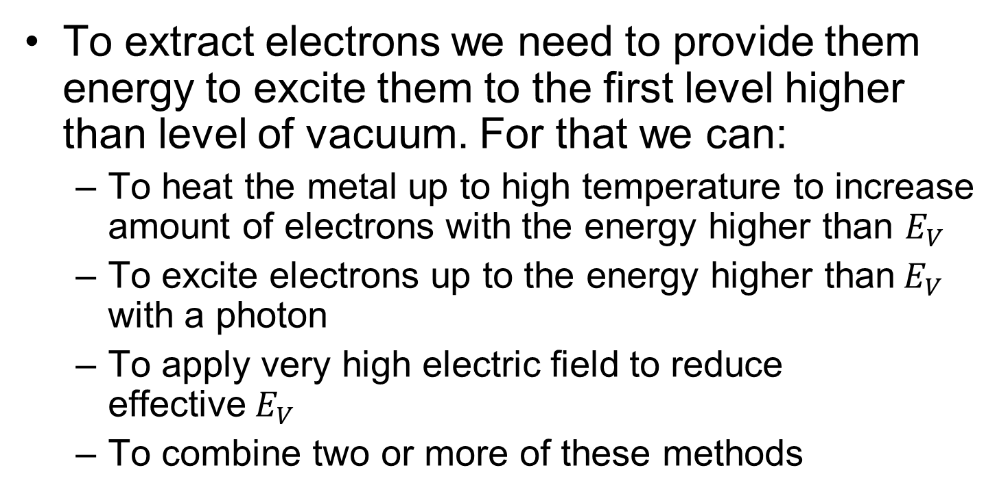
How to extract electrons?
To extract electrons we need to provide them energy to excite them to the first level higher than level of vacuum. For that we can:
  To heat the metal up to high temperature to increase amount of electrons with the energy higher than $E_{V}$
  To excite electrons up to the energy higher than$E_{V}$ with a photon
  To apply very high electric field to reduce effective$E_{V}$
  To combine two or more of these methods

Slide 6
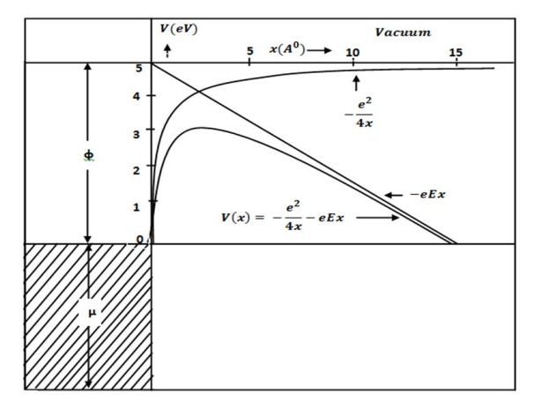
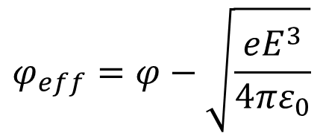

Electrons in metal
Schottky effect:
$$φ_{eff}=φ−\sqrt{\frac{{eE}^{3}}{4πε_{0}}}$$
$$E_{F}$$
Notes:
To replace the picture for better one.

Slide 7
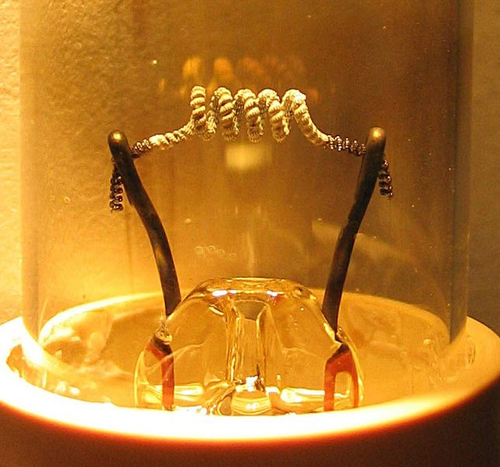
Thermionic emission
Experimentally investigated in 1901by Richardson
$$J=A_{G}T^{2}e^{−\frac{eφ}{kT}}$$
Where $A_{G}=λ_{r}A_{0}$
$$A_{0}=\frac{4πmk^{2}e}{h^{3}}=1.20173A/{{{mm}^{2}}/{K^{2}}}$$
$λ_{r}≃0.5$ is defined by material properties

Slide 8
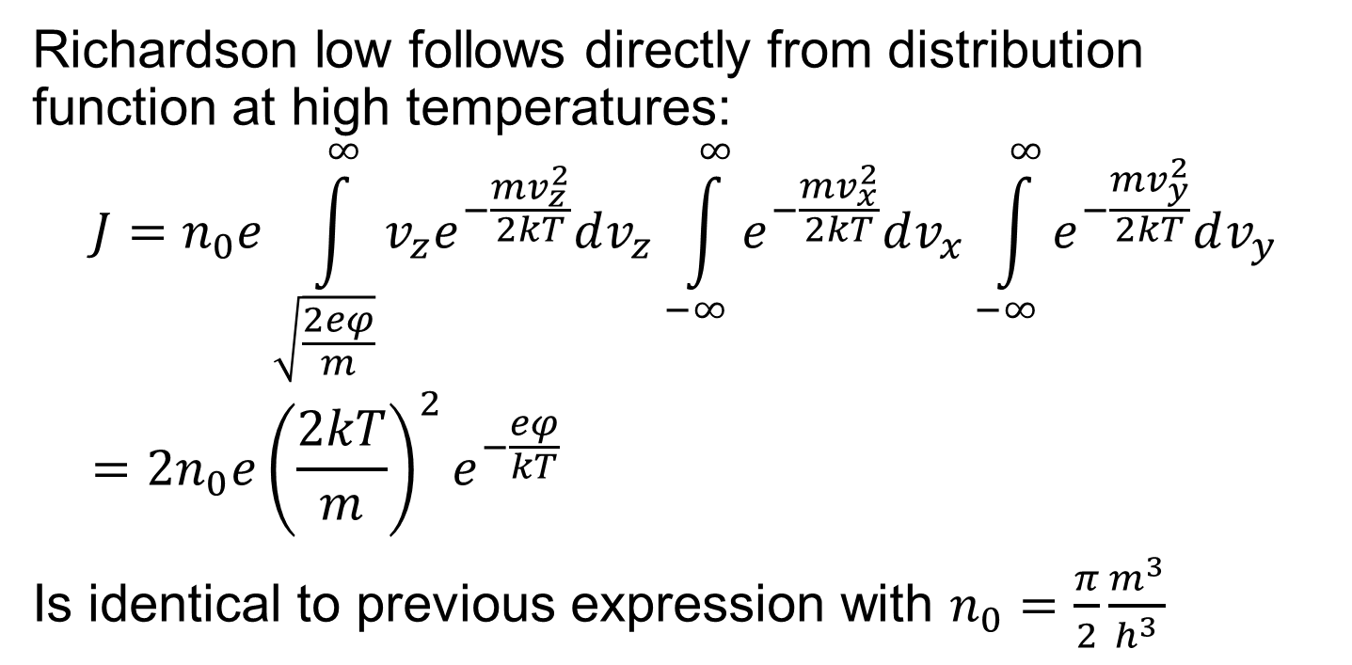
Richardson’s low
Richardson low follows directly from distribution function at high temperatures:
$$J=n_{0}e\int_{\sqrt{\frac{2eφ}{m}}}^{∞}{v_{z}e^{−\frac{mv_{z}^{2}}{2kT}}dv_{z}\int_{−∞}^{∞}{e^{−\frac{mv_{x}^{2}}{2kT}}dv_{x}}}\int_{−∞}^{∞}{e^{−\frac{mv_{y}^{2}}{2kT}}dv_{y}}=2n_{0}e{\left(\frac{2kT}{m}\right)}^{2}e^{−\frac{eφ}{kT}}$$
Is identical to previous expression with $n_{0}=\frac{π}{2}\frac{m^{3}}{h^{3}}$

Slide 9
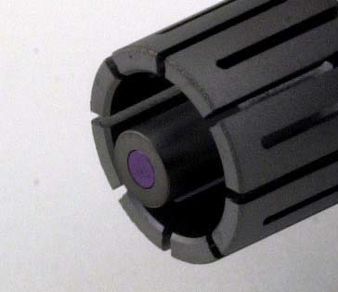
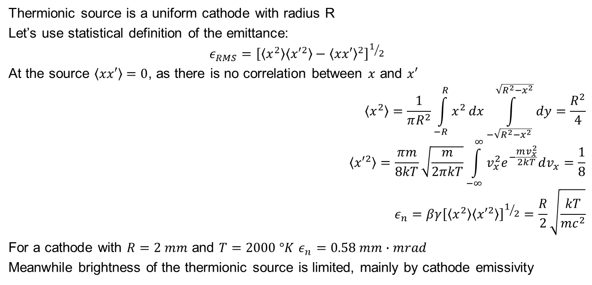
Emittance of the thermionic source
Thermionic source is a uniform cathode with radius R
Let’s use statistical definition of the emittance:
$$ε_{RMS}={\left[\left\langle x^{2}\right\rangle \left\langle {x′}^{2}\right\rangle −{\left\langle xx′\right\rangle }^{2}\right]}^{1/2}$$
At the source $\left\langle xx′\right\rangle =0$, as there is no correlation between $x$ and $x′$
$$\left\langle x^{2}\right\rangle =\frac{1}{πR^{2}}\int_{−R}^{R}{x^{2}}dx\int_{−\sqrt{R^{2}−x^{2}}}^{\sqrt{R^{2}−x^{2}}}{dy}=\frac{R^{2}}{4}$$
$$\left\langle {x′}^{2}\right\rangle =\frac{πm}{8kT}\sqrt{\frac{m}{2πkT}}\int_{−∞}^{∞}{v_{x}^{2}e^{−\frac{mv_{x}^{2}}{2kT}}dv_{x}}=\frac{1}{8}$$
$$ε_{n}=βγ{\left[\left\langle x^{2}\right\rangle \left\langle {x′}^{2}\right\rangle \right]}^{1/2}=\frac{R}{2}\sqrt{\frac{kT}{mc^{2}}}$$
For a cathode with $R=2 mm$ and $T=2000 °K$ $ε_{n}=0.58 mm∙mrad$
Meanwhile brightness of the thermionic source is limited, mainly by cathode emissivity

Slide 10
Space charge limit of thermionic emitter. Child-Langmuir low
Three-Halves Power Law for DC current
$$d$$
$$\frac{mv^{2}}{2}−eV\left(x\right)=0⇒v=\sqrt{\frac{2eV\left(x\right)}{m}}$$
$$J=−ρ\left(x\right)v\left(x\right)=−en\left(x\right)v\left(x\right)$$
$$\frac{∂^{2}V}{∂x^{2}}=−\frac{ρ}{ε_{0}}=\frac{J}{ε_{0}} \sqrt{\frac{m}{2eV\left(x\right)}}$$
$V\left(d\right)=V_{0},$ $\frac{∂V}{∂x}\left(0\right)=0$
$$J=\frac{4ε_{0}}{9d^{2}}\sqrt{\frac{2e}{m}}V_{0}^{3/2}$$
$$v$$
$$0$$
$$V_{0}$$
Planar diode

Slide 11
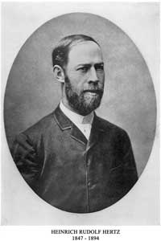
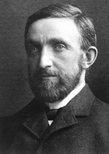
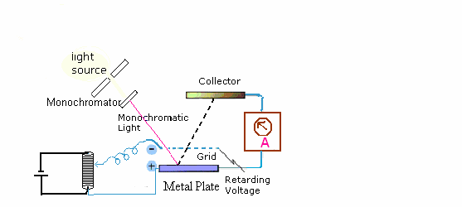
Photoemission discovery
Discovered in 1887
Heinrich Rudolf Hertz
(1847-1894)
Philipp Eduard Anton
von Lenard (1862-1947)
Notes:
In 1887, Heinrich Hertz and his assistant Philipp Lenard observed that when light was shone on certain substances, the substances gave out cathode rays (electrons); only the number of electrons changed, and not their energy increased when the strength (intensity) of the incident light was increased.

Slide 12
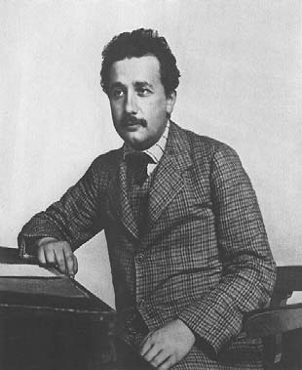
Nobel prize
Albert Einstein, On a Heuristic Point of View about the Creation and Conversion of Light. Annal der Physik, 17, 132(1905)
The Nobel Prize in Physics 1921 was awarded to Albert Einstein "for his services to Theoretical Physics, and especially for his discovery of the law of the photoelectric effect".
Albert Einstein (1879-1955)
Notes:
In 1887, Heinrich Hertz and his assistant Philipp Lenard observed that when light was shone on certain substances, the substances gave out cathode rays (electrons); only the number of electrons emitted, and not their energy, increased when the strength (intensity) of the incident light was increased.

Slide 13
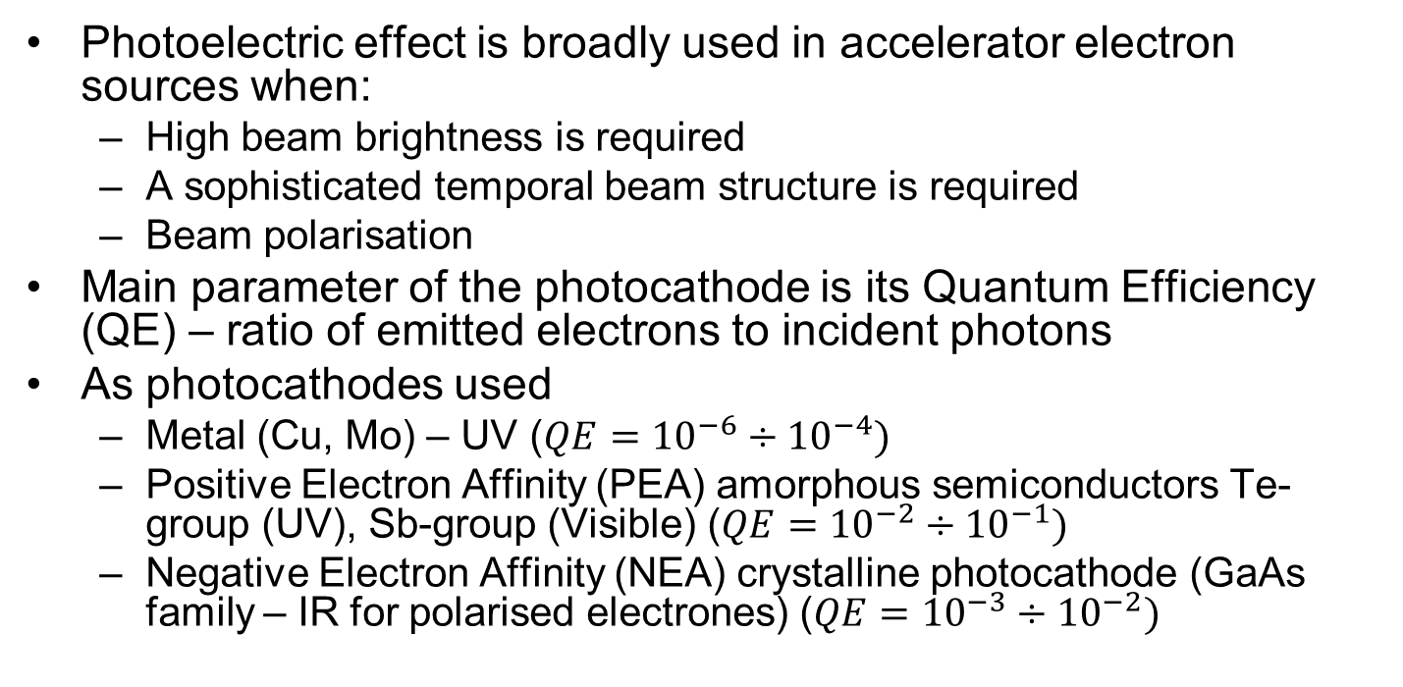
Photoelectron sources
Photoelectric effect is broadly used in accelerator electron sources when:
  High beam brightness is required
  A sophisticated temporal beam structure is required
  Beam polarisation
Main parameter of the photocathode is its Quantum Efficiency (QE) – ratio of emitted electrons to incident photons
As photocathodes used
  Metal (Cu, Mo) – UV ($QE={10}^{−6}÷{10}^{−4})$
  Positive Electron Affinity (PEA) amorphous semiconductors Te-group (UV), Sb-group (Visible) ($QE={10}^{−2}÷{10}^{−1})$
  Negative Electron Affinity (NEA) crystalline photocathode (GaAs family – IR for polarised electrones) ($QE={10}^{−3}÷{10}^{−2})$

Slide 14
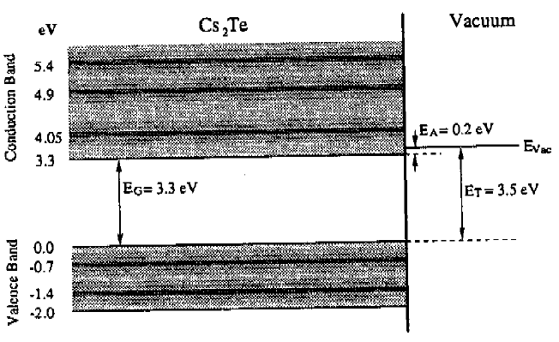
Photoemission from PEA photocathodes
Electron structure of PEA (Positive Electron Affinity photocathodes. Bottom of conduction band is lower than level of vacuum
Three step photoemission model
Adsorption of the photon and excitation of electron into conducting band
Drift of the electron to the photocathode surface
Escape of the electron to vacuum

Slide 15





Electron Excitation
Most of the electrons are excited between the states with high density
$$E_{F}+ℏω$$
$$E+ℏω−E_{B}$$
$$E+ℏω−E_{V}$$
$$E_{V}$$
$$E_{B}$$
$$E_{F}$$
$$E$$
PEA photocathodes are very fast and diffusion of electrons to surface does not impact on emission

Slide 16
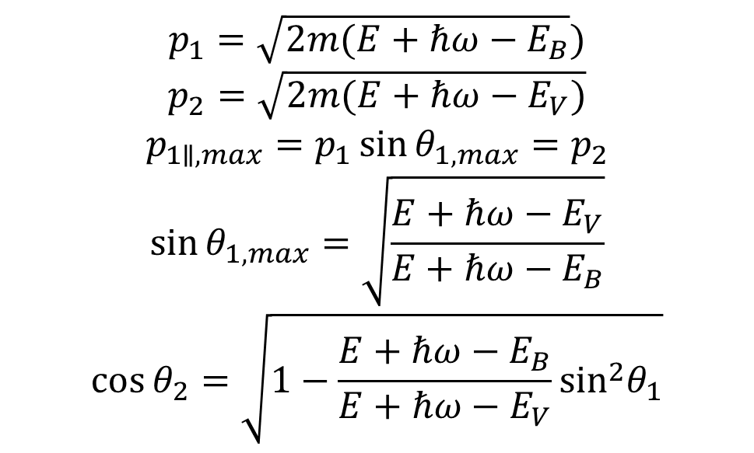
Surface escape
$$p_{1}=\sqrt{2m(E+ℏω−E_{B}})$$
$$p_{2}=\sqrt{2m(E+ℏω−E_{V})}$$
$$p_{1∥, max}=p_{1}\sin{θ_{1,max}}=p_{2}$$
$$\sin{θ_{1,max}=\sqrt{\frac{E+ℏω−E_{V}}{E+ℏω−E_{B}}}}$$
$$\cos{θ_{2}=\sqrt{1−\frac{E+ℏω−E_{B}}{E+ℏω−E_{V}}\sin^{2}θ_{1}}}$$
$$p_{2∥}$$
$$p_{2}$$
$$p_{1∥}$$
$$θ_{2}$$
$$p_{1}$$
$$p_{2⊥}$$
$$θ_{1}$$
$$p_{1⊥}$$

Slide 17
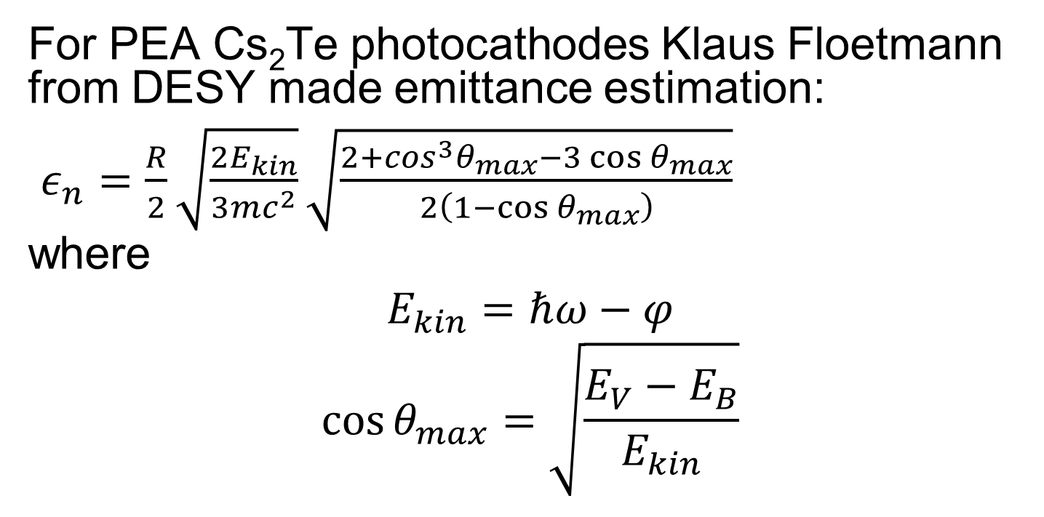
Emittance of the photocathode
For PEA Cs₂Te photocathodes Klaus Floetmann from DESY made emittance estimation:
$ε_{n}=\frac{R}{2}\sqrt{\frac{2E_{kin}}{3mc^{2}}}\sqrt{\frac{2+\cos^{3}θ_{max}−3\cos{θ_{max}}}{2\left(1−\cos{θ_{max}}\right)}}$
where
$$E_{kin}=ℏω−φ$$
$$\cos{θ_{max}=\sqrt{\frac{E_{V}−E_{B}}{E_{kin}}}}$$
Notes:
Metal photocathodes are typically very robust, but have typically low quantum efficiency
Semiconductor photocathodes are less robust, but quantum efficiency may reach dozen per cent
To add estimation of the emittance for the 1 mm radius photocathode

Slide 18
Photoemission from NEA photocathodes
As grown GaAs is PEA photocathode with a work function about 5 eV
To bring GaAs to NEA state it’s activated with Cs and an oxidant like O₂ or NF₃
NEA state is unstable and eventually degrade under residual gas in vacuum chamber returning back to PEA
Parameters of the photocathode unstable and changes with electron affinity

Slide 19
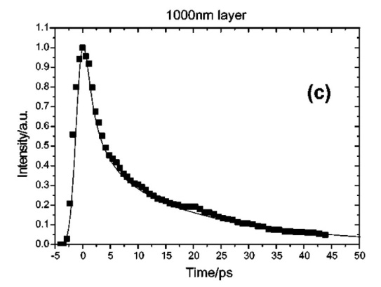
Time response of NEA GaAs. Thick photocathode
1000 nm
30 ps
University of Mainz investigations
Notes:
Significantly contributes to the emission process.
In thick photocathodes kinetic energy of the electrons reduced to thermal energy – electrons are thermolising
Response time of the photocathode significantly increasing

Slide 20
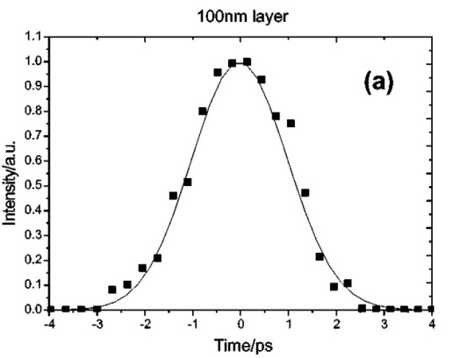
Time response of thin photocathode
100 nm
2.3 ps
Decreasing of the GaAs photocathode thickness leads to decrease of its Quantum Efficiency and increase of energy spread of emittance electrons and increase of emittance
Notes:
In thin photoctahodes electrons are not thermolised and their energy spread is higher than at thick samples
Response time is much shorter
Quantum efficiency is lower

Slide 21
Longitudinal energy distribution
Notes:
To add overall slide about photocathode characterisation.

Slide 22
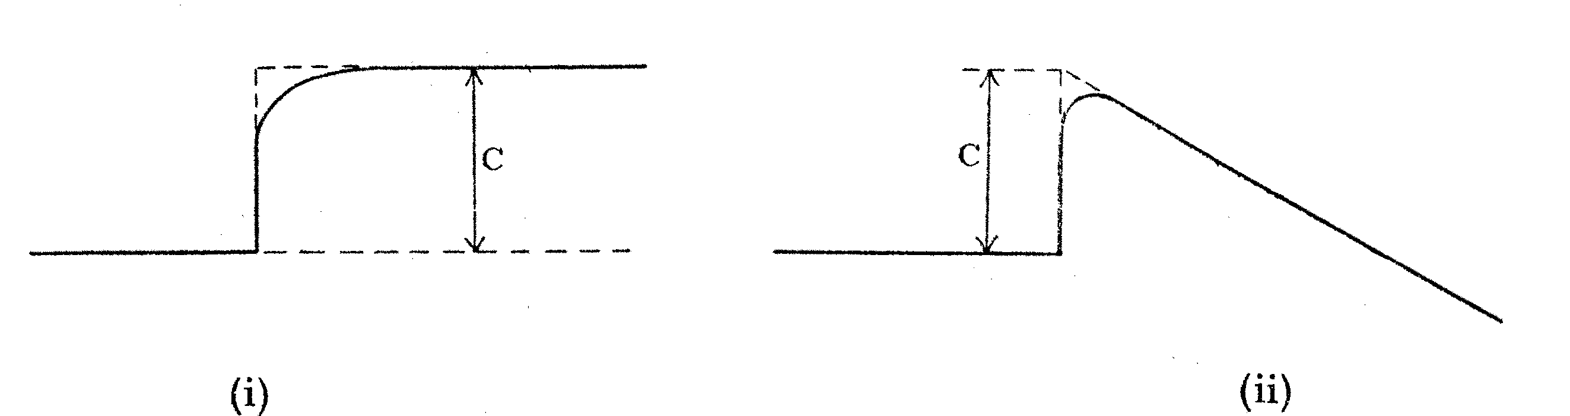
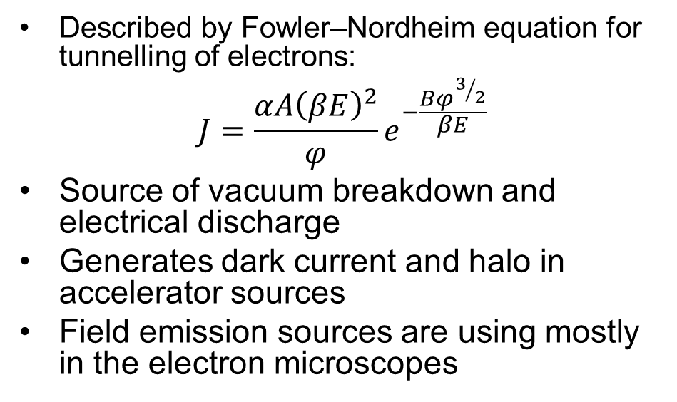
Field emission
Described by Fowler–Nordheim equation for tunnelling of electrons:
$$J=\frac{αA{\left(βE\right)}^{2}}{φ}e^{−\frac{Bφ^{3/2}}{βE}}$$
Source of vacuum breakdown and electrical discharge
Generates dark current and halo in accelerator sources
Field emission sources are using mostly in the electron microscopes

Slide 23
Combined electron emission mechanisms
Thermally enhanced field emission
  Allows field emission at lower field
Laser assisted (enhanced) field emission
  Allows for applying temporal structure of emitted beam
Laser assisted thermionic emission
  Allows for applying temporal structure of emitted beam
And others

Slide 24
Literature
M. Reiser, Theory and Design of Charged Particle Beams, ISBN 0-471-30616-9
K. Floettmann, Note on the thermal emittance of electrons emitted by Cesium Telluride photocathodes, TESLA-FEL-97-01
R.A. Powell et al., Photoemission Studies from Cesium Telluride, Phys. Rev. B, v. 8, Nr.8, 1973
B.L. Militsyn et al., Design of an upgrade to the ALICE photocathode gun, EPAC’08
R. H. Fowler and L. Nordheim, Proceedings of the Royal Society of London. Series A, Vol. 119, No. 781 (May 1, 1928), pp. 173-181

